Slide 1
Summary: Interior Graphic Standards
OK
Summary by Eng. Omar Khamis • Omar Khamis Library — 2026
A learning summary — not a substitute for the original book

Slide 2
What this deck covers
1
Introduction: the technical reference for interiors
7
Millwork and casework
2
Human factors and ergonomics
8
Furniture
3
Partitions and drywall
9
Lighting
4
Suspended ceilings
10
Acoustics
5
Floors
11
Interiors by building type
6
Finishes and specifications
12
Eng. Omar Khamis's takeaways

Slide 3
Introduction: the technical reference for interiors
1
2
Interior Graphic Standards (2nd edition, 2010), edited by Corky Binggeli, belongs to the famous Graphic Standards series. …
It turns an idea into a specification, a detail and a dimension.
3
4
It helps you write correct BOQ items and material specifications.
It reduces mistakes between design and site.
This summary is written by Eng. Omar Khamis in his own words; figures are common practice values. The book is based on US standards (ADA, IBC and others), …
Notes:
Interior Graphic Standards (2nd edition, 2010), edited by Corky Binggeli, belongs to the famous Graphic Standards series. It covers everything inside a building: partitions, ceilings, floors, finishes, joinery, furniture, lighting, acoustics, accessibility and interiors for each building type.
Why it matters to interior designers and fit-out engineers
It turns an idea into a specification, a detail and a dimension.
It helps you write correct BOQ items and material specifications.
It reduces mistakes between design and site.

Slide 4
Human factors and ergonomics
Wheelchair turning circle 150 cm.
Door clear width at least 80–90 cm.
Activity | Approximate value
Dining / desk chair seat | 43–48 cm
Desk / dining table | 72–76 cm
Standing work surface (kitchen) | 85–92 cm
Bar counter | 105–110 cm with 75–80 cm stools
Highest comfortable shelf | about 170–180 cm
Seated eye level | about 115–120 cm
Notes:
Accessibility
Wheelchair turning circle 150 cm.
Door clear width at least 80–90 cm.
Basin at about 80–85 cm with knee clearance below.
Bathroom grab bars at 70–75 cm.
Switches and lift buttons within the 40–120 cm reach range.

Slide 5
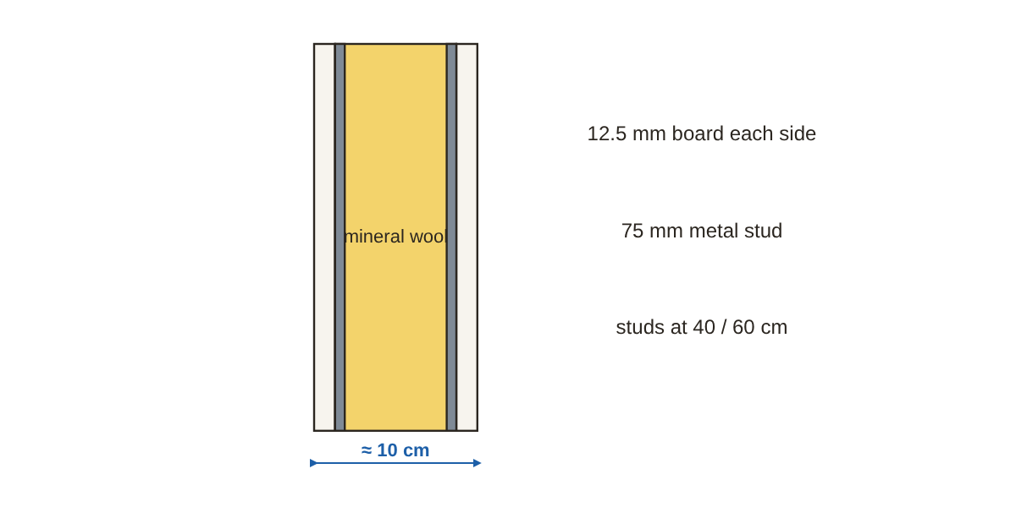
Partitions and drywall
Tracks top and bottom, vertical studs at 40 or 60 cm.
Gypsum board 12.5 mm (standard / moisture-resistant green / fire-rated red).
Mineral wool inside for sound and fire.
Board joints staggered between faces and not on the same stud.
Backing (timber or metal) where wall cabinets, TVs and basins hang.
Section through an insulated drywall partition
Notes:
Dry partition components
Tracks top and bottom, vertical studs at 40 or 60 cm.
Gypsum board 12.5 mm (standard / moisture-resistant green / fire-rated red).
Mineral wool inside for sound and fire.
Site rules
Board joints staggered between faces and not on the same stud.
Backing (timber or metal) where wall cabinets, TVs and basins hang.
An acoustic partition must run to the concrete slab, not just to the false ceiling.
Control joints in long partitions (about every 9–15 m).

Slide 6
Suspended ceilings
Plenum depth set by HVAC: often 15–60 cm.
Access panels at valves and indoor AC units.
Type | Use
Lay-in tiles on an exposed 60×60 grid | Offices, easy maintenance
Plain plasterboard | Homes and hotels, clean look
Aluminium / timber slats | Feature areas and façades
Stretch ceiling | Special shapes and lighting
Notes:
Plenum depth set by HVAC: often 15–60 cm.
Access panels at valves and indoor AC units.
Hangers at about 120 cm centres (per the manufacturer's system).
Coordinate downlights, diffusers and detectors with the ceiling grid.

Slide 7
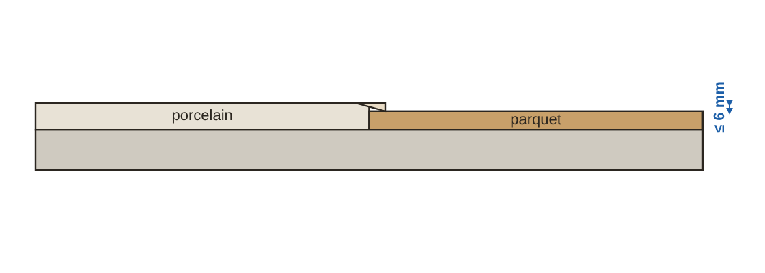
Floors
A level change up to 6 mm is acceptable without a bevel.
6 to 13 mm: bevel no steeper than 1:2.
Anything more is treated as a ramp.
A small bevelled transition between two floors
Notes:
Types and where to use them
Transitions between floors
A level change up to 6 mm is acceptable without a bevel.
6 to 13 mm: bevel no steeper than 1:2.
Anything more is treated as a ramp.

Slide 8
Finishes and specifications
1
2
3
Matt for ceilings and rooms, eggshell/semi-gloss for kitchens, bathrooms and corridors (washable).
Scrub resistance and cleanability are product properties written into the specification.
Walls must be dry and flat with a primer before wallpaper.
4
5
Timber and slat cladding on battens with a ventilation gap.
Finishes in corridors and escape routes must have a low flame-spread class per code.
Saudi Arabia: SBC 801 and SBC 201 Chapter 8 (interior finishes). Egypt: Egyptian fire protection code. Check the official text.
Notes:
Paint
Matt for ceilings and rooms, eggshell/semi-gloss for kitchens, bathrooms and corridors (washable).
Scrub resistance and cleanability are product properties written into the specification.
Wallcoverings and cladding
Walls must be dry and flat with a primer before wallpaper.
Timber and slat cladding on battens with a ventilation gap.
Fire performance
Finishes in corridors and escape routes must have a low flame-spread class per code.

Slide 9
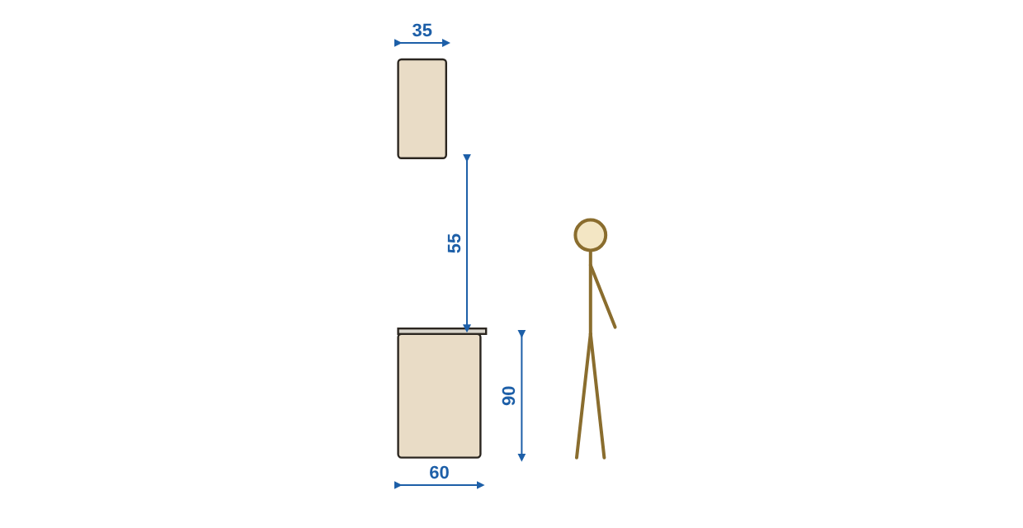
Millwork and casework
MDF (smooth for paint and acrylic), particleboard / melamine (economical), plywood (stronger, more moisture resistant), …
Edge banding on all exposed edges.
Hinges and runners (soft close / tandem) specified by load and cycles.
Kitchen section: base and wall units
Notes:
Board materials
MDF (smooth for paint and acrylic), particleboard / melamine (economical), plywood (stronger, more moisture resistant), HPL (hard surface).
Edge banding on all exposed edges.
Hinges and runners (soft close / tandem) specified by load and cycles.

Slide 10
Furniture
1
2
Circulation: 75–90 cm around furniture in homes, more in commercial spaces.
Dining: 60 cm per person, 90–120 cm behind chairs.
3
4
Living: coffee table 40–45 cm from the sofa, facing sofas about 2.4–3.0 m apart for easy conversation.
Offices: desk 72–75 cm, 80–100 cm behind the chair.
Notes:
Circulation: 75–90 cm around furniture in homes, more in commercial spaces.
Dining: 60 cm per person, 90–120 cm behind chairs.
Living: coffee table 40–45 cm from the sofa, facing sofas about 2.4–3.0 m apart for easy conversation.
Offices: desk 72–75 cm, 80–100 cm behind the chair.

Slide 11
Lighting
Ambient: ceiling lights and downlights.
Task: under-cabinet kitchen lights, desk lamps.
Space | Illuminance | Colour temperature
Living and bedrooms | 150–300 lux | 2700–3000K
Kitchen worktop | 300–500 lux | 3000–4000K
Bathroom (mirror) | 300 lux on the face | 3000–4000K
Office | 500 lux | 4000K
Retail display | 750–1500 lux on merchandise | product dependent
Notes:
Layers of light
Ambient: ceiling lights and downlights.
Task: under-cabinet kitchen lights, desk lamps.
Accent: highlighting artwork or a feature wall.
Decorative: chandeliers and pendants.

Slide 12
Acoustics
1
2
Insulation (stopping sound passing) depends on mass, separation and airtightness.
Absorption (reducing echo) depends on porous materials: carpet, curtains, acoustic panels.
3
4
Between dwellings: airborne sound insulation of about STC 50 or more.
Back-to-back sockets in a partition must be offset so sound does not pass.
Notes:
Insulation (stopping sound passing) depends on mass, separation and airtightness.
Absorption (reducing echo) depends on porous materials: carpet, curtains, acoustic panels.
Between dwellings: airborne sound insulation of about STC 50 or more.
Back-to-back sockets in a partition must be offset so sound does not pass.

Slide 13
Interiors by building type
1
2
3
Separate public and private, enough storage, daylight.
Flexible partitions, sometimes raised floors, acoustics in open plan.
Durable finishes, fire performance, easy maintenance.
4
5
Circulation routes, light on the product, flexibility to change displays.
Easy-to-disinfect surfaces, coved corners, seamless floors.
Notes:
Residential
Separate public and private, enough storage, daylight.
Offices
Flexible partitions, sometimes raised floors, acoustics in open plan.
Hospitality (hotels and restaurants)
Durable finishes, fire performance, easy maintenance.
Retail
Circulation routes, light on the product, flexibility to change displays.
Healthcare
Easy-to-disinfect surfaces, coved corners, seamless floors.

Slide 14
Eng. Omar Khamis's takeaways
1
2
3
Every interior decision must become a specification + detail + dimension.
Put backing inside partitions before closing them.
Suspended ceilings need coordination with HVAC, lighting and fire systems.
4
5
Finishes on escape routes must meet the fire code.
Lighting is layers; acoustics is insulation + absorption.
Summary by Eng. Omar Khamis — Omar Khamis Library for SketchUp.
Notes:
Every interior decision must become a specification + detail + dimension.
Put backing inside partitions before closing them.
Suspended ceilings need coordination with HVAC, lighting and fire systems.
Finishes on escape routes must meet the fire code.
Lighting is layers; acoustics is insulation + absorption.

Slide 15
Thank you
Summary by Eng. Omar Khamis • +20 100 543 3170
Omar Khamis Library for SketchUp

