Slide 1
Summary: Neufert Architects' Data
OK
Summary by Eng. Omar Khamis • Omar Khamis Library — 2026
A learning summary — not a substitute for the original book

Slide 2
What this deck covers
1
Introduction: why Neufert?
10
Seating and dining
2
The human as the measure
11
Offices
3
Units and dimensional coordination
12
Schools
4
Architectural drawing and scales
13
Health buildings (overview)
5
Stairs and ramps
14
Hotels and restaurants
6
Doors and windows
15
Car parks
7
Housing: rooms and areas
16
Lighting, ventilation and acoustics
8
The kitchen
17
Outdoor spaces
9
Bathrooms
18
Eng. Omar Khamis's takeaways

Slide 3
Introduction: why Neufert?
Ernst Neufert's Architects' Data first appeared in German in 1936 as Bauentwurfslehre and has since become the best-known dimensional reference in …
The book is not read from cover to cover. It is an atlas of sheets: almost every page is a dimensioned drawing, …
Part | What it covers
Basics | Units and scales, architectural drawing, the human as the measure
Building elements | Foundations, walls, roofs, stairs, ramps, doors and windows
Environment & services | Daylight and lighting, ventilation, acoustics, fire protection
Building types | Housing, offices, education, health, hotels, restaurants, sport, transport and parking
Outdoor spaces | Gardens, play areas, roads and car parks
Notes:
Ernst Neufert's Architects' Data first appeared in German in 1936 as Bauentwurfslehre and has since become the best-known dimensional reference in the world. The 5th English edition (2019) was edited by a team led by Johannes Kister and updated to current European standards.
The book is not read from cover to cover. It is an atlas of sheets: almost every page is a dimensioned drawing, and every building type has a group of sheets showing the spaces it needs, their sizes and how they relate.
Using the book well
Start with the chapter for your project type (housing, office, school...) and learn the usual space programme.
Go back to the basics (human body and movement) when you need to justify a corridor width or a clearance around furniture.
Treat every figure as a starting point, then check it against the local code (Egyptian, Saudi...) and the client's requirements.
How the book is organised

Slide 4
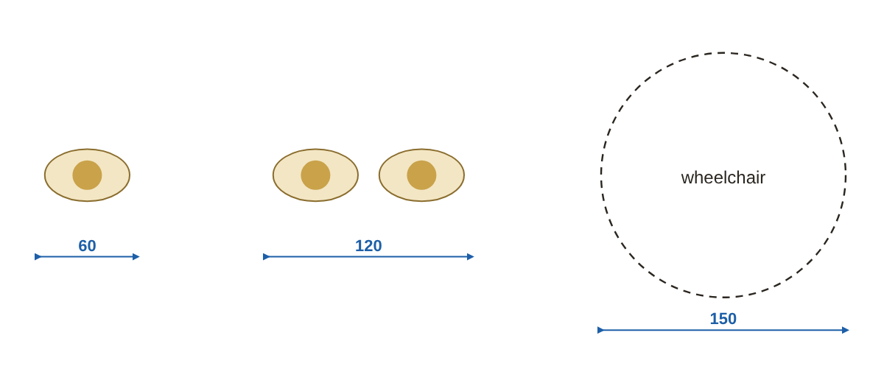
The human as the measure
Neufert's core idea is that the human body and its movement set the dimensions of everything around it, …
One person walking needs about 60–65 cm; with bags about 75–80 cm.
Two people side by side or passing: 110–125 cm.
Wheelchair: 75–80 cm wide, turning circle 150 cm diameter.
Frequently used shelves between 70 and 170 cm.
Basic human movement spaces (cm)
Notes:
Neufert's core idea is that the human body and its movement set the dimensions of everything around it, from a stair riser to a corridor width and a ceiling height.
Approximate body dimensions (average adult)
Movement space
One person walking needs about 60–65 cm; with bags about 75–80 cm.
Two people side by side or passing: 110–125 cm.
Wheelchair: 75–80 cm wide, turning circle 150 cm diameter.
Comfortable reach zones
Frequently used shelves between 70 and 170 cm.
Below 40 cm and above 190 cm: storage that is rarely used.
Standing work surfaces: about 10–15 cm below elbow height.

Slide 5
Units and dimensional coordination
Modular coordination means element sizes are multiples of a basic unit so parts fit together with little cutting.
The common basic module worldwide is M = 10 cm, with multiples 3M, 6M and 12M.
Element | Common grid-friendly sizes
Floor tiles | 30×30, 60×60, 60×120, 120×120 cm
Plasterboard | 120×240 or 120×300 cm
Ceiling tiles | 60×60, 60×120 cm
Internal doors | 70, 80, 90 cm wide (clear opening + frame)
Notes:
Modular coordination means element sizes are multiples of a basic unit so parts fit together with little cutting.
The common basic module worldwide is M = 10 cm, with multiples 3M, 6M and 12M.
Tiles of 30, 60 and 120, plasterboard 120 cm wide, bricks about 25×12×6 are all designed to fit a grid.
When a plan sits on a regular grid (60 or 120 cm, say), waste in tiles, ceilings and partitions drops.
Proportion and scale
Neufert discusses aesthetic proportions (such as the golden ratio 1:1.618) and how architects have used them. In practice the key is consistency: the same grid and rhythm in plan and elevation.

Slide 6
Architectural drawing and scales
Usual scales: site plan 1:500 or 1:200, plans 1:100 or 1:50, details 1:20, 1:10 and 1:5.
Each scale has its level of detail: at 1:100 a wall is two lines; at 1:20 plaster and insulation layers show.
Stage | Usual scale | Purpose
Concept | 1:200 – 1:100 | Idea, massing, areas
Developed design | 1:100 – 1:50 | Exact sizes, coordination of disciplines
Working drawings & details | 1:50 – 1:5 | Building on site without guesswork
Notes:
Usual scales: site plan 1:500 or 1:200, plans 1:100 or 1:50, details 1:20, 1:10 and 1:5.
Each scale has its level of detail: at 1:100 a wall is two lines; at 1:20 plaster and insulation layers show.
Dimensioning: staggered external dimension lines (openings, grid, overall) and levels relative to the project datum.
Drawing stages in a project

Slide 7
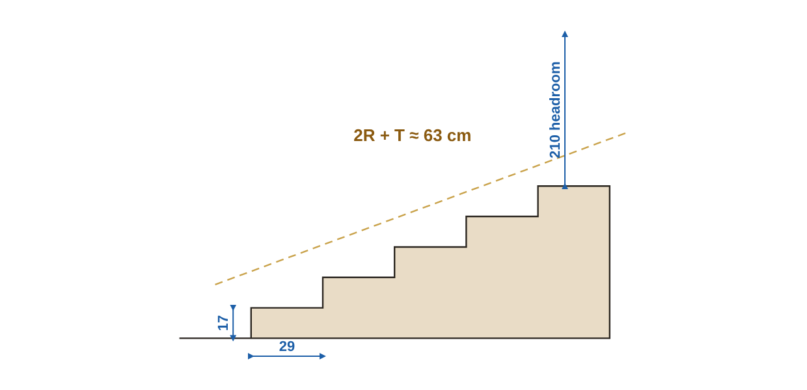
Stairs and ramps
Neufert's well-known rule: 2 × riser + tread ≈ 63 cm (a normal human stride), acceptable between 59 and 65.
Minimum headroom over a stair about 210 cm.
A landing after about 16–18 steps in one flight.
Landing at least as wide as the stair.
Handrail about 90 cm above the nosing, higher in public buildings and at upper floors.
Stair section showing riser, tread and headroom
Notes:
The step rule
Neufert's well-known rule: 2 × riser + tread ≈ 63 cm (a normal human stride), acceptable between 59 and 65.
General requirements
Minimum headroom over a stair about 210 cm.
A landing after about 16–18 steps in one flight.
Landing at least as wide as the stair.
Handrail about 90 cm above the nosing, higher in public buildings and at upper floors.
Ramps

Slide 8
Doors and windows
Door swing: open towards the wall, not into the room, and never hit another door or furniture.
Escape doors in public buildings open in the direction of escape.
Type | Clear width | Height
Apartment / villa entrance | 90–100 cm | 210–240 cm
Rooms | 80–90 cm | 210 cm
Bathroom | 70–80 cm | 210 cm
Accessible | at least 90 cm clear | 210 cm
Single garage | 250–300 cm | 210–240 cm
Notes:
Doors
Door swing: open towards the wall, not into the room, and never hit another door or furniture.
Escape doors in public buildings open in the direction of escape.
Windows
Sill height in living rooms and bedrooms 80–100 cm, kitchen above worktop 105–110 cm, bathroom 150–170 cm.
Glazing for daylight about 1/8 to 1/10 of floor area, at least half of it openable (the local code decides).
A room is well daylit from one window to a depth of about 2–2.5 times the window head height.

Slide 9
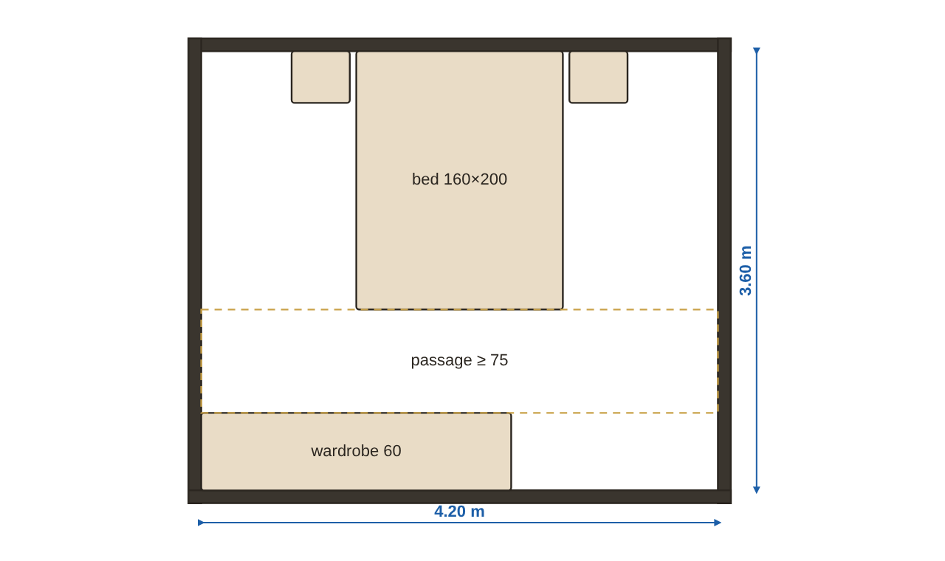
Housing: rooms and areas
Separate the public zone (reception, living, dining, kitchen, guest WC) from the private zone (bedrooms and bathrooms).
Kitchen close to dining and to the service entrance.
An en-suite for the master bedroom and a shared bathroom for the other rooms.
Typical master bedroom (4.20 × 3.60 m)
Notes:
Common approximate areas
Relationships between spaces
Separate the public zone (reception, living, dining, kitchen, guest WC) from the private zone (bedrooms and bathrooms).
Kitchen close to dining and to the service entrance.
An en-suite for the master bedroom and a shared bathroom for the other rooms.

Slide 10
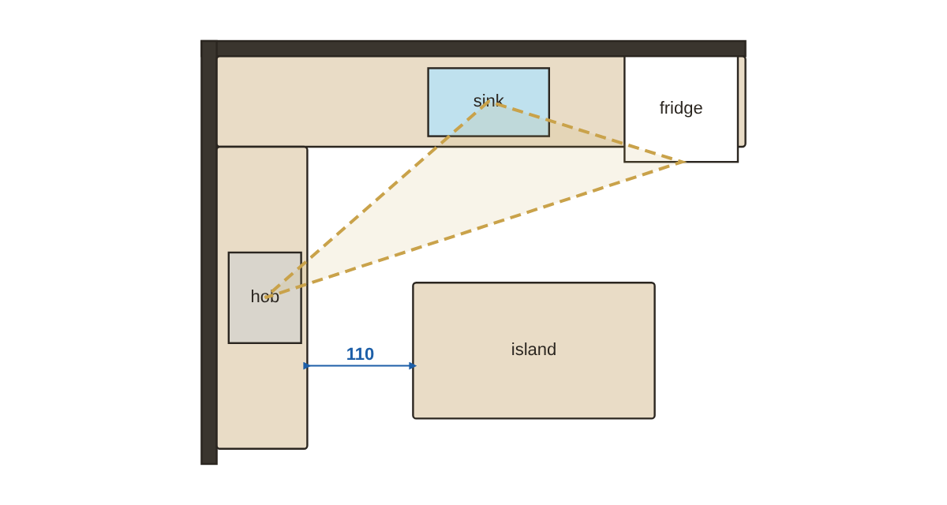
The kitchen
The three sides (sink, hob, fridge) total 4.0–7.9 m.
Each side 1.2–2.7 m.
Sink in the middle; hob away from the window and the fridge.
I (single run): narrow spaces, 2.4–3.6 m long.
II (galley): very efficient, 1.2 m aisle.
L kitchen with island and the work triangle
Notes:
The work triangle
The three sides (sink, hob, fridge) total 4.0–7.9 m.
Each side 1.2–2.7 m.
Sink in the middle; hob away from the window and the fridge.
Heights and depths
Kitchen layouts
I (single run): narrow spaces, 2.4–3.6 m long.
II (galley): very efficient, 1.2 m aisle.
L: the most common, comfortable triangle.
U: most storage, needs at least 2.4 m width.
Island: needs 1.0–1.2 m all round.

Slide 11
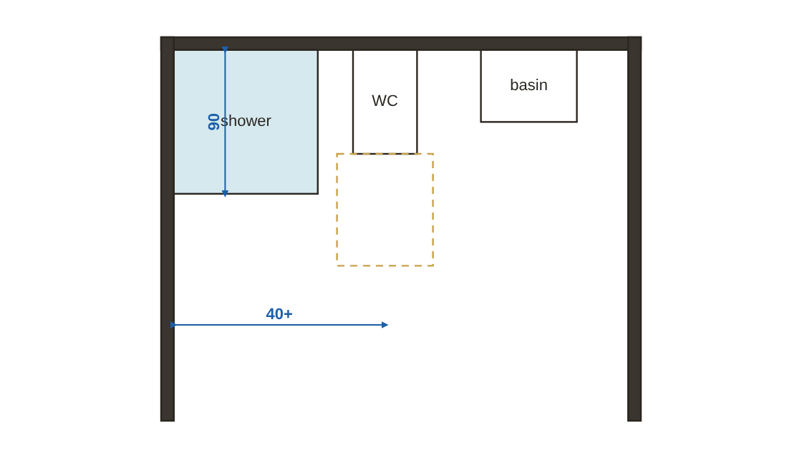
Bathrooms
Bathroom floor falls 1–2% to the drain and sits 1–2 cm below the corridor.
Accessible bathroom: 150 cm turning circle and grab bars at 70–75 cm.
Small bathroom layout and fixture clearances
Notes:
Bathroom floor falls 1–2% to the drain and sits 1–2 cm below the corridor.
Accessible bathroom: 150 cm turning circle and grab bars at 70–75 cm.

Slide 12
Seating and dining
60 cm width and 40 cm depth per diner.
Behind a chair 75–90 cm to sit and rise, 90–120 cm to pass behind.
Diners | Rectangular | Round (diameter)
4 | 120×80 | 100–110
6 | 160–180×90 | 120–130
8 | 200–220×100 | 150
10 | 240–260×100 | 180
Notes:
Dining
60 cm width and 40 cm depth per diner.
Behind a chair 75–90 cm to sit and rise, 90–120 cm to pass behind.
Living
Sofa: seat 40–45 cm, depth 85–100 cm.
Coffee table 40–45 cm from the sofa.
TV viewing distance about 1.5–2.5 times the screen diagonal.

Slide 13
Offices
About 8–12 m² per person in open plan including circulation; a private manager's office 15–25 m².
Desk top 72–75 cm, 80–100 cm behind the chair.
Office type | Approximate area per person
Open plan | 8–12 m²
Cellular single | 10–15 m²
Manager | 15–25 m²
Reception & waiting | 1.5–2 m² per waiting person
Notes:
About 8–12 m² per person in open plan including circulation; a private manager's office 15–25 m².
Desk top 72–75 cm, 80–100 cm behind the chair.
Meeting room about 2–2.5 m² per person.
About 500 lux on the desk.

Slide 14
Schools
1
2
Classroom about 1.8–2.2 m² per pupil depending on age.
Classroom depth preferably no more than 7–8 m for daylight from one side.
3
4
School corridors are wider (often 1.8–2.4 m or per code) because of crowd flows.
Labs and workshops need more area per pupil and special ventilation.
Notes:
Classroom about 1.8–2.2 m² per pupil depending on age.
Classroom depth preferably no more than 7–8 m for daylight from one side.
School corridors are wider (often 1.8–2.4 m or per code) because of crowd flows.
Labs and workshops need more area per pupil and special ventilation.

Slide 15
Health buildings (overview)
1
2
Patient rooms: space for the bed with at least 90 cm on the sides for nursing.
Corridors used by beds about 2.4 m (per the health code).
3
Patient room doors wide enough for a bed (about 110–130 cm).
Health buildings have very specific codes from each country's ministry of health — Neufert is only the general idea here.
Notes:
Patient rooms: space for the bed with at least 90 cm on the sides for nursing.
Corridors used by beds about 2.4 m (per the health code).
Patient room doors wide enough for a bed (about 110–130 cm).

Slide 16
Hotels and restaurants
A standard hotel room is about 24–32 m² including the bathroom.
Room width 3.6–4.2 m for the bed, passage and wardrobe.
Type | m² per seat (approx.)
Cafeteria / quick service | 1.1–1.4
Standard restaurant | 1.4–1.7
Fine dining | 1.7–2.0
Notes:
Hotels
A standard hotel room is about 24–32 m² including the bathroom.
Room width 3.6–4.2 m for the bed, passage and wardrobe.
Restaurants
Dining area about 1.2–1.8 m² per seat depending on the standard.
Commercial kitchen about 30–40% of the dining area.

Slide 17
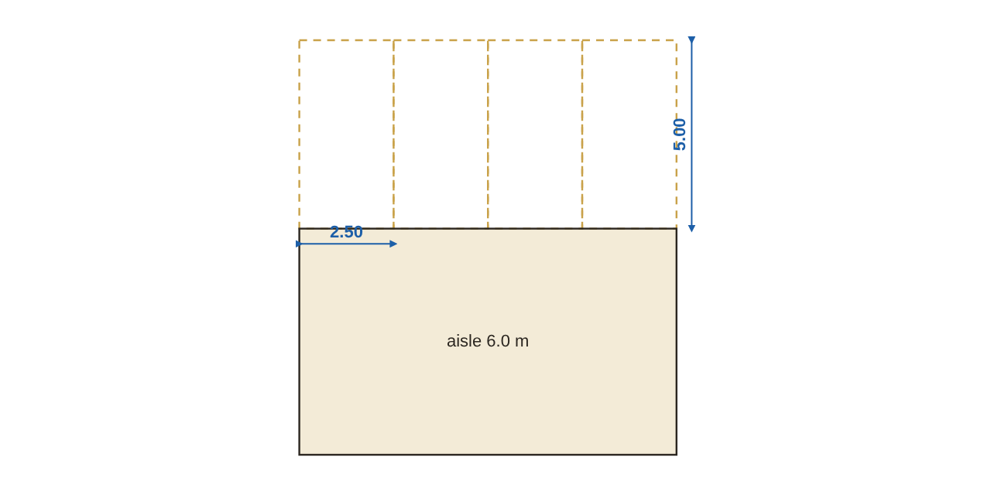
Car parks
Clear height in a car park at least 2.10–2.30 m under beams.
Accessible bay 3.50 m wide, close to the lift or entrance.
90° parking and aisle
Notes:
Clear height in a car park at least 2.10–2.30 m under beams.
Accessible bay 3.50 m wide, close to the lift or entrance.

Slide 18
Lighting, ventilation and acoustics
North light (northern hemisphere) is steady and glare-free; south needs shading.
In Egypt and Saudi Arabia: minimise west openings, use horizontal shading to the south and vertical fins east and west.
Space | Approximate illuminance
Corridors | 100 lux
Living | 150–300 lux
Kitchen worktop | 300–500 lux
Office | 500 lux
Fine drawing work | 750–1000 lux
Notes:
Daylight
North light (northern hemisphere) is steady and glare-free; south needs shading.
In Egypt and Saudi Arabia: minimise west openings, use horizontal shading to the south and vertical fins east and west.
Artificial lighting
Ventilation and sound
Cross ventilation (windows on opposite walls) is far more effective than a single window.
Sound separation between dwellings depends on the mass of the wall/slab and on breaks and insulation.

Slide 19
Outdoor spaces
1
2
Garden paths 1.2–2.0 m, a car drive 3.0–3.5 m.
External steps with lower risers (12–15 cm) and deeper treads.
3
4
A common residential pool is 8×4 m or 10×5 m, 1.2 to 1.8 m deep or more for diving.
Large trees at least 4–6 m from buildings because of roots.
Notes:
Garden paths 1.2–2.0 m, a car drive 3.0–3.5 m.
External steps with lower risers (12–15 cm) and deeper treads.
A common residential pool is 8×4 m or 10×5 m, 1.2 to 1.8 m deep or more for diving.
Large trees at least 4–6 m from buildings because of roots.

Slide 20
Eng. Omar Khamis's takeaways
1
2
3
Neufert is a reference for dimensions and spaces — use it at the start of design and to review plans.
Every figure is guidance and must match the local code and requirements.
Design for movement around furniture, not just for the furniture.
4
5
Keep plans on a regular grid to make building easier and cheaper.
Remember the basics: step 17×29, door 90×210, corridor 110–120, chair 45, table 75, worktop 90.
Summary by Eng. Omar Khamis — Omar Khamis Library for SketchUp.
Notes:
Neufert is a reference for dimensions and spaces — use it at the start of design and to review plans.
Every figure is guidance and must match the local code and requirements.
Design for movement around furniture, not just for the furniture.
Keep plans on a regular grid to make building easier and cheaper.
Remember the basics: step 17×29, door 90×210, corridor 110–120, chair 45, table 75, worktop 90.

Slide 21
Thank you
Summary by Eng. Omar Khamis • +20 100 543 3170
Omar Khamis Library for SketchUp

