Slide 1
Programming in the Next Dimension
Adrian King
6 April 2017

Slide 2
What Is the Future?
A lot of the future will look like the past.
  Sumerian persisted as a ceremonial language for almost 2000 years after it stopped being spoken for everyday purposes.
  How long will Fortran last?
So we're mainly interested in the parts of the future that look different from the past.

Slide 3
What Is Programming?
Some things are clearly not programming.

Slide 4
What Isn't Programming?
Some things might be programming.
Is any kind of communication with a machine programming?
  Setting a thermostat?
  Shoveling coal into a steam locomotive?
Is natural language programming?
  Asking Siri where to get lunch?
  Asking your coworker to join you for lunch?

Slide 5
Programming Is Formal
To me, programming differs from natural communication in that it is precise and detailed.
  Communication in natural languages is often sloppy and elliptical.
To be a proper program, the validity and behavior of the program must be specified formally.

Slide 6
The Constraints of Formality
If we accept that programming is a formally defined activity, that greatly constrains what we can consider programming.
Natural language (or other informal) communication with machines is also very interesting, but not programming in this sense.

Slide 7
Formalisms
A well-known formalism is the lambda calculus.
It represents a program as a one-dimensional sequence of symbols.
Haskell:
flip :: (a -> b -> c) -> b -> a -> c
flip f x y = f y x
Untyped lambda calculus:
λf. λx. λy. f y x

Slide 8
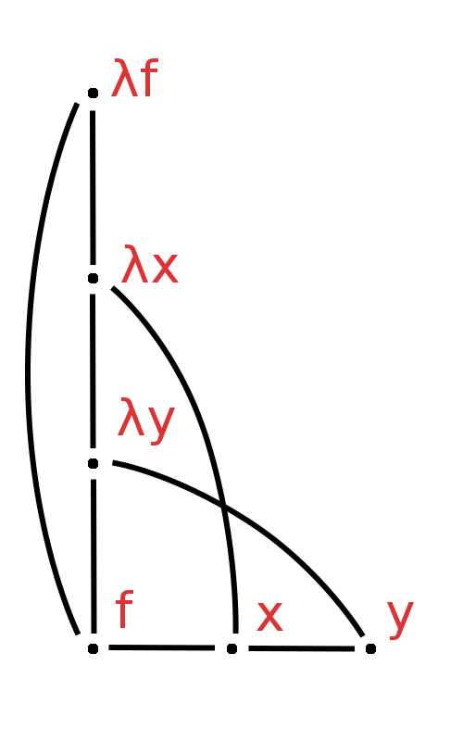
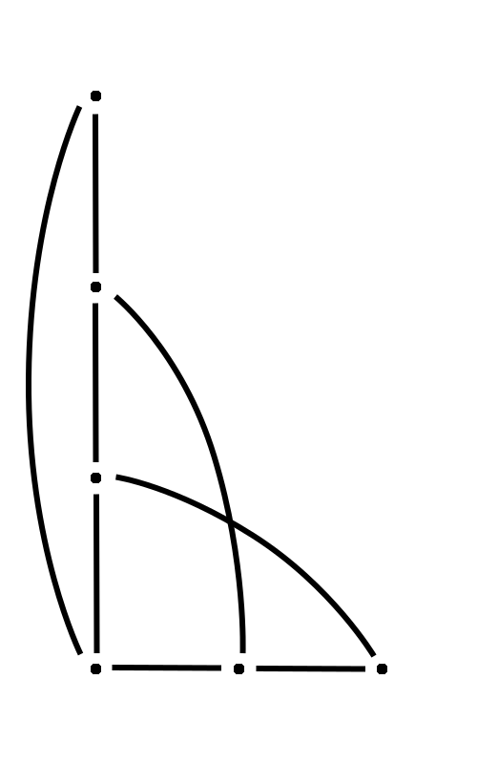
Wait!
Count Those Dimensions Again
We can adopt 2-dimensional conventions for depicting a lambda calculus term. Maybe a one-dimensional formalism isn't so one-dimensional after all.

Slide 9
Writing vs. Geometry
Geometric shapes can be an alternative to text for representing relationships in programs.
But written language has been around for 5000 years, and has survived many predictions of its demise.

Slide 10
Fortress:
Another Foray into the 2nd Dimension
Sun's experimental language Fortress was an attempt to support conventional (2-dimensional) mathematical notation, such as:
Fortress also supported a more conventional, linear textual format:
SUM[k←1:n] a[k] x^k
Some users thought this format was more convenient. Existing text manipulation tools impart a lot of inertia.

Slide 11
But We Already Live in Flatland
Most of us already think our 1-dimensional programs are 2-dimensional. After all, we can see them on our 2-dimensional screens!

Slide 12
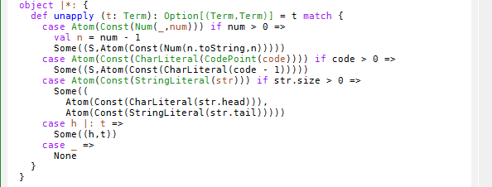
Phatter Than Flat
In fact, most text editors display code in three dimensions.
Ooh, colors!

Slide 13
Prediction Time
My guess: programming languages won't change much, at least internally.
But our tools may offer us views with more dimensions when we work with code.
Volumes, sounds, more? (Please don't say smells.)

