Slide 1
From Typesafe to Curry-Howard
Three Constraints That Give
Dependently Typed Languages
the Power to Prove
by Preventing Paradoxes
Adrian King
11 February 2019

Slide 2
Motivation:
Type Systems and What We
Get out of Them

Slide 3
Classifying Type Systems by the Guarantees They Provide
C-class: type annotations are just suggestions. You can cast anything to anything. Memory errors are possible.
Java-class: (non-array) type annotations are enforced, but arbitrary typecasts are allowed. Runtime type errors are possible, but not memory errors.
ML-class: runtime type errors are impossible (Milner's “well-typed programs cannot go wrong”), but termination is not guaranteed.
Agda-class: termination is guaranteed (we might say “well-typed programs always go right”). The Curry-Howard correspondence is valid.

Slide 4
Curry and Howard and the Fine Print
The Curry-Howard correspondence says that, in a programming language, types can be interpreted as propositions and a term with a given type as a proof of the corresponding proposition.
When I say the Curry-Howard correspondence is valid in a given language, I mean all terms are logically valid proofs of their types—it is impossible to prove a contradiction with such proofs.
It is also possible to say that Curry-Howard holds of languages where a proof term is augmented by a separate, manual proof that the proof term is valid. But I won't say that.

Slide 5
How Nontermination Breaks
Curry-Howard
Consider this Idris function:
partial
ohNo: a -> Void
ohNo x = ohNo x
Void is a type with no inhabitants. It is logically equivalent to falsehood.
If the typechecker accepts a top-level expression of type Void:
partial
argh: Void = ohNo 0
then it is letting us prove something false, which means the underlying logic is inconsistent.

Slide 6
Dependent Types in an
ML-Class Language
Cayenne-class: full support for dependent types. Type safety in the ML sense, but because evaluation does not always terminate and evaluation may occur during typechecking, typechecking is not decidable.

Slide 7
Some Cayenne
Cayenne example from Wikipedia:
PrintfType :: String -> #
PrintfType (Nil) = String
PrintfType ('%':('d':cs)) = Int -> PrintfType cs
PrintfType ('%':('s':cs)) = String -> PrintfType cs
PrintfType ('%':( _ :cs)) = PrintfType cs
PrintfType ( _ :cs) = PrintfType cs
aux :: (fmt::String) -> String -> PrintfType fmt
aux (Nil) out = out
aux ('%':('d':cs)) out = \ (i::Int) -> aux cs (out ++ show i)
aux ('%':('s':cs)) out = \ (s::String) -> aux cs (out ++ s)
aux ('%':( c :cs)) out = aux cs (out ++ c : Nil)
aux (c:cs) out = aux cs (out ++ c : Nil)
printf :: (fmt::String) -> PrintfType fmt
printf fmt = aux fmt Nil

Slide 8
Cayenne Is an Outlier
Cayenne occupies an unusual place in the programming language design space.
It offers type safety, but Cayenne terms are not valid proofs under the Curry-Howard correspondence.
I think most programming language designers, having gone to all the trouble to implement dependent types, figure they might as well go ahead and offer valid proofs as well as type safety.
ML-class languages with termination checks (so that Curry-Howard is valid) are also uncommon.
Cayenne is no longer supported.

Slide 9
Three Constraints

Slide 10
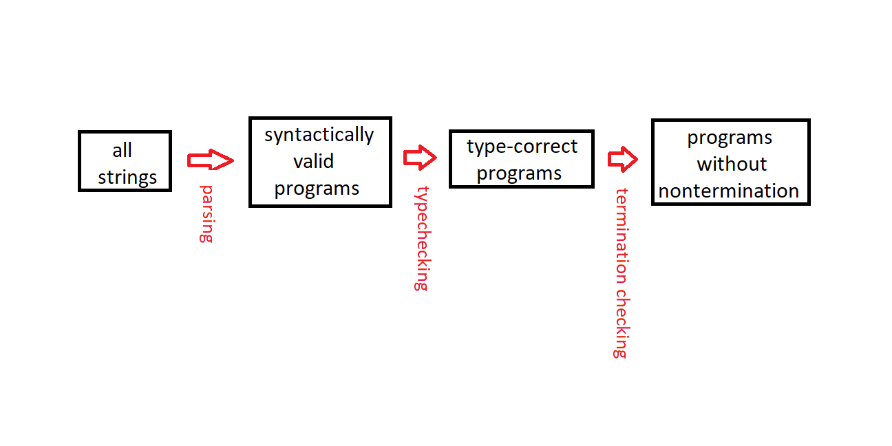
Compilation As a Series of Filters
Consider compilation as a sequence of filters:
Each filter can only reduce the set of programs accepted.
Cayenne stops at the third box, Agda at the last.
Termination checking in dependently typed languages has three components.

Slide 11
Code, Data, Type
It is convenient to think of the features of dependently typed languages as being grouped into three categories: code, data, type.
  Code is what can appear in a function.
  Data is what can be declared in an inductive datatype.
  Type is what can appear in a type annotation.
Each of the three termination constraints corresponds (roughly) to one of the above categories.

Slide 12
Constraint #1 (Code):
Structural Recursion

Slide 13
Recursing on Pieces
The structural recursion constraint requires that when a function calls itself, it can only do so by passing to the recursive call a proper substructure of one its arguments.
You can obtain such a substructure by pattern matching (in Coq, Idris, or Agda).
-- good: decreasing on the argument
total
len: List a -> Nat
len [] = 0
len (x :: xs) = S (len xs)
-- bad: increasing on the argument
partial
notLen: List Nat -> Nat
notLen xs = notLen (1 :: xs)
-- also bad: not decreasing on the
-- argument
partial
ohNo: a -> Void
ohNo x = ohNo x

Slide 14
Nested Primitive Recursion
Agda and Idris (at least) can recognize a slightly more complex case than the one from the previous slide, one where multiple arguments decrease in lexicographic order.
In ack below, either the first argument decreases, or it stays the same and the second argument decreases.
total
ack: Nat -> Nat -> Nat
ack Z n = S n
ack (S m) Z = ack m 1
ack (S m) (S n) = ack m (ack (S m) n)

Slide 15
Structural Recursion Is
Often Too Conservative
Many algorithms terminate for reasons that are obvious to a human reader, but invisible to the structural recursion checkers in available languages.
partial
mrgSort: (Ord a) => List a -> List a
mrgSort [] = []
mrgSort [x] = [x]
mrgSort xs =
mrg (mrgSort firstHalf) (mrgSort secondHalf)
where
halfLen: Nat
halfLen = (length xs) `div` 2
firstHalf = take halfLen xs
secondHalf = drop halfLen xs

Slide 16
Constraint #2 (Data):
Strict Positivity

Slide 17
Unbounded Recursion That
Looks Structurally OK
Consider this attempt to encode the untyped lambda calculus, adapted from Adam Chlipala's Certified Programming with Dependent Types:
data Term: Type where
App: Term -> Term -> Term
Abs: (Term -> Term) -> Term
partial
uhOh: Term -> Term
uhOh (Abs f) = f (Abs f)
uhOh t = t
Note that uhOh doesn't call itself.
But what happens when you do uhOh (Abs uhOh)?

Slide 18
Limits on a Datatype's
Occurrence in Its Own Definition
The strict positivity constraint says that a datatype cannot appear on the left side of an arrow in the type of any of its constructors' arguments.
data Term: Type where
App: Term -> Term -> Term
Abs: (Term -> Term) -> Term
As the previous slide showed, violating the constraint lets you sneak in an unbounded recursion.

Slide 19
Constraint #3 (Type):
Type Stratification

Slide 20
Russell and Girard
(a Pair o' Docs)
Bertrand Russell's famous paradox about the set of all sets that don't contain themselves has an analog that can be expressed in a programming language, which was discovered by Jean-Yves Girard.
Girard's paradox appears in any type system where Type (the type of types) is an element of itself.

Slide 21
A Paradox in Idris
Because of Idris bug #3194 (type stratification not enforced across module boundaries), this actually compiles:
%default total
data Tree: Type where
Sup: (a: Type) -> (f: a -> Tree) -> Tree
A: Tree -> Type
A (Sup a _) = a
F: (t: Tree) -> A t -> Tree
F (Sup _ f) = f
Normal: Tree -> Type
Normal t =
(y: A t ** (F t y = Sup (A t) (F t))) -> Void
NT: Type
NT = (t: Tree ** Normal t)
P: NT -> Tree
P (x ** _) = x
R: Tree
R = Sup NT P
Lemma: Normal R
Lemma ((y1 ** y2) ** z) =
y2 (
replace
{P =
(\y3 =>
(y: A y3 ** F y3 y =
Sup (A y3) (F y3)))}
(sym z) ((y1 ** y2) ** z))
Russel: Void
Russel = Lemma ((R ** Lemma) ** Refl)

Slide 22
Layered Universes
The usual solution to Russell's/Girard's paradox is divide the type of types into separate, stratified types (universe levels), where each level cannot contain itself or higher levels, but does contain the next lower level.
Type i : Type (i + 1)
Some programming languages (Coq, Idris) let you write Type for any level of the type hierarchy, but they don't really allow Type to be a member of itself. Instead, they figure out the appropriate level constraints automatically.

Slide 23
Type Stratification Rules
(Approximately)
The type level of a function type A → B is at least the maximum of the levels of A and B.
The type level of an inductive datatype is:
  at least the level of it largest parameter;
  greater than the largest level of its indices;
  and greater than the largest level of its constructors' parameters.
But note that the exact details for the inductive datatype rules vary from one language to another.

Slide 24
Agda Makes Stratification Explicit
Agda forces you to keep track of type levels explicitly:
data Tree : Set lone where
Sup : (a : Set) → (f : a → Tree) → Tree
A : Tree → Set
A (Sup a _) = a
F : (t : Tree) → A t → Tree
F (Sup _ f) = f
Normal : Tree → Set lone
Normal t =
¬ (Σ (A t) (λ y → F t y ≡ Sup (A t) (F t)))
NT : Set lone
NT = Σ Tree (λ t → Normal t)
P : NT → Tree
P (x , _) = x
R : Tree
R = Sup NT P
{- Agda objects to the use of NT in the last line above:
Set₁ != Set
when checking that the expression NT has type Set -}
The Agda approach is more work. Does it let you write code Coq or Idris wouldn't? I don't know.

Slide 25
Type Stratification
Is Also about Termination
The type stratification constraint is subtler than the other two, and violations are less localized.
But its purpose, like that of the other constraints, is to prevent nontermination.

Slide 26
So why is termination
such a big deal?

Slide 27
Theory and Terminology

Slide 28
Soundness and Completeness
We want compilers to accept only programs that obey the proper rules, that is, we want them to be sound.
A compiler that accepted every program that obeyed the rules would be complete.
Real-world compilers are usually sound (we hope), but not usually complete.
In languages complicated enough to be useful, typechecking would be undecidable if we tried to go for both soundness and completeness.

Slide 29
Soundness is Conservative
Consider:
good: Nat
good =
if 0 == 1 then 0 else 42
bad: Nat
bad =
if 0 == 1 then "oops"
else 42
If you ran the code without checking it first, both good and bad would return Nats. A complete typechecker would accept both. But the real Idris typechecker applies the more conservative rule that both branches of an if must have the same type.

Slide 30
Typing Rules and Judgments
Basic typing rules for a Cayenne-class language:
(x : S) ∈ Γ
Γ ⊢ x : S
Γ ;x:S ⊢ e : T Γ ⊢ (x:S)→T : Type
Γ ⊢ λx:S.e : (x:S)→T
Γ ⊢ f : (x:S)→T Γ ⊢ s : S
Γ ⊢ f s : T[s/x]
Γ ;x:S ⊢ T : Type Γ ⊢ S : Type
Γ ⊢ (x:S)→T : Type
Γ ⊢ Type : Type
Γ ⊢ e : T Γ ⊢ f : T e ⇓ v f ⇓ v
Γ ⊢ e ≡ f : T
Γ ⊢ x : S Γ ⊢ S ≡ T : Type
Γ ⊢ x : T

Slide 31
Evaluation Rules
Evaluation (aka reduction) is expressed in the small-step style. For example, a rule for function application:
Normalization (big-step evaluation) consists of small steps repeated until you get a value.
value v
v ⇓ v
v ⇒ vʹ vʹ ⇓ vʺ
v ⇓ vʺ
value v
(λx:S.e) v ⇒ e[v/x]
v above represents a value, something that cannot be evaluated further.

Slide 32
Progress and Preservation
Progress is a programming language property that says every well-typed term either is a value or can take a small evaluation step.
It is easy to ensure progress if your language is well-defined and you're writing an interpreter for it in a language that checks that pattern matching is complete.
(Type) preservation says that after each small evaluation step, a well-typed term has the same type as before the step.
Preservation is usually more interesting and harder to prove than progress.
Both properties are necessary if your language is to be well-behaved.

Slide 33
Logical Falsehood
In a dependently typed language, logical falsehood can be represented as a proposition in one of two ways:
A datatype with no data constructors (like Void in Idris):
data Void where
A function type that says every type is inhabited:
(a: Type) → a
If a programming language admits a well-typed term of either type above, that shows that the logic underlying the language is inconsistent, so the Curry-Howard correspondence does not hold.

Slide 34
With Preservation, All Proofs of Falsehood Involve Nontermination
Suppose a language has a value representing falsehood. Then it is either:
  headed by a constructor of a datatype with no constructors, which is a contradiction; or
  a function that can be applied to any type to produce a value of that type. Take the type to be a datatype with no constructors, and arrive at the previous case.
Given nontermination and preservation, every well-typed term normalizes to a value of its type. So there can be no term representing falsehood; it would reduce to a value that would give a contradiction.

Slide 35
… which means that fixing
nontermination in a
Cayennne-class language
gives you an
Agda-class language.

Slide 36
What about
Other Type Systems?

Slide 37
Alternatives to the Three Constraints
ML, Haskell: types are not terms (so you don't need universe levels).
Martin-Löf: raw induction principles (so structural recursion is automatic).
Coq: Prop universe (where, with some restrictions, you don't worry about type levels).

Slide 38
Believe Me?

Slide 39
Fake News?
I've made some assumptions. They might be wrong.
Does Cayenne have type preservation? I expect so, but I haven't found a proof.
Do I understand all the details of type stratification? No.
Are the three constraints sufficient to eliminate all unbound recursion? I think people think so.
When I talk about languages, I mostly assume away nonterminating primitives (like exceptions) or unsafe features.

