Slide 1
Subtyping: It's Good!

Slide 2
vs.

Slide 3
Subtyping: It's Bad!

Slide 4
<:
Adrian King
22 September 2014

Slide 5
What Are Subtypes?
Part One

Slide 6
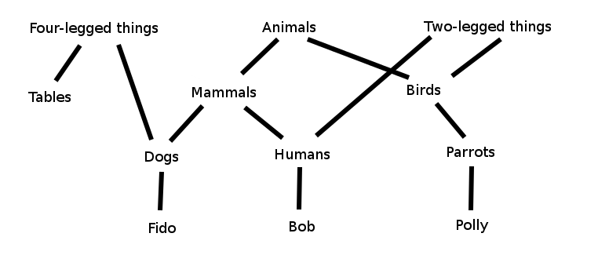
Overlapping Hierarchical Classifications
We talk about things in the real world as if they were members of overlapping hierarchies
All dogs are mammals; all mammals are animals
This might be someone's mental model of some typical classifications
Or a diagram from a book on OO

Slide 7
Substitutability
The intent of subtyping is often explained in terms of the Liskov Substitution Principle:
Let q(x) be a property provable about objects x of type T. Then q(y) should be provable for objects y of type S where S is a subtype of T.
So if something is true of mammals, it should be true of dogs

Slide 8
Subsumption
The usual subtype operator is <:. So S <: T means that S is a subtype of T
The mechanics of subtyping are expressed in the rule of subsumption:
Γ ⊢ e : S Γ ⊢ S <: T
Γ ⊢ e : T
and in the rules that guarantee that subtypes are partially ordered (omitting the “Γ ⊢”s for concisness):
S <: U U <: T S <: T T <: S
S <: S S <: T S = T
Subsumption means that a given expression does not have a unique type; hence, “subtype polymorphism”

Slide 9
Function Application
In functional programming terms, S <: T generally means that a value of type S can be passed to a function declared to take a parameter of type T
Other constraints imposed by substitutability might be of interest in more complicated systems (e.g., systems with mutable state), but here we develop our intuitions in terms of whether it makes sense to pass a value of one type to a function parameter of another type

Slide 10
Variance
Subtyping of function types is contravariant in the input type and covariant in the output type:
I₂ <: I₁ O₁ <: O₂
I₁ → O₁ <: I₂ → O₂
Barbara Liskov will tell you that that's because, for a given invocation of a function f, you can substitute a function with fewer constraints on its input than f, or more constraints on its output, and the assumptions at the call site will still be satisfied

Slide 11
Subtyping of Recursive Types
Type systems must allow type definitions to be recursive in order to be useful
The usual notation for recursion looks like:
μt.x
where x may contain t, and each t in x expands to μt.x
Subtyping for recursive types:
Γ, X <: Y ⊢ S <: T
Γ ⊢ μX.S <: μY.T

Slide 12
Top and Bottom
A type system with subtyping can include special types at the top of the type hierarchy (⊤, or Top) and at the bottom (⊥, or Bottom):
T <: ⊤ ⊥ <: T
Both of these types are optional in a type system (but it is more common to omit Bottom from a system than Top)

Slide 13
What's So Great about Subtypes?
Part Two

Slide 14
What Types Are For
Types constrain computation
The simply typed lambda calculus was invented to eliminate paradoxical or nonsensical behavior in the untyped lambda calculus, like infinite recursion
Types also serve as bookkeeping to make sure programs treat data consistently
But types are not just constraints; they also serve as commentary for human readers on the computations performed by the expressions they annotate

Slide 15
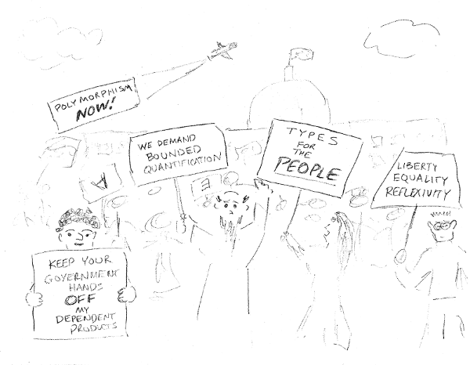
Types Are for People

Slide 16
Subtypes Are for People
Subtyping captures common-sense intuitions about how the world is organized
Many common or desirable programming language features suggest subtyping:
  Record types, OO-style object classes
  (Untagged) union and (non-disjoint) intersection types
  Refinements
  Universes
  Numbers
If we can support subtyping for these things without introducing inconsistencies or excessive computational cost, why not do so?

Slide 17
Records
Records are the classic textbook case in favor of subtyping:
fun f (r: {x: Int}) = … use r.x …
f({x = 17, y = false})
Why should we care about the unused field y in the call to f?
Fix by decreeing that:
{x: Int} <: {x: Int, y: Bool}

Slide 18
Deep Subtyping of Records
If a field of a record r1 is a subtype of the corresponding field of r2, then we should be able to use r1 in place of r2:
fun f ({x: Int, r: {y: Bool, z: String}}) = …
f({x = 2, r: {y = true, z = "hi!", aa = 42}})
The aa in the inner record gives the record passed to f a subtype of the parameter type in f's declaration. f doesn't use it, so this should be allowed

Slide 19
Record Formalities
Consider record types with labels li and types Ti
Record width subtyping:
{li: Ti for i ∈ 1..n+k} <: {li: Ti for i ∈ 1..n}
Record depth subtyping:
for i ∈ 1..n, Si<: Ti
{li: Si} <: {li: Ti}
Record types are indifferent to permutation of fields:
for i,j ∈ 1..n, {kj: Sj} is a permutation of {li: Ti}
{li: Ti} = {kj: Sj}

Slide 20
Object Subtyping
In statically typed object-oriented languages, you can think of classes as fancy record types, and subclasses as record types that have all the fields of their superclasses
Many OO languages have additional machinery that turns this idea into a gross oversimplification, but the basic idea is usually there
This talk has no more to say about OO

Slide 21
Unions and Intersections
Programming languages with algebraic data types let us construct tagged unions:
data Wrapper =
WrappedInt Int |
WrappedBool Bool
What if you could have untagged unions?:
S ∪ T
This works best in languages where all values are already tagged (typically, languages with a Top type)
If you can have unions, why not intersections?
S ∩ T

Slide 22
Union and Intersection Operations
If a type is a set of values, a union of types is the union of the corresponding sets of values; likewise with intersections
A value of S ∩ T belongs to both S and T; any operation allowed on either S or T is safe on S ∩ T
A value of S ∪ T belongs to S or T; you can safely perform only operations allowed on both S and T
  Unless you allow, say, a joint pattern match over constructors of both S and T

Slide 23
Union Rules, Intersection Rules
Idempotence:
T ∪ T = T T ∩ T = T
Commutativity:
T ∪ U = U ∪ T T ∩ U = U ∩ T
Simple subtyping:
S <: S ∪ T S ∩ T <: S
Combined subtyping:
T <: S U <: S S <: T S <: U
T ∪ U <: S S <: T ∩ U
Function types:
(T → S) ∪ (U → S) = (T ∪ U) → S
(S → T) ∩ (S → U) = S → (T ∩ U)

Slide 24
Refinement Types
(aka Subset Types)
A refinement type combines a base type with a proposition. For example:
{ n: Nat | n < 3 }
is the type of all natural numbers less than 3
Of course:
{ n: Nat | n < 2 } <: { n: Nat | n < 3 }
So when is one refinement type a subset of another? When both have the same base types, and the first proposition implies the second
This is an immensely powerful concept. Let it soak in for a bit—we'll come back to it

Slide 25
Universes
(aka the Infinite Tower of Types)
A universe is a type whose elements are types
You might suppose that Type: Type, that is, that Type (the type of types) is an element of itself
However, in type systems strong enough to use for proving theorems (as in Coq, Agda, Idris), this naive formulation leads to inconsistencies. Instead, each universe at level n, Typen, is an element not of itself, but of Typen+1
It is most convenient to treat all elements of Typen as also belonging to Typen+1; that is,
Typen <: Typen+1

Slide 26
Numbers
Numeric types might be the most widely known example of subtypes
But also maybe the worst example of subtypes
C programmers are used to thinking that all ints are floats, all longs are doubles, and so on, because such numeric promotions occur without overflow
But these promotions actual entail a change of representation, unlike most casts to a supertype
Not to mention that conflating different types of numbers is mathematically dubious

Slide 27
Formal Types and Informal Types
A given type system defines what it considers a type to be
But the English word “type” is not so constrained, and can refer to any kind of categorization, formal or informal
Perhaps such “folk types” should be invited into the formal type system, so we can use the system for communicating with folks

Slide 28
Folk Type Examples
Consider a Haskell declaration of a List datatype:
data List a = Empty | Cons a (List a)
deriving (Show, Read, Eq, Ord)
Haskell does not have a way to express directly “the type of all Conses”, that is, Lists built with a particular constructor
Also note that “the type of all datatypes for which there is an Eq typeclass implementation” is not itself a type (although it can be expressed indirectly using a type variable)
These are types that can be expressed in English but not Haskell, so they are Haskell folk types

Slide 29
Refined Folk
Many folk types in simpler languages can be expressed as refinement types in languages with a more expressive type system. If we have (Coq syntax):
Definition isCons {X: Type} (l: list X): bool :=
match l with
| nil => false
| cons _ _ => true
end.
then we can build:
{ l: list X | isCons l = true }

Slide 30
What's Wrong with Subtypes?
Part Three

Slide 31
The Problems with Subtypes
Many type systems for non-OO languages have no explicit way to express a subtype relation. Including such a relation in a type system can be complicated:
  It can be more difficult to figure out the type of an expression
  Subtyping may interact with other type system features to make typechecking undecidable
If a language has an otherwise rich type system, it may be easiest to leave subtyping out

Slide 32
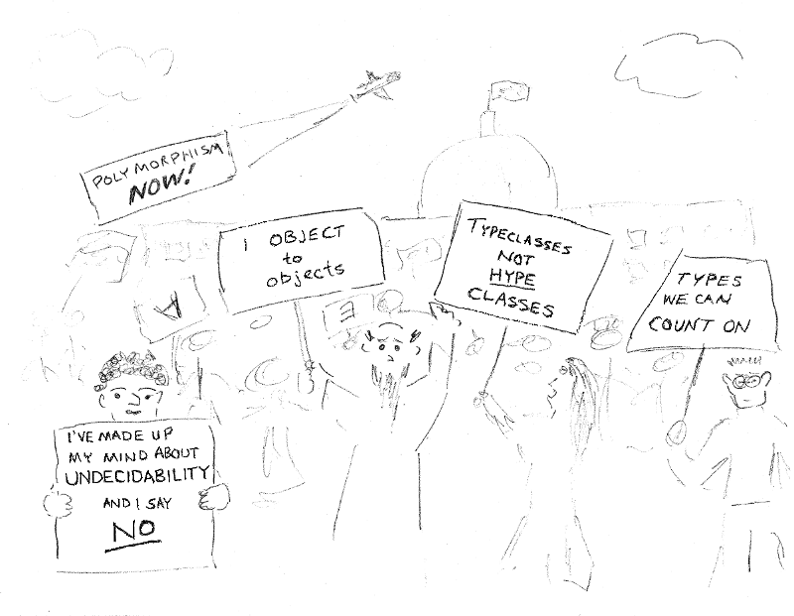
Types Are for Correctness

Slide 33
Superfluous Subtypes
The role of a type system is to ensure that programs are consistent with themselves
Unnecessary complications to the type system make it harder for the compiler writer to ensure that the type system fulfills its purpose
Anything that makes typechecking undecidable is right out

Slide 34
Unique Types
A type system like Haskell's or ML's ensures that all types are disjoint
This means that in a correctly typed program, exactly one type can be assigned to every term. This simplifies typechecking-related algorithms, like unification
Subtyping breaks the simple rule; every value of a type T is also a value of all of T's supertypes
So algorithms dealing with types must be phrased in terms of least upper bounds (joins) and greatest lower bounds (meets)

Slide 35
Meets and Joins
A join (least upper bound) of two types S and T is written S ∪ T. Similarly, their meet (greatest lower bound) is written S ∩ T
A join might not exist in a type system without Top; a meet might not exist in a type system without Bottom
Some properties we require of joins and meets:
T ∪ U = U ∪ T T ∩ U = U ∩ T
S <: S ∪ T S ∩ T <: S
T <: S U <: S S <: T S <: U
T ∪ U <: S S <: T ∩ U
Hmm, anything look familiar here?

Slide 36
Bounded Quantification and Its Discontents
In any language that includes both universal quantification (∀) and subtyping, the temptation is overwhelming to allow them to interact:
Γ ⊢ S <: T Γ, X <: S ⊢ U <: V
Γ ⊢ (∀X<:T.U) <: (∀X<:S.V)
Unfortunately, this rule makes typechecking undecidable
The problem arises only for rather odd-looking terms—details can be found in Pierce's Types and Programming Languages—but undecidability is disconcerting to programming language designers

Slide 37
Oddness at the Bottom
The Bottom type has unusual properties that complicate bookkeeping
Generally, if a type does not have an arrow in it (or a type variable is not unified with an arrow type), it can't be applied to an argument. But Bottom is a subtype of all function types, so it can be applied
Any assumption of the form X <: Bottom is actually an assumption that
X = Bottom

Slide 38
Some Lies
I Have Enjoyed Telling You
I've been acting as if types are partially ordered; that is, if A <: B and B <: A, then A = B
More realistically, types form a preorder, and types that are mutual subtypes are not necessarily equal (as usual, equality is a troublesome concept)
Many of the type rules shown can't be used directly in a compiler (not syntax-directed)
Most of the rules should include some sort of validity check for types
Worry about these things if you write a compiler

Slide 39
Subtype Alternatives
(Kinda Sorta)
Part Three and a Half

Slide 40
The Typeclass Solution:
Constraining Types without Using Types
Haskell achieves much expressivity using typeclasses:
member :: (Eq a) => a -> [a] -> Bool
member y [] = False
member y (x:xs) = (x == y) || member y xs
In Prolog terms, available typeclass instances are like a database of facts
Typeclass constraints on a function trigger a Prolog-style search for a matching typeclass instance
But typeclasses are not types, nor are they terms that have types

Slide 41
Subtypeclassing
Haskell allows typeclass constraints on typeclass declarations:
class (Eq a) => Num a where …
This says that in order to create a Num instance for a, there must exist an Eq instance for a
This sort of constraint is similar to the relationship between superclass (Eq) and subclass (Num) in OO systems: Num depends on Eq and is more specific than Eq

Slide 42
An Implicit Criticism of Typeclasses
Although Scala has a rich object system that includes subtyping, it also has a notion of implicit conversions that has much the same effect as typeclasses:
implicit def dbl2Cpx (d: Double) =
Complex(d,0.0)
implicit def pr2Cpx (ds: (Double,Double)) =
Complex(ds._1,ds._2)
which declares that a Double or pair of Doubles can be treated as a Complex (the methods of Complex play the role of the functions exported by a typeclass)
The Complex class is inside the regular type system

Slide 43
Row Polymorphism
Row polymorphism addresses the same problems as record subtyping, but with a different mechanism
Imagine a variable that can range over sets of record fields
A function might have a type like:
foo: ∀r: row without x, {x: Int | r} → {| r}
meaning that foo takes a record with a field x and some other fields r, and returns a record with the same fields r, but without x
This gives you genericity in record types without a subtype in sight

Slide 44
A Subtype by Any Other Name
Part Four

Slide 45
Curry and Howard and Their Amazing Correspondence
Haskell Curry and William Alvin Howard noticed that a value V of a type T can be construed as a proof that T is inhabited
(Lots of other people figured this out too, but Curry and Howard are the only ones who get the credit)
So T can also be viewed as a proposition with proof V
A function of type A → B is understood as a proof that A (as a proposition) implies B
This works only for total functions (no exceptions!)
Proof assistants like Coq are based on this idea

Slide 46
The Power of Dependent Types
A dependent function type lets you mention the function argument's value in the function's output type
Under the Curry-Howard correspondence, this means that proofs can go beyond propositional logic
So you can prove theorems that mention variables of arbitrary types, as in (Coq syntax):
forall n m: nat, n + m = m + n
This is the type of a function that takes two nats and returns a value of the type n + m = m + n
A value of n + m = m + n is a proof that n + m = m + n

Slide 47
Building Type Refinements with Dependent-Type-Based Proofs
The refinement type:
{ n: nat | n > 0 }
can be encoded in a dependently typed language as a dependent pair, or a pair of consecutive function arguments. For example, the type of a Coq function that returns the predecessor of a positive number looks like:
predecessor: forall n: nat, n > 0 -> nat
which takes a natural number n and a proof that n is greater than zero (because zero has no predecessor), and returns n's predecessor

Slide 48
Refineder and Refineder
A little syntactic sugar in Coq lets us use the familiar curly brace notation for refinements
With that, we can create a predecessor function with an even more precise type than on the previous slide:
predecessor:
forall n: nat, n > 0 -> {m : nat | n = S m}
This type says that predecessor takes n and a proof that n is positive, and returns m such that n is m's successor
This type completely specifies the behavior of predecessor—a type can't get more informative

Slide 49
But Wait,
What about the Subtyping?
Dependently typed languages might not have an explicit notion of subtyping, but for refinement types built from dependent types, implication is just as good
Instead of showing:
{ n: Nat | n < 2 } <: { n: Nat | n < 3 }
we prove that:
forall n: nat, n < 2 -> n < 3
and apply the resulting proof to our proof of n < 2 to yield a proof of n < 3

Slide 50
Unions and Intersections by Proof
Unions and intersections of refinement types are just types whose refinements are conjunctions or disjunctions. For example:
{ n: nat | 0 < n /\ n < 100 }
is the intersection of:
{ n: nat | 0 < n } and { n: nat | n < 100 }
where /\ is the Coq conjunction-of-propositions operator
Now go back to the union and intersection rules page. Can you construct proofs that those rules are correct?

Slide 51
With Great Power
Comes Great Responsibility
The change in mindset from subtyping to proving propositions gives you tremendous flexibility
You can prove all sorts of interesting things, including things that have nothing to do with subtyping
The price to be paid is that you now have to provide proofs of type claims that, in simpler type systems, the compiler proves for you
(That should set your spider sense tingling)

Slide 52
You're the Decider
Dependent type systems can express both parametric polymorphism (type parameters become ordinary parameters) and, using implication, subtyping
So what happened to the undecidability problems that arose when we mixed subtyping and parametric polymorphism before? Are we still worried about them?
No. Decidability is a property of algorithms, but constructing proof objects, although it can be done by an algorithm, is fundamentally not algorithmic
The burden of proof rests on you

Slide 53
So, Where Do We Go with All This?
Part Five

Slide 54
Refinements Rule but Proofs Are Painful
You might wonder just what the proof looks like for theorem:
forall n: nat, n < 2 -> n < 3
mentioned a few slides back. In Coq, it looks like:
fun (n : nat) (H : n < 2) =>
n_le_m__Sn_le_Sm n 2 (le_S n 1 (Sn_le_Sm__n_le_m n 1 H))
: forall n : nat, n < 2 -> n < 3
where n_le_m__Sn_le_Sm and Sn_le_Sm__n_le_m are lemmas that say n <= m -> S n <= S m and
S n <= S m -> n <= m.
Whew!

Slide 55
A Little Help, Please
Imagine littering proofs like the one from the previous slide throughout your code
It doesn't have to be that bad; for highly repetitive cases like type unions and intersections, you can write functions that generate proofs automatically
This is not a convincing plan for more general proofs, as in the refinement types we've looked at
Can use SMT solvers to automatically handle base types whose properties are well understood
And then what?

Slide 56
Hybrid Typechecking
Would Be Nice
Hybrid typechecking is a technique that supplements compiletime typechecking with runtime membership type checks
Hybrid typechecking is not airtight, but allows you to use highly expressive types without proving theorems
Check out the experimental language Sage
(https://sage.soe.ucsc.edu/)
And my previous talk on hybrid typechecking (https://github.com/archontophoenix/hybridTypecheckingTalk/)

Slide 57
Can Refinements Be
Both Reliable and Easy to Use?
Sage allows non-total functions and doesn't track whether functions are total
So a function in Sage is not a proof of an implication
Idris (http://www.idris-lang.org/) tracks whether functions are total, but allows partial functions
You can insist that functions treated as proofs be total, so that your proofs are reliable
What if you could retrofit Idris with Sage-style runtime typechecking, or Sage with total function tracking?

