Slide 1

IT Training
Module Name: Mozilla Thunderbird
Author: Dewan Shamsul Alam
Date: 2013/05/22

Slide 2
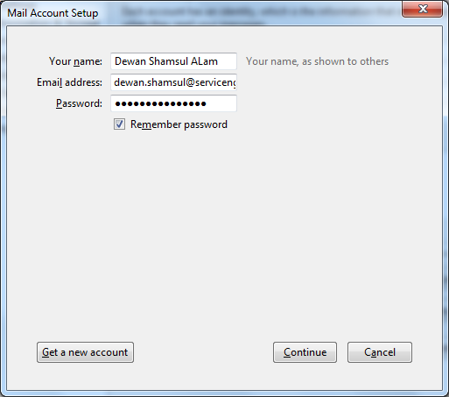
Type your name, email address and password
Then click Continue

Slide 3
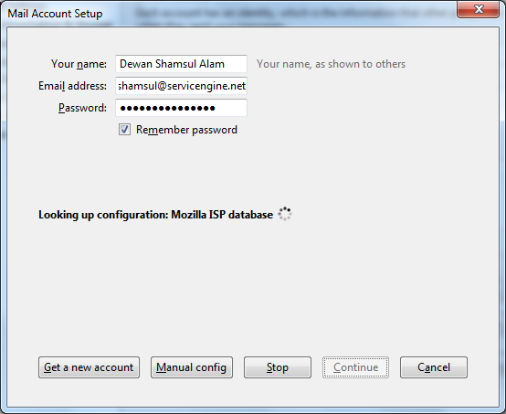
Wait a while..

Slide 4
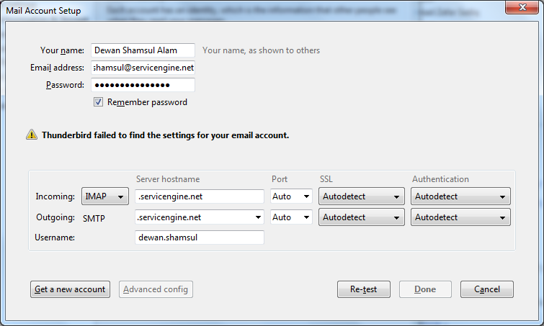
Thunderbird will fail to connect to your account. That’s ok.
You need to fill up some information described in the following slides.

Slide 5
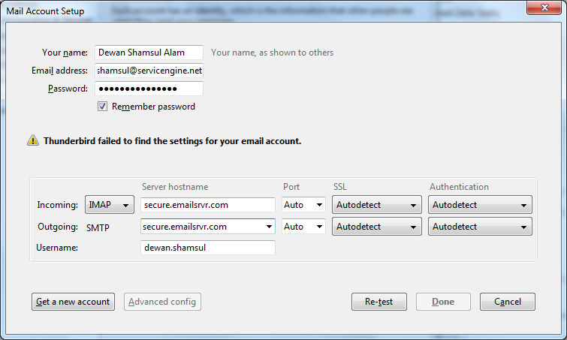
Incoming Server hostname: secure.emailsrvr.com
Outgoing Server hostname: secure.emailsrvr.com

Slide 6
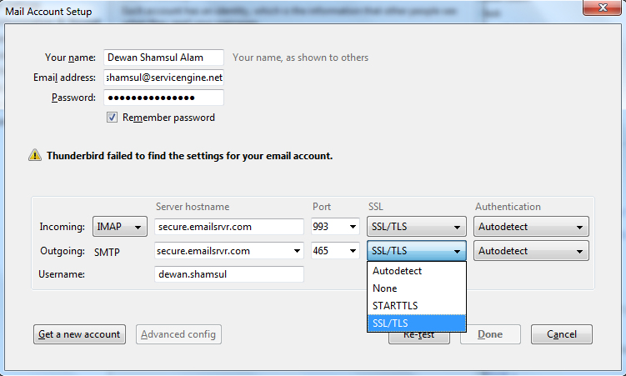
Select SSL/TLS in the SSL section the ports will be automatically selected.

Slide 7
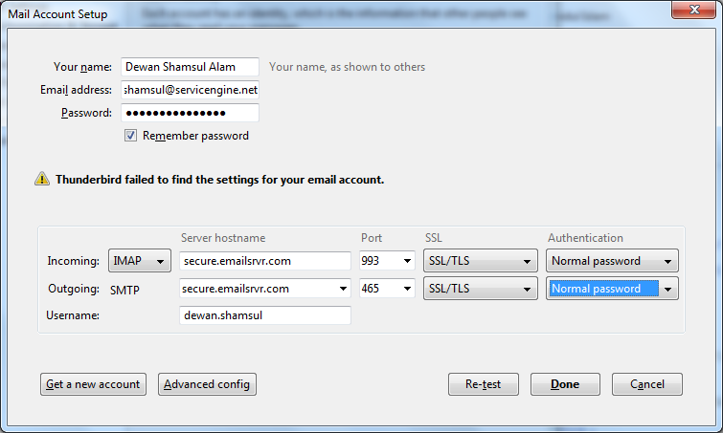
Select Normal Password in the Authentication section

Slide 8
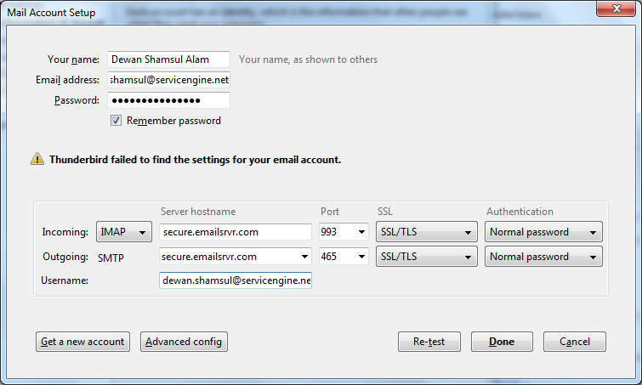
Copy your email address in the Username field
Then click Done

