Slide 1
Hack Bloomberg
*Ahem… what we really mean is “Bloomberg Hackathon”

Slide 2

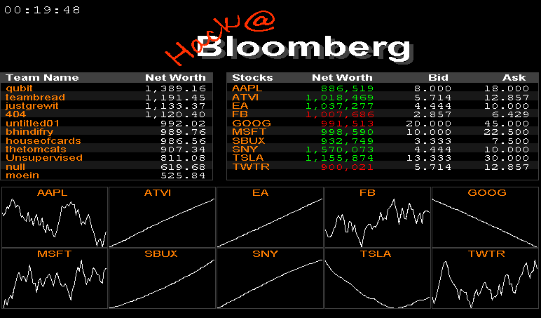

Slide 3
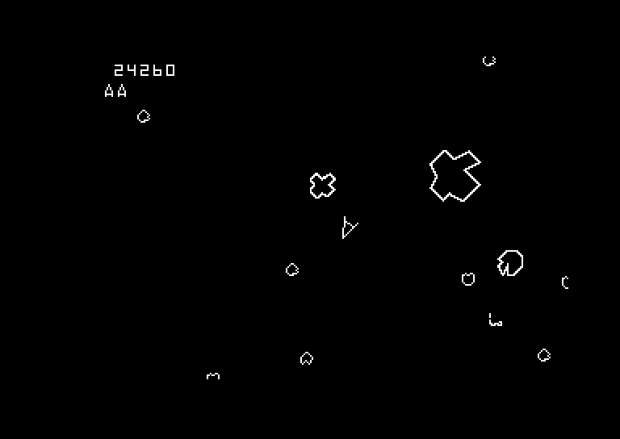
The Inspiration
We’re going old school…

Slide 4

So what are we doing here…

Slide 5
So what are we doing here…

Slide 6
So what are we doing here…

Slide 7
So what are we doing here…
Physics!

Slide 8

So what are we doing here…

Slide 9
What’s the fun in that?
We’re playing for points here.
Points matter.
Team with most points wins.
You should get as many points as possible.
Points will help you win so you should get them.
Oh yeah, you can mine points from MINES

Slide 10
Mines
This is a MINE

Slide 11
Mines

Slide 12

Mines
This MINE is mine

Slide 13

Mines
This MINE is mine

Slide 14
Mines
A MINE, mine for none

Slide 15

So really no Pew Pew?
Nope
No cake either
We do have EXPLOSIONS

Slide 16
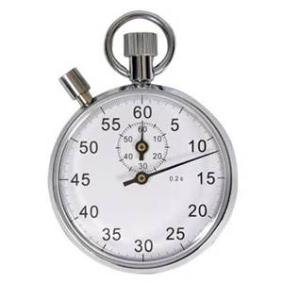

Slide 17

Mines
Bombs
This MINE is mine

Slide 18

Mines
Bombs
This MINE is mine

Slide 19
Other stuff
The game is divided into rounds (Discretized)
Set your acceleration or brake each round
Each round is a few milliseconds
Everyone’s movement and ownership is recalculated each round
You gain as many points as you own MINES each round
The world is a donut
A small frictional coefficient is factored into movement
Ships are have a limited sensor range
Ships can scan any are of the map on a cool down
All formulas in the game will be given as a virtual handout
There will be cake

Slide 20
How To Play
Bring up a server OR use the global server that is always up
Using both may help test strategies more efficiently
Easier to fine-tune own instance (and you can slow it down)
Easier to test high level strategies on global server
Connect to the server
Open a socket on a port
Enter: <team_name> SPACE <password> NEW_LINE
Enter: <Command> NEW_LINE
Read: <Response>
Math
Rinse
Math
Repeat
Connect to the UI via
$ run_server.tsk ux
http://codebb.cloudapp.net/BaseInvaders.jar then java -j BaseInvaders.jar

Slide 21
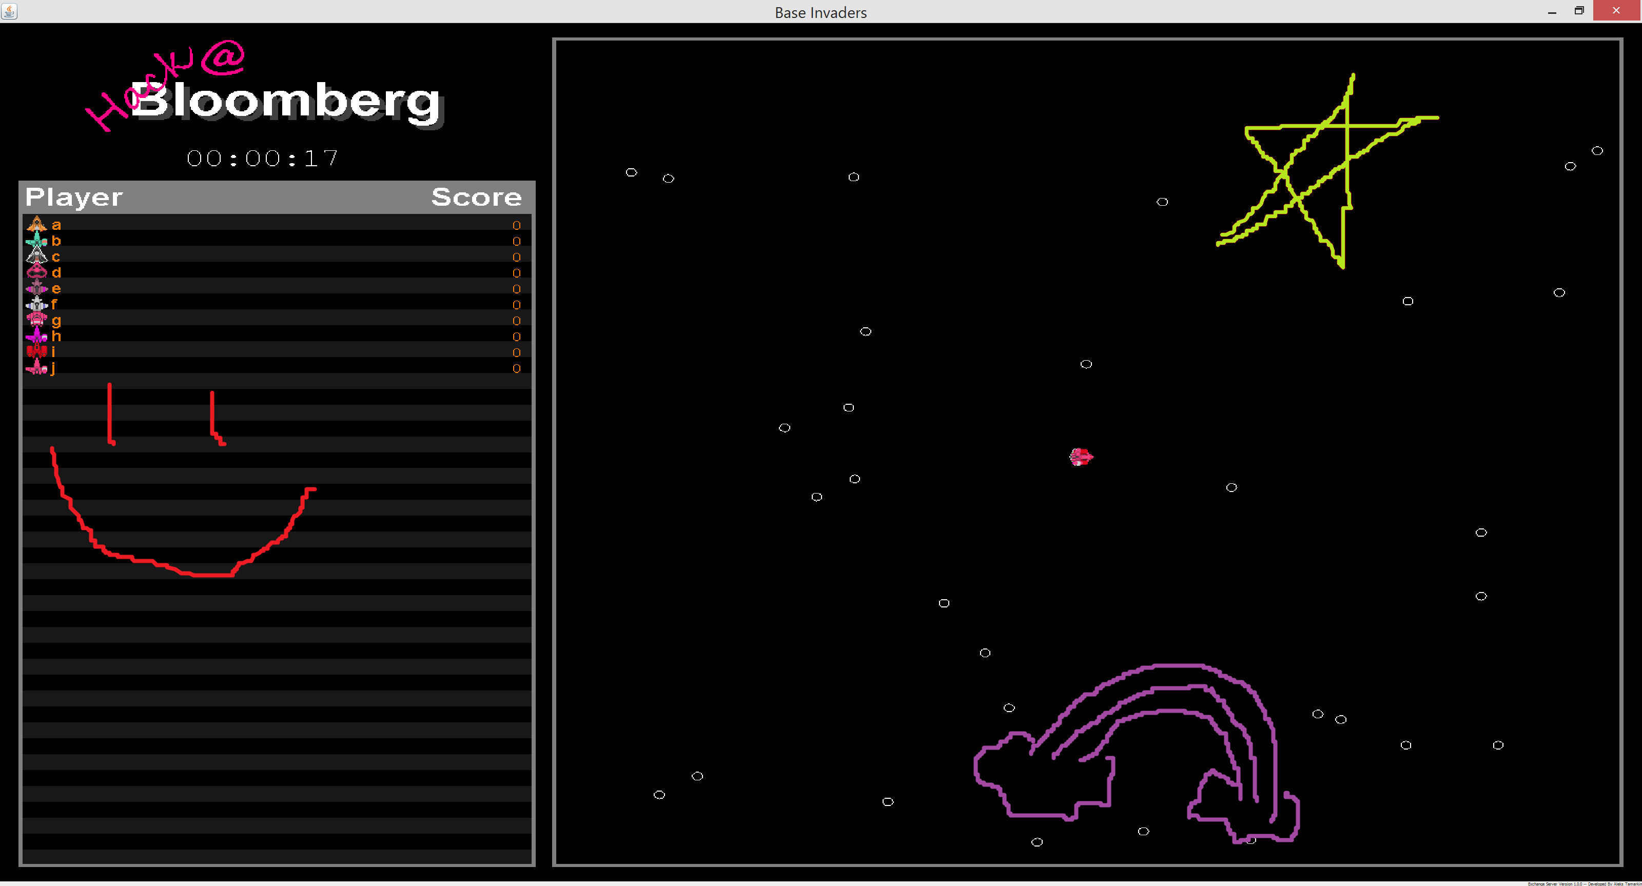
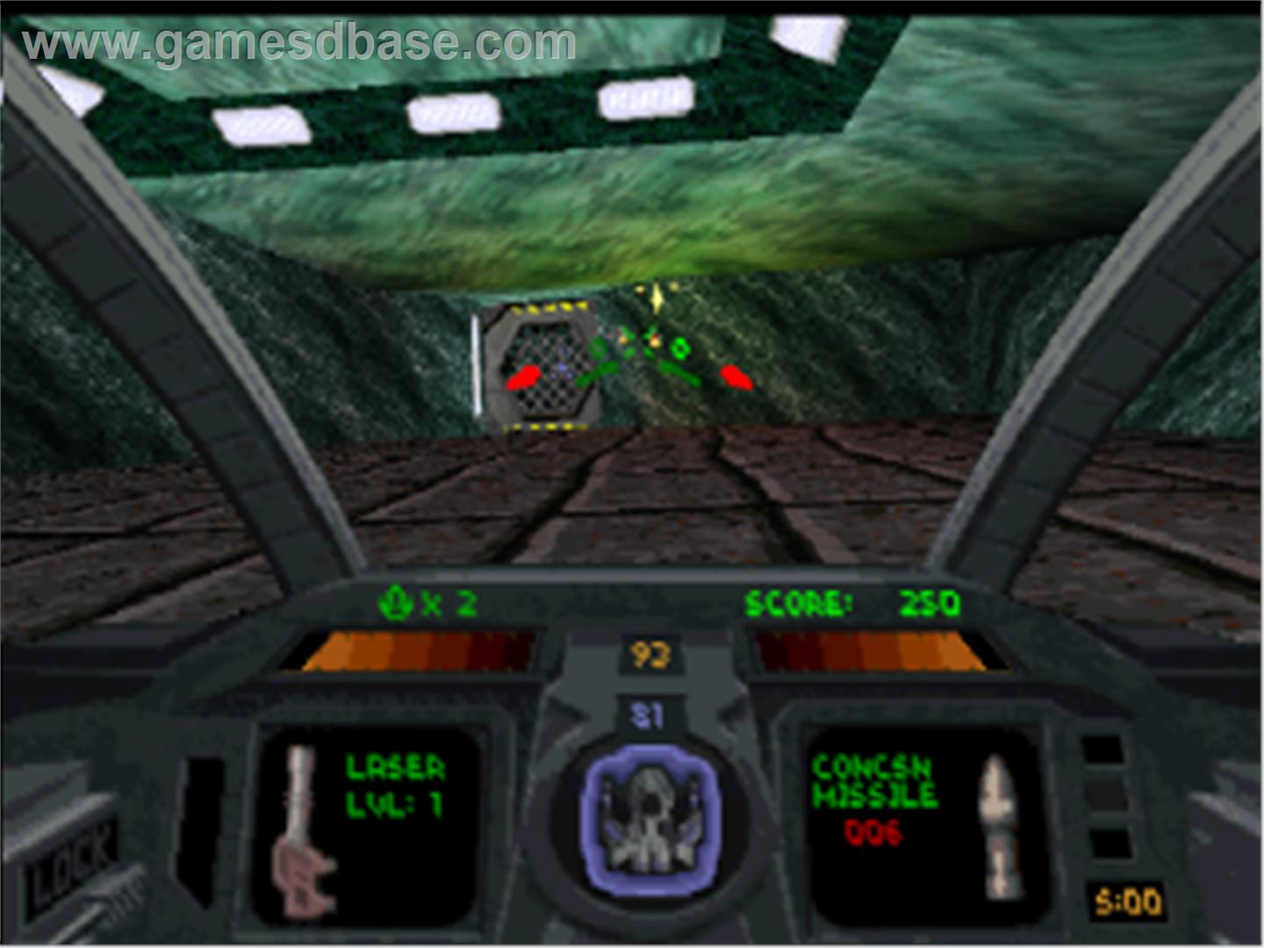
UI Competition… (Half the prizes)

Slide 22
The mandatory slide
Don’t do anything against the spirit of the competition
Don’t packet sniff
Don’t DDOS the server
Don’t login as someone else
Don’t bring down our infrastructure
Don’t bring down the server machines
Don’t bfing down others’ code
Don’t steal others’ code
Etc…

Slide 23






All the things
There is a world
With ships
No lasers
Points (that matter)
Mines
EXPLOSIONS

Slide 24
Oops!
DEMO

Slide 25
We are done here
Lets get to Pizza
Hacking…

