Slide 1

PROPOSAL PRESENTATION
Chest X-Ray Difference VQA with Registration
Kaung Sithu
st124974
COMMITTEE MEMBERS
Dr. Chaklam Silpasuwanchi (Chairperson)
Prof. Attaphongse Taparugssanagorn (Member)
Dr. Chantri Polprasert (Member)

Slide 2
01
BACKGROUND
02
RELATED WORK
03
METHODOLOGY
TABLE OF CONTENTS
04
EXPERIMENT
05
EXPECTED RESULT

Slide 3
1. INTRODUCTION
Medical VQA
An adaptation of general VQA to support medical diagnosis
A multimodal task combining image analysis with natural language processing to provide answers to complex questions
Medical Diff VQA for CXR
It addresses questions regarding the disparities observed between two CXRs of the same patient taken at different times.
Closely reflects the diagnostic procedure of radiologists who conduct longitudinal comparisons to track disease progression or treatment response
This task is enabled by the creation of specialized datasets, such as the MIMIC-Diff-VQA dataset introduced by Hu et al.
Notes:
As a field, we've seen significant advancements in Visual Question Answering, and its adaptation to the medical domain aims to tackle complex diagnostic tasks. Med-VQA combines visual and linguistic analysis to answer nuanced questions about radiological images.
The core challenge, as we know, is that interpreting these images requires deep, specialized knowledge of subtle pathologies. A persistent limitation in many Med-VQA methods has been the framing of the task as a simple classification problem, which fails to capture the flexibility and open-ended nature of real clinical inquiry
To better align with clinical workflows, the field has evolved toward Difference VQA. This task is explicitly designed to model the longitudinal assessment that is fundamental to radiology. It provides a model with two images from different time points and asks it to articulate the changes
The creation of the MIMIC-Diff-VQA dataset was a pivotal moment, providing the first large-scale benchmark to seriously pursue this complex and clinically relevant problem

Slide 4
1. INTRODUCTION
EKAID
Expert-knowledge-aware image difference graph
Represent images as graphs where anatomical structures are nodes
Image difference graph feature is computed by subtracting the graph feature of two images.
ReAl
Residual Alignment Framework
Introduces a dedicated residual encoder that processses a subtracted residual image as a direct input
Uses residual feature alignment (RFA) module to enforce consistency between feature difference and residual feature
Notes:
Initial state-of-the-art approaches focused on novel architectures for processing the two images.
EKAID took a structured approach, which is creating graphs based on expert anatomical knowledge and then comparing these graphs.
In contrast, ReAl worked at the pixel and feature level, that is creating a literal difference image and feeding it into a special residual encoder, using a loss function to align the features.

Slide 5
1. INTRODUCTION
PLURAL
Pretrain language-vision model
Pretrains on general images, then on longitudinal CXR
Image difference graph feature is computed by subtracting the graph feature of two images.
RegioMix
Retrieval Augmented Generation (RAG) Paradigm
Generates retrieval pair by mixing and matching different anatomical regions from various images in the training set
Instead of looking at input images
Notes:
More recently, the field has seen two major advances.
First, PLURAL showed us that a strong, pretrained foundation is critical.
By pretraining on vast amounts of data, PLURAL outperformed models with more complex, task-specific architectures.
This confirmed that robust representations are key. Following this, RegioMix introduced a retrieval-augmented approach.
Instead of just looking at the input images, it finds similar anatomical regions from a database and uses them to provide context, which leads to a dramatic improvement in performance.
This shows that having access to relevant, well-matched examples is extremely powerful.

Slide 6
1.1 RESEARCH QUESTIONS
Research Question 1 (The 'Detection' Question)
What are the characteristics and quantifiable frequencies of diagnostic errors generated within the difference VQA paradigm when models rely on unregistered longitudinal chest x-rays?
Research Question 2 (The 'Action' Question)
What architectural and algorithmic choices constitute an optimal multi-stage registration pipeline to minimize non-pathological variance in longitudinal chest x-rays for the difference VQA task?
Research Question 3 (The 'Impact' Question)
What is the performance impact of proposed registration-enhanced Diff VQA model, compared to leading methods like EKAID, PLURAL or ReAI, on established metrics such as BLEU, ROUGE-L, CIDEr, and to what extent does it demonstrate superior clinical impact through enhanced sensitivity to subtle pathological differences?

Slide 7
1.2 HYPOTHESIS
Characteristics and diagnostic errors generated within difference VQA models are primarily caused by misinterpretation of geometric artifacts in unregistered images. Thus, implementing an optimal, registration pipeline designed specifically to minimize this non-pathological variance, will result in a VQA model that demonstrates a significant improvement on quantitative evaluation metrics while benchmarked against leading non-registration models such as EKAID, PLURAL and ReAI.

Slide 8
1.3 OBJECTIVES
Detect and Quantify Baseline Errors
Systematically identify and quantify the characteristic errors in Diff VQA models that arise from a lack of image registration, linking to RQ1
Design & Implement an Optimal Registration Pipeline
Develop and validate an image registration pipeline specifically tailored to minimize non-pathological variance in longitudinal CXR, linking to RQ2
Demonstrate Superior Performance & New Capabilities
Benchmark the pipeline to demonstrate a statistically significant performance improvement over the SOTA models, linking to RQ3
Explore the model’s accuracy on subtle findings and its potential for quantitative analysis
Notes:
First, I will systematically detect and quantify the problem. My goal is to show that the errors caused by misalignment are predictable and frequent in the current Diff VQA paradigms. This corresponds to my first research question.
Second, I will design and implement the solution. This is the core technical contribution: an optimized registration pipeline built specifically for this task. I will validate its effectiveness at minimizing the geometric noise between image pairs, which addresses my second research question.
Finally, I will demonstrate the impact of this solution. I will integrate this pipeline into a VQA model and prove its superiority through direct, quantitative benchmarking against the state-of-the-art models we've discussed. Beyond just improving scores

Slide 9
1.4 SCOPE
Dataset: Exclusively using the Medical-Diff-VQA dataset for all experiments and benchmarking
Core Task: Focusing on difference question category within Diff VQA
Methodology
Implementing and evaluating image registration pipelines
Integrating multistage (rigid and deformable) registration pipeline as a pre-preprocessing step for an existing VQA model
Evaluation: Benchmarking against SOTA models using standard metrics (BLEU, ROUGE-L, CIDEr)
Out of scope
Collecting new clinical data or conducting clinical trials with human radiologists
Expanding the VQA task beyond the established question types in Medical-Diff-VQA
Notes:
Rigid Registration: First, perform a rigid alignment (translation, rotation, scaling) to correct for gross differences in patient positioning. This establishes a common coordinate frame.
Deformable (Non-Rigid) Registration: This is the crucial step. Use advanced algorithms (e.g., B-spline or Demons-based registration) to warp the reference image to match the main image, accounting for non-linear changes like breathing and soft-tissue deformation. The chest is not a rigid body, so this is essential. This step would align anatomical landmarks like the diaphragm, spine, and heart silhouette.

Slide 10
2. RELATED WORK
Name | Approach | Dataset | Key Idea | Implicit Weakness
EKAID | Architectural Innovation |  | specialized graph to process difference features | Assumes initial difference from subtraction is reliable
ReAl | Architectural Innovation |  | residual modules to process difference features | Assume residual image is reliable
PLURAL | Pretraining |  | large-scale natural and medical data to learn robust representation | Learns to be robust to misalignment but does not include a way to fix it
RegioMix | Retrieval Augmentation |  | retrieve similar, well-matched anatomical regions from a database to provide context | Avoids the alignment problem for input pair by using a database of pre-aligned regions
Notes:
First, we have Architectural Innovation, represented by EKAID and ReAl. Their core idea was to build specialized network modules to handle difference features.
EKAID used knowledge graphs, while ReAl used a residual encoder.
Their implicit weakness, however, is that they assume the raw difference signal they receive is a reliable representation of change, which makes them highly sensitive to the geometric noise I mentioned earlier
The EKAID paper itself notes the challenges posed by large variances in image orientation and deformation
Second is the Pretraining approach, championed by PLURAL. Here, the key idea is that pre-training on massive datasets provides the model with robust representations that help it better understand medical images.
While incredibly effective, this approach learns to be robust to the noise from misalignment rather than explicitly correcting it.
Finally, the most recent advance is Retrieval Augmentation, with RegioMix. This model cleverly retrieves similar, pre-existing regions from a database to inform its answer. This is powerful but ultimately sidesteps the core problem: it doesn't align the actual input image pair the user provides; it finds other examples that are easier to work with.

Slide 11
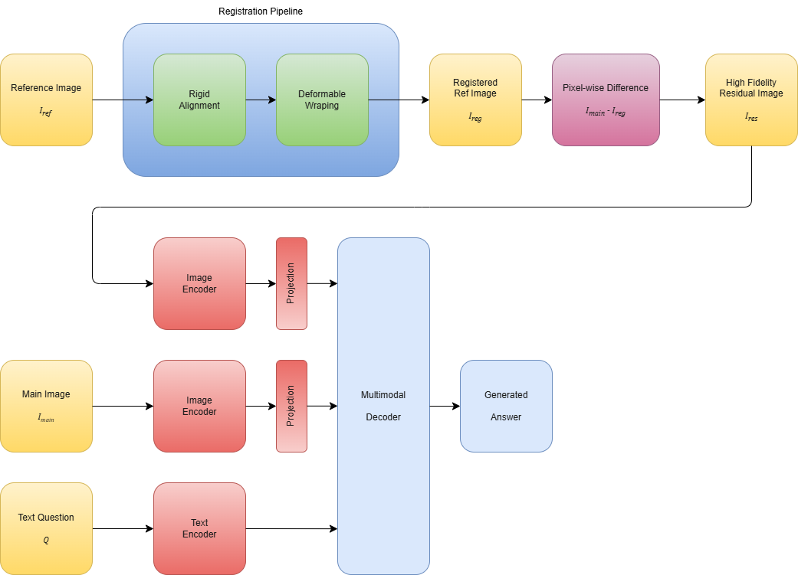
3. METHODOLOGY
Notes:
My methodology is centered around introducing a critical pre-processing step that has been overlooked by prior work. This diagram shows the complete workflow. We start with the input reference and main images.
Firstly, the reference image is rigidly aligned for correcting global translation and rotation.
Secondly, the deformable algorithm is used to warp the rigidly aligned reference image for non-rigid anatomical changes.

Slide 12
3.2 DATASET
Medical Diff VQA dataset, introduced by Hu Et Al.
It is the largest and most established benchmark for this specific task
used by all SOTA models, ensuring a fair and direct comparison.
It contains 700,703 QA pairs over 164,324 image pairs
Size of images in JPEG (MIMIC-CXR-JPG): 570.3GB
Size of images in Dicom (MIMIC-CXR): 4.7 TB
Notes:
For all experiments, I will use the MIMIC-Diff-VQA dataset. Not only it is the standard benchmark for the field but also It is used by EKAID, ReAl, PLURAL, and RegioMix. This factor makes it the only choice for a fair, head-to-head comparison of my model's performance against the current state-of-the-art.

Slide 13
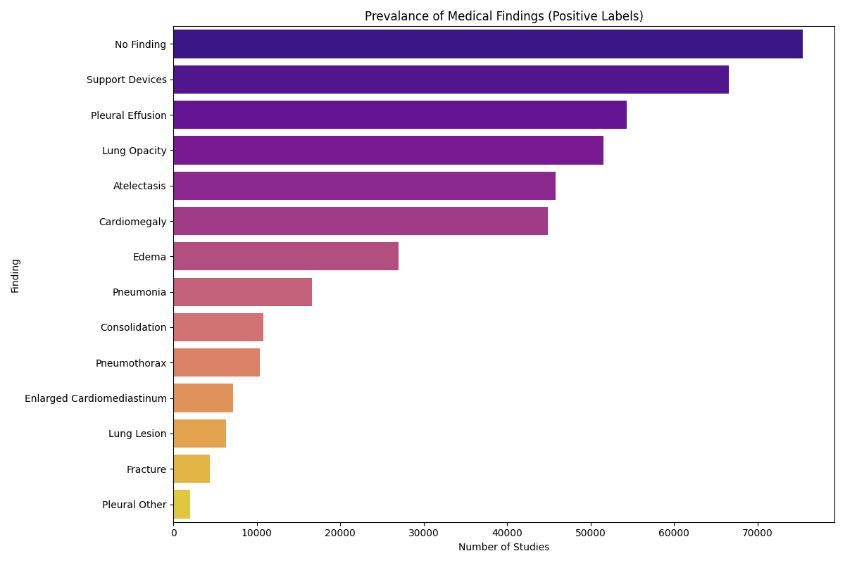
3.2 DATASET
Notes:
For all experiments, I will use the MIMIC-Diff-VQA dataset. Not only it is the standard benchmark for the field but also It is used by EKAID, ReAl, PLURAL, and RegioMix. This factor makes it the only choice for a fair, head-to-head comparison of my model's performance against the current state-of-the-art.

Slide 14
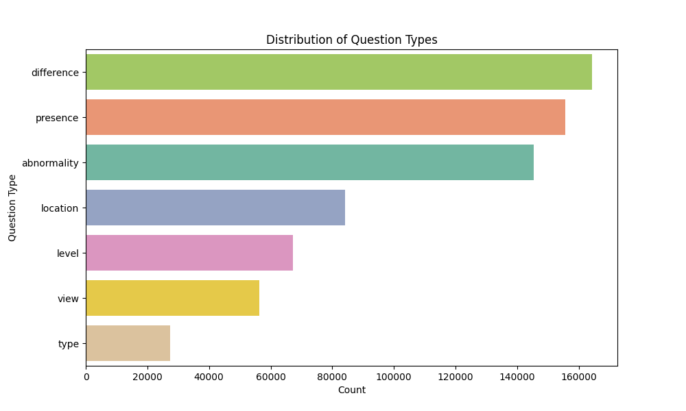
3.2 DATASET
Notes:
For all experiments, I will use the MIMIC-Diff-VQA dataset. Not only it is the standard benchmark for the field but also It is used by EKAID, ReAl, PLURAL, and RegioMix. This factor makes it the only choice for a fair, head-to-head comparison of my model's performance against the current state-of-the-art.

Slide 15
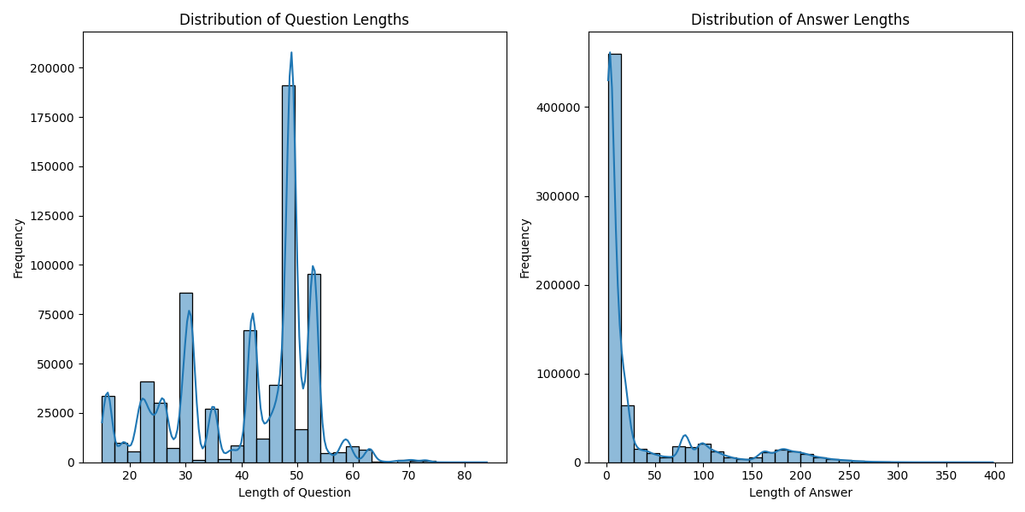
3.2 DATASET
Notes:
For all experiments, I will use the MIMIC-Diff-VQA dataset. Not only it is the standard benchmark for the field but also It is used by EKAID, ReAl, PLURAL, and RegioMix. This factor makes it the only choice for a fair, head-to-head comparison of my model's performance against the current state-of-the-art.

Slide 16
3.4 MODELS
Baseline Model: A SOTA model, PLURAL, that performs simple subtraction without any registration. This replicates the SOTA approach.
Proposed Model v1: The baseline model integrated with only the rigid alignment step.
Proposed Model v2: The baseline model integrated with the fully deformable registration pipeline.

Slide 17
4. EXPERIMENTS
IV (image registration method applied before VQA model)
no registration method
rigid registration
full deformable registration pipeline
DV
quantitative performance measured using standard metrics
BLEU, ROUGE-L, CIDEr
qualitative performance
model accuracy on a curated subset of test cases featuring subtle pathological changes
Notes:
My experimental design is straightforward and directly aimed at answering my research questions.
The independent variable, the thing I am changing, is the registration method used on the images. I will test three levels: no registration, rigid registration only, and the full deformable registration pipeline
The dependent variables, what I will measure, are the model's performance.
This will be captured quantitatively using the same standard metrics as the papers I'm comparing against—BLEU, ROUGE-L, and CIDEr—to ensure a fair comparison.
I will also perform a qualitative analysis by evaluating the model's accuracy on a curated set of challenging cases with very subtle findings, which are likely to be caused by noise in the baseline model.

Slide 18
5. PRELIMINARY/EXPECTED RESULT
Model | BLEU-4 | ROUGE-L | CIDE-r
Baseline | 53.0 | 73.6 | 2.409
RigidReg-VQA | 55.0 | 74.5 | 2.6
DefReg-VQA | 58.0 | 76.0 | 3.1
We can expect the largest jump here. By removing noise, the model will be better at identifying the correct, clinically relevant rare words such as “pneumothorax” vs “atelectasis”, which are heavily rewarded by CIDEr.
Overall sentence structure, measured by BLEU-4 and ROUGE-L, is also expected have moderate improvement
Notes:
The largest jump is expected here. I have clear expectations for the results.

Slide 19
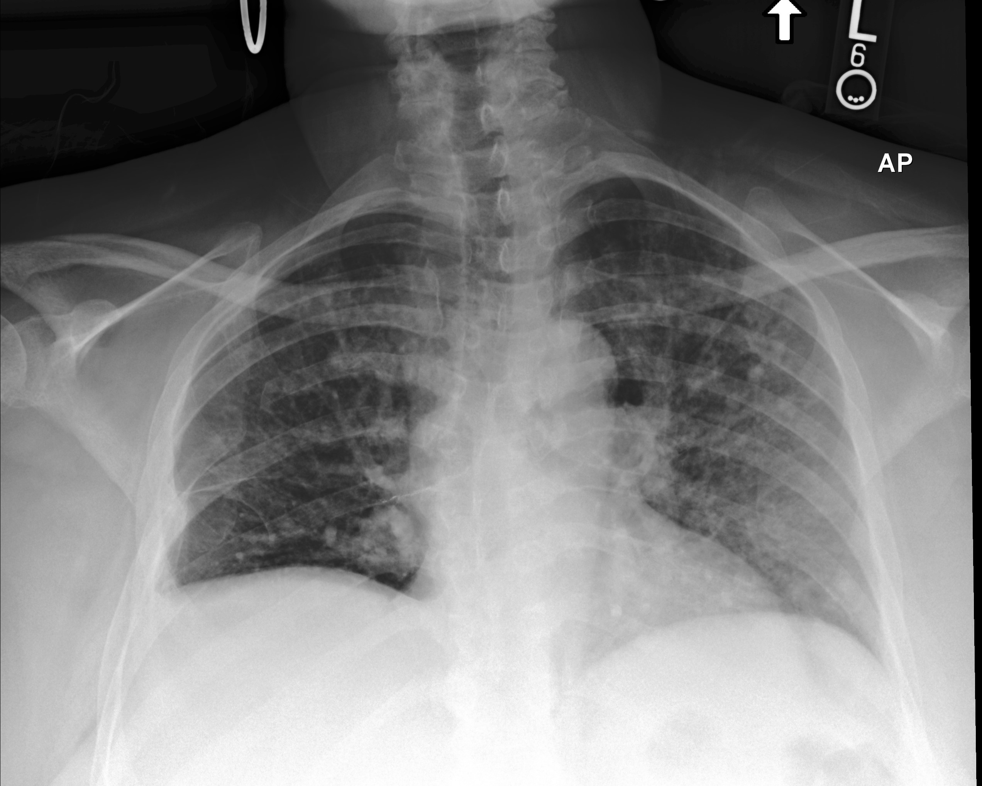
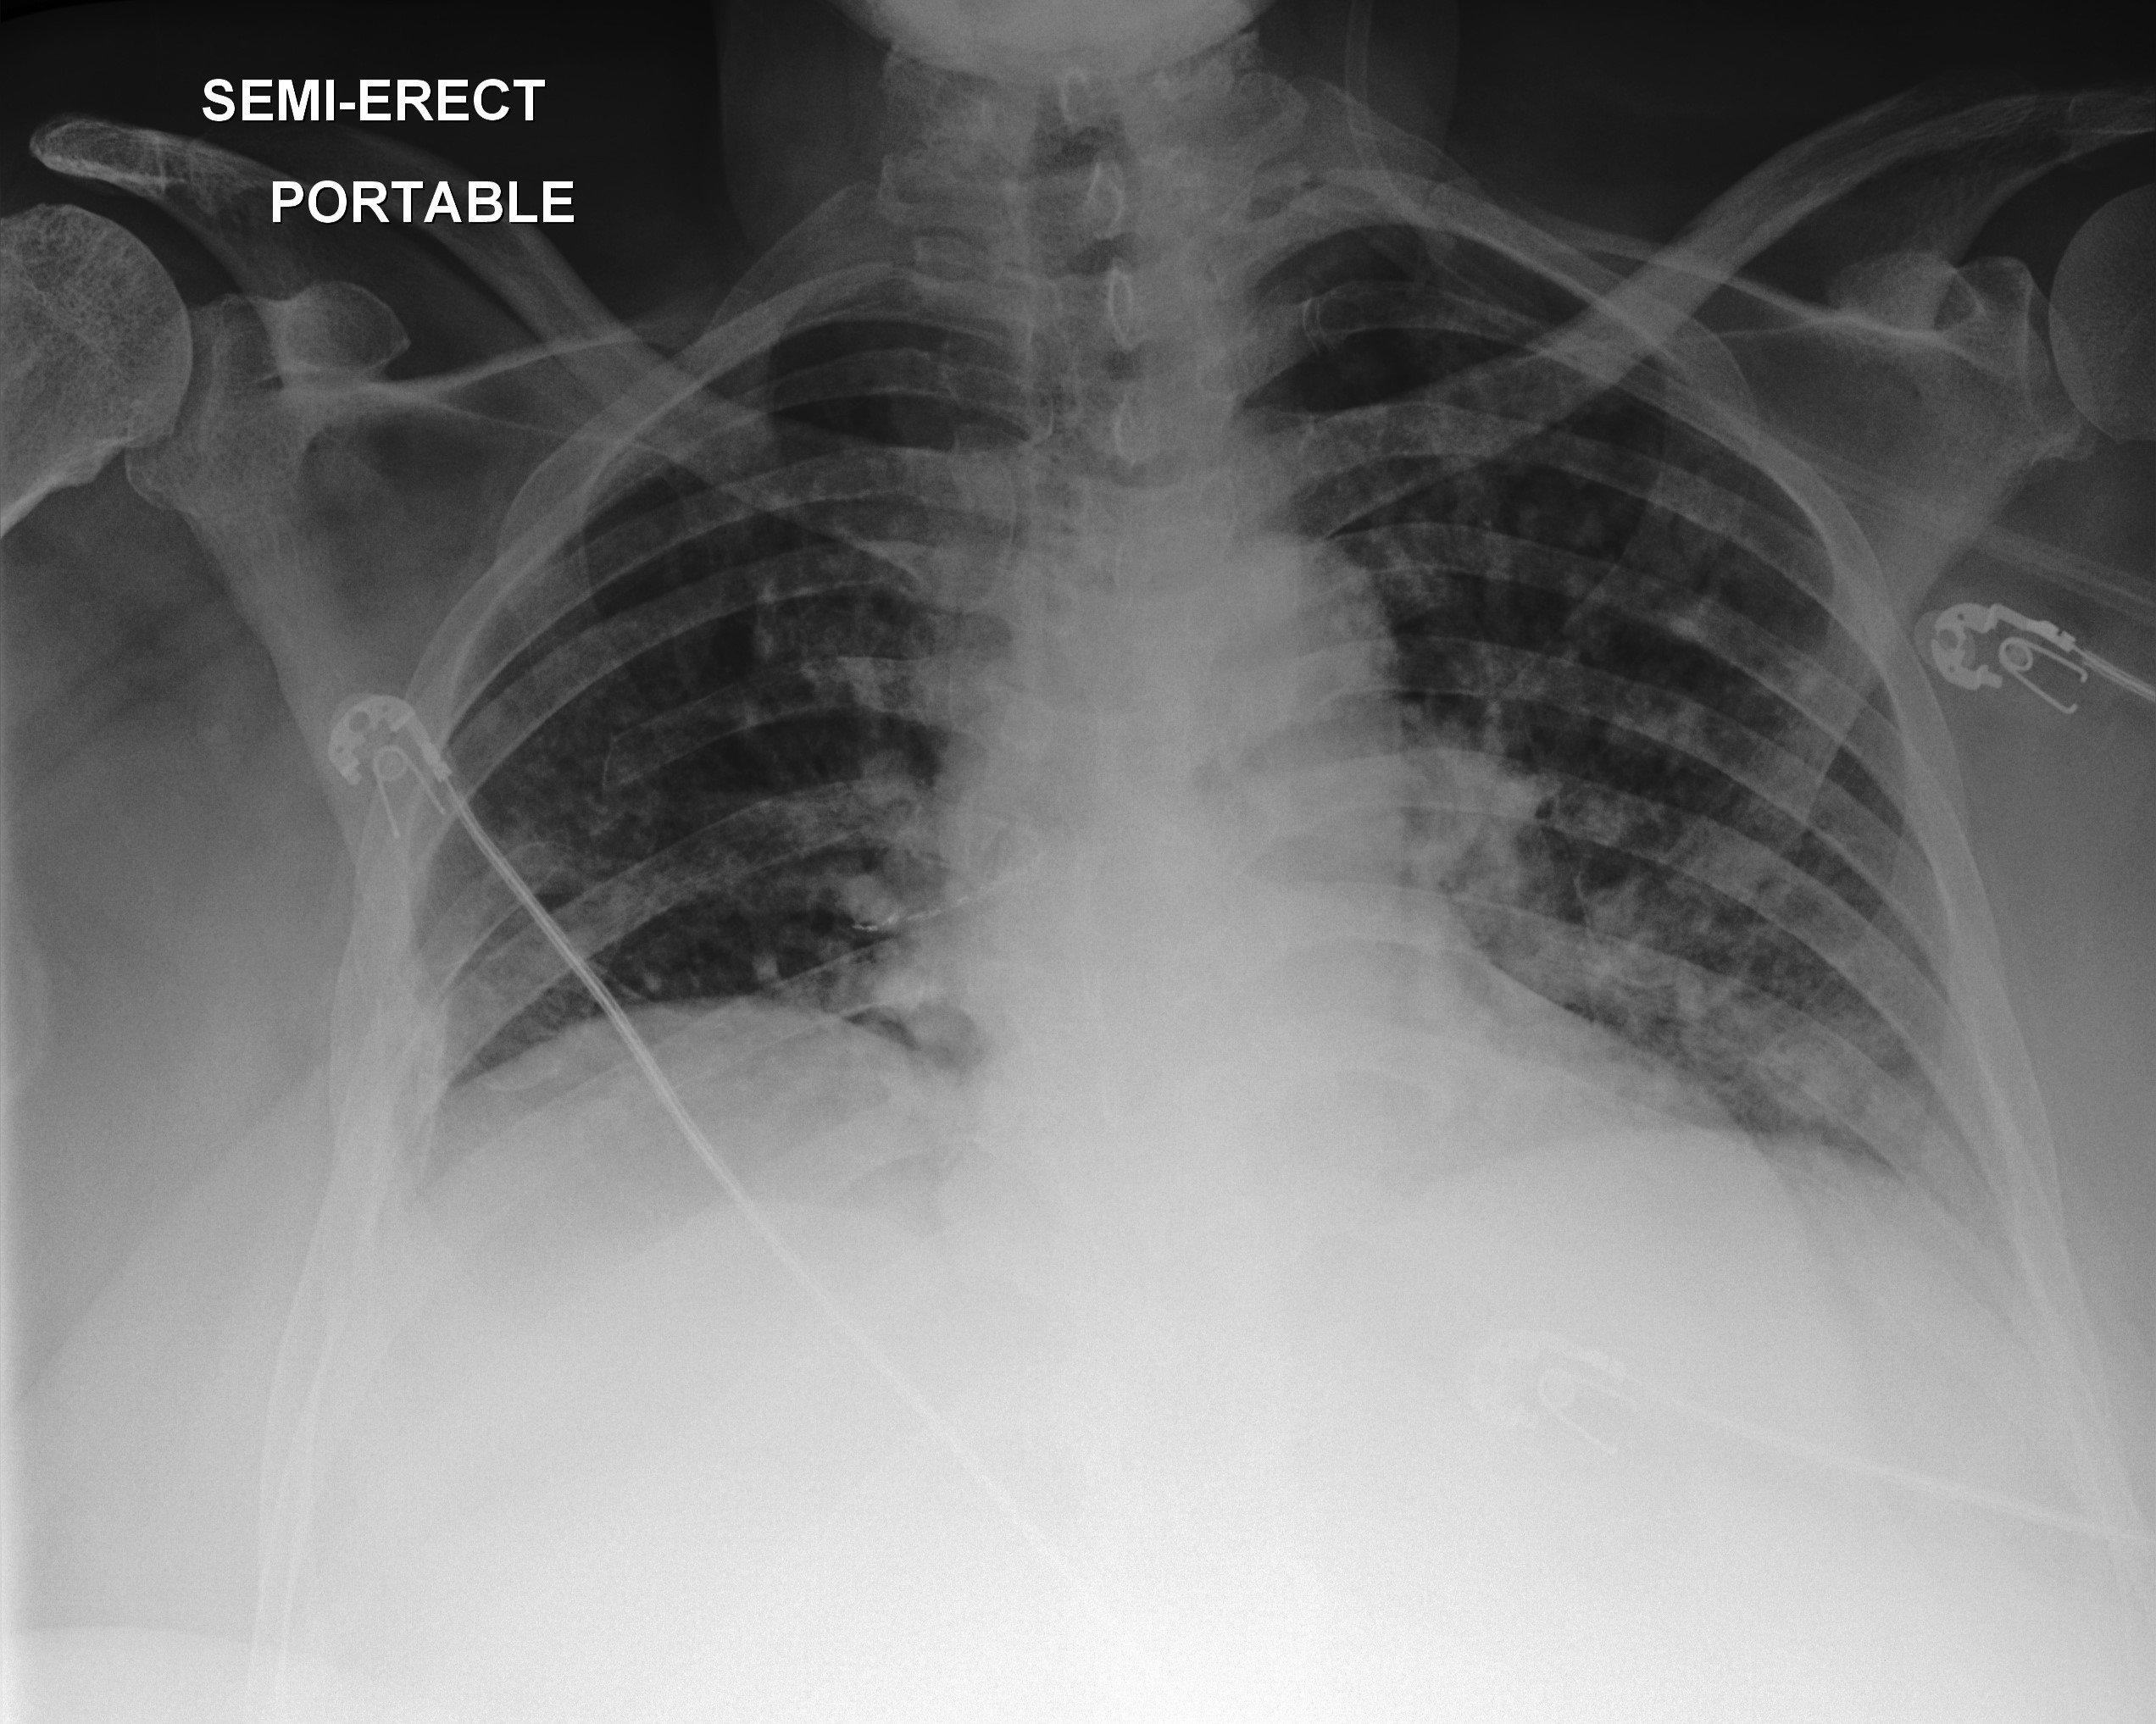
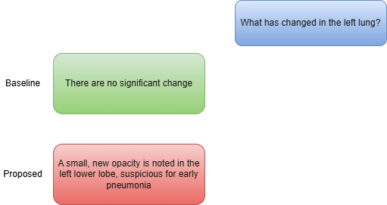
5. PRELIMINARY/EXPECTED RESULT
Notes:
I expect my model to be better than baseline in qualitative results, detecting subtle changes.
There is also the risk that if the registration algorithm is not carefully optimized, it could introduce its own artifacts.
Finally, this is a pipeline approach, so any errors made in the registration step will be passed down to the VQA model.
Mitigating these challenges through careful implementation and tuning will be a key part of my work.

Slide 20
TENTATIVE WORK PLAN
2025
2026
JUN
JUL
AUG
SEP
OCT
NOV
DEC
JAN
FEB
MAR
APR
MAY
JUN
JUL
Literature Review
Proposal Defense
Development
Experiment
Progress Defense
Analysis
Writing
Publication
Final Defense

Slide 21
REFERENCES
Skip for brevity. See full references in the report.

Slide 22
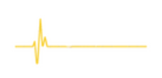
THANK YOU
for your attention

