Slide 1

PROPOSAL PRESENTATION
Enhancing Difference VQA on Longitudinal CXR using Affine and Deformable Image Registration
Kaung Sithu
st124974
COMMITTEE MEMBERS
Prof. Chaklam Silpasuwanchi (Chairperson)
Prof. Attaphongse Taparugssanagorn (Member)
Prof. Chantri Polprasert (Member)

Slide 2
01
INTRODUCTION
02
RELATED WORK
03
METHODOLOGY
TABLE OF CONTENTS
04
EXPERIMENT
05
EXPECTED RESULT

Slide 3
1. INTRODUCTION
What is medical VQA?
An adaptation of general VQA to support medical diagnosis
A multimodal task combining image analysis with natural language processing to provide answers to complex questions
Interpret x-ray, CT scans, MRI scans, EHR
Assists in clinical decision making to reduce diagnostic errors
What is the problem on general medical VQA?
Jack of all trades, master of none
Vastly different modalities and pathologies
What is medical diff VQA?
Specialized for difference between 2 medical images
Compares a current image with a previous one of the same patient
Notes:
What is medical VQA?
- Medical VQA is a crucial area at the intersections of medical artificial intelligence and visual question answering VQA
- It insolves systems that can interpret x-ray, computed tomography, magnetic resonance imaging and electronic health records
Why do we need to use Medical VQA?
- Medical professionals have to deal with hundreds of patients per day. It assists in clinical decision making and lessen the strain on clinical staff, which reduces diagnostic errors. - Medical VQAs understand open-ended free-form questions in natural language and provide reliable user-friendly answers, unlike other medical AI applications which are restricted to predefined diseases.
Ref: medical visual question answering: a survey
What is the problem with general medical VQA?
- Jack of all trades, master of none: A single AI model struggles to understand the vast complexity of all medical images and specialties
- Model fails to learn subtle details because of vastly different modalities (x-ray, CT, MRI) and vastly different pathologies including head, abdomen, limbs

Slide 4
1. INTRODUCTION
What is the effective use of longitudinal images?
Same patient visited different time frame, making it easy for doctor to check medication and recovery of patient
Medical Diff VQA for CXR
It addresses questions regarding the disparities observed between two CXRs of the same patient taken at different times.
Closely reflects the diagnostic procedure of radiologists who conduct longitudinal comparisons to track disease progression or treatment response
This task is enabled by the creation of specialized datasets, such as the Medical-Diff-VQA dataset introduced by Hu et al.
Notes:
To better align with clinical workflows, the field has evolved toward Difference VQA. This task is explicitly designed to model the longitudinal assessment that is fundamental to radiology. It provides a model with two images from different time points and asks it to articulate the changes
The creation of the Medical-Diff-VQA dataset was a pivotal moment, providing the first large-scale benchmark to seriously pursue this complex and clinically relevant problem

Slide 5
2. RELATED WORK
Name | Approach | Dataset | Key Idea | Implicit Weakness
EKAID | Represent images as graphs, anatomical structures are nodes | Medical-Diff-VQA | specialized graph to process difference features | Assumes initial difference from subtraction is reliable
ReAl | dedicated residual encoder that processes a subtracted residual image as a direct input | Medical-Diff-VQA | Residual feature alignment to enforce consistency of difference | Assume residual image is reliable
PLURAL | Pretrains on natural images, then on longitudinal CXR | Medical-Diff-VQA MIMIC-CXR COCO, SBU CC12M | large-scale natural and medical data to learn robust image difference | Learns to be robust to misalignment but does not include a way to fix it
RegioMix | Generates retrieval pair by mixing and matching different anatomical regions from images | Medical-Diff-VQA | retrieve similar, well-matched anatomical regions from a database to provide context | Avoids the alignment problem for input pair by using a database of pre-aligned regions
Notes:
To position my work, this slide categorizes the current state-of-the-art in Difference VQA, revealing a consistent research gap.
We can group these methods into two main strategies. The first, used by models like EKAID and ReAl, focuses on architectural innovations. EKAID uses knowledge graphs and ReAl uses a dedicated residual encoder. While effective, they both share a critical, flawed assumption: that the initial difference image from a simple subtraction is a reliable and clean signal.
The second, more recent strategy uses powerful workarounds. PLURAL leverages massive pre-training to learn feature representations that are robust to noise, but it learns to tolerate misalignment rather than actively fixing it. RegioMix, which achieves state-of-the-art performance, cleverly sidesteps the problem altogether by retrieving other, better-matched anatomical regions from a database to provide context.
This analysis reveals the fundamental gap that my thesis addresses. While all these methods are innovative, they are all trying to overcome the problem of geometric variance at the feature level. None of them solve it at the source by explicitly aligning the input images first, and that is precisely the contribution of my work.
Finally, the most recent advance is Retrieval Augmentation, with RegioMix. This model cleverly retrieves similar, pre-existing regions from a database to inform its answer. This is powerful but ultimately sidesteps the core problem: it doesn't align the actual input image pair the user provides; it finds other examples that are easier to work with.

Slide 6
2.1 RESEARCH QUESTIONS
Research Question 1 (The 'Detection' Question)
Does explicit spatial alignment via image registration improve performance on clinical questions for medical diff vqa?
Research Question 2 (The 'Action' Question)
How does applying an unsupervised registration quantitatively and qualitatively alter the model’s visual attention alter the model’s focus on clinically relevant regions?
Research Question 3 (The 'Impact' Question)
How does the proposed registration method model performance vary across different categories of clinical questions compared to state of the art models?

Slide 7
2.2 HYPOTHESIS
Characteristics and diagnostic errors generated within difference VQA models are primarily caused by misinterpretation of geometric artifacts in unregistered images. Thus, implementing an optimal, registration pipeline designed specifically to minimize this non-pathological variance, will result in a VQA model that demonstrates a significant improvement on quantitative evaluation metrics while benchmarked against leading non-registration models such as EKAID, PLURAL and ReAI.

Slide 8
2.2 OBJECTIVES
Detect and Quantify Baseline Errors
Systematically identify and quantify the characteristic errors in Diff VQA models that arise from a lack of image registration, linking to RQ1
Design & Implement an Optimal Registration Pipeline
Develop and validate an image registration pipeline specifically tailored to minimize non-pathological variance in longitudinal CXR, linking to RQ2
Demonstrate Superior Performance & New Capabilities
Benchmark the pipeline to demonstrate a statistically significant performance improvement over the SOTA models, linking to RQ3
Explore the model’s accuracy on subtle findings and its potential for quantitative analysis
Notes:
First, I will systematically detect and quantify the problem. My goal is to show that the errors caused by misalignment are predictable and frequent in the current Diff VQA paradigms. This corresponds to my first research question.
Second, I will design and implement the solution. This is the core technical contribution: an optimized registration pipeline built specifically for this task. I will validate its effectiveness at minimizing the geometric noise between image pairs, which addresses my second research question.
Finally, I will demonstrate the impact of this solution. I will integrate this pipeline into a VQA model and prove its superiority through direct, quantitative benchmarking against the state-of-the-art models we've discussed. Beyond just improving scores

Slide 9
2.3 SCOPE
Dataset: Exclusively using the Medical-Diff-VQA dataset for all experiments and benchmarking
Core Task: Focusing on difference question category within Diff VQA
Methodology
Implementing and evaluating image registration pipelines
Integrating multistage (rigid and deformable) registration pipeline as a pre-preprocessing step for an existing VQA model
Evaluation: Benchmarking against SOTA models using standard metrics (BLEU, ROUGE-L, CIDEr)
Out of scope
Collecting new clinical data or conducting clinical trials with human radiologists
Expanding the VQA task beyond the established question types in Medical-Diff-VQA
Notes:
Rigid Registration: First, perform a rigid alignment (translation, rotation, scaling) to correct for gross differences in patient positioning. This establishes a common coordinate frame.
Deformable (Non-Rigid) Registration: This is the crucial step. Use advanced algorithms (e.g., B-spline or Demons-based registration) to warp the reference image to match the main image, accounting for non-linear changes like breathing and soft-tissue deformation. The chest is not a rigid body, so this is essential. This step would align anatomical landmarks like the diaphragm, spine, and heart silhouette.

Slide 10
3. METHODOLOGY
Image Registration
Aligning reference image to current image to minimize non-pathological differences
TransMorph
Hybrid Transformer-ConvNet model designed for unsupervised medical image registration
Encoder
Built upon Swin Transformer architecture to capture long-range spatial relationships
Decoder
The encoder's output, which provides abstract, lower-resolution information, is then processed by a ConvNet decoder

Slide 11
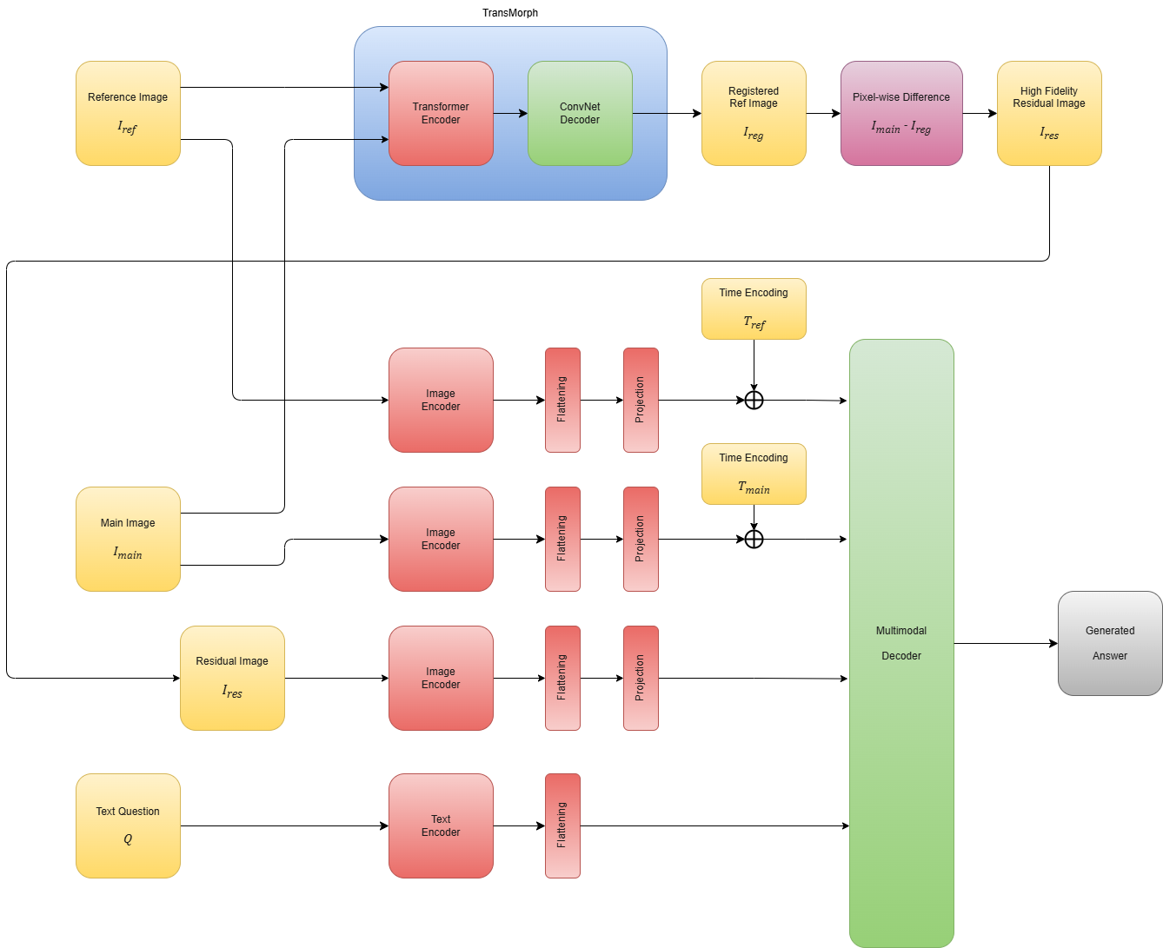
3. METHODOLOGY
Notes:
My methodology is centered around introducing a critical pre-processing step that has been overlooked by prior work. This diagram shows the complete workflow. We start with the input reference and main images.

Slide 12
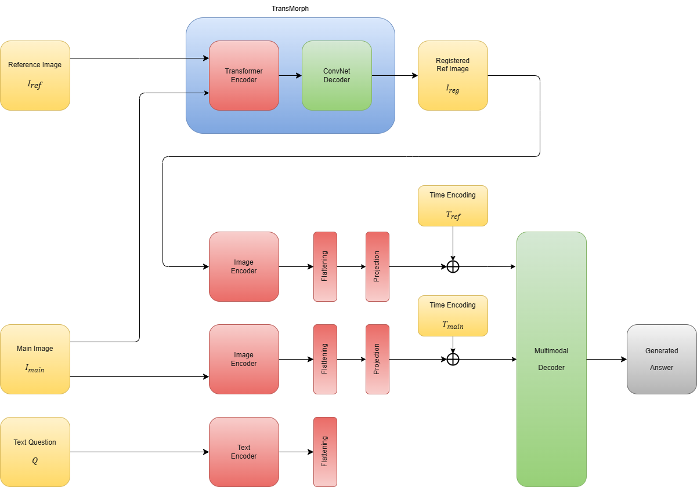
3. METHODOLOGY
Notes:
My methodology is centered around introducing a critical pre-processing step that has been overlooked by prior work. This diagram shows the complete workflow. We start with the input reference and main images.

Slide 13
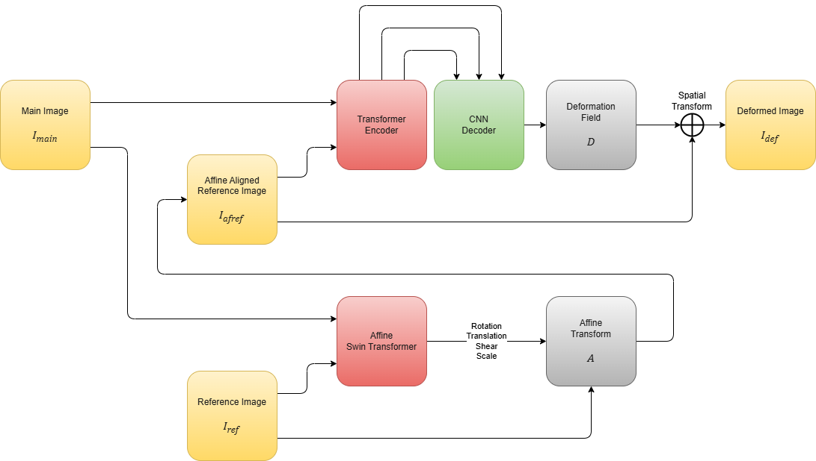
3.1 TRANSMORPH
Notes:
My methodology is centered around introducing a critical pre-processing step that has been overlooked by prior work. This diagram shows the complete workflow. We start with the input reference and main images.

Slide 14
3.1 DATASET
Attributes | Details
Dataset name | Medical-Diff-VQA
Introduced by | Hu et al.
Description | It is the largest and most established benchmark for the CXR Difference VQA task, used by all state-of-the-art models for ensuring a fair and direct comparison
Question Answer Pairs | 700,703
Image Pairs | 164,324
Image Source (JPG) | MIMIC-CXR-JPG (570.3 GB)
Image Source (DICOM) | MIMIC-CXR (4.7 TB)
Notes:
For all experiments, I will use the MIMIC-Diff-VQA dataset. Not only it is the standard benchmark for the field but also It is used by EKAID, ReAl, PLURAL, and RegioMix. This factor makes it the only choice for a fair, head-to-head comparison of my model's performance against the current state-of-the-art.

Slide 15
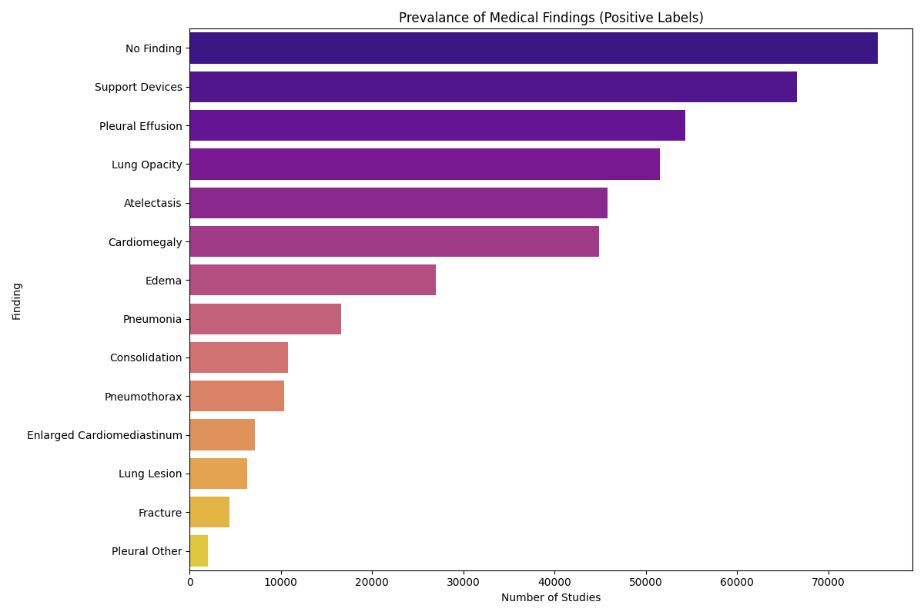
3.1 DATASET
Notes:
Here we can see the prevalence of positive findings from the database

Slide 16
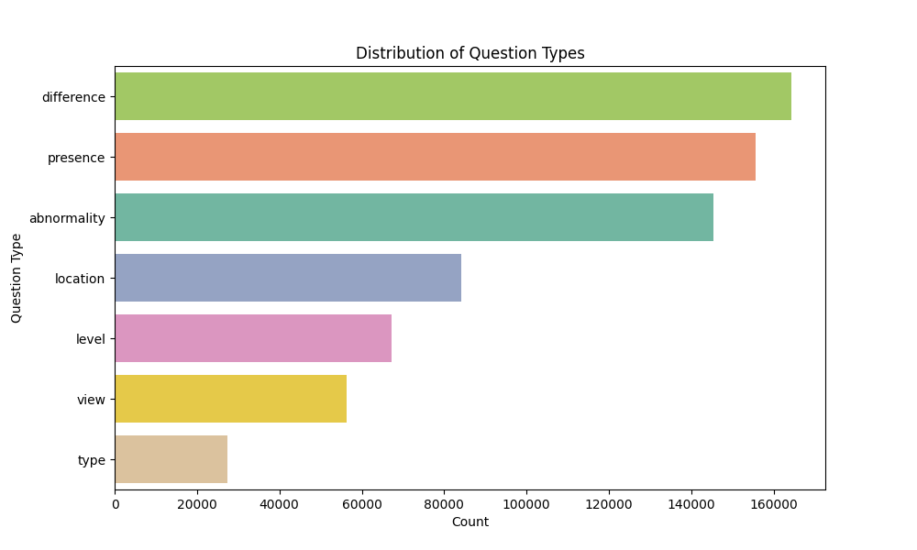
3.1 DATASET
Notes:
Total of 8 question types are covered. As this is a dataset focused on difference VQA, the most dominant question is the difference question

Slide 17
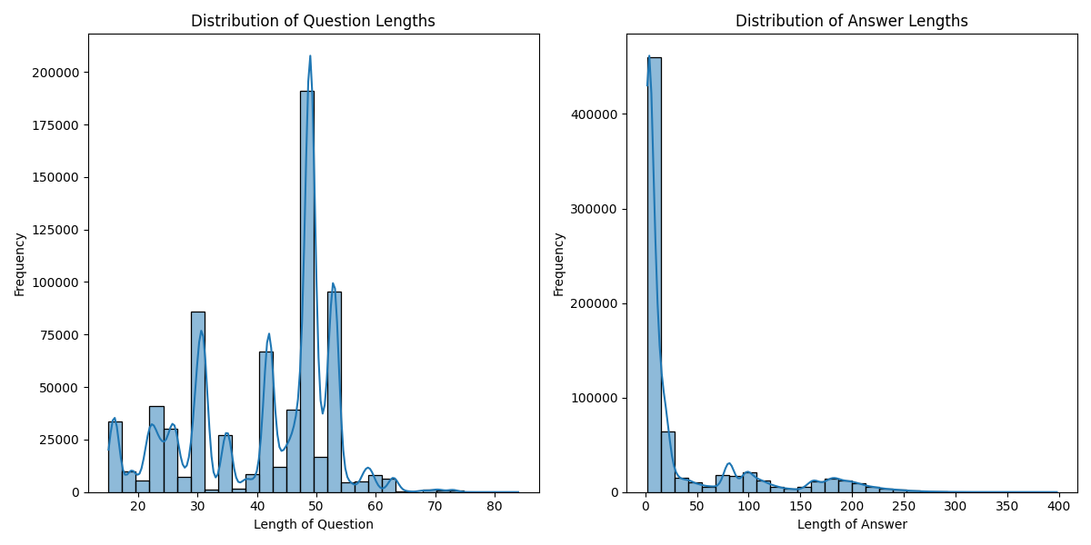
3.1 DATASET

Slide 18
3.2 MODELS
Baseline Model: A model that performs simple subtraction without any registration. This replicates the SOTA approach.
Proposed Model v1: The baseline model integrated with TransMorph registration pipeline.

Slide 19
4. EXPERIMENTS
IV (image registration method applied before VQA model)
no registration method
TransMorph registration pipeline
DV
quantitative performance measured using standard metrics
BLEU, ROUGE-L, CIDEr
qualitative performance
model accuracy on a curated subset of test cases featuring subtle pathological changes
Notes:
My experimental design is straightforward and directly aimed at answering my research questions.
The independent variable, the thing I am changing, is the registration method used on the images. I will test three levels: no registration and TransMorph pipeline
The dependent variables, what I will measure, are the model's performance.
This will be captured quantitatively using the same standard metrics as the papers I'm comparing against—BLEU, ROUGE-L, and CIDEr—to ensure a fair comparison.
I will also perform a qualitative analysis by evaluating the model's accuracy on a curated set of challenging cases with very subtle findings, which are likely to be caused by noise in the baseline model.
BLEU bilingual evaluation understudy - metric used to evaluate the quality of machine-translated text
ROUGE-L a metric used to evaluate text summarization, particularly focusing on recall and the longest common subsequence (LCS)
CIDEr Consensus-based Image Description Evaluation - a way of evaluating the quality of generated textual descriptions of images

Slide 20
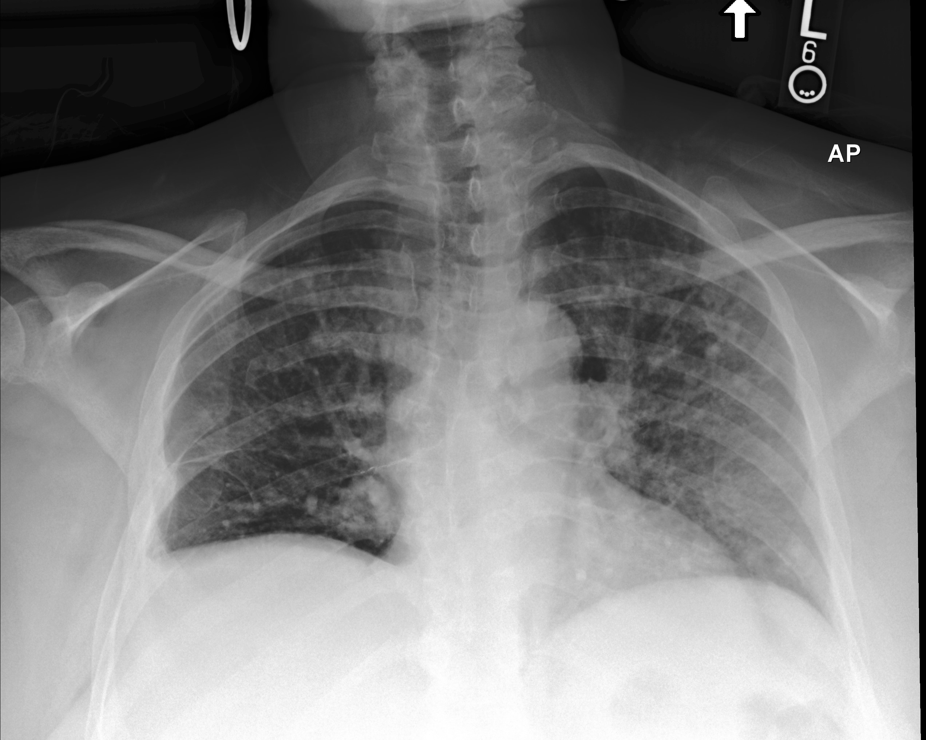
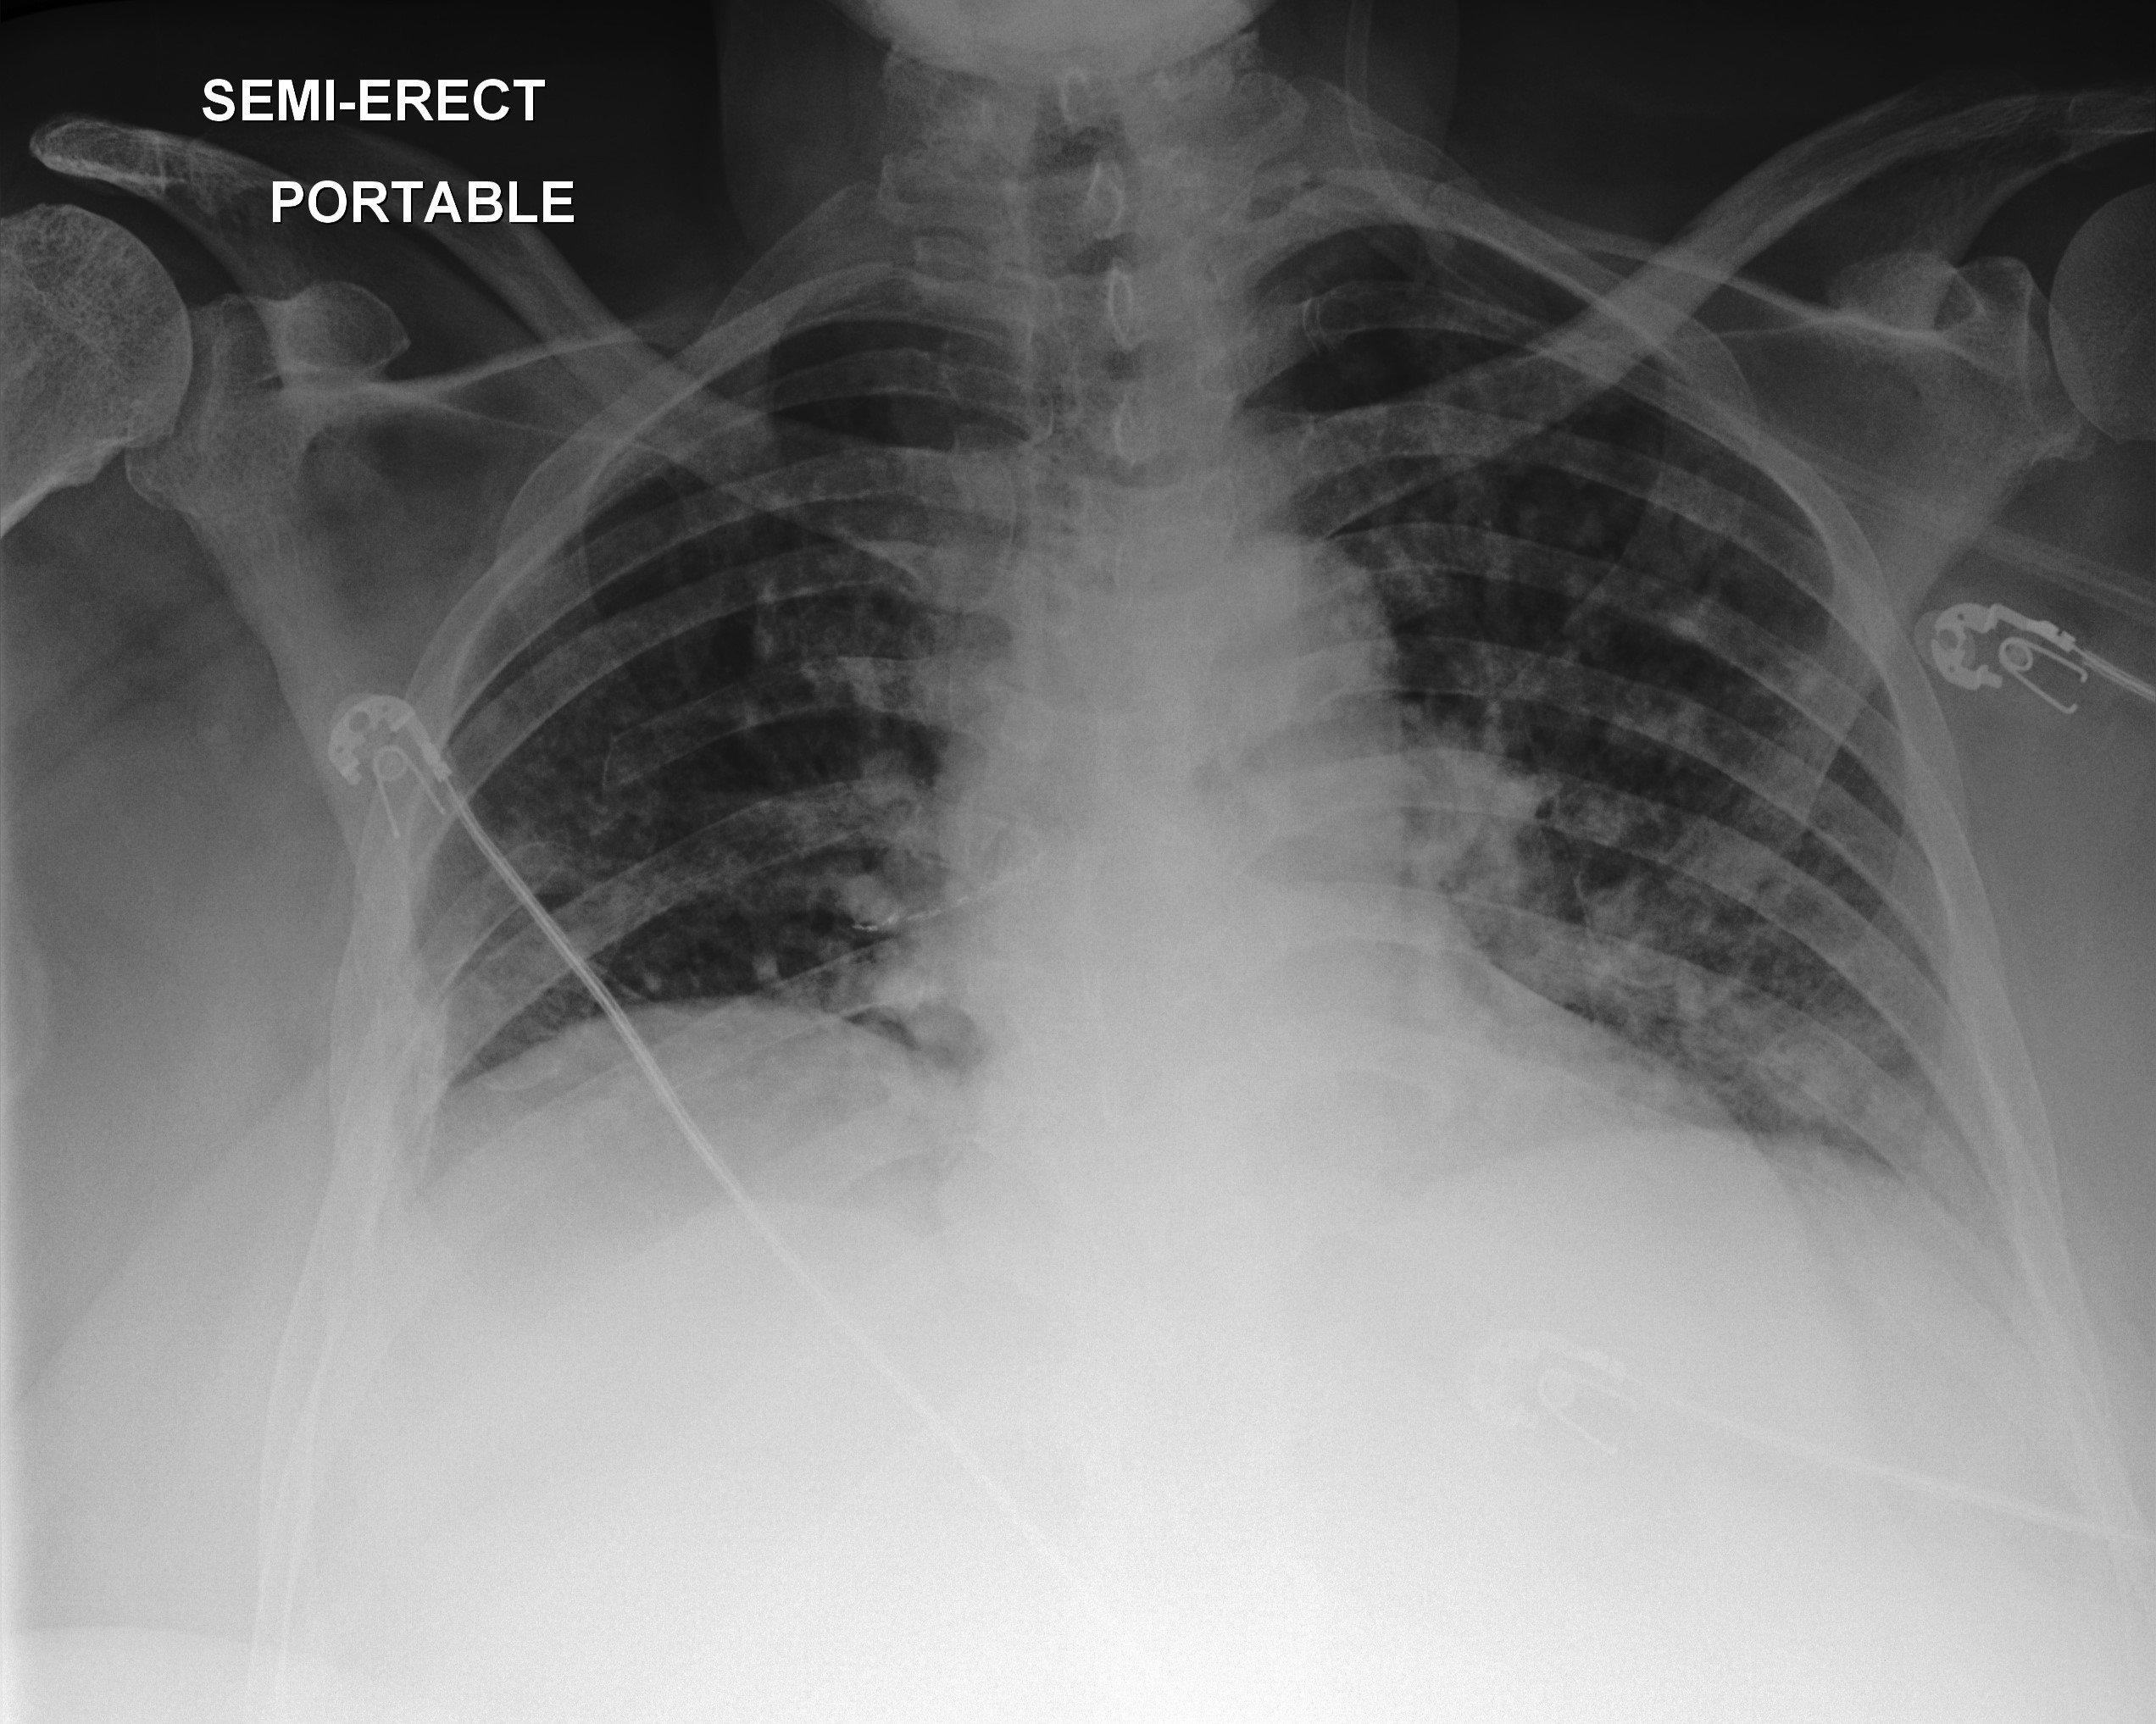
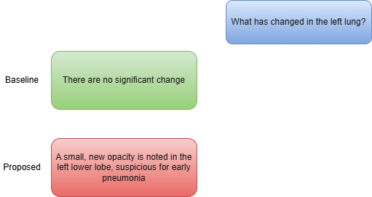
5. PRELIMINARY/EXPECTED RESULT
Notes:
I expect my model to be better than baseline in qualitative results, detecting subtle changes.
There is also the risk that if the registration algorithm is not carefully optimized, it could introduce its own artifacts.
Finally, this is a pipeline approach, so any errors made in the registration step will be passed down to the VQA model.
Mitigating these challenges through careful implementation and tuning will be a key part of my work.

Slide 21
TENTATIVE WORK PLAN
2025
2026
JUN
JUL
AUG
SEP
OCT
NOV
DEC
JAN
FEB
MAR
APR
MAY
JUN
JUL
Literature Review
Proposal Defense
Development
Experiment
Progress Defense
Analysis
Writing
Publication
Final Defense

Slide 22
REFERENCES
Skip for brevity. See full references in the report.

Slide 23
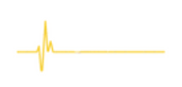
THANK YOU
for your attention

Slide 24
5. PRELIMINARY/EXPECTED RESULT
Todo Add time encoding
Add Transmorph Registration
Notes:
The largest jump is expected here. I have clear expectations for the results.

Slide 25
5. PRELIMINARY/EXPECTED RESULT
Model | BLEU-4 | ROUGE-L | CIDE-r
Baseline | 53.0 | 73.6 | 2.409
RigidReg-VQA | 55.0 | 74.5 | 2.6
DefReg-VQA | 58.0 | 76.0 | 3.1
We can expect the largest jump here. By removing noise, the model will be better at identifying the correct, clinically relevant rare words such as “pneumothorax” vs “atelectasis”, which are heavily rewarded by CIDEr.
Overall sentence structure, measured by BLEU-4 and ROUGE-L, is also expected have moderate improvement
Notes:
The largest jump is expected here. I have clear expectations for the results.

Slide 26
1. INTRODUCTION (RELATED WORK)
EKAID
Expert-knowledge-aware image difference graph
Represent images as graphs where anatomical structures are nodes
Image difference graph feature is computed by subtracting the graph feature of two images.
ReAl
Residual Alignment Framework
Introduces a dedicated residual encoder that processses a subtracted residual image as a direct input
Uses residual feature alignment (RFA) module to enforce consistency between feature difference and residual feature
Notes:
Initial state-of-the-art approaches focused on novel architectures for processing the two images.
EKAID took a structured approach, which is creating graphs based on expert anatomical knowledge and then comparing these graphs.
In contrast, ReAl worked at the pixel and feature level, that is creating a literal difference image and feeding it into a special residual encoder, using a loss function to align the features.

Slide 27
1. INTRODUCTION (RELATED WORK)
PLURAL
Pretrain language-vision model
Pretrains on general images, then on longitudinal CXR
Image difference graph feature is computed by subtracting the graph feature of two images.
RegioMix
Retrieval Augmented Generation (RAG) Paradigm
Generates retrieval pair by mixing and matching different anatomical regions from various images in the training set
Instead of looking at input images
Notes:
More recently, the field has seen two major advances.
First, PLURAL showed us that a strong, pretrained foundation is critical.
By pretraining on vast amounts of data, PLURAL outperformed models with more complex, task-specific architectures.
This confirmed that robust representations are key. Following this, RegioMix introduced a retrieval-augmented approach.
Instead of just looking at the input images, it finds similar anatomical regions from a database and uses them to provide context, which leads to a dramatic improvement in performance.
This shows that having access to relevant, well-matched examples is extremely powerful.

Slide 28
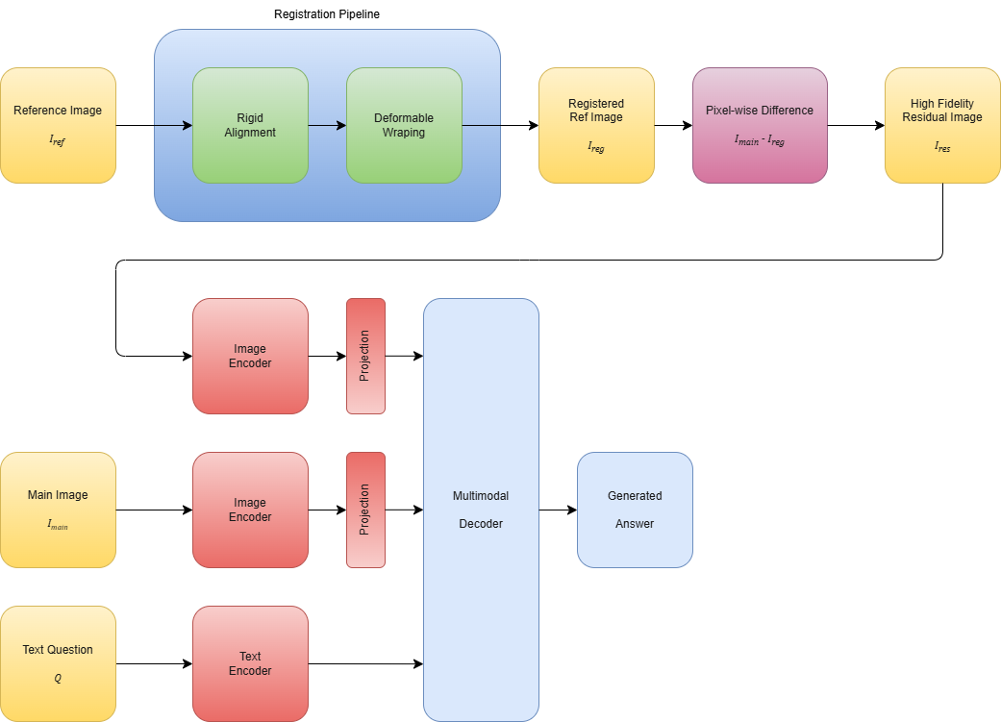
3. METHODOLOGY
Why we use this partificular registration?
What is image registration? What are different types of registration?
Notes:
My methodology is centered around introducing a critical pre-processing step that has been overlooked by prior work. This diagram shows the complete workflow. We start with the input reference and main images.
Firstly, the reference image is rigidly aligned for correcting global translation and rotation.
Secondly, the deformable algorithm is used to warp the rigidly aligned reference image for non-rigid anatomical changes.

Slide 29
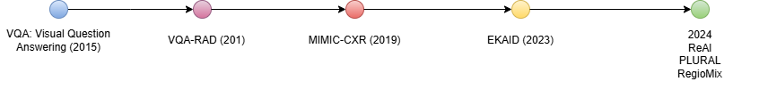
2. RELATED WORK

Slide 30
3.1 DATASET (change it to table format)
Medical Diff VQA dataset, introduced by Hu Et Al.
It is the largest and most established benchmark for this specific task
used by all SOTA models, ensuring a fair and direct comparison.
It contains 700,703 QA pairs over 164,324 image pairs
Size of images in JPEG (MIMIC-CXR-JPG): 570.3GB
Size of images in Dicom (MIMIC-CXR): 4.7 TB
Notes:
For all experiments, I will use the MIMIC-Diff-VQA dataset. Not only it is the standard benchmark for the field but also It is used by EKAID, ReAl, PLURAL, and RegioMix. This factor makes it the only choice for a fair, head-to-head comparison of my model's performance against the current state-of-the-art.

Slide 31
2.1 RESEARCH QUESTIONS
Research Question 1 (The 'Detection' Question)
Does explicit spatial alignment via image registration improve performance on clinical questions for medical diff vqa?
Research Question 2 (The 'Action' Question)
Which of the algorithms of image registration technique is the best suited to maximize the performance of the model in longitudinal CXR VQA task?
Research Question 3 (The 'Impact' Question)
How does the proposed registration method model performance vary across different categories of clinical questions compared to state of the art models?

Slide 32
2.1 RESEARCH QUESTIONS
Research Question 1 (The 'Detection' Question)
Does explicit spatial alignment via image registration improve performance on clinical questions for medical diff vqa?
Research Question 2 (The 'Action' Question)
What is the optimal implementation and training strategy for an unsupervised, Transformer-based registration model to minimize non-pathological variance in longitudinal chest X-rays for the Difference VQA task?
Research Question 3 (The 'Impact' Question)
How does the proposed registration method model performance vary across different categories of clinical questions compared to state of the art models?

Slide 33
3.2 MODELS
Baseline Model: A model that performs simple subtraction without any registration. This replicates the SOTA approach.
Proposed Model v1: The baseline model integrated with only the rigid alignment step.
Proposed Model v2: The baseline model integrated with the fully deformable registration pipeline.

Slide 34
4. EXPERIMENTS
IV (image registration method applied before VQA model)
no registration method
rigid registration
full deformable registration pipeline
DV
quantitative performance measured using standard metrics
BLEU, ROUGE-L, CIDEr
qualitative performance
model accuracy on a curated subset of test cases featuring subtle pathological changes
Notes:
My experimental design is straightforward and directly aimed at answering my research questions.
The independent variable, the thing I am changing, is the registration method used on the images. I will test three levels: no registration, rigid registration only, and the full deformable registration pipeline
The dependent variables, what I will measure, are the model's performance.
This will be captured quantitatively using the same standard metrics as the papers I'm comparing against—BLEU, ROUGE-L, and CIDEr—to ensure a fair comparison.
I will also perform a qualitative analysis by evaluating the model's accuracy on a curated set of challenging cases with very subtle findings, which are likely to be caused by noise in the baseline model.

