Slide 1


Money Manager: Intuitive Financial Management for Everyone
The purpose of this application is to create an intuitive and useful budget and financial management tool that would facilitate the efficient management of the user's expenses and income. The main goal is to enable users to effectively control their finances, save money, invest and achieve their financial goals.

Slide 2


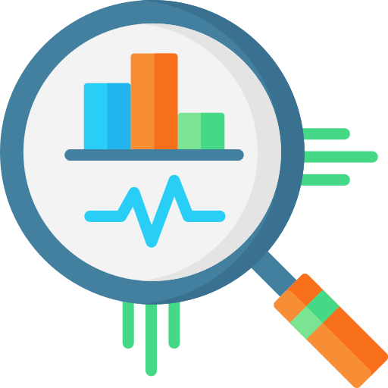
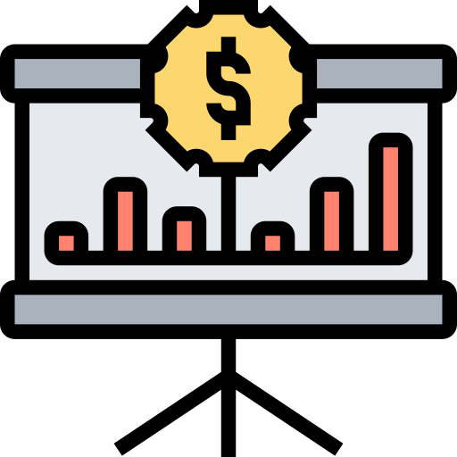

Problem solving
Simplifying budgeting
Monitoring of expenses
and income
Saving time
The app will allow users to create budgets, allocate money to different categories, and set financial goals.
The application will simplify the process of keeping records of finances, effectively using automation and calculations.
Users will be able to study their financial activity over the past month in detail to better understand where their money goes and where their income comes from.
Visualisation of finances
Motivation to save and invest
The application will provide users with convenient charts and graphs to visually display their financial status.
The application will create the conditions for effective financial management, encouraging users to use their money efficiently and achieve their financial goals.

Slide 3

Basic requirements for the application
1
Intuitive and user-friendly interface
4
Goal setting and notification function
2
Security and confidentiality
5
Warnings about overspending
3
Data visualization

Slide 4
Types of users
1
User
1. Ability to enter data on income and expenses
2. Ability to use one currency(UAH)
3. Ability to view the history of transactions
4. Ability to view graphs(income and expenses) and charts to better understand the financial situation
5. Ability to set financial goals
6. Ability to create different budgets
7. Ability to edit your own profile and basically personal information
8. Ability to make transfer between accounts

Slide 5
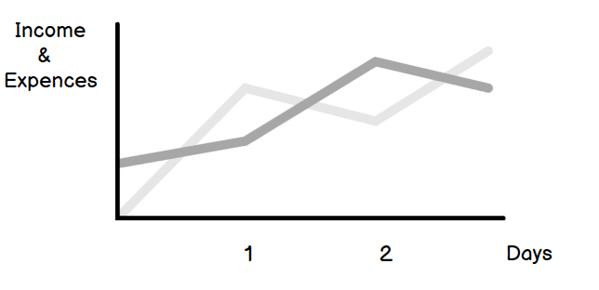
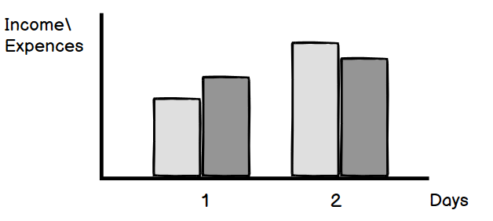
Description of graph
An income/expenses graph, referred to as a "budget graph" or "financial statement," is a visual representation of an individual's income and expenses over a specific period, typically monthly or annually. This graph is a valuable tool for tracking and managing personal or business finances. Here's how it typically works:
X-Axis (Horizontal Axis): This axis represents time, with each point on the axis corresponding to a specific month or year, depending on the chosen timeframe. The graph may cover a single month, a quarter, a year, or multiple years.
Y-Axis (Vertical Axis): This axis represents the amount of money. It usually starts from zero and goes up in increments, depending on the scale required to display income and expenses accurately.

Slide 6
Description of financial goal
A financial goal is a specific, measurable, objective that individuals set to achieve with their finances. These goals help provide direction and purpose to financial planning and management. Financial goals can vary widely from person to person and can cover various aspects of personal finance. Examples:
1. Education Fund: Save for your own education or your children's education, setting a target amount to cover tuition and related expenses.
2. Debt Repayment: Create a plan to pay off high-interest debts, such as credit card balances or student loans, within a certain timeframe.

Slide 7

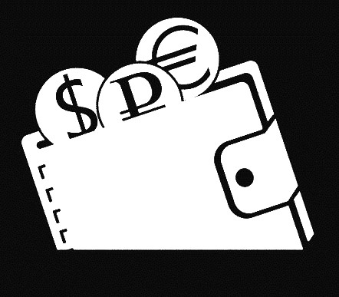
Similar apps
Moneygraph+
Money Wallet

Slide 8
Moneygraph+
Advantages
Disadvantages
Ability to manage multiple accounts
Confusing interface
Reports and analytics
Not perfect graphics
Regular backups
Prerequisites for making a deposit

Slide 9
Money Wallet
Advantages
Disadvantages
The ability to synchronize data between multiple devices.
Some interface issues that may not be entirely user-friendly.
Support for different types of accounts and currencies.
The software is paid.
The trial version has limitations on the number of accounts, groups, scheduled transactions and budgets.
Problems with app stability, especially after updates.

