Slide 1
Scuola di Ingegneria Industriale e dell'Informazione
Corso di Laurea Magistrale in Ingegneria Informatica
Anno Accademico 2013 - 2014
Avoiding CRUD operations lock-in in NoSQL databases: extension of the CPIM library
Candidato: Fabio Arcidiacono (799001)
Relatore: Prof.ssa Elisabetta Di Nitto
Correlatore: Ing. Marco Scavuzzo

Slide 2
Data management techniques
NoSQL
Non-structured data
Horizontal scaling
BASE properties
No standard language
RDBMS
Well structured data
Vertical scaling
ACID transactions
SQL

Slide 3
Common language approaches
Meta-model
Apache MetaModel
SOS platform
SQLification
Apache Phoenix
UnQL
ORM
Kundera
PlayORM
Spring-data
Apache Gora

Slide 4
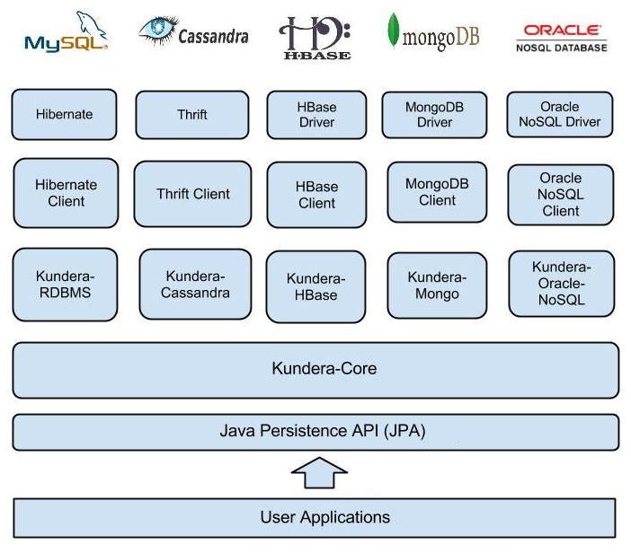
Kundera
A JPA 2.1 compliant ORM Library for NoSQL databases

Slide 5
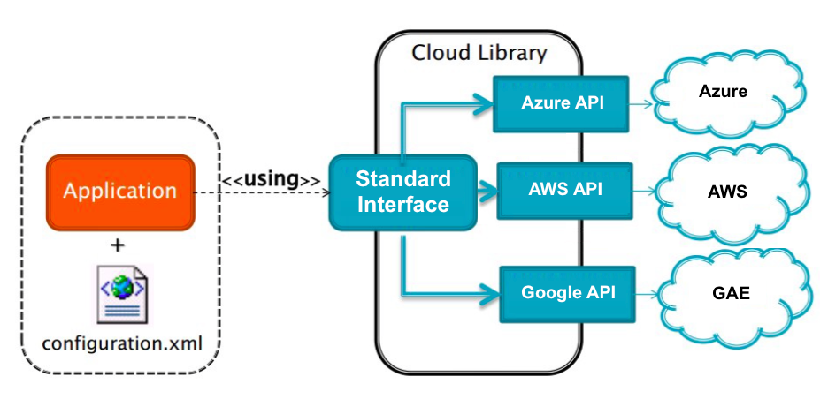
Cloud Platform Independent Model
Abstract application logic from the specific PaaS Provider to overcome the vendor lock-in
Many supported services:
Blob
NoSQL
Memcache
Queue
Mail
SQL

Slide 6
Work objectives
Integrate Kundera in the CPIM library
  extending the number of NoSQL databases supported
  fixing of the problems of the NoSQL service of CPIM
Contribute to the open source project Kudera
  developing a client for GAE Datastore
  developing a client for Azure Tables
Support data migration among NoSQL databases through the migration and synchronization system Hegira

Slide 7
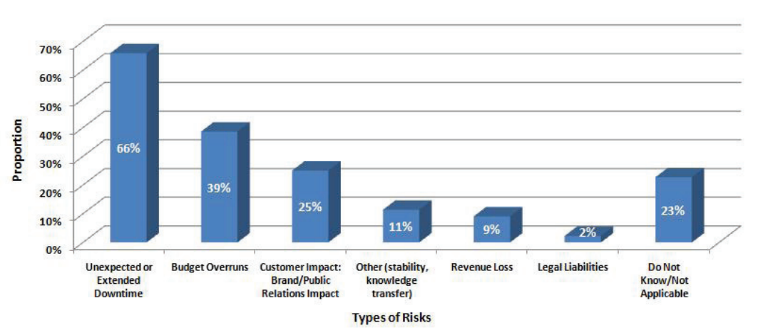
Data migration
Move application to another cloud provider
load balancing, system expansion, failure recovery, etc.
modern computer systems are expected to be up continuously
data synchronization between the two involved systems

Slide 8
Why Kundera
Open source
Developed with extensibility in mind
Ployglot persistency
In the field since 2010 with an active community
Already used in production
Support to many different NoSQL databases

Slide 9
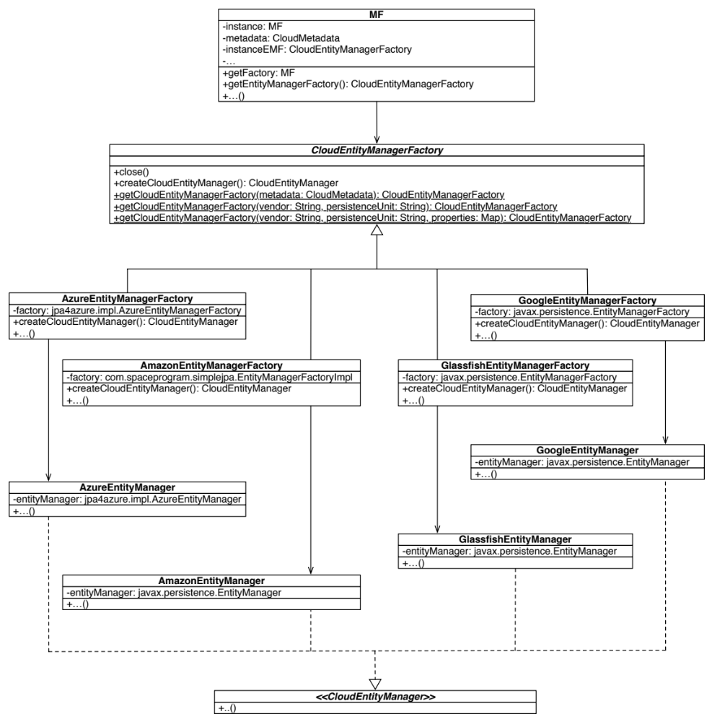
Kundera integration (1)
Current implementation
Many JPA provider
Duplicated code
No complete code portability

Slide 10
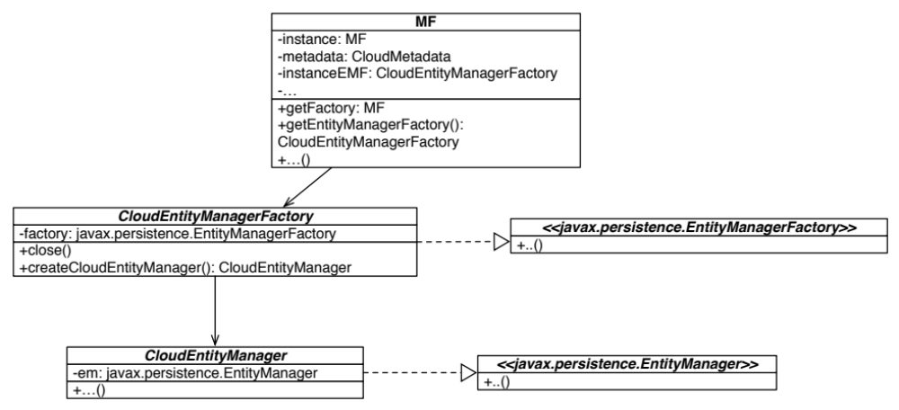
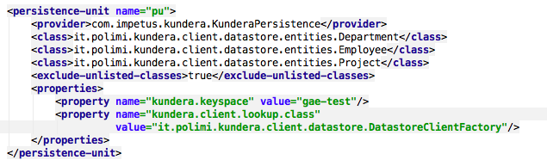
Kundera integration (2)

Slide 11
Why Kundera
Open source
Developed with extensibility in mind
Ployglot persistency
In the field since 2010 with an active community
Already used in production
Support to many different NoSQL databases

Slide 12
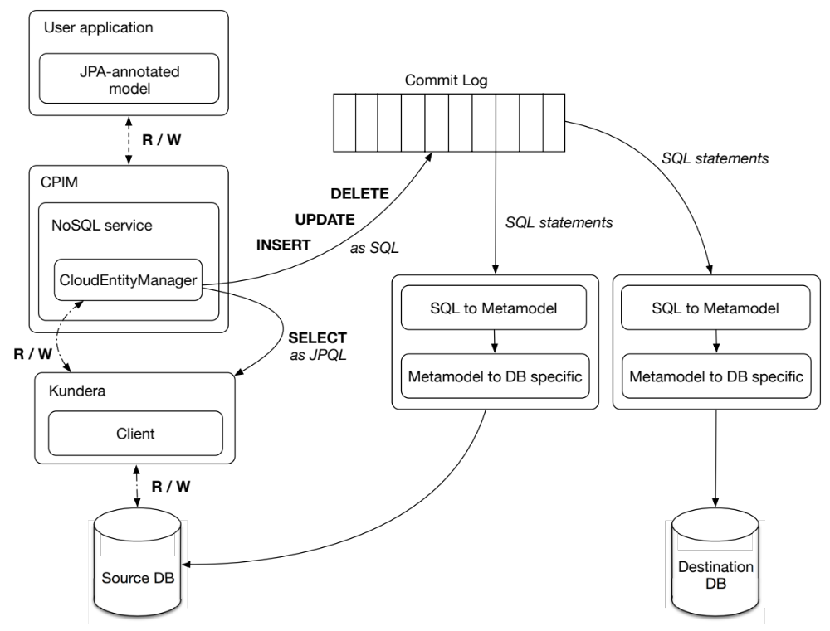
Supporto a Hegira
Migration service transparent to the user of the CPIM library

Slide 13
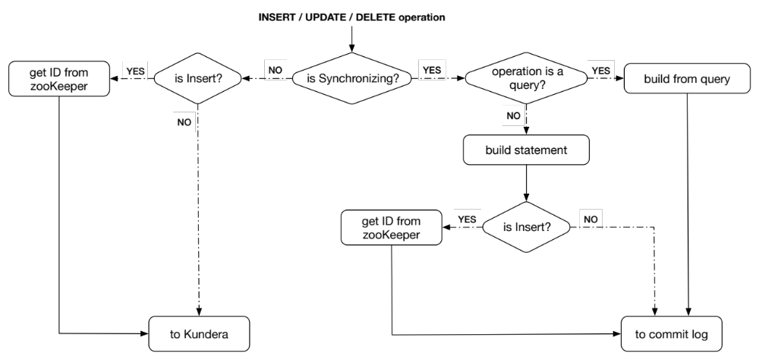
Hegira support
Intercepting user operations (DMQ)
Translate operations to SQL statements
Send them to the Hegira commit-log

Slide 14
Performance
Performance test of the developed Kundera clients by using YCSB
(Yahoo Cloud Serving Benchmark).
Adapter YCSB for operations through Kundera
Adapter YCSB for operations through low-level API
Workload of 100.000 operations, splitted in two phases (write/read) on remote instances of Google Datastore and Azure Tables.

Slide 15
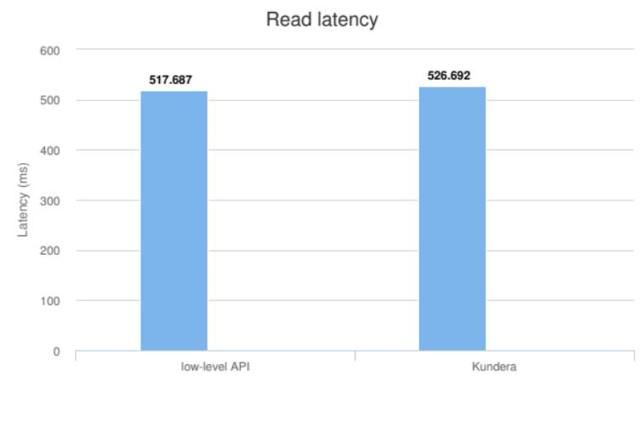
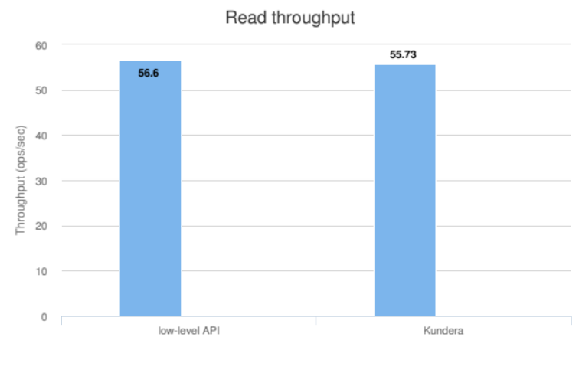
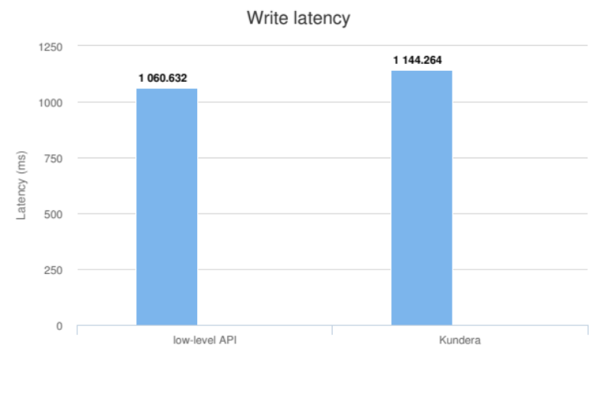
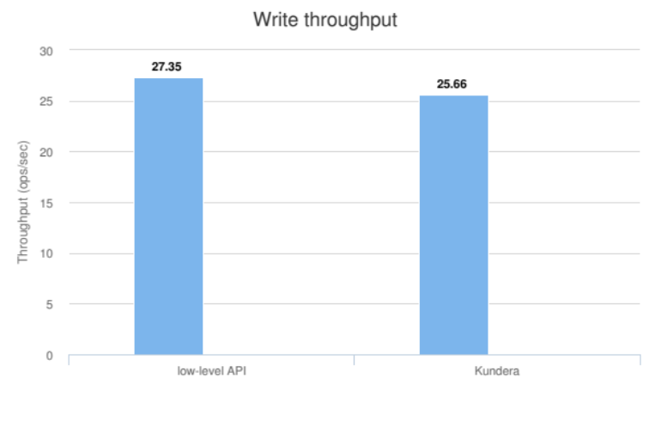
Azure Tables results

Slide 16
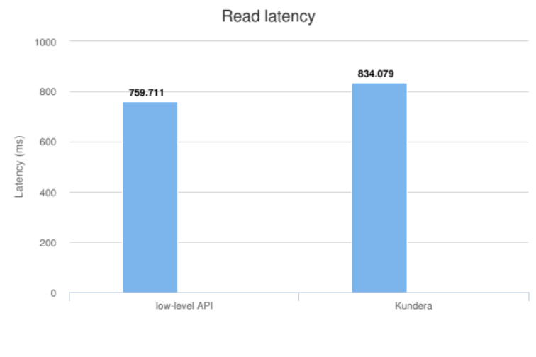
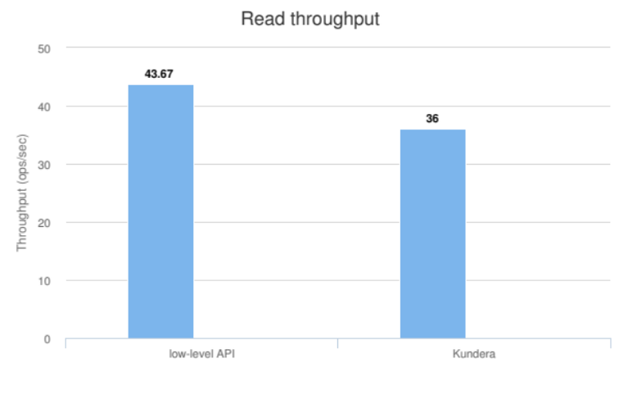
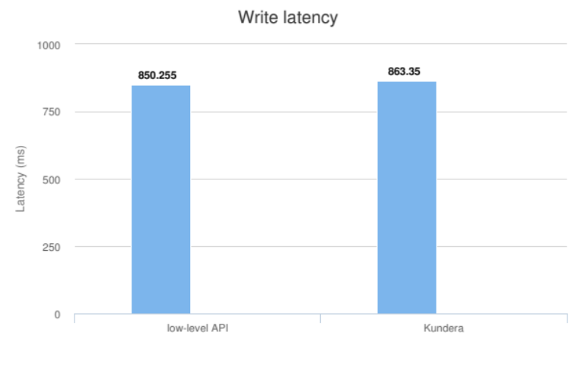
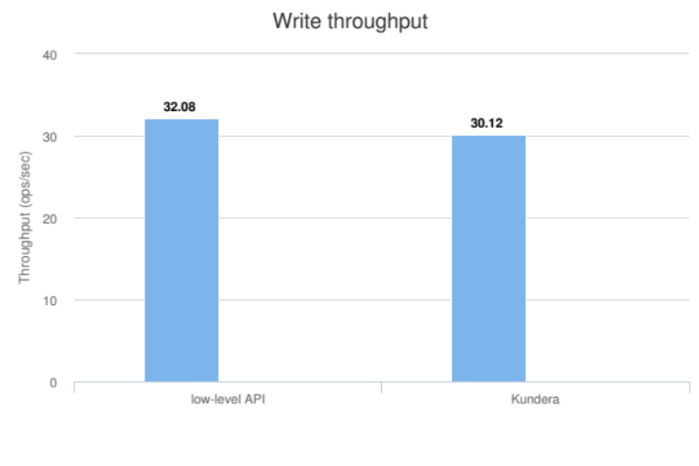
GAE Datastore results

Slide 17
Conclusions
Contributions:
  New clients for Kundera to support Google Datastore and Azure Tables
  Hegira integration in the CPIM library
Sviluppi futuri:
  Extend the CPIM library to support more cloud providers and/or new cloud services
  Develop new extensions for Kundera to support more NoSQL technologies

