Slide 1
REGIONAL HCI+ AVERAGE
Human Capital Index Plus
201.7
HCI+ | 2025
out of 325 | World avg: 188.5
EAST ASIA & PACIFIC
Health
42.8
Education
118.1
Regional overview across 27 economies spanning health, education, and employment dimensions of human capital
Employment
40.7
Ranked #3 among 7 World Bank regions
27 Economies
All Income Levels

Slide 2
East Asia & Pacific | HCI+ vs GDP per Capita
201.7 / 325
HCI+ SCORE vs LOG GDP PER CAPITA (PPP)
EAP IN CONTEXT
EAP countries in blue. All other regions shown in light gray for context.
Regional Average
201.7
JPN
SGP
World Average
188.5
AUS
NLD
KOR
SWE
NZL
POL
HKG
CAN
DEU
MAC
Economies
27
FRA
USA
CHL
VNM
CHN
ROU
Top Performer
Japan (284.3)
MNG
ARG
TUR
BRN
GEO
ALB
BRA
KGZ
JAM
COL
THA
MUS
MYS
FJI
MEX
IRN
NIC
LKA
Lowest in EAP
Lao PDR (135.6)
KEN
TON
PHL
IDN
KIR
TUV
JOR
EGY
RWA
MMR
GHA
IND
BWA
vs Europe/C. Asia
233.3
MAR
UGA
KHM
BGD
VUT
TZA
NGA
LAO
ZAF
ETH
vs Latin America
183.2
SEN
PAK
KEY INSIGHT
vs Sub-Saharan Africa
128.4
EAP (avg 201.7) ranks 3rd among WB regions, exceeding the global average by 13 points. The region shows enormous variation: Japan (284.3) leads globally, while Lao PDR (135.6) trails. High-income EAP economies rival Europe.
Source: World Bank Human Capital Index Plus (HCI+) 2025 | github.com/worldbank/HCI-Plus
humancapital.worldbank.org/hciplus
1

Slide 3
East Asia & Pacific | Component Decomposition by Region
201.7 / 325
EAP vs WORLD AVERAGE
Filled = EAP | Hollow = World
Health
42.8
Education
118.1
Employment
40.7
REGIONAL AVERAGES
Sub-Saharan Africa
128.4
South Asia
147.5
Latin America & Carib.
183.2
MENA+
185.7
East Asia & Pacific
201.7
Europe & Central Asia
233.3
World
188.5
Source: World Bank Human Capital Index Plus (HCI+) 2025 | github.com/worldbank/HCI-Plus
humancapital.worldbank.org/hciplus
2

Slide 4
Health Component | Regional Comparison
EAP Avg: 42.8 / 50
Source: World Bank Human Capital Index Plus (HCI+) 2025 | github.com/worldbank/HCI-Plus
humancapital.worldbank.org/hciplus
3

Slide 5
Education Component | Regional Comparison
EAP Avg: 118.1 / 180
Source: World Bank Human Capital Index Plus (HCI+) 2025 | github.com/worldbank/HCI-Plus
humancapital.worldbank.org/hciplus
4

Slide 6
Employment Component | Regional Comparison
EAP Avg: 40.7 / 70
Source: World Bank Human Capital Index Plus (HCI+) 2025 | github.com/worldbank/HCI-Plus
humancapital.worldbank.org/hciplus
5

Slide 7
East Asia & Pacific | All Economies Ranking
201.7 / 325
ALL EAP ECONOMIES BY HCI+ SCORE
Above world avg (188.5)
Below world avg
Source: World Bank Human Capital Index Plus (HCI+) 2025 | github.com/worldbank/HCI-Plus
humancapital.worldbank.org/hciplus
6

Slide 8
East Asia & Pacific | Country Decomposition
Health + Education + Employment
COMPONENT DECOMPOSITION BY ECONOMY (sorted by total HCI+)
Source: World Bank Human Capital Index Plus (HCI+) 2025 | github.com/worldbank/HCI-Plus
humancapital.worldbank.org/hciplus
7

Slide 9
Health Component | East Asia & Pacific
Avg: 42.8 / 50
Health outcomes reflect adult survival (ages 15-60) and freedom from childhood stunting.
ADULT SURVIVAL RATE (EAP AVG)
NOT STUNTED RATE (EAP AVG)
Probability of surviving from age 15 to 60
Share of children under 5 not stunted
85.3%
World avg: 81.5%
86.6%
World avg: 77.1%
Best: Korea 96.7%
Best: Korea 99.1%
World
World
KEY INSIGHT
EAP's health score of 42.8 ranks 3rd among regions, just above the world average (42.6). Adult survival averages 85.3% — well above the global mean (81.5%) — and stunting rates are low (13.4%). Korea leads with 96.7% adult survival and 99.1% not-stunted. Pacific Island nations and some ASEAN economies remain below regional averages, presenting targeted opportunities for health investment.
Source: World Bank Human Capital Index Plus (HCI+) 2025 | github.com/worldbank/HCI-Plus
humancapital.worldbank.org/hciplus
8

Slide 10
Education Component | East Asia & Pacific
Avg: 118.1 / 180
Education captures learning quality, years of schooling, pre-primary education, and tertiary enrollment.
Expected Years of Schooling
Harmonized Learning Outcomes
Pre-Primary Education
Tertiary Enrollment
10.8
436
0.59
37.4%
years (EAP avg)
HLO score (out of 625)
learning-adj. years
gross enrollment rate
World
World
World
World
World: 10.1 yrs
World: 411
World: 0.46 yrs
World: 32.6%
Best: Japan 12.0
Best: Singapore 594
Best: Singapore 0.91
Best: Korea 76.9%
KEY INSIGHT
Education is EAP's strongest component, scoring 118.1 — well above the world average (107.4) and second only to Europe & Central Asia (140.8). Singapore leads globally with an HLO of 594. EAP averages 10.8 expected years of schooling. Tertiary enrollment (37.4%) and pre-primary (0.59 years) remain areas for growth across the region.
Source: World Bank Human Capital Index Plus (HCI+) 2025 | github.com/worldbank/HCI-Plus
humancapital.worldbank.org/hciplus
9

Slide 11
Employment Component | East Asia & Pacific
Avg: 40.7 / 70
Employment captures labor force participation, wage employment, and skill accumulation for youth (15–24) and working-age (25–65).
YOUTH (15–24)
LFP Youth (15–24)
Emp. Rate Youth (15–24)
Wage Emp. Youth
60.0%
EAP average
53.0%
EAP average
75.2%
wage share of employment
World
World
World
World: 48.2%
World: 39.6%
World: 55.1%
Best: Nauru 79.7%
Best: Cambodia 68.5%
Best: Japan 93.8%
WORKING AGE (25–65)
LFP Working Age (25–65)
Emp. Rate Working Age (25–65)
Wage Emp. Working Age
75.3%
EAP average
72.5%
EAP average
71.0%
wage share of employment
World
World
World
World: 72.6%
World: 68.8%
World: 59.8%
Best: Palau 87.8%
Best: Palau 85.2%
Best: Japan 92.4%
KEY INSIGHT
EAP employment (40.7) ranks 3rd among regions, above world avg (37.2). Youth LFP (60.0%) far exceeds global avg (48.2%). Japan leads wage employment; Palau and Nauru post strong LFP rates.
Source: World Bank Human Capital Index Plus (HCI+) 2025 | github.com/worldbank/HCI-Plus
humancapital.worldbank.org/hciplus
10

Slide 12
Gender Analysis | Male vs Female HCI+
East Asia & Pacific
MALE HCI+ vs FEMALE HCI+ BY ECONOMY
GENDER ANALYSIS
Countries above the 45° line: Male HCI+ > Female HCI+. Below: Female HCI+ > Male HCI+.
Male HCI+ > Female HCI+
Female HCI+ ≥ Male HCI+
JPN
AUS
SGP
KEY FINDINGS
KOR
HKG
NZL
Above 45° line
MAC
15 economies
Male HCI+ exceeds Female
Below 45° line
CHN
10 economies
FJI
MYS
VNM
MNG
Female HCI+ exceeds Male
BRN
IDN
THA
Largest male advantage
PHL
Indonesia (+33.4) Fiji (+31.2)
TON
WSM
Largest female advantage
MMR
KIR
TUV
VUT
MHL
Cambodia (−22.2) Thailand (−16.4)
LAO
KHM
KEY INSIGHT
Most EAP economies show higher male HCI+, driven largely by employment gaps. However, several countries — notably Cambodia, Thailand, China, and Vietnam — show female advantage, reflecting higher female education outcomes and labor force participation in these economies.
Source: World Bank Human Capital Index Plus (HCI+) 2025 | github.com/worldbank/HCI-Plus
humancapital.worldbank.org/hciplus
11

Slide 13
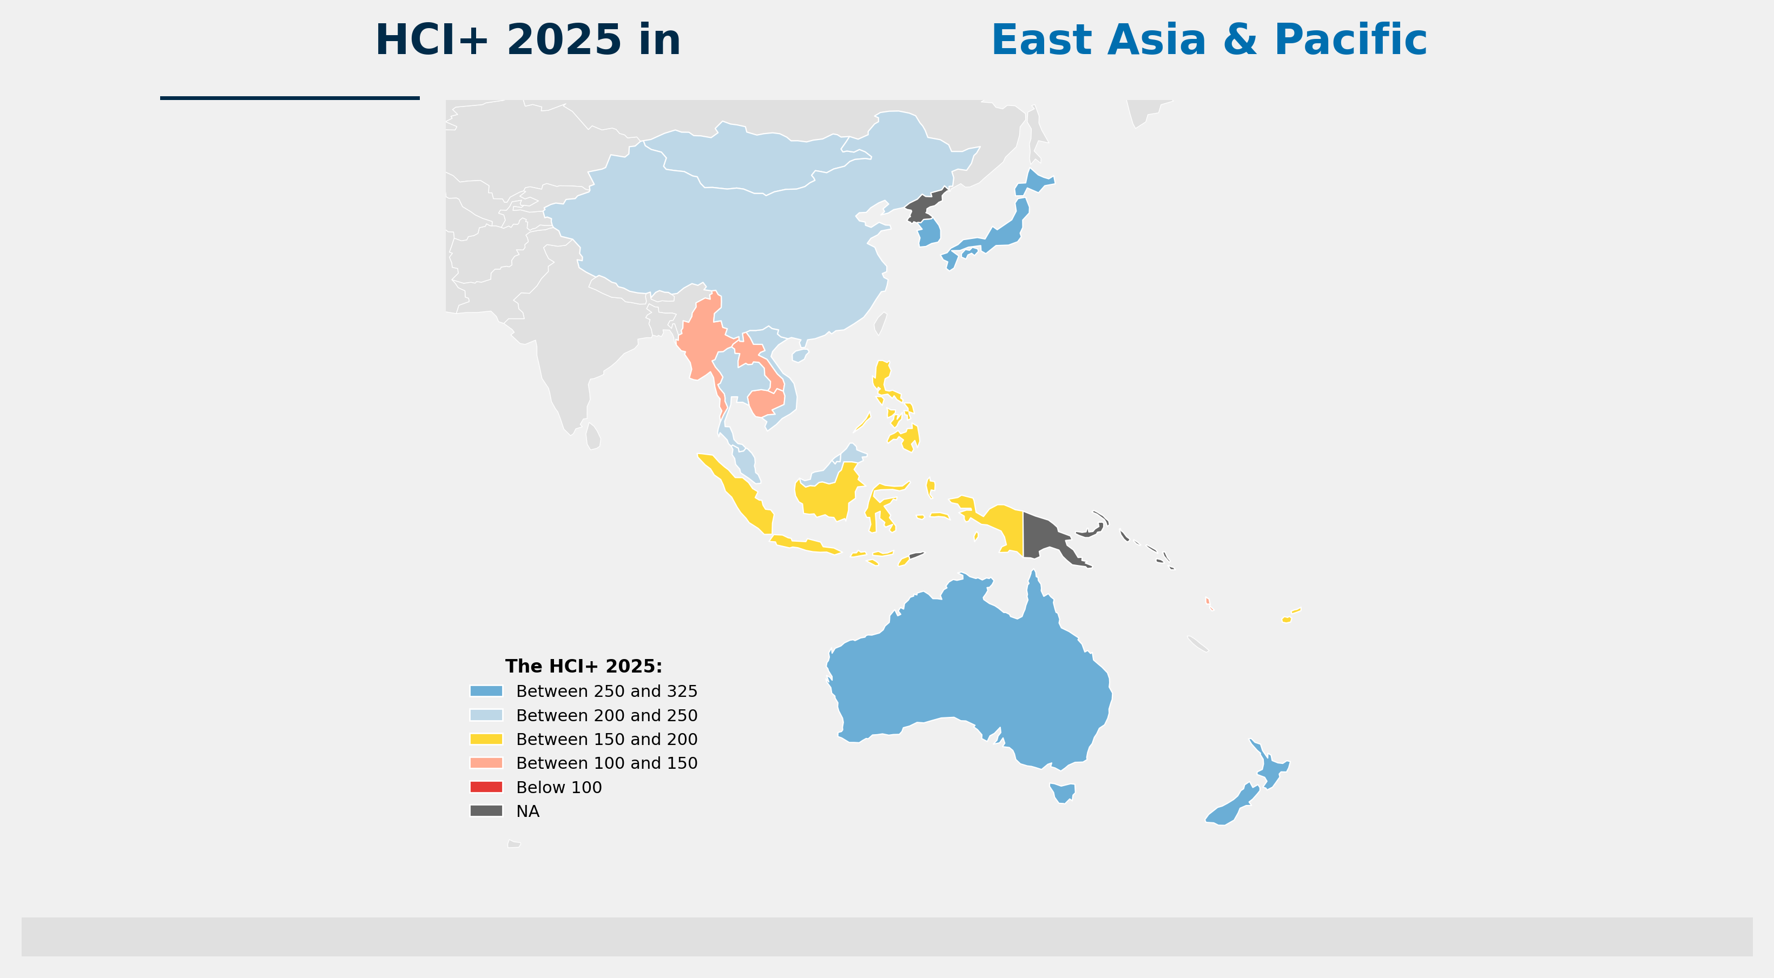
East Asia & Pacific | HCI+ Map
2025
Source: World Bank Human Capital Index Plus (HCI+) 2025 | github.com/worldbank/HCI-Plus
humancapital.worldbank.org/hciplus
12

