Slide 1
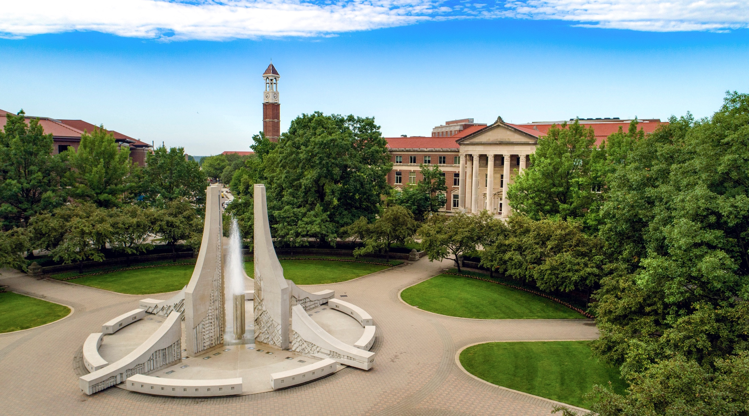
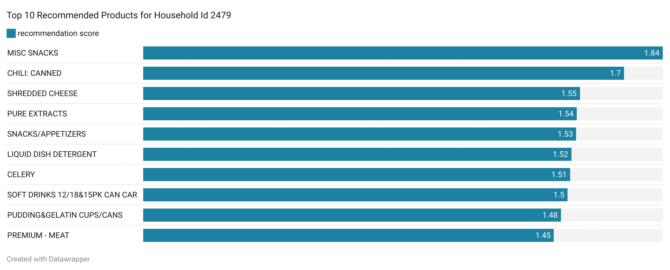
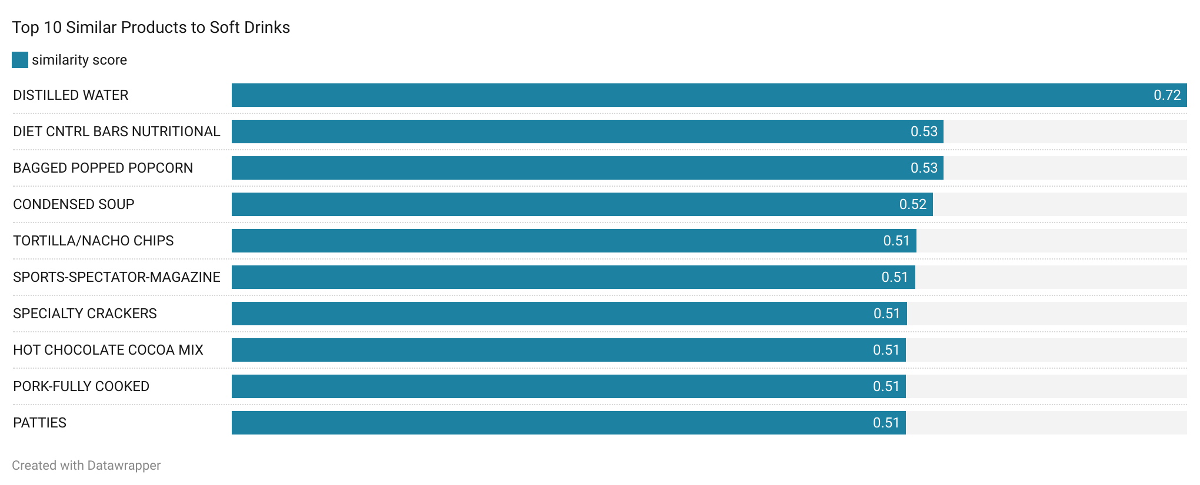











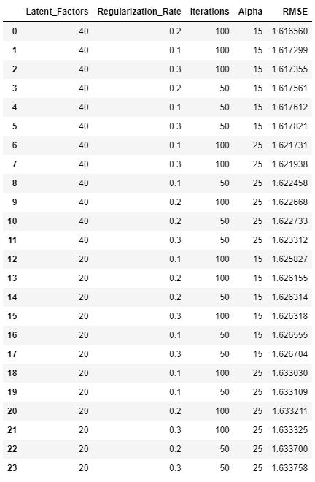
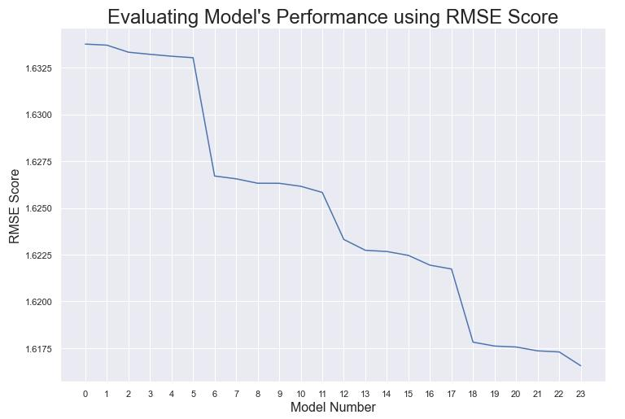





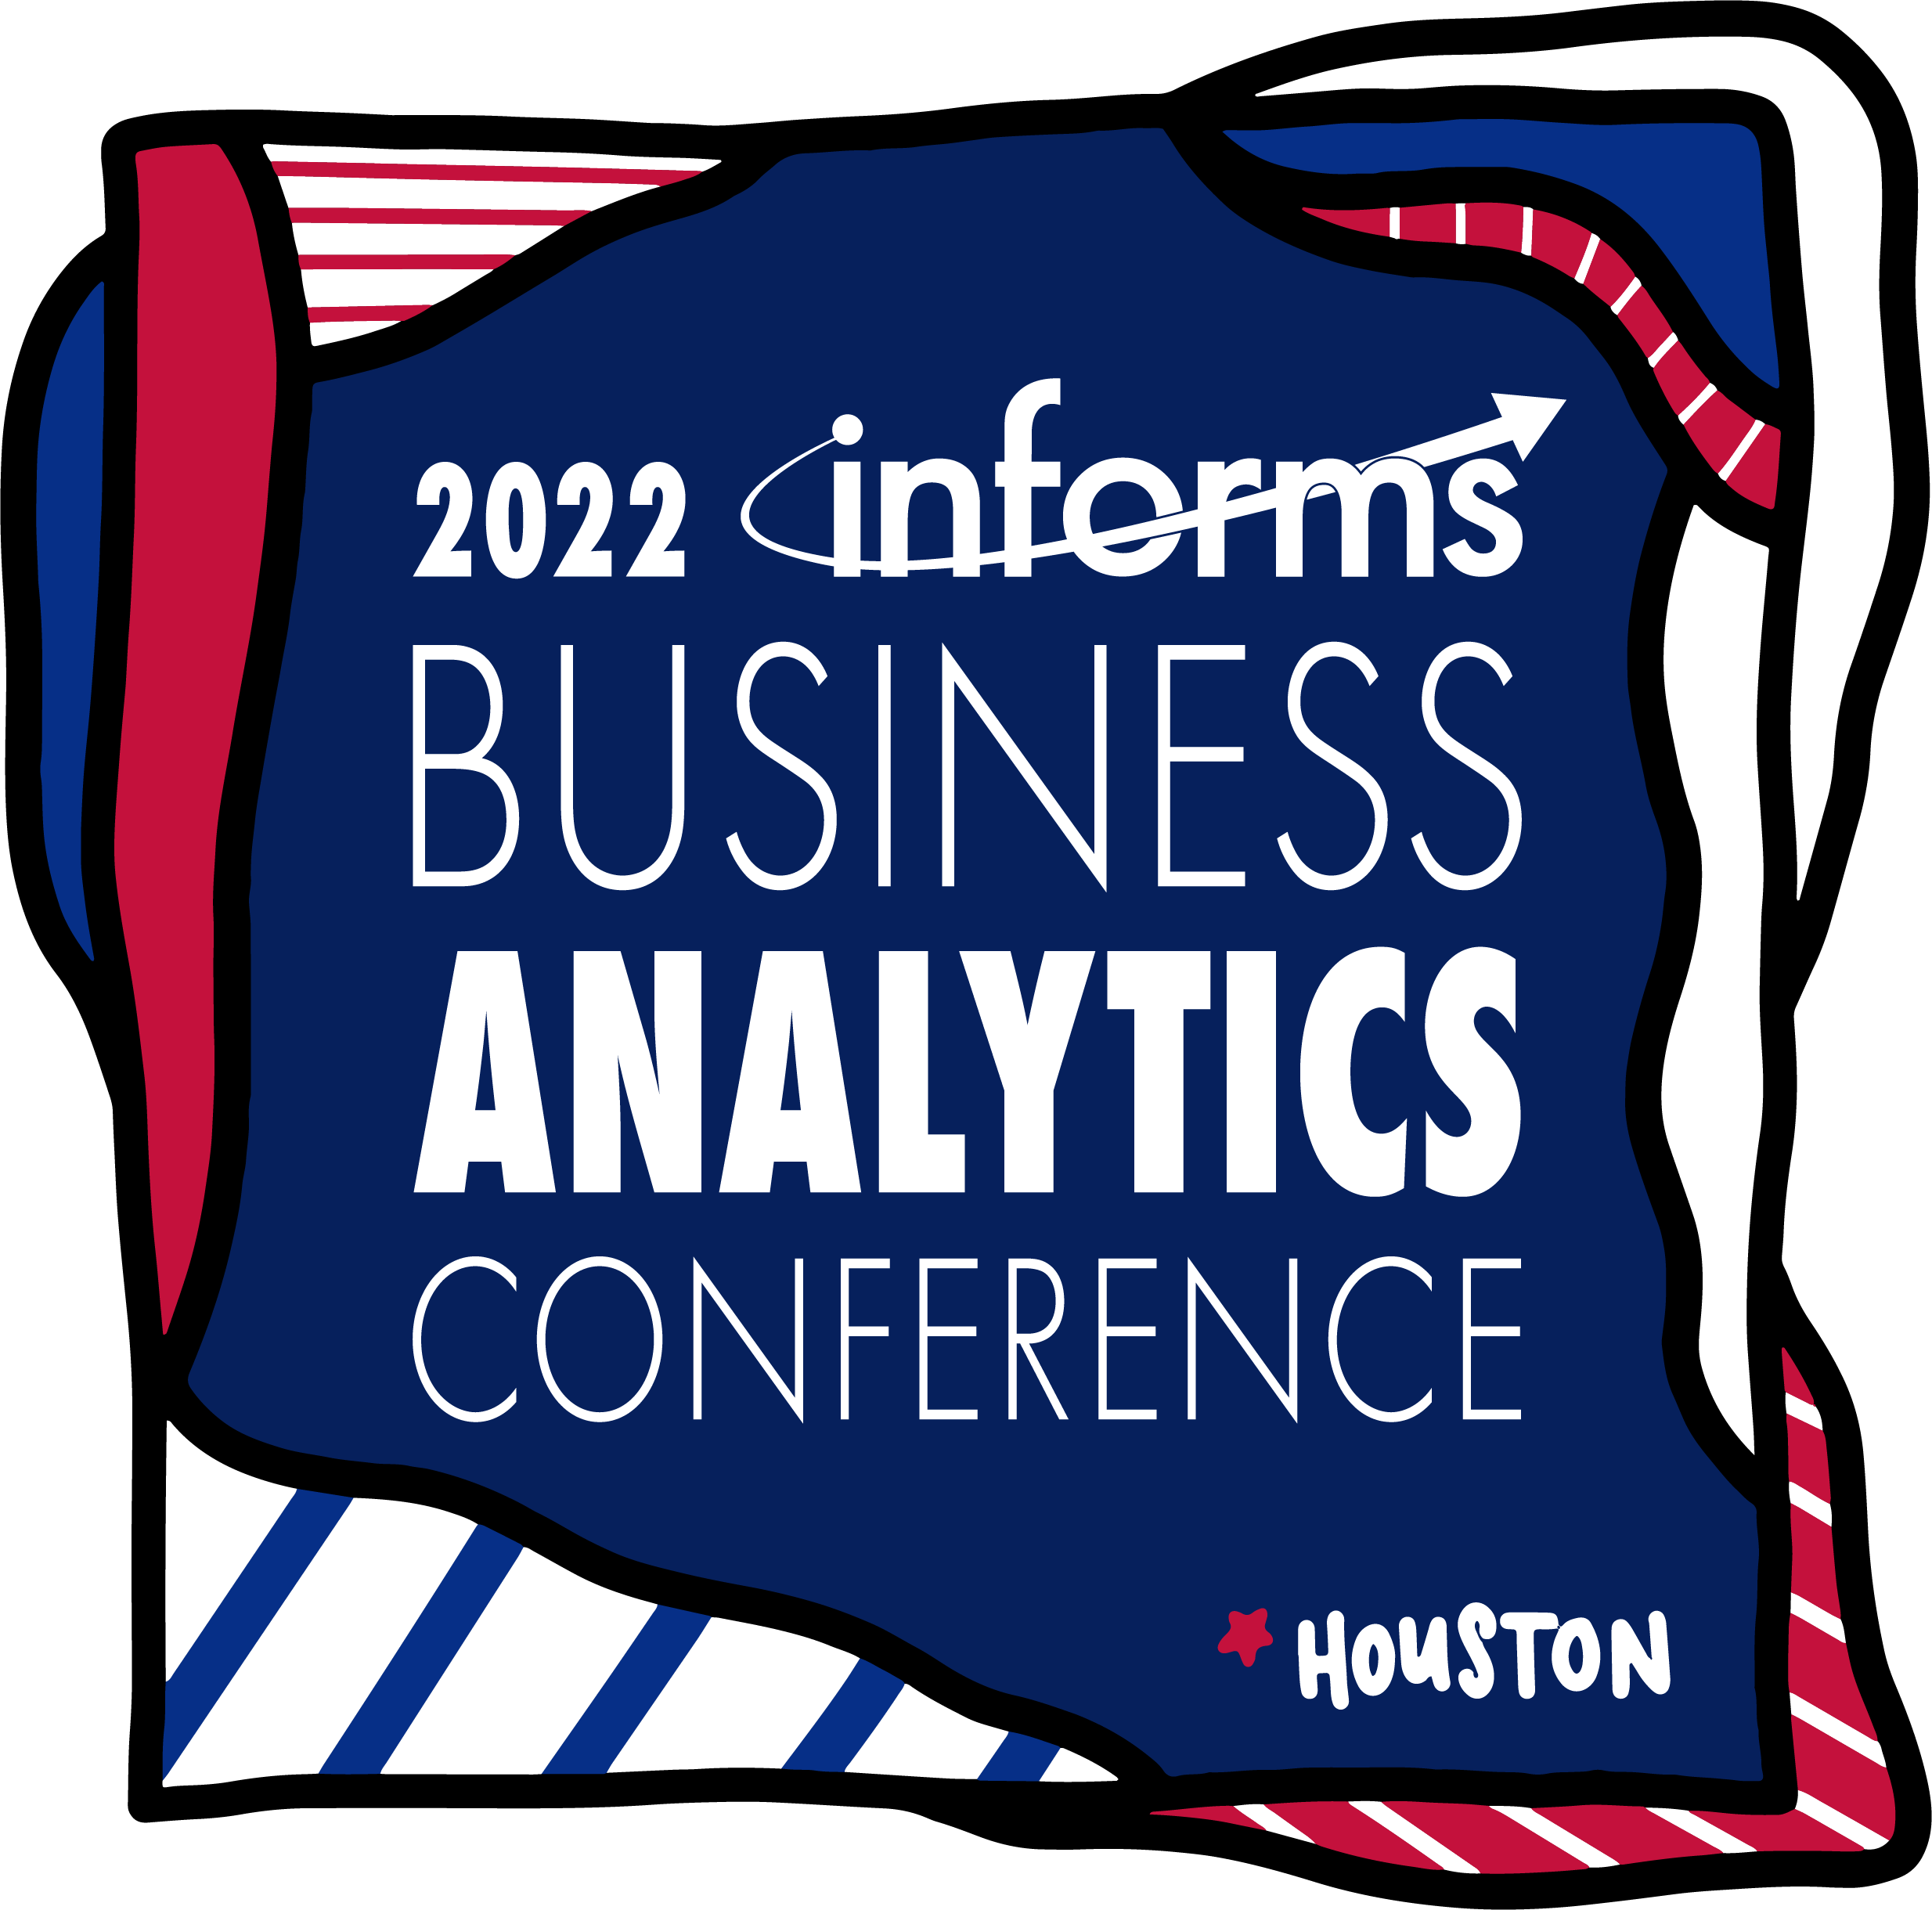





LITERATURE REVIEW
STATISTICAL RESULTS
BUSINESS IMPACT
Following resources were studied and referred to understand importance of coupon distribution optimization to improve retail performance, MLflow, MLOps, and Recommender Systems.
Johnson et al., 2013
Algorithmia, 2020
Dr. Larysa et al., DDD Advisor
Wang et al., 2020
Doshi, S (2019)
MLflow Documentation
Extracting Top Products Recommendations for a Household using Collaborative Filtering Recommender System
Leveraging ML flow to implement recommender system on continuously expanding data reduced a lot of effort as ML Engineer against conventional method of CI/CD lifecycle resulting in saving work hours by more than 90% and establishing higher sense of reliability/robustness towards the process.
Using recommender system, we will generate the likeliness of a product to be purchased by a customer. Using that likeliness to broadly classifying into two categories in order to create an impact in business.
Highly likely products to be purchased by a customer (0.9<p<1) based on probability will be shown to the customer with higher visibility to ensure our client secure business through these products
Products that have likeliness between 0.7 to 0.9 to be purchased by a customer is the segment of products that our client will offer discount coupon
Feature Name | ML Flow Support
Real-time & Batch Prediction | ✓
GIT Integration | ✓
Model Registry | ✓
Role Based Access Controls | ✓
Event Based Alerts & Notifications | ✓
A/B testing and Multi-Arm Bandit Testing | ⨯
Data Drift | ⨯
Detection of Model Bias | ⨯
Model Accuracy, Health and Prediction Stability | ⨯
Streamlining Machine Learning Lifecycle to Improve Retail Sales Performance Using MLflow
Sagar Baronia, Shubham Goyanka, Abhishek Jani, Aditya Roy Choudhary, Shirish Shinde, Matthew A. Lanham
Purdue University, Department of Management, 403 W. State Street, West Lafayette, IN 47907
sbaronia@purdue.edu; sgoyanka@purdue.edu; jania@purdue.edu; roychoua@purdue.edu; shinde1@purdue.edu; lanhamm@purdue.edu
+11%
ABSTRACT
Fig 3.1. Model Results
Organizations leveraging machine learning seek to streamline their machine learning development lifecycle. Machine learning model development possesses additional new challenges as compared to the traditional software development lifecycle. These include tracking experiments, code & data versioning, reproducing results, model management, and deployment. This paper aims to describe the implementation of MLflow on Azure databricks to streamline the process of building a recommender system to predict the user preference for a product or the likelihood of the user purchasing a product, given they are targeted with coupons in a promotional campaign. Finally, the entire machine learning pipeline is integrated with Flask using Rest API to serve the model on real-time and batch inferencing.
Table 1. ML Flow feature availability for deploying Recommendation Engine
Extracting Top Similar Products using Collaborative Filtering Recommendation System
METHODOLOGY
ML DEVELOPMENT
DATA
Automatic Retrain
Fig 4. Promotional Lift
Exploration
& Validation
Wrangling
(Cleaning)
CONCLUSIONS
INTRODUCTION
Test
Train
Streamlining the development of a recommender system using a hybrid collaborative filtering technique to improve retail sales performance using MLflow is feasible. Out of the many functionalities evaluated, role-based access controls, real-time prediction, batch inferences, and model registry are the top strength of MLflow.
Furthermore, many functionalities like Model Bias detection, Data drift, Concept Drift, and Resource Monitoring can be seamlessly integrated with ML flow using open-source libraries and tools like why logs, shap, Azure monitor, delta lake.
Understanding factors that affect coupon redemption is crucial to determining the success of a promotional campaign. This paper discusses how our client can use millions of past transactions and demographics data to improve promotional campaigns efficacy using advanced recommender systems. However, getting a model into the real-world concerns more than building it. Deployment of the model into production is essential to take full advantage of the produced machine learning (ML) model; still only 22% of companies that use ML have successfully deployed an ML model into production. This paper discusses building and streamlining an entire ML pipeline and deploying the end model using a flask container using MLOps principles.
MODEL
Model
Packaging
Model
Evaluation
Model
Engineering
Fig 3. Model Results
Fig 4. Probability Calibration Plot
Fig 3.2. Model Results
ML OPS
ML CONSUMPTION
ACKNOWLEDGEMENTS
Model Deployment
Performance Monitoring
Lifecycle Management
CODE
We would like to thank Professor Matthew Lanham and our industry partner for this opportunity, their guidance, and support on this project.
APIs
Fig 1. Proportion of Companies Successfully Deploying ML solutions
ML GOVERNANCE
RESEARCH OBJECTIVES
AI driven Retail Application
How can we leverage historical transactions and demographics data to build sophisticated machine learning system to improve promotional campaign efficacy?
Is MLflow feasible MLOps tool to streamline the machine learning lifecycle?
Central Registry
Workflow Approvals
Compliance Reports
Fig 3.3. Model Results
Fig 2. Architecture

