Slide 1
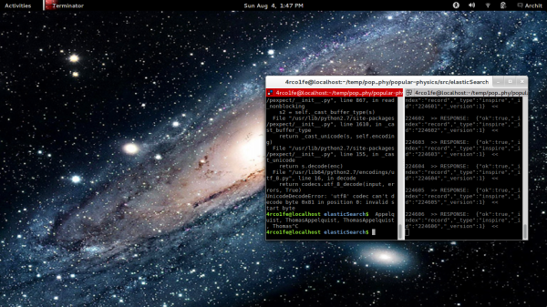
Popular Physics in History
Correlating their contributions to Physics and collaborations with fellow physicists..
Team
Archit Sharma ( Twitter / @arcolife )
Jian Nan Zhang ( FB / eric.j.zhang.5 )
Marco Guerri ( FB / marco.guerri.39 )
Xiaoli Zoe Chen ( FB / soyoungsogone )
Wiki :
https://github.com/arcolife/popular-physics/wiki
Repository:
https://github.com/arcolife/popular-physics

Slide 2
So..
we decided to correlate topics published by physicists over time, their contributions/collaborations with fellow physicists and their popularity as well as popularity of their work in subsequent years.

Slide 3
We wanted something like..

Slide 4
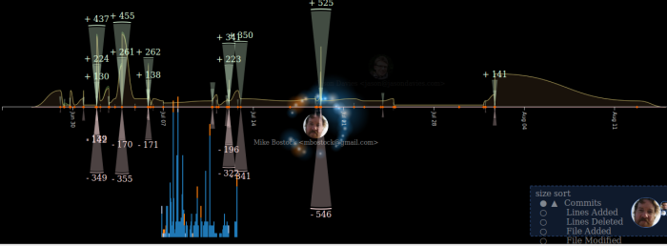
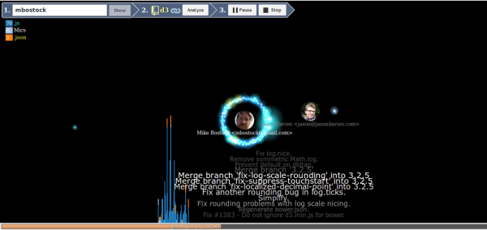

This !
Credits: /artzub

Slide 5
However..
.. the final result was something like ..

Slide 6
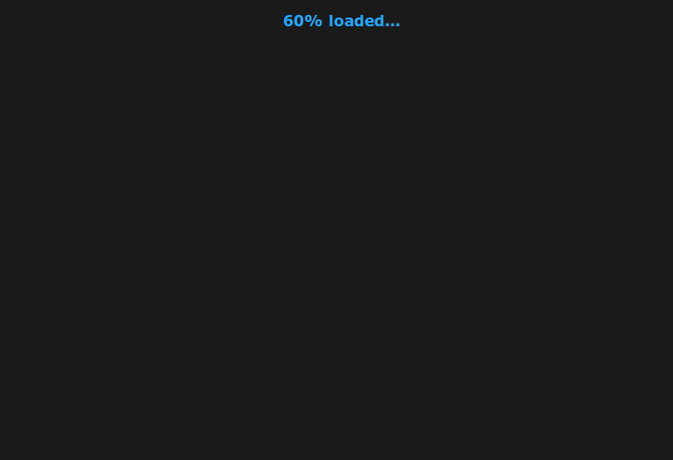
Drum roll..Drum roll..Drum roll..Drum roll..Drum roll..
Drum roll..Drum roll..Drum roll..Drum roll..Drum roll.. :P

Slide 7
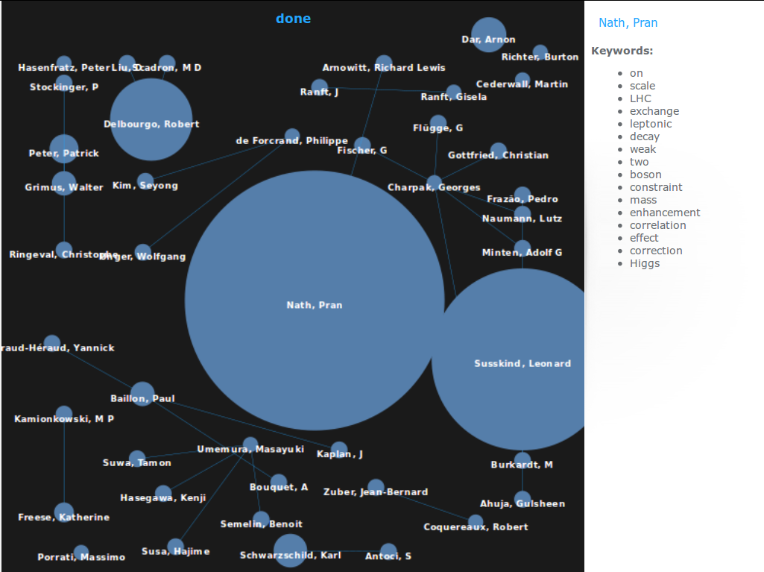
TaaDAAA! This :D

Slide 8
# A few bottlenecks#
------------------------------
Taking a DB dump from CERN's Document Servers CDS and INSPIRE.
And moreover, converting them and uploading them to our own local instance.
(So here is the # of documents we handled in 2 days: approximately 2 million. Yeah, 2,000,000)
Limited processing powers from normal Laptops and Desktop computers
(ok. It was intel core i5 & i7 that we had , but still, processing those huge amounts,
..swamps even that kind of CPU! )
Keyword error investigation
(Data redundancy / deficiency / non-uniform availability across all documents, issues! =.= )
Visualizing that kind of data – sifting through available visualizations, bringing them in proper format.
All over, it was the time, which gave us the goosebumps.

Slide 9
====================
' Additional Information '
----------------------------------
** Primary metadata requirements are:
Topic
Author(s)
Co-author(s)
Abstract
Citations
Year
References
Top Cites, yearly distributed index(if possible)
keywords list per record (if it exists?)
A link to plain text downloads for all records

Slide 10
~~ FUTURE PLANS ~~
To further enhance the quality of data sets and the visualization part as well.
To add more visualizations and make it attractive, and set up
a 'CrowdCrafting Project' to involve more people in the development process.
If possible, put up a public interactive website, mobile/tablet apps out of this and help spread the word about Science (especially Physics)
To think about its possible applications in various fields, for example: Journalism.

Slide 11
Questions / Clarification?

Slide 12

&
Thank You !
:)
/arcolife/popular-physics

