Slide 1
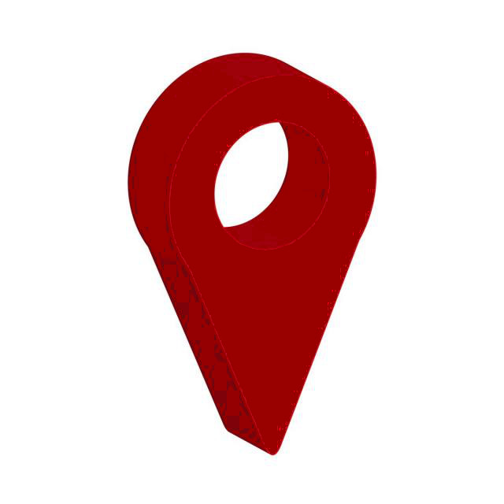
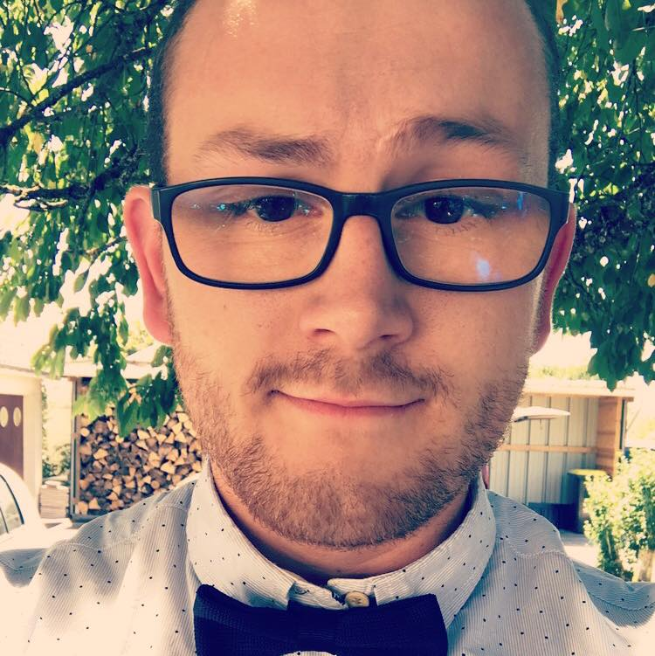



Fabrice
Bazire
32ter rue Saint Marc 41600 Nouan le Fuzelier
06.45.97.93.70
bazire.fabrice@gmail.com
Permis B
15/01/1997
Currently in computer science DUT in special year (DUT in one year) at the University of Orleans, I want to pursue a professional bachelor's degree to specialize in the web
Curriculum Vitae
Developer
TRAINING
Skills
2019-2020
DUT COMPUTER SCIENCE
Special Year, IUT Orléans
PHP – HTML – CSS – MYSQL – TCP/IP - JAVASCRIPT
2015-2019
BACHELOR COMPUTER SCIENCE (First and Second Year)
University of Orleans
JAVA – JAVAFX
2015
SCIENTIFIC BACCALAUREATE
High School Claude de France
Romorantin-Lanthenay (41200)
C – C++ - Python - Bash
UML - Design Pattern
Professional Experience
English
SINCE 2016
IKEA | STUDIENT WORK
Customer relations service :
Reception and checkout
nursery
Currently : after sales service
Technical level
Center of interest
SINCE 2015
UNIVERSITY OF ORLEANS | COMPUTER SCIENCE PROJECTS
Web project : Car garage management website (HTML, CSS, PHP, MVC)
Java Project : application for managing a performance hall and makinf a game of life (use of API and error handling)
C Project : use of binary trees to encrypt and decrypt strings (coding of HUFFMAN)
MOUNTAIN BIKE
AUTOMOTIVE
PERSONALITY
AMIBITIOUS
SERIOUS
DYNAMIC

