Slide 1
AUDIO COMPRESSION USING DCT
ECE4007 – Information Theory and Coding
SLOT: B1+TB1
Team Members:
P.VAISHNAVI 17BEC0066
A.ABID ALI 17BEC0513
Submitted to:
Prof. K.S.Preetha

Slide 2
Objective/Problem Statement
As technology is growing, there is an increasing need for data storage and transmission. Compression makes the storage and transmission of audio data more effective. There are many forms of audio compression techniques that offer a range of complexity encoder and decoder, compressed audio quality, and varying amounts of data compression such as DCT, MPEG, DWT etc. This project aims to implement an audio signal compression algorithm using the Discrete Cosine Transform (DCT) technique. Implemented algorithm performance is assessed on the basis of compression ratio, Signal to Noise Ratio (SNR), and Root Mean Square Error (MSE). For further, efficient storage and transmission we also implemented Huffman Encoding

Slide 3
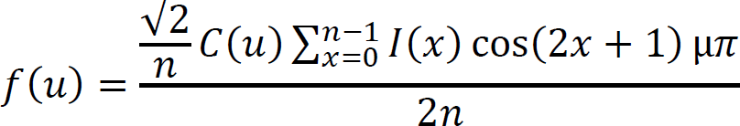
Literature survey
DISCRETE COSINE TRANSFORM:
DCT is the real part of the Fourier transform. A discrete cosine transform (DCT) describes a finite sequence of data points in terms of the sum of oscillating cosine functions at different frequencies.
DCT based compression retains those coefficients which are just enough to represent the signal at a particular desired quality.
It identifies pieces of information that can be effectively thrown away without seriously reducing the audio's quality.

Slide 4
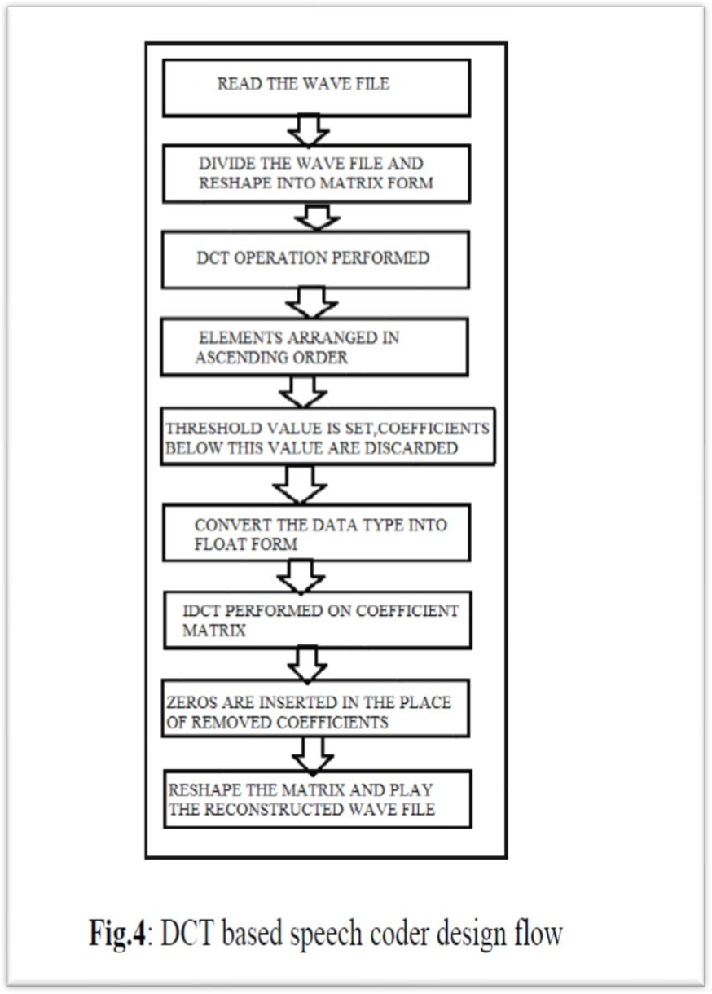
Diagram/ Flow chart

Slide 5
Methodology with precise explanation
ALGORITHM:
DCT
1.Select the audio and find the actual signal size.
2.Set a particular sampling frequency
3.In the procedure, we will decompose the signal into DCT basis vectors. There will be as many terms in the decomposition as there are samples in the signal. The expansion coefficients will be assembled in a vector X which will actually measure how much energy is stored in each of the components. Sort the coefficients from largest to smallest.
4.Then we will determine the number of DCT coefficients that comprises 99.9% of the energy in the signal.
5.we will set coefficients to zero that contain the remaining 0.1% of the energy.
6. At last, using inverse discrete cosine transformation (IDCT) we can reconstruct the signal from the compressed representation of signal
7.Finally we will ,analyze the compressed signal through Compression factor, the quality of the signal by parameters such as Signal to Noise Ratio (SNR), and Root Mean Square Error (MSE)

Slide 6
Huffman coding:
1.follow above same instruction up to 6th step.
2.Then we quantize DCT coefficients with 256 levels between their Max and Min Value.
3.Then we will find the probability distribution of these quantized coefficients
4.With the help of probability distribution we generate “dictionary” for Huffman coding
5.Then we will perform Huffman encoding, which has much compressed for storage and transmission
6.Atlast we will perform Huffman decoding
7.finally apply IDCT to get our compressed file.

Slide 7
EXPLANATION:
First, we will select the file to extract to our MATLAB simulator
Then we sample our audio file using read function at a specific frequency
After that we will take the DCT of the generated samples.
Then DCT coefficients are rearranged in descending order.
We then run a loop and iterate until the sorted vector's magnitude is equal to the original vector's magnitude of 99 percent. The vector magnitude gives us the energy that is in the signal.
Then we will apply Inverse cosine transform to reconstruct the signal.
Finally, by using the audio write function, these samples are again sampled back to the same sampling frequency thus creating an output compressed audio.
For Huffman coding, we need to quantize the DCT coefficient, then we have find probability distribution, then dictionary ,then encoding-decoding-IDCT to get compressed file

Slide 8
List of references
1. Sankalp Shukla, Maniram Ahirwar, Ritu Gupta, Sarthak Jain, Dheeraj Singh Rajput. Audio Compression Algorithm using Discrete Cosine Transform (DCT) and Lempel-Ziv-Welch(LZW) Encoding Method, 2019 International Conference on Machine Learning, Big Data, Cloud and Parallel Computing (Com-IT-Con), India, 14th -16th Feb 2019
2. M. V. Patil, Apoorva Gupta, Ankita Varma, Shikhar Salil.Audio and Speech Compression Using DCTand DWT Techniques, International Journal of Innovative Research in Science, Engineering and TechnologyVol. 2, Issue 5, May 2013
3. Sudha Rawat, Ajeet Kumar Verma Survey paper on image compression techniques, ,2017
4. Mr. R. R. Karhe Ms. P. B. Shinde Ms. J. N. Fasale Audio Compression using DCT & CS, , 2015
5. A.M.Raid, W.M.Khedr , M. A. El-dosuky and Wesam Ahmed .Jpeg Image Compression Using Discrete Cosin Transform, , 2014

