Slide 1
ARC-Data Analytics
Sagar Rokade

Slide 2
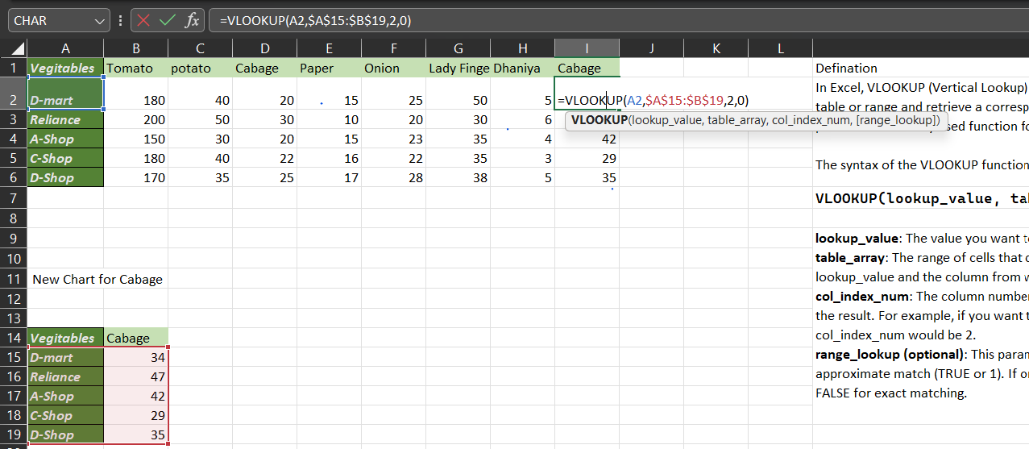
Vlookup

Slide 3
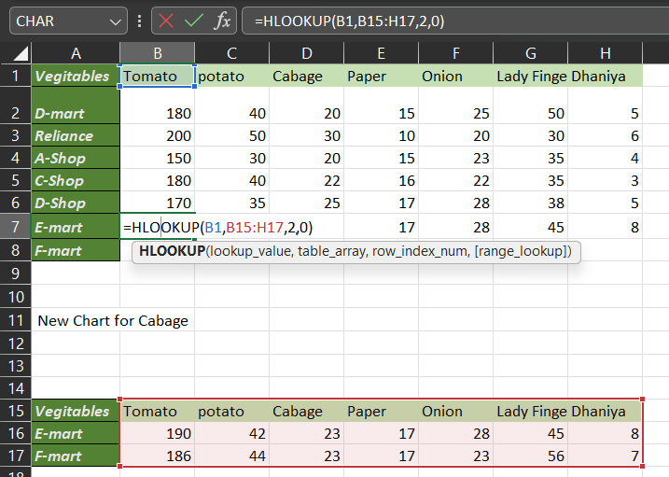
HLookUp

Slide 4
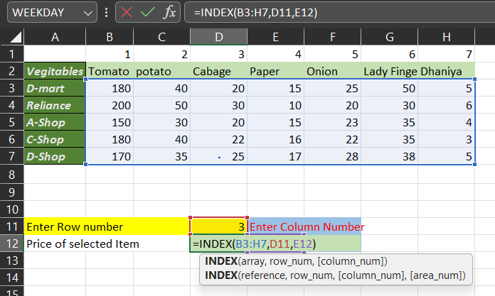
Index

Slide 5
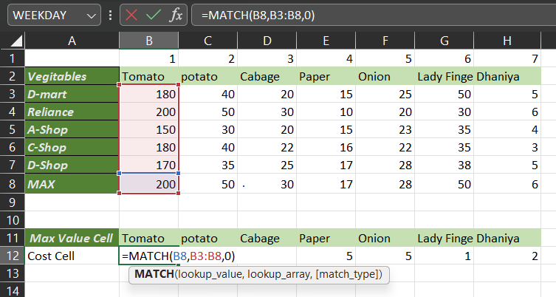
Match

Slide 6
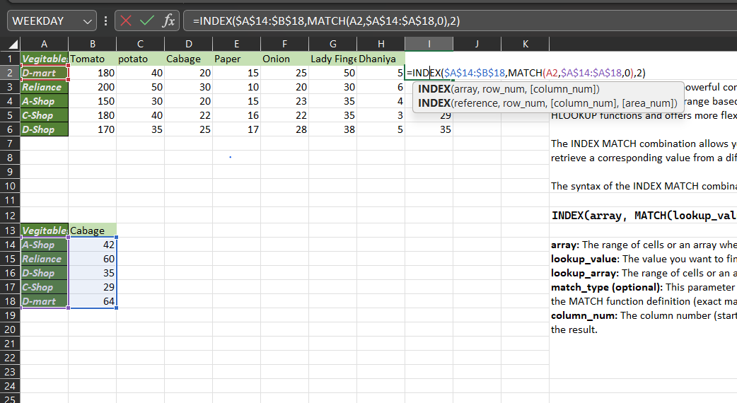
Index match

Slide 7
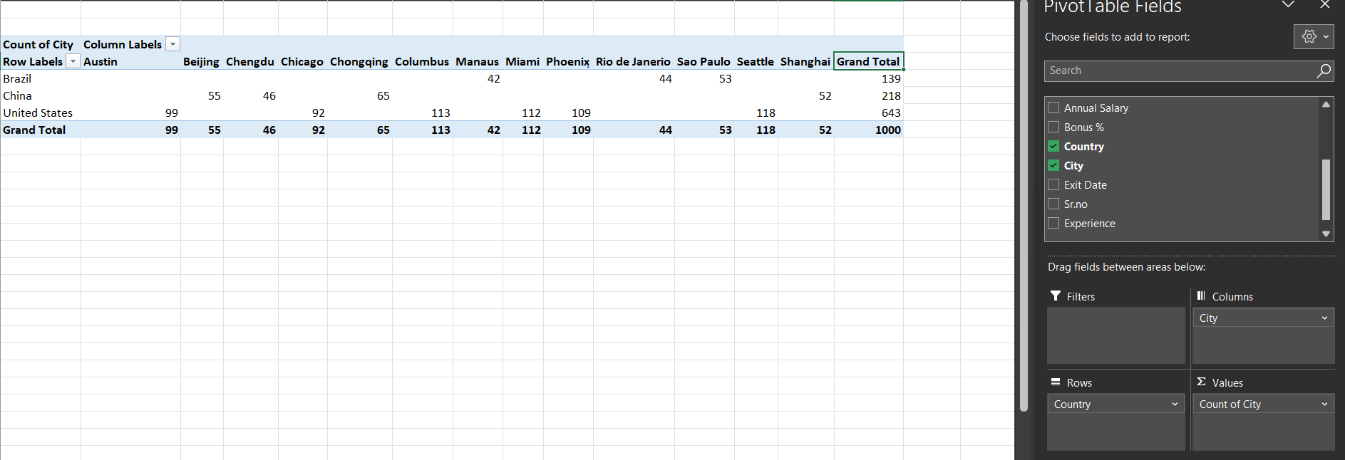
Pivot Table

Slide 8
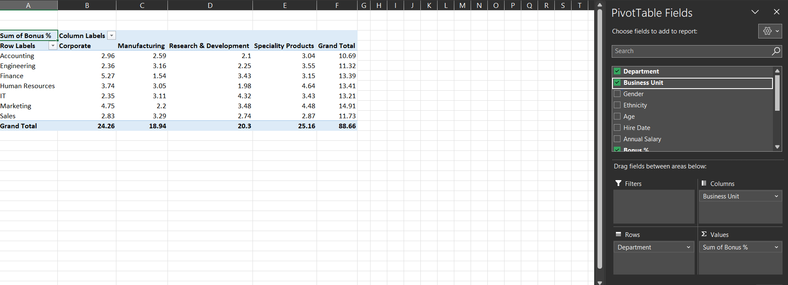
Pivot Table

Slide 9
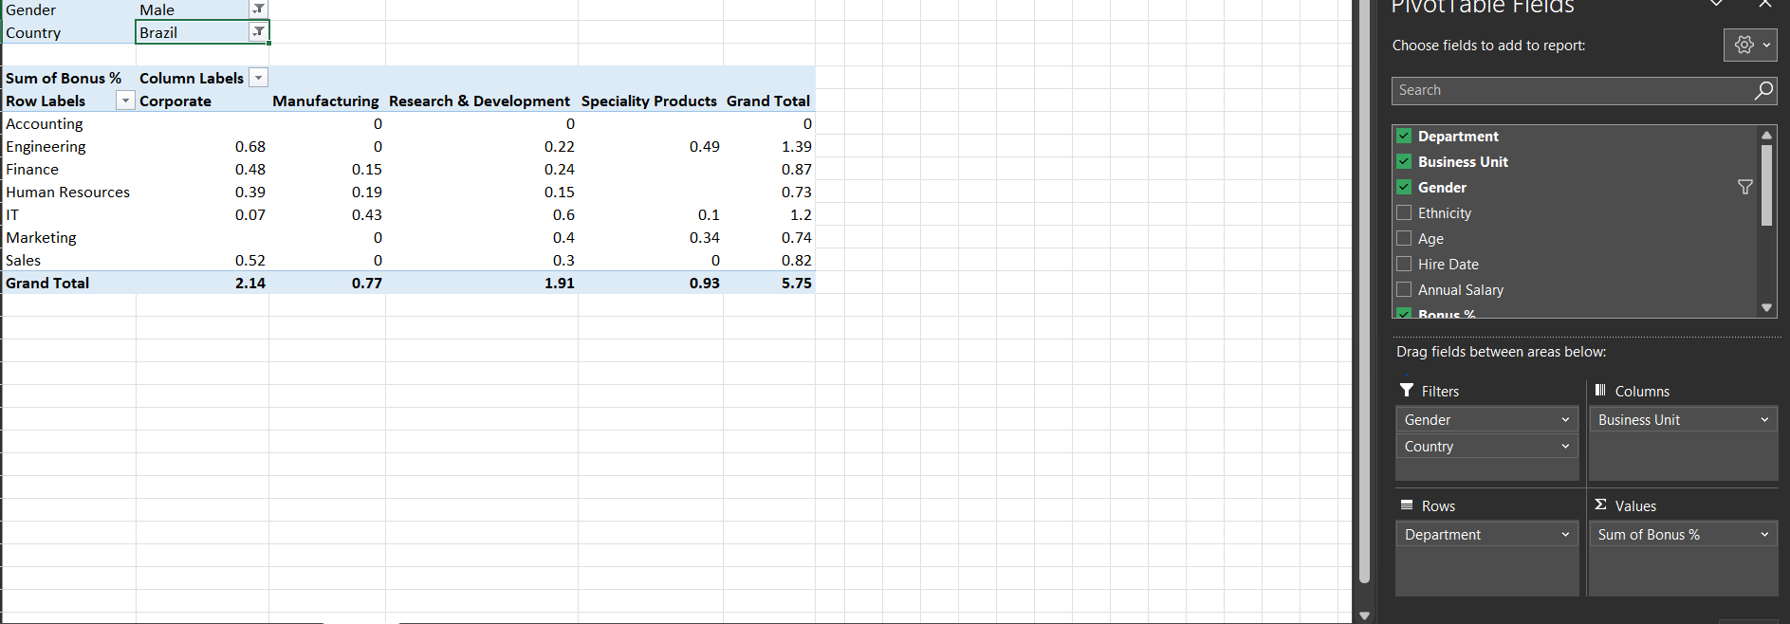
Pivot Table Filter

Slide 10
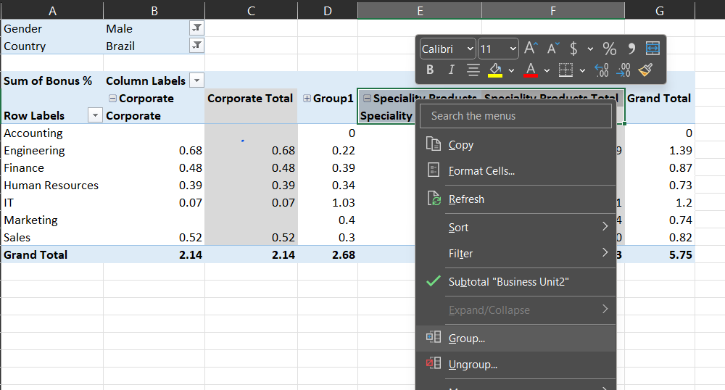
Pivot Table Group

Slide 11
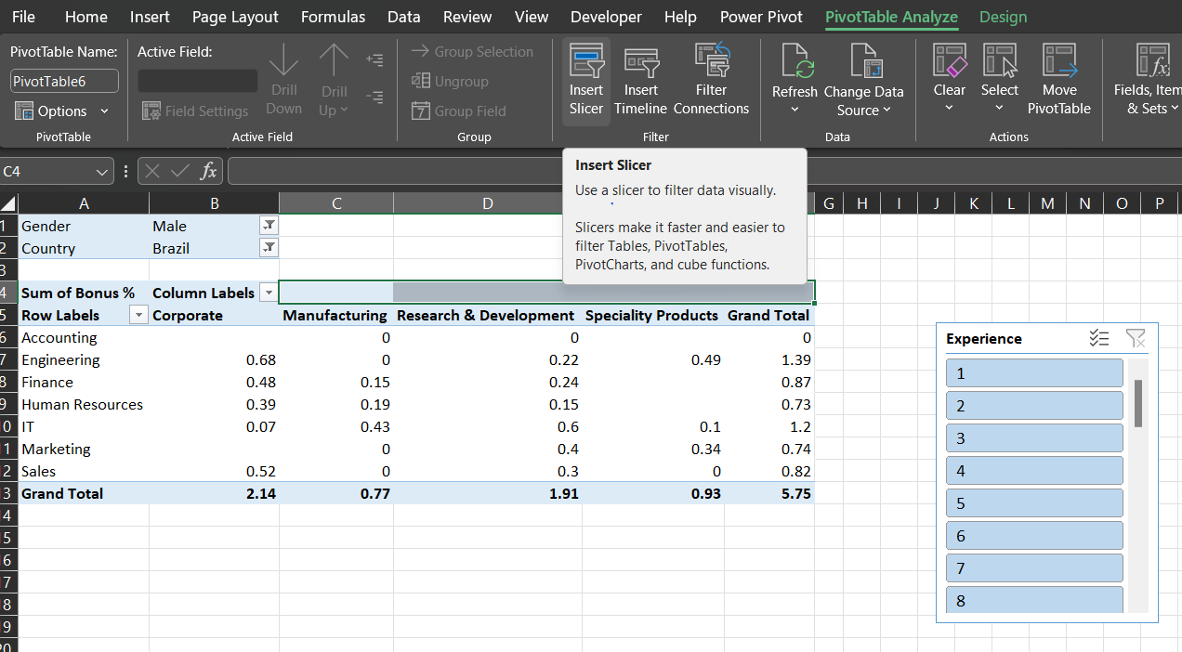
Pivot Table Insert Slicer

Slide 12
Pivot Table Insert Slicer

Slide 13
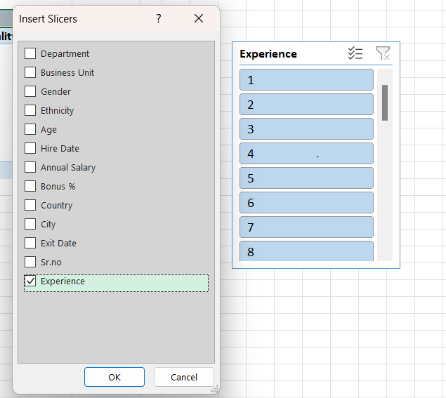
Pivot Table Insert Slicer

Slide 14
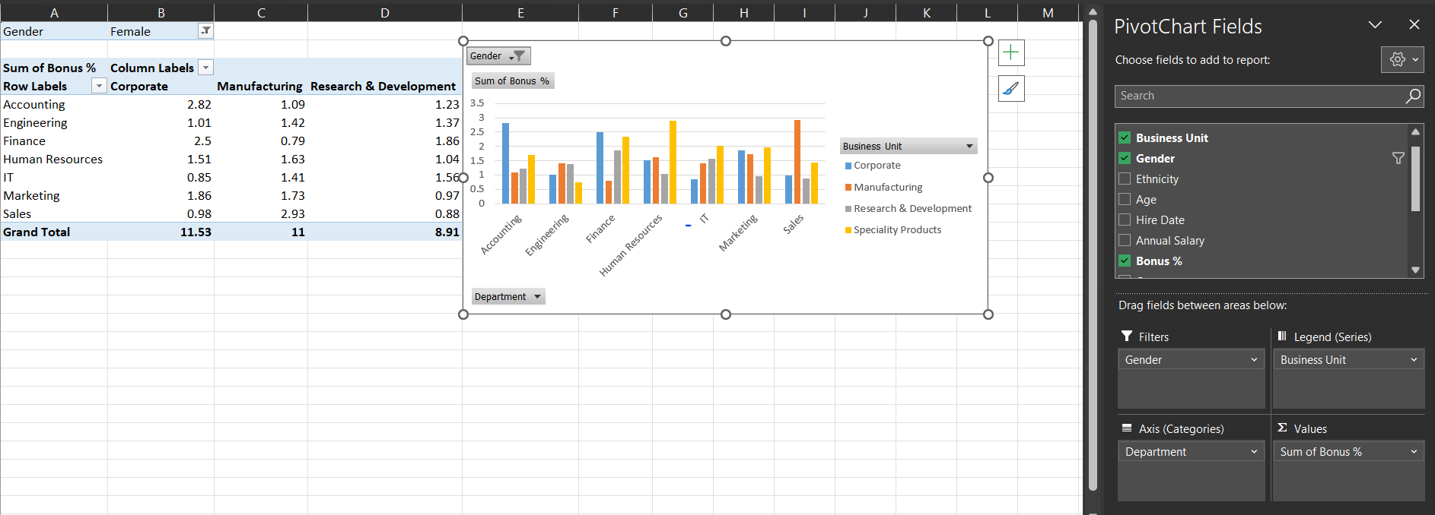
Pivot Chart

