Slide 1
ARC-Data Analytics
Sagar Rokade

Slide 2
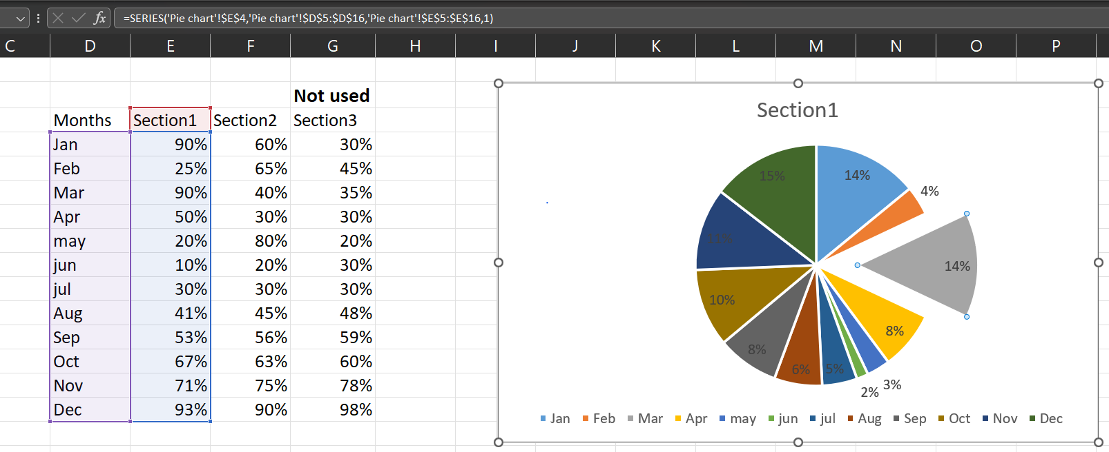
Pie Chart

Slide 3
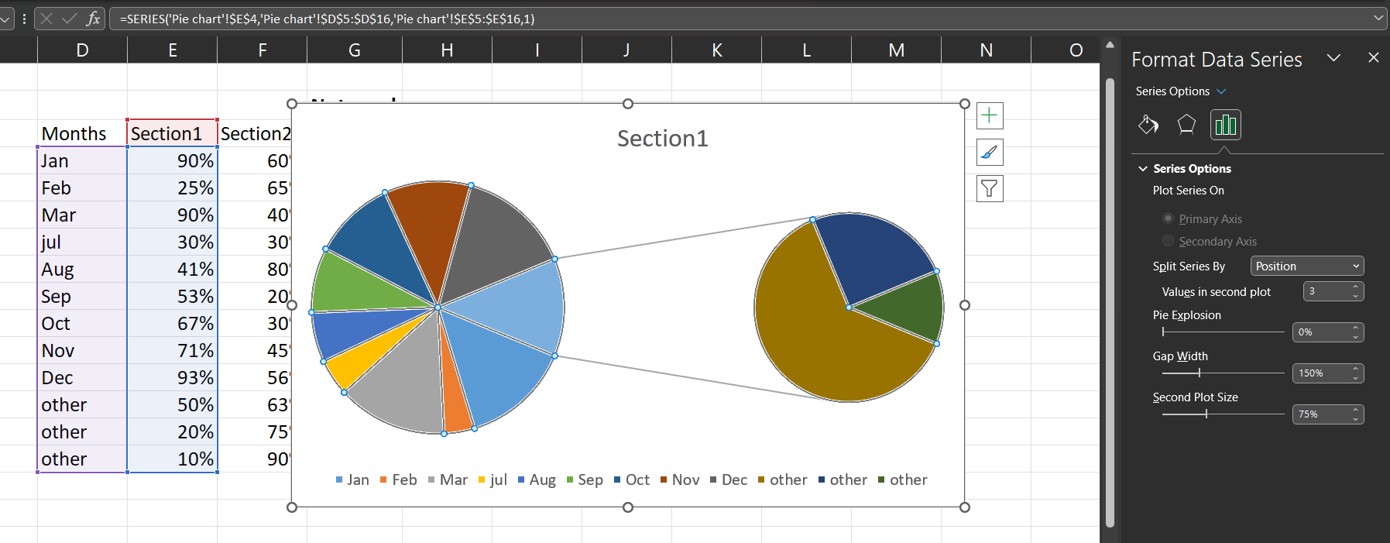
Pie of Pie Chart

Slide 4
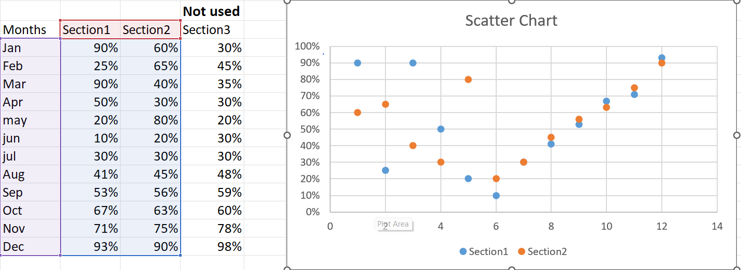
Scatter Chart

Slide 5
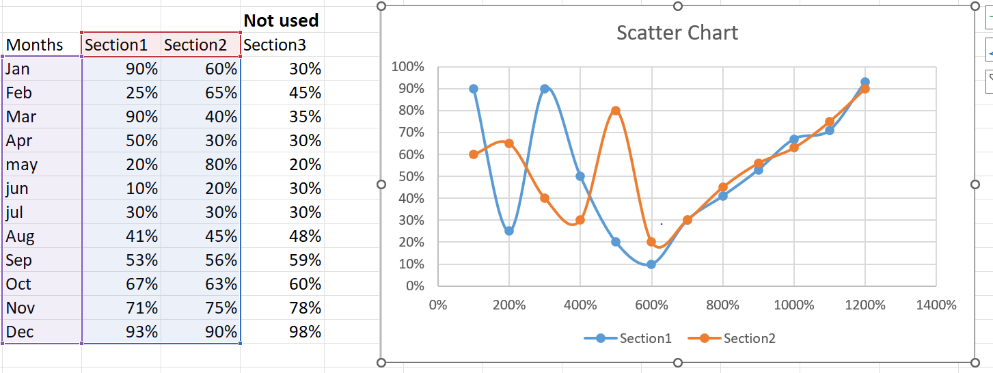
Scatter Chart smooth lines

Slide 6
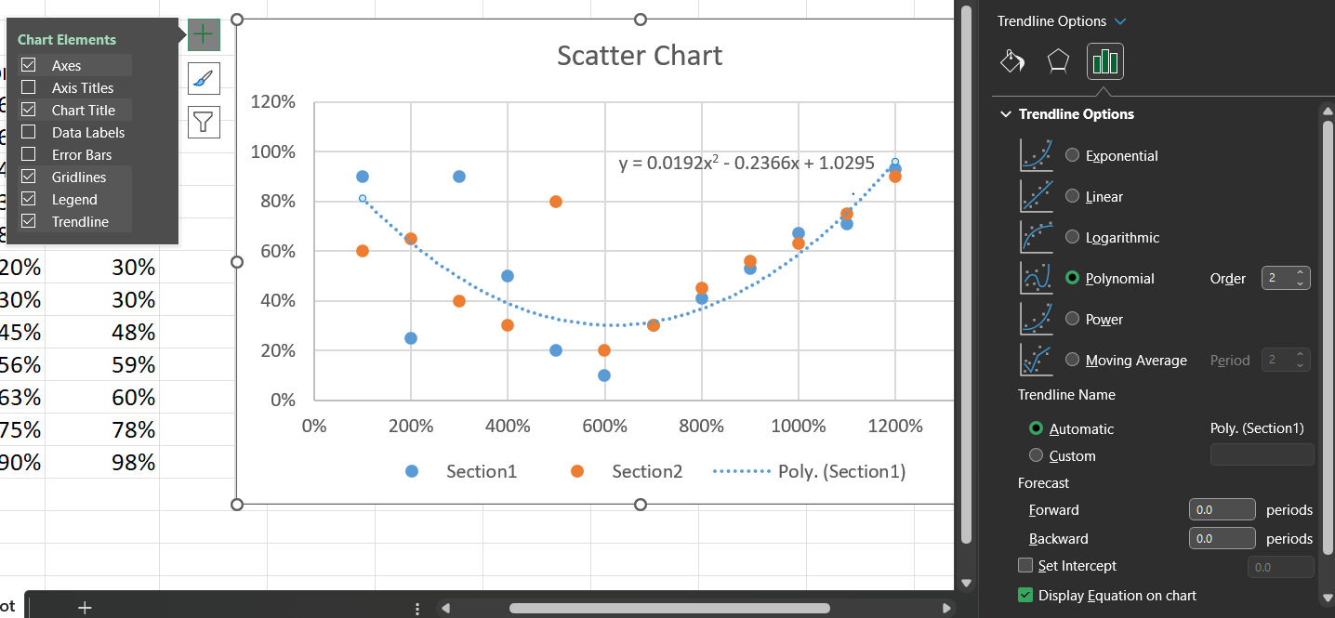
Trend Line

Slide 7
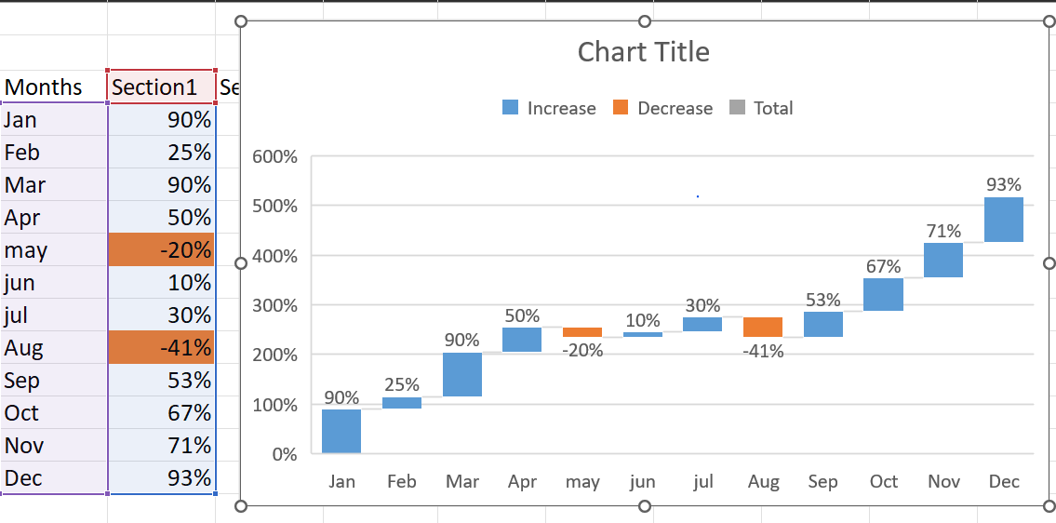
Waterfall Chart

Slide 8
Waterfall Chart

Slide 9
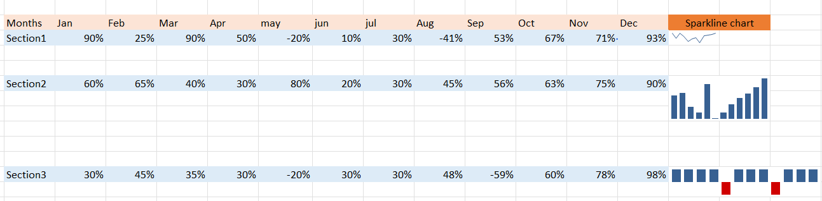
Spark Line Chart

Slide 10
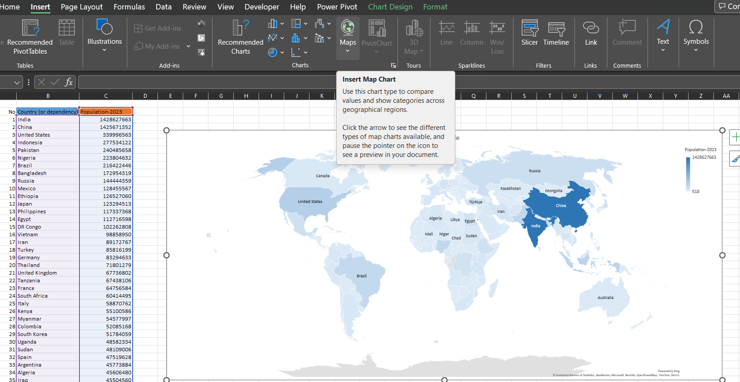
Map Chart

Slide 11
Map Chart - copy

