Slide 1
I18n
Sunil Joshi

Slide 2
Goal
Simple
Consumer Agnostic
Quick and Easy Live Updates
Reuse Out of Box Features than Building

Slide 3
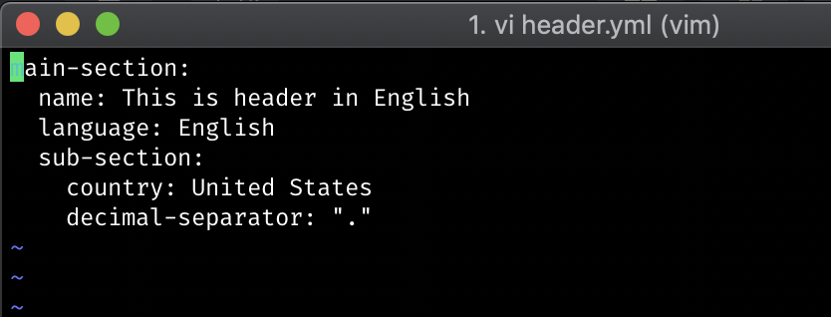
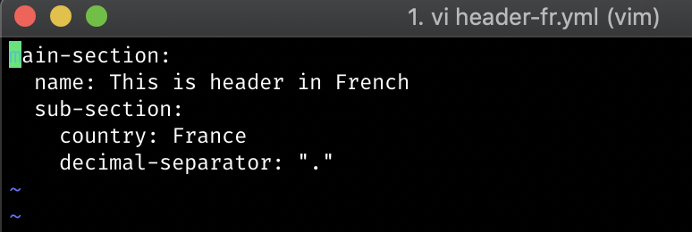
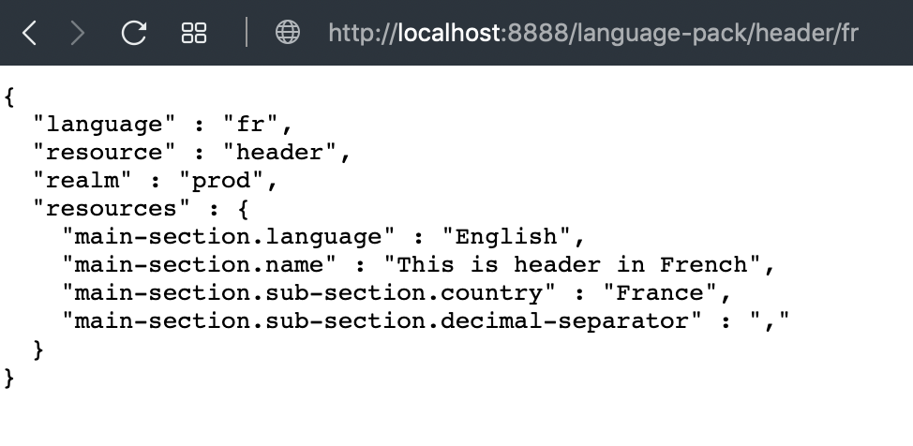
Scalable and Stable

Slide 4
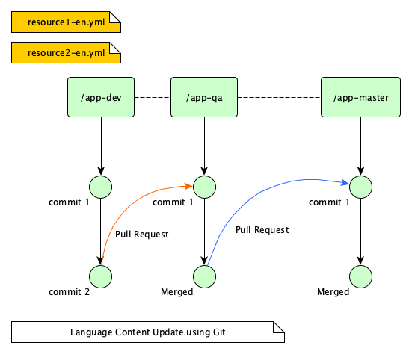
Resource Management
Branch Name = Profile Name
Resource name: <appname>-<lang>.yml

Slide 5
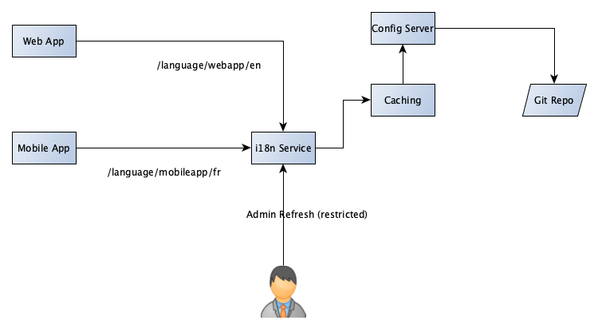
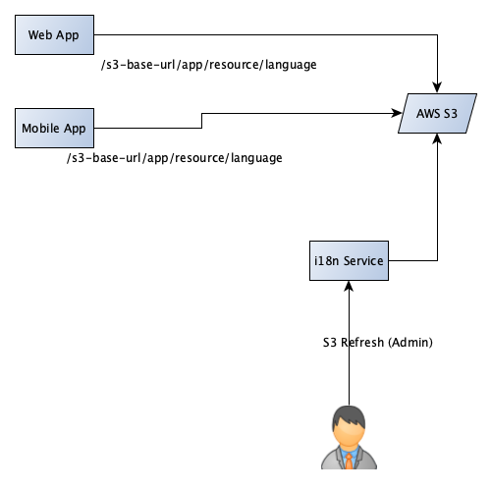
Process Flow

