Slide 1
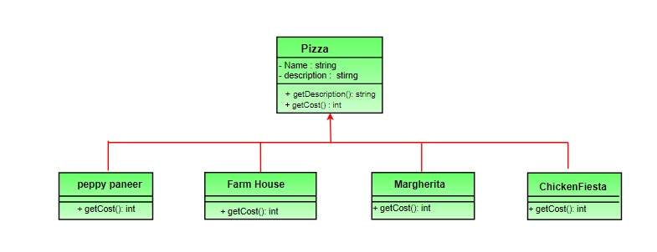
Pizza use case
Suppose we are building an application for a pizza store and we need to model their pizza classes. Assume they offer four types of pizzas namely Peppy Paneer, Farmhouse, Margherita and Chicken Fiesta. Initially we just use inheritance and abstract out the common functionality in a Pizza class.
Notes:
Each pizza has different cost. We have overridden the getCost() in the subclasses to find the appropriate cost. Now suppose a new requirement, in addition to a pizza, customer can also ask for several toppings such as Fresh Tomato, Paneer, Jalapeno, Capsicum, Barbeque, etc. Let us think about for sometime that how do we accommodate changes in the above classes so that customer can choose pizza with toppings and we get the total cost of pizza and toppings the customer chooses.

Slide 2
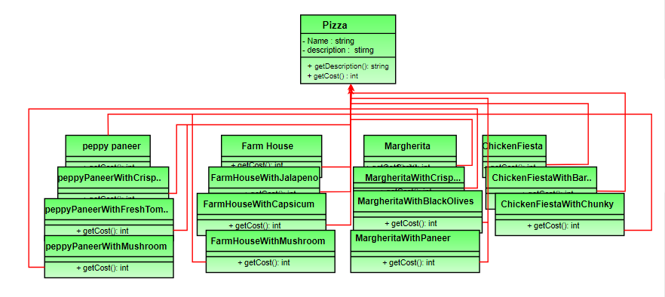
Option 1
Notes:
Create a new subclass for every topping with a pizza. The class diagram would look like this. This looks very complex. There are way too many classes and is a maintenance nightmare. Also if we want to add a new topping or pizza we have to add so many classes. This is obviously very bad design.

Slide 3
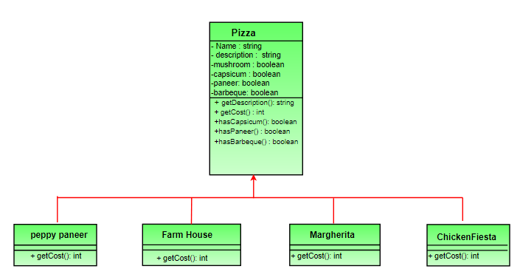
Option 2
Notes:
Let’s add instance variables to pizza base class to represent whether or not each pizza has a topping. The class diagram would look like this. The getCost() of superclass calculates the costs for all the toppings while the one in the subclass adds the cost of that specific pizza.

Slide 4
Option 2 - continued
This design looks good at first but lets take a look at the problems associated with it.
Price changes in toppings will lead to alteration in the existing code.
New toppings will force us to add new methods and alter getCost() method in superclass.
For some pizzas, some toppings may not be appropriate yet the subclass inherits them.
What if customer wants double capsicum or double cheeseburst?
In short our design violates one of the most popular design principle – The Open-Closed Principle which states that classes should be open for extension and closed for modification.

Slide 5
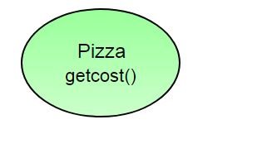
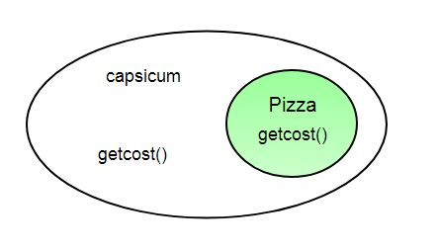
Decorator design pattern
Take a pizza object.
“Decorate” it with a Capsicum object.

Slide 6
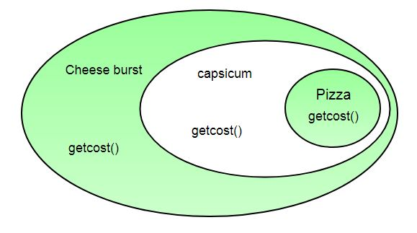
“Decorate” it with a CheeseBurst object
What we get in the end is a pizza with cheeseburst and capsicum toppings. Visualize the “decorator” objects like wrappers.

Slide 7
Decorator properties
Decorators have the same super type as the object they decorate.
You can use multiple decorators to wrap an object.
Since decorators have same type as object, we can pass around decorated object instead of original.
We can decorate objects at runtime.

Slide 8
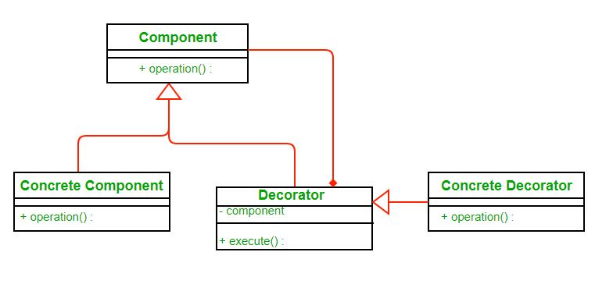
Defination
The decorator pattern attaches additional responsibilities to an object dynamically. Decorators provide a flexible alternative to subclassing for extending functionality.

