Slide 1
pointers
In function fun, it creates a pointer that is pointing to the Point object. The object Point contains two integers, x and y.
When the function fun ends, p will be destroyed as it is a local variable. But, the memory it consumed won’t be deallocated because we forgot to use delete p; at the end of the function.
That means the memory won’t be free to be used by other resources. But, we don’t need the variable anymore, but we need the memory.
In function main, fun is called in an infinite loop. That means it’ll keep creating p. It’ll allocate more and more memory but won’t free them as we didn’t deallocate it. The memory that’s wasted can’t be used again. Which is a memory leak. The entire heap memory may become useless for this reason. C++11 comes up with a solution to this problem, Smart Pointer.
class Point {
private:
int x; int y;
};
void fun()
{
Point* p = new Point();
}
int main()
{
// Infinite Loop
while (1) {
fun();
}
}

Slide 2
Smart pointer
A Smart Pointer is a wrapper class over a pointer with an operator like * and -> overloaded.
The objects of the smart pointer class look like normal pointers. But, unlike Normal Pointers it can deallocate and free destroyed object memory.
The idea is to take a class with a pointer, destructor and overloaded operators like * and ->. Since the destructor is automatically called when an object goes out of scope, the dynamically allocated memory would automatically be deleted (or reference count can be decremented)

Slide 3
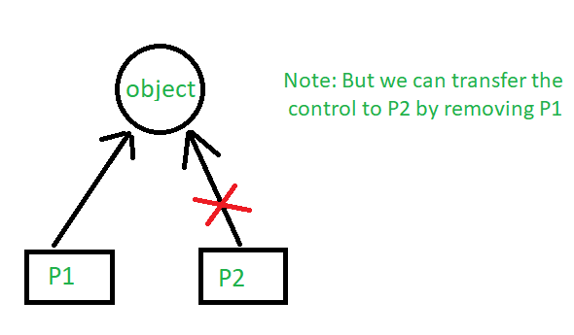
unique_ptr
Allows exactly one owner of the underlying pointer. Use as the default choice for choice unless you know for certain that you require a shared_ptr. Can be moved to a new owner, but not copied or shared.

Slide 4
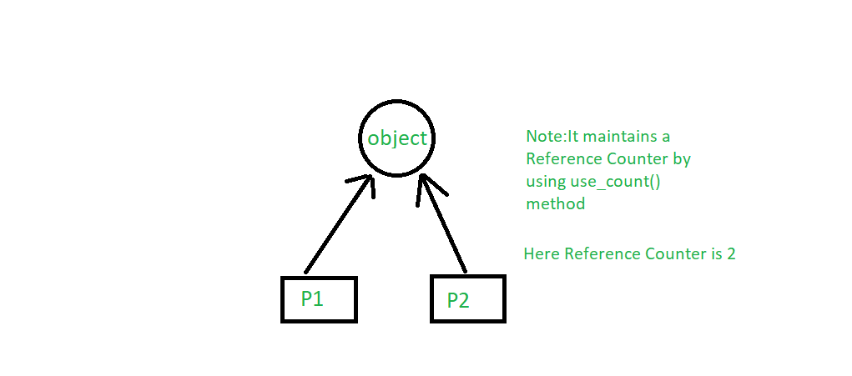
shared_ptr
By using shared_ptr more than one pointer can point to this one object at a time and it’ll maintain a Reference Counter using use_count() method.

Slide 5
weak_ptr
It’s much more similar to shared_ptr except it’ll not maintain a Reference Counter. In this case, a pointer will not have a stronghold on the object. The reason is if suppose pointers are holding the object and requesting for other objects then they may form a Deadlock.

