Slide 1
Arctic-SDI vector tiles pilot & architectures
15th June 2021
Some architectural notes…
Teemu Sipilä, National Land Survey of Finland

Slide 2
Some parts of the workshop agenda...
How to deliver VT data:
Service;
Download
API
Cascading service
Standards and Guidelines to follow when developing VT services
MapBox Vector Tile Specification
OGC API Tiles Core
OGC API Styles
Common guidelines
Others?

Slide 3
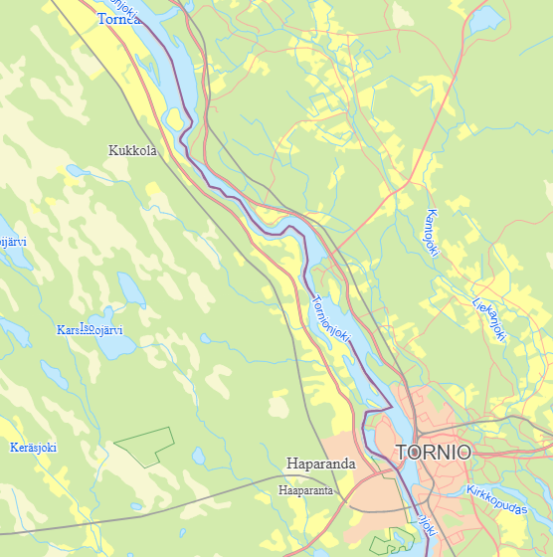
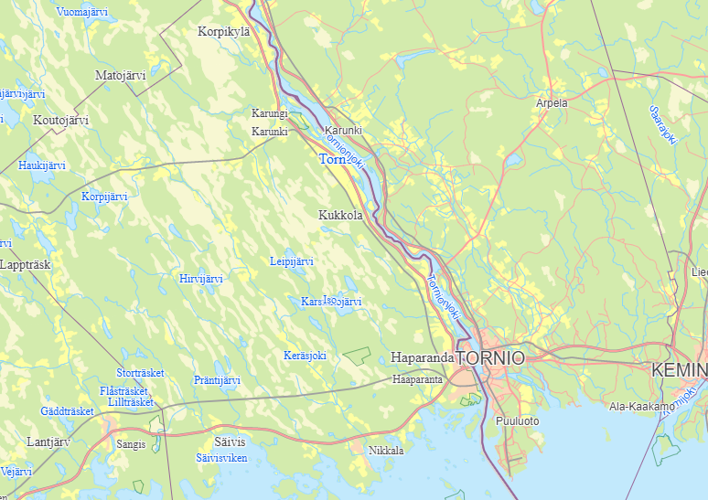
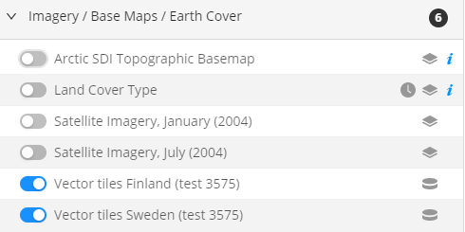
Arctic SDI Geoportal dev – vector tiles
https://geoportaldev.arctic-sdi.org/?zoomLevel=10&coord=651530.6794195516_-2587581.3929899265&
mapLayers=304+100+ASDI_v1,325+100+ASDI_v1&uuid=db032a85-2a5d-41a7-b453-eef493385f83&noSavedState=true&showIntro=false

Slide 4
Vector Tile Pilot – 2019-2020 (Sweden+Finland)
Style files manually copied to geoportal layer/style configurations.
Glyphs (available on service) not currently connected to geoportal.
Arctic SDI geoportal (dev) browser app
Layers/styles configured, mvt-tiles requested as needed
Pilot based on: North_Pole_LAEA_Europe (EPSG:3575)
Style files manually copied to geoportal layer/style configurations.
Glyphs accessed from server?
Geoportal Tile Proxy
HTTP server with Basic Auth
HTTP server without authentication
Symbols
Glyphs/sprites
Style JSON
MapBox Style
WMTS
EPSG:3575 MVT vector tiles
WMTS
EPSG:3575 MVT vector tiles
Symbols
Glyphs
Style JSON
MapBox Style
Sample vector tile request (WMTS): https://****.lantmateriet.se
/vt/asdi/v1/wmts/1.0.0/asdi/default/3575/9/384/287.mvt
https://***.lantmateriet.se/vt/asdi/v1/style/style_asdi-3575.json
Sample WMTS: https://beta-karttakuva.maanmittauslaitos.fi/vt/asdi/
wmts/1.0.0/asdi/default/latest/North_Pole_LAEA_Europe/8/195/144.pbf
Supported projection/tile matrix sets: North_Pole_LAEA_XX (EPSG:357x)
WGS84_Pseudo-Mercator (EPSG:3857), ETRS-TM35FIN (EPSG:3067)
Vector tiles pilot service (Sweden)
Vector tiles pilot service (Finland)

Slide 5
Cascading vector tiles service?
Vector tiles pilot (Sweden+Finland) architecture
National VT services + “cascading” on the client (geoportal dev)
Cross-organizational cascading service for vector tiles?
Schemas, styles, projections/tile matrix sets must be harmonized if cascading service proxies / combines tiles from national vt services
Projection/tile matrix sets needed?
OGC API Features based solution?
National OGC API Features / WGS 84 only
Cascading vector tile services
Reads features from national services
Provides vector tiles and styles in multiple projections / tile matrix sets
WGS84_Pseudo-Mercator (EPSG:3857)
North_Pole_LAEA_BeringSea (EPSG:3571)
North_Pole_LAEA_Alaska (EPSG:3572)
North_Pole_LAEA_Canada (EPSG:3573)
North_Pole_LAEA_Atlantic (EPSG:3574)
North_Pole_LAEA_Europe (EPSG:3575)
North_Pole_LAEA_Russia (EPSG:3576)

Slide 6
One option for Arctic SDI vector tiles architecture?
Client X
MVT based
Arctic SDI geoportal browser app
Layers/styles and mvt-tiles requested as needed
Web Mercator? All North_Pole_LAEA_XX projections?
Client Y
OGC API Tiles/Styles?
HTTP server without authentication
Static / dynamic tile cache
WMTS / OGC API Tiles
MVT (or other) vector tiles, different projections/tile matrix sets
Symbols
Glyphs/sprites
Style JSON
MapBox Style
OGC API Styles?
Configuration to national OGC API Feature services, any mappings to harmonized schemas, etc.
Harmonized common data, ie. country borders
Cascading Vector tiles
Access features, clip as needed, combine features, generate vt
Cascading and centralized
vector tile service
OGC API Features (GeoJSON)
Small-scale topographic data / WGS 84
OGC API Features (GeoJSON)
Small-scale topographic data / WGS 84
OGC API Features (GeoJSON)
Small-scale topographic data / WGS 84
National service A
National service B
National service C

