Slide 1
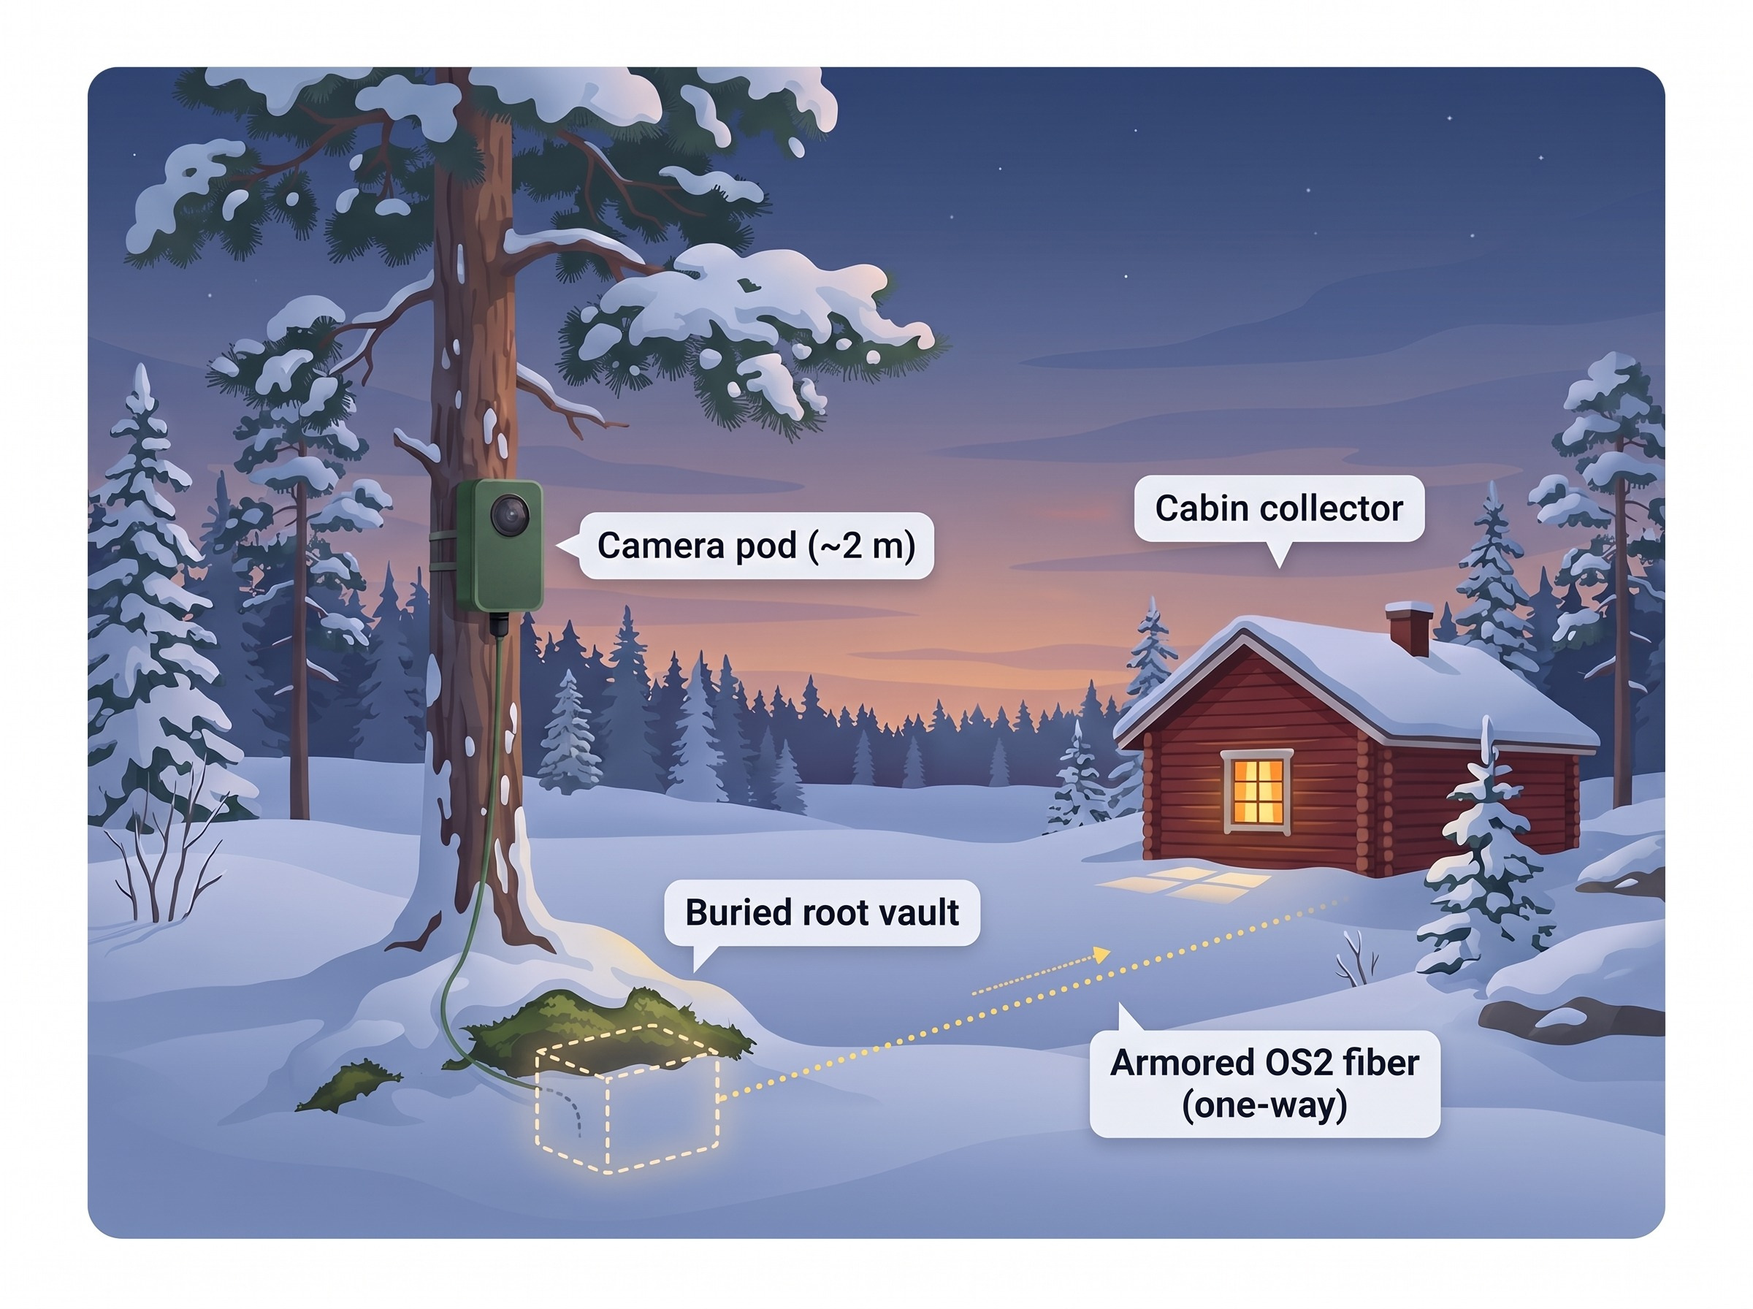
Arctic Trail Cam & Message Relay System
Off-grid detection, signed imaging and one-way delivery for remote sites
v0.9-beta experimental prototype · 20 Oct 2026

Slide 2
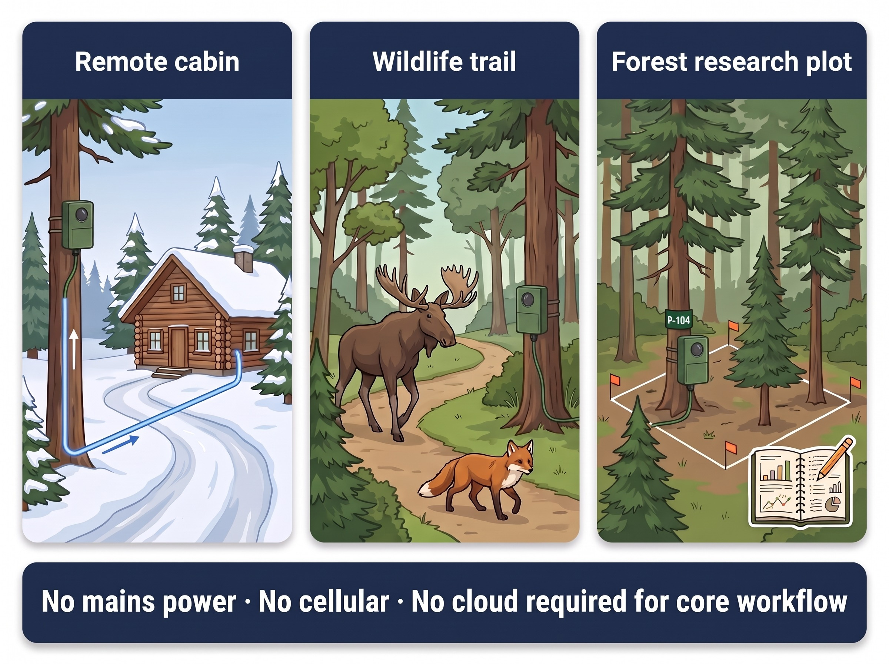
Purpose: Evidence-Quality Images Off-Grid
Who it serves: remote cabin owners, wildlife-trail observers and forest research plots in eastern and northern Finland
What it does: wakes on a qualifying event, takes a 1080p photo, analyses it locally, signs it and sends it one way to a local collector
Design priorities: very low standby power, small visual footprint, no return path into the field node, no SIM card or subscription
Status: v0.9-beta. Software and Stage 1–3 bench bring-up verified. Field performance not yet demonstrated

Slide 3
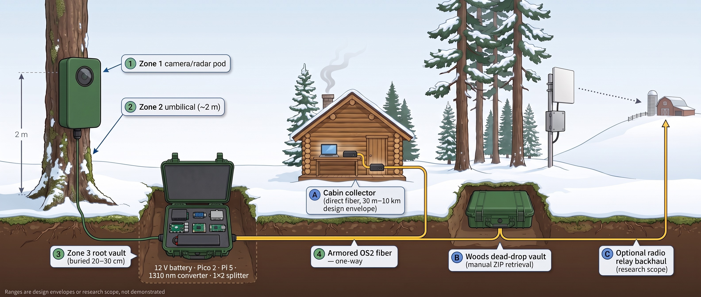
Complete Landscape Architecture: Sense at the Tree, Decide at the Roots, Deliver One Way

Slide 4
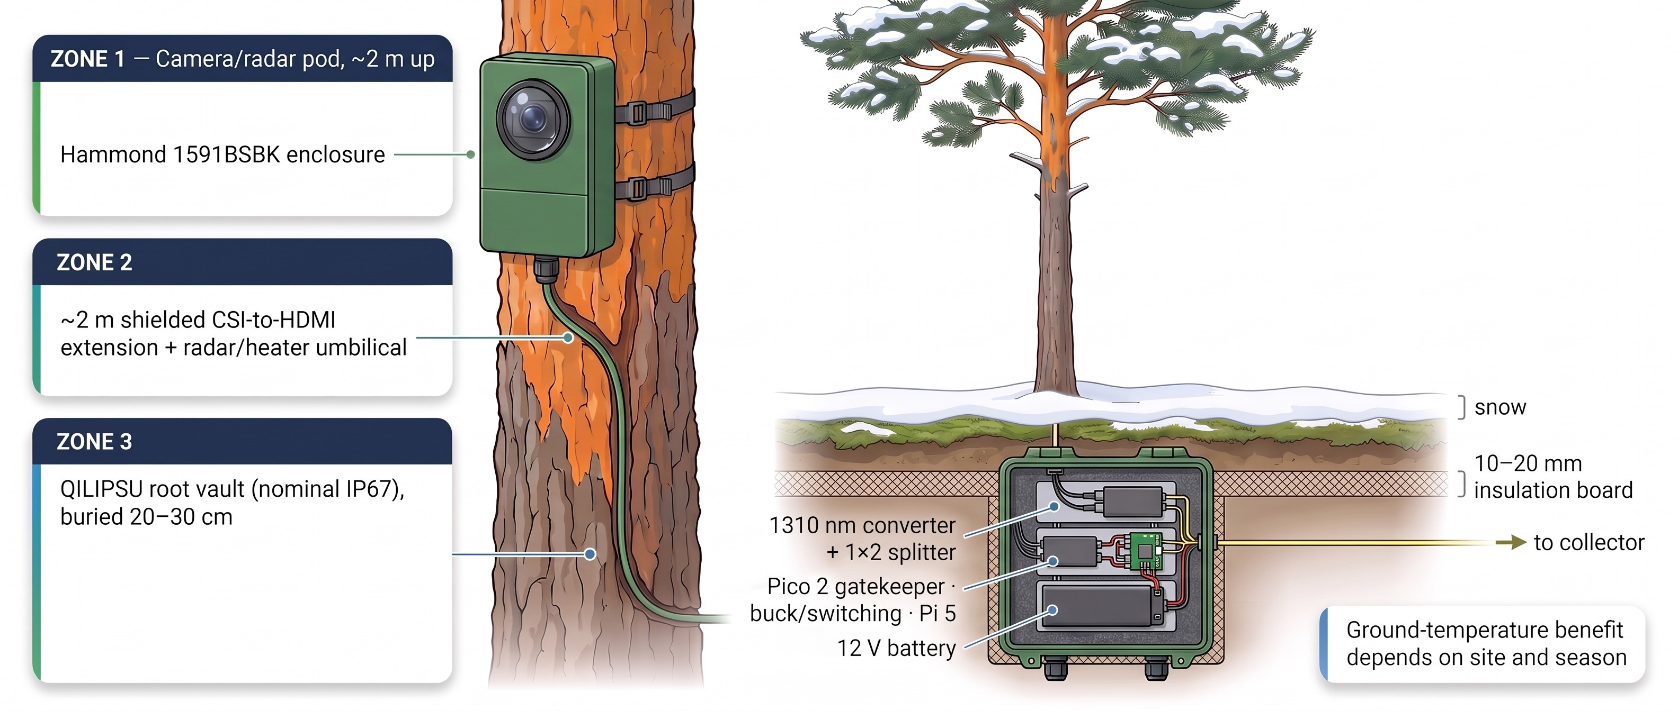
Three-Zone Tree Cutaway: A Small Eye Up High, the Heavy Parts Buried Below

Slide 5
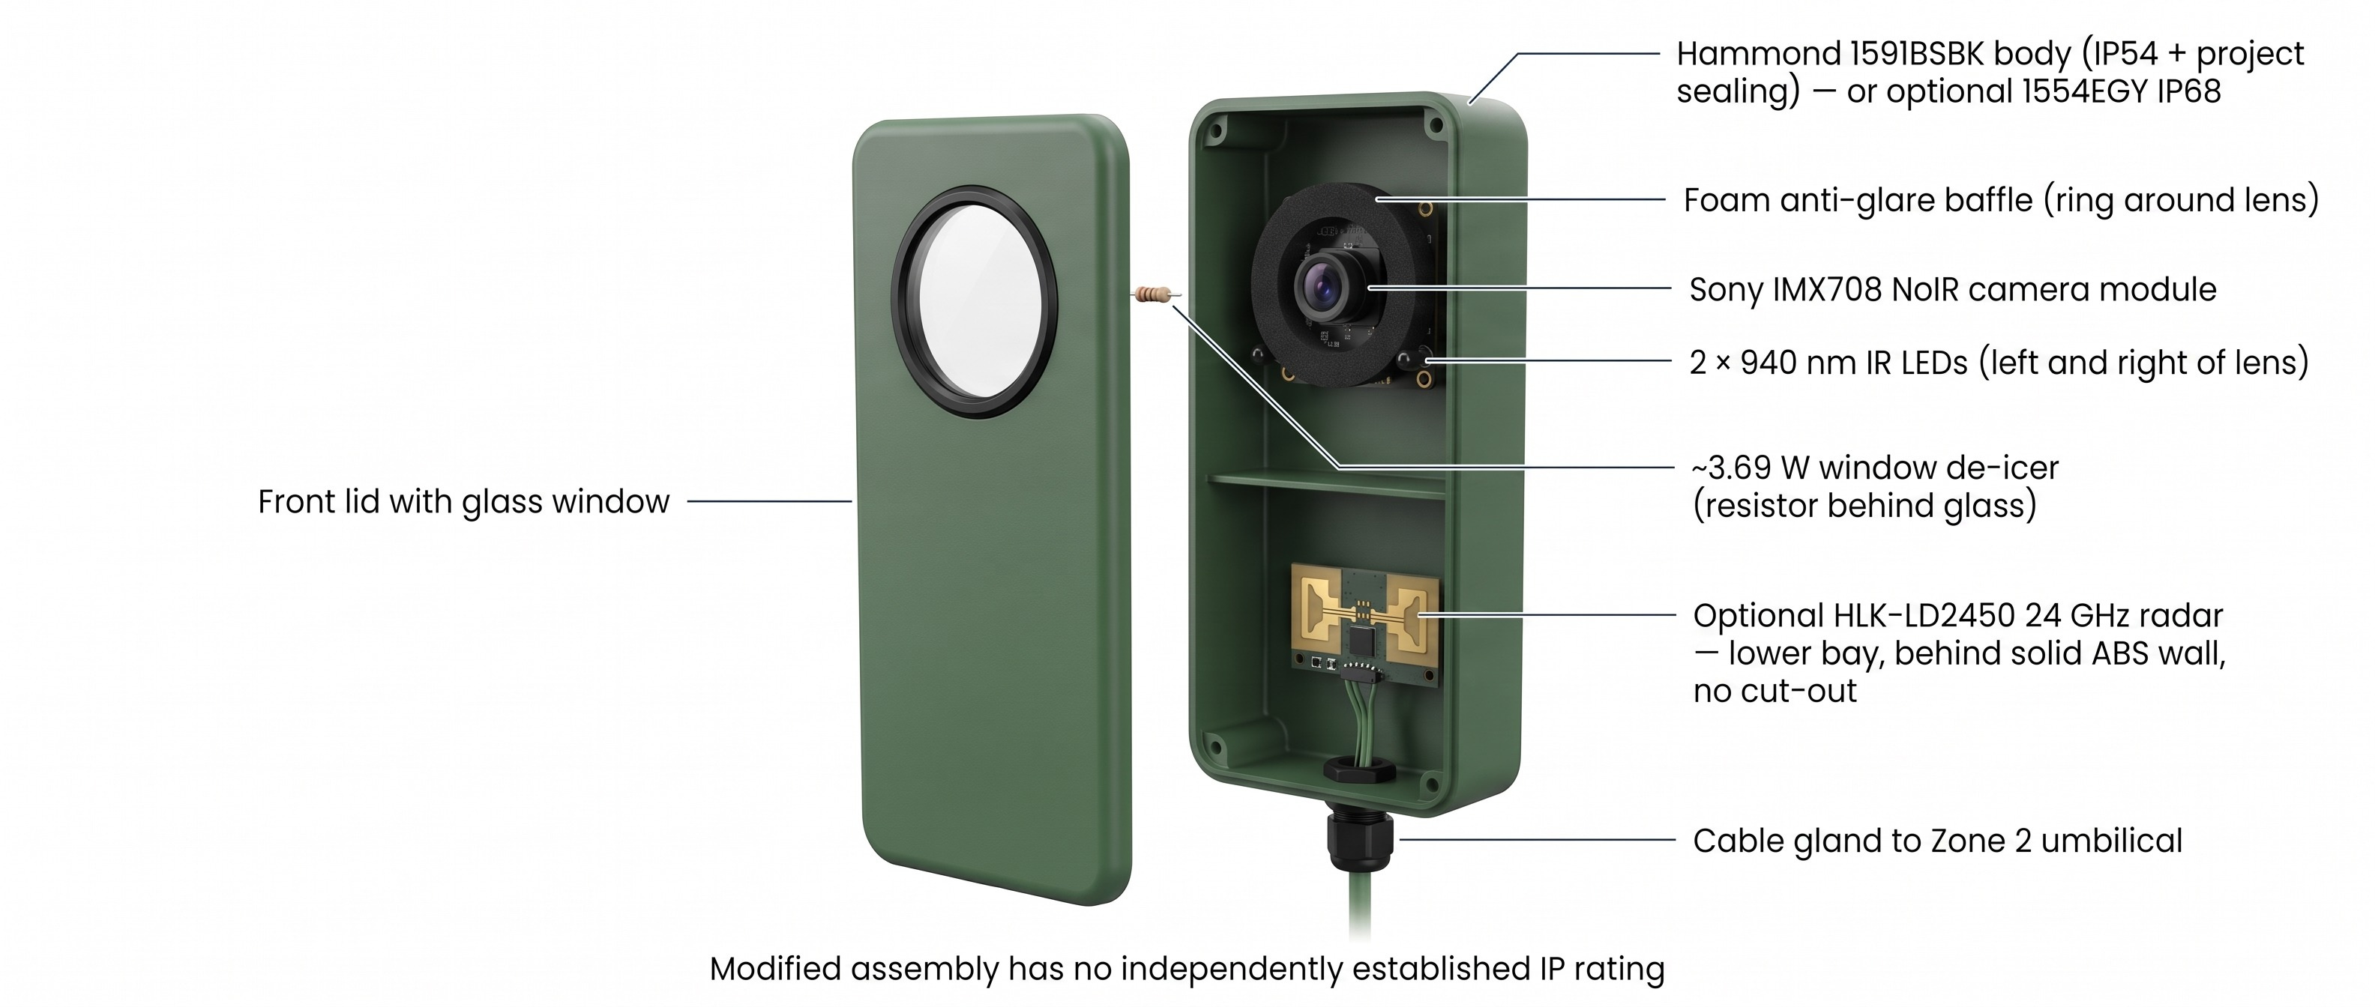
Camera Pod Exploded View: One Window, One Camera, Hidden Radar

Slide 6
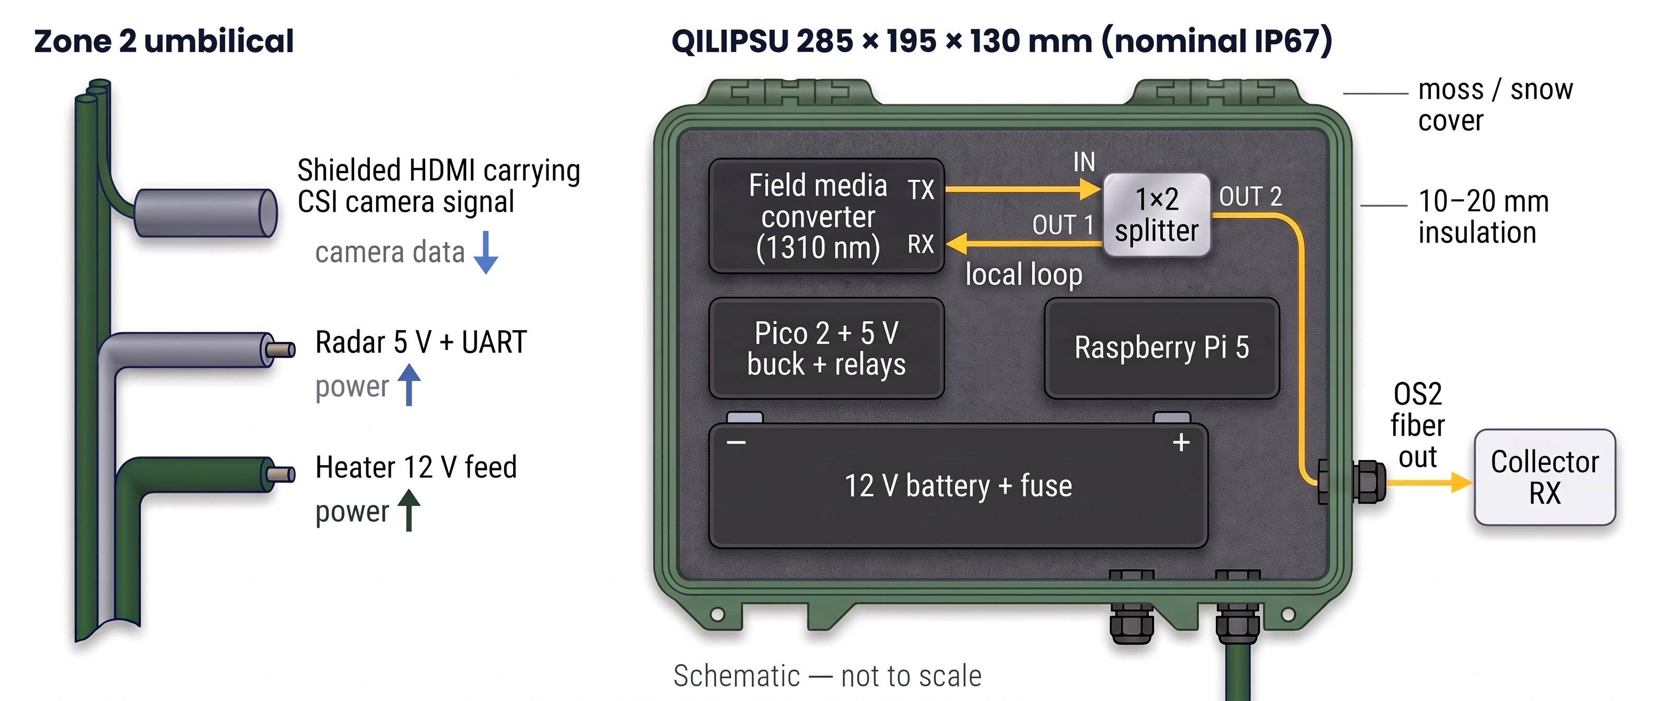
Umbilical and Root Vault: Power Goes Up, Camera Data Comes Down

Slide 7
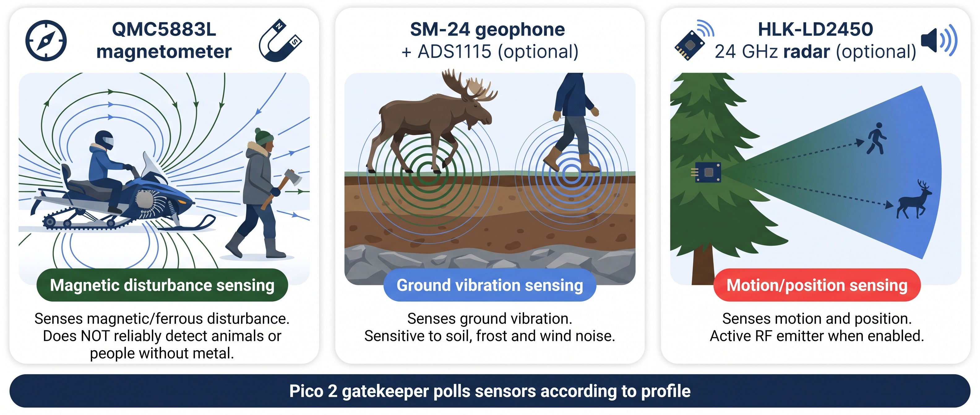
Sensor Roles: Three Different Physical Signals, Each with Blind Spots

Slide 8
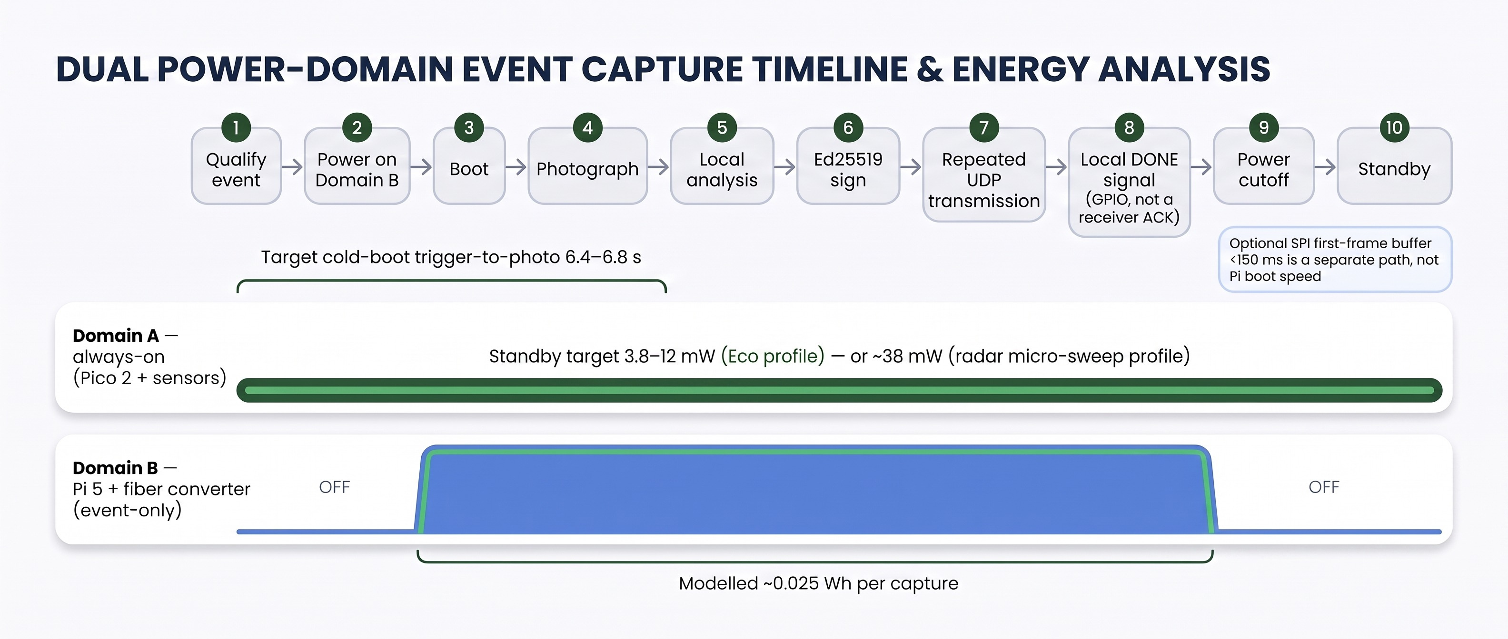
Wake and Power Sequence: The Pi 5 Is Off Until an Event Qualifies

Slide 9
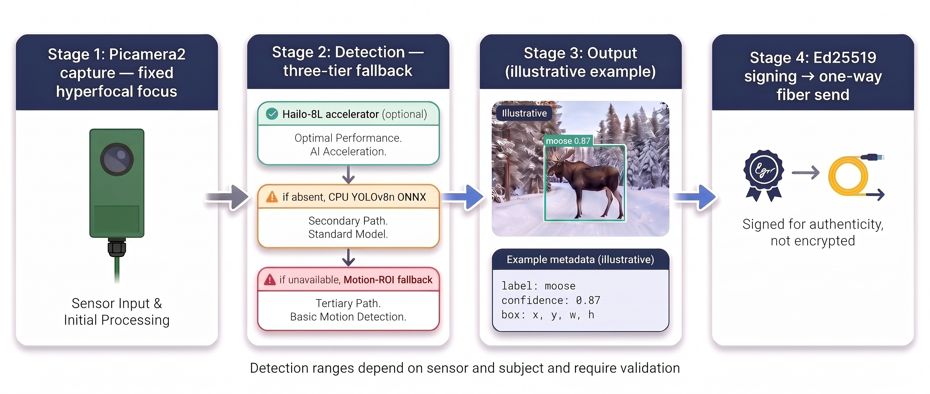
Capture and Local AI: Detection Runs at the Tree, Not in a Cloud

Slide 10
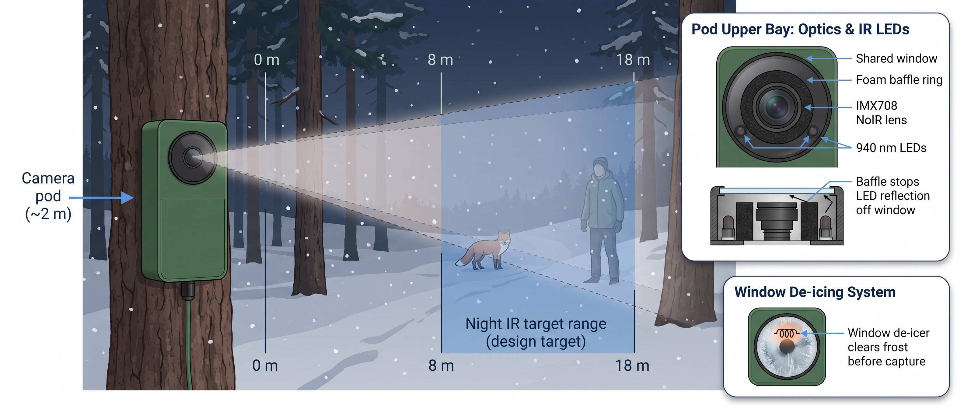
Night Imaging: Invisible 940 nm Light and a Baffle Against Window Glare

Slide 11
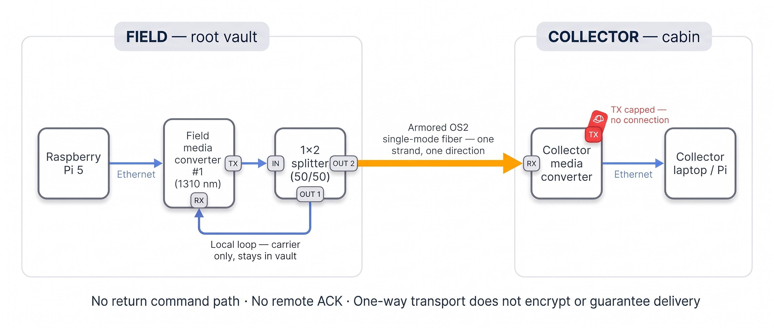
Optical Diode: The Local Loop Keeps the Link Up; Only One Strand Leaves the Tree

Slide 12
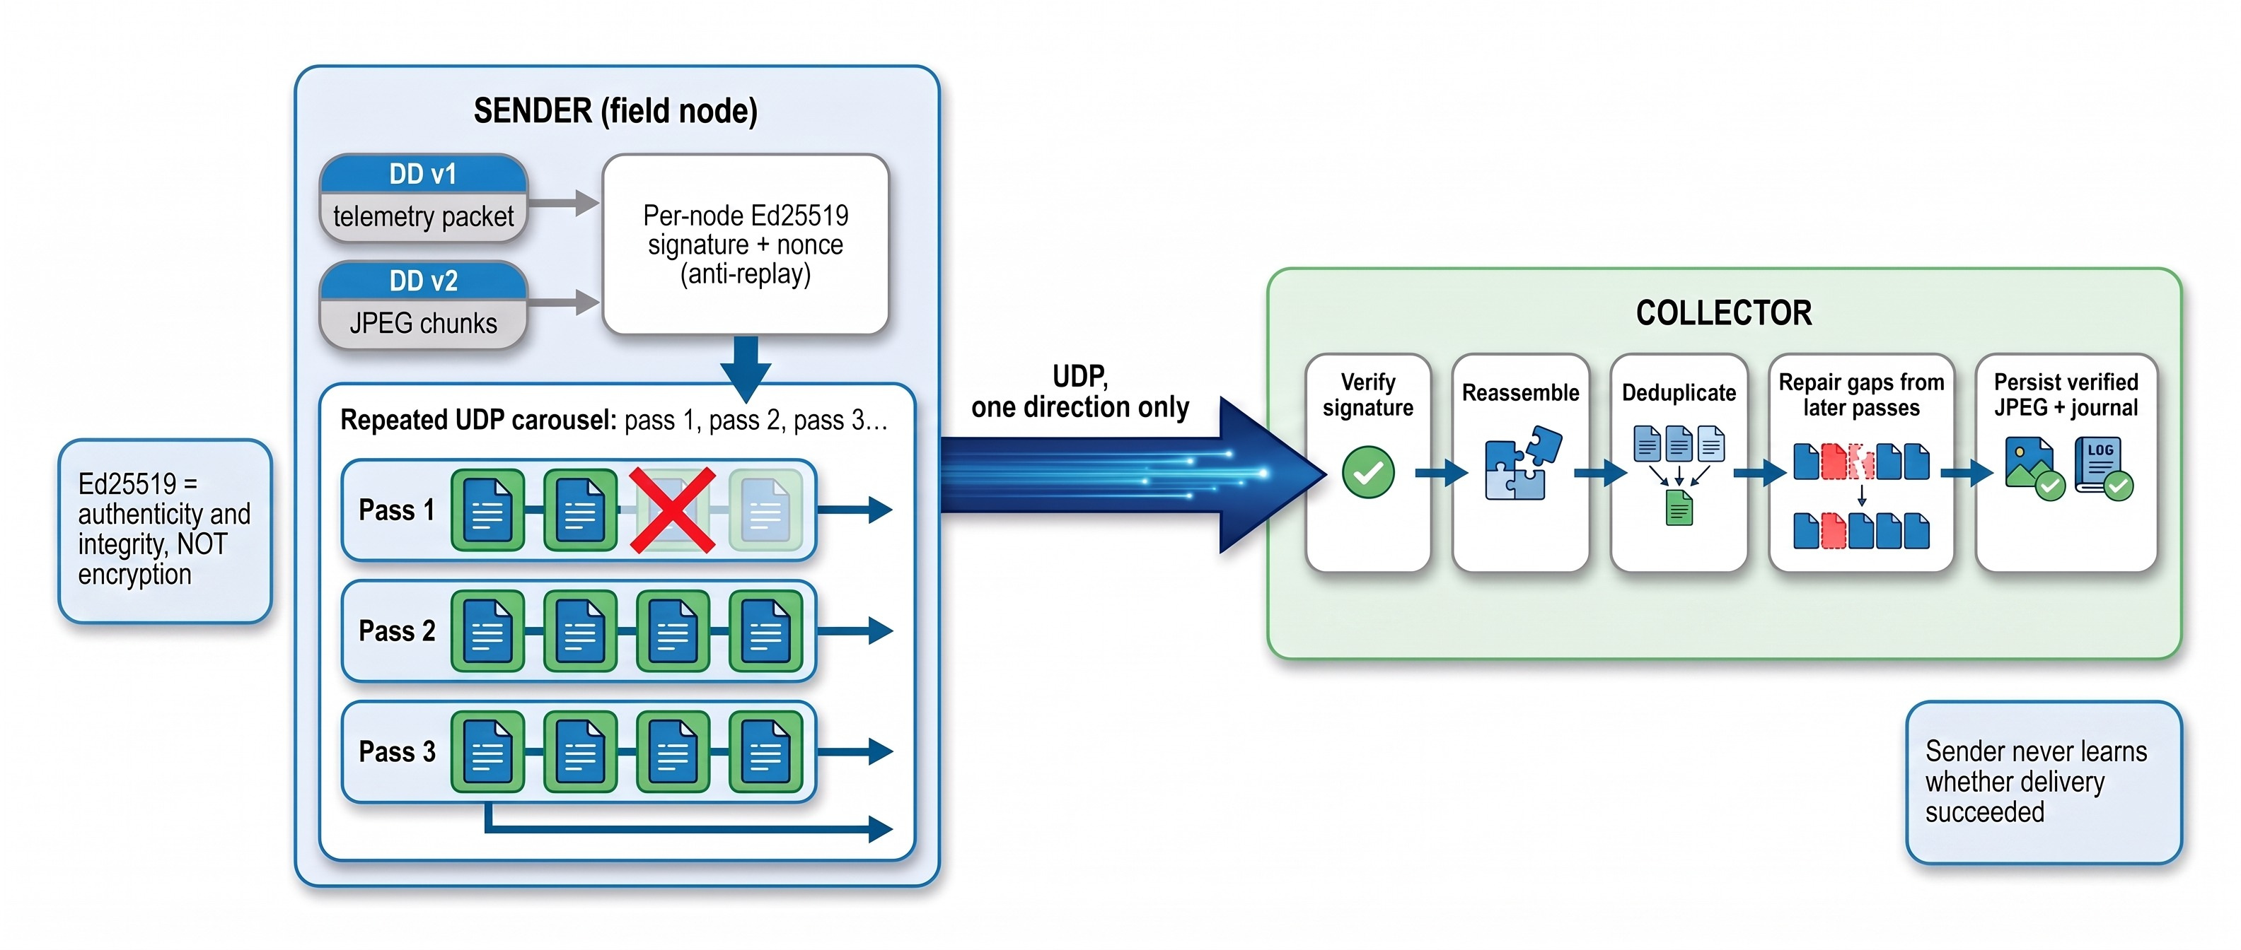
Signed Message Journey: Repetition Replaces Acknowledgement

Slide 13
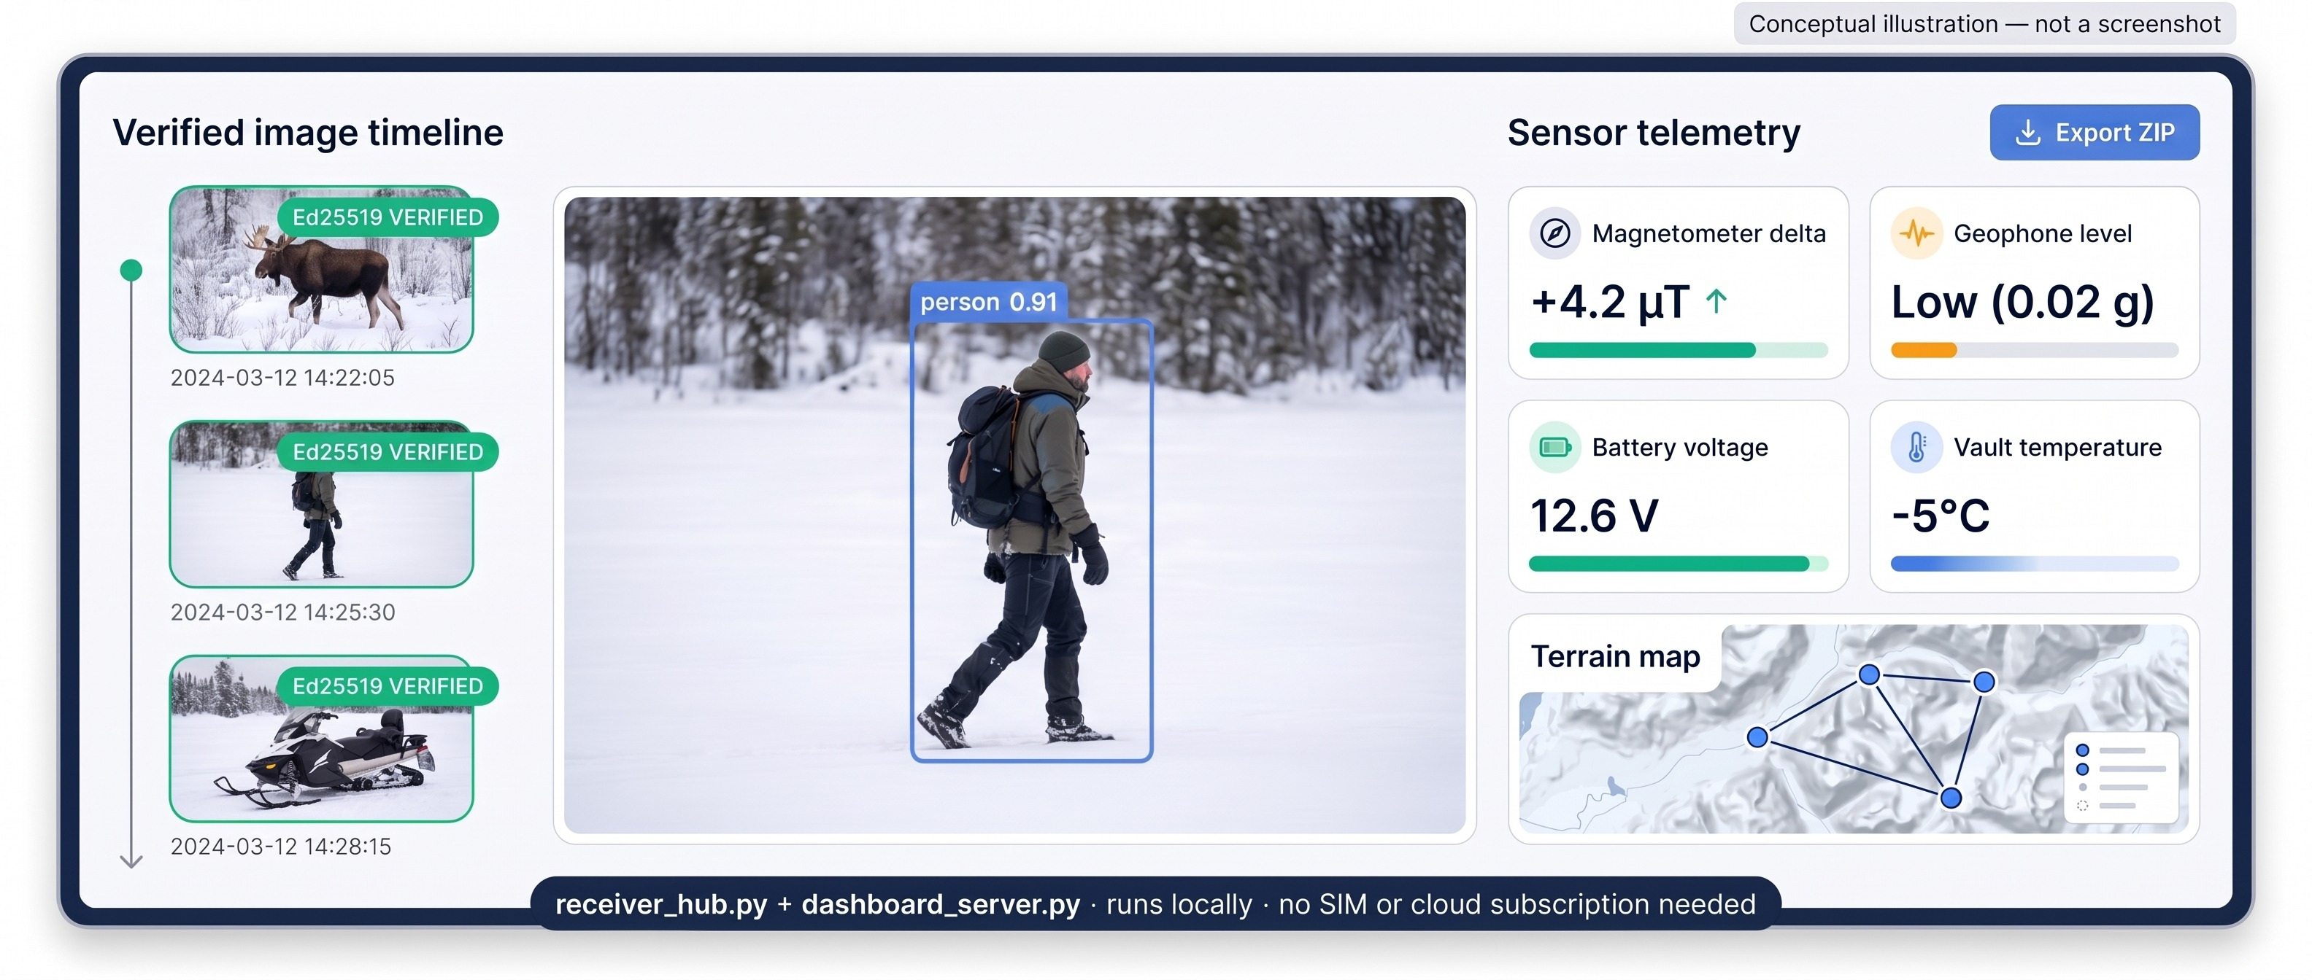
Collector Experience: An Offline Browser Console at the Cabin

Slide 14
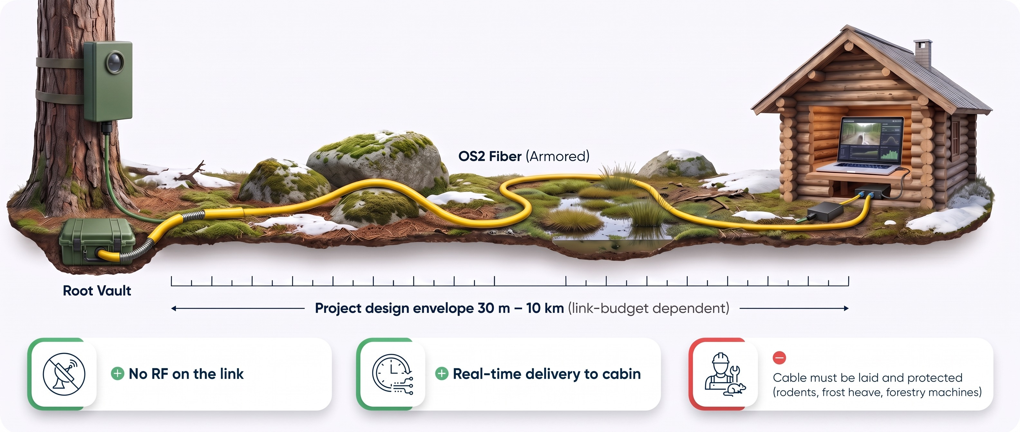
Configuration 1 — Direct Fiber: The Simplest Path When the Cabin Is Within Reach

Slide 15
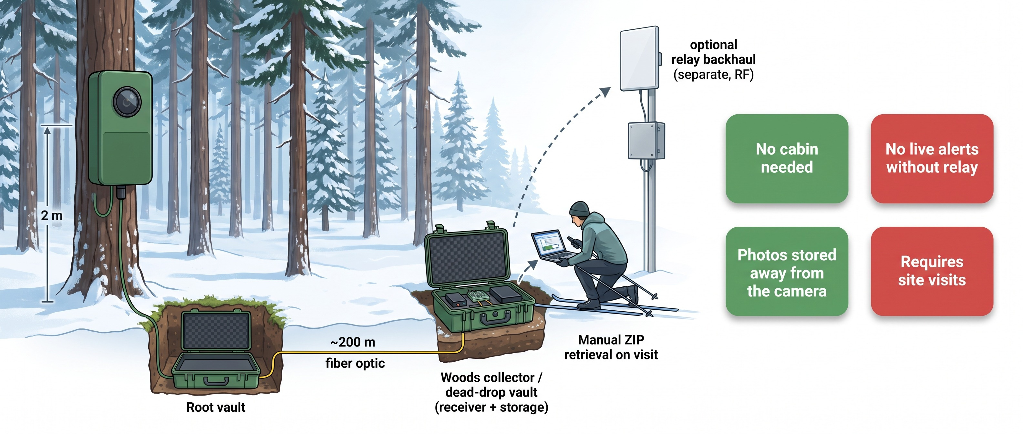
Configuration 2 — Woods Dead-Drop: Images Survive Even If the Pod Does Not

Slide 16
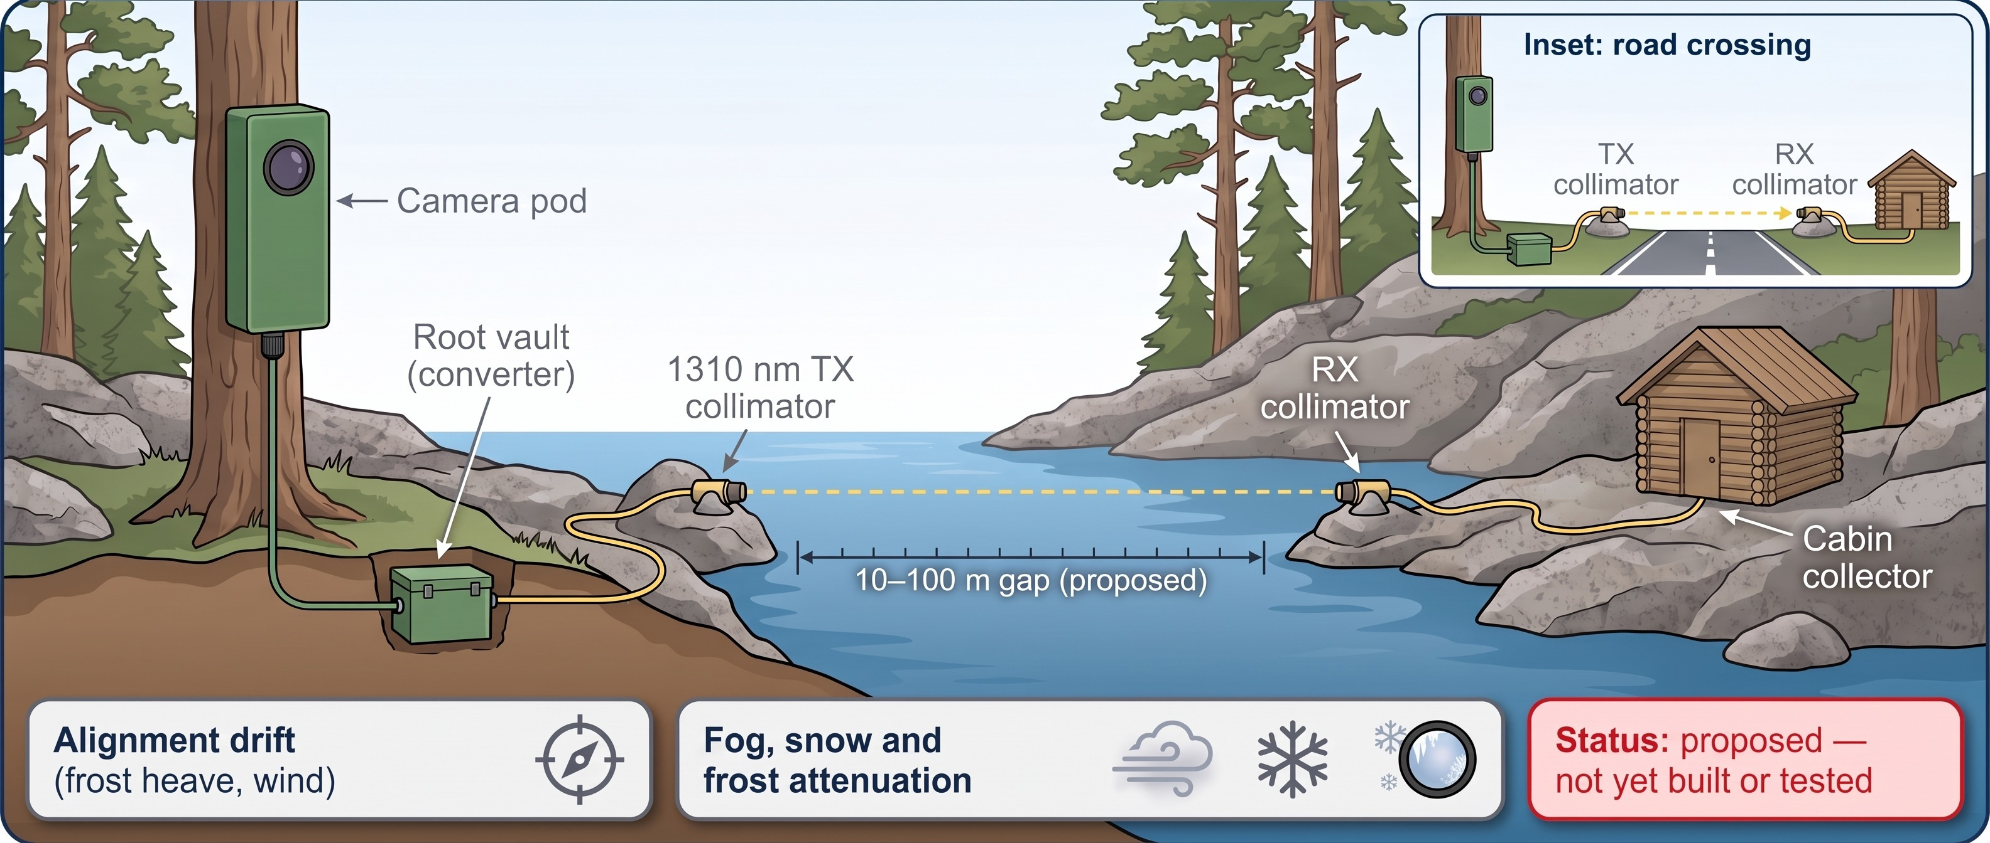
Configuration 3 — Optical Water Bridge (Proposed): Crossing a Gap Without Cable

Slide 17
Relay Choices: Match the Path to the Gap
Option | Distance basis | RF emitted? | Main constraint | Status
Direct OS2 fiber | 30 m–10 km design envelope | No (optical) | Cable laying and protection | Bench diode reported
Woods dead-drop | ~200 m fiber standoff | No (optical) | Manual retrieval | Design
Optical water bridge | 10–100 m gap | No (1310 nm light) | Alignment, weather | Proposed
Build D radio relay | 200 m–20 km research scope | Yes (2.4 GHz) | Authorization, throughput | Hardware ordered; trials pending
868/915 MHz backhaul | Not quantified | Yes | Authorization, low data rate | Optional
Optical Builds A/B/C | Research alternatives | No | Research-stage | Out of scope here

Slide 18
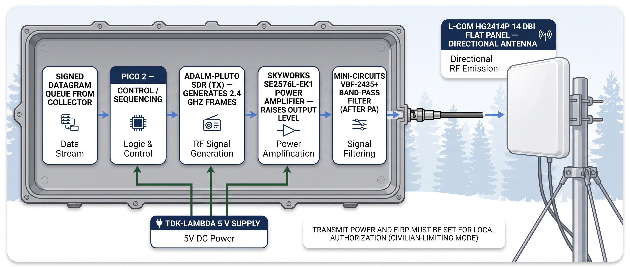
Build D Transmitter: SDR Signal Shaped, Amplified, Filtered and Aimed

Slide 19
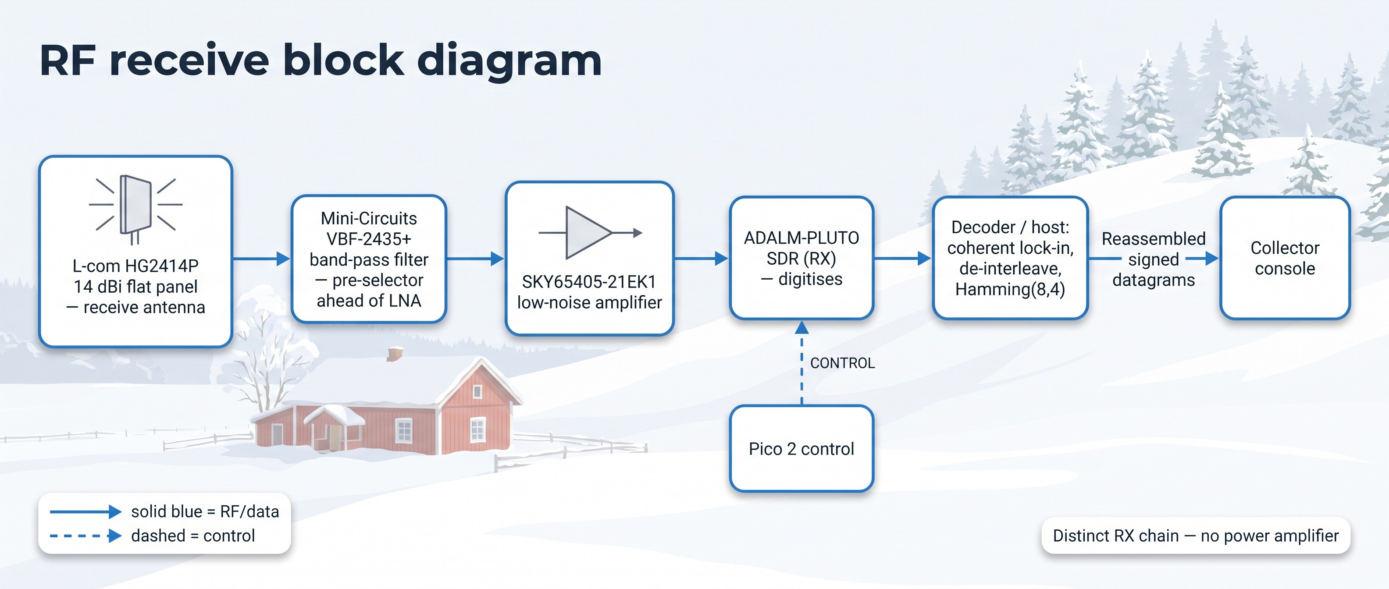
Build D Receiver: Filter First, Then Amplify the Faint Scattered Signal
Power: regulated 5 V to Pico 2, LNA and SDR; host supply as required. Band-pass filter is passive.

Slide 20
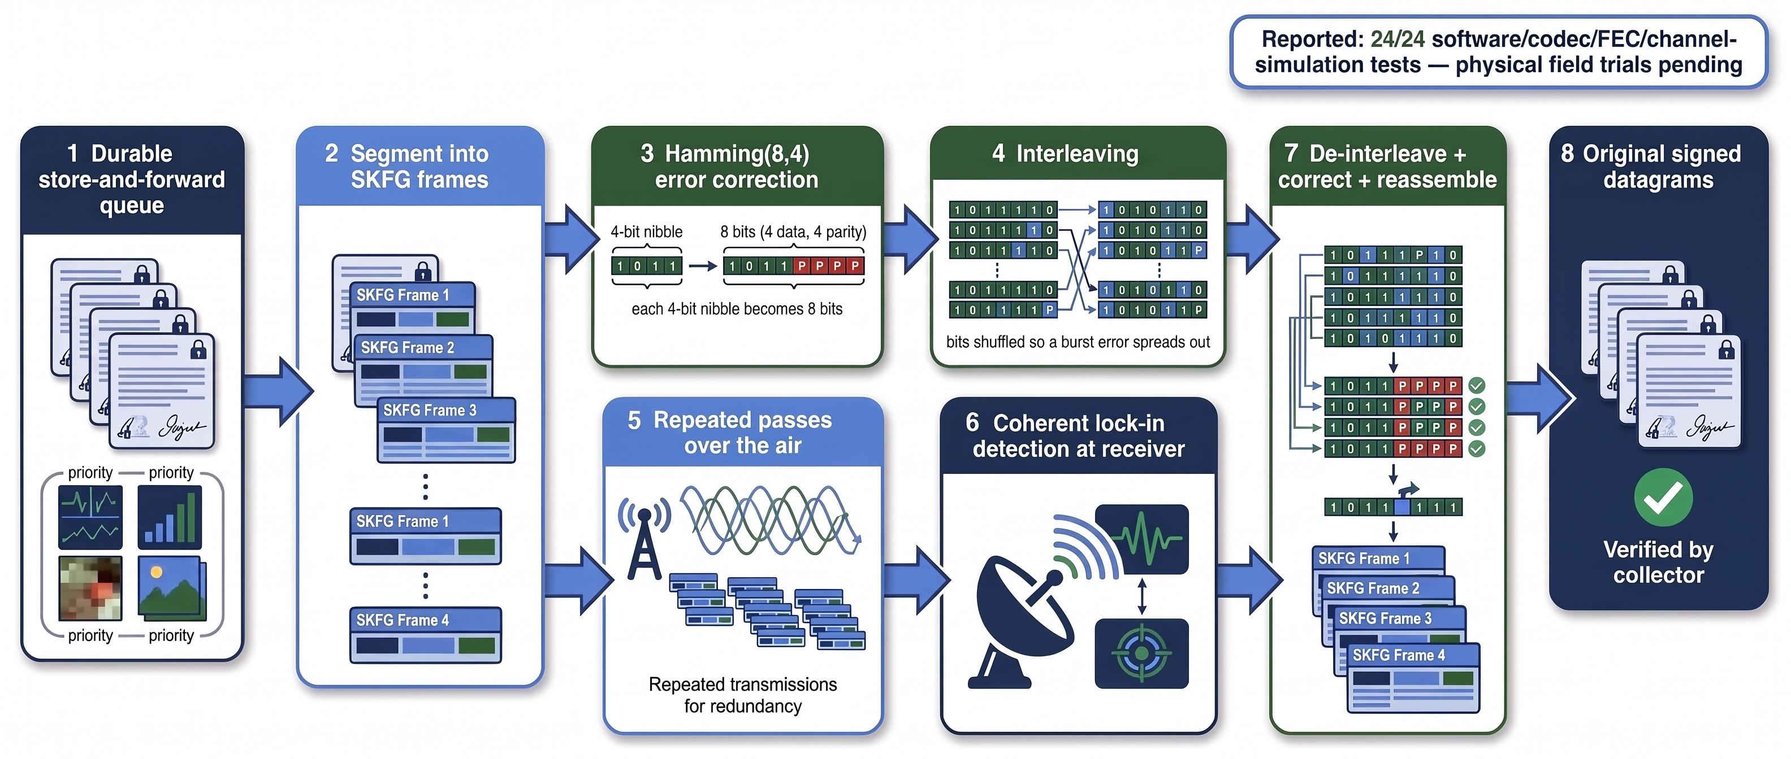
Store-and-Forward with Error Correction: Small, Robust Pieces, Sent Repeatedly

Slide 21
Range and Throughput Limits: What the Relay Can and Cannot Claim Today
Reported scope
200 m–20 km non-line-of-sight canopy/scatter paths are model and research scope
SNR figures in project PDFs are model outputs
24/24 software/codec/FEC/channel-simulation tests reported; Build D hardware ordered
Physical relay field trials: pending
Not claimed
No live video and no instantaneous full-image delivery at 20 km
Throughput and delivery latency need measurement
Delivery is not guaranteed; prioritise small messages and crops
Weather and season effects on the path are unmeasured
🔗
Relay sizing has to wait for throughput logs from longer test paths

Slide 22
Emissions Boundary: Not a Zero-RF System
Element | Emits | Notes
Optical data link (fiber / collimator) | 1310 nm light, no RF | Light stays inside the fiber, except across the proposed open-air bridge
Magnetometer, geophone | Nothing intentional | Passive sensing
24 GHz radar (if enabled) | RF | Optional; can be disabled
Build D 2.4 GHz relay | RF | Optional; authorization required
868/915 MHz backhaul | RF | Optional
940 nm IR LEDs | Infrared light | Visible to IR-sensitive cameras
Pi 5 Wi-Fi / Bluetooth | RF if left on | Disable for a no-intentional-RF profile
Passive sensing + optical transport, with Wi-Fi/BT off, avoidsintentionalRF. The system is not zero-RF, undetectable, jam-proof or guaranteed all-weather.

Slide 23
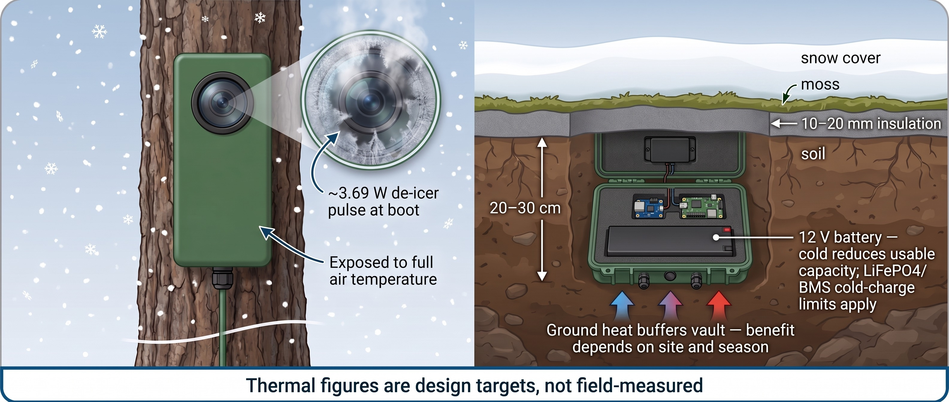
Arctic Thermal Design: Heat the Window Briefly, Keep the Battery Below the Snow

Slide 24
Battery Life Projections by Capture Rate and Season
Projected battery life (days) — model projections, not field-measured
Assumptions behind the projections
Standby draw (3.8–12 mW Eco target)
Capture rate (~0.025 Wh per capture, modelled)
Usable capacity and cold derating
Self-discharge over months
High-traffic LiFePO4 runtime depends on winter recharge profile
Battery/BMS cold-charge limits apply
Scenario | Lower (days) | Upper (days)
AGM 12 Ah · 10 photos/month · three-season | 365 | 480
AGM 12 Ah · 10 photos/month · winter | 270 | 365
AGM 12 Ah · 10 photos/day | 120 | 220
LiFePO4 15–24 Ah · 10 photos/month | 565 | 900+
All values are source projections, not measurements. LiFePO4 "900+": the source gives an open-ended upper figure of at least 900 days; no higher value is stated.

Slide 25
BOM Tiers: A Field Node Plus Fiber Costs About $600; the Radio Relay Is a Separate $1,342
Project BOM snapshot (US$) — not a current quote
$598.20 covers camera + 30 m fiber + cabin RX + listed cables and adapters. It excludes the relay
$1,341.94 is the Build D TX+RX parts subtotal, separate
Labor, shipping, taxes, host equipment and optional items may come on top
Snapshot prices, not latest quotes
Tier | US$
Core bench | 233.37
Bench + diode | 402.67
Weatherproof field node only | 497.25
Camera + 30 m fiber + cabin RX + cables/adapters | 598.20
Build D relay TX+RX pair (separate, not included above) | 1,341.94

Slide 26
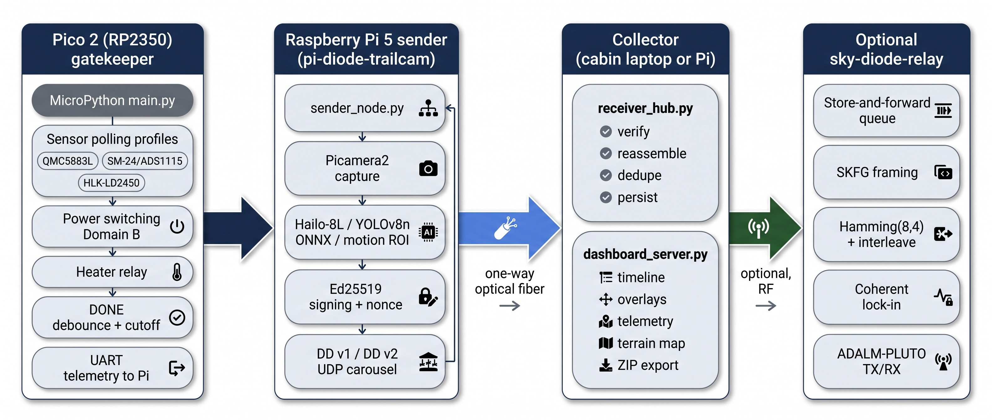
Software Map: Who Runs What, Where

Slide 27
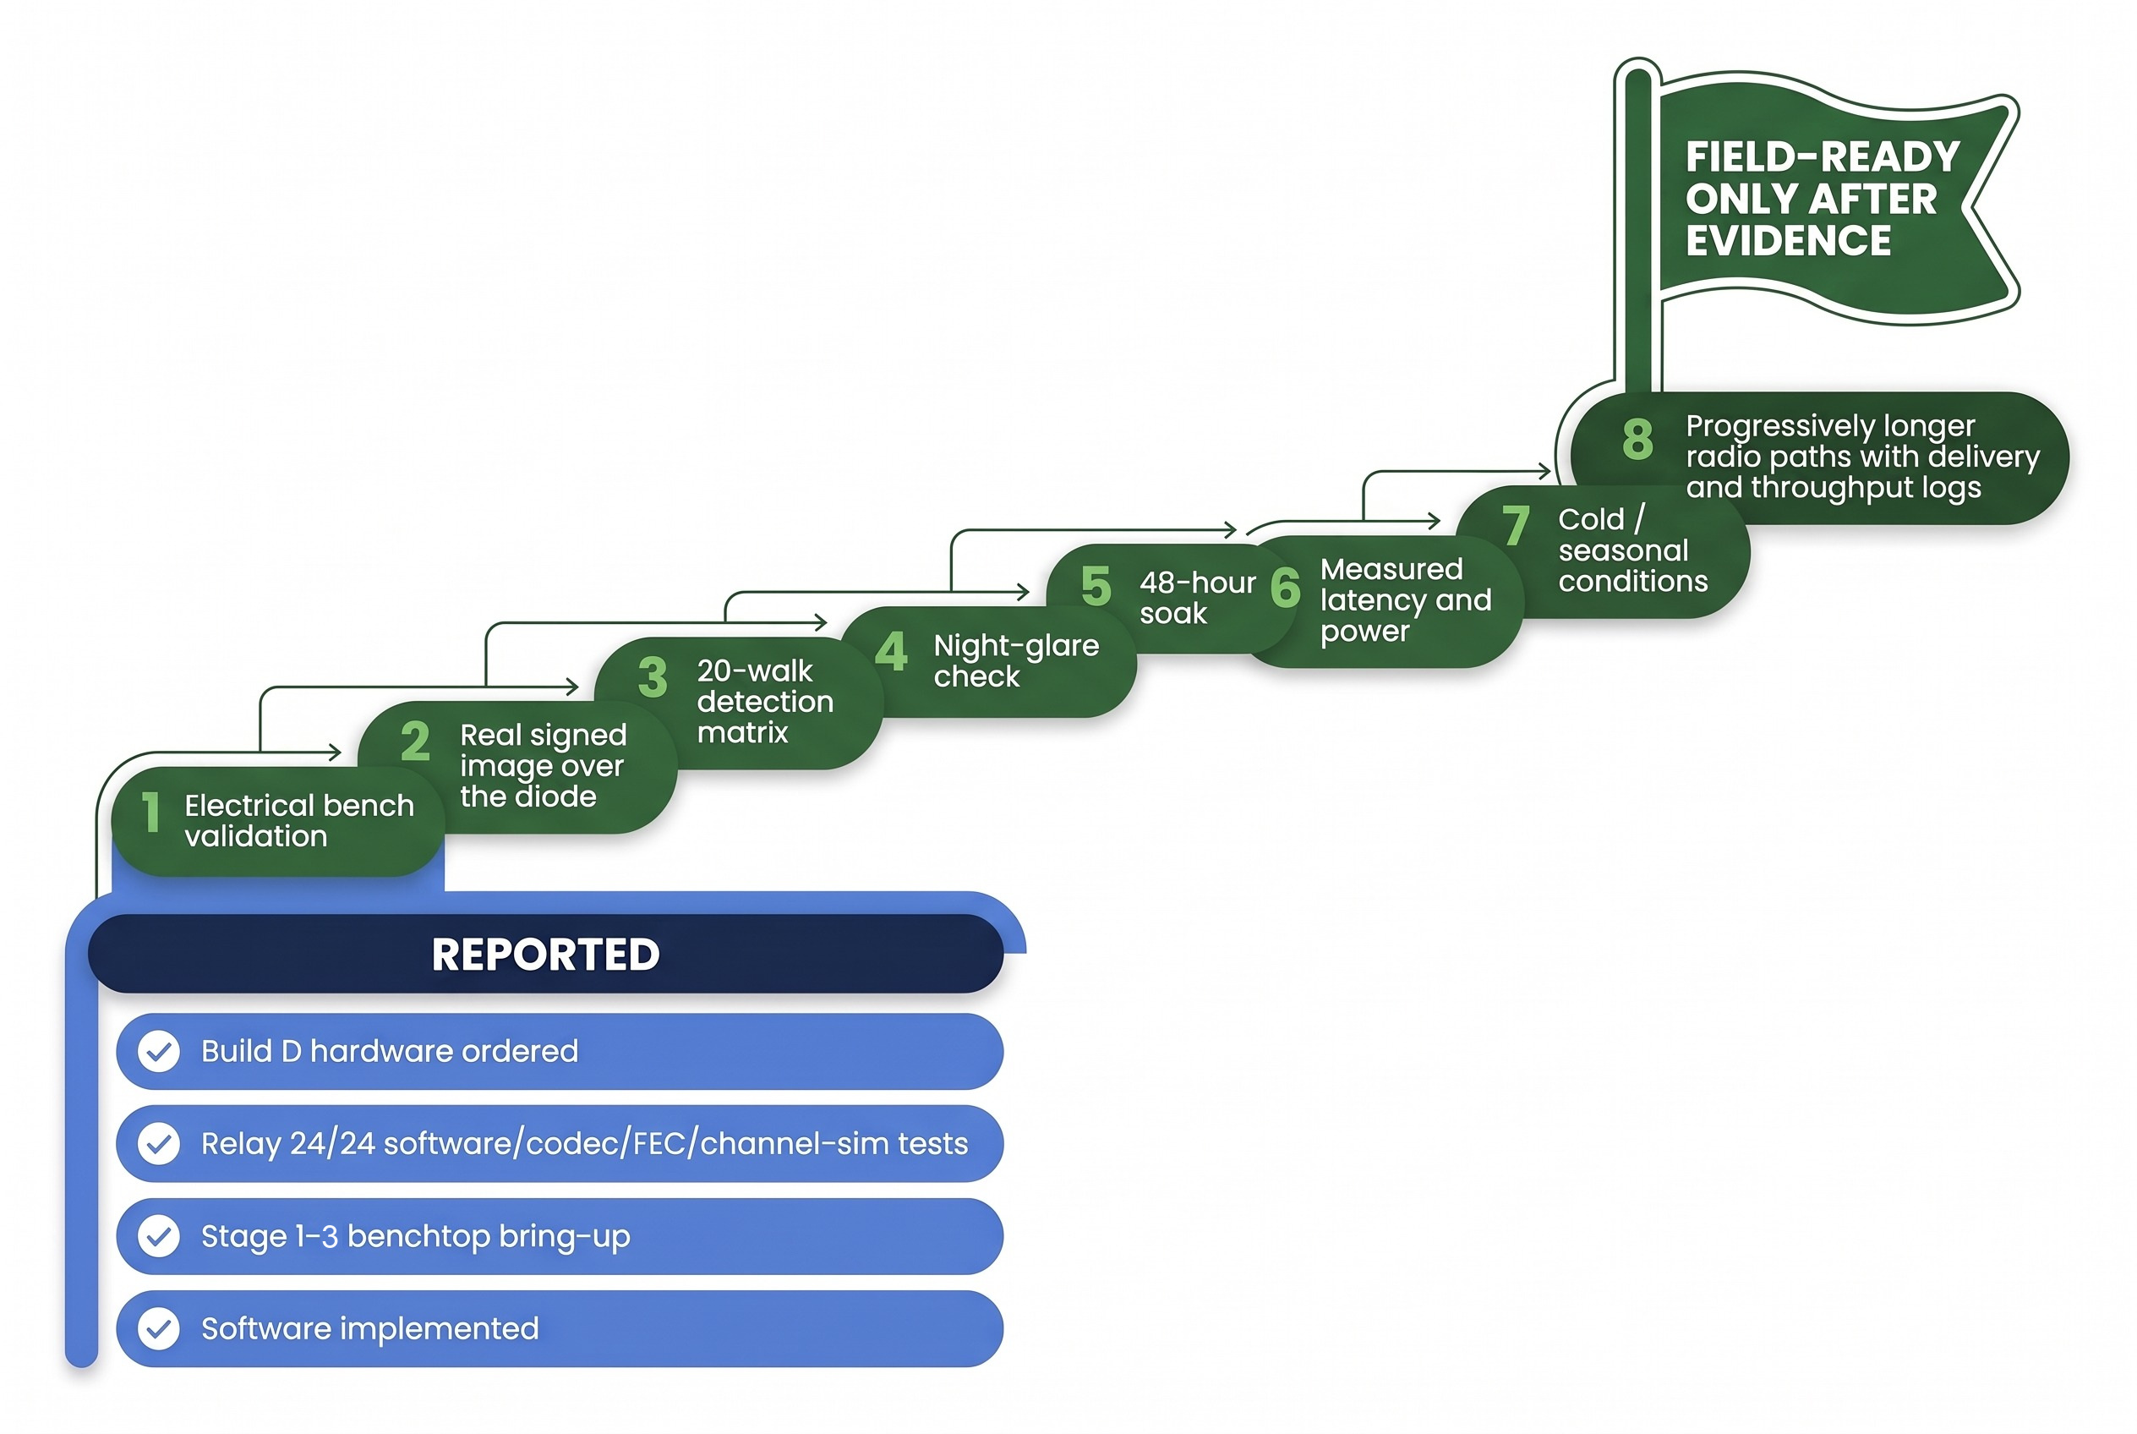

Validation Roadmap: Bench Work Reported; Field Evidence Still to Come
Reported bench build (project photo)
Stage 2 powered bench system, Build & Field Guide p.9

Slide 28
Source Map and Open Questions
Sources (in order of precedence)
Project root README, pi-diode-trailcam README, sky-diode-relay README and relay field-readiness guide (docs/FIELD_READINESS_AND_VALIDATION_GUIDE.md). These govern
Executive Overview PDF (6 pp.): architecture, zones, Build D illustrations
Build & Field Guide PDF (55 pp.): 72-photo Stage 1–3 bench log, wiring, diode topology, collector commands
Source basis
Repository README and PDF manuals govern this deck; performance figures remain design projections or research targets where marked.
Open questions
Is the splitter-loop link stable over real fiber lengths?
What IP rating does the sealed pod actually achieve?
What are the vault temperatures by season and site?
What is the magnetometer false-trigger and miss rate per site?
What relay throughput and latency can be measured, by season?
What authorization path applies to each RF mode?

