Slide 1
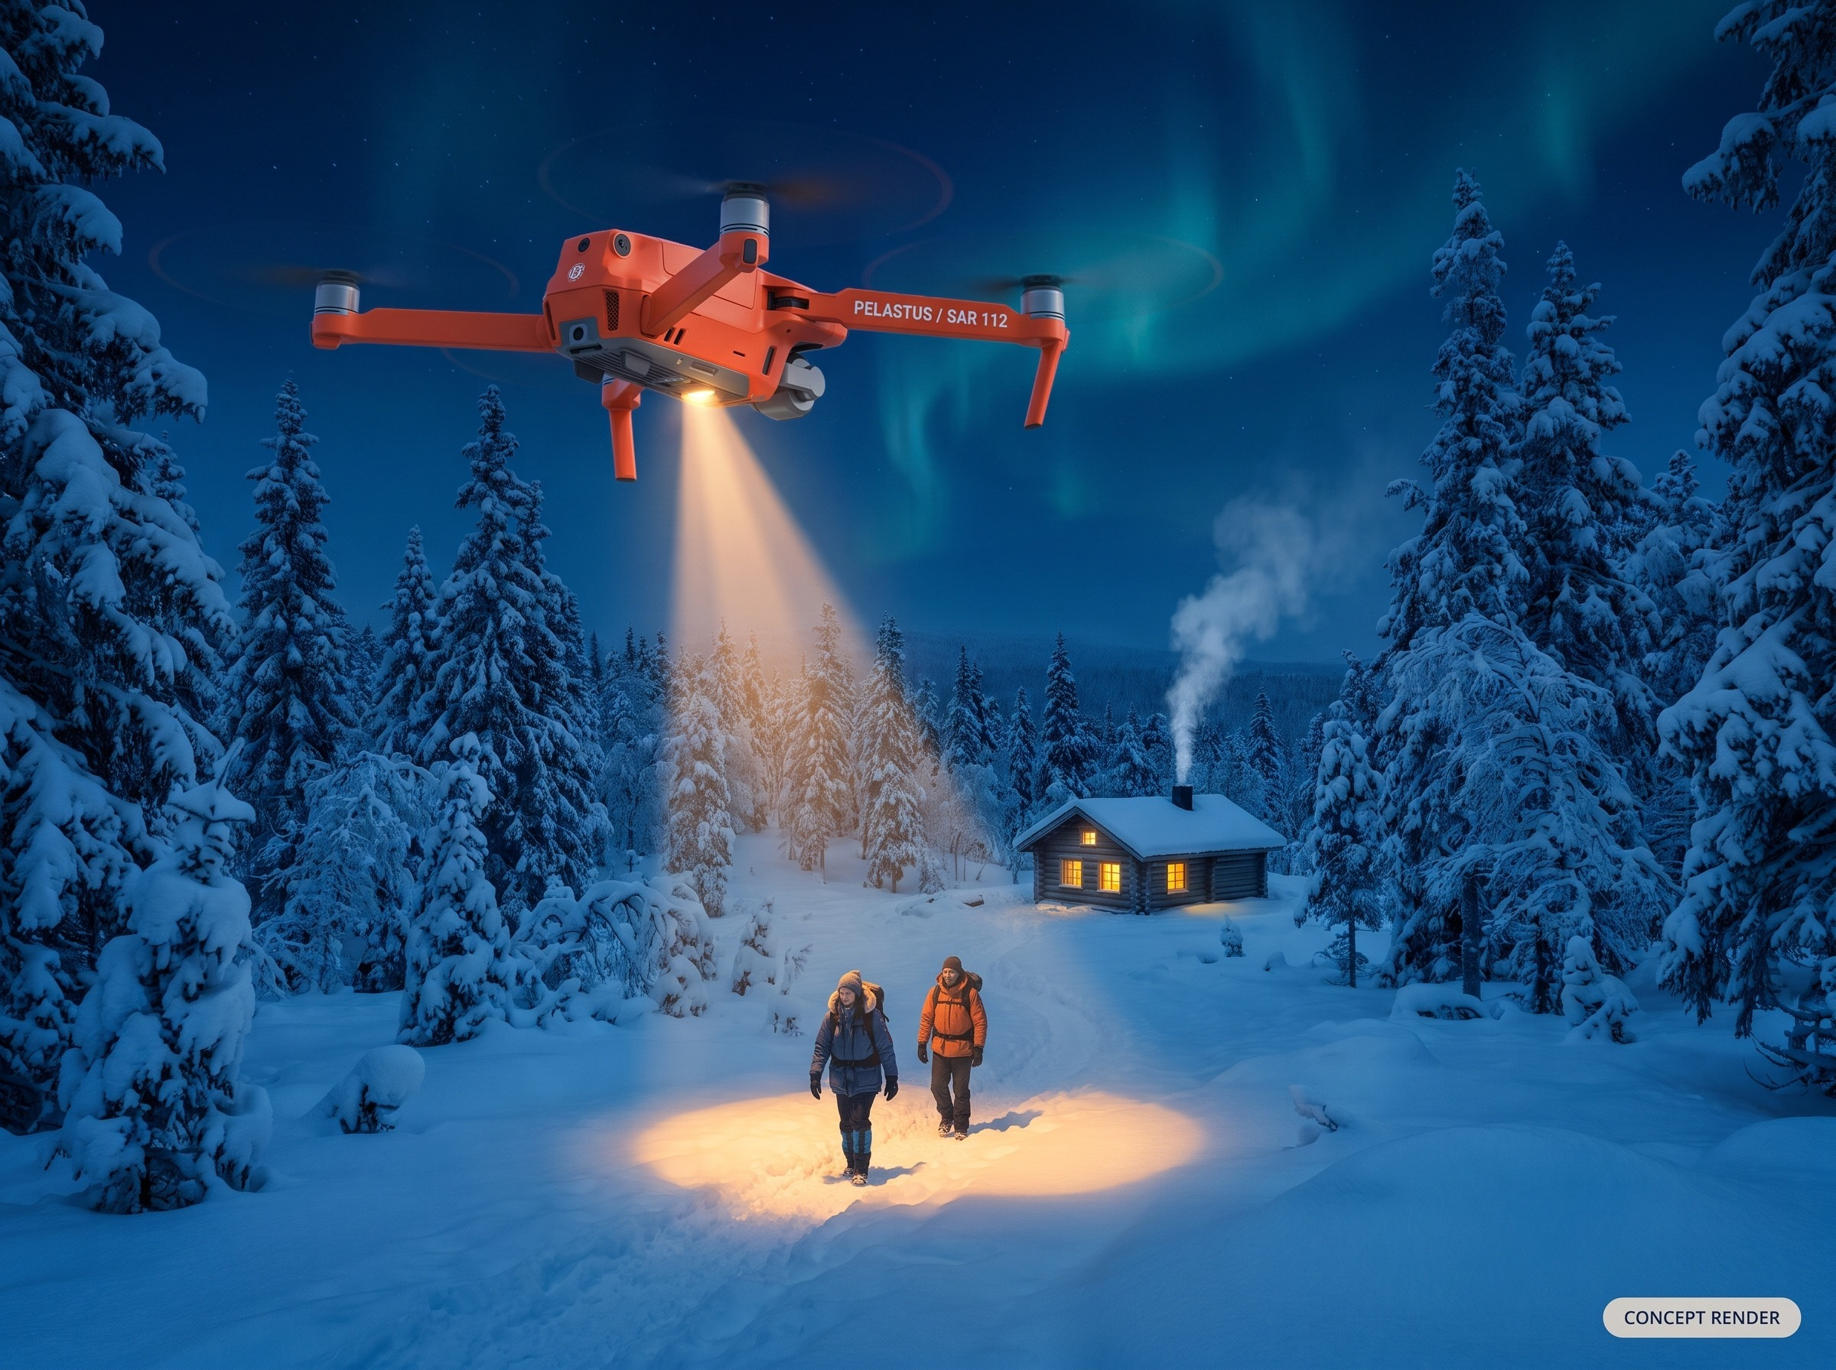
Karhunkierros SAR
The Complete Wilderness Rescue System
Civilian search and rescue for Finland's roadless wilderness
For technical partners and rescue stakeholders20 October 2026
Open-source design reference. Not a certified aircraft or rescue service.

Slide 2
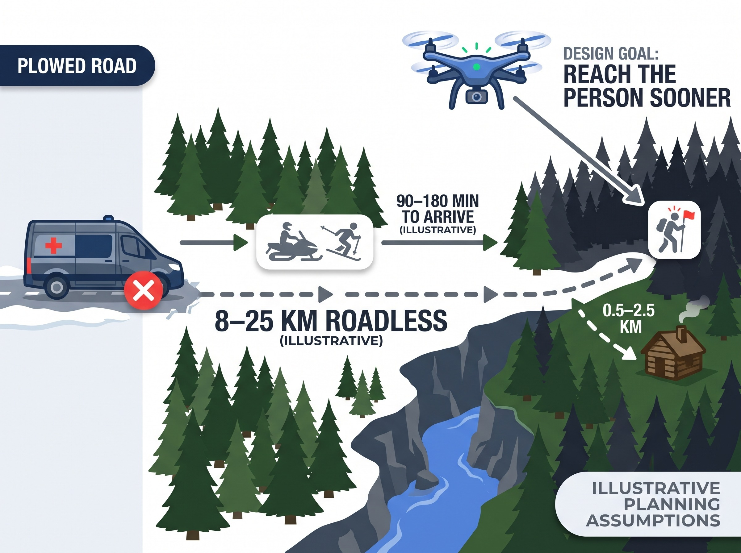
The Problem: Help Can Be Hours Away, Shelter Is Often Closer
8–25 km
ILLUSTRATIVE DISTANCE, LOST HIKER TO PLOWED ROAD
90–180 min
ILLUSTRATIVE SNOWMOBILE OR SKI PATROL ARRIVAL
450+
WILDERNESS AND DAY HUTS (FACILITIES VARY BY HUT)
Mission: find the person fast, keep them warm, and guide them to the nearest hut, or keep watch until the ground team arrives.
8–25 km and 90–180 min are illustrative planning assumptions from the project packet, not agency statistics. Hut stoves and supplies are not guaranteed at every hut. Drone timings in this deck are design targets.

Slide 3
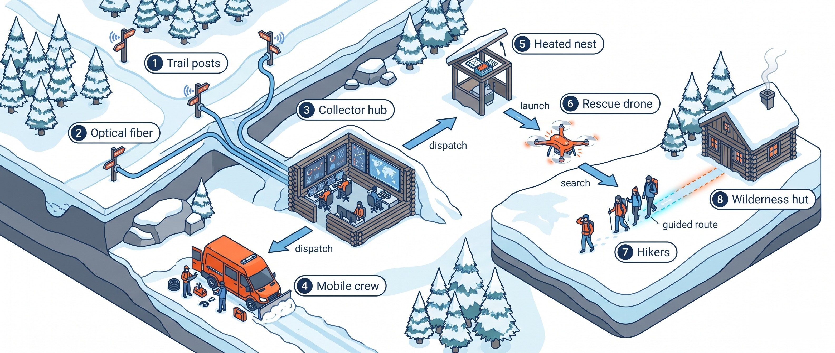
One System, Eight Parts Working Across the Landscape

Slide 4
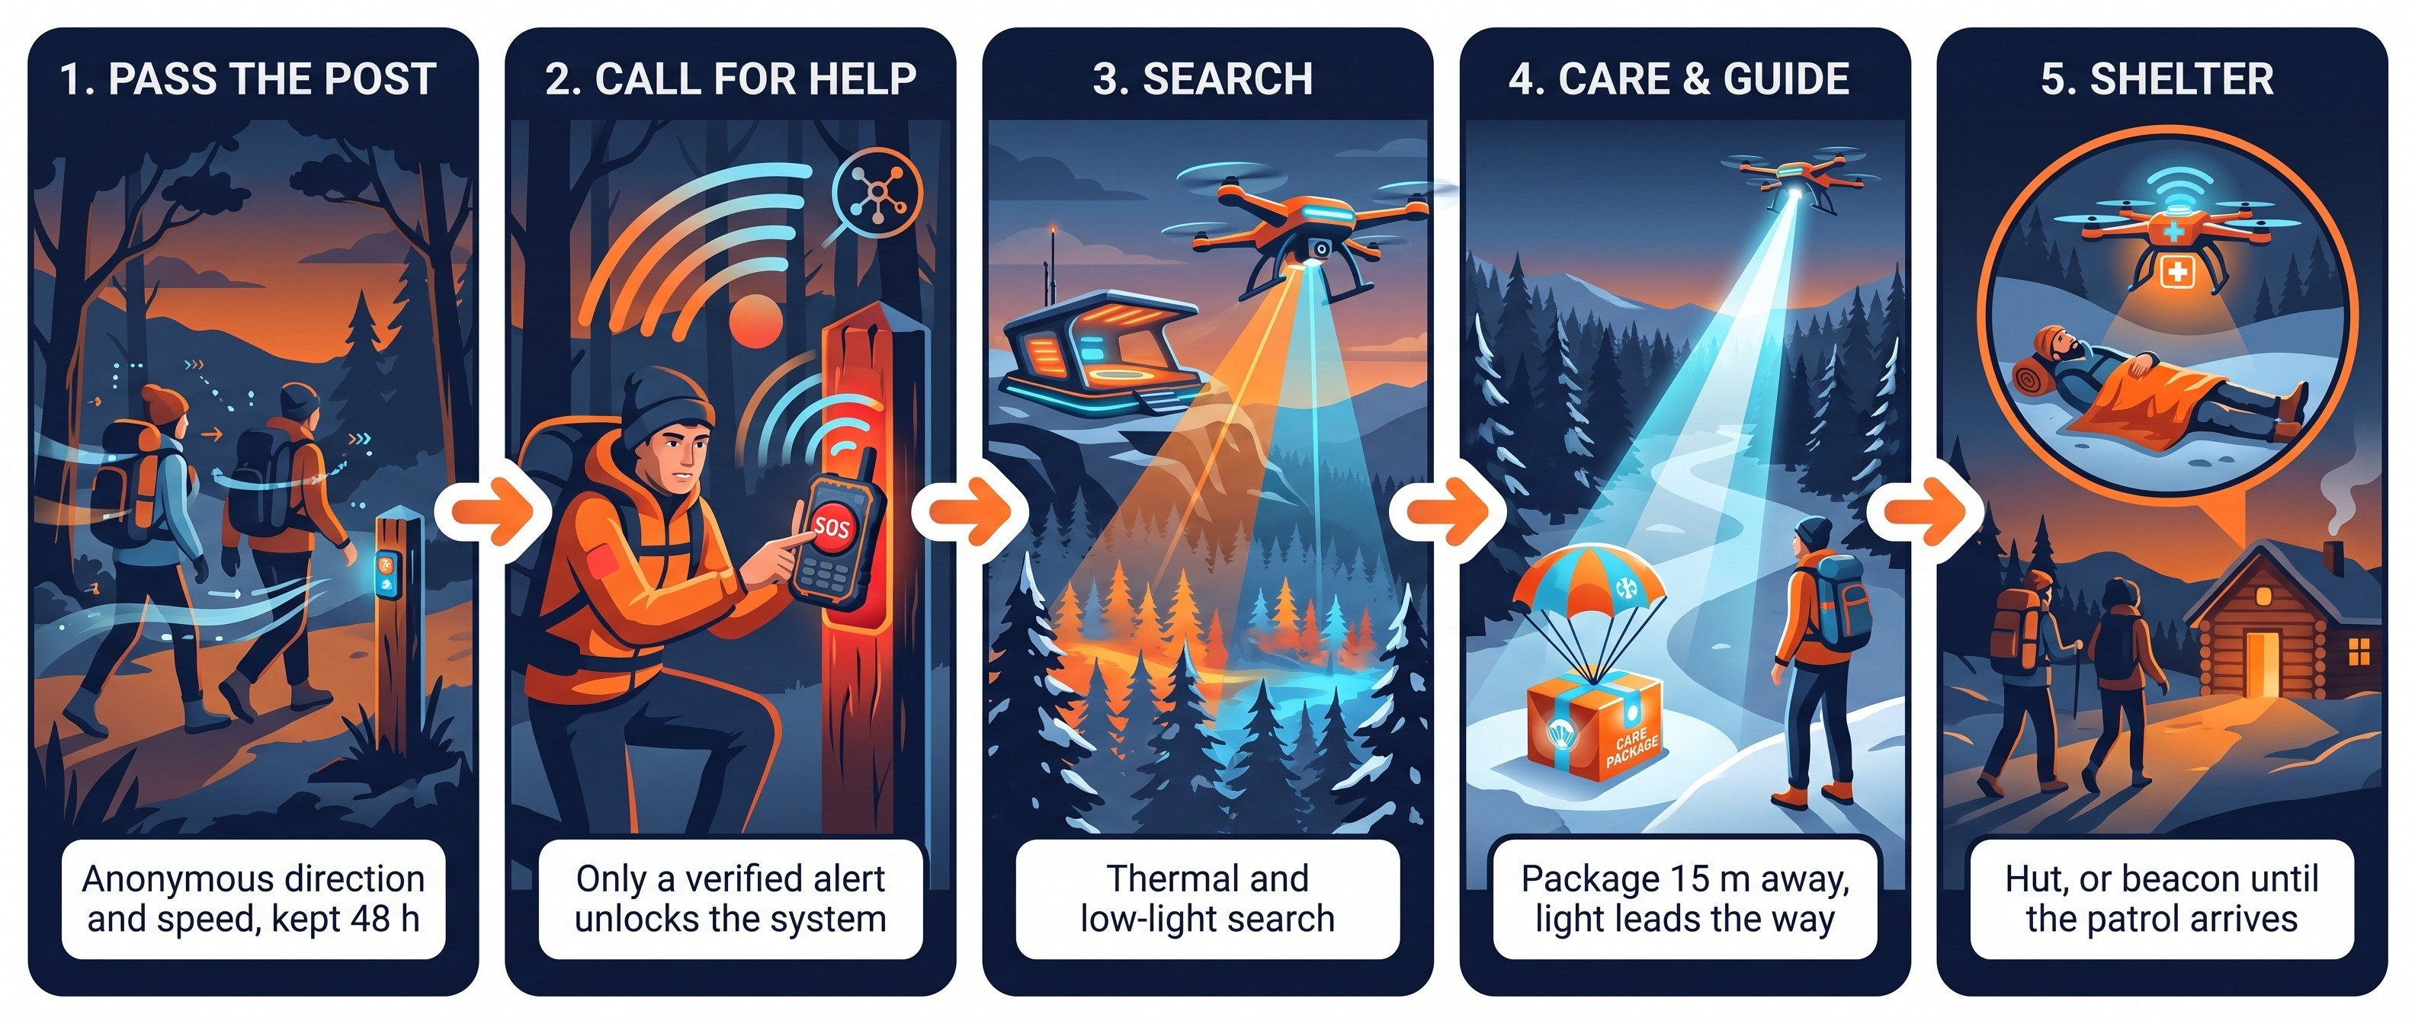
The Rescue in Five Stages

Slide 5
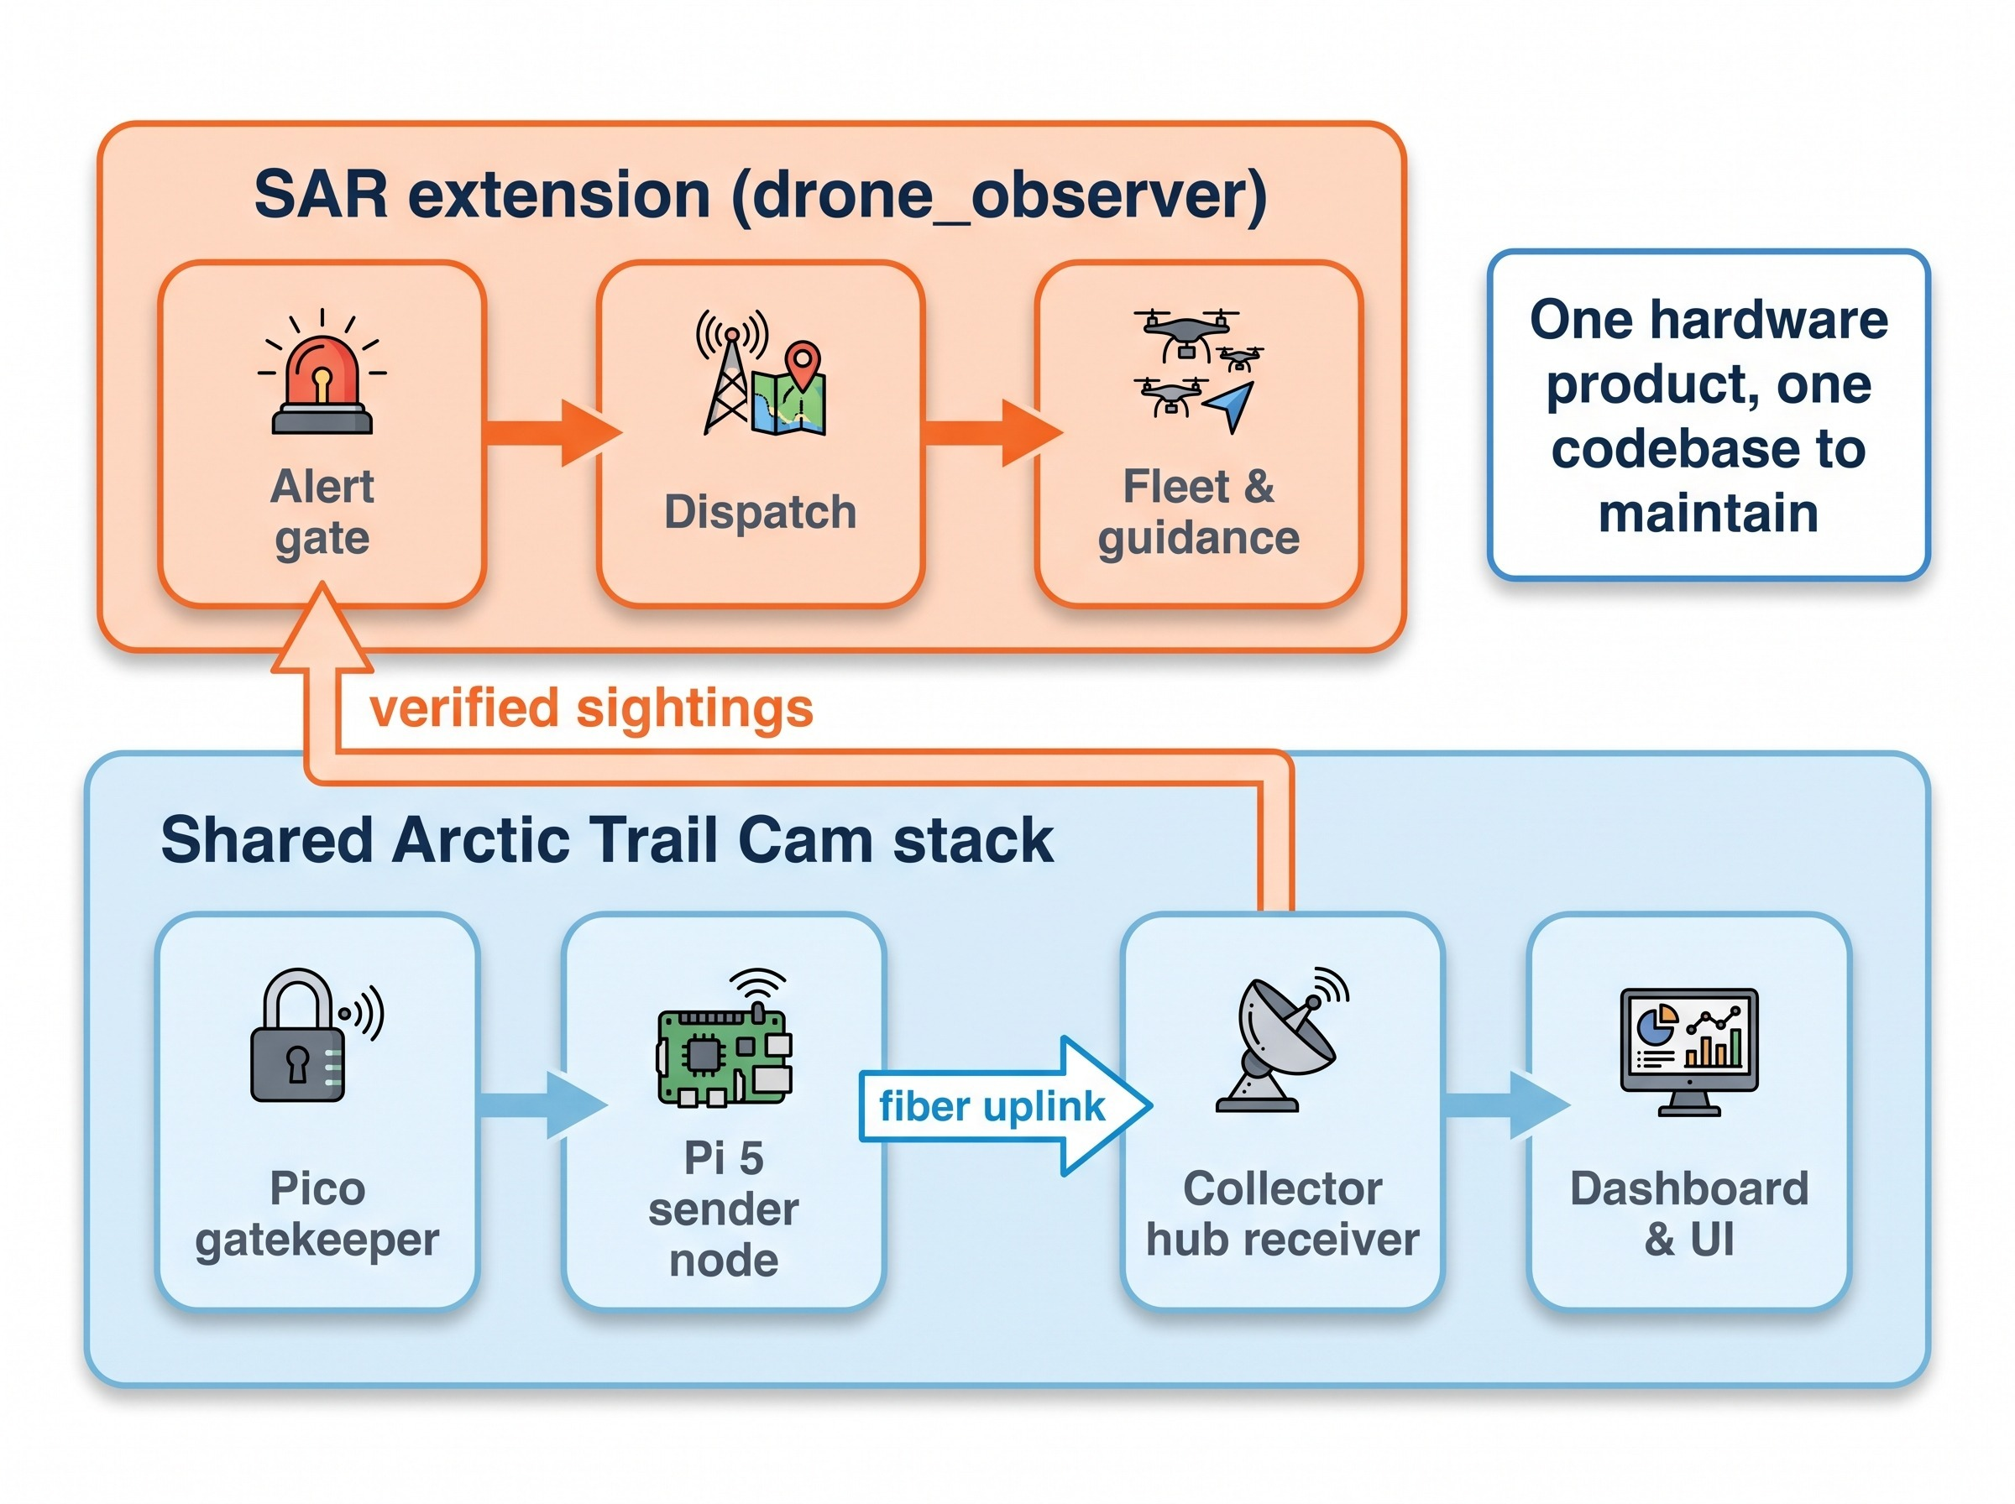
One Trail Camera, Two Missions
Wildlife trails and rescue share one stack
Ground node and collector hub are 100% shared with the arctic-trail-cam project
Only one trail camera to build and maintain
SAR logic lives in a separate module and repository
Off-the-shelf snap-in parts, no custom circuit boards
MIT-licensed reference design

Slide 6
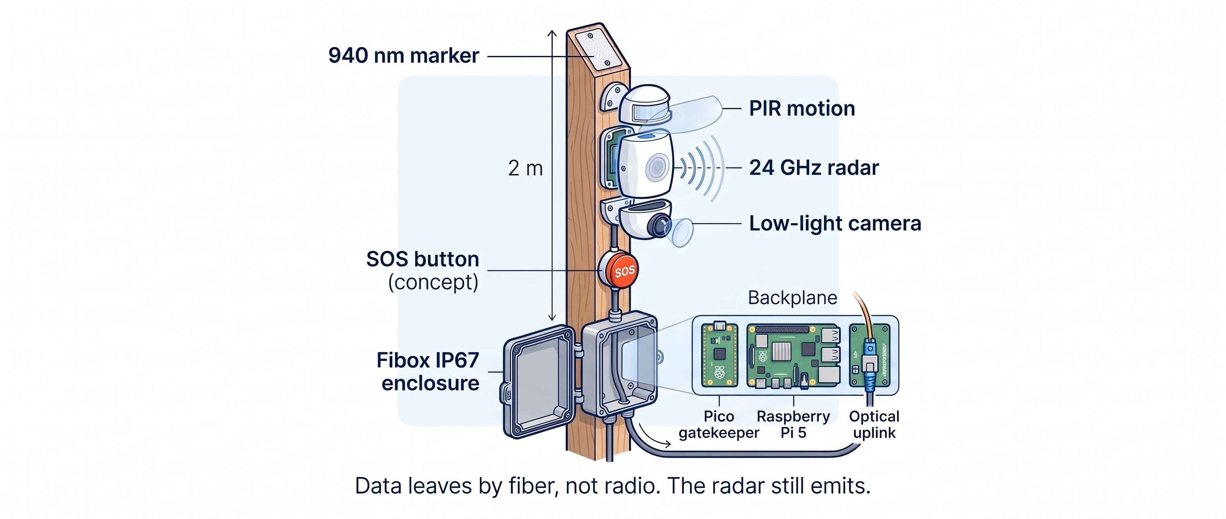
Inside the Trail Post

Slide 7
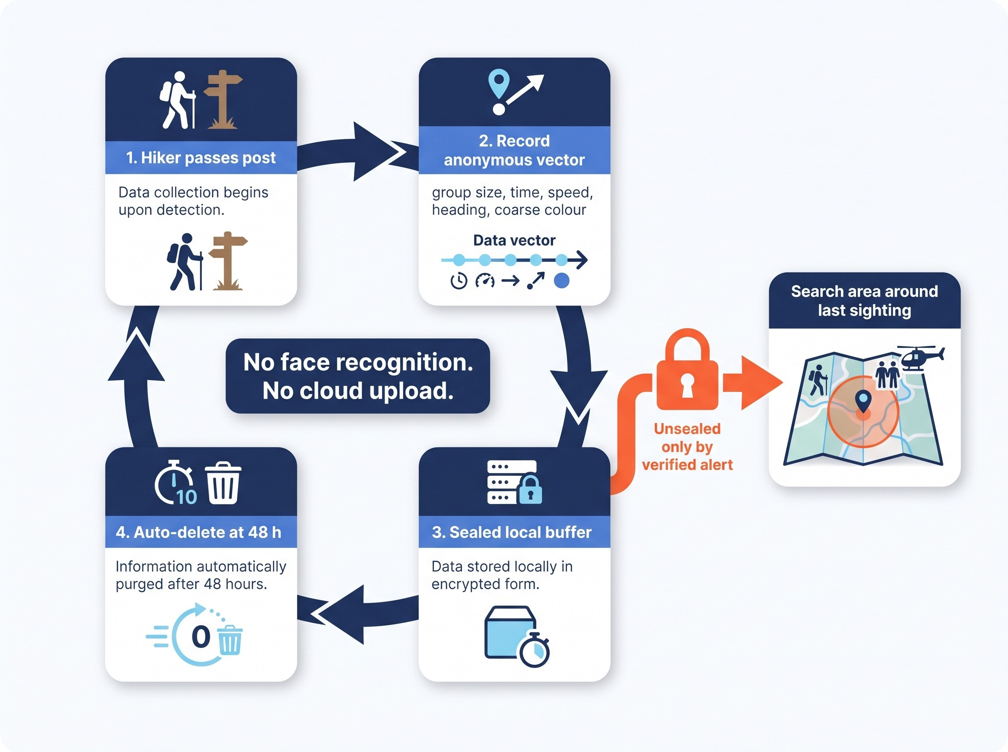
Sightings Expire After 48 h Unless an Alert Unlocks Them
What is stored
Group size, time, speed, heading, coarse jacket colour
Kept on the post, deleted after 172,800 s
What is never done
No facial recognition
No cloud upload
No following routine hikers
Qualification: these are design controls, not a legal-compliance claim. Anonymous tracks can still be privacy-sensitive.

Slide 8
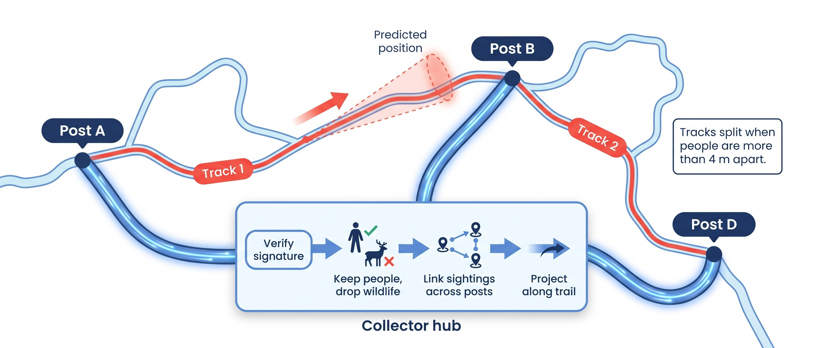
The Collector Hub Fuses Sightings into Tracks
Fusion pipeline verified in simulation; posts send data to the hub over fiber, not radio.

Slide 9
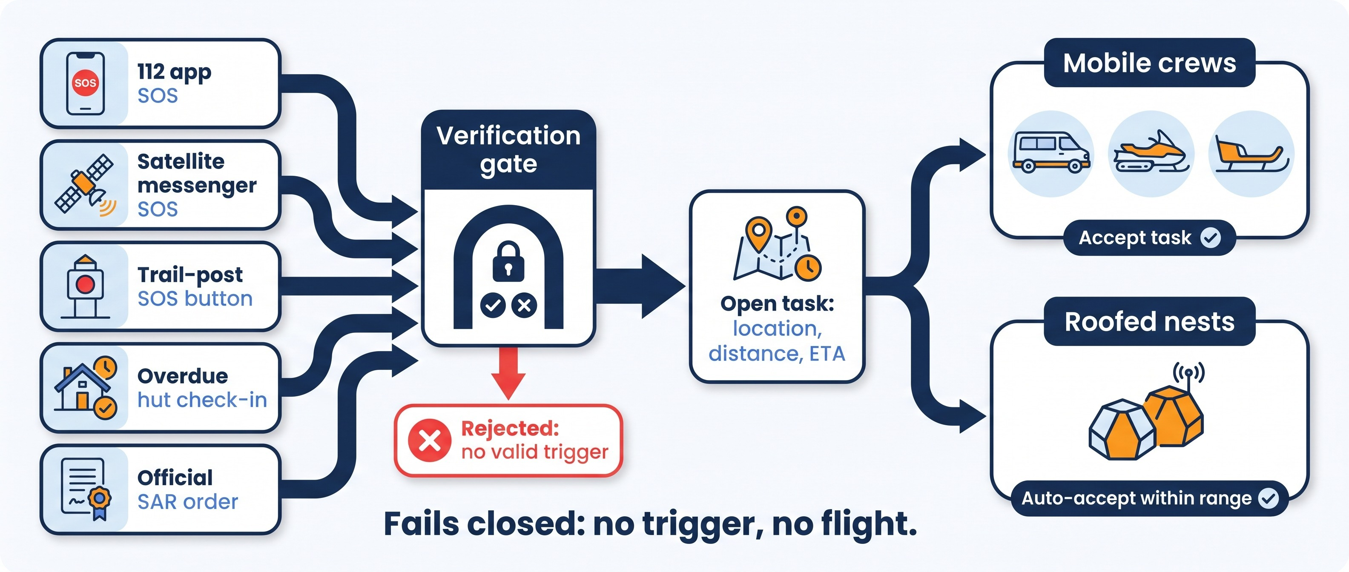
A Verified Alert Becomes an Open Task for Every Nearby Unit
112, satellite-messenger and agency links are proposed interfaces, not live integrations or partnerships. Gate logic is simulated.

Slide 10
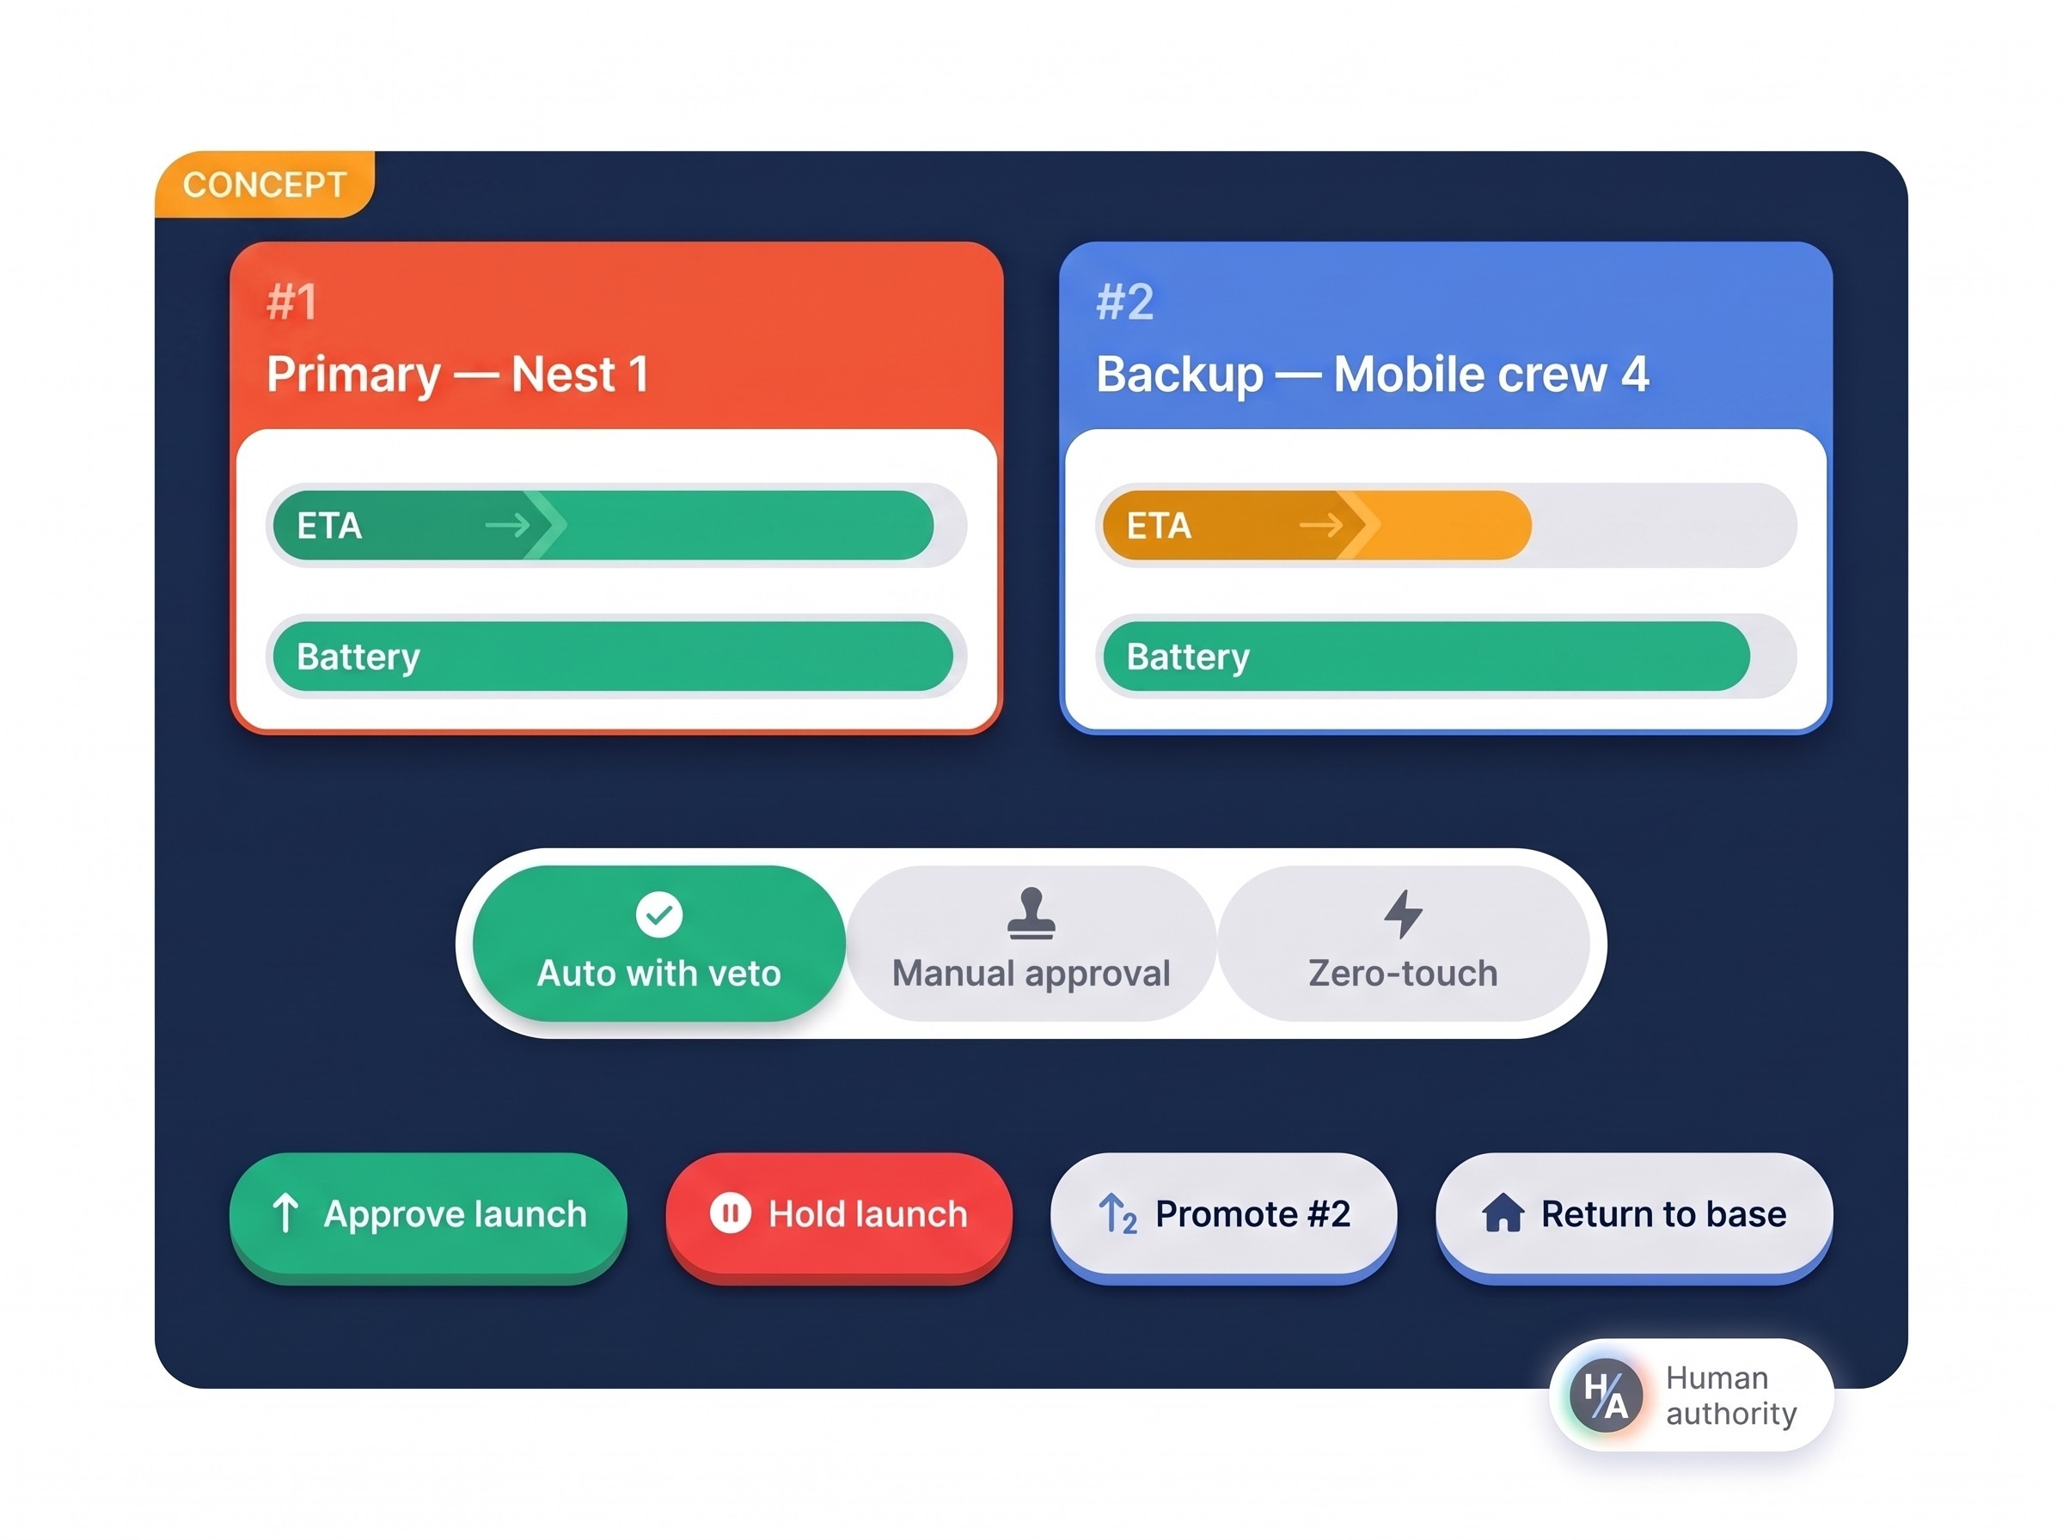
The System Ranks Volunteers; a Human Keeps Authority
Default scoring of each accepting unit
Factor | Weight
Flight ETA | 45%
Winter battery margin | 25%
Sensor and payload capability | 15%
Readiness of shelter and links | 15%
#1 Primary rescuer and #2 Backup are awarded
If #1 aborts, #2 is re-checked live before promotion
No feasible, safe unit means no launch

Slide 11
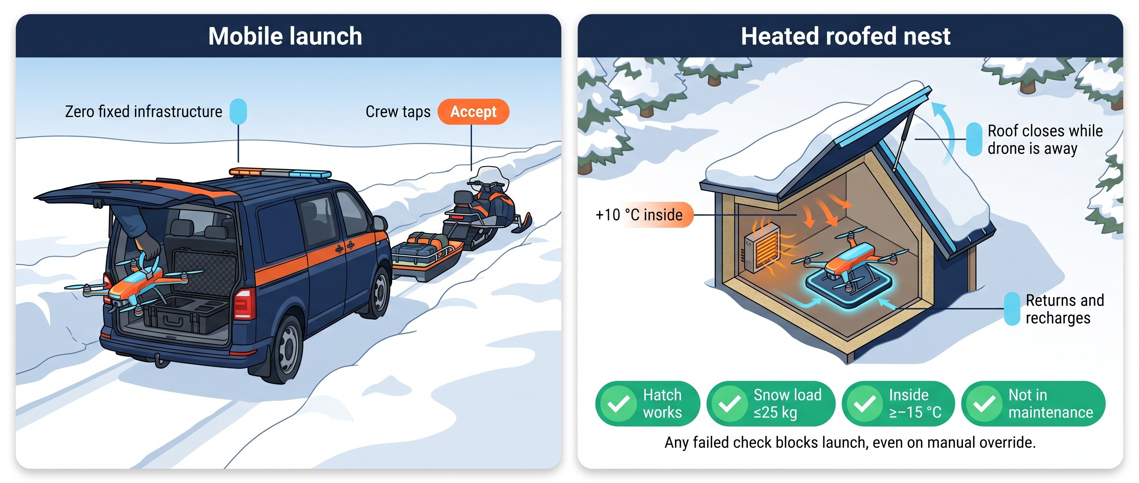
Two Ways to Launch: Mobile Crew or Heated Roofed Nest
Interlock thresholds and nest temperature are design values; the 14 km auto-accept radius is a configurable default.

Slide 12
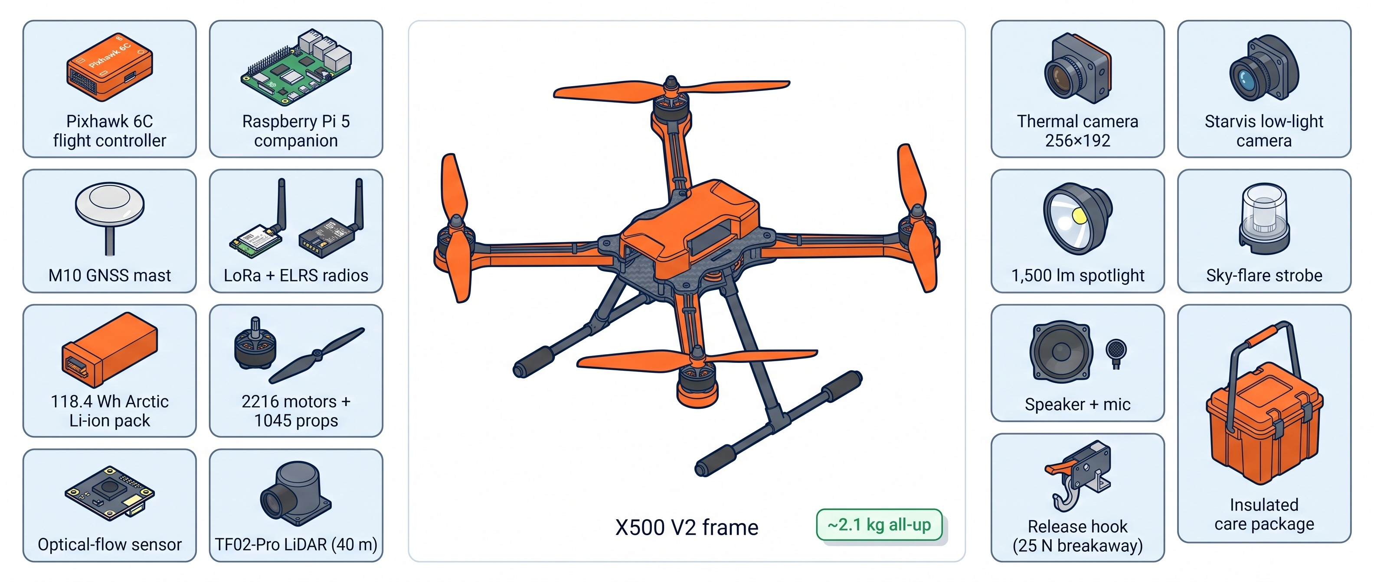
The Rescue Aircraft, Part by Part
Concept catalog of reference COTS parts (v2.0 BOM). Compatibility and integration are still to be verified.

Slide 13
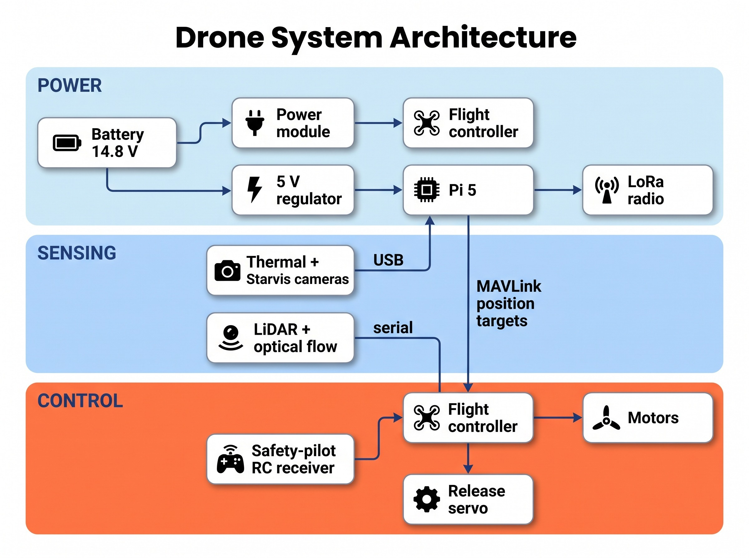
Power, Data and Control Flow
Who does what in the aircraft
Pixhawk 6C (ArduCopter 4.5+): stabilises, fuses navigation, runs failsafes
Raspberry Pi 5: detects people, tracks, plans guidance, enforces the 15 m standoff (design constraint)
Safety pilot: can take over instantly with LOITER, GUIDED or RTL
Coordinator: approves, holds or recalls

Slide 14
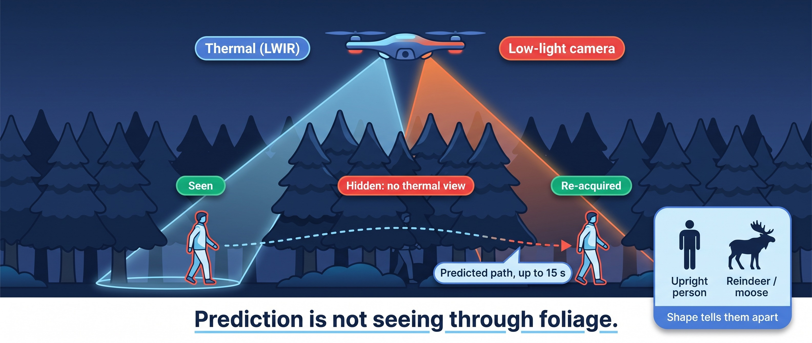
Seeing People at Night, and the Limits Under Canopy

Slide 15
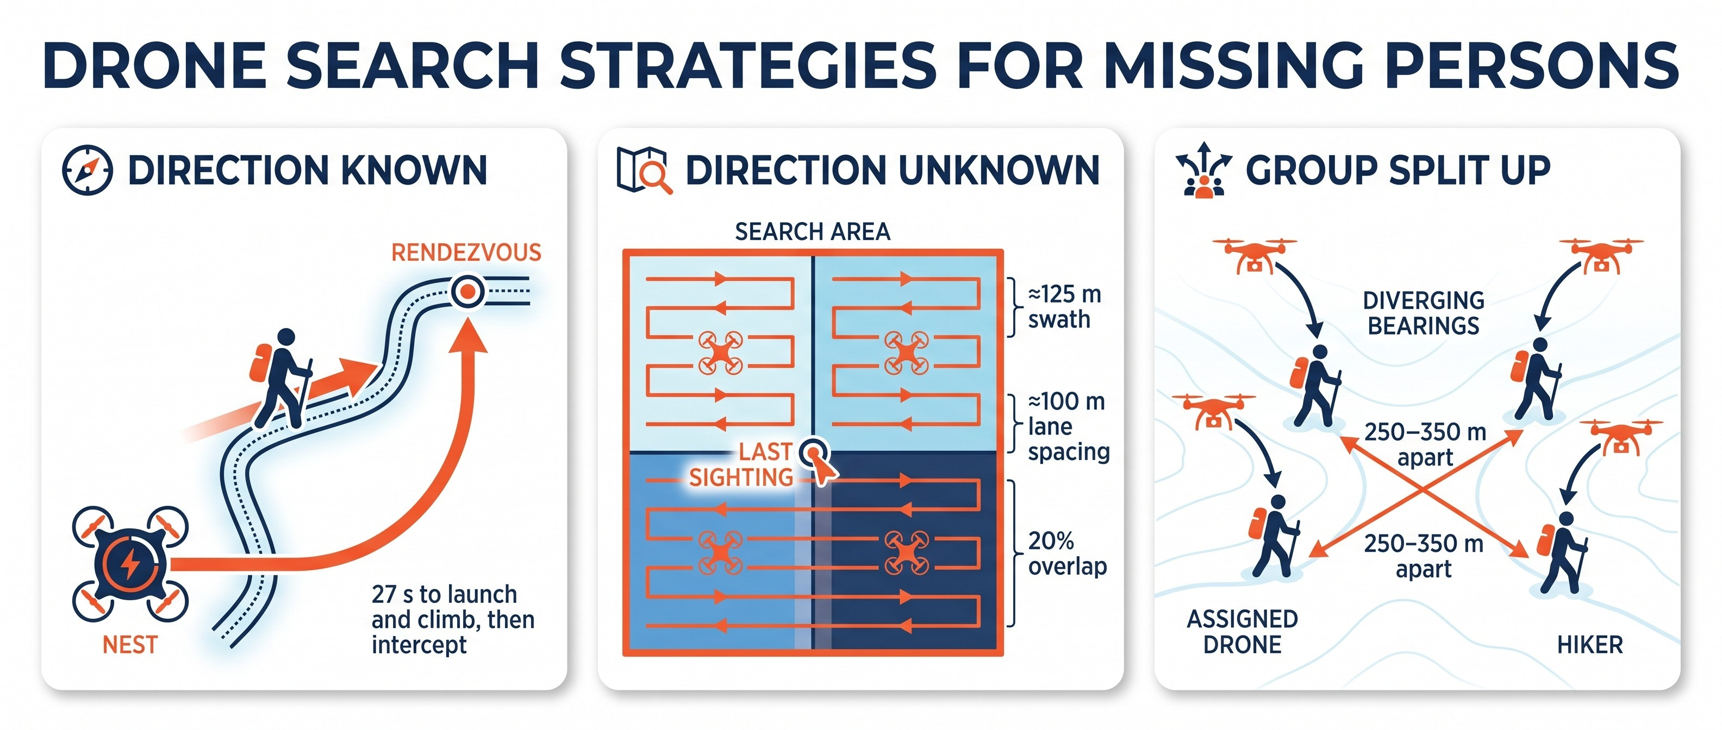
Meet the Hiker Where They Will Be, or Search the Area Systematically
Timings and search geometry are modeled in simulation, not field-measured.

Slide 16
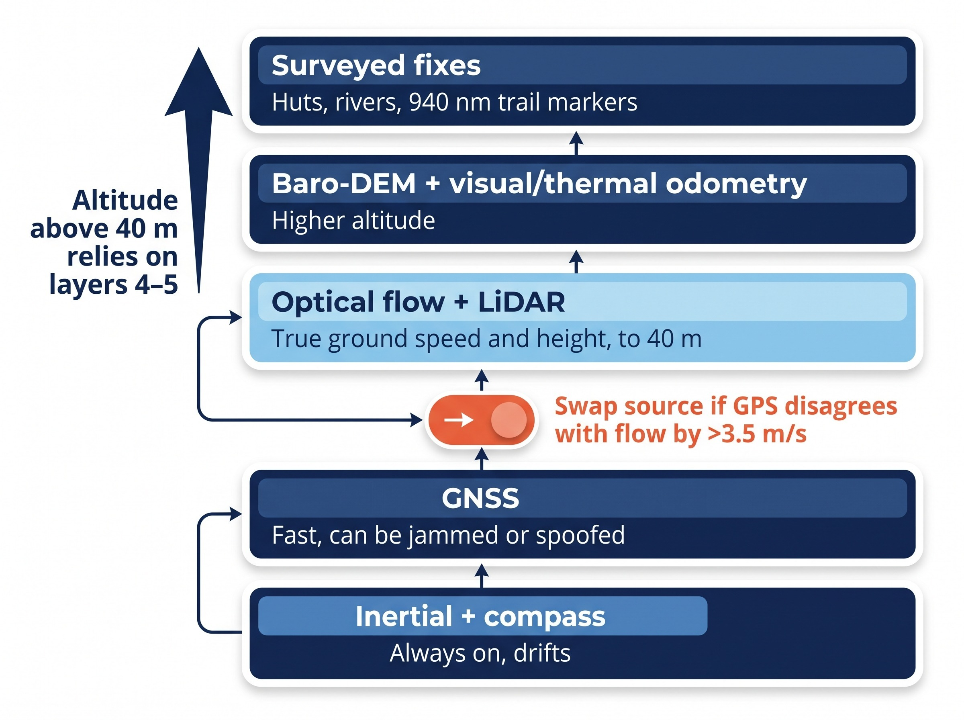
Navigation in Layers, So a Jammed GPS Does Not Mean a Lost Drone
Design rules
ArduPilot EKF3 holds two source sets: GNSS or optical flow + LiDAR
Jamming indicator triggers a pre-emptive switch
Above 40 m, height comes from cold-corrected barometer and terrain model
Surveyed landmarks reset drift
Qualification: source switching is tested in simulation only, not flight-proven. Navigation above 40 m: next slide.

Slide 17
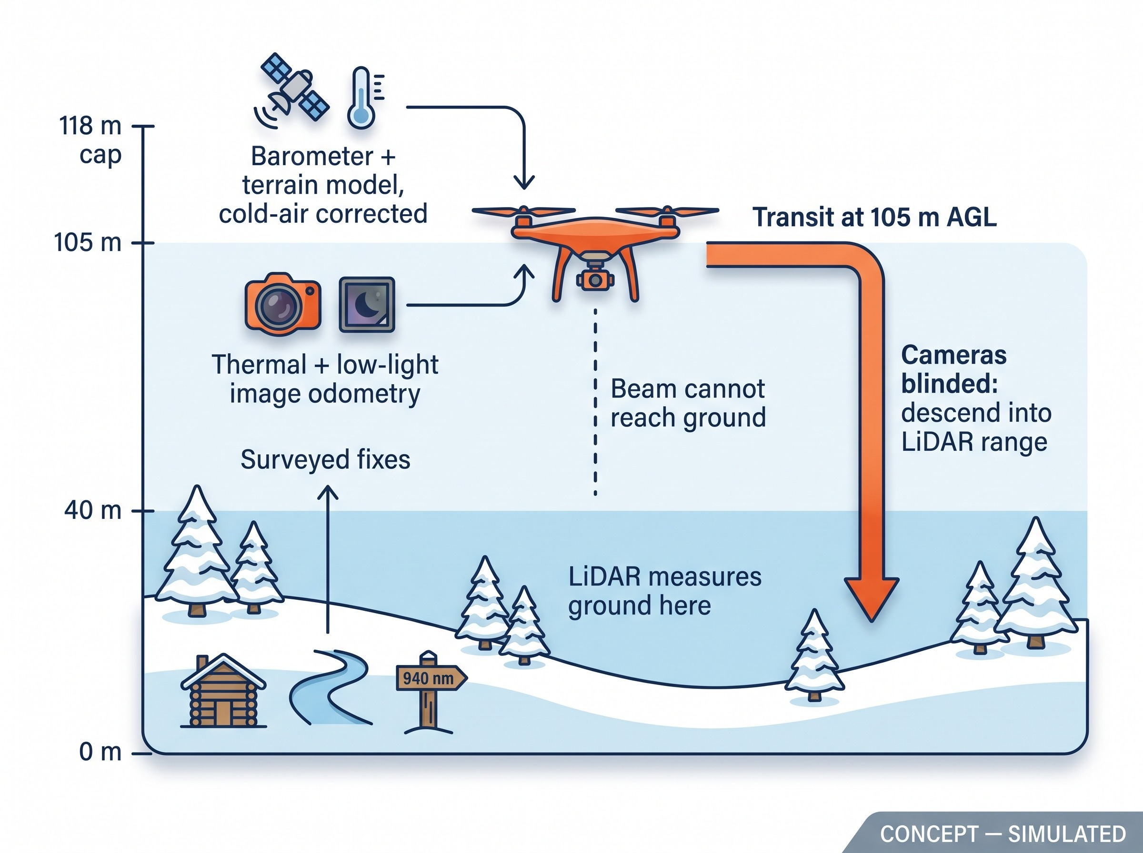
Above 40 m the LiDAR Cannot See the Ground, So Other Layers Take Over
The gap
TF02-Pro LiDAR reference range is 40 m
At 105 m transit it cannot measure terrain
High-altitude layers (FIN-LAB-03 concept)
Barometric height scaled for cold air, checked against a terrain model
Image odometry from the thermal and Starvis cameras
Watchdog for a frozen thermal shutter
Drift reset over surveyed huts, rivers and trail-post markers
Qualification: simulated 30-min drift of 20.76 m against a 30 m pass mark. Simulation only, not flight data.

Slide 18
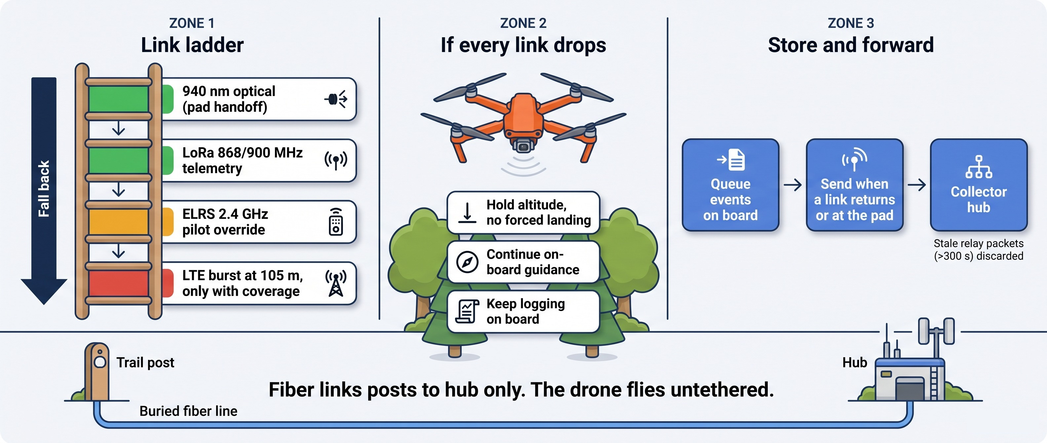
Four Links, a Lost-Link Plan and Store-and-Forward
Resilient by design, not jam-proof. Lost-link behaviour is simulated; store-and-forward is a design concept.

Slide 19
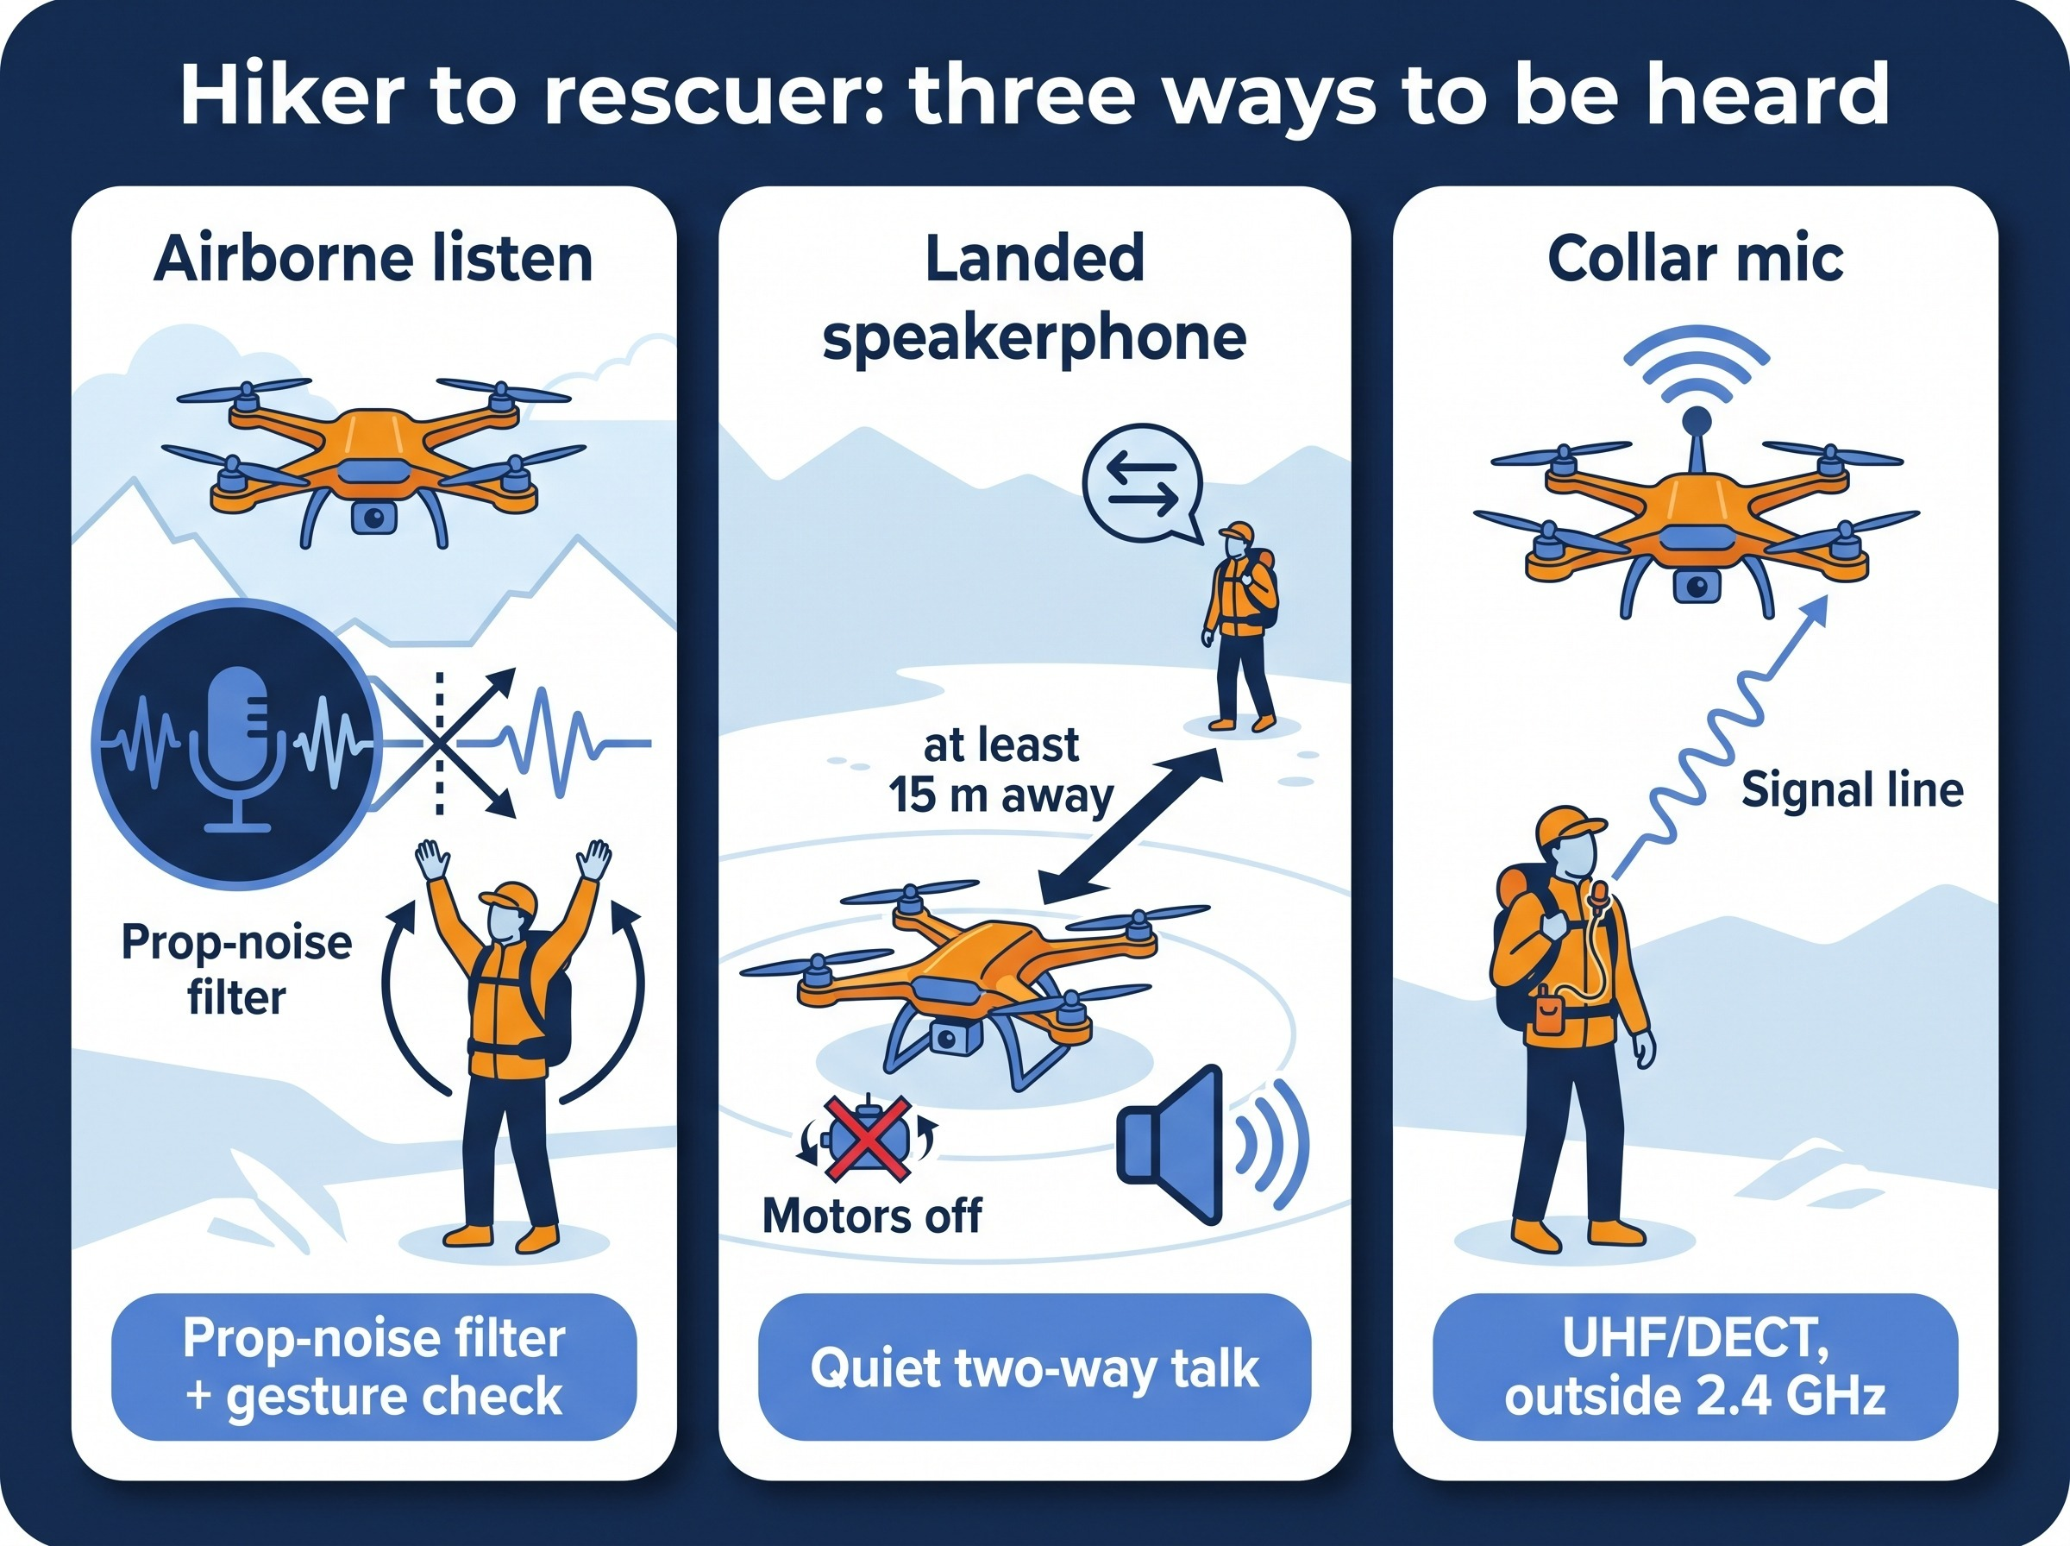
Once Found, a Human Pilot and a Human Voice Take Over
Why hand over
Close-in obstacles in the dark need human judgement
A frightened person trusts a named rescuer more than a silent robot
Pilot controls
Hold at 35 m AGL / 25 m offset
Remote nudges or handheld RC (LOITER, GUIDED, RTL)
15 m standoff and 6 m LiDAR floor stay enforced
Three ways the hiker is heard: airborne listening, landed speakerphone, collar mic from the cask
Voice levels are modeled, not measured.

Slide 20
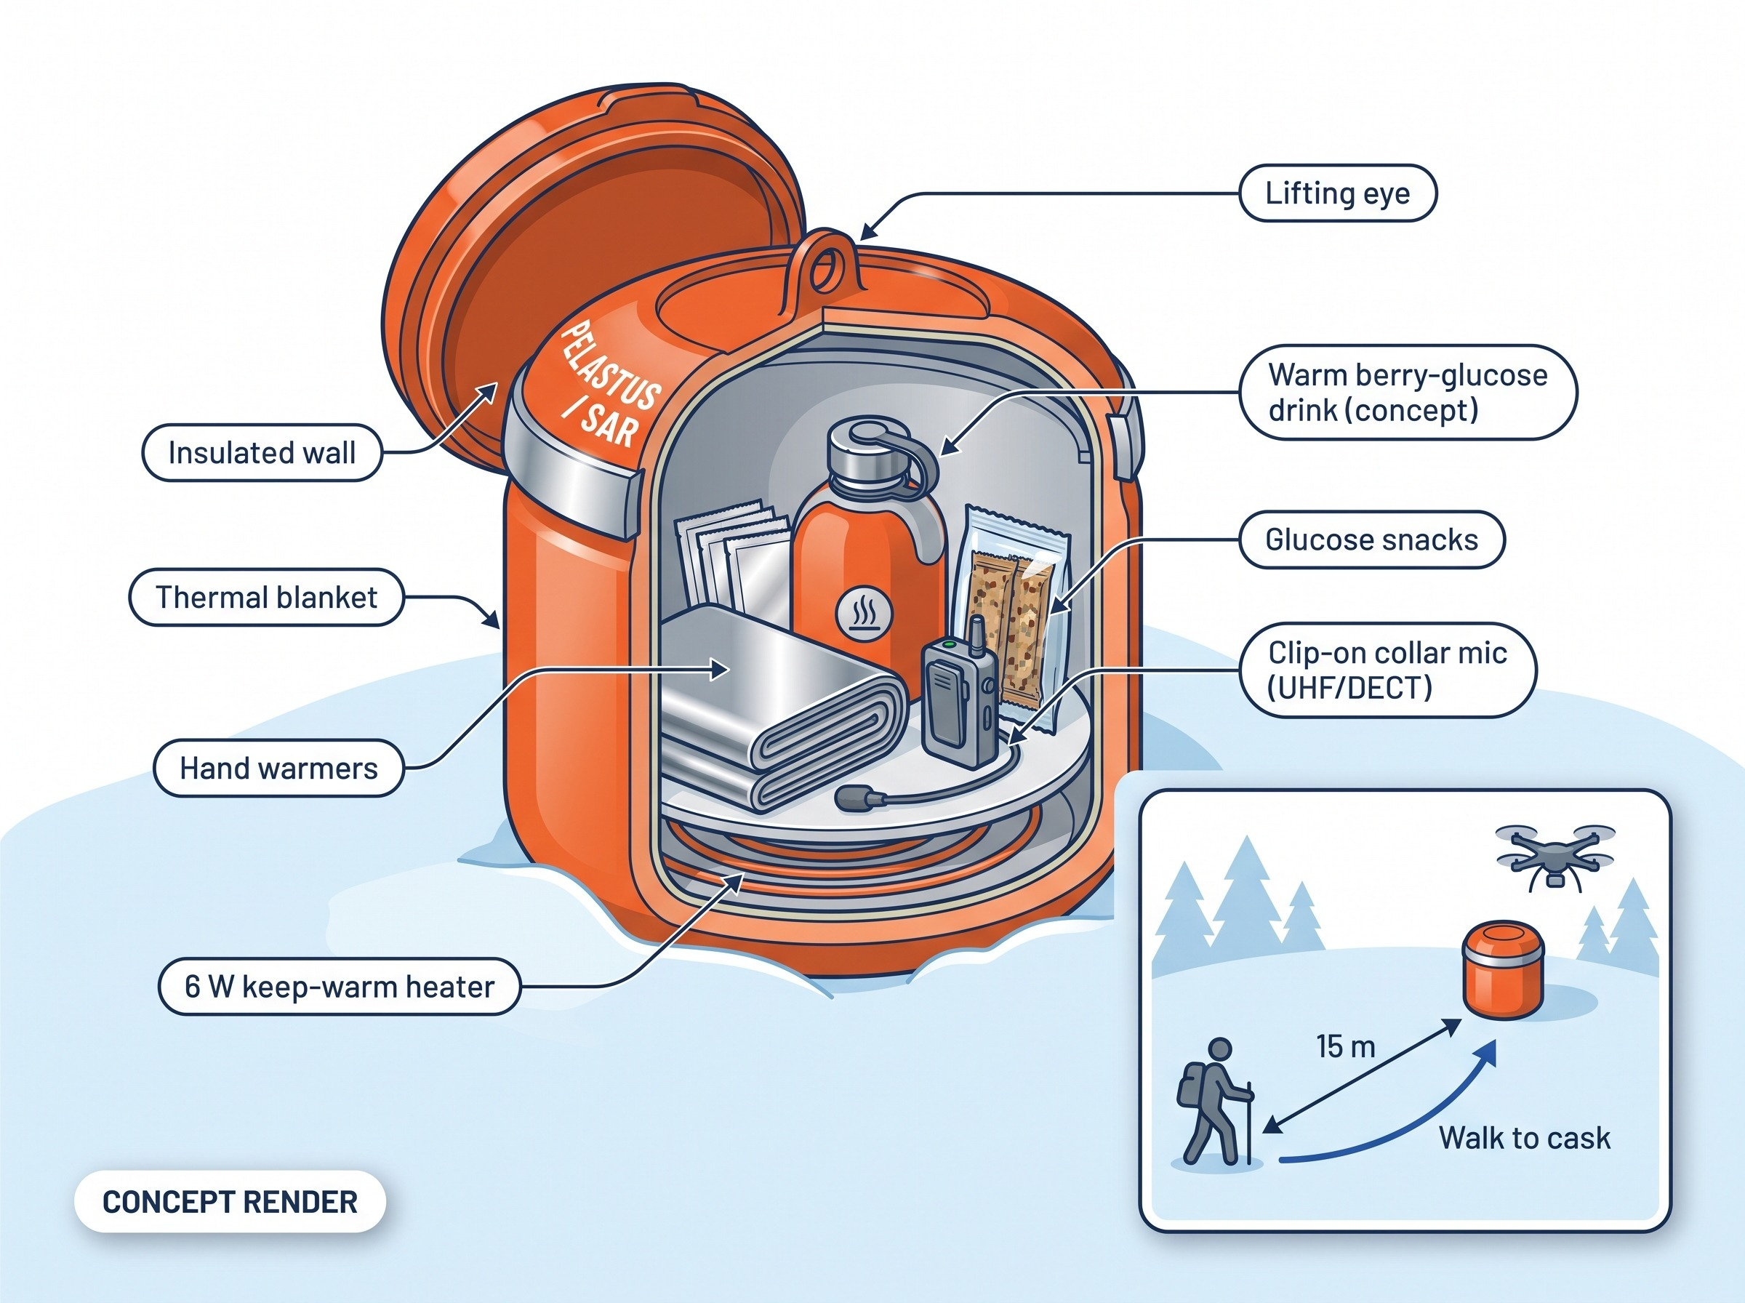
The Rescue Cask: Warmth, Comfort and a Voice Link
Delivery rules
Lowered onto clear snow 15 m from the person, never overhead
25 N breakaway: a snagged line cannot pull the drone down
Drone climbs to 50 m before it speaks
Public specification
Comfort items only, alcohol-free
Collar mic lets the hiker talk back
Qualification: design targets. No medical treatment instructions and no claim about survival time.

Slide 21
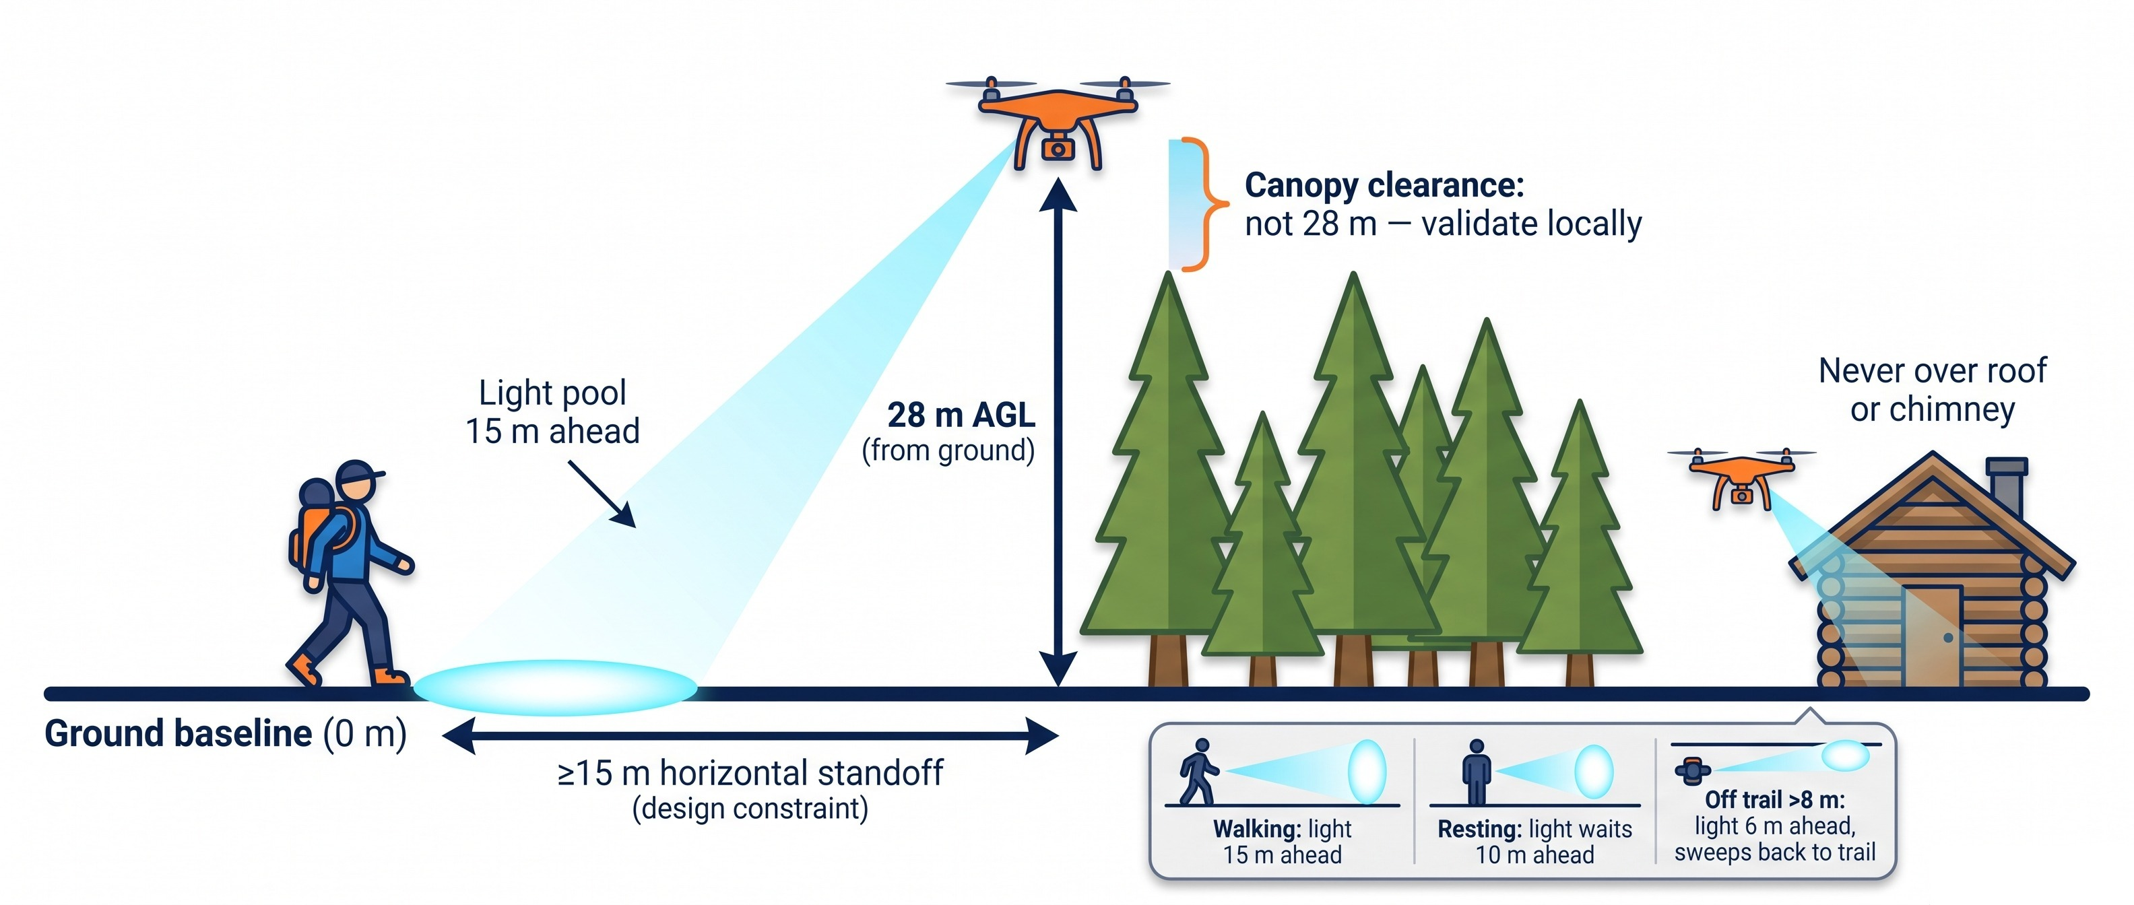
Opaslyhty: Leading the Hiker to the Hut With Light
28 m AGL is measured from the ground, not from the tree crowns; canopy clearance must be validated locally. The ≥15 m horizontal standoff is a design constraint, not certified safety.

Slide 22
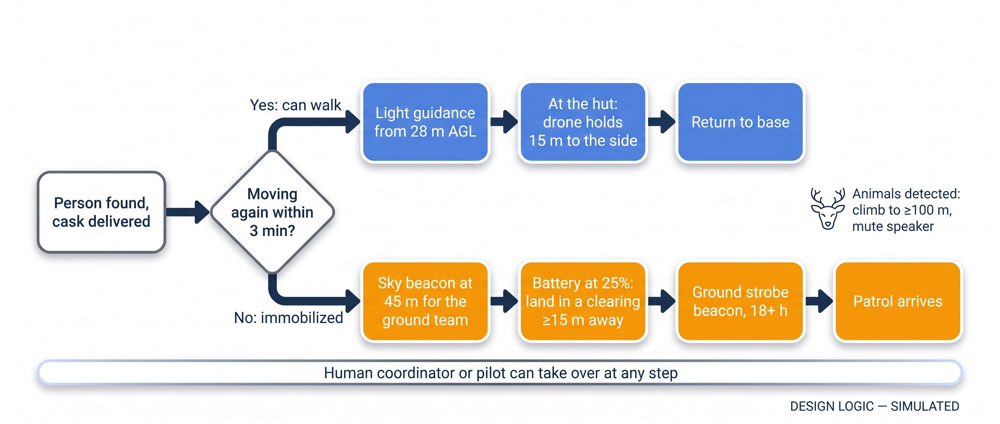
Two Branches After Contact: Walk to the Hut, or Shelter in Place
Thresholds are design values tested in simulation; the 18+ h beacon is a planning estimate.

Slide 23
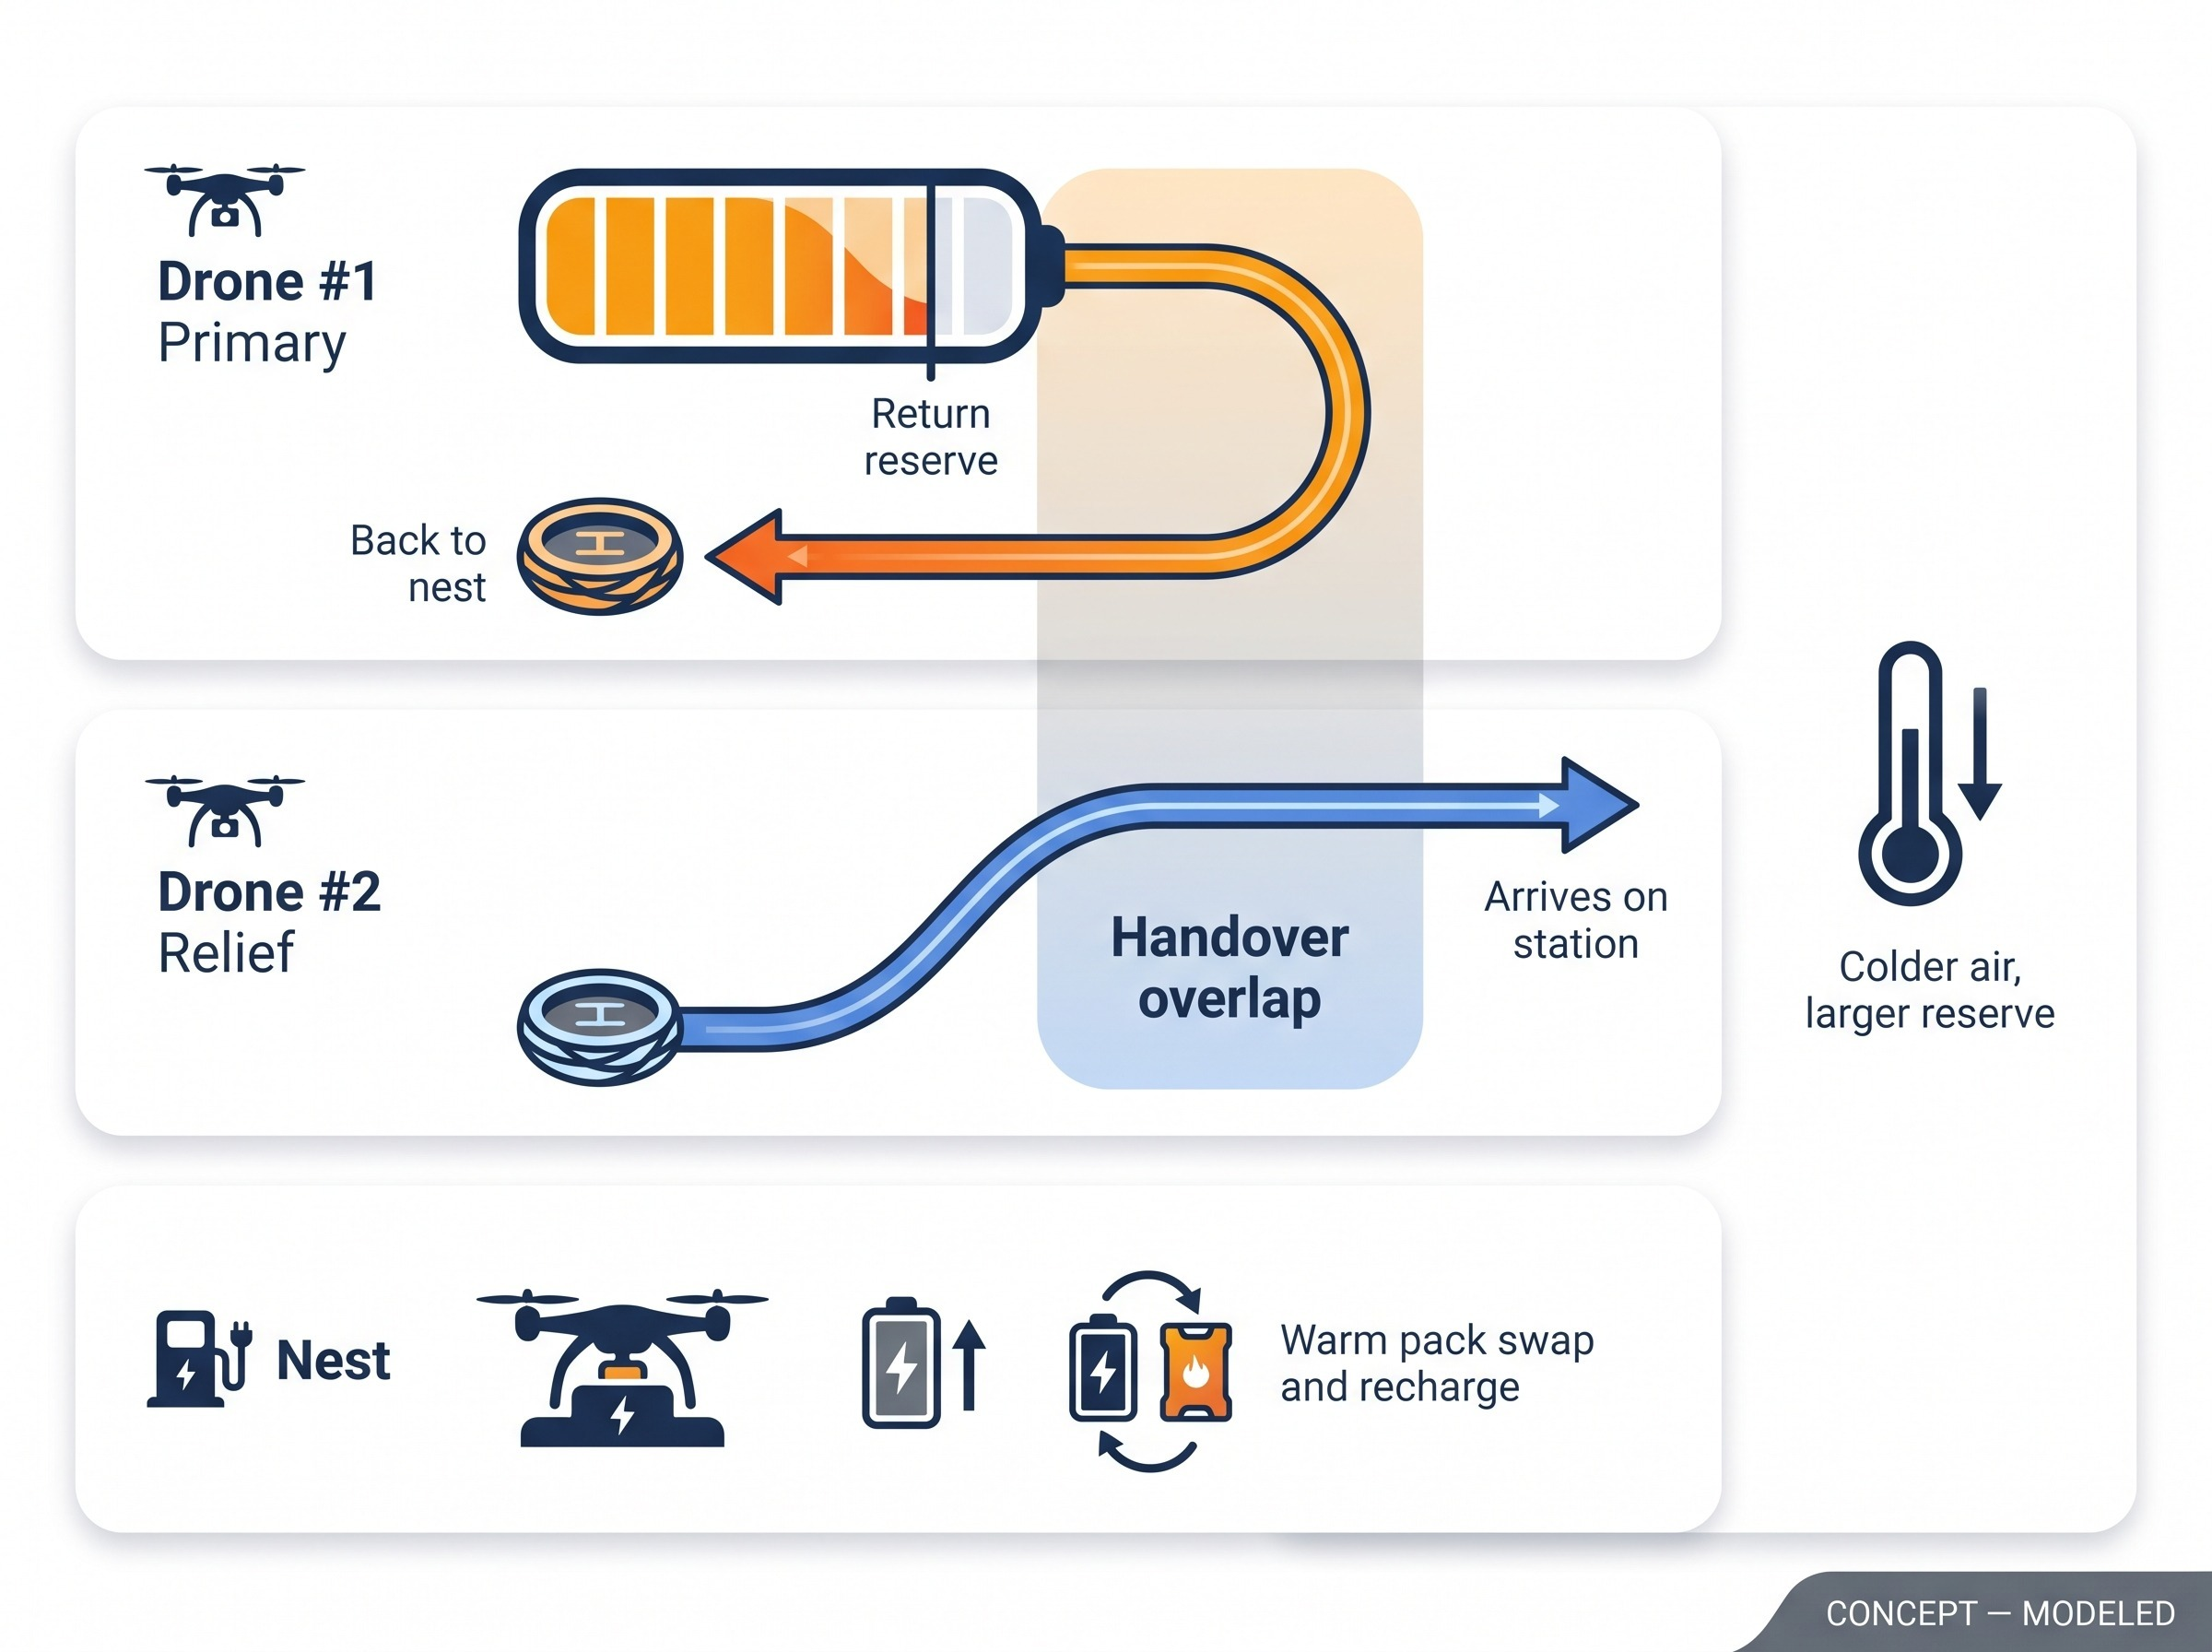
Relief Before Reserve: Keeping a Drone Over the Hiker
Air temperature | Return reserve
≥ 0 °C | 30%
≤ −15 °C | 40%
≤ −25 °C | 45%
#2 Backup is re-checked live before it is promoted
Relief battery is checked before launch
Pre-warmed endurance 36–38 min (planning estimate)
Qualification: reserve rules are design values; handover timing is modeled.

Slide 24
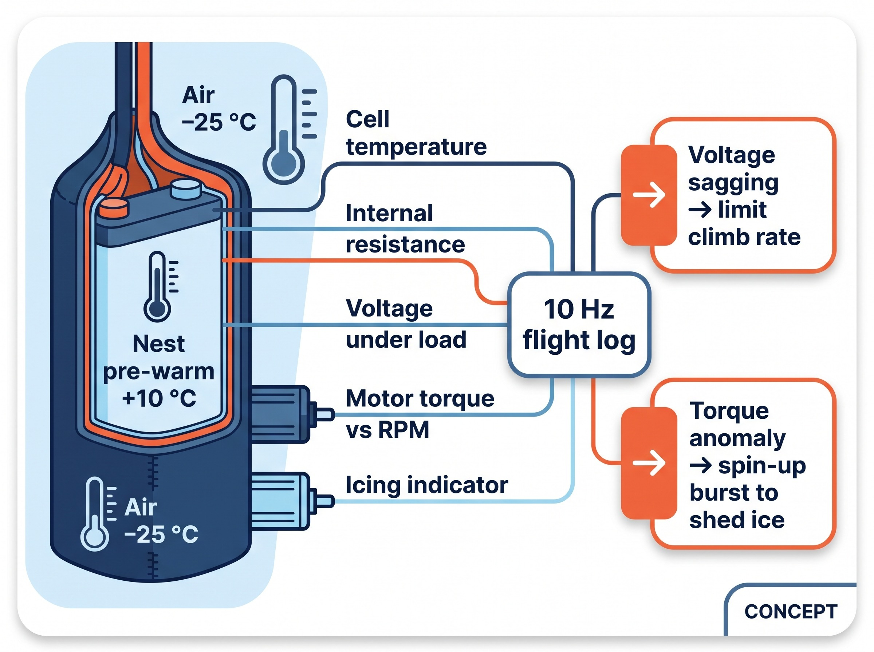
Kaamos Winter: Battery Care and a 10 Hz Black Box
Parameter | Planning value
Pack | 8,000 mAh 4S2P, 118.4 Wh
Endurance, pre-warmed | 36–38 min
Endurance, cold-soaked −25 °C | 28+ min
Climb limit on sag | 1.5 m/s below 12.2 V
Icing trigger | >12% torque anomaly
Shed burst | 8,500 RPM
Qualification: planning estimates. Icing tolerance is unproven; the logger's grade label is a software classification, not laboratory qualification.

Slide 25
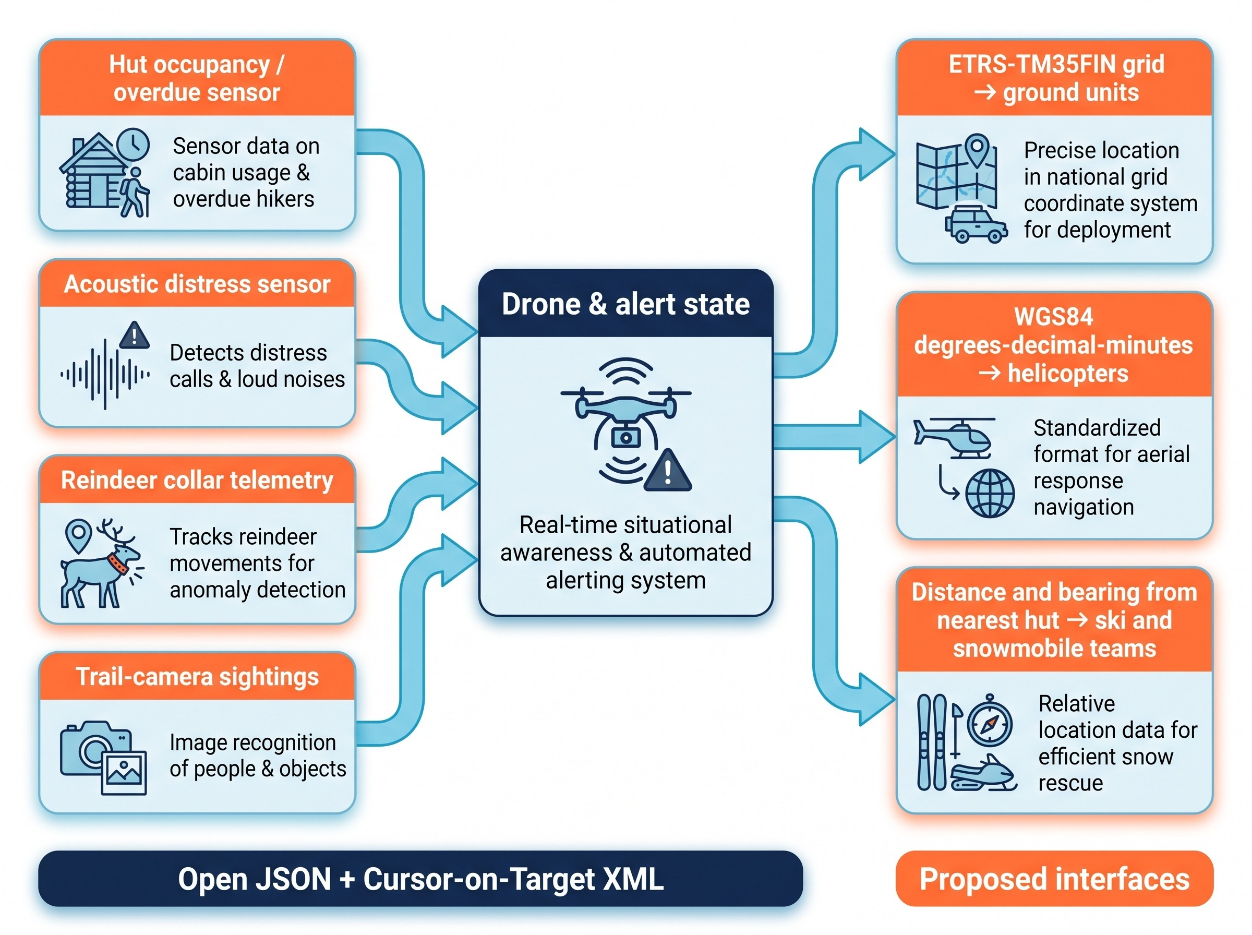
FIN-LAB Sensor Adapters Feed One Common Ingest
Adapters (FIN-LAB-01 Open Ingest API v0.9)
Hut occupancy and overdue check-in, with a stove false-alarm guard
Acoustic distress, with a geometry gate and wind suppression
Reindeer-herding collar telemetry
Trail-camera radar and optical sightings
Common outputs
ETRS-TM35FIN, WGS84 DDM, hut-relative bearing
Open JSON + Cursor-on-Target XML, conformance scorecard
Qualification: proposed interfaces, simulated adapters. No live agency integration or partnership is claimed.

Slide 26
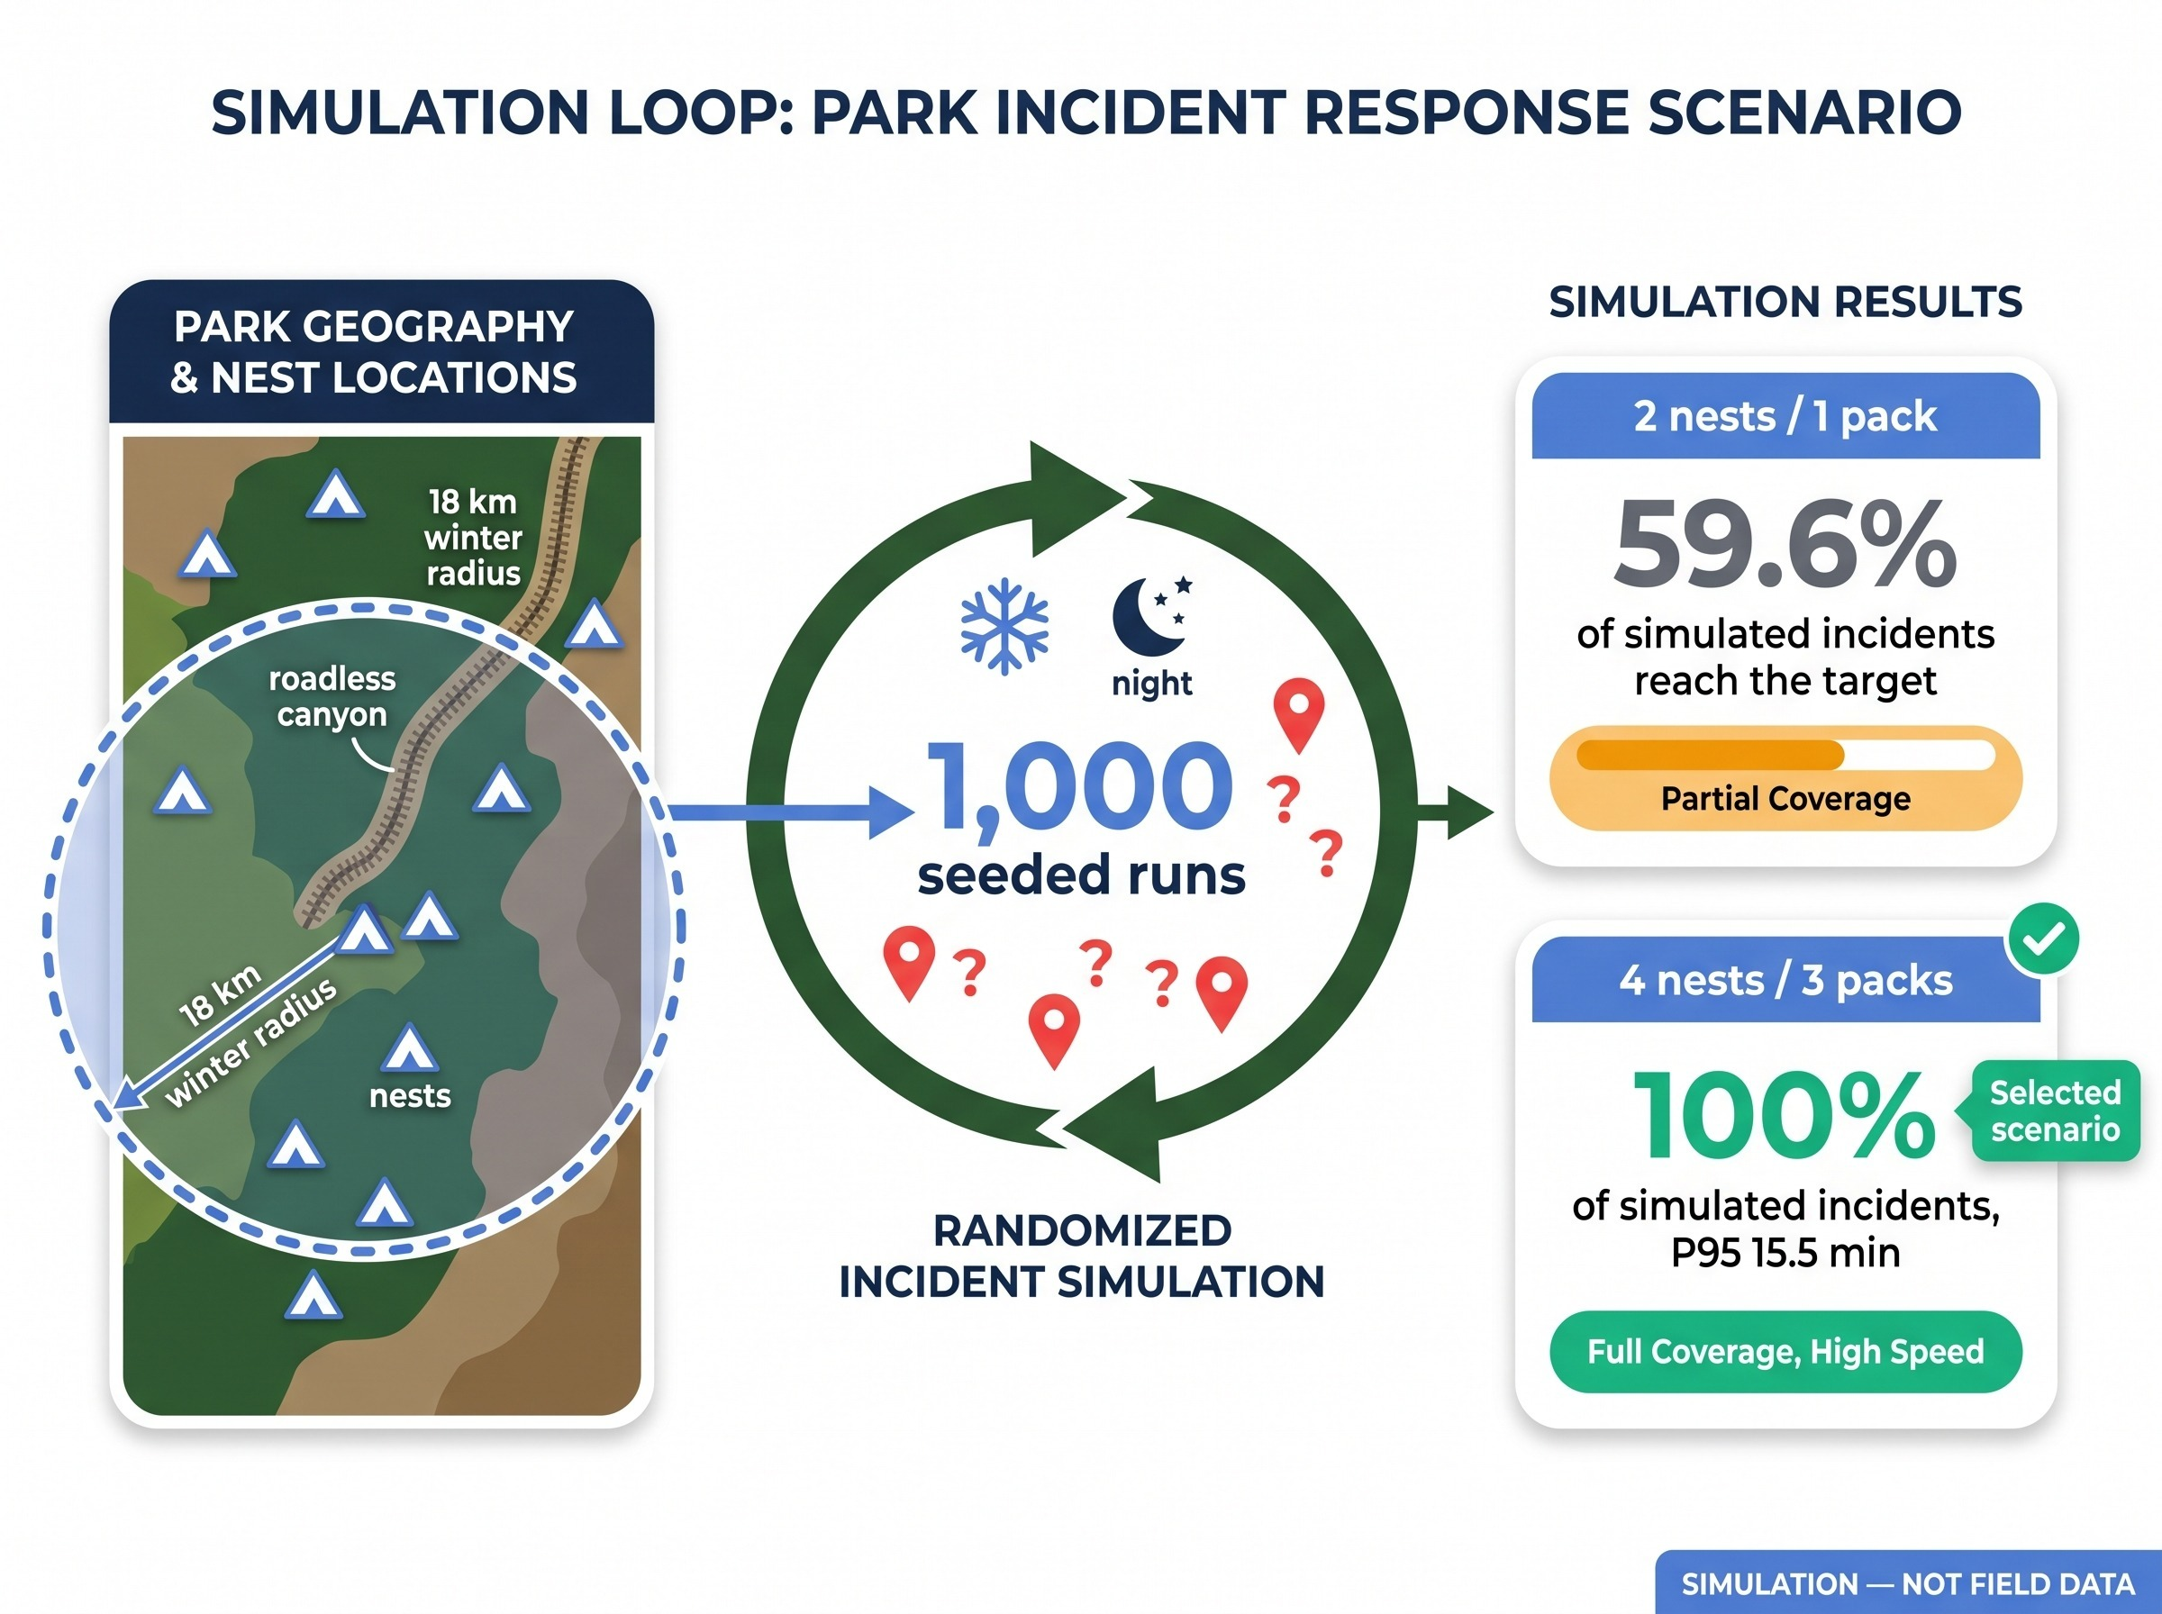
Sizing the Fleet With a Simulated Digital Twin
1,000-run seeded Monte Carlo (FIN-LAB-04)
Selected scenario: 4 nests, 3 packs, ~€185k, P95 15.5 min
All figures are simulation outputs, not field results. Validate against real incident data.

Slide 27
Eight BOM Lines and Four Sourcing Tiers
Core drone subsystem | EUR
Airframe, autopilot, GNSS, telemetry | 490
Pi 5 companion and bench kit | 115
Thermal + Starvis cameras | 255
LiDAR + optical flow | 90
Spotlight, sky-flare, release, speaker, cask | 99
Arctic battery and charger | 155
Safety-pilot RC and cells | 80
EMI ferrites and collar mic | 45
Total core drone | 1,329
All tiers under the project's €5,000 rule
Planning estimates, not quotations. Compatibility and procurement still to verify
Optional heated clamshell pad +€212. Trail posts, nests, deployment, training and programme costs are separate.

Slide 28
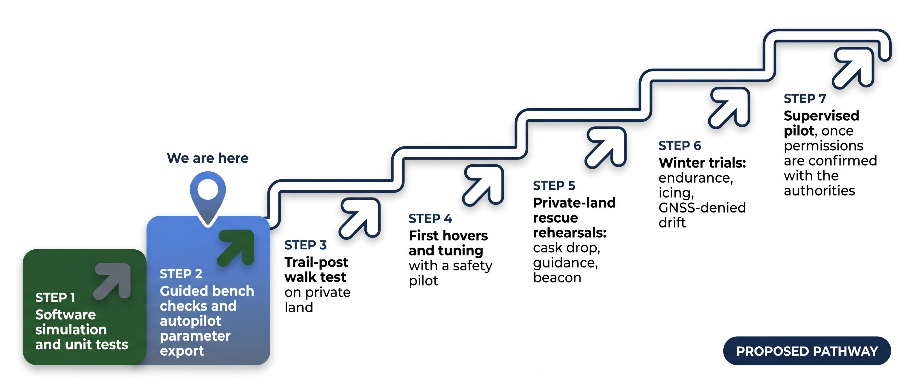
From Bench to Field: The Validation Ladder
Proposed pathway built from the design log and Finnish brief. Steps 3–7 have not been completed. Operational permissions and pilot requirements must be confirmed with Traficom and the tasking authorities; no certification or legal conclusion is implied.

Slide 29
Readiness and Verification Matrix
Capability | Designed | Simulated / unit-tested | Hardware bench | Field-validated | Authorised
Trail post and 48 h buffer | Yes | Yes (log) | Partial | Not yet | Not yet
Alert gate, dispatch, ranking | Yes | Yes (log) | n/a | Not yet | Not yet
Navigation layers and high altitude | Yes | Yes (log) | Partial | Not yet | Not yet
Links and lost-link behaviour | Yes | Yes (log) | Partial | Not yet | Not yet
Cask drop and guidance geometry | Yes | Yes (log) | Not yet | Not yet | Not yet
Immobilized-hiker beacon | Yes | Yes (log) | Not yet | Not yet | Not yet
Human pilot and two-way voice | Yes | Yes (log) | Partial | Not yet | Not yet
Winter battery and black box | Yes | Yes (log) | Not yet | Not yet | Not yet
FIN-LAB adapters and ingest | Yes | Yes (log) | n/a | Not yet | Not yet
Fleet digital twin | Yes | Yes (log) | n/a | Not yet | n/a
29 unit-test suites reported passing in the design log (historical, not re-run) · audit findings F01–F53 recorded as resolved · physical assembly and live tuning self-reported in the source as about 20% (historical, unverified). "Partial" means bench tooling or parts exist but assembly is incomplete. "Authorised" requires confirmation by the relevant authorities. Not a certified aircraft or medical device.

Slide 30
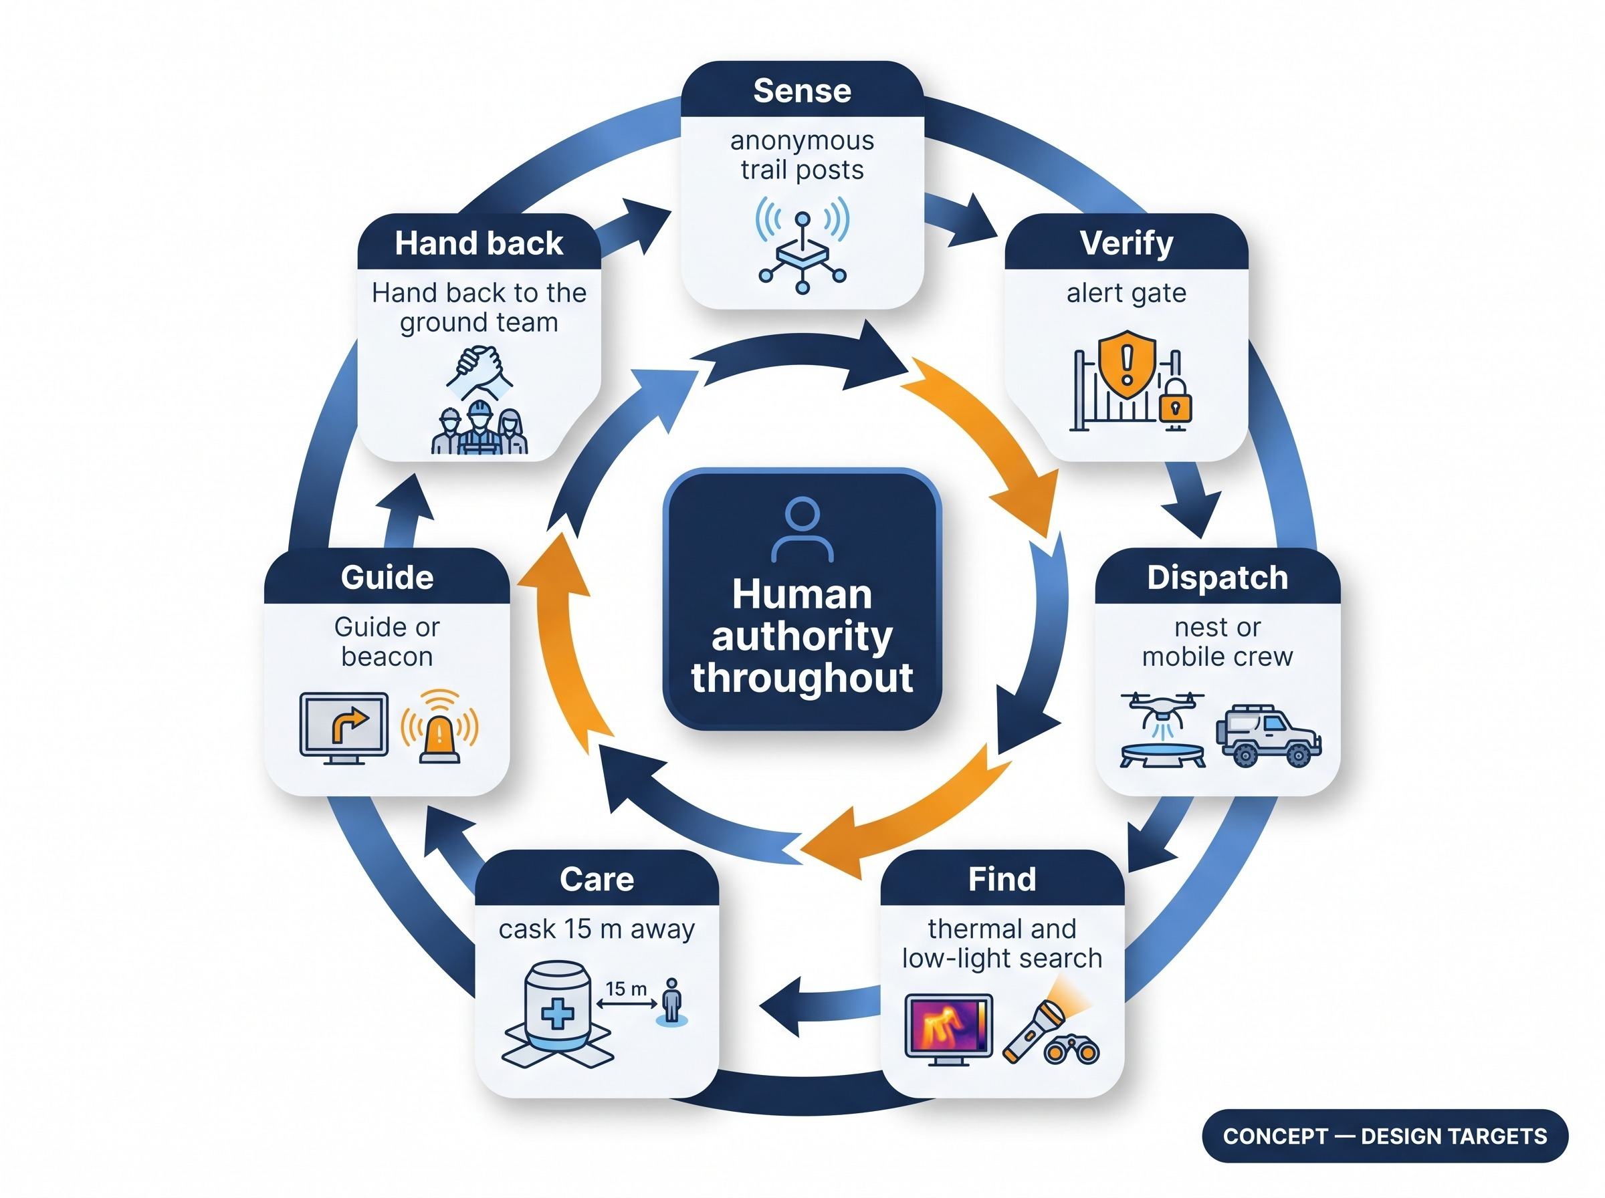
Recap and Sources
Source
README.md & DESIGN_EVOLUTION_AND_STABILIZATION_LOG.md, 20 October 2026: README and Finnish brief (v1.6); design log and technical guide (v2.0, F01–F53)
The packet's editorial reconciliation is applied on every slide
Where versions conflict, v2.0 governs: €1,329 core BOM, 1,500 lm spotlight, 256×192 thermal
Status
Draft for discussion; open-source reference design
Performance figures are design targets or simulation outputs
Agency links are proposed interfaces
Full source code & unit tests in repository.

