Slide 1
CS21
Decidability and Tractability
Lecture 27
March 12, 2014
March 12, 2014
CS21 Lecture 27

Slide 2
Outline
“Challenges to the (extended) Church-Turing Thesis”
  randomized computation
  quantum computation
March 12, 2014
CS21 Lecture 27

Slide 3
Extended Church-Turing Thesis
the belief that TMs formalize our intuitive notion of an efficient algorithm is:
quantum computation challenges this belief
The “extended” Church-Turing Thesis
everything we can compute in time t(n) on a physical computer can be computed on a Turing Machine in time t(n)^{O(1)} (polynomial slowdown)
March 12, 2014
CS21 Lecture 27

Slide 4
For use later…
Fourier transform:
time domain
frequency domain
r
can recover r from position
time domain
frequency domain
March 12, 2014
CS21 Lecture 27

Slide 5
A different model
infinite tape of a Turing Machine is an idealized model of computer
real computer is a Finite Automaton (!)
  n bits of memory
  2^{n} states
March 12, 2014
CS21 Lecture 27

Slide 6
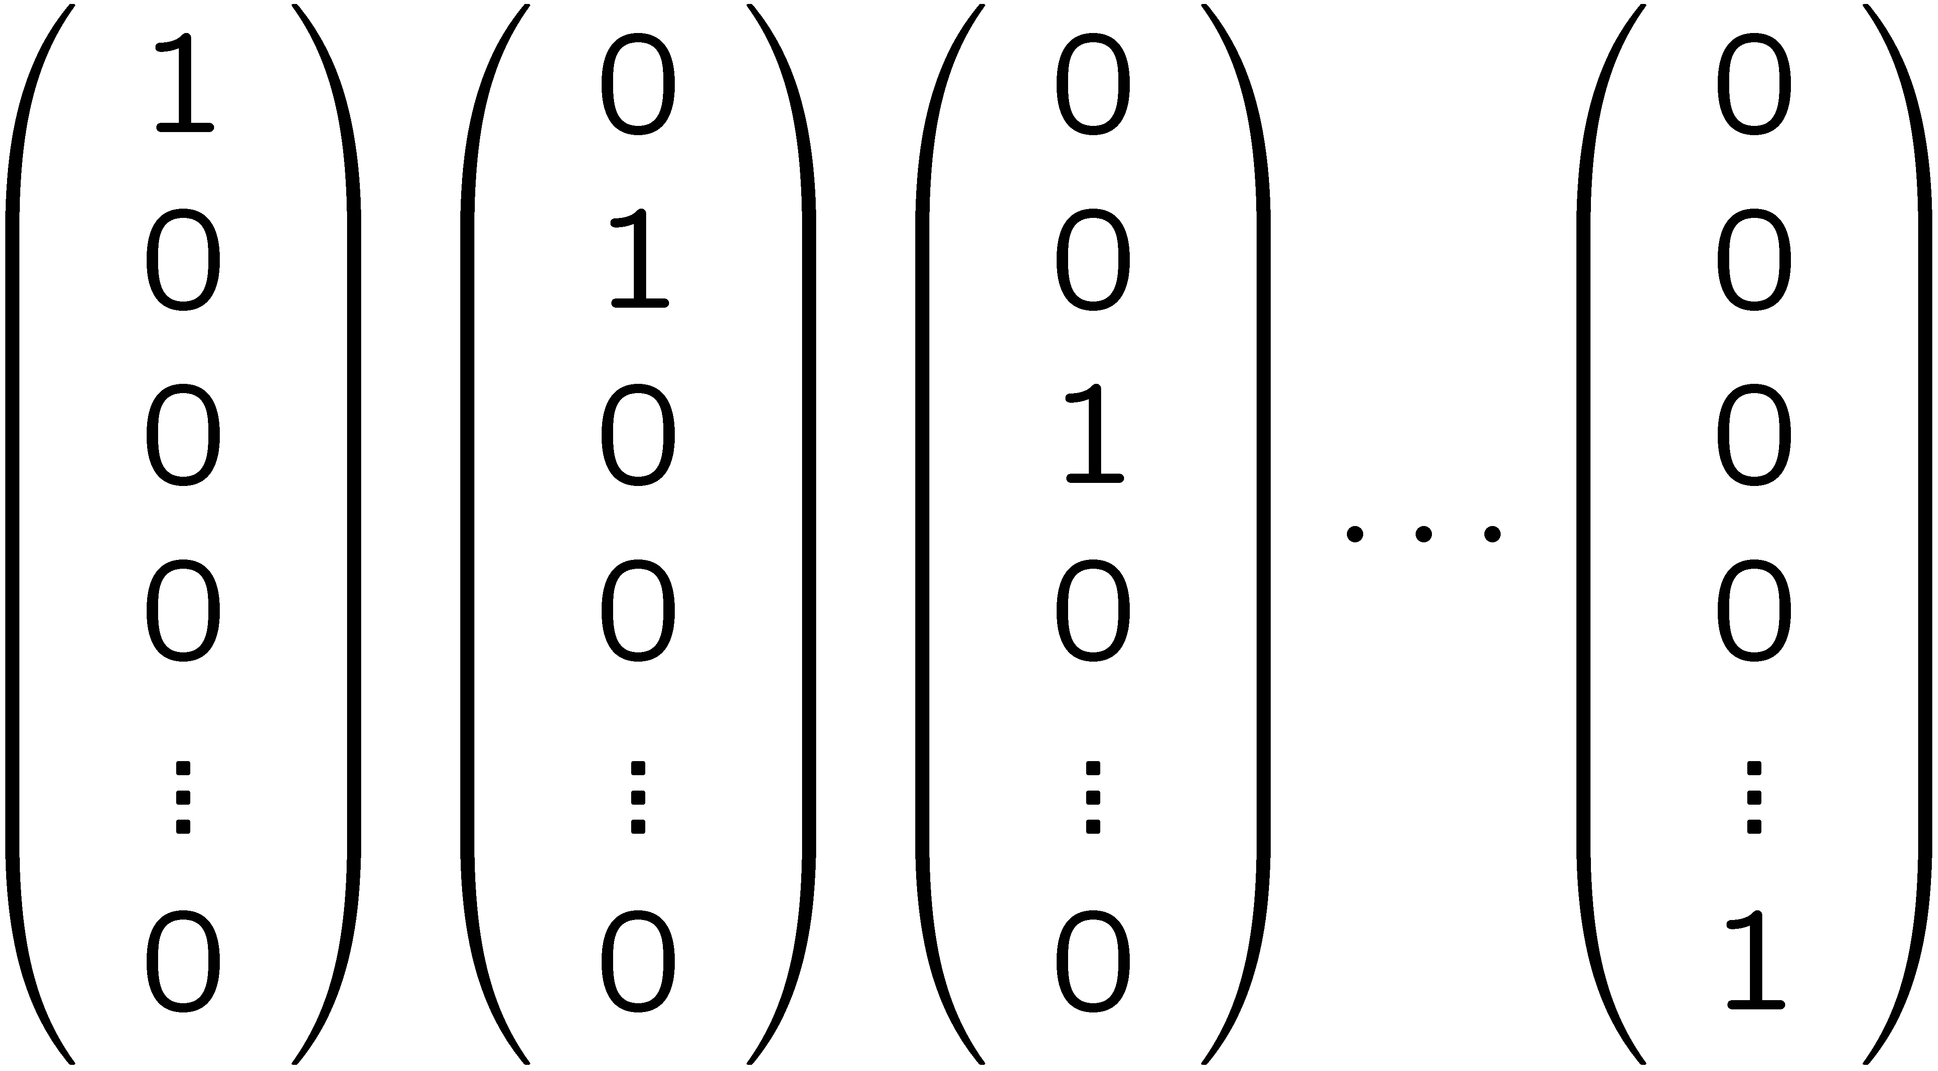
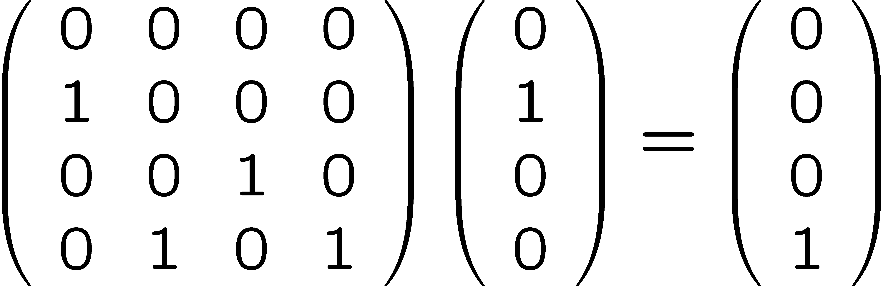
Model of deterministic computation
2^{n} possible basic states
state at time t+1
state at time t
one 1 per column
March 12, 2014
CS21 Lecture 27

Slide 7
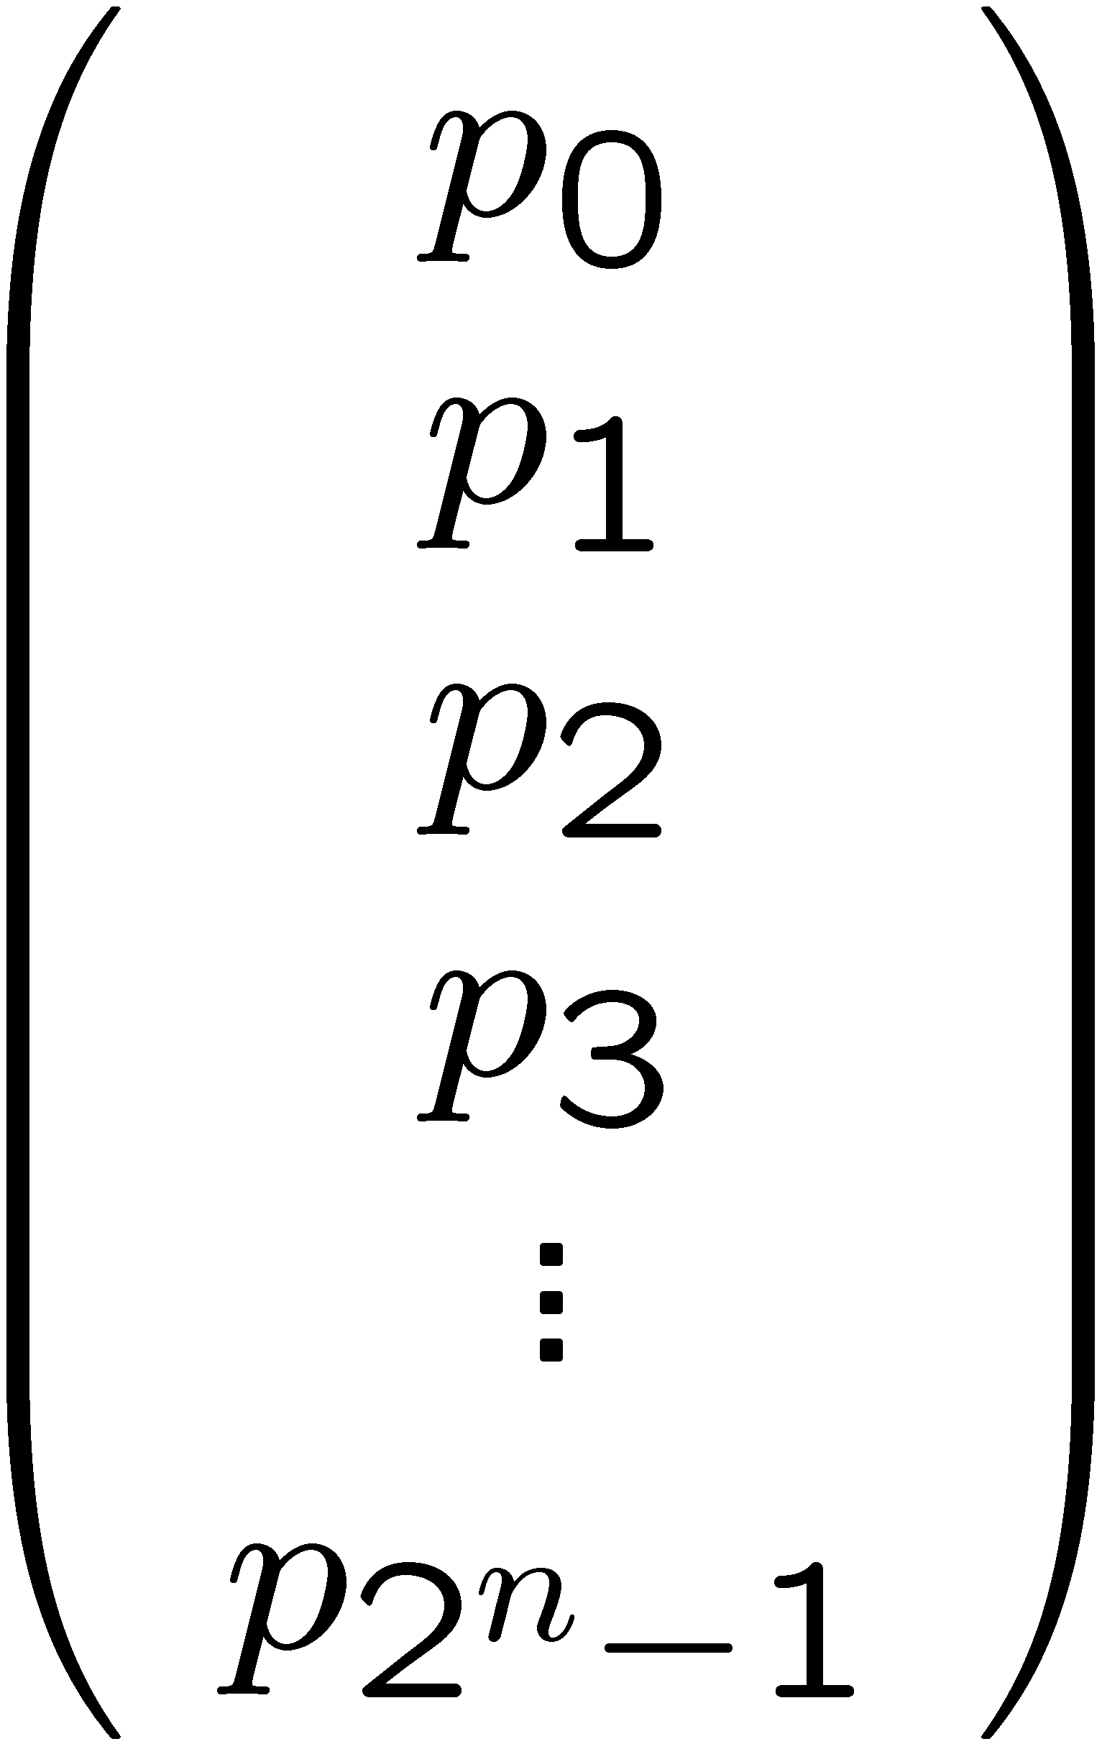
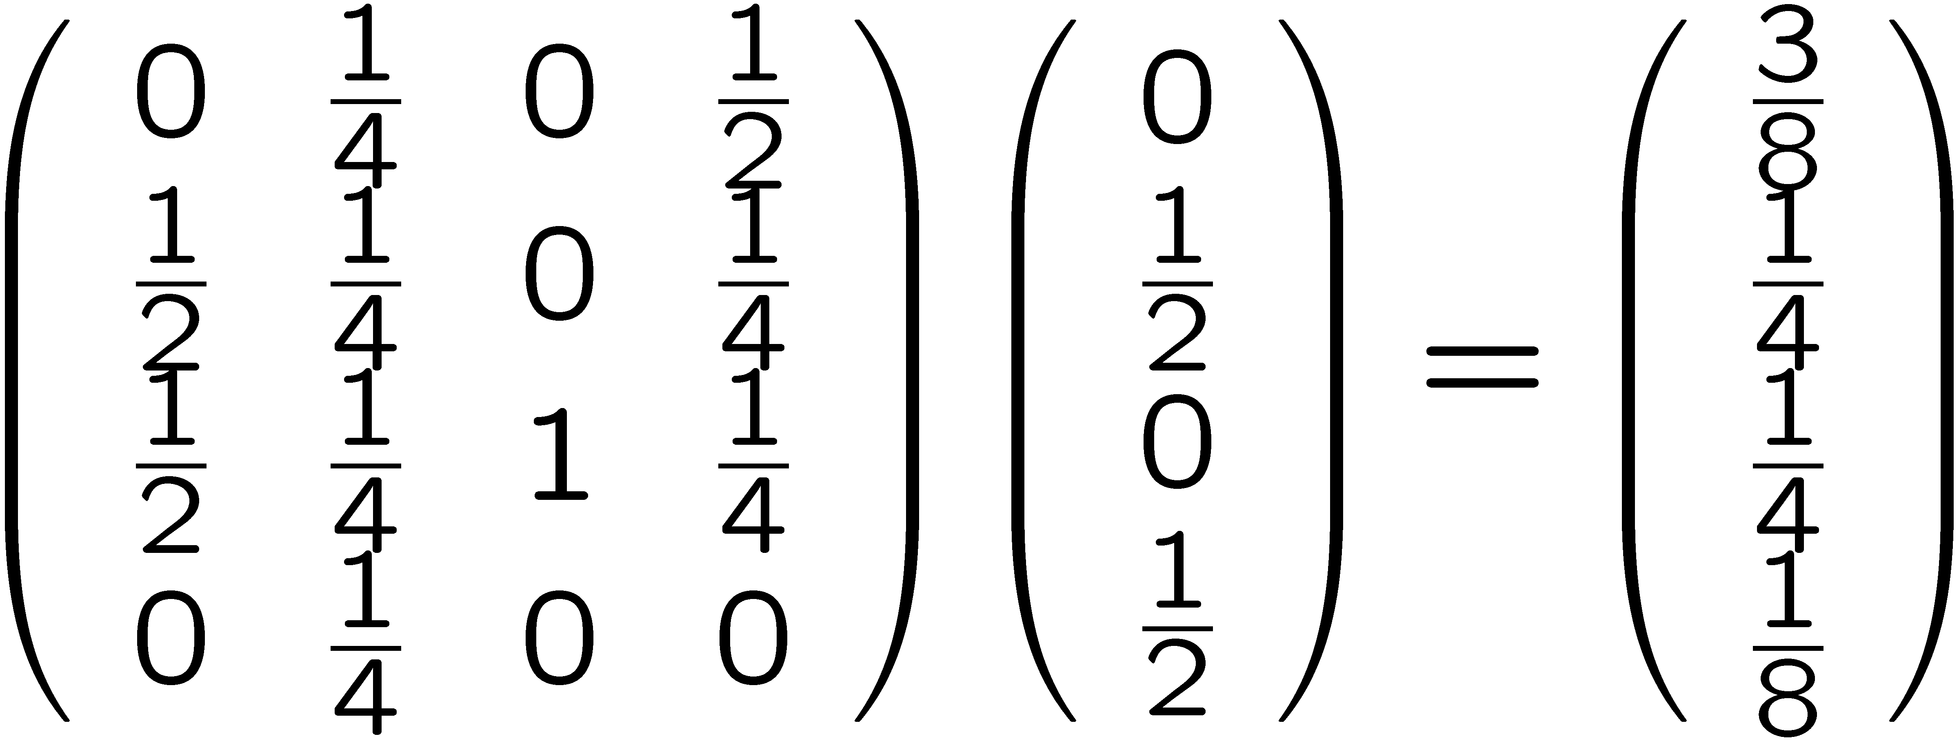
Model of randomized computation
possible states at time t:
∑ p_{i} = 1 p_{i} ∈ R⁺
state at time t+1
state at time t
“stochastic matrix ” sum in each column = 1
March 12, 2014
CS21 Lecture 27

Slide 8
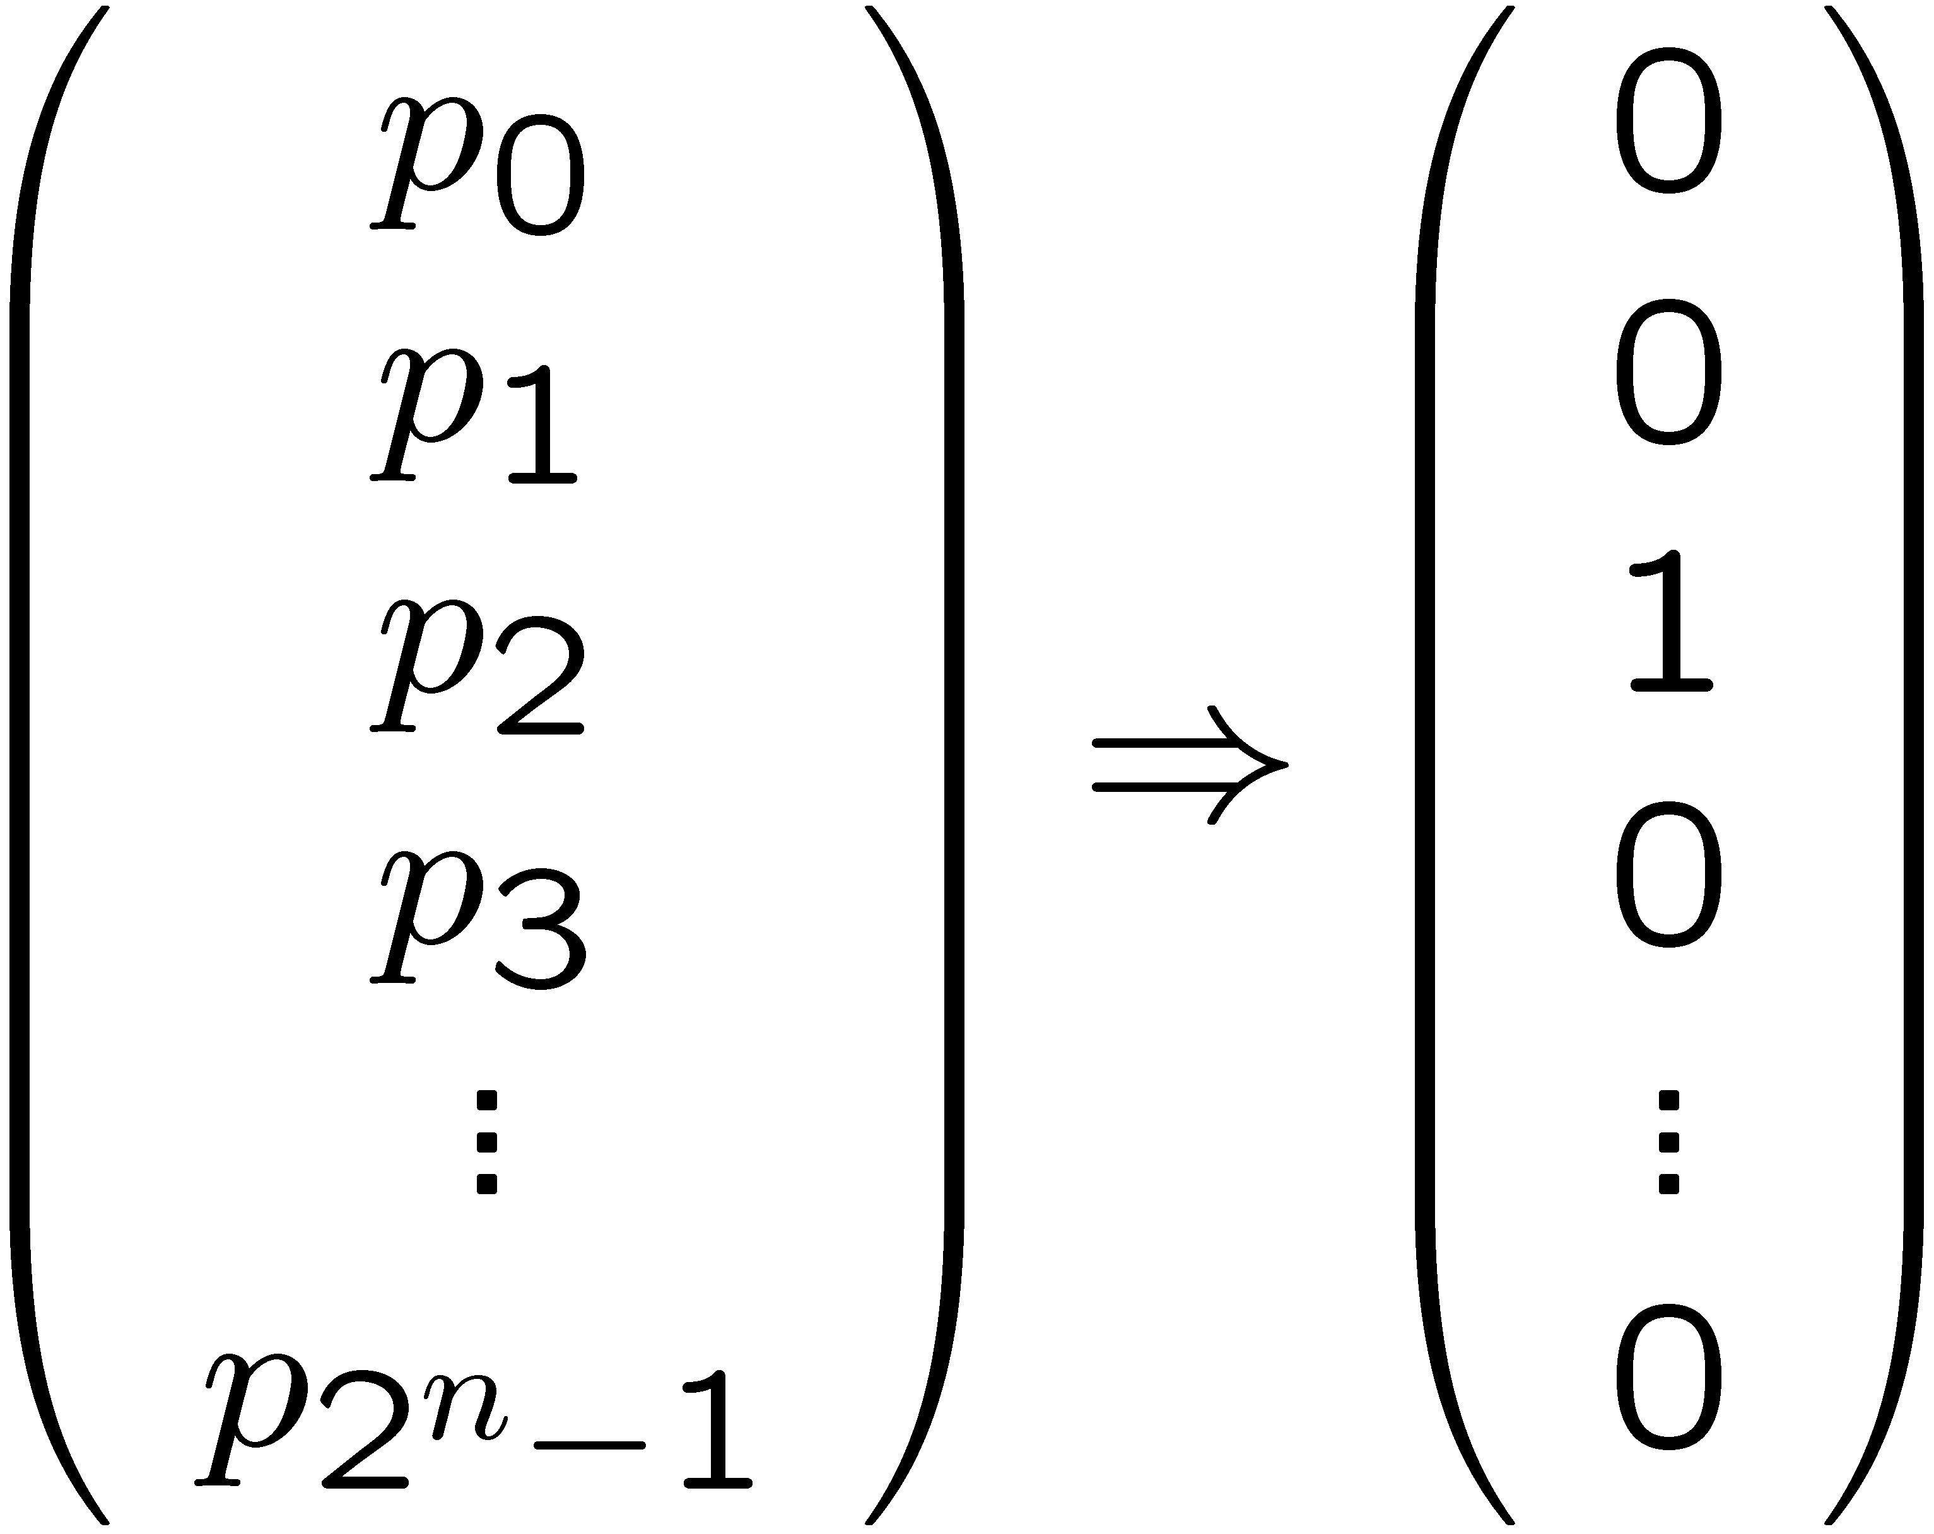
Model of randomized computation
at end of computation, see specific state
demand correct result with high probability
think of as “measuring” system:
see i^{th} basic state with probability p_{i}
March 12, 2014
CS21 Lecture 27

Slide 9
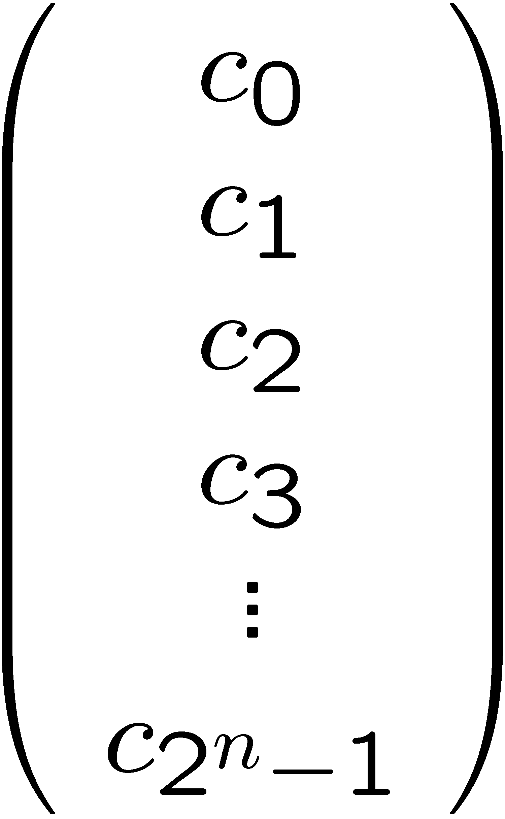
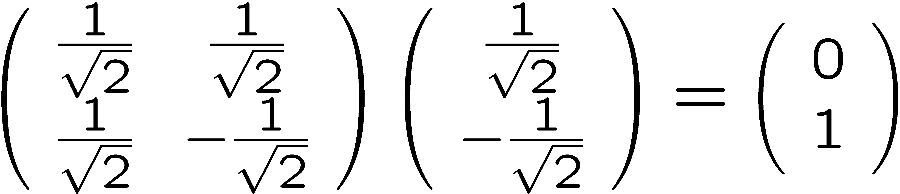
Model of quantum computation
possible states at time t:
∑ |c_{i}|² = 1 c_{i} ∈ C
state at time t+1
state at time t
“unitary matrix ” preserves L₂ norm
March 12, 2014
CS21 Lecture 27

Slide 10
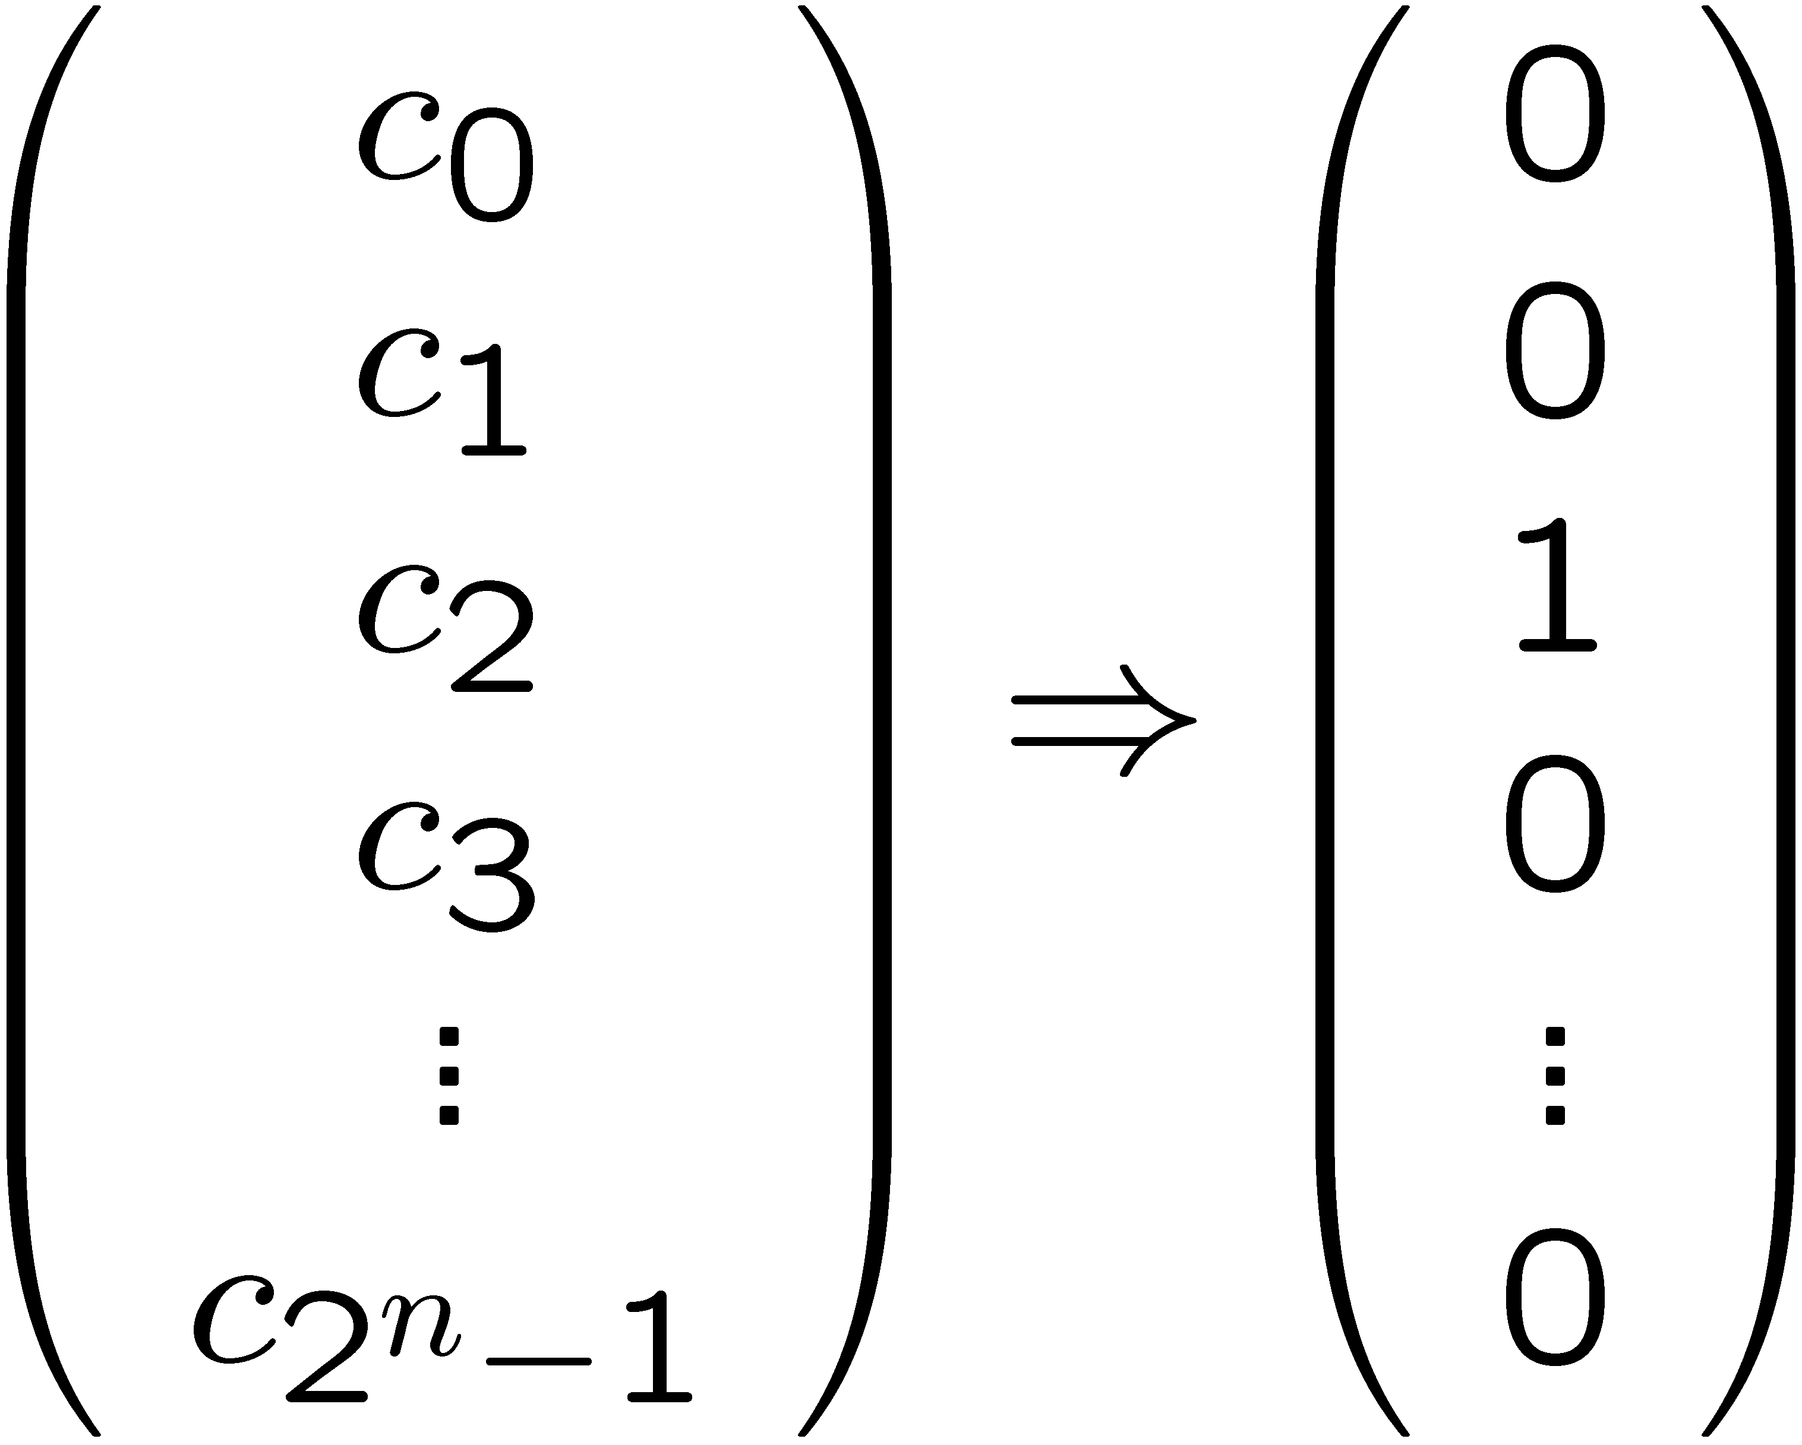
Model of quantum computation
at end of computation, see specific state
think of as “measuring” system:
see i^{th} basic state with probability |c_{i}|²
March 12, 2014
CS21 Lecture 27

Slide 11
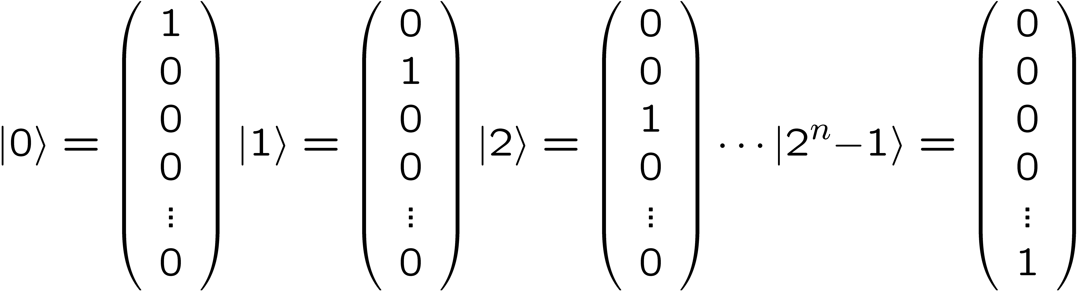
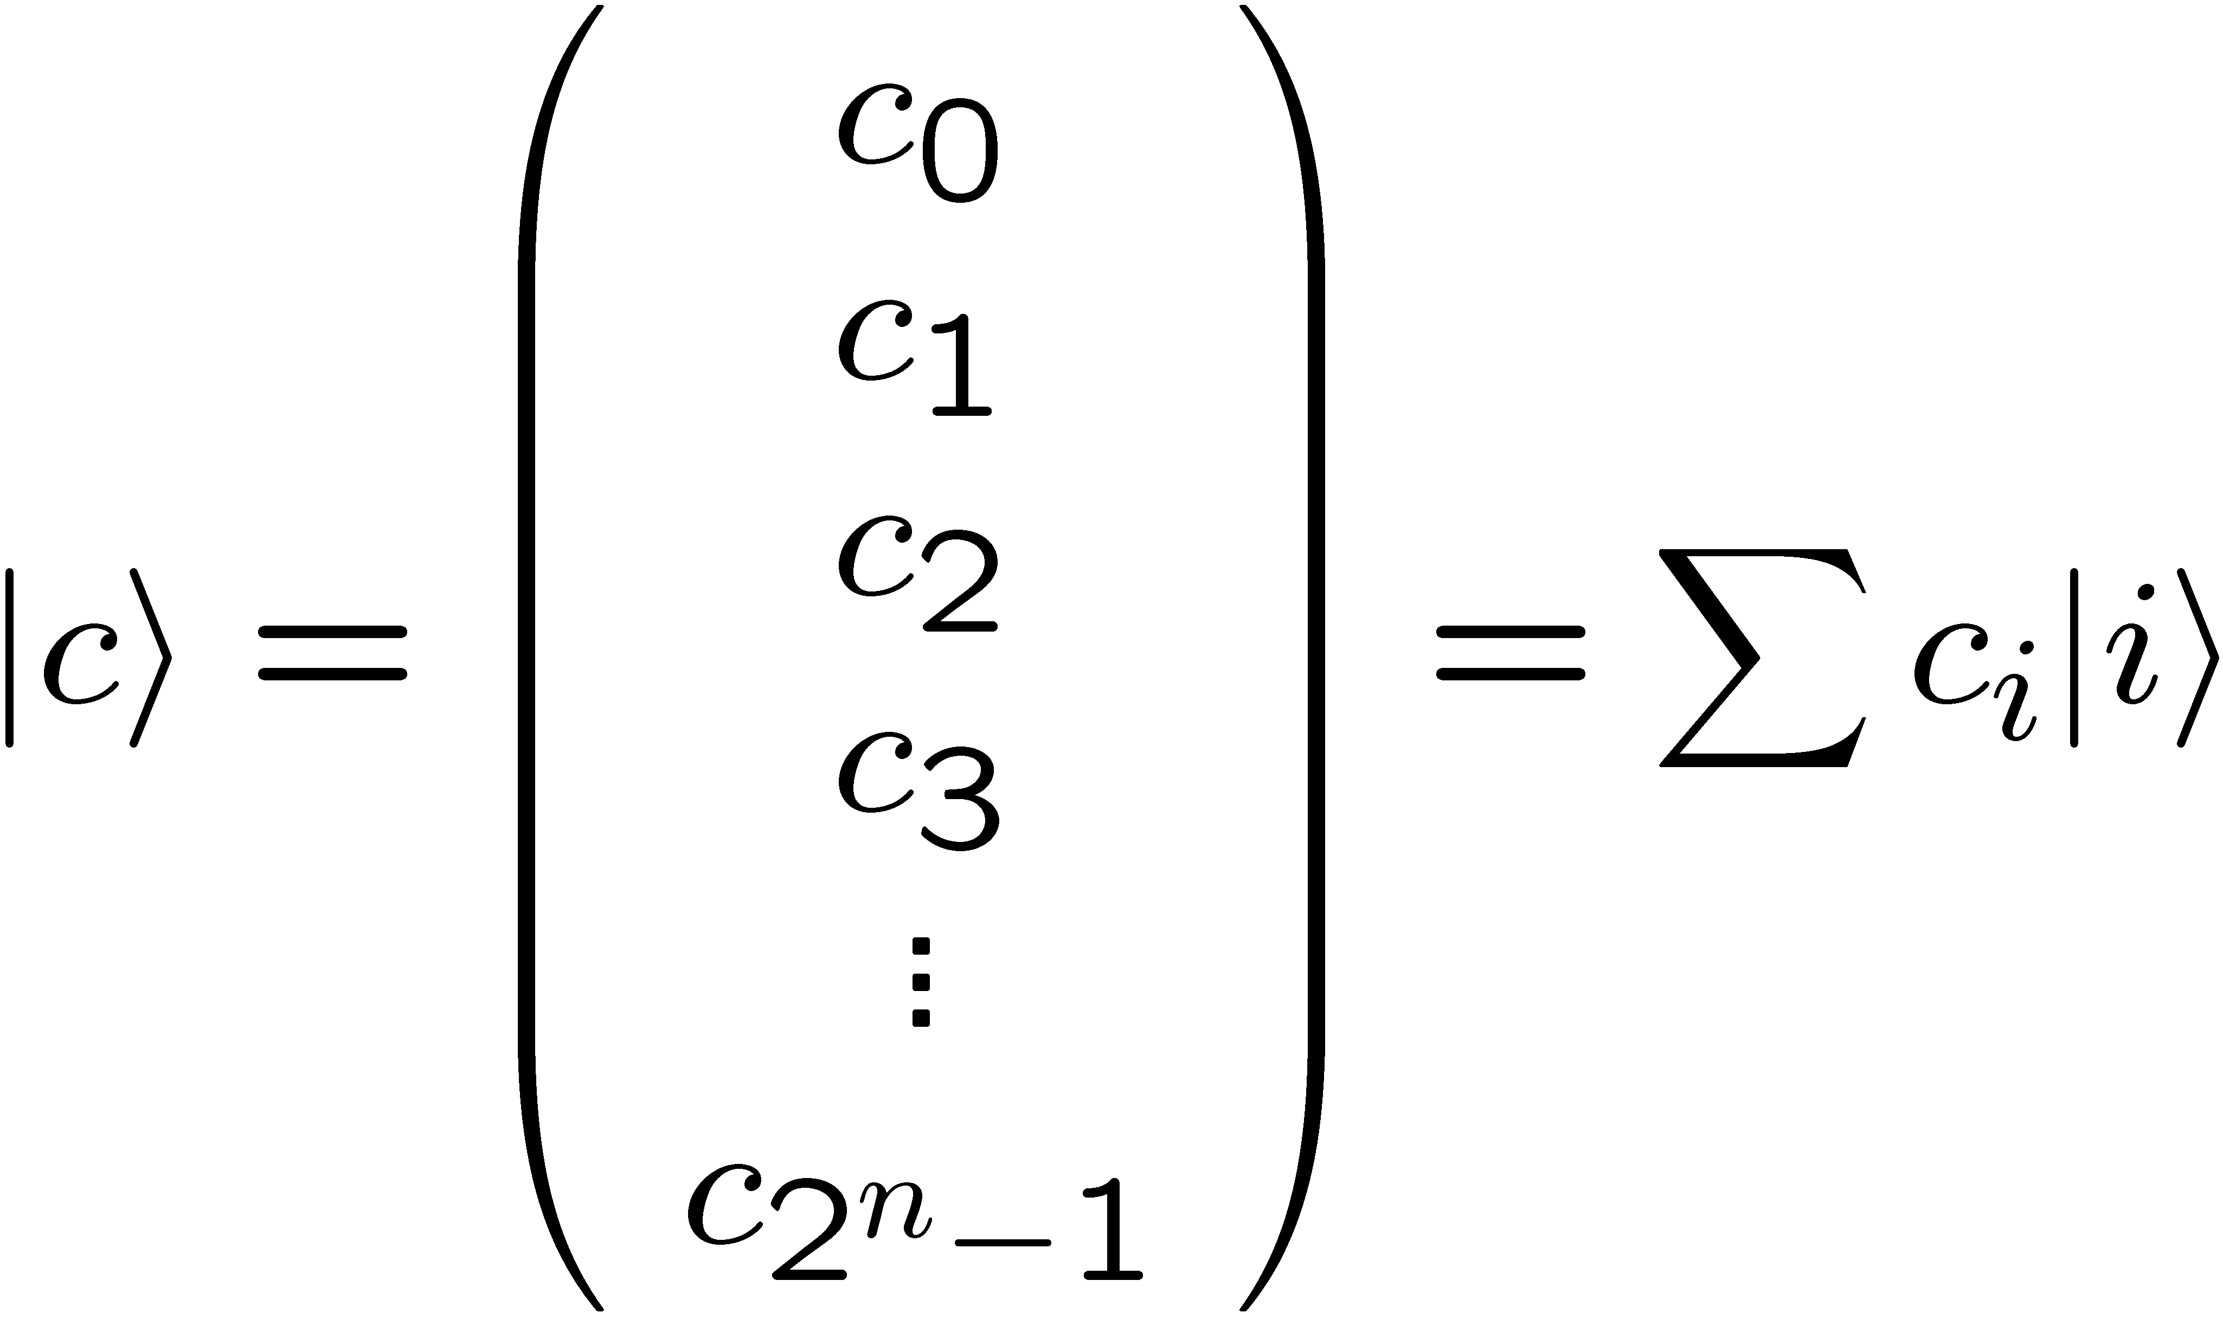
One quantum register
register with n qubits; shorthand for basic states
shorthand for general state
March 12, 2014
CS21 Lecture 27

Slide 12
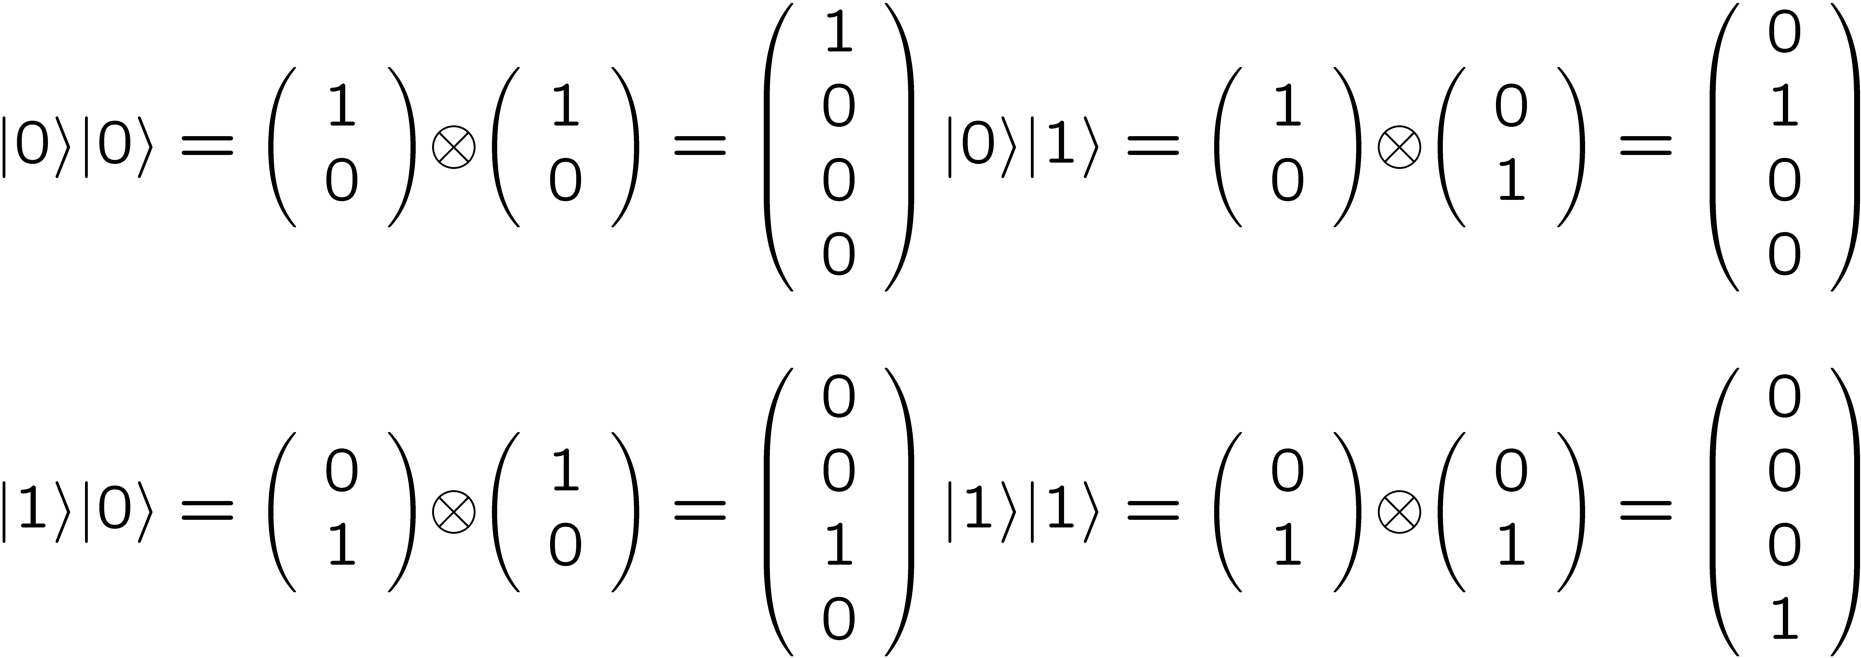
Two quantum registers
registers with n, m qubits: shorthand for 2^{n+m} basic states:
March 12, 2014
CS21 Lecture 27

Slide 13
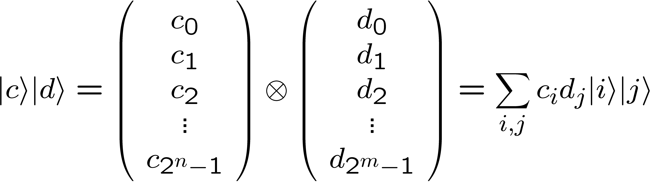
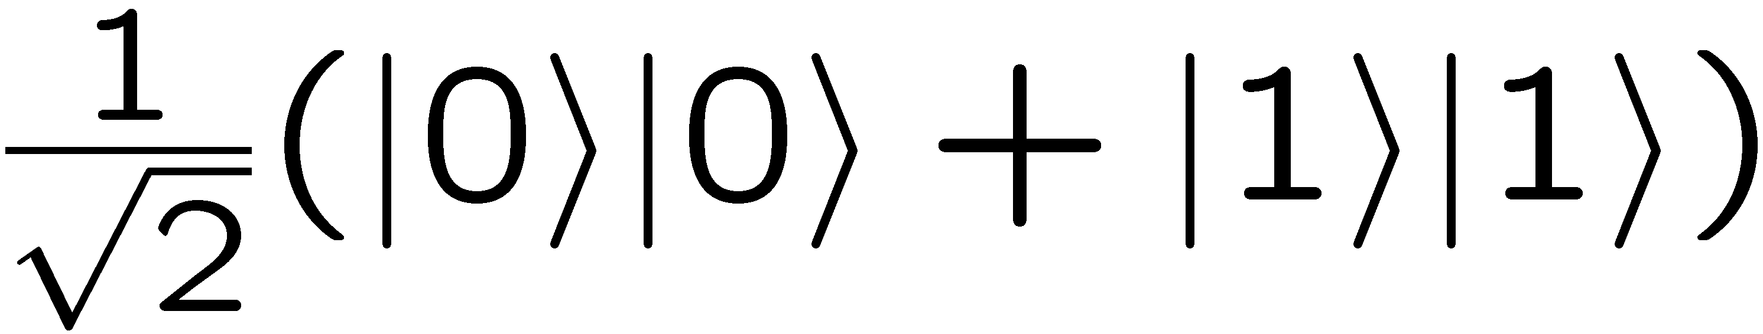
Two quantum registers
shorthand for general unentangled state
shorthand for any other state (entangled state)
|a⟩ = ∑_{i,j} a_{i,j}|i⟩|j⟩
example:
March 12, 2014
CS21 Lecture 27

Slide 14
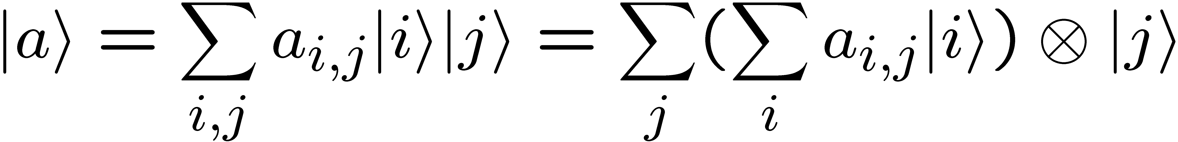
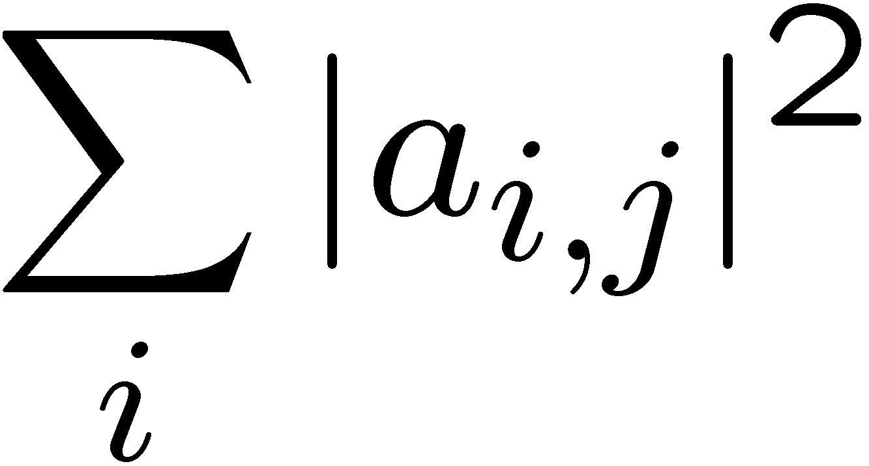
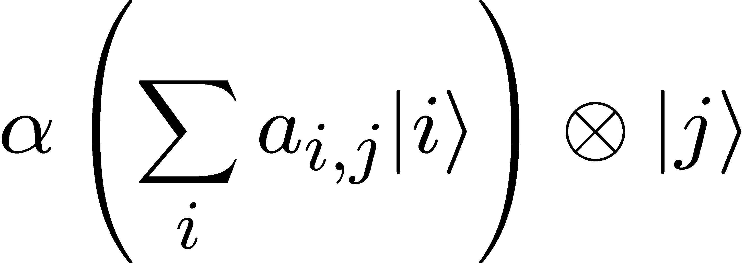
Partial measurement
general state:
if measure just the 2nd register, see state |j⟩ in 2nd register with probability
state collapses to:
normalization constant
March 12, 2014
CS21 Lecture 27

Slide 15
EPR paradox
register 1 in LA, register 2 sent to NYC
measure register 2
  probability ½: see |0⟩, state collapses to |0⟩|0⟩
  probability ½: see |1⟩, state collapses to |1⟩|1⟩
measure register 1
  guaranteed to be same as observed in NYC
  instantaneous “communication”
March 12, 2014
CS21 Lecture 27

Slide 16
Quantum complexity
classical computation of function f
some functions are easy, some hard
need to measure “complexity” of M_{f}
x^{th} position
f(x)^{th} position
M_{f} = transition matrix for f
March 12, 2014
CS21 Lecture 27

Slide 17
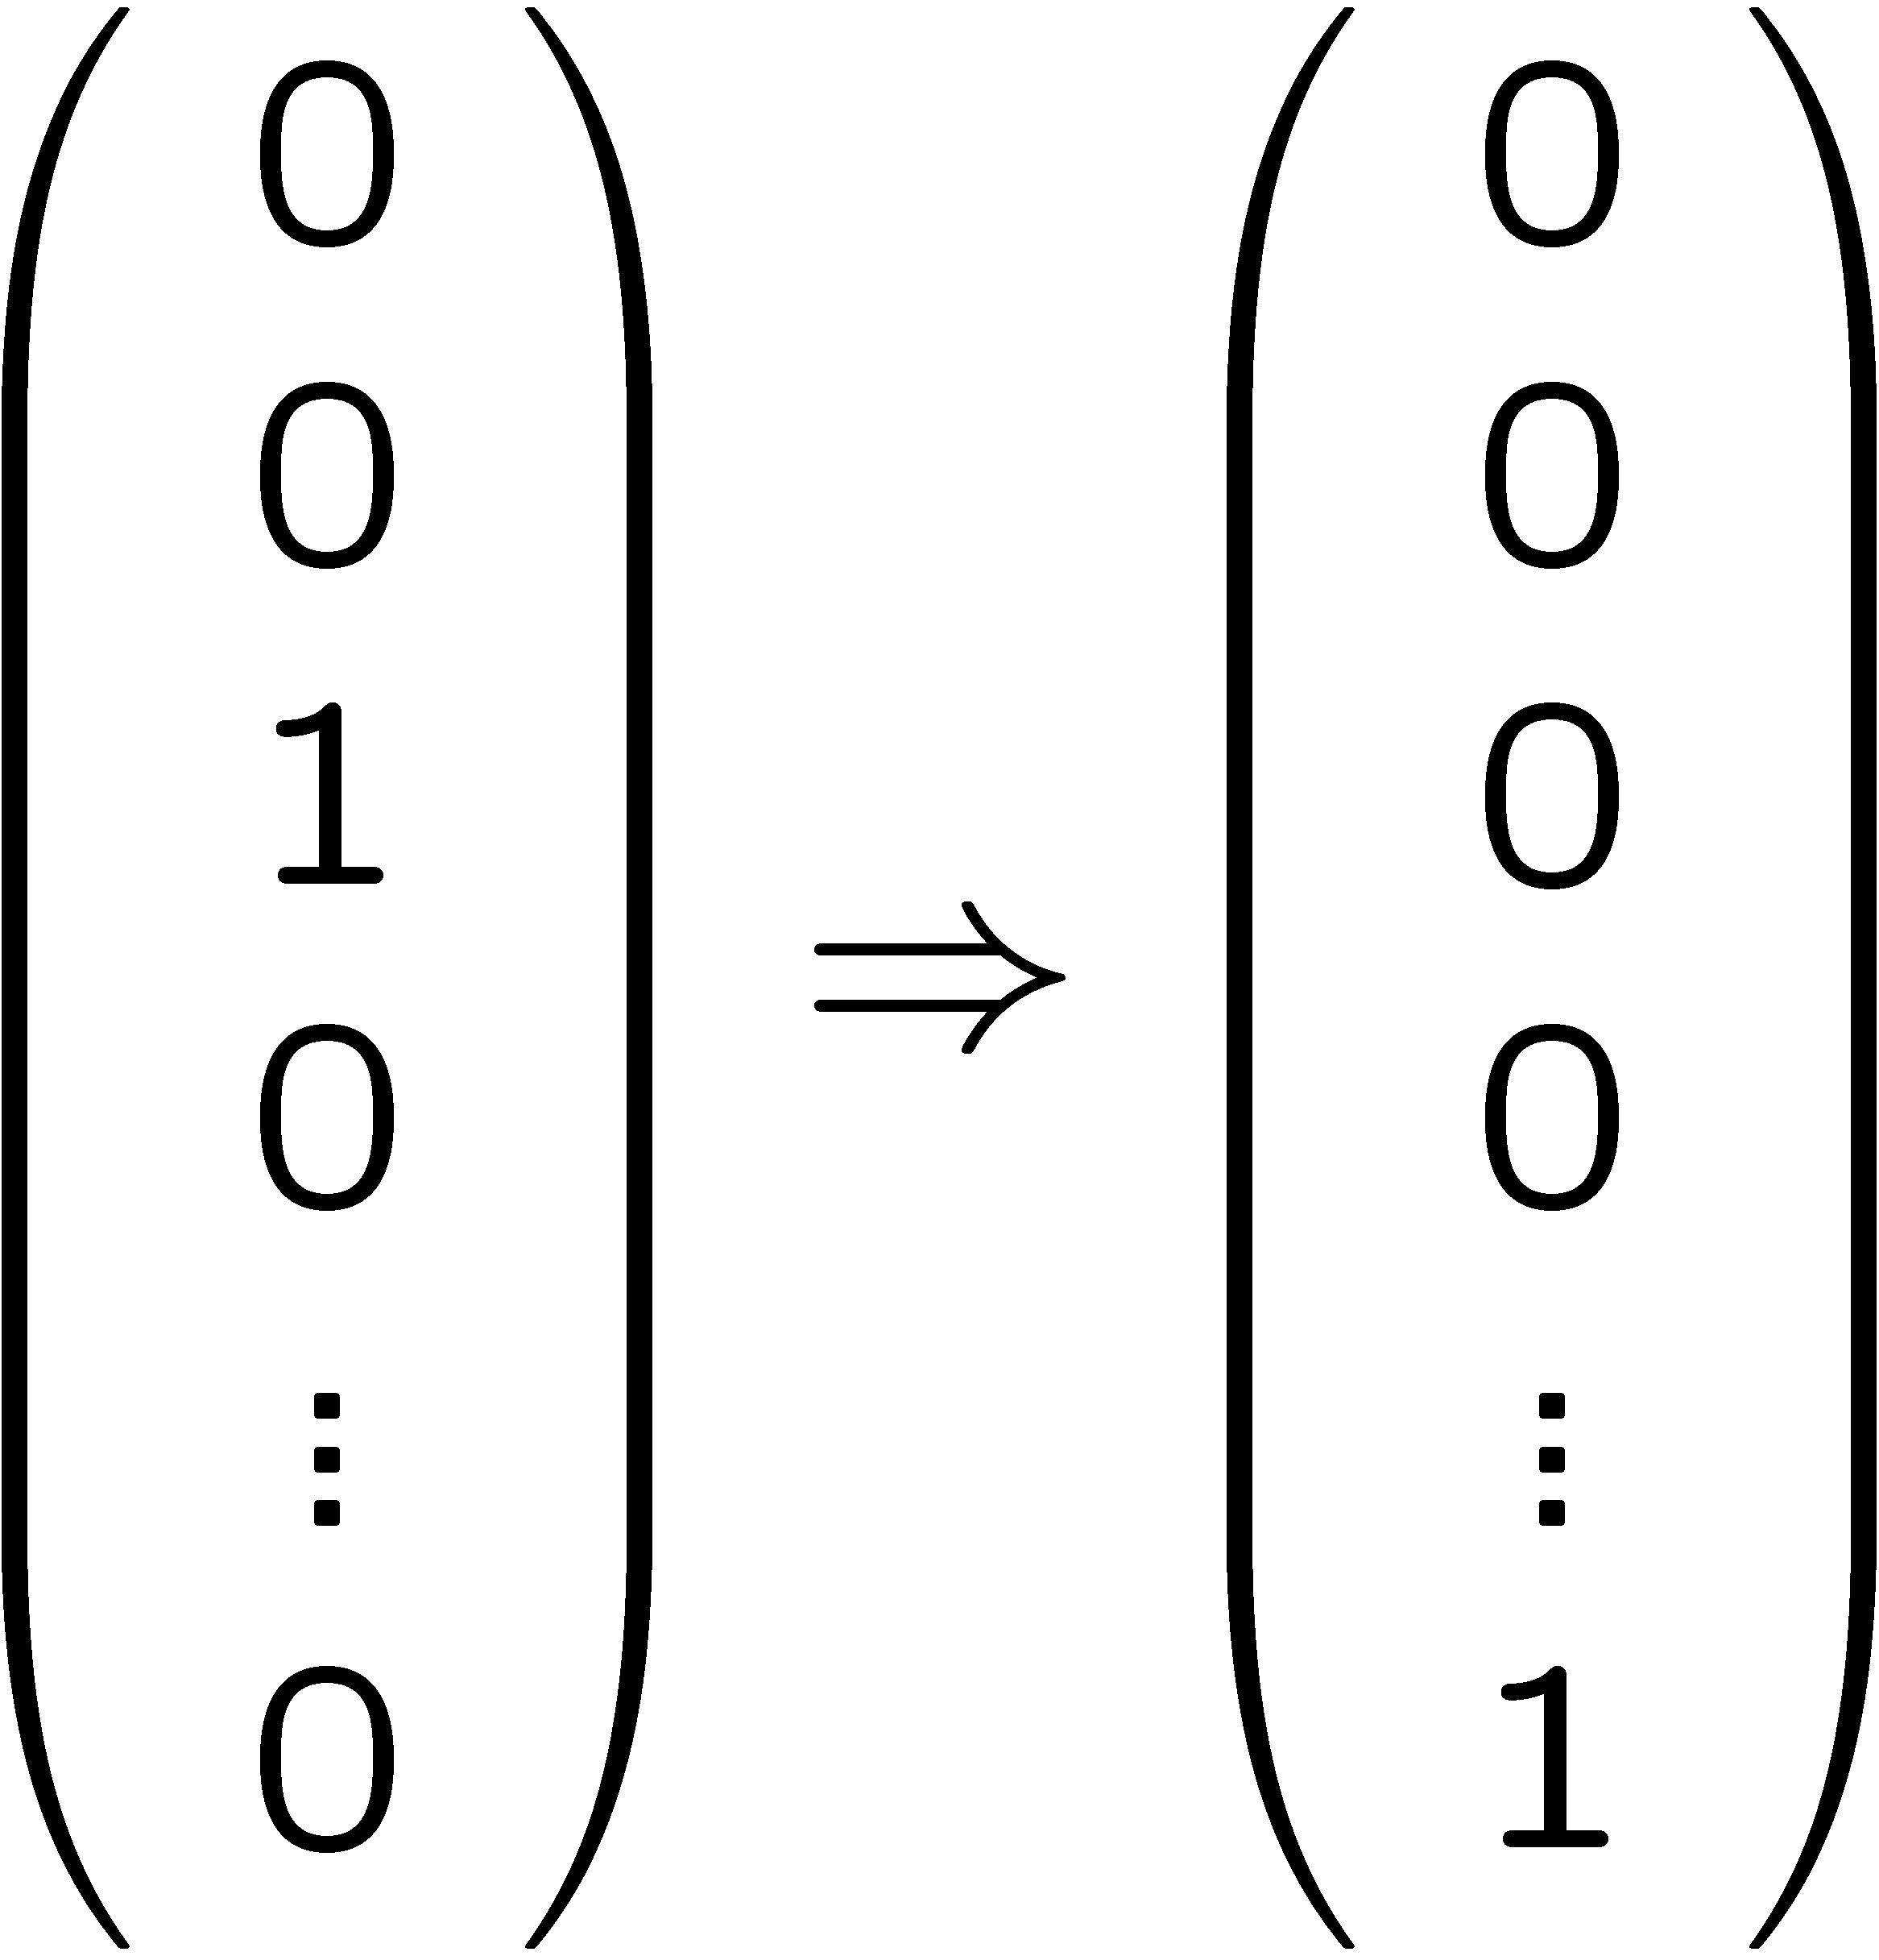
Quantum complexity
one measure: complexity of f =
length of shortest sequence of local operations computing f
example local operation:
position x = 0010
logical OR
position x’ = 1010
March 12, 2014
CS21 Lecture 27

Slide 18
Quantum complexity
analogous notion of “local operation” for quantum systems
in each step
  split qubits into register of 1 or 2, and rest
  operate only on small register
“efficient” in both settings: # local operations polynomial in # bits n
March 12, 2014
CS21 Lecture 27

Slide 19
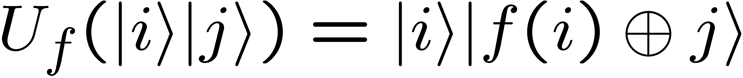
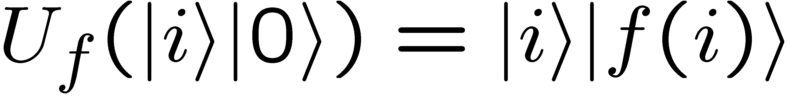
Efficiently quantum computable functions
For every f:{0,1}^{n} → {0,1}^{m} that is efficiently computable classically
the unitary transform U_{f}:
note, when 2nd register = |0⟩:
March 12, 2014
CS21 Lecture 27

Slide 20
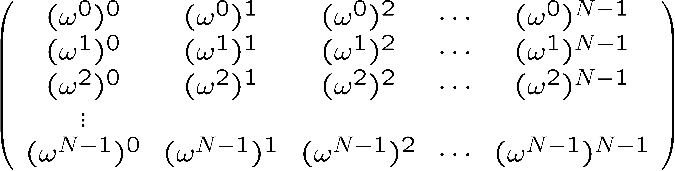
Efficiently quantum computable functions
Fourier Transform
  N=2^{n}; ω such that ω^{N} = 1; unitary matrix FT =
  usual FT dimension n; this is dimension N
  note: FT ⋅ |0⟩ = all ones vector
March 12, 2014
CS21 Lecture 27

Slide 21
Shor’s factoring algorithm
well-known: factoring equivalent to order finding
  input: y, N
  output : smallest r>0 such that
  y^{r} = 1 mod N
March 12, 2014
CS21 Lecture 27

Slide 22
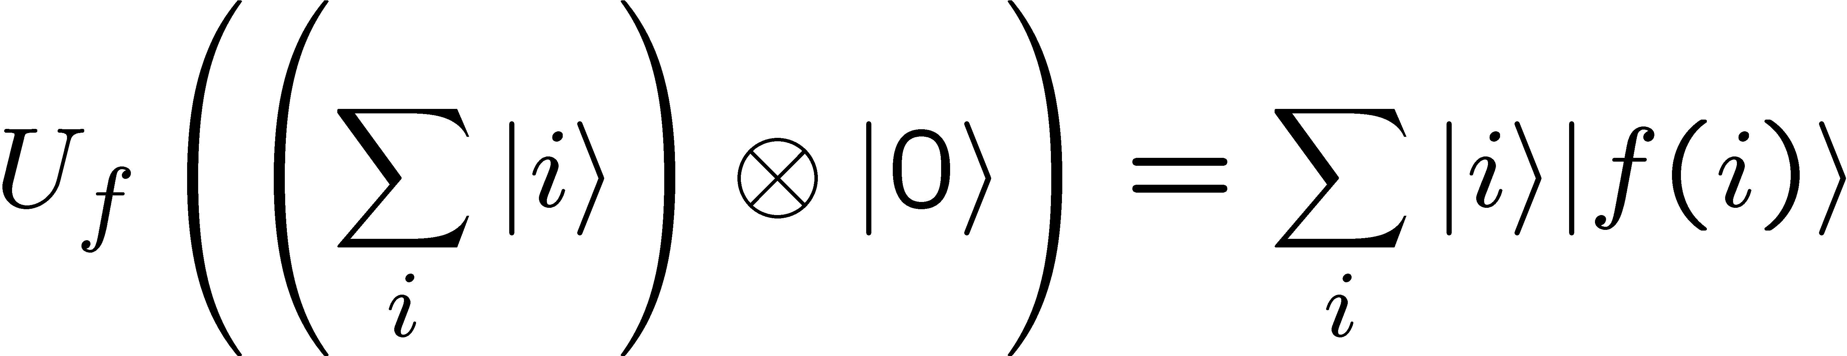
Factoring: step 1
input: y, N
start state: |0⟩|0⟩
apply FT on register 1: (∑ |i⟩) ⊗ |0⟩
apply U_{f} for function f(i) = y^{i} mod N
“quantum parallelization”
March 12, 2014
CS21 Lecture 27

Slide 23
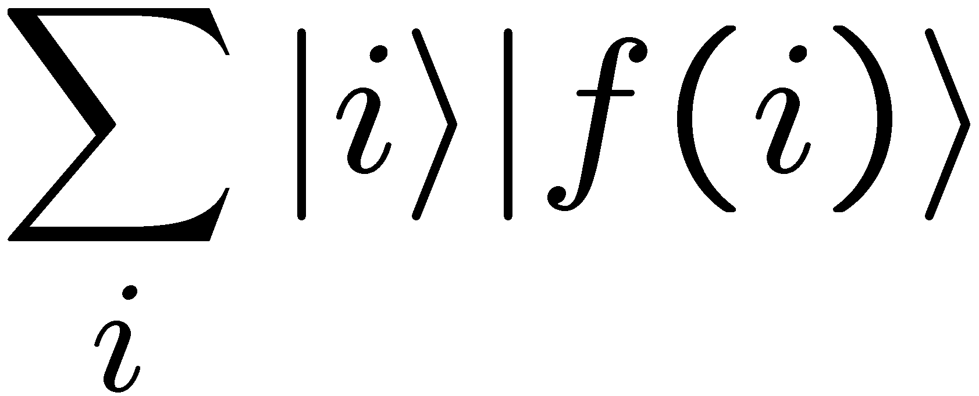
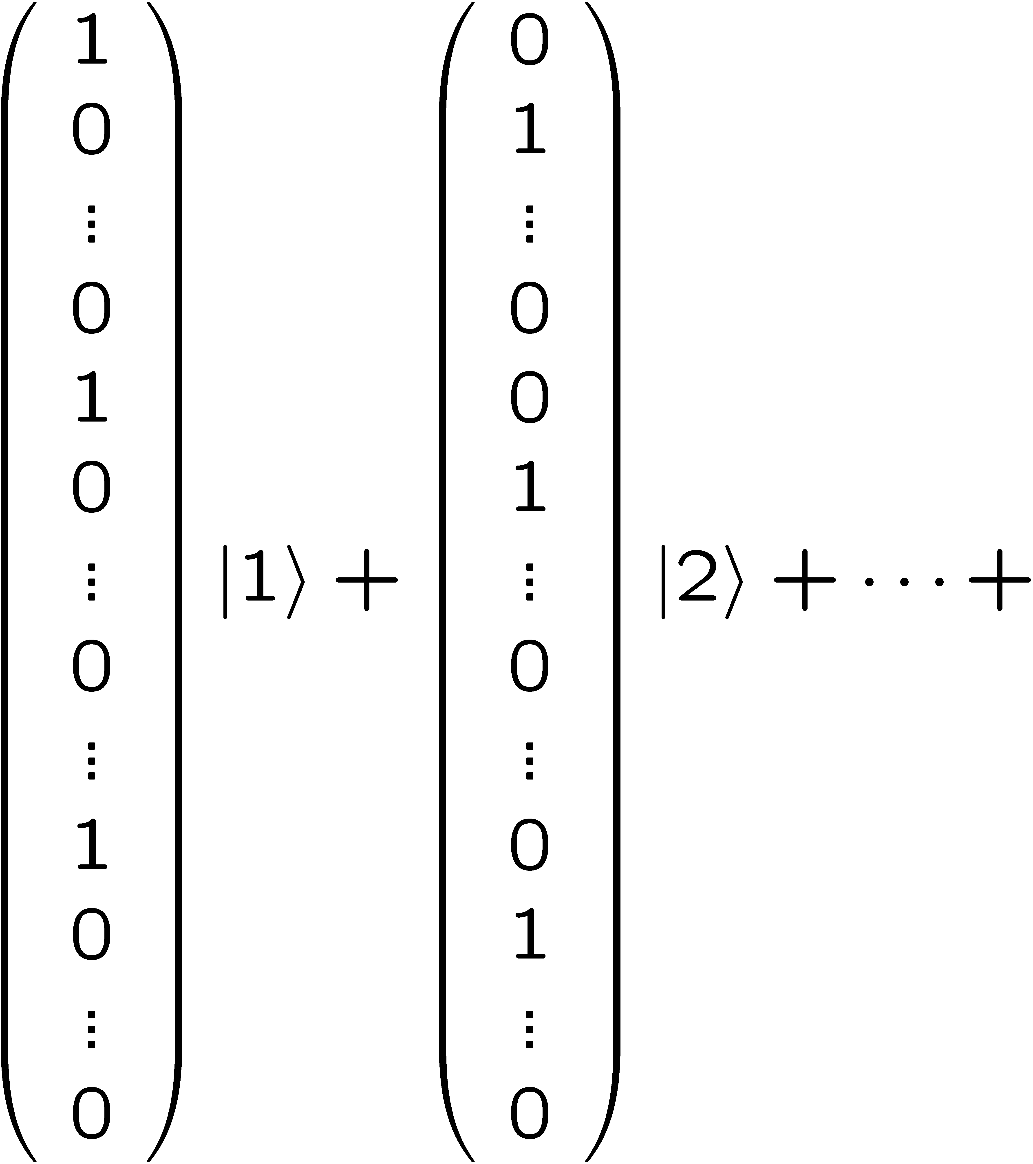
Factoring: step 1
given y, N; f(i) = y^{i} mod N; have
in each vector, period = r, the order of y mod N
offset depends on 2nd register
March 12, 2014
CS21 Lecture 27

Slide 24
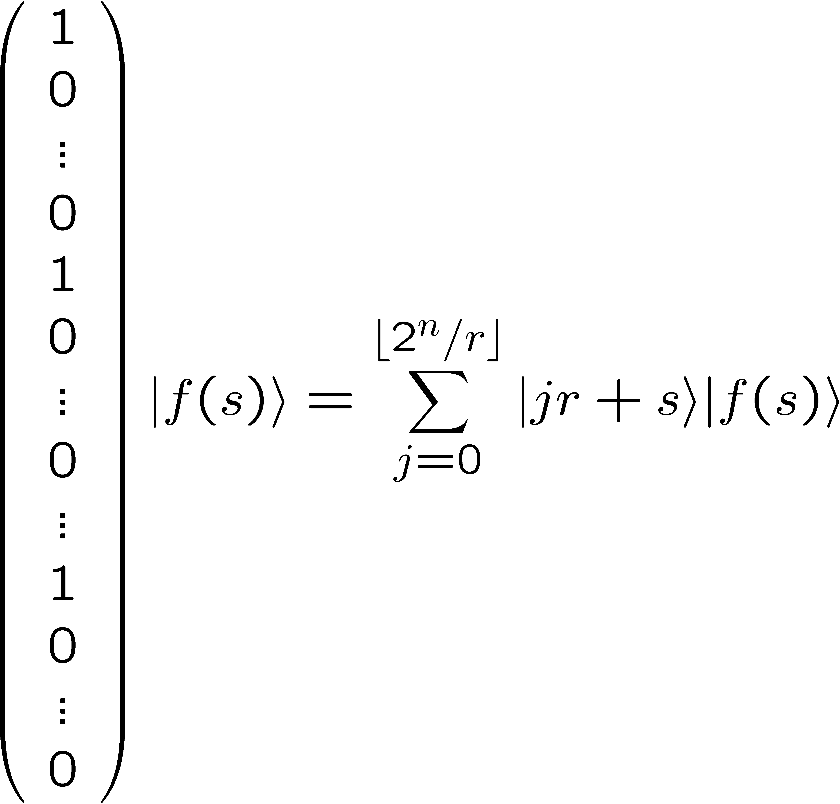
Factoring: step 2
measure register 2
state collapses to:
Key: period = r (the number we are seeking)
March 12, 2014
CS21 Lecture 27

Slide 25
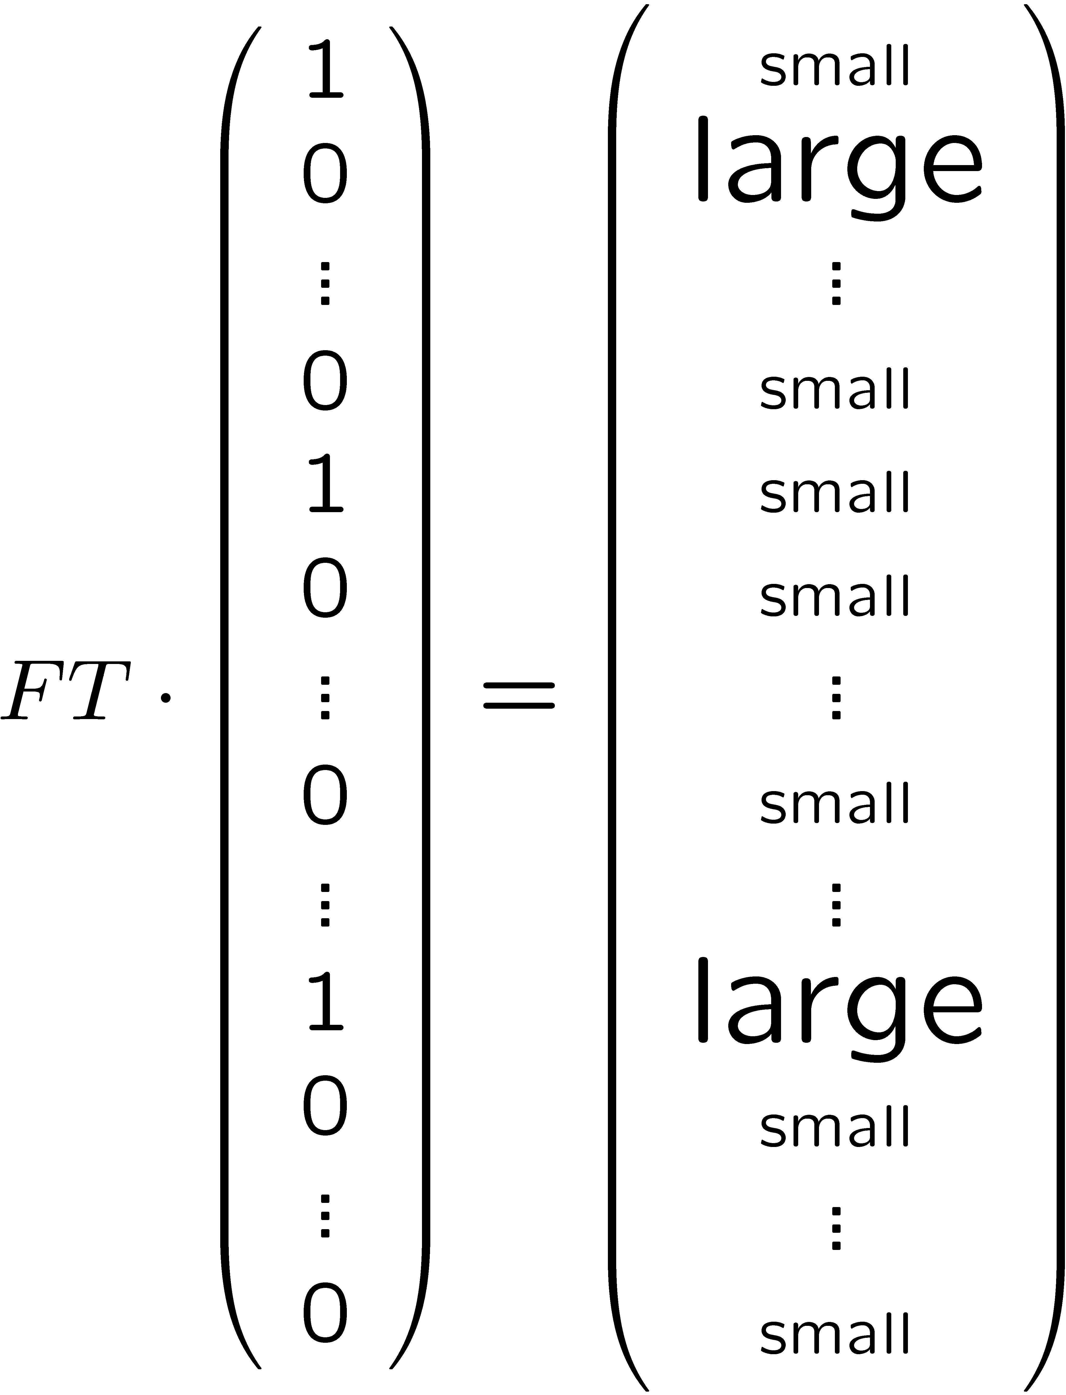
Factoring: step 3
Apply FT to register 1
large in positions b such that r⋅b close to N
measure register 1
obtain b
determine r from b (classically, basic number theory)
March 12, 2014
CS21 Lecture 27

Slide 26
Quantum computation
if can build quantum computers, they will be capable of factoring in polynomial time
  big “if”
do not believe factoring possible in polynomial time classically
  but factoring in P if P = NP
serious challenge to extended Church-Turing Thesis
March 12, 2014
CS21 Lecture 27

Slide 27

March 12, 2014
CS21 Lecture 27

Slide 28
The very last slide
Fill out TQFR surveys!
Course to consider
  CS138 (advanced algorithms)
  CS150 (probability and computation)
  CS151 (complexity theory)
  CS153 (current topics in theoretical CS)
Good luck
  on final
  in CS, at Caltech, beyond…
Thank you!
March 12, 2014
CS21 Lecture 27

