Slide 1
CS38
Introduction to Algorithms
Lecture 1
April 1, 2014

Slide 2
Outline
administrative stuff
motivation and overview of the course
stable matchings example
graphs, representing graphs
graph traversals (BFS, DFS)
connectivity, topological sort, strong connectivity
April 1, 2014
CS38 Lecture 1

Slide 3
Administrative Stuff
Text: Introduction to Algorithms (3rd Edition) by Cormen, Leiserson, Rivest, Stein
  “CLRS”
  recommended but not required
lectures self-contained
slides posted online
April 1, 2014
CS38 Lecture 1

Slide 4
Administrative Stuff
weekly homework
  collaboration in groups of 2-3 encouraged
  separate write-ups (clarity counts)
midterm and final
  indistinguishable from homework except cumulative, no collaboration allowed
April 1, 2014
CS38 Lecture 1

Slide 5
Administrative Stuff
no programming in this course
things I assume you are familiar with:
  programming and basic data structures: arrays, lists, stacks, queues
  asymptotic notation “big-oh”
  sets, graphs
  proofs, especially induction proofs
  exposure to NP-completeness
April 1, 2014
CS38 Lecture 1

Slide 6
Motivation/Overview
Computability and Complexity
Theory
Algorithms
Systems and Software
Design and Implementation
April 1, 2014
CS38 Lecture 1

Slide 7
Motivation/Overview
at the heart of programs lie algorithms
in this course algorithms means:
  abstracting problems from across application domains
  worst case analysis
  asymptotic analysis (“big-oh”)
  rigorous proofs paradigm (vs. “heuristics”)
main figure of merit
April 1, 2014
CS38 Lecture 1

Slide 8
Motivation/Overview
algorithms as a key technology
think about:
  mapping/navigation
  Google search
  Shazam
  word processing (spelling correction, layout…)
  content delivery and streaming video
  games (graphics, rendering…)
  big data (querying, learning…)
April 1, 2014
CS38 Lecture 1

Slide 9
Motivation/Overview
In a perfect world
  for each problem we would have an algorithm
  the algorithm would be the fastest possible
What would CS look like in this world?
April 1, 2014
CS38 Lecture 1

Slide 10
Motivation/Overview
Our world (fortunately) is not so perfect:
  for many problems we know embarrassingly little about what the fastest algorithm is
    multiplying two integers or two matrices
    factoring an integer into primes
    determining shortest tour of given n cities
  for many problems we suspect fast algorithms are impossible (NP-complete problems)
  for some problems we have unexpected and clever algorithms (we will see many of these)
April 1, 2014
CS38 Lecture 1

Slide 11
Motivation/Overview
Two main themes:
  algorithm design paradigms
  algorithms for fundamental problems
  (data structures as needed)
NP-completeness and introduction to approximation algorithms
April 1, 2014
CS38 Lecture 1

Slide 12
definitions and conventions
April 1, 2014
CS38 Lecture 1

Slide 13
What is a problem?
Some examples:
  given n integers, produce a sorted list
  given a graph and nodes s and t, find a shortest path from s to t
  given an integer, find its prime factors
problem associates each input to an output
a problem is a function:
f:Σ* → Σ*
April 1, 2014
CS38 Lecture 1

Slide 14
What is an algorithm?
a problem is a function:
f:Σ* → Σ*
formally: an algorithm is a Turing Machine that computes function f
more informal: a precisely specified sequence of basic instructions computing f
level of detail is a judgment call
high-level description , detailed pseudo-code
April 1, 2014
CS38 Lecture 1

Slide 15
Underlying model
Officially, Random Access Machine (RAM)
  essentially, low level programming language like assembly code
Will not come up in this course
We all can distinguish between, e.g.
  x Ã i-th element of array A (single step)
  x Ã minimum element of array A (not a single step)
April 1, 2014
CS38 Lecture 1

Slide 16
Worst-case analysis
Figure of merit: resource usage
  running time (primary for this course)
  storage space
  others…
Always measure resource usage via:
  function of the input size
  value of the fn. is the maximum quantity of resource used over all inputs of given size
  called “worst-case analysis”
April 1, 2014
CS38 Lecture 1

Slide 17
Asymptotic notation
Measure time/space complexity using asymptotic notation (“big-oh notation”)
  disregard lower-order terms in running time
  disregard coefficient on highest order term
example:
f(n) = 6n³ + 2n² + 100n + 102781
  “f(n) is order n³”
  write f(n) = O(n³)
April 1, 2014
CS38 Lecture 1

Slide 18
Asymtotic notation
captures behavior for “large n”
3n² +100
2^{n}/30
f(n)
n !
April 1, 2014
CS38 Lecture 1

Slide 19
Asymptotic notation
Definition: given functions f,g:N → R⁺, we say f(n) = O(g(n)) if there exist positive integers c, n₀ such that for all n ≥ n₀
f(n) ≤ cg(n).
meaning: f(n) is (asymptotically) less than or equal to g(n)
if g > 0 can assume n₀ = 0, by setting
c’ = max_{0≤n≤n0}{c, f(n)/g(n)}
April 1, 2014
CS38 Lecture 1

Slide 20
Asymptotic notation facts
each bound asymptotically less than next
“logarithmic”: O(log n)
  log_{b} n = (log₂ n)/(log₂ b)
  so log_{b}n = O(log₂ n) for any constant b; therefore suppress base when write it
“polynomial”: O(n^{c}) = n^{O(1)}
  also: c^{O(log n)} = O(n^{c’}) = n^{O(1)}
“exponential”: O(2^{nδ}) for δ > 0
April 1, 2014
CS38 Lecture 1

Slide 21
Why worst case, asymptotic?
Why worst-case?
  well-suited to rigorous analysis, simple
  stringent requirement better
Why asymptotic?
  not productive to focus on fine distinctions
  care about behavior on large inputs
  general-purpose alg. should be scalable
  exposes genuine barriers/motivates new ideas
April 1, 2014
CS38 Lecture 1

Slide 22
Stable matchings example
April 1, 2014
CS38 Lecture 1

Slide 23
Stable matchings
Motivation:
  n medical students and n hospitals
  each student has ranking of hospitals
  each hospital has ranking of students
  Goal: match each student to a hospital
  Goal: make the matching stable
Definition: (student x, hospital y) pair unstable if x prefers y to its match and y prefers x to its match
April 1, 2014
CS38 Lecture 1

Slide 24
Stable matchings
Captures many settings, e.g.,
  employee/employer
  students/dorms
  men/women
Usually described via men/women:
  ranked list of n women for each of n men
  ranked list of n men for each of n women
  produce a stable matching (no unstable pairs)
f
April 1, 2014
CS38 Lecture 1

Slide 25
Stable matchings
Does a stable matching always exist?
Is there an efficient algorithm to find one?
Gale-Shapley Stable Matching Algorithm
Input: ranking lists for each man, women
1. S Ã empty matching
2. WHILE some man m is unmatched and hasn't proposed to every woman
w ← ﬁrst woman on m's list to whom m has not yet proposed
IF w is unmatched THEN add pair (m,w) to matching S
5. ELSE IF w prefers m to her current partner m’ THEN
replace pair (m’,w) with pair (m,w) in matching S
6. ELSE w rejects m
April 1, 2014
CS38 Lecture 1

Slide 26
Stable matchings
We have
  a well-defined problem
  a proposed algorithm
Now we need to
  prove correctness
  bound running time, possibly requiring filling in implementation details
April 1, 2014
CS38 Lecture 1

Slide 27
Stable matchings
Gale-Shapley Stable Matching Algorithm
Input: ranking lists for each man, women
1. S Ã empty matching
2. WHILE some man m is unmatched and hasn't proposed to every woman
w ← ﬁrst woman on m's list to whom m has not yet proposed
IF w is unmatched THEN add pair (m,w) to matching S
5. ELSE IF w prefers m to her current partner m’ THEN
replace pair (m’,w) with pair (m,w) in matching S
6. ELSE w rejects m
Lemma: algorithm terminates with all men, women matched, and with no unstable pair
Proof: terminates?
April 1, 2014
CS38 Lecture 1

Slide 28
Stable matchings
Gale-Shapley Stable Matching Algorithm
Input: ranking lists for each man, women
1. S Ã empty matching
2. WHILE some man m is unmatched and hasn't proposed to every woman
w ← ﬁrst woman on m's list to whom m has not yet proposed
IF w is unmatched THEN add pair (m,w) to matching S
5. ELSE IF w prefers m to her current partner m’ THEN
replace pair (m’,w) with pair (m,w) in matching S
6. ELSE w rejects m
Lemma: algorithm terminates with all men, women matched, and with no unstable pair
Proof: all matched?
April 1, 2014
CS38 Lecture 1

Slide 29
Stable matchings
Gale-Shapley Stable Matching Algorithm
Input: ranking lists for each man, women
1. S Ã empty matching
2. WHILE some man m is unmatched and hasn't proposed to every woman
w ← ﬁrst woman on m's list to whom m has not yet proposed
IF w is unmatched THEN add pair (m,w) to matching S
5. ELSE IF w prefers m to her current partner m’ THEN
replace pair (m’,w) with pair (m,w) in matching S
6. ELSE w rejects m
Lemma: algorithm terminates with all men, women matched, and with no unstable pair
Proof: unstable pair (m, w)?
April 1, 2014
CS38 Lecture 1

Slide 30
Stable matchings
Lemma: algorithm terminates with all men, women matched, and S containing no unstable pair
Proof:
terminates: only n² possible proposals, 1 per iteration
all matched: suppose not. Then some m unmatched and some w unmatched. So w never proposed to. But m proposed to everyone if ends unmatched.
April 1, 2014
CS38 Lecture 1

Slide 31
Stable matchings
Lemma: algorithm terminates with all men, women matched, and S containing no unstable pair
Proof:
pair (m, w) not in S
case 1: m never proposed to w,
) m prefers his current partner
case 2: m proposed to w
) w rejected m (in line 6 or line 5)
in both cases (m, w) is not an unstable pair.
April 1, 2014
CS38 Lecture 1

Slide 32
Stable matchings
Gale-Shapley Stable Matching Algorithm
Input: ranking lists for each man, women
1. S Ã empty matching
2. WHILE some man m is unmatched and hasn't proposed to every woman
w ← ﬁrst woman on m's list to whom m has not yet proposed
IF w is unmatched THEN add pair (m,w) to matching S
5. ELSE IF w prefers m to her current partner m’ THEN
replace pair (m’,w) with pair (m,w) in matching S
6. ELSE w rejects m
Lemma: can implement with running time O(n²)
Proof: create two arrays wife, husband
wife[m] = w if (m,w) in S, 0 if unmatched (same for husband)
April 1, 2014
CS38 Lecture 1

Slide 33
Stable matchings
Gale-Shapley Stable Matching Algorithm
Input: ranking lists for each man, women
1. S Ã empty matching
2. WHILE some man m is unmatched and hasn't proposed to every woman
w ← ﬁrst woman on m's list to whom m has not yet proposed
IF w is unmatched THEN add pair (m,w) to matching S
5. ELSE IF w prefers m to her current partner m’ THEN
replace pair (m’,w) with pair (m,w) in matching S
6. ELSE w rejects m
implementing step 5? for each preference list pref can create inv-pref via: for i = 1 to n do inv-pref[pref[i]] = i
w prefers m to m’ iff inv-pref[m] < inv-pref[m’]
O(n²) preprocessing; O(1) time for each iteration of loop

Slide 34
Stable matchings
We proved:
Theorem (Gale-Shapley ‘62): there is an O(n²) time algorithm that is given
n rankings of women by each of n men
n rankings of men by each of n women
and outputs
a stable matching of men to women.
April 1, 2014
CS38 Lecture 1

Slide 35
Basic graph algorithms
April 1, 2014
CS38 Lecture 1

Slide 36
Graphs
Graph G = (V, E)
  directed or undirected
  notation: n = |V|, m = |E| (note: m · n²)
  adjacency list or adjacency matrix
a b c
a
c
b
a
a
0 | 1 | 1
0 | 0 | 0
0 | 1 | 0
b
b
b
c
c
b
c
April 1, 2014
CS38 Lecture 1

Slide 37
Graphs
Graphs model many things…
  physical networks (e.g. roads)
  communication networks (e.g. internet)
  information networks (e.g. the web)
  social networks (e.g. friends)
  dependency networks (e.g. topics in this course)
… so many fundamental algorithms operate on graphs
April 1, 2014
CS38 Lecture 1

Slide 38
Graphs
Graph terminology:
  an undirected graph is connected if there is a path between each pair of vertices
  a tree is a connected, undirected graph with no cycles; a forest is a collection of disjoint trees
  a directed graph is strongly connected if there is a path from x to y and from y to x, 8 x,y2V
  a DAG is a Directed Acyclic Graph
April 1, 2014
CS38 Lecture 1

Slide 39
Graph traversals
Graph traversal algorithm: visit some or all of the nodes in a graph, labeling them with useful information
  breadth-first: useful for undirected, yields connectivity and shortest-paths information
  depth-first: useful for directed, yields numbering used for
    topological sort
    strongly-connected component decomposition
April 1, 2014
CS38 Lecture 1

Slide 40
Breadth first search
BFS(undirected graph G, starting vertex s)
for each vertex v, v.color = white, v.dist = 1, v.pred = nil
s.color = grey, s.dist = 0, s.pred = nil
Q = ;; ENQUEUE(Q, s)
WHILE Q is not empty u = DEQUEUE(Q)
for each v adjacent to u
IF v.color = white THEN
v.color = grey, v.dist = u.dist + 1, v.pred = u
ENQUEUE(Q, v)
u.color = black
Lemma: BFS runs in time O(m + n), when G is represented by an adjacency list.
Proof?

Slide 41
Breadth first search
BFS(undirected graph G, starting vertex s)
for each vertex v, v.color = white, v.dist = 1, v.pred = nil
s.color = grey, s.dist = 0, s.pred = nil
Q = ;; ENQUEUE(Q, s)
WHILE Q is not empty u = DEQUEUE(Q)
for each v adjacent to u
IF v.color = white THEN
v.color = grey, v.dist = u.dist + 1, v.pred = u
ENQUEUE(Q, v)
u.color = black
Lemma: BFS runs in time O(m + n), when G is represented by an adjacency list.
Proof: each vertex enqueued at most 1 time; its adj. list scanned once; O(1) work for each neighbor

Slide 42
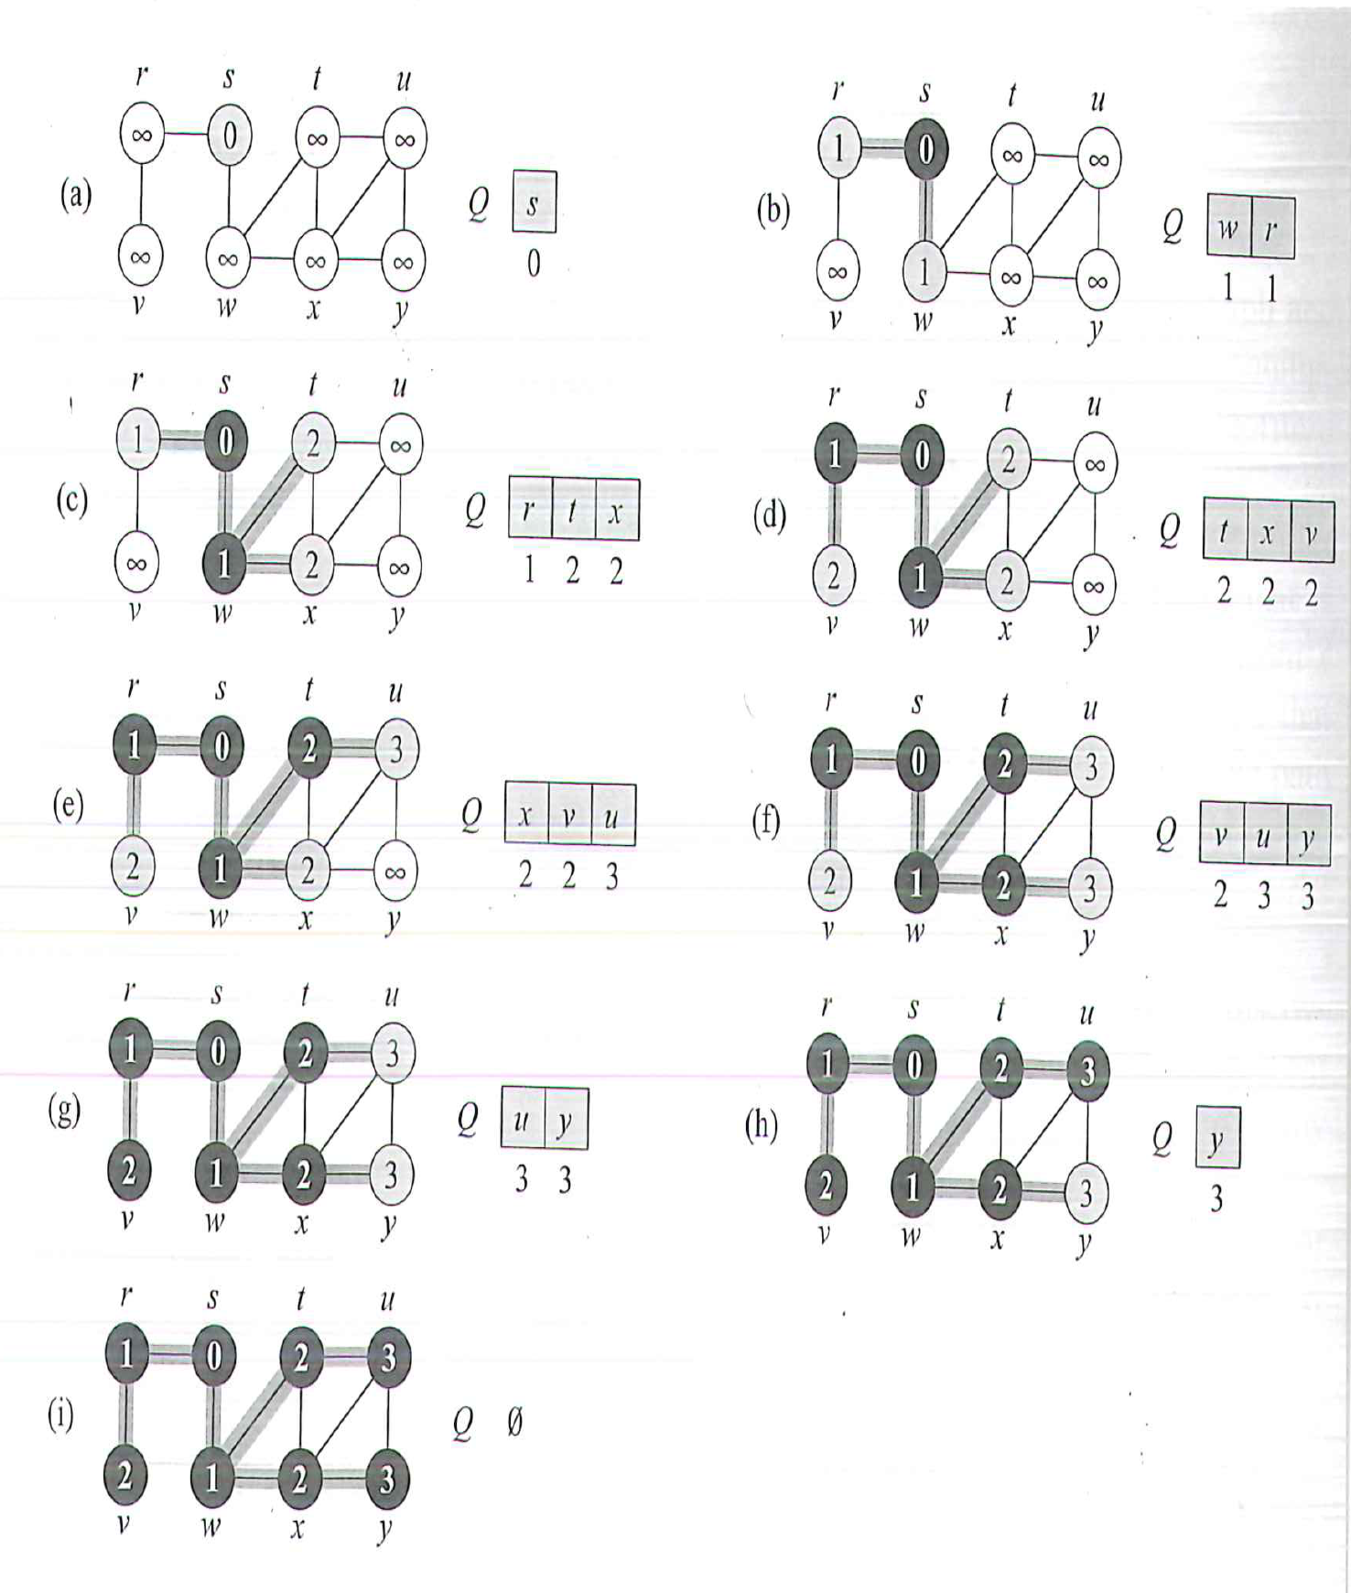
BFS example from CLRS

