Slide 1
CS38 Introduction to Algorithms
Lecture 15
May 20, 2014

Slide 2
Outline
Linear programming
simplex algorithm
LP duality
ellipsoid algorithm
* slides from Kevin Wayne

Slide 3
Linear programming

Slide 4
Standard Form LP
"Standard form" LP.
Input: real numbers a_{ij}, c_{j}, b_{i}.
Output: real numbers x_{j}.
n = # decision variables, m = # constraints.
Maximize linear objective function subject to linear inequalities.
Linear. No x², x y, arccos(x), etc.
Programming. Planning (term predates computer programming).
Notes:
Solving simultaneous linear equations (Ax = b) can be accomplished using Gaussian elimination. LP is a generalization with inequalities instead of equalities.
Note: simple transformations to handle >= inequalities, unrestricted variables, or min objective

Slide 5
Brewery Problem: Converting to Standard Form
Original input.
Standard form.
Add slack variable for each inequality.
Now a 5-dimensional problem.

Slide 6
Equivalent Forms
Easy to convert variants to standard form.
Less than to equality:
x + 2y – 3z · 17 ) x + 2y – 3z + s = 17, s ¸ 0
Greater than to equality:
x + 2y – 3z ¸ 17 ) x + 2y – 3z – s = 17, s ¸ 0
Min to max:
min x + 2y – 3z ) max –x – 2y + 3z
Unrestricted to nonnegative:
x unrestricted ) x = x⁺ – x –, x⁺ ¸ 0, x – ¸ 0

Slide 7
Linear programming
geometric perspective

Slide 8
Brewery Problem: Feasible Region
Hops 4A + 4B · 160
Malt 35A + 20B · 1190
(0, 32)
(12, 28)
Corn 5A + 15B · 480
(26, 14)
Beer
(0, 0)
Ale
(34, 0)

Slide 9
Brewery Problem: Objective Function
Profit
(0, 32)
(12, 28)
13A + 23B = $1600
(26, 14)
Beer
13A + 23B = $800
(0, 0)
Ale
(34, 0)
13A + 23B = $442
Notes:
isoprofit lines

Slide 10
Brewery Problem: Geometry
Brewery problem observation. Regardless of objective function coefficients, an optimal solution occurs at a vertex.
(0, 32)
(12, 28)
vertex
(26, 14)
Beer
(0, 0)
Ale
(34, 0)

Slide 11
Convexity
Convex set. If two points x and y are in the set, then so is ¸ x + (1- ¸ ) y for 0 · ¸ · 1.
Vertex. A point x in the set that can't be written as a strict convex combination of two distinct points in the set.
Observation. LP feasible region is a convex set.
convex combination
vertex
x
y
convex
not convex
Notes:
LP feasible region is intersection of finitely many halfspaces

Slide 12
Geometric perspective
Theorem. If there exists an optimal solution to (P), then there exists one that is a vertex.
Intuition. If x is not a vertex, move in a non-decreasing direction until you reach a boundary. Repeat.
x' = x + ®* d
x + d
x
x - d
Notes:
Note: it is a common misperception that the extreme point theorem is true for LPs in non-standard form, as some polyhedra have
no vertices

Slide 13
Geometric perspective
Theorem. If there exists an optimal solution to (P), then there exists one that is a vertex.
Pf.
Suppose x is an optimal solution that is not a vertex.
There exist direction d νοτ εθυαλ το 0 such that x ± d 2 P.
A d = 0 because A(x ± d) = b.
Assume c^{T} d¸ 0 (by taking either d or –d).
Consider x + ¸d, ¸ > 0 :
Case 1. [ there exists j such that d_{j} < 0 ]
Increase ¸ to ¸* until first new component of x + ¸d hits 0.
x + ¸*d is feasible since A(x + ¸*d) = Ax = b and x + ¸*y ¸ 0.
x + ¸*d has one more zero component than x.
c^{T}x' = c^{T} (x + ¸*d) = c^{T} x + ¸* c^{T} d¸ c^{T} x.
d_{k} = 0 whenever x_{k} = 0 because x ± d 2 P

Slide 14
Geometric perspective
Theorem. If there exists an optimal solution to (P), then there exists one that is a vertex.
Pf.
Suppose x is an optimal solution that is not a vertex.
There exist direction d νοτ εθυαλ το 0 such that x ± d 2 P.
A d = 0 because A(x ± d) = b.
Assume c^{T} d¸ 0 (by taking either d or –d).
Consider x + ¸d, ¸ > 0 :
Case 2. [d_{j} ¸ 0 for all j ]
x + ¸ d is feasible for all ¸ ¸ 0 since A(x + ¸ d) = b and x + ¸ d ¸ x ¸ 0.
As ¸ ! 1, c^{T}(x + ¸ d) ! 1 because c^{T} d > 0.
if c^{T}d = 0, choose d so that case 1 applies
Notes:
Note that d != 0. So if c^T d = 0 we must be able to choose d (or -d) so that dj < 0 for some j

Slide 15
Linear programming
linear algebraic perspective

Slide 16
Intuition
Intuition. A vertex in R^{m} is uniquely specified by m linearly independent equations.
4A + 4B · 160
35A + 20B · 1190
4A + 4B = 160 35A + 20B = 1190
(26, 14)

Slide 17
Basic Feasible Solution
Theorem. Let P = { x : Ax = b, x ¸ 0 }. For x 2 P, define B = { j : x_{j} > 0 }. Then x is a vertex iff A_{B} has linearly independent columns.
Notation. Let B = set of column indices. Define A_{B} to be the subset of columns of A indexed by B.
Ex.

Slide 18
Basic Feasible Solution
Theorem. Let P = { x : Ax = b, x ¸ 0 }. For x 2 P, define B = { j : x_{j} > 0 }. Then x is a vertex iff A_{B} has linearly independent columns.
Pf. (
Assume x is not a vertex.
There exist direction d not equal to 0 such that x ± d 2 P.
A d = 0 because A(x ± d) = b.
Define B' = { j : d_{j} νοτ εθυαλ το 0 }.
A_{B'} has linearly dependent columns since d not equal to 0.
Moreover, d_{j} = 0 whenever x_{j} = 0 because x ± d ¸ 0.
Thus B’ µ B, so A_{B'} is a submatrix of A_{B}.
Therefore, A_{B} has linearly dependent columns.

Slide 19
Basic Feasible Solution
Theorem. Let P = { x : Ax = b, x ¸ 0 }. For x 2 P, define B = { j : x_{j} > 0 }.
Then x is a vertex iff A_{B} has linearly independent columns.
Pf. )
Assume A_{B} has linearly dependent columns.
There exist d not equal to 0 such that A_{B} d = 0.
Extend d to R^{n} by adding 0 components.
Now, A d = 0 and d_{j} = 0 whenever x_{j} = 0.
For sufficiently small ¸, x ± ¸ d 2 P ) x is not a vertex.

Slide 20
Basic Feasible Solution
Theorem. Given P = { x : Ax = b, x ¸ 0 }, x is a vertex iff there exists B µ { 1, …, n } such | B | = m and:
A_{B} is nonsingular.
x_{B} = A_{B}⁻¹ b ¸ 0.
x_{N} = 0.
Pf. Augment A_{B} with linearly independent columns (if needed). •
Assumption. A 2 R^{m £} ^{n} has full row rank.
basic feasible solution
Notes:
if rank(A) < m, (i) either Ax = b has no solutions or (ii) we can identify a redundant constraint from Ax = b and remove it
Note: A vertex can have several associated BFS.

Slide 21
Basic Feasible Solution: Example
Basic feasible solutions.
Basis {A, B, S_{M} } (12, 28)
{B, S_{H}, S_{M} } (0, 32)
Infeasible {A, B, S_{H} } (19.41, 25.53)
Beer
{A, B, S_{C} } (26, 14)
{S_{H}, S_{M}, S_{C} } (0, 0)
Ale
{A, S_{H}, S_{C} } (34, 0)
Notes:
A = 330/17, B = 434/17
Note 4A + 4B = 179.77 > 160
Each BFS corresponds to one extreme point, but different BFS can correspond to the same extreme point

Slide 22
Simplex algorithm

Slide 23
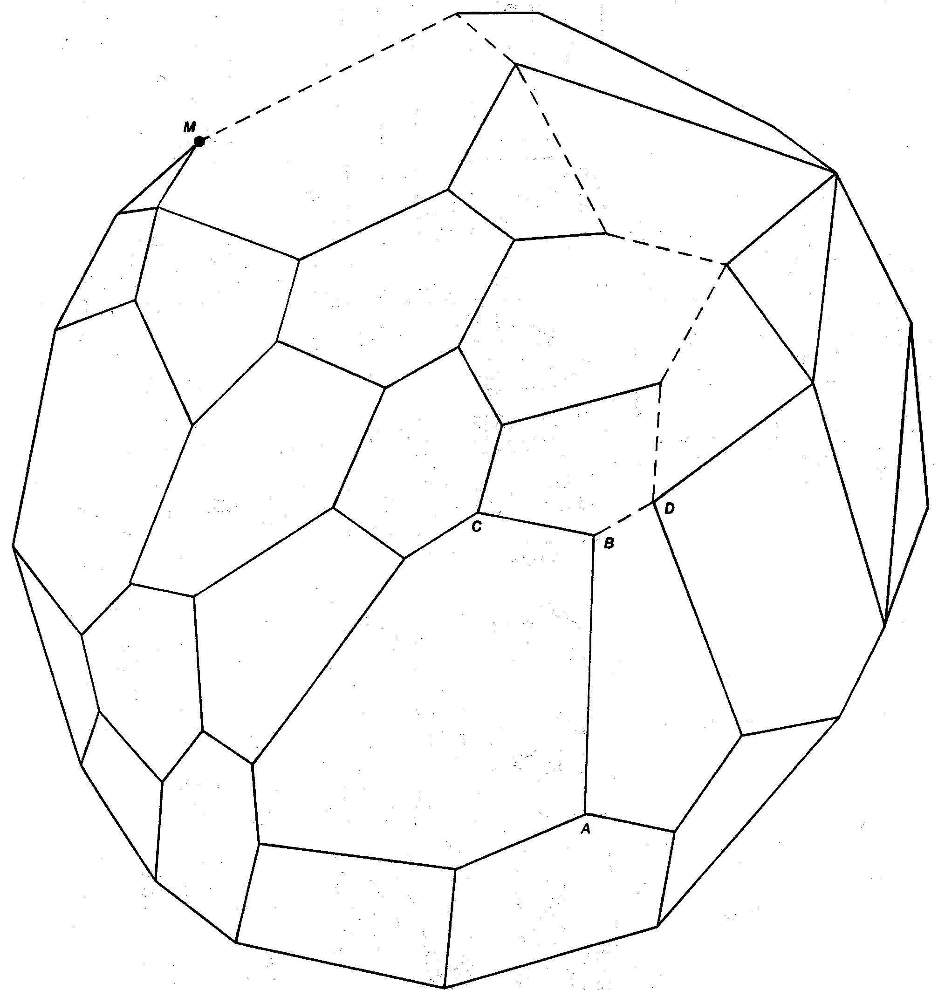
Simplex Algorithm: Intuition
Simplex algorithm. [George Dantzig 1947] Move from BFS to adjacent BFS, without decreasing objective function.
Greedy property. BFS optimal iff no adjacent BFS is better.
Challenge. Number of BFS can be exponential!
replace one basic variable with another
edge
Notes:
local optima are global optimal since feasible region is convex
n-dimensional hypercube has exponentially many vertices
As a graduate student at the University of California Berkeley in 1939, Dantzig arrived late to class one day and copied two problems from a blackboard. After struggling with what he thought was a difficult homework assignment, he submitted his work to the eminent statistician Jerzy Neyman. Six weeks later on a Sunday at 8 AM, Neyman excitedly awoke Dantzig to say he had written an introduction to Dantzig's paper. It turned out that Dantzig had found solutions to two famous, previously unsolved statistical problems.
Moral of the Story: if you come in late to class, you must solve a previously unsolved problem.

Slide 24
Simplex Algorithm: Initialization
Basis = {S_{C}, S_{H}, S_{M}} A = B = 0 Z = 0 S_{C} = 480 S_{H} = 160 S_{M} = 1190
Notes:
called simplex tableaux

Slide 25
Simplex Algorithm: Pivot 1
Basis = {S_{C}, S_{H}, S_{M}} A = B = 0 Z = 0 S_{C} = 480 S_{H} = 160 S_{M} = 1190
Substitute: B = 1/15 (480 – 5A – S_{C})
Basis = {B, S_{H}, S_{M}} A = S_{C} = 0 Z = 736 B = 32 S_{H} = 32 S_{M} = 550
Notes:
called simplex tableaux

Slide 26
Simplex Algorithm: Pivot 1
Q. Why pivot on column 2 (or 1)?
A. Each unit increase in B increases objective value by $23.
Q. Why pivot on row 2?
A. Preserves feasibility by ensuring RHS ¸ 0.
Basis = {S_{C}, S_{H}, S_{M}} A = B = 0 Z = 0 S_{C} = 480 S_{H} = 160 S_{M} = 1190
min ratio rule: min { 480/15, 160/4, 1190/20 }
Notes:
if some nonbasic variable has a positive coefficient in obj function row, then we can increase this variable x and improve objective function. What is simplest way to do this? Don't ruin feasibility! Other equations must still hold. So other variables must change. Each equation has a single isolated basic variable which can be used to balance the change in x, keeping other nonbasic variables = 0.
degeneracy if RHS is 0 and hence min ratio is 0.

Slide 27
Simplex Algorithm: Pivot 2
Basis = {B, S_{H}, S_{M}} A = S_{C} = 0 Z = 736 B = 32 S_{H} = 32 S_{M} = 550
Substitute: A = 3/8 (32 + 4/15 S_{C} – S_{H})
Basis = {A, B, S_{M}} S_{C} = S_{H} = 0 Z = 800 B = 28 A = 12 S_{M} = 110

Slide 28
Simplex Algorithm: Optimality
Q. When to stop pivoting?
A. When all coefficients in top row are nonpositive.
Q. Why is resulting solution optimal?
A. Any feasible solution satisfies system of equations in tableaux.
In particular: Z = 800 – S_{C} – 2 S_{H} , S_{C} ¸ 0, S_{H} ¸ 0.
Thus, optimal objective value Z* · 800.
Current BFS has value 800 ) optimal.
Basis = {A, B, S_{M}} S_{C} = S_{H} = 0 Z = 800 B = 28 A = 12 S_{M} = 110
Notes:
Theorem: if simplex algorithm terminates, it terminates with optimal solution.

Slide 29
Simplex Tableaux: Matrix Form
Initial simplex tableaux.
Simplex tableaux corresponding to basis B.
subtract c_{B}^{T} A_{B}⁻¹ times constraints
multiply by A_{B}⁻¹
x_{B} = A_{B}⁻¹ b ¸ 0
x_{N} = 0
c_{N}^{T} – c_{B}^{T} A_{B}⁻¹ A_{N} · 0
basic feasible solution
optimal basis
Notes:
multiply constraints by (A_B)^-1.
Subtract c_B * (A_B)^-1 times constraints from objective function equation

Slide 30
Simplex Algorithm: Corner Cases
Simplex algorithm. Missing details for corner cases.
Q. What if min ratio test fails?
Q. How to find initial basis?
Q. How to guarantee termination?

Slide 31
Unboundedness
Q. What happens if min ratio test fails?
A. Unbounded objective function.
all coefficients in entering column are nonpositive

Slide 32
Phase I Simplex
Q. How to find initial basis?
A. Solve (P'), starting from basis consisting of all the z_{i} variables.
Case 1: min > 0 ) (P) is infeasible.
Case 2: min = 0, basis has no z_{i} variables ) OK to start Phase II.
Case 3a: min = 0, basis has z_{i} variables. Pivot z_{i} variables out of basis. If successful, start Phase II; else remove linear dependent rows.
Notes:
zi variables are called "artificial variables"

Slide 33
Simplex Algorithm: Degeneracy
Degeneracy. New basis, same vertex.
Degenerate pivot. Min ratio = 0.

Slide 34
Simplex Algorithm: Degeneracy
Degeneracy. New basis, same vertex.
Cycling. Infinite loop by cycling through different bases that all correspond to same vertex.
Anti-cycling rules.
Bland's rule: choose eligible variable with smallest index.
Random rule: choose eligible variable uniformly at random.
Lexicographic rule: perturb constraints so nondegenerate.
Notes:
New basis, same vertex = "stalling" is common in practice
Cycling Doesn't occur in the wild.

Slide 35
Lexicographic Rule
Intuition. No degeneracy ) no cycling.
Perturbed problem.
Lexicographic rule. Apply perturbation virtually by manipulating ² symbolically:
much much greater, say ²_{i} = ±^{i} for small ±

Slide 36
Lexicographic Rule
Intuition. No degeneracy ) no cycling.
Perturbed problem.
Claim. In perturbed problem, x_{B} = A_{B}⁻¹ (b + ²) is always nonzero.
Pf. The j^{th} component of x_{B} is a (nonzero) linear combination of the components of b + ² ) contains at least one of the ²_{i} terms.
Corollary. No cycling.
much much greater, say ²_{i} = ±^{i} for small ±
which can't cancel
Notes:
it's a nonzero linear combination because no row of A_B can be zero - it's invertible

Slide 37
Simplex Algorithm: Practice
Remarkable property. In practice, simplex algorithm typically terminates after at most 2(m + n) pivots.
Issues.
Choose the pivot.
Maintain sparsity.
Ensure numerical stability.
Preprocess to eliminate variables and constraints.
Commercial solvers can solve LPs with millions of variables and tens of thousands of constraints.
but no polynomial pivot rule known
Notes:
stalling = new basis, same vertex
Reference to remarkable property: Mike Todd, The Many Facets of Linear Programming, Math Programming

Slide 38
LP duality

Slide 39
LP Duality
Primal problem.
Goal. Find a lower bound on optimal value.
Easy. Any feasible solution provides one.
Ex 1. (A, B) = (34, 0) ) z* ¸ 442
Ex 2. (A, B) = (0, 32) ) z* ¸ 736
Ex 3. (A, B) = (7.5, 29.5) ) z* ¸ 776
Ex 4. (A, B) = (12, 28) ) z* ¸ 800

Slide 40
LP Duality
Primal problem.
Goal. Find an upper bound on optimal value.
Ex 1. Multiply 2nd inequality by 6: 24 A + 24 B · 960.
) z* = 13 A + 23 B · 24 A + 24 B · 960.
objective function

Slide 41
LP Duality
Primal problem.
Goal. Find an upper bound on optimal value.
Ex 2. Add 2 times 1st inequality to 2nd inequality: ≤
) z* = 13 A + 23 B · 14 A + 34 B · 1120.

Slide 42
LP Duality
Primal problem.
Goal. Find an upper bound on optimal value.
Ex 2. Add 1 times 1st inequality to 2 times 2nd inequality: ≤
) z* = 13 A + 23 B · 13 A + 23 B · 800.
Recall lower bound. (A, B) = (12, 28) ) z* ¸ 800 Combine upper and lower bounds: z* = 800.

Slide 43
LP Duality
Primal problem.
Idea. Add nonnegative combination (C, H, M) of the constraints s.t.
Dual problem. Find best such upper bound.

Slide 44
LP Duality: Economic Interpretation
Brewer: find optimal mix of beer and ale to maximize profits.
Entrepreneur: buy individual resources from brewer at min cost.
C, H, M = unit price for corn, hops, malt.
Brewer won't agree to sell resources if 5C + 4H + 35M < 13.

Slide 45
LP Duals
Canonical form.

Slide 46
Double Dual
Canonical form.
Property. The dual of the dual is the primal.
Pf. Rewrite (D) as a maximization problem in canonical form; take dual.

Slide 47
Taking Duals
LP dual recipe.
Pf. Rewrite LP in standard form and take dual.
Primal (P)
maximize
minimize
Dual (D)
constraints
a x = b_{i} a x · b a x ¸ b_{i}
y_{i} unrestricted y_{i} ¸ 0 y_{i} · 0
variables
variables
x_{j} · 0 x_{j} ¸ 0 unrestricted
a^{T}y ¸ c_{j}
a^{T}y · c_{j} a^{T}y = c_{j}
constraints

Slide 48
Strong duality

Slide 49
LP Strong Duality
Theorem. [Gale-Kuhn-Tucker 1951, Dantzig-von Neumann 1947] For A 2 R^{m x n}, b 2 R^{m}, c 2 R^{n}, if (P) and (D) are nonempty, then max = min.
Generalizes:
Dilworth's theorem.
König-Egervary theorem.
Max-flow min-cut theorem.
von Neumann's minimax theorem.
…
Pf. [ahead]
Notes:
Duality theorem first written down by Gale-Kuhn-Tucker, but inspired from conversation between Dantzig and von-Neumann

