Slide 1
CS38
Introduction to Algorithms
Lecture 2
April 3, 2014

Slide 2
Outline
graph traversals (BFS, DFS)
connectivity
topological sort
strongly connected components
heaps and heapsort
greedy algorithms…
April 3, 2014
CS38 Lecture 2

Slide 3
Graphs
Graph G = (V, E)
  directed or undirected
  notation: n = |V|, m = |E| (note: m · n²)
  adjacency list or adjacency matrix
a b c
a
c
b
a
a
0 | 1 | 1
0 | 0 | 0
0 | 1 | 0
b
b
b
c
c
b
c
April 3, 2014
CS38 Lecture 2

Slide 4
Graphs
Graphs model many things…
  physical networks (e.g. roads)
  communication networks (e.g. internet)
  information networks (e.g. the web)
  social networks (e.g. friends)
  dependency networks (e.g. topics in this course)
… so many fundamental algorithms operate on graphs
April 3, 2014
CS38 Lecture 2

Slide 5
Graphs
Graph terminology:
  an undirected graph is connected if there is a path between each pair of vertices
  a tree is a connected, undirected graph with no cycles; a forest is a collection of disjoint trees
  a directed graph is strongly connected if there is a path from x to y and from y to x, 8 x,y2V
  a DAG is a Directed Acyclic Graph
April 3, 2014
CS38 Lecture 2

Slide 6
Graph traversals
Graph traversal algorithm: visit some or all of the nodes in a graph, labeling them with useful information
  breadth-first: useful for undirected, yields connectivity and shortest-paths information
  depth-first: useful for directed, yields numbering used for
    topological sort
    strongly-connected component decomposition
April 3, 2014
CS38 Lecture 2

Slide 7
Breadth first search
BFS(undirected graph G, starting vertex s)
for each vertex v, v.color = white, v.dist = 1, v.pred = nil
s.color = grey, s.dist = 0, s.pred = nil
Q = ;; ENQUEUE(Q, s)
WHILE Q is not empty u = DEQUEUE(Q)
for each v adjacent to u
IF v.color = white THEN
v.color = grey, v.dist = u.dist + 1, v.pred = u
ENQUEUE(Q, v)
u.color = black
Lemma: BFS runs in time O(m + n), when G is represented by an adjacency list.
April 3, 2014
CS38 Lecture 2

Slide 8
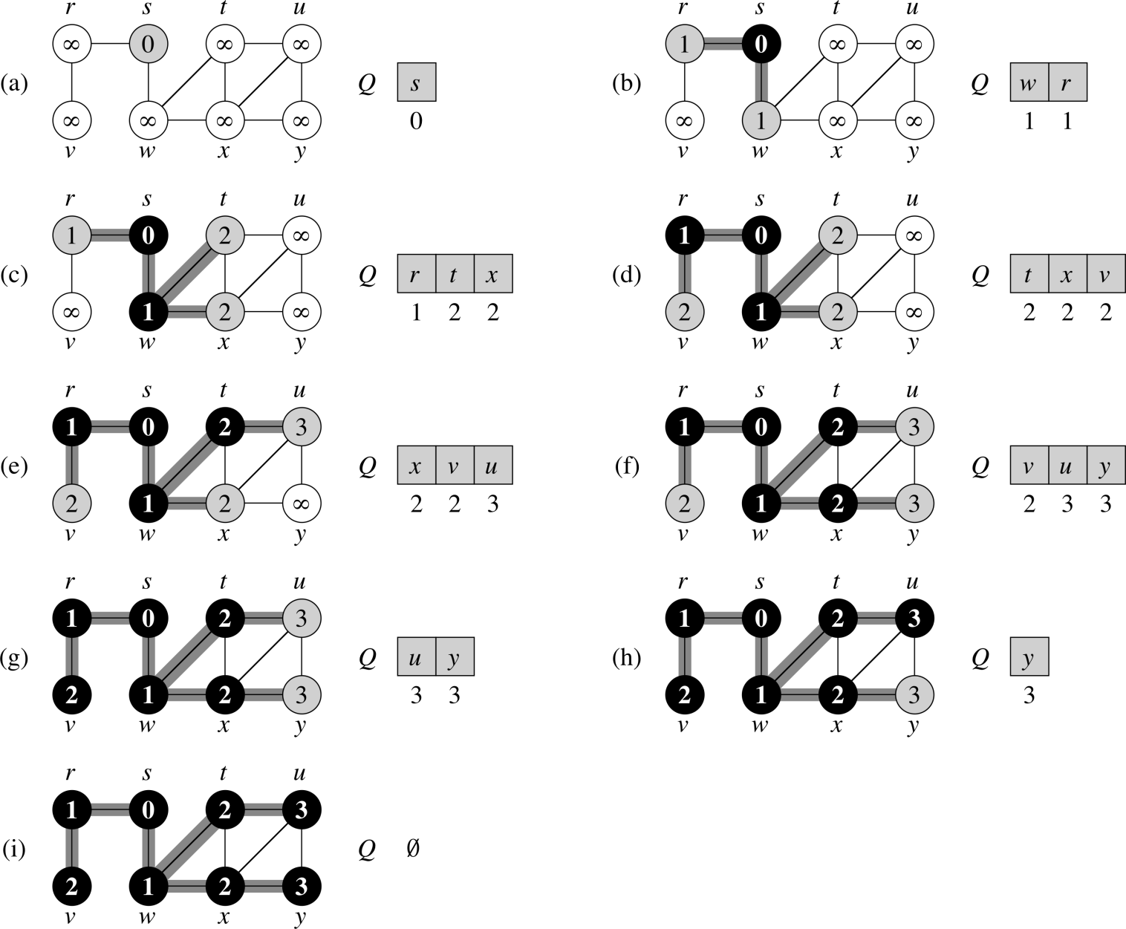
BFS example from CLRS

Slide 9
Breadth first search
Lemma: for all v 2 V, v.dist = distance(s, v), and a shortest path from s to v is a shortest path from s to v.pred followed by edge (v.pred,v)
Proof: partition V into levels
  L₀ = {s}
  L_{i} = {v : 9 u 2 L_{i-1} such that (u,v) 2 E}
  Observe: distance(s,v) = i , v 2 L_{i}
edges only within layers or between adjacent layers
s
L₀
L₁
L₂
L_{n}

Slide 10
Breadth first search
edges only within layers or between adjacent layers
s
L₀
L₁
L₂
L_{n}
Claim: at any point in operation of algorithm:
1. black/grey vertices exactly L₀, L₁, …, L_{i} and part of L_{i+1}
2. Q = (v₀, v₁, v₂, v₃, …, v_{k}) and all have v.dist = level of v
holds initially: s.color = grey, s.dist = 0, Q = (s)
level i
level i+1
April 3, 2014
CS38 Lecture 2

Slide 11
Breadth first search
edges only within layers or between adjacent layers
s
L₀
L₁
L₂
L_{n}
Claim: at any point in operation of algorithm:
1. black/grey vertices exactly L₀, L₁, …, L_{i} and part of L_{i+1}
2. Q = (v₀, v₁, v₂, v₃, …, v_{k}) and all have v.dist = level of v
1 step: dequeue v₀; add white nbrs of v₀ w/ dist = v₀.dist + 1
level i+1
) level ¸ i+1
level i
) level · i+1
April 3, 2014
CS38 Lecture 2

Slide 12
Depth first search
DFS(directed graph G)
for each vertex v, v.color = white, v.pred = nil
time = 0
for each vertex u, IF u.color = white THEN DFS-VISIT(G, u)
DFS-VISIT(directed graph G, starting vertex u)
time = time +1, u.discovered = time, u.color = grey
for each v adjacent to u, IF v.color = white THEN
v.pred = u, DFS-VISIT(G, v)
u.color = black; time = time + 1; u.finished = time
Lemma: DFS runs in time O(m + n), when G is represented by an adjacency list.
Proof?
April 3, 2014
CS38 Lecture 2

Slide 13
Depth first search
DFS(directed graph G)
for each vertex v, v.color = white, v.pred = nil
time = 0
for each vertex u, IF u.color = white THEN DFS-VISIT(G, u)
DFS-VISIT(directed graph G, starting vertex u)
time = time +1, u.discovered = time, u.color = grey
for each v adjacent to u, IF v.color = white THEN
v.pred = u, DFS-VISIT(G, v)
u.color = black; time = time + 1; u.finished = time
Lemma: DFS runs in time O(m + n), when G is represented by an adjacency list.
Proof: DFS-VISIT called for each vertex exactly once; its adj. list scanned once; O(1) work
April 3, 2014
CS38 Lecture 2

Slide 14
Depth first search
DFS yields a forest: “the DFS forest”
each vertex labeled with discovery time and finishing time
edges of G classified as
  tree edges
  back edges (point back to an ancestor)
  forward edges (point forward to a descendant)
  cross edges (all others)
April 3, 2014
CS38 Lecture 2

Slide 15
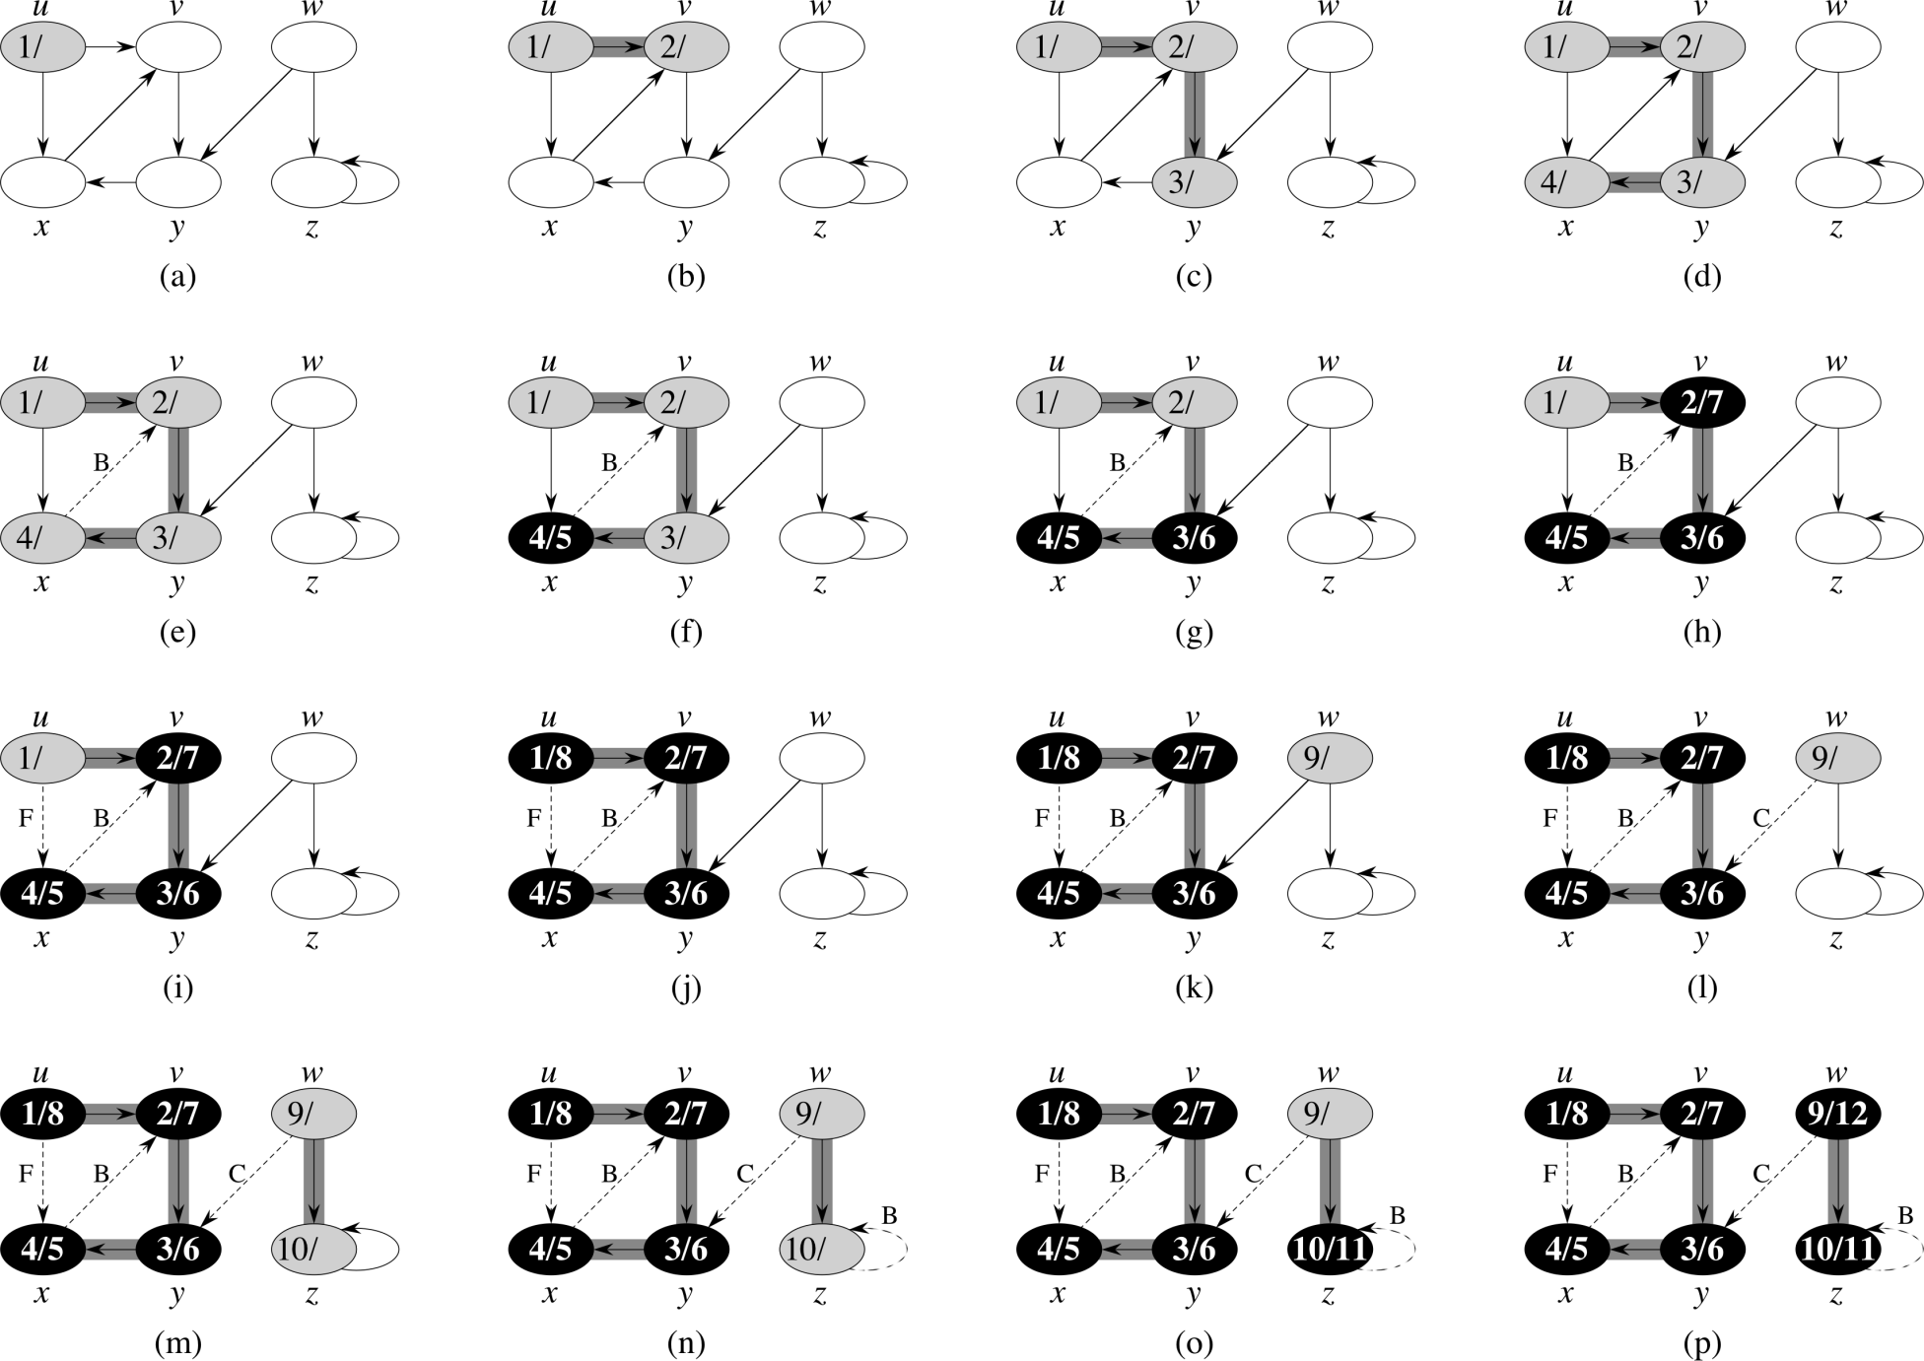
DFS example from CLRS

Slide 16
DFS application: topological sort
Given DAG, list vertices v₀, v₁, …., v_{n} so that no edges from v_{i} to v_{j} (j < i)
  example:
a
d
b
f
c
e
a
b
f
d
e
c
April 3, 2014
CS38 Lecture 2

Slide 17
DFS application: topological sort
Theorem: listing vertices in reverse order of DFS finishing times yields a topological sort of DAG G
  (can implement in linear time; how?)
Proof: claim for all (u,v) 2 E, v.finish < u.finish
  when (u,v) explored, v not grey since then G would have a cycle [back-edge]
  v white ) descendent of u so v finishes first
  v black ) already done, so v.finish is set and u.finish will be set with a later time
April 3, 2014
CS38 Lecture 2

Slide 18
Strongly connected components
say that x » y if there is a directed path from x to y and from y to x in G
equivalence relation, equivalence classes are strongly connected components of G
  also, maximal strongly connected subsets
SCC structure is a DAG (why?)
April 3, 2014
CS38 Lecture 2

Slide 19
Strongly connected components
DFS tree from v in G: all nodes reachable from v
DFS tree from v in G^{T}: all nodes that can reach v
Key: in sink SCC, this is exactly the SCC
G with edges reversed
v
April 3, 2014
CS38 Lecture 2

Slide 20
Strongly connected components
v
given v in a sink SCC, run DFS starting there, then move to next in reverse topological order…
  DFS forest would give the SCCs
Key #2: topological ordering consistent with SCC DAG structure! (why?)
April 3, 2014
CS38 Lecture 2

Slide 21
Strongly connected components
SCC(directed graph G)
1. run DFS(G)
2. construct G^{T} from G
3. run DFS(G^{T}) but in line 3, consider vertices in decreasing order of finishing times from the first DFS
running time O(n + m) if G in adj. list
  note: step 2 can be done in O(m + n) time
trees in DFS forest of the second DFS are the SCCs of G
April 3, 2014
CS38 Lecture 2

Slide 22
Strongly connected components
SCC(directed graph G)
1. run DFS(G)
2. construct G^{T} from G
3. run DFS(G^{T}) but in line 3, consider vertices in decreasing order of finishing times from the first DFS
Correctness (sketch):
  first vertex is in sink SCC, DFS-VISIT colors black, effectively removes
  next unvisited vertex is in sink after removal
  and so on…
April 3, 2014
CS38 Lecture 2

Slide 23
Summary
O(m + n) time algorithms for
  computing BFS tree from v in undirected G
  finding shortest paths from v in undirected G
  computing DFS forest in directed G
  computing a topological ordering of a DAG
  identifying the strongly connected components of a directed G
  (all assume G given in adjacency list format)
April 3, 2014
CS38 Lecture 2

Slide 24
Heaps
A basic data structure beyond stacks and queues: heap
  array of n elt/key pairs in special order
  min-heap or max-heap
  operations:
  INSERT(H, elt)
  INCREASE-KEY(H, i)
  EXTRACT-MAX(H)
April 3, 2014
CS38 Lecture 2

Slide 25
Heaps
A basic data structure beyond stacks and queues: heap
  array of n elt/key pairs in special order
  min-heap or max-heap
  operations: time:
  INSERT(H, elt) O(log n)
  INCREASE-KEY(H, i) O(log n)
  EXTRACT-MAX(H) O(log n)
April 3, 2014
CS38 Lecture 2

Slide 26
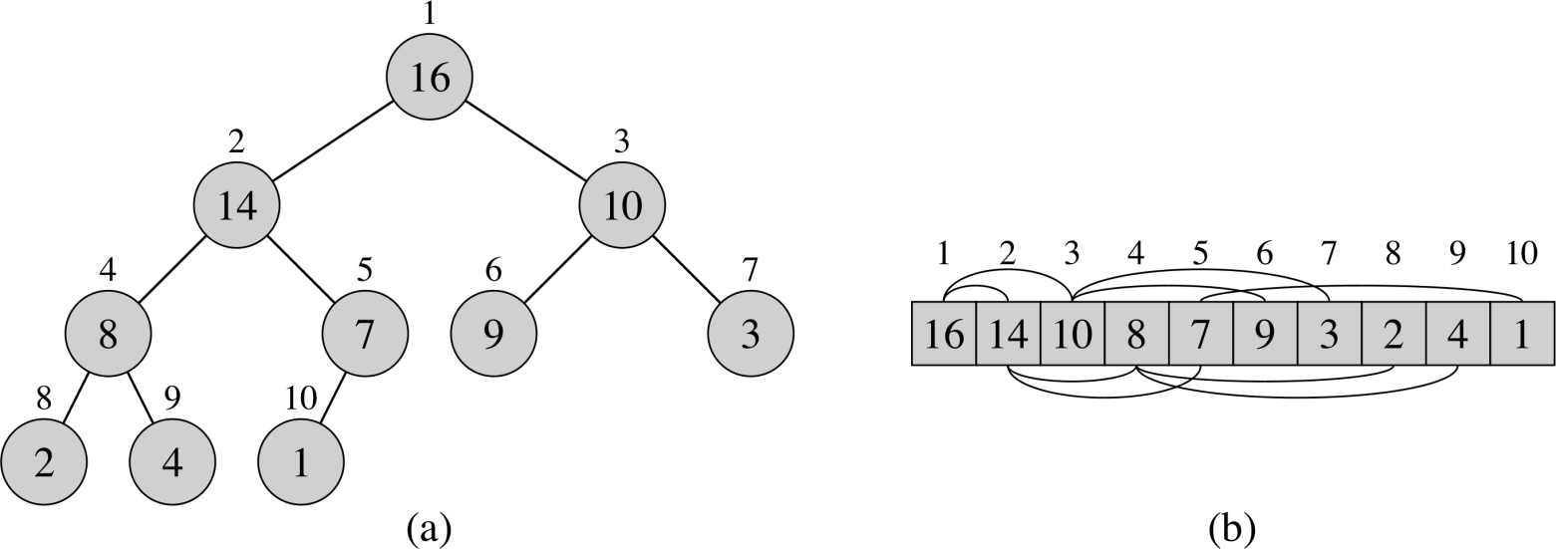
Heaps
array A represents a binary tree that is full except for possibly last “row”
heap property: A[parent(i)] ¸ A[i] for all i
parent(i) = bi/2c
left(i) = 2i
right(i) = 2i+1
height = O(log n)
April 3, 2014
CS38 Lecture 2

Slide 27
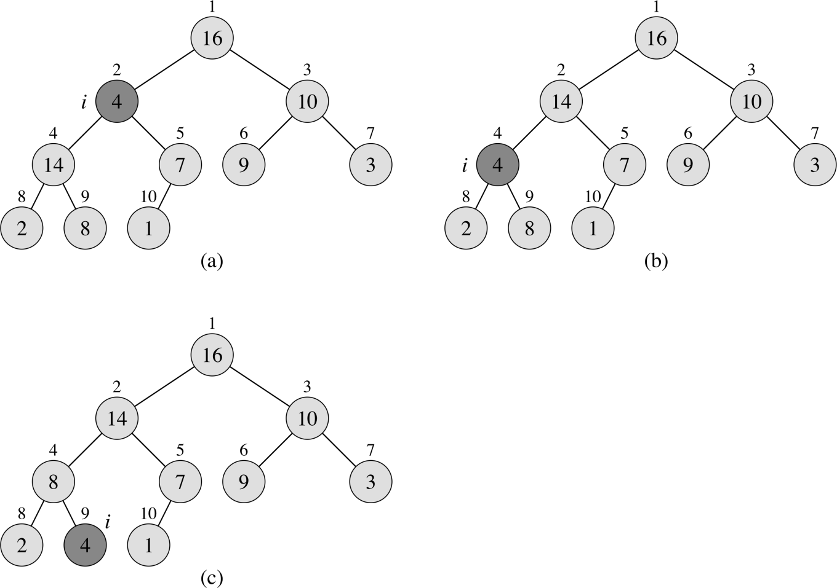
Heaps
key operation: HEAPIFY-DOWN(H, i)
  A[i] may violate heap property
  repeatedly swap with larger child
  running time? O(log n) or O(ht)
April 3, 2014
CS38 Lecture 2

Slide 28
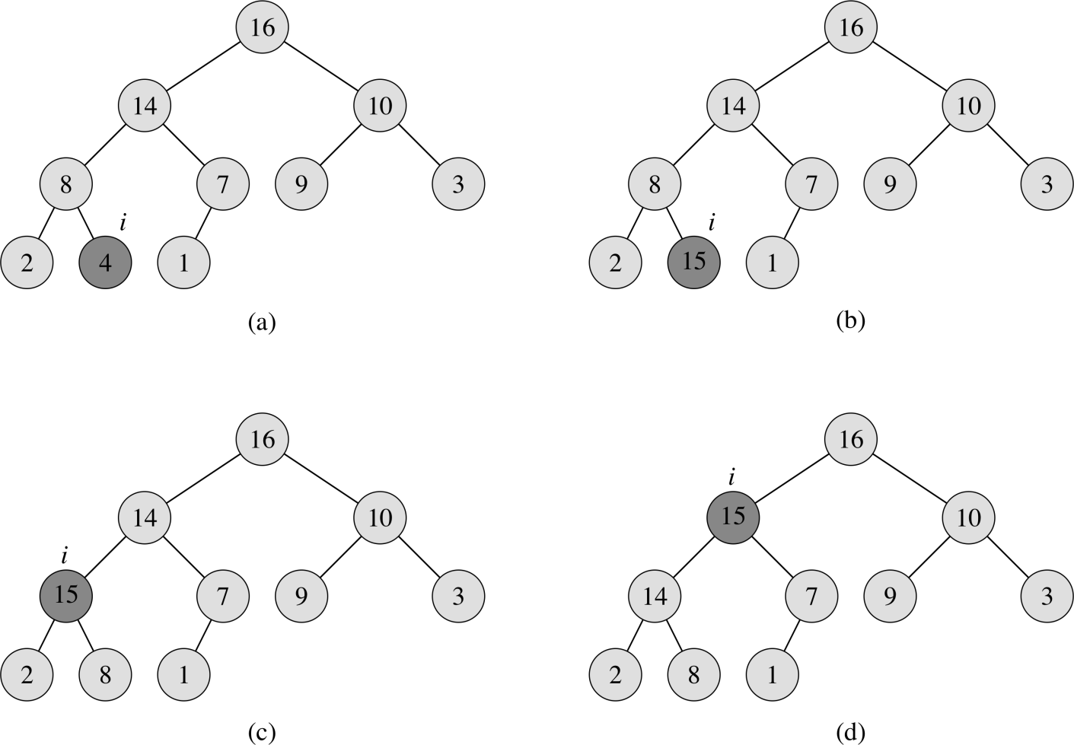
Heaps
key operation: HEAPIFY-UP(H, i)
  A[i] may violate heap property
  repeatedly swap with larger child
  running time? O(log n) or O(ht)
April 3, 2014
CS38 Lecture 2

Slide 29
Heaps
How do you implement
  operations: time:
  INSERT(H, elt) O(log n)
  INCREASE-KEY(H, i) O(log n)
  EXTRACT-MAX(H) O(log n)
  using HEAPIFY-UP and HEAPIFY-DOWN?
BUILD-HEAP(A): re-orders array A so that it satisfies heap property
  how do we do this? running time?
April 3, 2014
CS38 Lecture 2

Slide 30
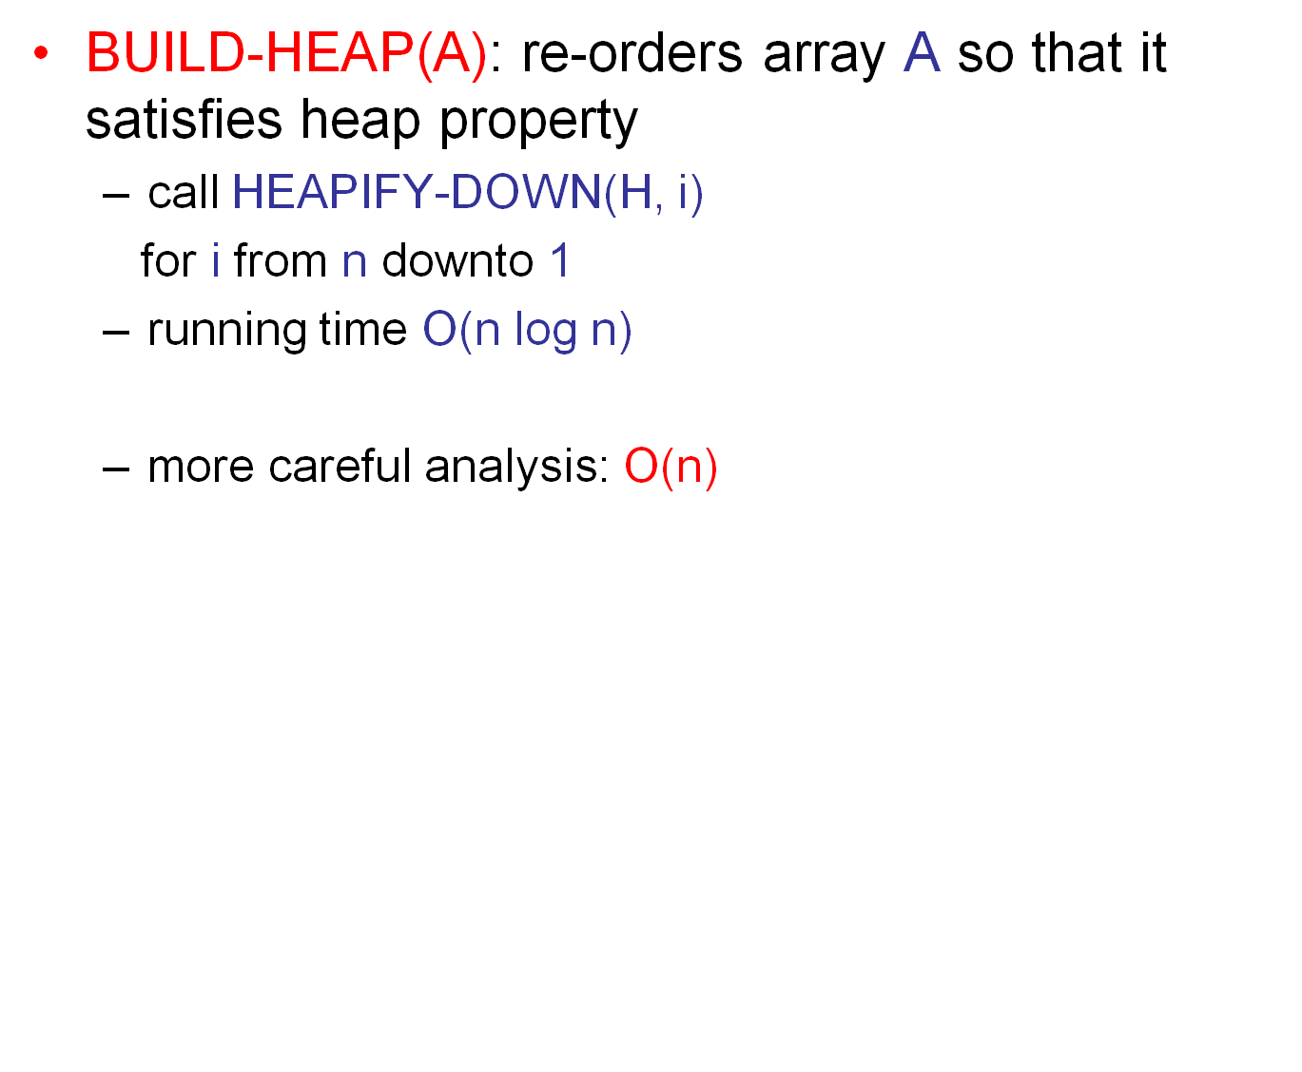
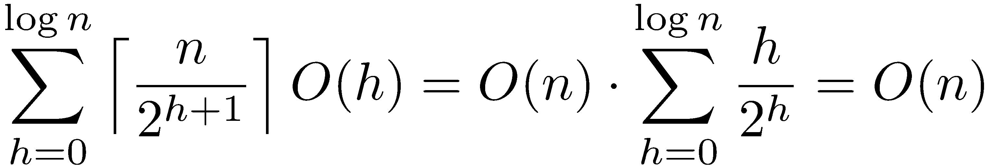
Heaps
April 3, 2014
CS38 Lecture 2

Slide 31
Heaps
suffices to show ∑_{h¸0} h/2^{h} = O(1)
note: ∑_{h¸0} c^{h} = O(1) for c < 1
observe: (h+1)/2^{h+1} = h/(2^{h}) ¢ (1+1/h)/2
(1+1/h)/2 < 1 for h > 1
April 3, 2014
CS38 Lecture 2

Slide 32
Heapsort
Sorting n numbers using a heap
  BUILD-HEAP(A) O(n)
  repeatedly EXTRACT-MIN(H) n¢O(log n)
  total O(n log n)
Can we do better? O(n)?
  observe that only ever compare values
  no decisions based on actual values of keys
April 3, 2014
CS38 Lecture 2

Slide 33
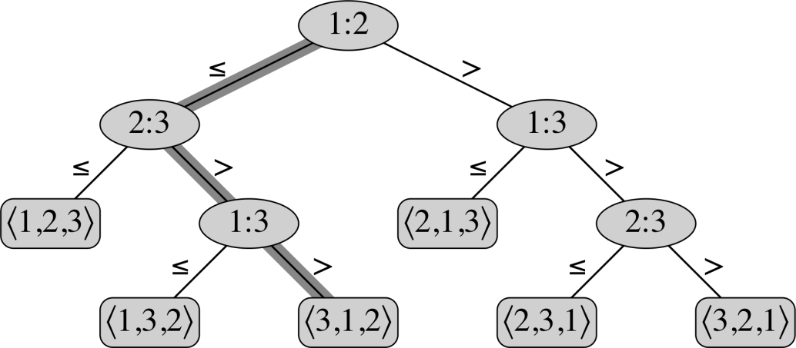
Sorting lower bound
comparison-based sort: only information about A used by algorithm comes from pairwise comparisons
  heapsort, mergesort, quicksort, …
visualize sequence of com-parisons in tree:
“is A[i] · A[j]?”
each root-leaf path consistent with 1 perm.
maximum path length ¸ log(n!) = Ω(n log n)
April 3, 2014
CS38 Lecture 2

Slide 34
Greedy
Algorithms
April 3, 2014
CS38 Lecture 2

Slide 35
Greedy algorithms
Greedy algorithm paradigm
  build up a solution incrementally
  at each step, make the “greedy” choice
Example: in undirected graph G = (V,E), a vertex cover is a subset of V that touches every edge
  a hard problem: find the smallest vertex cover
a
d
a
d
b
b
f
f
c
c
e
April 3, 2014
CS38 Lecture 2

Slide 36
Dijkstra’s algorithm
given
  directed graph G = (V,E) with non-negative edge weights
  starting vertex s 2 V
find shortest paths from s to all nodes v
  note: unweighted case solved by BFS
April 3, 2014
CS38 Lecture 2

Slide 37
Dijkstra’s algorithm
shortest paths exhibit “optimal substructure” property
  optimal solution contains within it optimal solutions to subproblems
  a shortest path from x to y via z contains a shortest path from x to z
shortest paths from s form a tree rooted at s
Main idea:
  maintain set S µ V with correct distances
  add nbr u with smallest “distance estimate”
April 3, 2014
CS38 Lecture 2

