Slide 1
CS38
Introduction to Algorithms
Lecture 3
April 8, 2014

Slide 2
Outline
greedy algorithms…
  Dijkstra’s algorithm for single-source shortest paths
guest lecturer (this lecture and next)
  coin changing
  interval scheduling
  MCST (Prim and Kruskal)
April 8, 2014
CS38 Lecture 3

Slide 3
Greedy algorithms
Greedy algorithm paradigm
  build up a solution incrementally
  at each step, make the “greedy” choice
Example: in undirected graph G = (V,E), a vertex cover is a subset of V that touches every edge
  a hard problem: find the smallest vertex cover
a
d
a
d
b
b
f
f
c
c
e
April 8, 2014
CS38 Lecture 3

Slide 4
Dijkstra’s algorithm
given
  directed graph G = (V,E) with non-negative edge weights
  starting vertex s 2 V
find shortest paths from s to all nodes v
  note: unweighted case solved by BFS
April 8, 2014
CS38 Lecture 3

Slide 5
Dijkstra’s algorithm
shortest paths exhibit “optimal substructure” property
  optimal solution contains within it optimal solutions to subproblems
  a shortest path from x to y via z contains a shortest path from x to z
shortest paths from s form a tree rooted at s
Main idea:
  maintain set S µ V with correct distances
  add nbr u with smallest “distance estimate”
April 8, 2014
CS38 Lecture 3

Slide 6
Dijkstra’s algorithm
Dijkstra(G = (V,E), s)
1. S = ;, s.dist = 0, build Min-Heap H from V, keys are distances
2. while H is not empty
u = EXTRACT-MIN(H) Ã “greedy choice”
S = S [ {u}
for each neighbor v of u
if v.dist > u.dist + weight(u,v) then
v.dist = u.dist + weigth(u,v), DECREASE-KEY(H, v)
Lemma: can be implemented to run in O(m) time plus n EXTRACT-MIN and m DECREASE-KEY calls.
Proof?
April 8, 2014
CS38 Lecture 3

Slide 7
Dijkstra’s algorithm
Dijkstra(G = (V,E), s)
1. S = ;, s.dist = 0, build Min-Heap H from V, keys are distances
2. while H is not empty
u = EXTRACT-MIN(H) Ã “greedy choice”
S = S [ {u}
for each neighbor v of u
if v.dist > u.dist + weight(u,v) then
v.dist = u.dist + weigth(u,v), DECREASE-KEY(H, v)
Lemma: can be implemented to run in O(m) time plus n EXTRACT-MIN and m DECREASE-KEY calls.
Proof: each vertex added to H once, adj. list scanned once, O(1) work apart from min-heap calls
April 8, 2014
CS38 Lecture 3

Slide 8
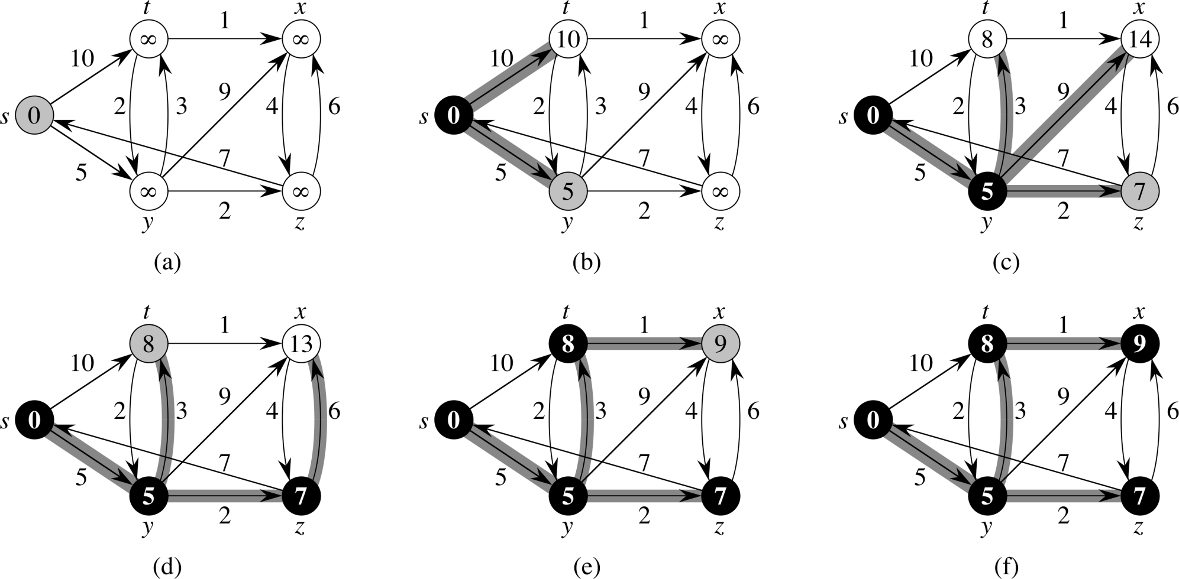
Dijkstra’s example from CLRS
April 8, 2014
CS38 Lecture 3

Slide 9
Dijkstra’s algorithm
Lemma: invariant of algorithm: for all v 2 S it v.dist = distance(s, v).
Proof: induction on size of S
  base case: S = ;, trivially true
  case |S| = k:
consider any other s – v path, let (x,y) be edge exiting S
x
y
x.dist, u.dist correct by induction, so s – y path already longer than s – v since algorithm chose latter
s
u
v
S
April 8, 2014
CS38 Lecture 3

Slide 10
Dijkstra’s algorithm
We proved:
  later: Fibonacci heaps: O(n log n + m) time
Theorem (Dijkstra): there is an O(n ⁺ m log n) time algorithm that is given
a directed graph with nonnegative weights a starting vertex s
and finds
distances from s to every other vertex
(and produces a shortest path tree from s)
April 8, 2014
CS38 Lecture 3

