Slide 1
CS38
Introduction to Algorithms
Lecture 5
April 15, 2014

Slide 2
Outline
review of Dijkstra’s algorithm
greedy algorithms: Huffman codes
data structures for MST and Dijkstra’s
  union-find with log* analysis
  Fibonacci heaps with amortized analysis
April 15, 2014
CS38 Lecture 5

Slide 3
Dijkstra’s algorithm
given
  directed graph G = (V,E) with non-negative edge weights
  starting vertex s 2 V
find shortest paths from s to all nodes v
  note: unweighted case solved by BFS
  shortest paths from s form a tree rooted at s
  “find” = fill in predecessor pointers for each vertex to define shortest-path tree from s
April 15, 2014
CS38 Lecture 5

Slide 4
Dijkstra’s algorithm
shortest paths exhibit “optimal substructure” property
  optimal solution contains within it optimal solutions to subproblems
  a shortest path from x to y via z contains a shortest path from x to z
Main idea:
  maintain set S µ V with correct distances
  add nbr u with smallest “distance estimate”
April 15, 2014
CS38 Lecture 5

Slide 5
Dijkstra’s algorithm
Dijkstra(G = (V,E), s)
1. S = ;, s.dist = 0, build Min-Heap H from V, keys are distances
2. while H is not empty
u = EXTRACT-MIN(H) Ã “greedy choice”
S = S [ {u}
for each neighbor v of u
if v.dist > u.dist + weight(u,v) then
v.dist = u.dist + weigth(u,v), DECREASE-KEY(H, v)
Lemma: can be implemented to run in O(m) time plus n EXTRACT-MIN and m DECREASE-KEY calls.
Proof?
April 15, 2014
CS38 Lecture 5

Slide 6
Dijkstra’s algorithm
Dijkstra(G = (V,E), s)
1. S = ;, s.dist = 0, build Min-Heap H from V, keys are distances
2. while H is not empty
u = EXTRACT-MIN(H) Ã “greedy choice”
S = S [ {u}
for each neighbor v of u
if v.dist > u.dist + weight(u,v) then
v.dist = u.dist + weigth(u,v), DECREASE-KEY(H, v)
Lemma: can be implemented to run in O(m) time plus n EXTRACT-MIN and m DECREASE-KEY calls.
Proof: each vertex added to H once, adj. list scanned once, O(1) work apart from min-heap calls
April 15, 2014
CS38 Lecture 5

Slide 7
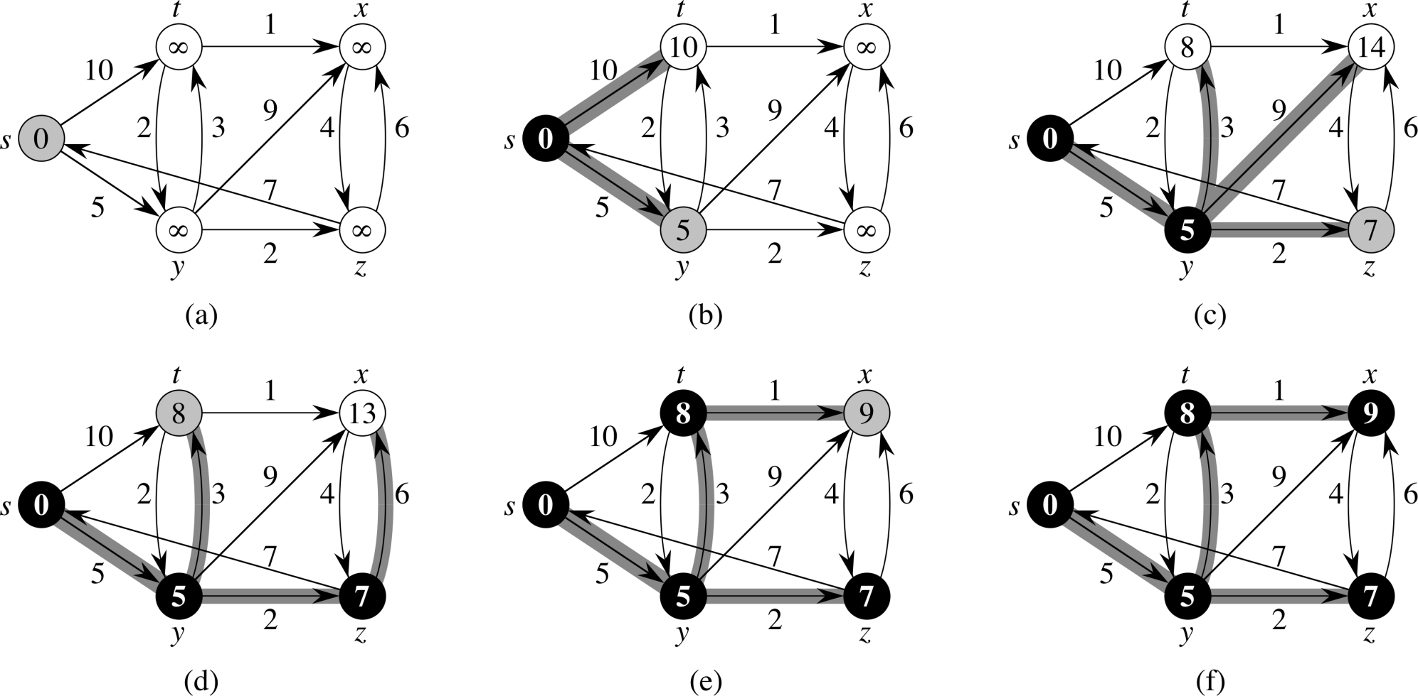
Dijkstra’s example from CLRS
April 15, 2014
CS38 Lecture 5

Slide 8
Dijkstra’s algorithm
Lemma: invariant of algorithm: for all v 2 S it holds that v.dist = distance(s, v).
Proof: induction on size of S
  base case: S = ;, trivially true
  case |S| = k:
consider any other s – v path, let (x,y) be edge exiting S
x
y
x.dist, u.dist correct by induction, so s – y path already longer than s – v since algorithm chose latter
s
u
v
S
April 15, 2014
CS38 Lecture 5

Slide 9
Dijkstra’s algorithm
We proved:
  using binary heaps
  later: Fibonacci heaps: O(m + n log n) time
Theorem (Dijkstra): there is an O(n ⁺ m log n) time algorithm that is given
a directed graph with nonnegative weights a starting vertex s
and finds
distances from s to every other vertex
(and produces a shortest path tree from s)
April 15, 2014
CS38 Lecture 5

Slide 10
Variable-length encoding
Scenario: large file with n symbol types and frequencies f_{x} for each symbol x
Goal: compress the file (losslessly)
  represent each symbol x by a length L_{x} string of binary digits (“variable-length”)
  prefix-free: no encoding string is a prefix of another; ) can write them one after another
minimize total length: ∑_{x} L_{x}f_{x}
April 15, 2014
CS38 Lecture 5

Slide 11
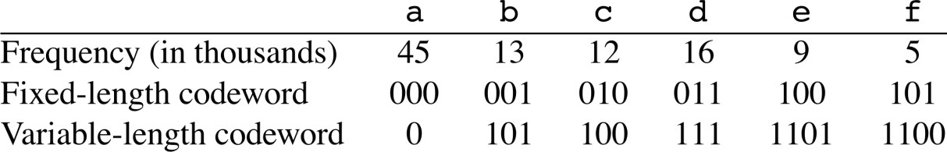
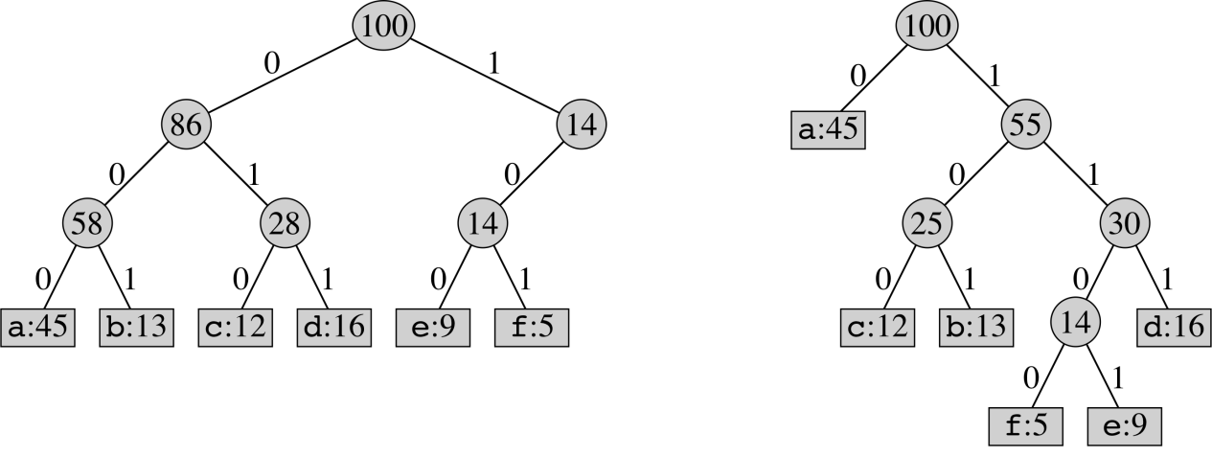
Huffman codes
can represent prefix-free encoding scheme by binary tree T:
Example:
cost C(T) = ∑_{c}L(T)_{c}f_{c}
Problem: given frequencies, construct optimal tree (prefix-free encoding scheme)
April 15, 2014
CS38 Lecture 5

Slide 12
Huffman codes
Idea: build tree bottom-up and make greedy choice (what is it?)
  joining two symbols commits to a bit to distinguish them; which should we choose?
build heap H with frequencies as keys
for i = 1 to n-1
allocate new node z
z.left = x = EXTRACT-MIN(H)
z.right = y = EXTRACT-MIN(H)
z. freq = x.freq + y.freq; INSERT(H, z)
return EXTRACT-MIN(H)
April 15, 2014
CS38 Lecture 5

Slide 13
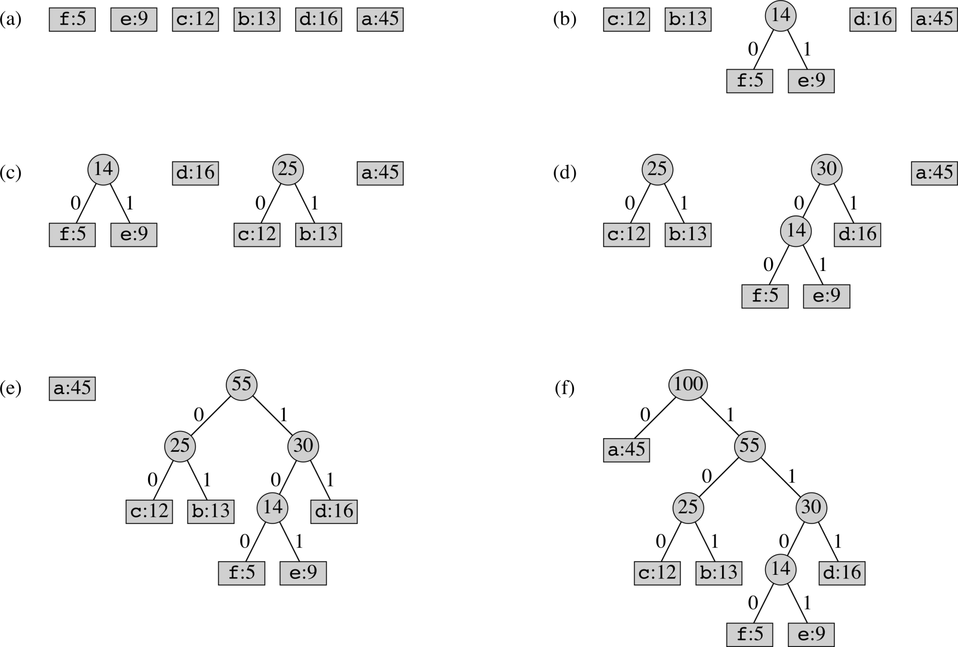
Huffman example from CLRS
April 15, 2014
CS38 Lecture 5

Slide 14
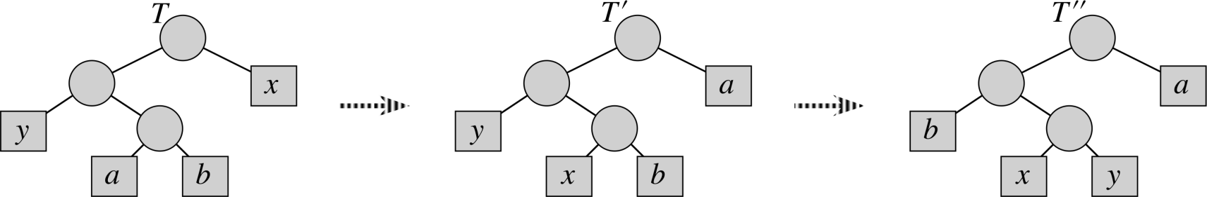
Huffman codes
Lemma: there exists an optimal tree where the 2 lowest frequency symbols are siblings.
Proof: let T be an optimal tree; a,b lowest siblings
change from exchanging x, a:
∑_{c}L(T)_{c}f_{c} - ∑_{c}L(T’)_{c}f_{c} = (f_{a} – f_{x})(L(T)_{a} – L(T)_{x})¸0
April 15, 2014
CS38 Lecture 5

Slide 15
Huffman codes
Lemma: there exists an optimal tree where the 2 lowest frequency symbols are siblings.
Proof: let T be an optimal tree; a,b lowest siblings
change from exchanging y, b:
∑_{c}L(T’)_{c}f_{c} - ∑_{c}L(T’’)_{c}f_{c} = (f_{b} – f_{y})(L(T’)_{b} – L(T’’)_{y})¸0
April 15, 2014
CS38 Lecture 5

Slide 16
Huffman codes
T’
“optimal substructure”
Lemma: T’ is an optimal tree.
Proof: consider another tree S’, w.l.o.g. having x, y as siblings. Let S be merged version. Optimality of T gives:
C(S’) = C(S) + f_{x}+ f_{y} ¸ C(T) + f_{x} + f_{y} = C(T’)
T
T: optimal tree with merged symbol
x
y
z
T’: replace z
April 15, 2014
CS38 Lecture 5

Slide 17
Greedy algorithms review
Coin changing: choose largest coin
Interval scheduling: choose job w/ first finish
Dijkstra’s: extend shortest paths tree by vertex with smallest distance estimate
Prim’s: extend tree by lowest weight edge
Kruskal’s: extend forest by lowest weight edge
Huffman : build tree by merging lowest freq. pair
Safe choice: can always extend to an optimal solution
April 15, 2014
CS38 Lecture 5

Slide 18
Role of data structures
Running times: using heaps
  Huffman: O(n) INSERT, O(n) EXTRACT-MIN
  Dijkstra: O(n) INSERT + EXTRACT-MIN; O(m) DECREASE-KEY
  Prim: O(n) INSERT + EXTRACT-MIN, O(m) DECREASE-KEY
… and using union-find
  Kruskal: time to sort m items and then O(m) FIND + UNION
April 15, 2014
CS38 Lecture 5

Slide 19
Coming up: two data structures
amortized analysis:
  each operation has an amortized cost
  any sequence of operations has cost bounded by sum of amortized costs
1. Fibonacci heap amortized vs. binary heap
  EXTRACT-MIN O(log n) vs. O(log n)
  INSERT, DECREASE-KEY O(1) vs. O(log n)
April 15, 2014
CS38 Lecture 5

Slide 20
Coming up: two data structures
ammortized analysis:
  each operation has an amortized cost
  any sequence of operations has cost bounded by sum of amortized costs
2. Union find (amortized)
  any sequence of n UNIONs and m FINDs: O(n log* m)
April 15, 2014
CS38 Lecture 5

Slide 21
Improvements to running times
using Fibonacci heaps (vs. binary heaps):
  Dijkstra: O(n) INSERT + EXTRACT-MIN; O(m) DECREASE-KEY
  Prim: O(n) INSERT + EXTRACT-MIN, O(m) DECREASE-KEY
using union-find
  Kruskal: time to sort m items and then O(m) FIND + UNION
O(m + n log n) vs. O(m log n)
O(m log m + m log* n)
April 15, 2014
CS38 Lecture 5

Slide 22
Union-find
data structure
Kevin Wayne’s slides
based on Kleinberg + Tardos text and
Dasgupta, Papadimitriou,Vazirani text
April 15, 2014
CS38 Lecture 5

