Slide 1
CS38
Introduction to Algorithms
Lecture 8
April 24, 2014

Slide 2
Outline
Divide and Conquer design paradigm
  closest pair (finishing up)
  the DFT and the FFT
  polynomial multiplication
  polynomial division with remainder
  integer multiplication
  matrix multiplication
April 25, 2014
CS38 Lecture 8

Slide 3
Closest pair in the plane
Given n points in the plane, find the closest pair
April 25, 2014
CS38 Lecture 8

Slide 4
Closest pair in the plane
Divide and conquer approach:
  split point set in equal sized left and right sets
  find closest pair in left, right, + across middle
April 25, 2014
CS38 Lecture 8

Slide 5
Closest pair in the plane
Divide and conquer approach:
  split point set in equal sized left and right sets
  find closest pair in left, right, + across middle
April 25, 2014
CS38 Lecture 8

Slide 6
Closest pair in the plane
Divide and conquer approach:
  split point set in equal sized left and right sets
  time to perform split?
  sort by x coordinate: O(n log n)
  running time recurrence:
  T(n) = 2T(n/2) + time for middle + O(n log n)
Is time for middle as bad as O(n²)?
April 25, 2014
CS38 Lecture 8

Slide 7
Closest pair in the plane
Claim: time for middle only O(n log n) !!
key: we know d = min of
distance between closest pair on left
distance between closest pair on right
Observation: only need to consider points within distance d of the midline
April 25, 2014
Ã 2d !

Slide 8
Closest pair in the plane
Ã 2d !
scan left to right to identify, then sort by y coord.
  still Ω(n²) comparisons?
  Claim: only need do pairwise comparisons 15 ahead in this sorted list !
April 25, 2014
CS38 Lecture 8

Slide 9
Closest pair in the plane
no 2 points lie in same box (why?)
if 2 points are within ¸ 16 positions of each other in list sorted by y coord…
… then they must be separated by ¸ 3 rows
implies dist. > (3/2)¢ d
d/2 by d/2 boxes
Ã 2d !
April 25, 2014
CS38 Lecture 8

Slide 10
Closest pair in the plane
Closest-Pair(P: set of n points in the plane)
sort by x coordinate and split equally into L and R subsets
(p,q) = Closest-Pair(L)
(r,s) = Closest-Pair(R)
d = min(distance(p,q), distance(r,s))
scan P by x coordinate to find M: points within d of midline
sort M by y coordinate
compute closest pair among all pairs within 15 of each other in M
return best among this pair, (p,q), (r,s)
Running time:
  T(2) = O(1); T(n) = 2T(n/2) + O(n log n)
April 25, 2014
CS38 Lecture 8

Slide 11
Closest pair in the plane
Running time:
  T(2) = a; T(n) = 2T(n/2) + bn¢log n
  set c = max(a/2, b)
Claim: T(n) · cn¢log²n
Proof: base case easy…
T(n) · 2T(n/2) + bn¢log n
· 2cn/2(log n - 1)² + bn¢log n
< cn(log n)(log n - 1) + bn¢log n
· cnlog² n
April 25, 2014
CS38 Lecture 8

Slide 12
Closest pair in the plane
we have proved:
can be improved to O(n log n) by being more careful about maintaining sorted lists
Theorem: There is an O(n log²n) time algorithm for finding the closest pair among n points in the plane.
April 25, 2014
CS38 Lecture 8

Slide 13
The DFT,
the FFT,
and polynomial multiplication
April 25, 2014
CS38 Lecture 8

Slide 14
Roots of unity
An n-th root of unity is an element ! such that !^{n} = 1
  primitive if !^{k} ≠ 1 for 1 · k < n
examples:
  in C: e^{2¼i/n} = cos(2¼/n) + i¢sin(2¼/n) is a primitive n-th root of unity
  in integers mod 7: 2 is a primitive 3-th root of unity
April 25, 2014
CS38 Lecture 8

Slide 15
Roots of unity
An n-th root of unity is an element ! such that !^{n} = 1
  primitive if !^{k} ≠ 1 for 1 · k < n
key property:
  !^{n-1} + !^{n-2} + … + !¹ + !⁰ = 0
  why? ! ≠ 1 and
  0 = !^{n} - 1 = (! – 1)(!^{n-1}+!^{n-2}+…+!¹+!⁰)
April 25, 2014
CS38 Lecture 8

Slide 16
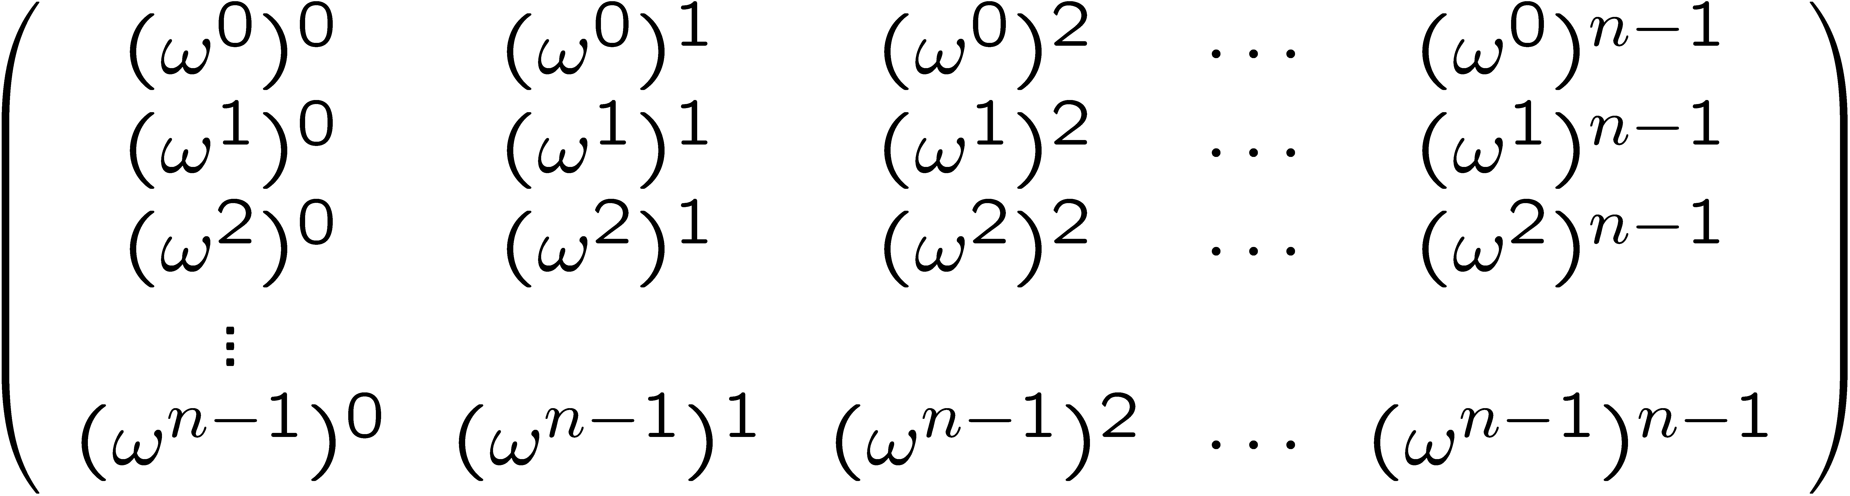
Discrete Fourier Transform (DFT)
Given n-th root of unity !, DFT_{n} is a linear map from C^{n} to C^{n}:
(i,j) entry is !^{ij}
April 25, 2014
CS38 Lecture 8

Slide 17
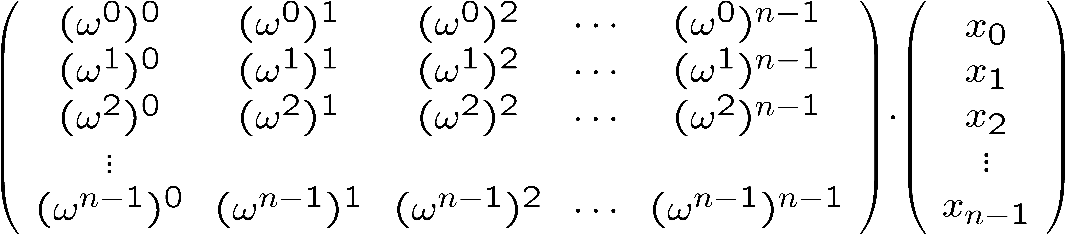
Fast Fourier Transform (FFT)
Given vector x 2 C^{n}, how many operations to compute DFT_{n}¢x?
standard matrix-vector multiplication: O(n²)
April 25, 2014
CS38 Lecture 8

Slide 18
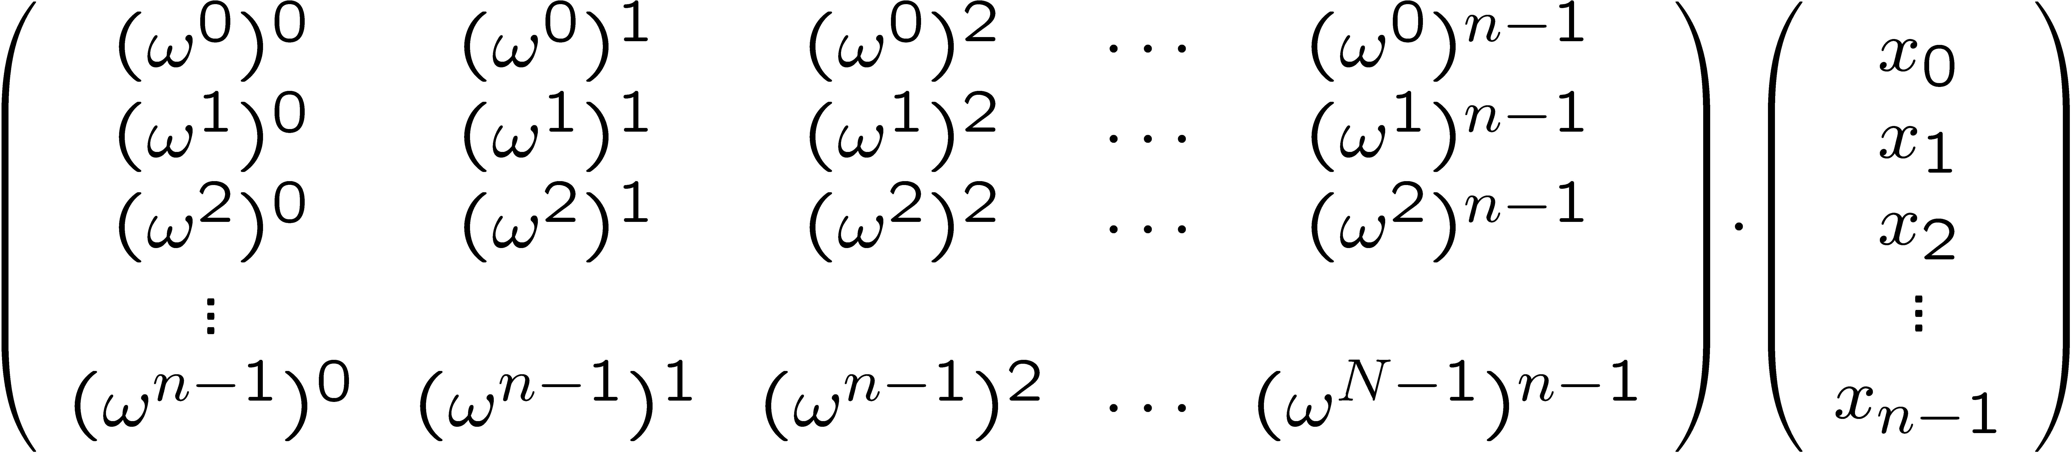
Fast Fourier Transform (FFT)
try Divide and Conquer:
would lead to
  T(n) = 4T(n/2) + time to split/combine
  which implies T(n) = Ω(n²)
April 25, 2014
CS38 Lecture 8

Slide 19
Fast Fourier Transform (FFT)
DFT_{n} has special structure (assume n= 2^{k})
  reorder columns: first even, then odd
  consider exponents on ! along rows:
multiples of:
same multiples plus:
0
0 | 0 | 0 | 0 | 0 | 0 | … | 0 | 0 | 0 | 0 | 0 | 0 | …
0 | 2 | 4 | 6 | 8 | 10 | … | 1 | 3 | 5 | 7 | 9 | 11 | …
0 | 4 | 8 | 12 | 16 | 20 | … | 2 | 6 | 10 | 14 | 18 | 22 | …
0 | 6 | 12 | 18 | 24 | 30 | … | 3 | 9 | 15 | 21 | 27 | 33 | …
0 | 8 | 16 | 24 | 32 | 44 | … | 4 | 12 | 20 | 28 | 36 | 40 | …
0
2
1
4
2
6
3
8
4
rows repeat twice since !^{n} = 1

Slide 20
Fast Fourier Transform (FFT)
!² is (n/2)-th root of unity
so we are actually computing:
so to compute DFT_{n}¢x
D = diagonal matrix diag(!⁰, !¹, !², …, !^{n/2-1})
FFT(n:power of 2; x)
let ! be a n-th root of unity
compute a = FFT(n/2, x_{even})
compute b = FFT(n/2, x_{odd})
y_{even} = a + D¢b and y_{odd} = a + !^{n/2} ¢D¢b
return vector y
April 25, 2014
CS38 Lecture 8

Slide 21
Fast Fourier Transform (FFT)
Running time?
  T(1) = 1
  T(n) = 2T(n/2) + O(n)
  solution: T(n) = O(n log n)
FFT(n:power of 2; x)
let ! be a n-th root of unity
compute a = FFT(n/2, x_{even})
compute b = FFT(n/2, x_{odd})
y_{even} = a + D¢b and y_{odd} = a + !^{n/2} ¢D¢b
return vector y
April 25, 2014
CS38 Lecture 8

Slide 22
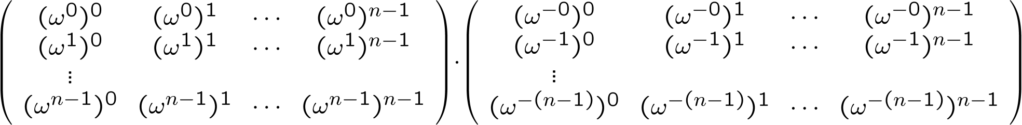
Discrete Fourier Transform (DFT)
entry (i,j) of DFT_{n} is !^{ij} (n-th root of unity !)
claim: entry (i,j) of inverse-DFT_{n} is !^{-ij}/n
entry (a,b) of this product is
  ∑_{k} !^{ak}!^{-kb} = ∑_{k} !^{(a-b)k} = n if a=b; 0 otherwise
April 25, 2014
CS38 Lecture 8

Slide 23
Discrete Fourier Transform (DFT)
Theorem: can compute DFT and inverse-DFT in O(n log n) operations
extremely efficient in practice
  parallel implementation via “butterfly circuit”
April 25, 2014
CS38 Lecture 8

Slide 24
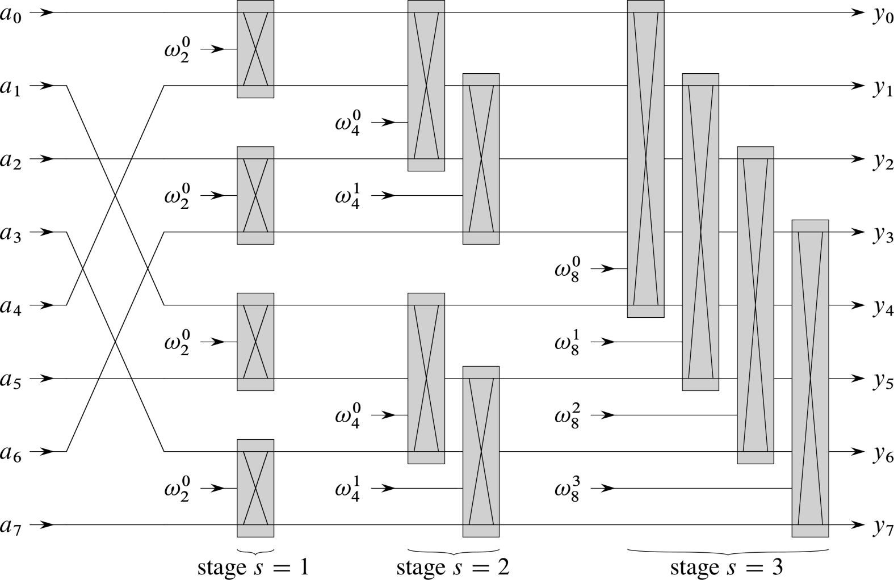
butterly circuit from CLRS
April 25, 2014
CS38 Lecture 8

Slide 25
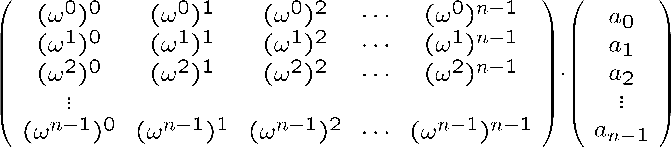
the DFT and polynomials
given a polynomial
  a(x) = a₀x⁰ + a₁x¹ + a₂x² + … + a_{n-1}x^{n-1}
observe that DFT_{n}¢a gives evaluations of a at !^{i} for i=0,1,…, n-1
April 25, 2014
CS38 Lecture 8

Slide 26
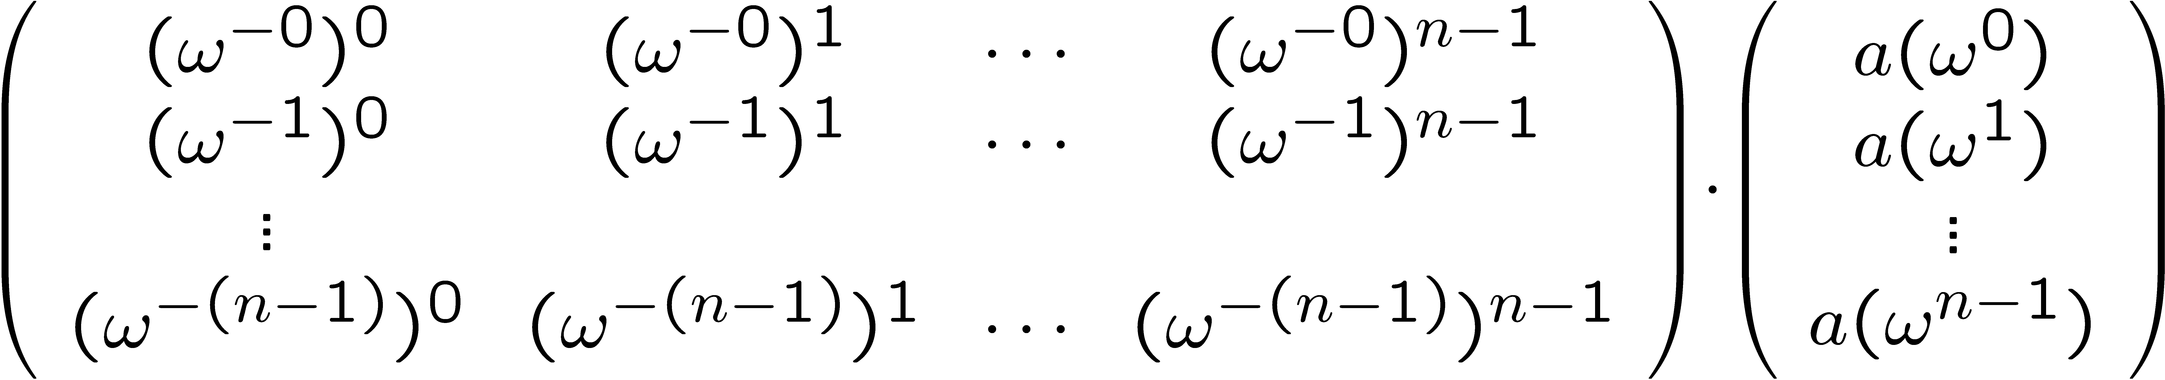
the DFT and polynomials
since DFT_{n}¢a gives evaluations of a at !^{i} for i=0,1,…, n-1…
inverse-DFT_{n}¢(vector of these evaluations) must give back a
April 25, 2014
CS38 Lecture 8

Slide 27
Polynomial multiplication
given two polynomials
  a(x) = a₀x⁰ + a₁x¹ + a₂x² + … + a_{n-1}x^{n-1}
  b(x) = b₀x⁰ + b₁x¹ + b₂x² + … + b_{n-1}x^{n-1}
we want to compute the polynomial
a(x)¢ b(x)
of degree at most 2n-2
standard method takes O(n²) operations
April 25, 2014
CS38 Lecture 8

Slide 28
Polynomial multiplication
given two polynomials
  a(x) = a₀x⁰ + a₁x¹ + a₂x² + … + a_{n-1}x^{n-1}
  b(x) = b₀x⁰ + b₁x¹ + b₂x² + … + b_{n-1}x^{n-1}
  DFT_{2n}¢a and DFT_{2n}¢b give evaluations of a, b at !^{i} for i = 0,1,…, 2n-1
  can get evaluations of a¢b at same points since a(!^{i})¢b(!^{i}) = (a¢b)(!^{i})
  inverse-DFT_{2n} applied to (vector of these evaluations) gives back a¢b
April 25, 2014
CS38 Lecture 8

Slide 29
Polynomial multiplication
polynomial-product(a, b: coeffs of degree n polynomials )
compute u = FFT(2n, a)
compute v = FFT(2n, b)
multiply vectors u,v pointwise to get vector w
return(inverse-FFT(2n,w))
Running time?
  O(n log n) for FFT and inverse-FFT
  O(n) to multiply pointwise
overall O(n log n)
April 25, 2014
CS38 Lecture 8

Slide 30
Polynomial division
x²
+ 3x
- 2
remainder : x - 8
x² + 2
x⁴ + 3x³ + 7x - 12
x⁴ + 2x²
3x³ - 2x² + 7x - 12
3x³ + 6x
- 2x² + x - 12
- 2x² - 4
x - 8
check: x⁴ + 3x³ + 7x – 12 equals
(x² + 2)(x² + 3x - 2) + (x – 8) = (x⁴ + 3x³ + 6x - 4) + (x – 8)
April 25, 2014
CS38 Lecture 8

Slide 31
Polynomial inversion
Theorem: given polynomial f with f(0) = 1, if
g₀ = 1, and
g_{i+1} ≡ 2g_{i} – (f)(g_{i})² mod x^{2i+1}
then fg_{i} ≡ 1 mod x^{2i} for all i.
Proof: induction on i
  base case: fg₀ ≡ f(0)g₀ = 1¢1 ≡ 1 (mod x)
  1-fg_{i+1} ≡ 1-f(2g_{i} –f(g_{i})²) ≡ (1 - fg_{i})² ≡ 0 mod x^{2i+1}
April 25, 2014
CS38 Lecture 8

Slide 32
Polynomial division
polynomial-inversion (f: coeffs of deg. n poly; int. k)
output: polynomial g satisfying fg = 1 mod x^{k}
g₀ = 1; r = dlog ke
for i = 1 to r
g_{i} = 2g_{i} – (f)(g_{i-1})² rem x^{2i}
return(g_{r})
Running time? (# operations)
  O(log k) ¢ O(k log k) = O(k log² k)
  O(k log k) if careful about degrees in loop
April 25, 2014
CS38 Lecture 8

Slide 33
Polynomial division
(monic) polys a, b of deg. m, n (m · n)
we want polys q, r such that a = qb + r and deg(r) < deg(b)
key observation:
  a(x) = a₀x⁰ + a₁x¹ + a₂x² + … + a_{n-1}x^{n}
  x^{n} a(1/x) = a₀x^{n} + a₁x^{n-1} + a₂x^{n-2} + … + a_{n-1}x⁰
denote by rev_{n}(a) this polynomial: x^{n}a(1/x)
April 25, 2014
CS38 Lecture 8

Slide 34
Polynomial division
(monic) polys a, b of deg. m, n (m · n)
we want polys q, r such that a = qb + r and deg(r) < deg(b)
algebra:
  rev_{n}(a) = rev_{n-m}(q)¢rev_{m}(b) + x^{n-m+1}rev_{m-1}(r)
  rev_{n}(a) ≡ rev_{n-m}(q)¢rev_{m}(b) mod x^{n-m+1}
  rev_{n}(a)¢rev_{m}(b)⁻¹ ≡ rev_{n-m}(q) mod x^{n-m+1}
rev_{n-m}(b) is invertible mod x^{n-m+1} because constant coefficient is 1 (so rev_{n-m}(b) not divisible by x)
April 25, 2014
CS38 Lecture 8

Slide 35
Polynomial division
poly-division-with-rem (a, b: coeffs of degr m, n polys)
output: polys q,r satisfying a = bq + r and deg(r) < deg(b)
r = deg(a) – deg(b)
compute inverse of rev_{deg(b)}(b) mod x^{r+1}
q* = (rev_{deg(a)} a)¢(rev_{deg(b)} b )⁻¹ rem x^{r +1}
return(q = rev_{m}(q*) and r = a – bq)
Running time? (# operations)
  O(n log n)
April 25, 2014
CS38 Lecture 8

Slide 36
Polynomial multiplication and division
Theorem: can multiply and divide with remainder degree n polynomials in O(n log n) time
April 25, 2014
CS38 Lecture 8

Slide 37
integer multiplication
given 2 n-bit integers x, y
compute their product xy
standard multiplication O(n²)
simple divide and conquer improves to O(n^{log23}) = O(n^{1.59})
April 25, 2014
CS38 Lecture 8

Slide 38
integer multiplication
given 2 n-bit integers x, y
write:
  x = x₁ ¢ 2^{n/2} + x₀
  y = y₁ ¢ 2^{n/2} + y₀
note: xy = x₁y₁¢2^{n} + (x₁y₀ + x₀y₁)¢2^{n/2} + x₀y₀
clever idea:
  (x₁ + x₀)(y₁ + y₀) = x₁y₁ + x₁y₀ + x₀y₁ + x₀y₀
April 25, 2014
CS38 Lecture 8

Slide 39
integer multiplication
integer-mult(x, y: n-bit integers)
write x = x₁ ¢ 2^{n/2} + x₀ and y = y₁ ¢ 2^{n/2} + y₀
a = integer-mult(x₁, y₁)
b = integer-mult(x₀, y₀)
c = integer-mult(x₀ + x₁, y₀ + y₁)
return(a ¢ 2^{n} + (c - a - b) ¢ 2^{n/2} + b)
Running time recurrence? (# operations)
  T(n) = 3T(n/2) + O(n)
  T(n) = O(n^{log23}) = O(n^{1.59})
April 25, 2014
CS38 Lecture 8

