Slide 1

Preliminary analysis on yelp data
Group members: Cheng lu, Linhai Zhang, Lan Wang

Slide 2
stars | name | text | date | city | longitude | latitude | categories
1 | McD | … | 2015-12-29 | Glendale | -112.205 | 33.509 | ['Burgers', 'Fast Food',
… | … | … | …
Total number of records in train dataset: 1,546,379
Used: 30,000

Slide 3
1. Variable Selection

Slide 4
Primary outcomes
Included | Not Included
Text | Location parameters
Date | Categories
 | Name of business

Slide 5
1.1 Text processing

Slide 6
Step1: Noise removing
Example
Step1: Remove punctuation except for !? And keep 26 letters
Step2: change into lower case
Come with birds?!? Uh that was kinda gross actually I understand the authenticity and all but I dont really like birds eating scraps around my feet during a meal
Come with birds......?!? Uh, that was kinda gross actually. I understand the authenticity and all, but I don't really like birds eating scraps around my feet during a meal.

Slide 7
Step3: Remove edited stopwords
Step4: Normalize the verbs and nouns
come birds?!? uh kinda gross actually understand authenticity all dont really like birds eating scraps around feet meal
come with birds?!? uh that was kinda gross actually i understand the authenticity and all but i dont really like birds eating scraps around my feet during a meal
come bird?!? uh kinda gross actually understand authenticity all dont really like bird eat scrap around feet meal

Slide 8
Step2: Selecting words by counts
Index | Word | Count
1 | ! | 41282
2 | food | 23692
3 | place | 20183
…
43103 | jojos | 1
43104 | coudln | 1
1 | not impress food all ambience great food not good……
2 | cute place venitian ! really make feel like Europe…...
 | …….
30000 | not try acai bowl juice n go really miss something yummy……
Cleaned Text
Word Dictionary
I will never order this again!
✗
✓
Word | Count
never | +1
order | +1
Word | Count
never order | +1

Slide 9
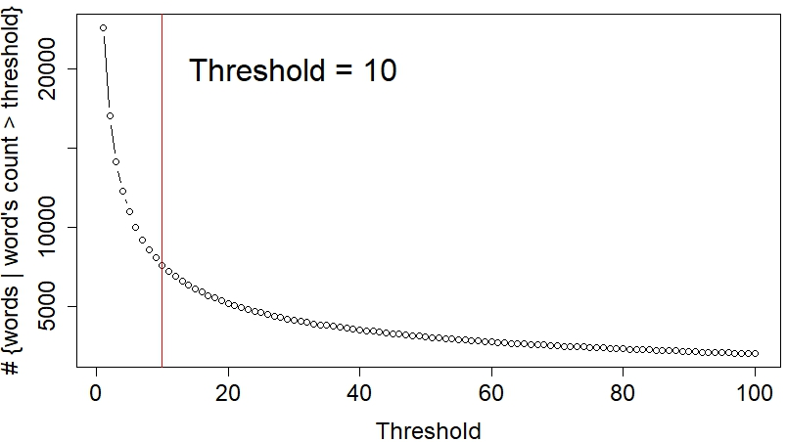
Index | Word | Count
1 | ! | 41282
2 | food | 23692
3 | place | 20183
…
43103 | jojos | 1
43104 | coudln | 1
Threshold vs. # words > threshold
Word Dictionary
Cut off words with counts under 10!

Slide 10
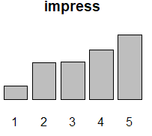
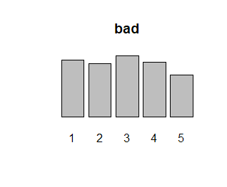
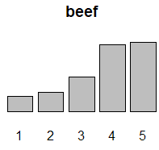
Step3: Selecting words by variance
> 8000 histograms !!!
……
Quantify them by variance between stars!

Slide 11
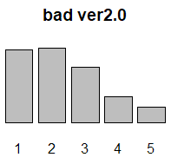
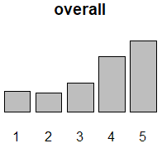
Problems
1: the stars has its own distribution
Scale each count of “bad” by the overall count!

Slide 12
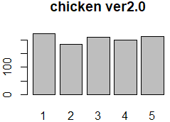
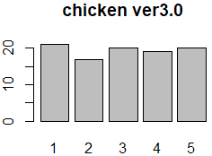
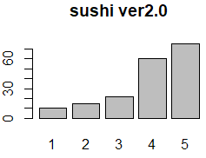
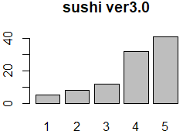
2: If they has 10 times difference in counts
Scale each count of “chicken” by sum of its counts!

Slide 13
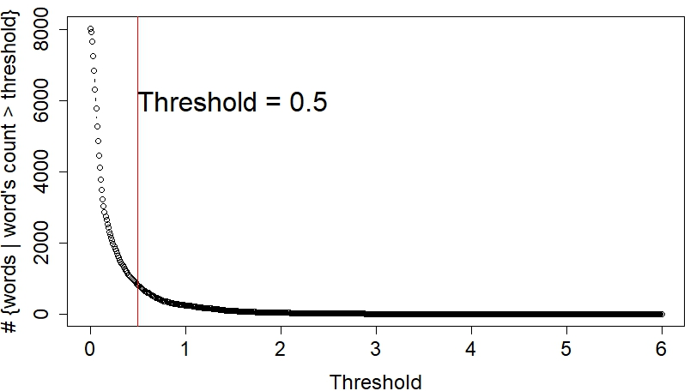
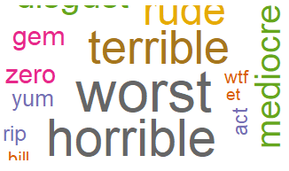
Index | Word | 1 star | 2 star | 3 star | 4 star | 5 star
1 | impress | 54 | 150 | 153 | 200 | 261
… | …. | … | … | … | … | …
8045 | miss | 2 | 2 | 1 | 3 | 2
Select top 800
Index | Word | Variance
1 | impress | 0.7936934
…… | ……
8045 | miss | 1.223552

Slide 14
Selected features
cleaned texts
1 | not impress food all ambience great food not good……
2 | cute place venitian ! really make feel like Europe…...
 | …….
30000 | not try acai bowl juice n go really miss something yummy……
+
Feature Matrix
Index | Word1 | Word2 | …… | word800
1 | 1 | 0 |  | 0
2 | 0 | 1 | …… | 1
…… | ……
30000 | 1 | 2 | ….. | 1
=

Slide 15
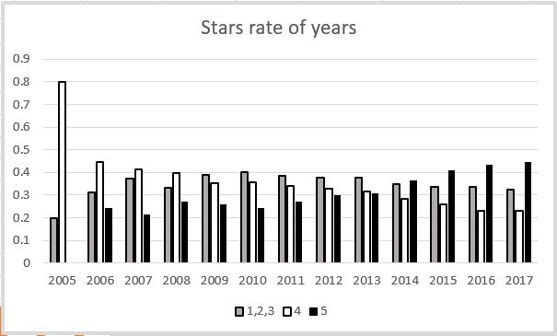
1.2 Date

Slide 16
1.3 Location parameters
City
Latitude
Longitude

Slide 17
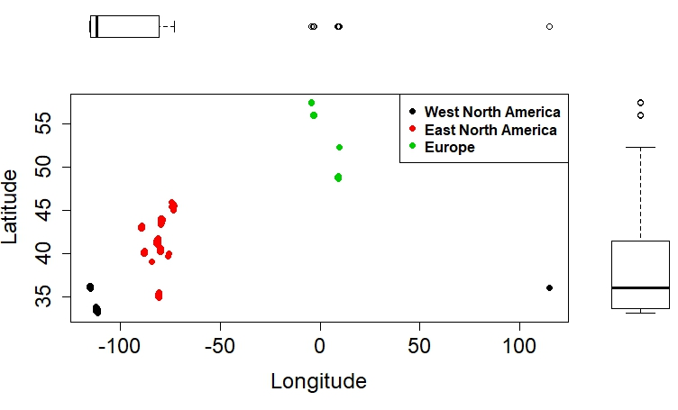
Area | Avg. Star
West part of North America | 3.733
East part of North America | 3.638
Europe | 3.725

Slide 18
Index | Word1 | Word2 | …… | Word800 | Year
1 | 1 | 0 |  | 0 | “2015”
2 | 0 | 1 | …… | 1 | “2017”
…… | …… |  |  |  | …
30000 | 1 | 2 | ….. | 1 | “2010”

Slide 19
2. Further analysis plan

Slide 20
 | Prediction Method | Reason
1 | Linear regression | Simple and interpretable
2 | Logistic regression | Interpretable
3 | Random forest | Understandable result
4 | Naïve Bayes | Common solution to text classification
5 | Support vector machine | Multiple classification
6 | Neural network | Accurate but hard to explain

Slide 21
Thank you!

