Slide 1
CSS3 Positioning
Yay!

Slide 2
CSS x SCSS
Sass (Sassy CSS) is a CSS pre-processor with syntax advancements.
Superset of CSS3’s syntax. This means that every valid CSS3 stylesheet is valid SCSS as well. SCSS files use the extension .scss.
Style sheets in the advanced syntax are processed by the program, and turned into regular CSS style sheets.
SCSS do not extend the CSS standard itself.
Main reason to use: the addition of features that CSS painfully lacks (like variables, mixins, selector inheritance, and more)

Slide 3
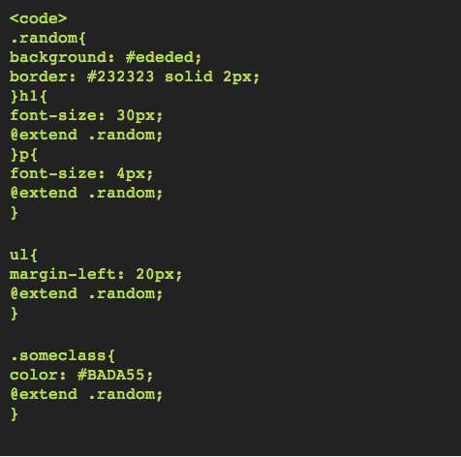
SCSS features – selector inheritance
Selector Inheritance allows us to give one class the attributes of another.

Slide 4
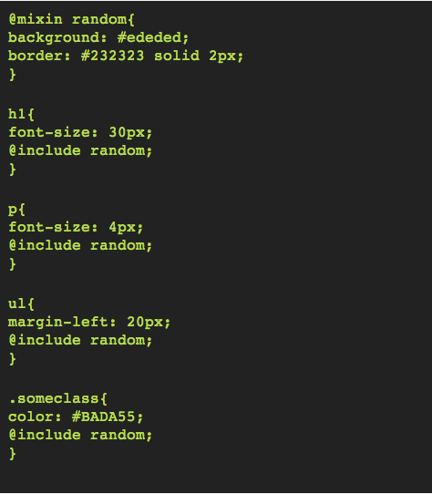
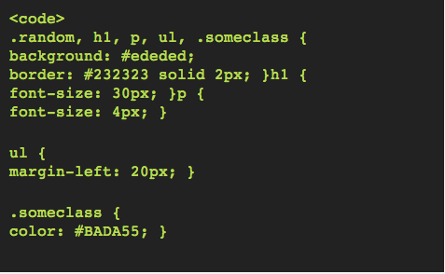
SCSS features - Mixins
Then what is the point of Mixins?

Slide 5
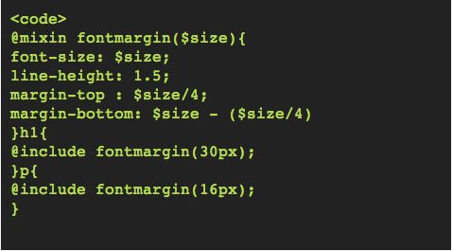
SCSS features - Mixins
Unlike Selector Inheritance, Mixins give us the option to pass parameters to them.

Slide 6
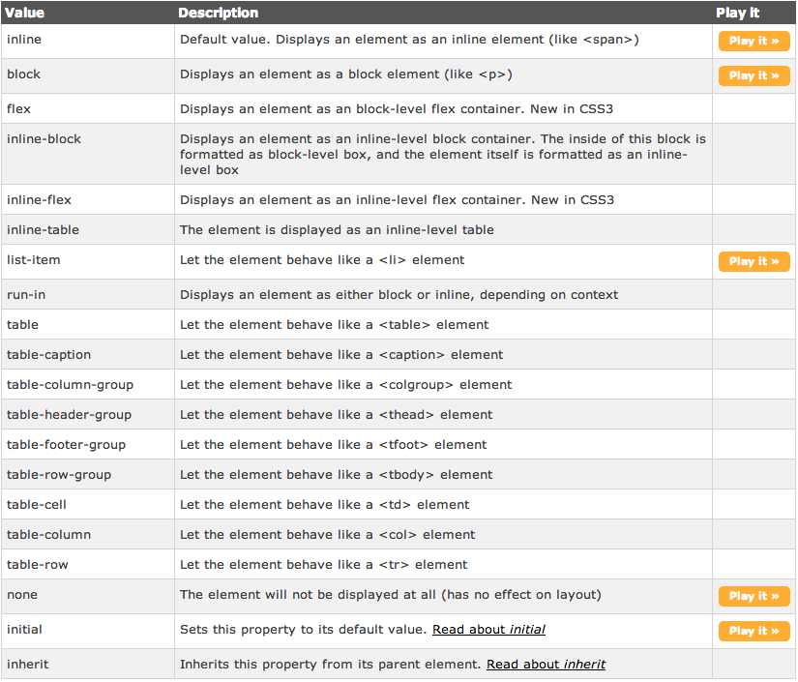
CSS Display property
The display property specifies the type of box used for an HTML element.

Slide 7

Display
DEMO

Slide 8
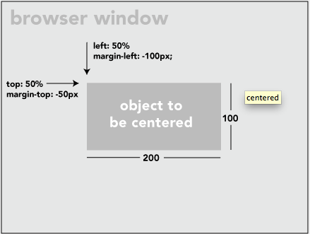
Centering
Not too hard: Known Child
If you know the height and width of both the element to be centered and its parent element (and those measurements won't change, i.e. not fluid width environment) one foolproof way to center the element is just to absolute position it with pixel values so it looks perfectly centered.
Let's say you know the exact width and height of the element you are centering, but the parent element can change in height and width.
You absolutely position the element to be centered and set the top and left values to 50% and the margin top and left values to negative half of the elements height and width. So check this out.

Slide 9
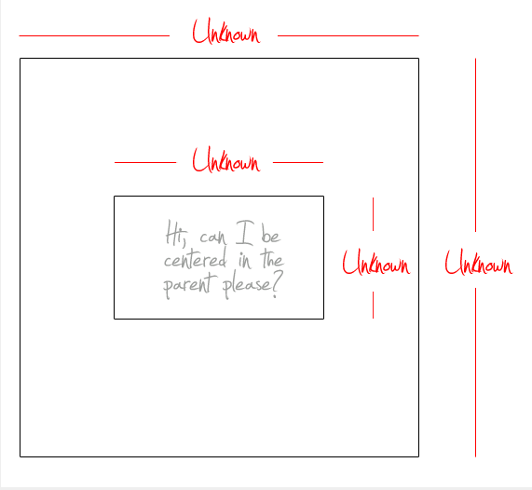
Centering
Harder: Unknown Child
The hard comes in when you don't know the dimensions of the element to be centered.
Instead of using negative margins, you use negative translate() transforms
CSS:
transform: translate (-50%, -50%)
.

