Slide 1

WEEK 0
DAY 1
GitHub
Notes:
Depending on the proficiency of students and instructional staff this lesson’s length can vary greatly
This lecture can go long and it’s OK if you eat into the code along time.
To keep things brief, I’d recommend switching into a code along style lesson once you get to slide 9
There are many pitfalls for students in this lecture!
Be sure students are keeping up and instructional staff may have to work with students individually who are having trouble.
If there are insurmountable technical issues, use the remaining time as review for loops and arrays, and inform the Curriculum Director

Slide 2
GitHub
What is Git?
What’s GitHub?
Making your account
Starting your first repo

Slide 3
WHAT IS VERSION CONTROL?
Version control helps a software engineering team manage changes to their code over time
Version control keeps track of modification made in the code

Slide 4
WHY USE VERSION CONTROL?
If a mistake is made,
developers can turn back the clock and compare earlier versions of the code to fix the mistake
Git is a version control system used profusely by the Tech industry

Slide 5

HOW GIT IS USED?
For example, imagine a team of developers working on the Twitter App
Notes:
Cover this slide quickly

Slide 6
HOW GIT IS USED?
For example, imagine a team of developers working on the Twitter App
If team of developers are making changes on the same code, how do they all combine and save their work?
Notes:
Cover this slide quickly

Slide 7
HOW GIT IS USED?
For example, imagine a team of developers working on the Twitter App
If team of developers are making changes on the same code, how do they all combine and save their work?
Version control/Git
Notes:
Cover this slide quickly

Slide 8
HOW GIT IS USED?
For example, imagine a team of developers working on the Twitter App
If team of developers are making changes on the same code, how do they all combine and save their work?
Version control/Git
Allows multiple people to work on same project safely (no work lost!)
Notes:
Cover this slide quickly

Slide 9
HOW GIT IS USED?
For example, imagine a team of developers working on the Twitter App
If team of developers are making changes on the same code, how do they all combine and save their work?
Version control/Git
Allows multiple people to work on same project safely (no work lost!)
Keeps organized changes to code
Notes:
Cover this slide quickly

Slide 10

WHAT IS GITHUB?
It is an online repository using Git version control
Developers store their code/files on GitHub
Allows developers to work collaboratively
Notes:
Cover this slide quickly
Explain a Repo means, Repository, which is just another word for folder or directory.
Ask, “Why is it useful to store files online, instead of just on your laptops?” Elicit or provide: “Safer in case something happens to laptop” OR “Allows collaborators to have easier access to a project’s files”

Slide 11
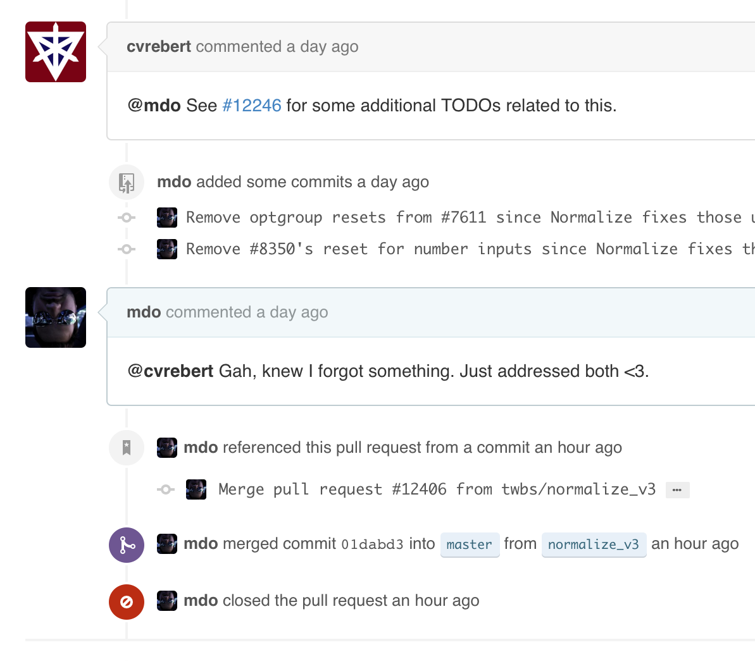
WHY USE GITHUB?
Code is public
Experts can contribute
New developers can learn!
Social Programming, but NOT facebook
Professional space
You have a reputation - Be respectful!
Notes:
Cover this slide quickly

Slide 12
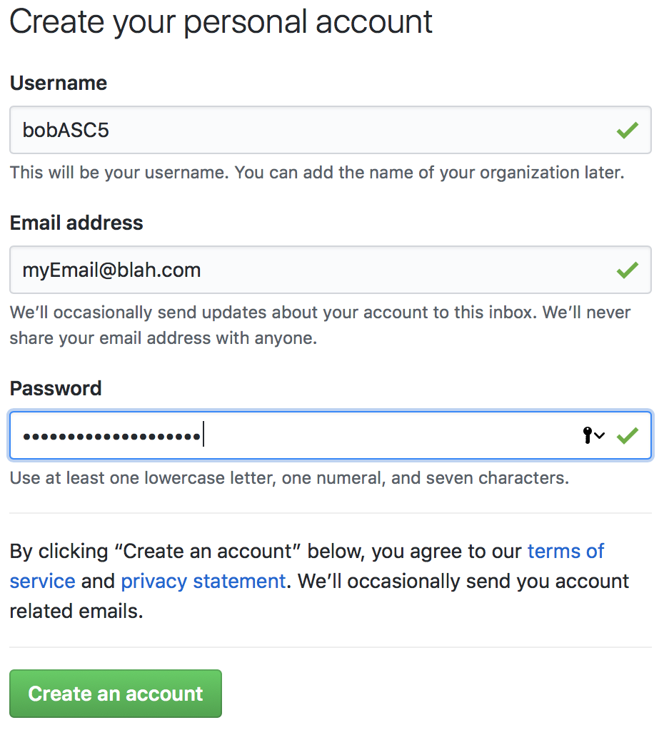
MAKING YOUR ACCOUNT ON GITHUB
Go to Github.com
Click “Sign up”
Create a Username with your first name followed by “ASC5”
For example: bobASC5
The e-mail address should be VALID
needed to confirm your account
Notes:
At this point, if you, as an instructor, don’t have a github account created, you can go through the steps to setup your own github account, otherwise, have a student come up and use their account creature as the example.
If a student can’t get their “{name}ASC5” account name then let them make some combination of the first and last name that works out - end with “ASC5” is what matters.

Slide 13
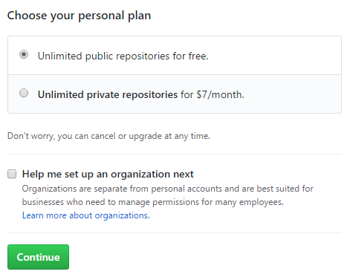
MAKING YOUR ACCOUNT ON GITHUB
Select the free plan (unless you’re a baller)
Answer a few questions to help make GitHub better
Click Submit
Verify your account via e-mail

Slide 14
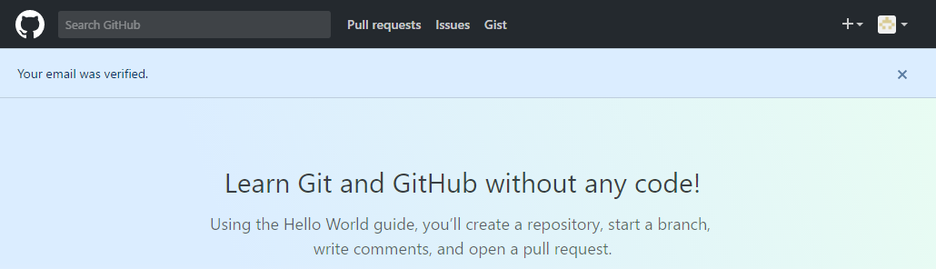
WELCOME TO GITHUB
Notes:
You must verify your account via e-mail
“We’ll come back to this tab, so keep it open in the background”

Slide 15
GIVE ME DEM ACCOUNTS!
To Instructors: collect each student’s name and their GitHub username
Add them to your Team on GitHub!
Notes:
Collect each student’s GitHub account names
https://github.com/orgs/AllStarCodeOrg/teams

Slide 16
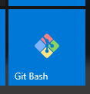
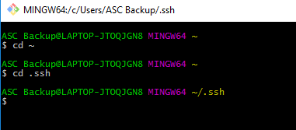
OPEN GIT BASH
Open Git Bash
Navigate to the root directory
cd ~
Navigate to the “.ssh” directory
Note how it starts with a period!
If the “.ssh” directory doesn’t exist, create it!
Notes:
Think of Git Bash as just another console using command line.
Remember, students are still getting familiar with typing in the console
Go slowly when typing in commands to let students keep up
It just has a little more functionality working with git.
The “~” stands for the root, or home, directory.
If students don’t have a folder named “.ssh” they should create one in the root directory.
Note: the “.” at the beginning of the “.ssh” designates this as a hidden folder.
Using the “ls” will not reveal it, however you can see all files, including hidden with “ls -a”
AT THIS POINT, you can switch this into a code along style lesson, and not use the slides (though you have them for reference)

Slide 17
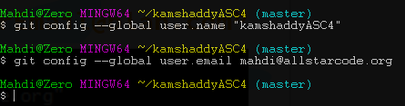
SET UP CREDENTIALS
git config --global user.name “yourAccountName”
git config --global user.email “yourEmail@blah.com”
Notes:
This is a 1-time only setup
This step simply sets the identity of the user committing changes
The actual directory you’re in doesn’t matter since it’s a global variable
You won’t have to do these steps ever again (unless you get another computer)!

Slide 18

LINKING UP WITH GITHUB
While in .ssh directory
ssh-keygen -t rsa -b 4096 -C “yourEmail@blah.com”
Takes a few seconds to generate key
When asked “Enter file…” JUST HIT ENTER
You will be asked to enter your passphrase
JUST HIT ENTER (no password)
Notes:
Note the capital “-C” in the keygen command
“By making an SSH key, we’re creating a “passport” that will help prove to GitHub you are who you claim to be.”
Essentially we’re storing authentication credentials so students don’t have to put in their username and password EVERY time they want to communicate to GitHub servers
SSH stands for Secure Socket Shell, a way for administrator users to access remote computers over a network.
If students enter a password here, they’ll have to enter it every time they save their work (which I’m trying to avoid!)
have them input the command again (press up on the keyboard)
replace the previous files

Slide 19
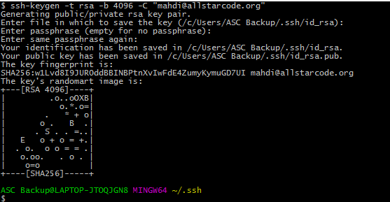

LINKING UP WITH GITHUB
After key made we need to copy it:
clip < id_rsa.pub
Notes:
What did we just do?
We’ve made a unique randomly generated key, like an Passport ID, that GitHub uses to recognize us as US (and not someone hacking our account)
Now, we just need to tell GitHub what our Passport looks like (you’ll never have to do this again, unless you want to link another computer to your github account)
Clip < “file”
Copies the contents of the file onto the clipboard
Mac computers use the command “pbcopy”
NOTE: if you have trouble copying the document, you can simply open it up in a text editor and copy the text like you normally would

Slide 20
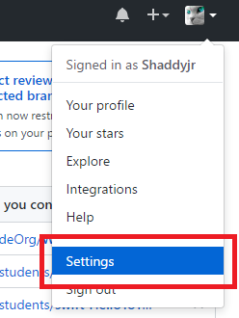
LINKING UP WITH GITHUB
Go back to the browser with your GitHub account open
Go to “Settings”

Slide 21
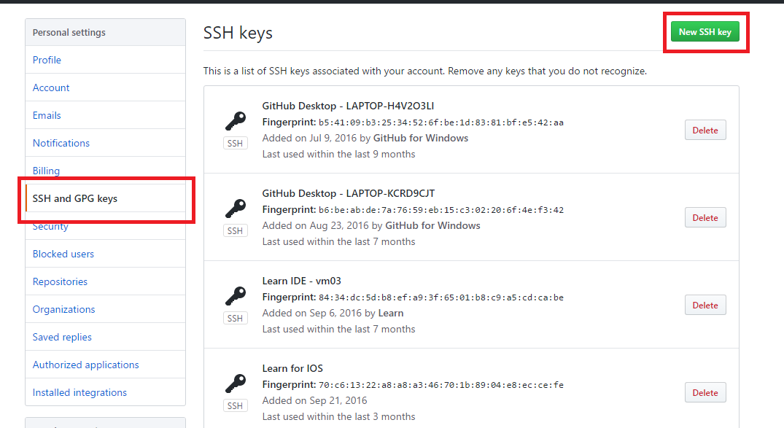
ADDING OUR SSH KEY
Go to “SSH and GPG keys”
Add a new SSH key
Notes:
(it’s OK if you don’t have a bunch of SSH keys, like in the image - I was doing some testing for these slides!)

Slide 22
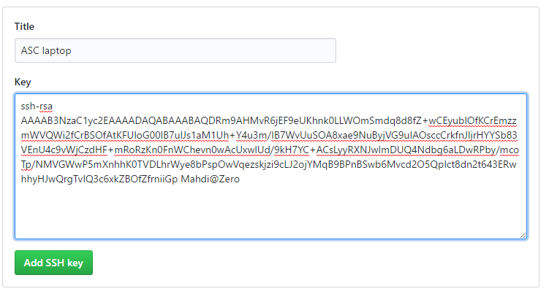
ADDING OUR SSH KEY
Give your key a relevant Title
Paste your key using ctrl + v
Click “Add SSH key”
Notes:
“Your GitHub account will now recognize your specific laptop”
“GitHub can recognize our laptop, but now when we save our work, our laptop needs to know where to put that saved information”
You won’t have to do these steps ever again (unless you get another computer)!

Slide 23
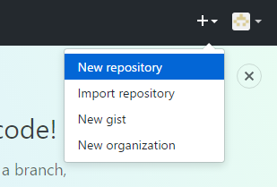
STARTING YOUR FIRST REPO
These next steps are something you’ll be doing a lot, so pay attention!
Create a “New repository”
Notes:
Remind students, Repo is just a folder, a Git folder

Slide 24
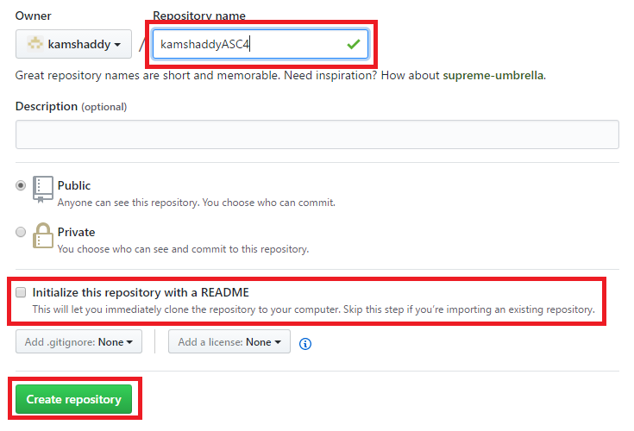
STARTING YOUR FIRST REPO
Name it “myFirstRepo”
“Initialize this repository with a README”
Create your repo!
myFirstRepo
Notes:
We want to initialize with a Readme file because this option creates an empty repo.
If had a local repo already, then we would leave this unchecked and go about setting the GitHub repo as the target for a remote, which would then require adding, committing, and pushing to the remote.

Slide 25
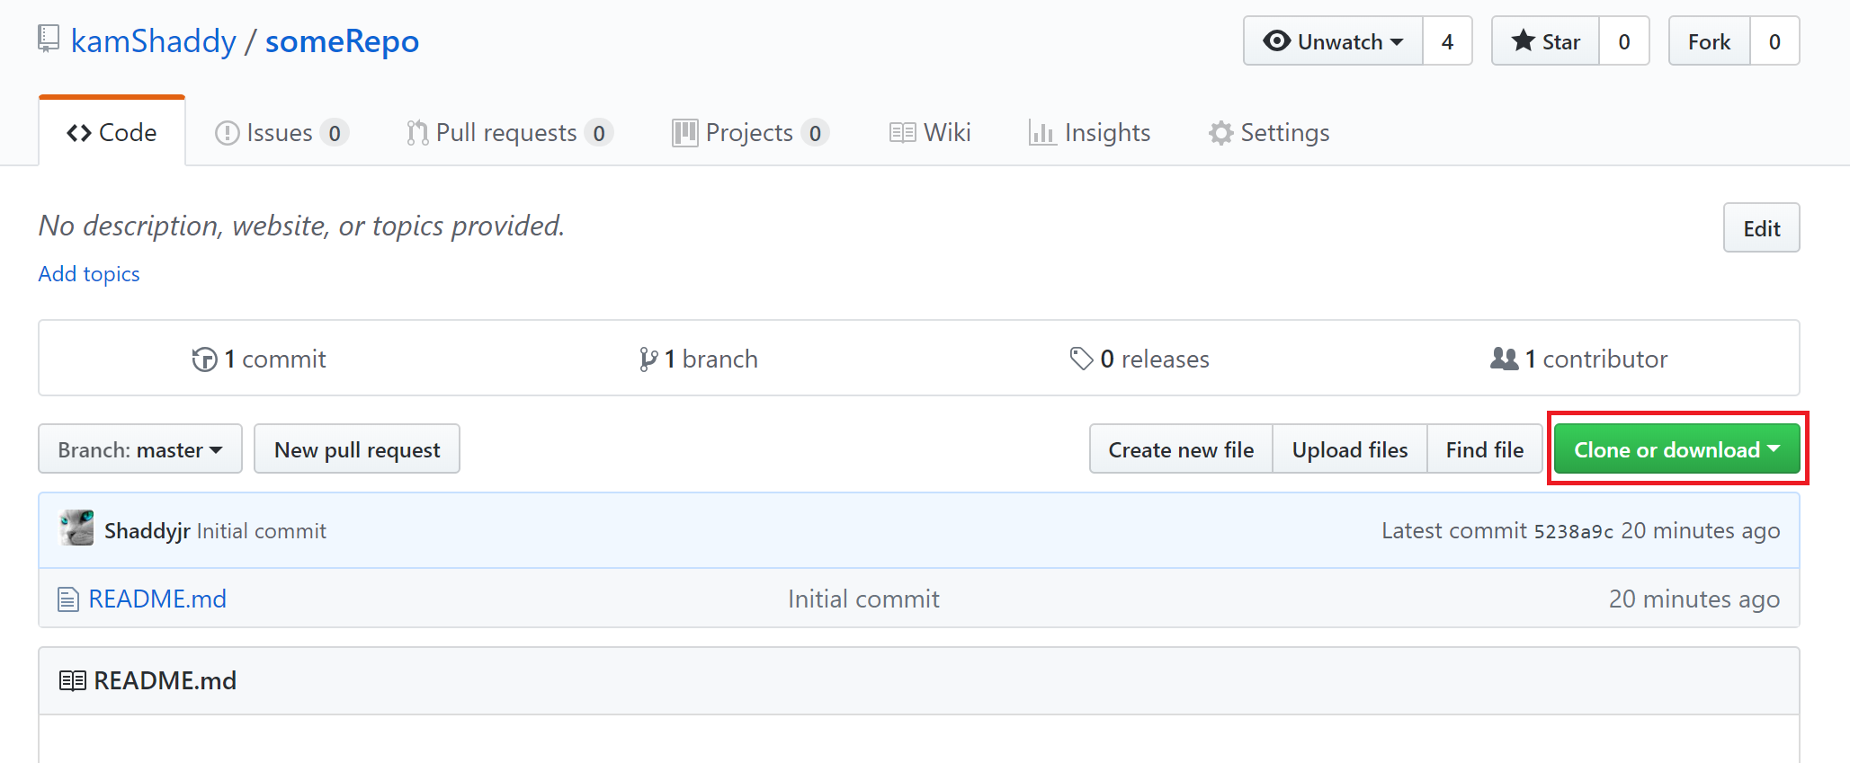
STARTING YOUR FIRST REPO
myFirstRepo

Slide 26
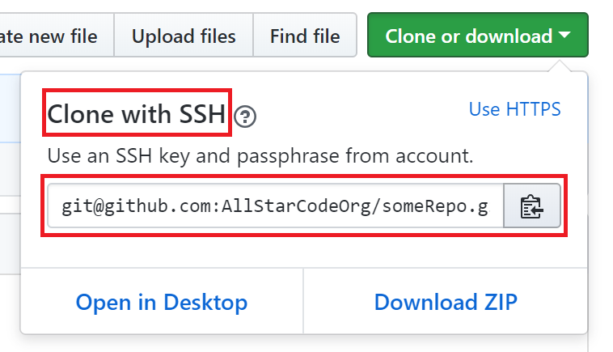
CLONING YOUR REPO
We’ve set up SSH, so be sure to select this option
Copy the link
Notes:
Creating a new remote repo and cloning it locally instead of creating files locally removes the additional steps of having to:
git init
git add .
git commit -m “first commit”
setting the remote manually
git push -u origin master
If students ever do want to use a local folder and push remotely, they’ll have to create a repo on GitHub without initializing with README.md and then follow the step listed above (for setting remote, it should look something like “git remote add origin git@github.com:userName/repoName.git”)

Slide 27
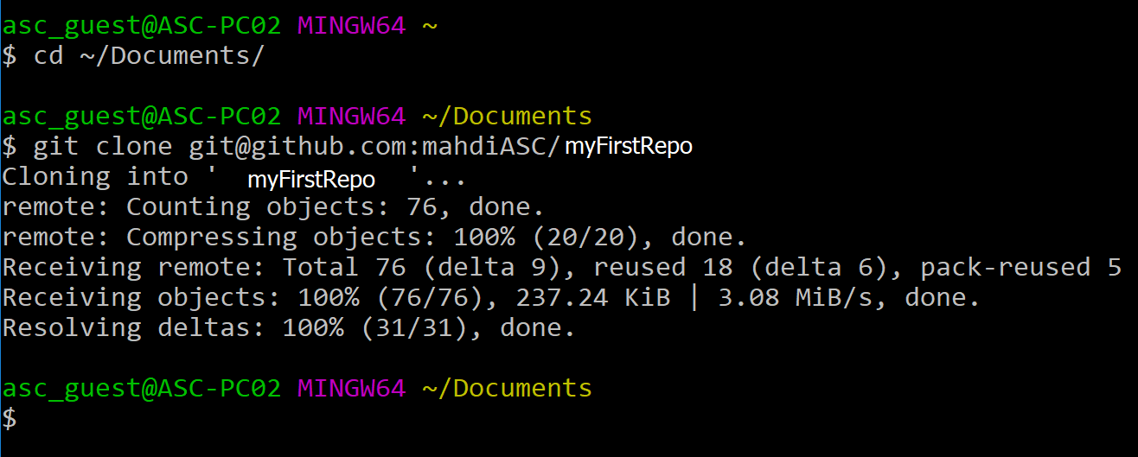
ALMOST THERE...
In Git Bash, Navigate into your “Documents” folder
Clone your repo with git clone {paste url}
Notes:
Mention that students should use the “Documents” folder as the place to put their projects and other repos during the SI (this is just to keep things organized!)
git clone
The command that downloads the associated repo, so long as you have permission to access it on GitHub (since we set up SSH already, students should have access to their own remote repos on GitHub)

Slide 28
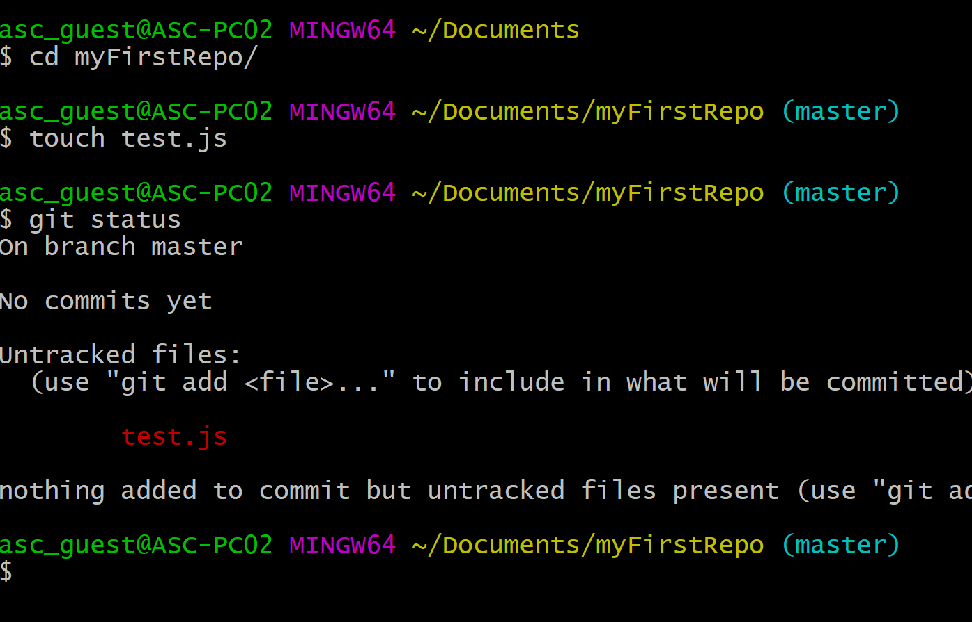
MAKE SOME CHANGES
Navigate into the repo you just downloaded
In command line, make a change!
Create a new file called “test.js”

Slide 29
MAKE SOME CHANGES
Check to see what’s changed
git status

Slide 30
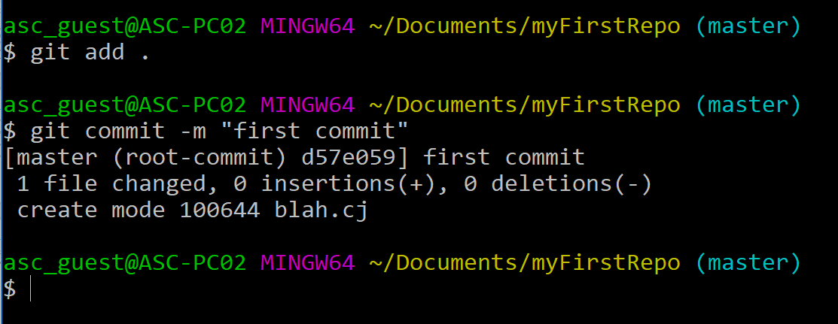
ALMOST THERE...
Officially add and commit the files you already have
git add .
git commit -m “first commit”
THIS IS HOW YOU’LL SAVE YOUR WORK!
Notes:
During this step you might be asked to input your password one last time!
Stress this is probably the two most common commands students will be using with git!
For the commit message, mention that “first commit” is standard for the first time you commit, but the message is up to you to quickly describe the changes that have occured.
git add . / git commit -m “first commit”
git add .
The command to “stage” changes, which we’ll cover later
NOTE the period at the end separated by a space!
git commit -m “first commit”
The command to actually commit the “staged” changes
The message “first commit” is a standard message for the first commit

Slide 31
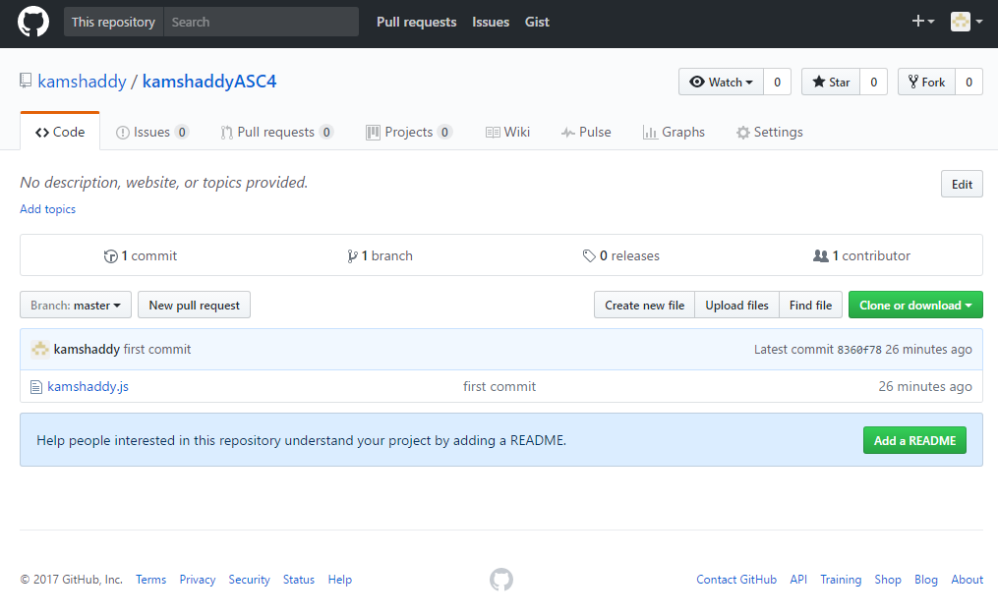
DONE!
Go back to your browser with your GitHub account
Your repo should be updated with your files!
Notes:
To viewing repos on your account, click the account icon in the upper right, go to “Your Profile” and once there, there should be a tab called “Repositories” containing your accounts repos.

Slide 32
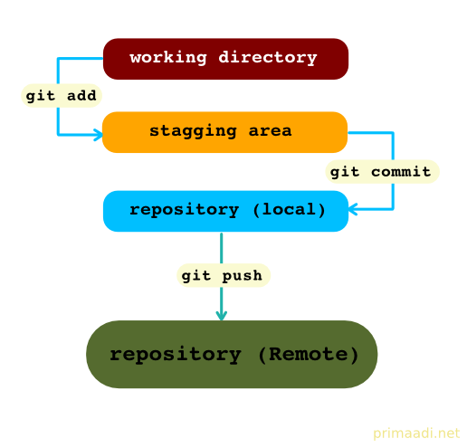
RECAP
THIS is how to save your work
git add .
git commit -m “some message”
git push
Other stuff
git clone
git status
Notes:
Cover this slide, even if you went with the code along style lesson
Stress that from now on, THESE 3 main commands are how students should save their work.
git add .
Adds all changes to the “stagging area”
Think of “committing” being the final decision - changes are written in stone (not really)!
Think of the “stagging area” as being the step right before that final decision - like saying, “I’m thinking these are good enough, but I’m still deciding”
git commit -m “some message”
Every commit must come with a message
The point of the message is to briefly describe the changes you’ve made
These messages are PUBLIC and tied to your account, so keep them professional and relevant
git push
So far, “add” and “commit” are all local (on your computer) - if your computer blows up, your files are gone!
“push” saves your changes online, on GitHub.com (in the cloud) - if your computer blows up, your files are safe!
Note: last year, students like Ayinde, Jordan, Stephen, and many more had their computers spontaneously die - black screen!
They lost all of their work because they didn’t properly push their changes to GitHub
Developers will add, commit, push on a regular basis, and students should be doing the same! (every ~15 min.)
git clone
Downloads a repo you own from GitHub
git status
Doesn’t change anything, just checks to see what files have changed without being committed
NOTE: We will cover forking later on!
NOTE: We will not touch on branches officially, but feel free to discuss it on your own time (“Wiggle Room”, office hours, etc.)!
NOTE: At the end of every day, have one instructional team member remind students to add and commit their work to GitHub!

Slide 33
RESOURCE FOR SELF-EXPLORATION
https://learngitbranching.js.org/
Notes:
THE END

