Slide 1

WEEK 0
DAY 0
Variables

Slide 2
Variables
Data Types
Operators
Variables
Quizes
Coding Exercise
Notes:
The quizes is a simple walkthrough of examples. The answers for each examples are given on the slides.

Slide 3
DATA TYPES
A data type is the type of information being stored in the program
JavaScript allows the programmer to store different types of information in different ways
Each built-in data can be used differently has different attributes
Notes:
Explain: In JavaScript, we can make different kinds of variables. These data types do different things.

Slide 4
THE 3 MAIN TYPES OF DATA
Notes:
There are 3 main types of information we use
“What kinds of information humans commonly use?“ Elicit - words and numbers
Students might struggle with this question, so provide the answer if responses are lacking.
“In programming, there are 3 main types of information we use, the first might be obvious...”

Slide 5
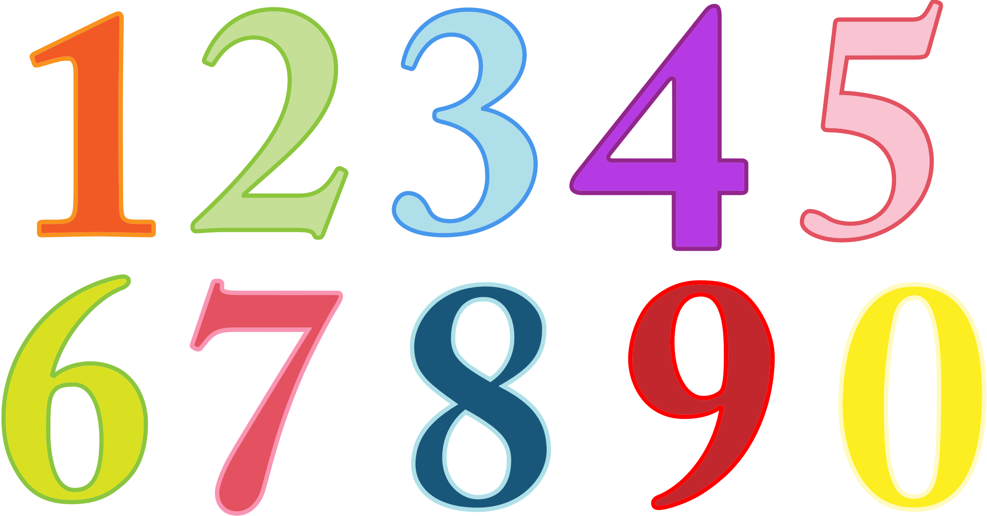
THE 3 MAIN TYPES OF DATA
Integers and Decimals
Notes:
One obvious answer might be numbers, since computers already work in binary

Slide 6

THE 3 MAIN TYPES OF DATA
Integers and Decimals
Strings
Notes:
Strings are words
Explain the naming of words as STRINGS comes from the idea that words are like a STRING of single characters strung together

Slide 7

THE 3 MAIN TYPES OF DATA
Integers and Decimals
Strings
Boolean
Notes:
Students might not be familiar with Boolean, but assure them we’ll discuss it in a bit.

Slide 8
THE 3 MAIN TYPES OF DATA
Integers and Decimals
Strings
Boolean
Other types:
Dates
Null
Undefined
Eventually, create your own – custom - Data Types!
Notes:
There are additional types, but the first three are absolutely the most used.

Slide 9
INTEGERS AND DECIMALS
JavaScript treats integers and decimal numbers the same way
Other programming languages are not like this
9 + 0.1 = 9.1

Slide 10
MATH OPERATORS
Notes:
Quickly go over basic math operations
Students will likely be familiar enough with how these work
These are the operations for JS. Another language might use a different symbol to signify these basic math operations.

Slide 11
MATH OPERATORS
Addition +
Notes:
Quickly go over basic math operations
Students will likely be familiar enough with how these work
These are the operations for JS. Another language might use a different symbol to signify these basic math operations.

Slide 12
MATH OPERATORS
Addition +
Subtraction -
Notes:
Quickly go over basic math operations
Students will likely be familiar enough with how these work
These are the operations for JS. Another language might use a different symbol to signify these basic math operations.

Slide 13
MATH OPERATORS
Addition +
Subtraction -
Multiplication *
Notes:
Quickly go over basic math operations
Students will likely be familiar enough with how these work
These are the operations for JS. Another language might use a different symbol to signify these basic math operations.

Slide 14
MATH OPERATORS
Addition +
Subtraction -
Multiplication *
Division /
Notes:
Quickly go over basic math operations
Students will likely be familiar enough with how these work
These are the operations for JS. Another language might use a different symbol to signify these basic math operations.

Slide 15
MODULO (THE “REMAINDER” OPERATOR)
When we divide two numbers, we get a remainder
Examples:
6 / 4 gives a remainder of 2 (so 6 % 4 = 2).
12 / 3 gives a remainder of 0 (so 12 % 3 = 0).
The modulo operator tells us what the remainder is
If the remainder is 0, that means the numbers divide evenly!
Notes:
For example, we can tell a number is even by modulo of 2 to see if we get a remainder of 0 (and a remainder of 1 means the number is odd!)
Point out that the symbol for modulo is the percentage sign: %
i.e. “5 % 2 = 1”

Slide 16
OPERATOR QUIZ!
5 - 9;
6/2
4 * 21
9%4
Notes:
“Laptops down!”
For this activity, the whole class participates.
Don’t linger on this, it should go by fairly quickly

Slide 17
OPERATOR QUIZ!
5 - 9;
6/2
4 * 21
9%4
-4

Slide 18
OPERATOR QUIZ!
5 - 9;
6/2
4 * 21
9%4
-4
3

Slide 19
OPERATOR QUIZ!
5 - 9;
6/2
4 * 21
9%4
-4
3
84

Slide 20
OPERATOR QUIZ!
5 - 9;
6/2
4 * 21
9%4
-4
3
84
1
Notes:
If students are confused with the modulo, explain this is giving the remainder from the division of 9 and 4.
4 goes into 9 twice, totally 8. 9 - 8 = 1 remainder

Slide 21
STRINGS
Strings are used to hold texts
Examples:
Names
Stories
Anything text-based
In order to declare a variable as a string, use quotation marks, “” or ‘’
Examples:
const name = “Madhi”;
let sentence = “I woke up today and saw a butterfly”;
let letter = ‘C’;
Notes:
Reinforce the idea that ANYTHING in quotation marks is a string.
Without quotation marks, the computer will assume we’re referring to a variable

Slide 22
STRINGS
Examples:
const name = “Madhi”;
let sentence = “I woke up today and saw a butterfly”;
let letter = ‘C’;
Its good practice to use ‘single quotation’ for single letters in the alphabet
For anything that’s greater than one letter or characters, use “double quotation marks”
Why do we have to use quotation marks?

Slide 23
STRINGS
Examples:
const name = “Madhi”;
let sentence = “I woke up today and saw a butterfly”;
let letter = ‘C’;
Why do we have to use quotation marks?
Whats the difference between: “hello”; vs hello;
Notes:
“what would happen if we tried hello by itself without quotation marks?” Elicit- Error, variable not defined
A COMMON mistake students make is the put quotation marks around a variable during declaration
let “prez” = “Obama”

Slide 24
BOOLEAN
Two values:
Notes:
“What’s a boolean?” Elicit: A Boolean is simply a value of true or false.
If students don’t know the answer, just explain it.

Slide 25
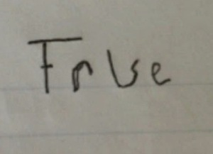
BOOLEAN
Two values (lowercase):
true
false
Notes:
true and false (all lowercase) are keywords used to represent these two values in JavaScript

Slide 26
BOOLEAN
Two values (lowercase):
true
false
Reserved keywords
true = 5; //Error
Notes:
Given their unique importance, true and false are reserved keywords and CANNOT be used as variable names
If students ask:
Other restrictions for variable naming include numbers, even words starting with numbers (however number after the first letter are OK!), spaces and most special characters are also not permitted in naming a variable.

Slide 27
Representation
What does it mean for one thing to represent another?
Notes:
Gloss over question (will ask students for examples later)
Try not to linger on any 1 slide; go at a brisk pace for this content.

Slide 28
Representation
What does it mean for one thing to represent another?
Symbolism
Notes:
Explain the concept of symbolism, the idea of one thing representing another.
It may seem “simple”, but this is one of the most fundamental concepts to understand in programming
The computer only sees the value a symbol POINTS to

Slide 29

Representation
What does it mean for one thing to represent another?
Symbolism
What’s does this represent?
Notes:
Elicit “peace” from students

Slide 30
Representation
What does it mean for one thing to represent another?
Symbolism
What’s does this represent?
PEACE

Slide 31

Representation
What does it mean for one thing to represent another?
Symbolism
What’s does this represent?
PEACE
Notes:
Elicit “Michael Jordan”

Slide 32
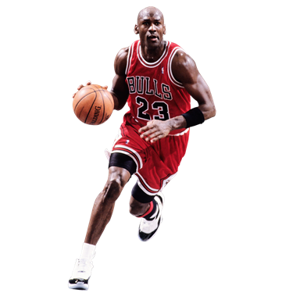
Representation
What does it mean for one thing to represent another?
Symbolism
What’s does this represent?
PEACE
Notes:
Transition into variables being the symbols we use to represent information for the computer.

Slide 33
VARIABLES
What are variables?

Slide 34
VARIABLES
What are variables?
Variables represent information

Slide 35
VARIABLES
What are variables?
Variables represent information
Can CHANGE
Notes:
Comment on the word “variable” coming from the root of “vary” because its can easily change

Slide 36
VARIABLES
What are variables?
Variables represent information
Can CHANGE
What are some examples of real life variables?
Notes:
Hold here to get answers from students.
Encourage students to participate as a way of assessing if student understand the underlying concept of a label, whose underlying value can change.
Examples: Names, job position, favorite color/food/etc, age

Slide 37
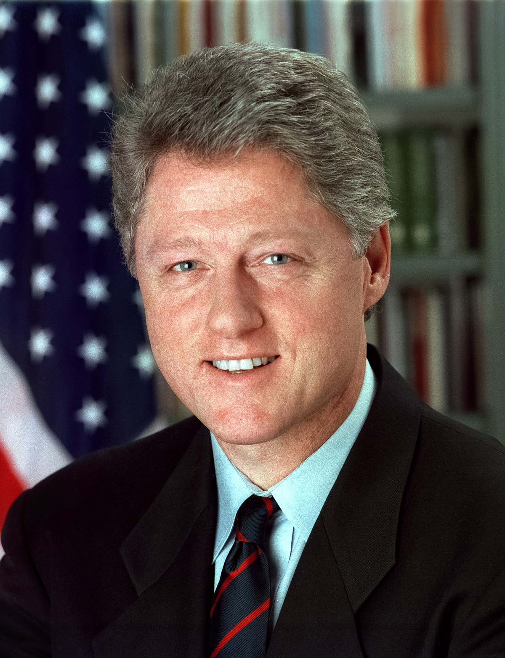
VARIABLES
President
What are variables?
Variables represent information
Can CHANGE
What are some examples of real life variables?
The President

Slide 38
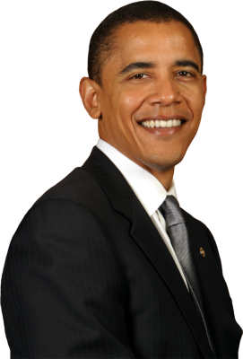
VARIABLES
President
What are variables?
Variables represent information
Can CHANGE
What are some examples of real life variables?
The President

Slide 39
STRING QUIZ!
“this_is_a_string”
Notes:
“Laptops down!”
For this activity, the whole class participates.
Don’t linger on this, it should go by fairly quickly

Slide 40
STRING QUIZ!
“this_is_a_string”
STRING

Slide 41
STRING QUIZ!
“this_is_a_string”
this_is_a_variable
STRING

Slide 42
STRING QUIZ!
“this_is_a_string”
this_is_a_variable
STRING
VARIABLE

Slide 43
STRING QUIZ!
“this_is_a_string”
this_is_a_variable
6
STRING
VARIABLE

Slide 44
STRING QUIZ!
“this_is_a_string”
this_is_a_variable
6
STRING
VARIABLE
NUMBER

Slide 45
STRING QUIZ!
“this_is_a_string”
this_is_a_variable
6
“6”
STRING
VARIABLE
NUMBER

Slide 46
STRING QUIZ!
“this_is_a_string”
this_is_a_variable
6
“6”
STRING
VARIABLE
NUMBER
STRING

Slide 47
STRING QUIZ!
“this_is_a_string”
this_is_a_variable
6
“6”
true
STRING
VARIABLE
NUMBER
STRING

Slide 48
STRING QUIZ!
“this_is_a_string”
this_is_a_variable
6
“6”
true
STRING
VARIABLE
NUMBER
STRING
BOOLEAN

Slide 49
STRING QUIZ!
“this_is_a_string”
this_is_a_variable
6
“6”
true
“true”
STRING
VARIABLE
NUMBER
STRING
BOOLEAN

Slide 50
STRING QUIZ!
“this_is_a_string”
this_is_a_variable
6
“6”
true
“true”
STRING
VARIABLE
NUMBER
STRING
BOOLEAN
STRING

Slide 51
STRING QUIZ!
“this_is_a_string”
this_is_a_variable
6
“6”
true
“true”
this_is_a_string
STRING
VARIABLE
NUMBER
STRING
BOOLEAN
STRING

Slide 52
STRING QUIZ!
“this_is_a_string”
this_is_a_variable
6
“6”
true
“true”
this_is_a_string
STRING
VARIABLE
NUMBER
STRING
BOOLEAN
STRING
VARIABLE

Slide 53
STRING QUIZ!
“this_is_a_string”
this_is_a_variable
6
“6”
true
“true”
this_is_a_string
“this_is_a_variable”
STRING
VARIABLE
NUMBER
STRING
BOOLEAN
STRING
VARIABLE

Slide 54
STRING QUIZ!
“this_is_a_string”
this_is_a_variable
6
“6”
true
“true”
this_is_a_string
“this_is_a_variable”
STRING
VARIABLE
NUMBER
STRING
BOOLEAN
STRING
VARIABLE
STRING

Slide 55
STRING QUIZ!
“this_is_a_string”
this_is_a_variable
6
“6”
true
“true”
this_is_a_string
“this_is_a_variable”
“1” + “1”
STRING
VARIABLE
NUMBER
STRING
BOOLEAN
STRING
VARIABLE
STRING
Notes:
“1” + “1” gives “11”

Slide 56
STRING QUIZ!
“this_is_a_string”
this_is_a_variable
6
“6”
true
“true”
this_is_a_string
“this_is_a_variable”
“1” + “1”
STRING
VARIABLE
NUMBER
STRING
BOOLEAN
STRING
VARIABLE
STRING
STRING
Notes:
Explain: This not adding two numbers, but adding two strings together, which can be done by putting them side-by-side (also known as concatenation)

Slide 57
CODING EXERCISE
In command line, navigate to the folder you made earlier.
Open the .js file in VS Code
Create 3 variables with the following values:
ps4 = 299.99;
godOfWar = 59.99;
fortnite = 59.99;
detroitBecomeHuman = 59.99;
Write “const” before some variables and “let” before others
Notes:
For opening the .js file, you can either:
open VS Code and directly open the folder
In command line (navigate into the folder you want to open and type the command “code .” (notice the period, which stands for ‘this directly’))
VS Code’s “code.exe” should have been added to your PATH.
The file should be blank. Inform students that this is a simple text file that will be run using JavaScript
Explain that we can store data into variables by first typing “const” or “let” followed by whatever name for the variable we want, then 1 equal sign, =, and then the value, ending with a semi-colon.
Explain the semi-colon is like putting a period at the end of a sentence. JavaScript will use it to determine when the code for that line ends.
Help students deduce which variable declaration to use: “const” is used when the value won’t change. “let” is used when the value can change.
This small difference is very useful for developers because it helps prevent problems before they start, which is a big help during debugging.
Use the rule of thumb to use “const” always, unless you really HAVE to use let.
Mention that an older version of JavaScript used “var” when declaring variables, which they might see in other people’s code online. Explain it works much like “let” does now, but for a few reasons is not considered good practice to use.

Slide 58
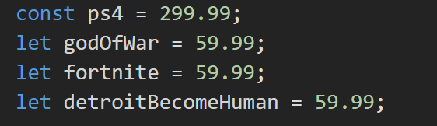
CODING EXERCISE
In command line, navigate to the folder you made earlier.
Open the .js file in VS Code
Create 3 variables with the following values:
ps4 = 299.99;
godOfWar = 59.99;
fortnite = 59.99;
detroitBecomeHuman = 59.99;
Write “const” before some variables and “let” before others
Create a variable called “total” that is the sum of all of the previous variables
Notes:
If you or your students used different keywords for your variable declarations, that’s OK!
The distinction largely comes from the developer’s understanding on how their code is going to be used
Some students might declare the variable as the sum of literal values and not the variables - make sure they’re following the instructions

Slide 59
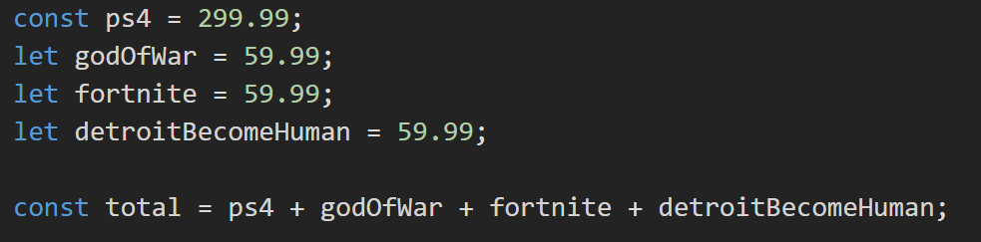
CODING EXERCISE
Create a variable called “total” that is the sum of all of the previous variables
Save the file (Ctrl + S)
Run your script in command line
node mahdi.js
Notes:
For running the command, make sure students are entering the name of THEIR file.
Note: VS Code also has a console from which you can execute command line commands (View > Integrated Terminal). Just make sure you’re in the right working directory!
Ask: What was the result of executing our script? Ans: NOTHING!
Explain: the code actually did run! However, we don’t see anything in the console

Slide 60
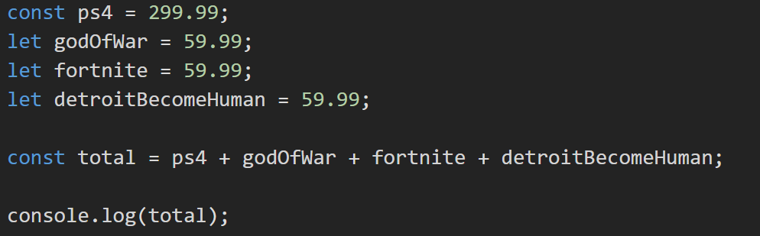
CODING EXERCISE (CONT)
Add this to the end of the .js file:
console.log(total);
Save the file (Ctrl + S)
Run your script in command line
node mahdi.js
Notes:
Explain: We can see stuff in our console by using console.log() statements.
Explain: We’ll learn more about what this is doing later, but for now remember the syntax, or the specific way the code looks, is important. Notice the words “console” and “log” are all lower case, there’s a period in between them, and there are parenthesis being used with the variable “total” in between them.
Explain: console.log only does 1 thing, print something in the console so we humans can see it. console.log does NOT alter or affect the actual code or their values.
Run the code again…
Now we can see our code actually did run, and thanks to console.log we can see something!
You’ll probably notice the math is wrong!
Explain: The value of “total” we’re seeing comes from something called binary floating points, which is how our computers can do math so quickly. We won’t go into too much detail, but essentially the people who made JavaScript traded off a small amount of accuracy for a huge boost in calculation speed. For the most part, you’ll never notice this small error!
I’ve only included it here to explain something students might observe in the future.

Slide 61
SELF EXPLORATION
Come up with three problems using the operators we have learned and find out how they act on the different data types we have learned about:
Examples of problems to come up with:
true / true
“Madhi” % “Swati”
true * “Swati”
OPERATORS
Addition
Subtraction
Division
Multiplication
Modulo
DATA TYPES
Integers and Decimals
Strings
Booleans

Slide 62
SELF EXPLORATION (CONT)
Turn to an elbow partner and give them the problems you created
Have them guess or figure out the answers to the problems
Let them know if they are correct or incorrect

