Slide 1
Gender Dashboard
ETL documentation

Slide 2
Schema
Metadata_Indicator
country
Indicator_ID
Source_id
Source
Source Goup
Indicator
Indicator description
Topic
Gender
Division
Multiplier
Age
Area
Education
UOM
Country name
Region
ISO2
ISO3
Idb_Region
Indicator_Data
Indicator_ID
Year
Value
ISO
Value_normalized
Dimension
Fact

Slide 3


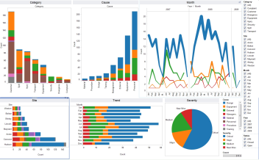





Process and plan
Sources | Staging | ETL | DWH | 4. Build visualization
 |  | Classify indicators (Gender, Area, Education, etc.) | Generate reporting table
World Bank API
NCD
Copy sources
Dashboard
IDB

Slide 4
Code
https://github.com/arcuellar88/gender-indicator/tree/dashdb

