Slide 1
PG4200: Algorithms And Data Structures Lesson 10: Decision and Optimization Problems
Prof. Andrea Arcuri

Slide 2
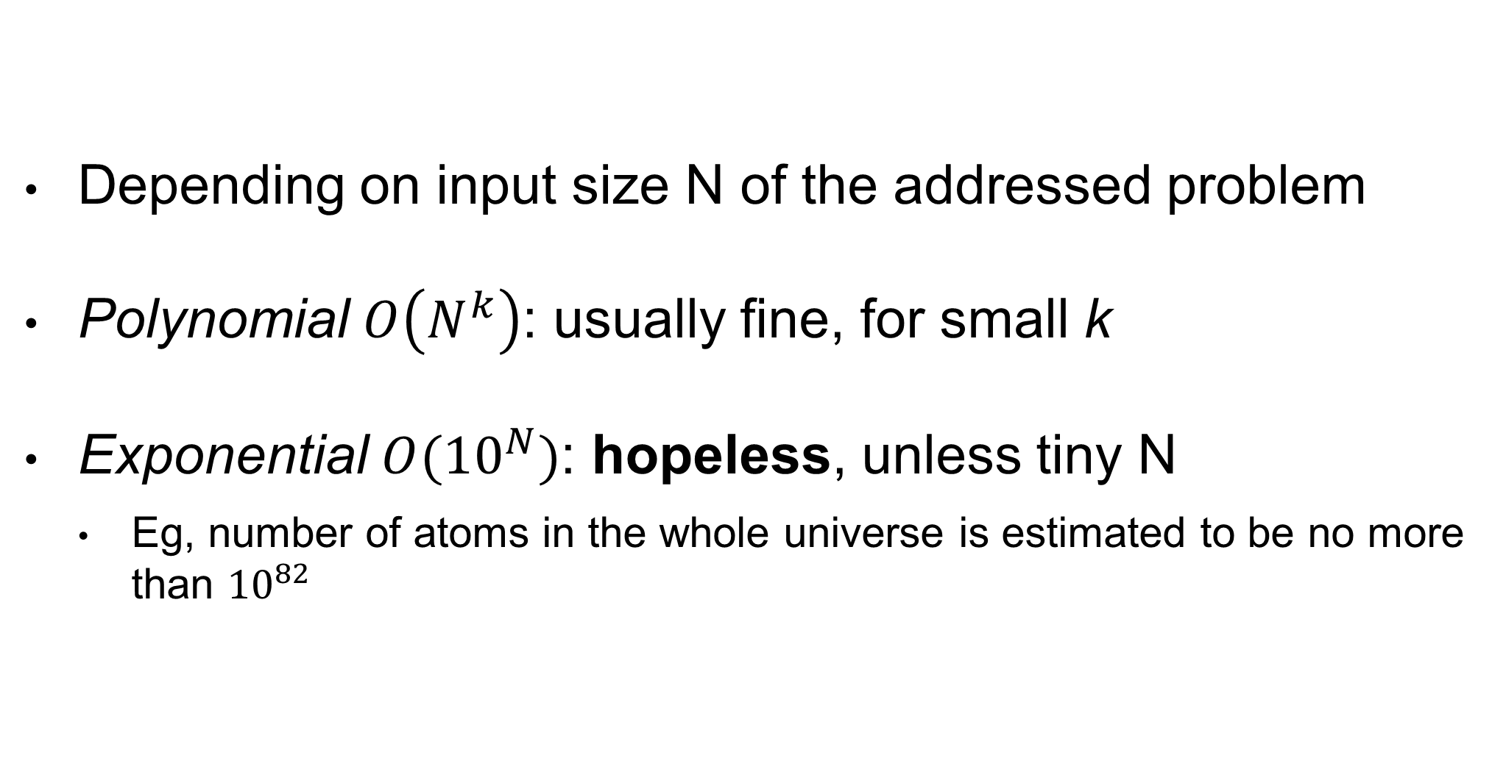
Runtime Of Algorithms
Depending on input size N of the addressed problem
Polynomial $O\left(N^{k}\right)$: usually fine, for small k
Exponential $O({10}^{N})$: hopeless, unless tiny N
Eg, number of atoms in the whole universe is estimated to be no more than ${10}^{82}$

Slide 3
Complex Problems
There are a lot of problems in science and engineering for which we do not know any algorithm that can solve them in polynomial time
Such algorithms might exist, but we do not know them yet
Brute Force: try all possible combinations, until find valid solution… but that is exponential!!!
We need some heuristics to address these problems
But no guarantee that we can find a solution in reasonable time

Slide 4
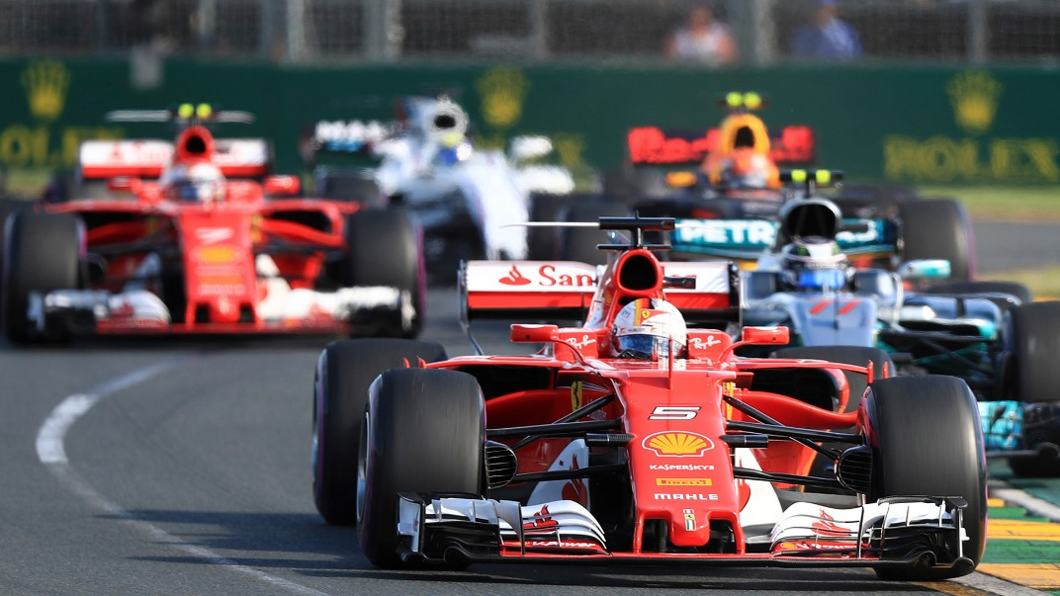
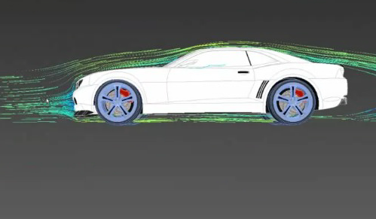

Vehicle Design
How to find best shape to reduce air resistance?
Can have different designs, and then test them in a wind tunnel

Slide 5
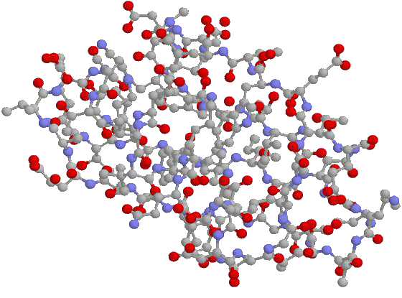
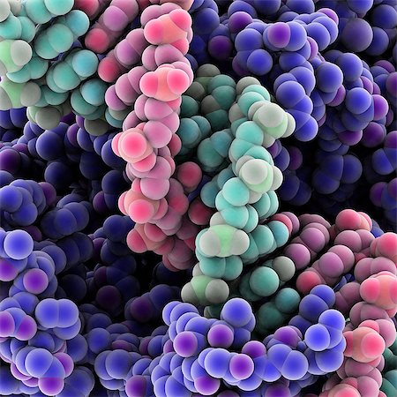
Protein Design
How to find the right sequence of amino acids which will result in a protein with some sought properties?

Slide 6


Stock Market
How to find best investment portfolio to maximize profit?

Slide 7


Class Schedule
How to find best class schedule for which:
There is time for all classes
Classes in same year are not in parallel (ie conflicting)
Preferences of lectures are taken into account
Etc.
?

Slide 8
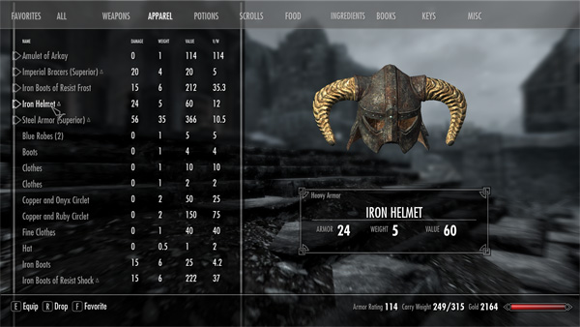
RPG Equipment
In RPGs, how find best combination of wearable items to maximize attack and defense under the constraints of maximum weight and item slots available?

Slide 9
Optimization Problem
2 main components: Search Space and Fitness Function
Goal: find the best solution from the search space such that the fitness function is minimized/maximized

Slide 10
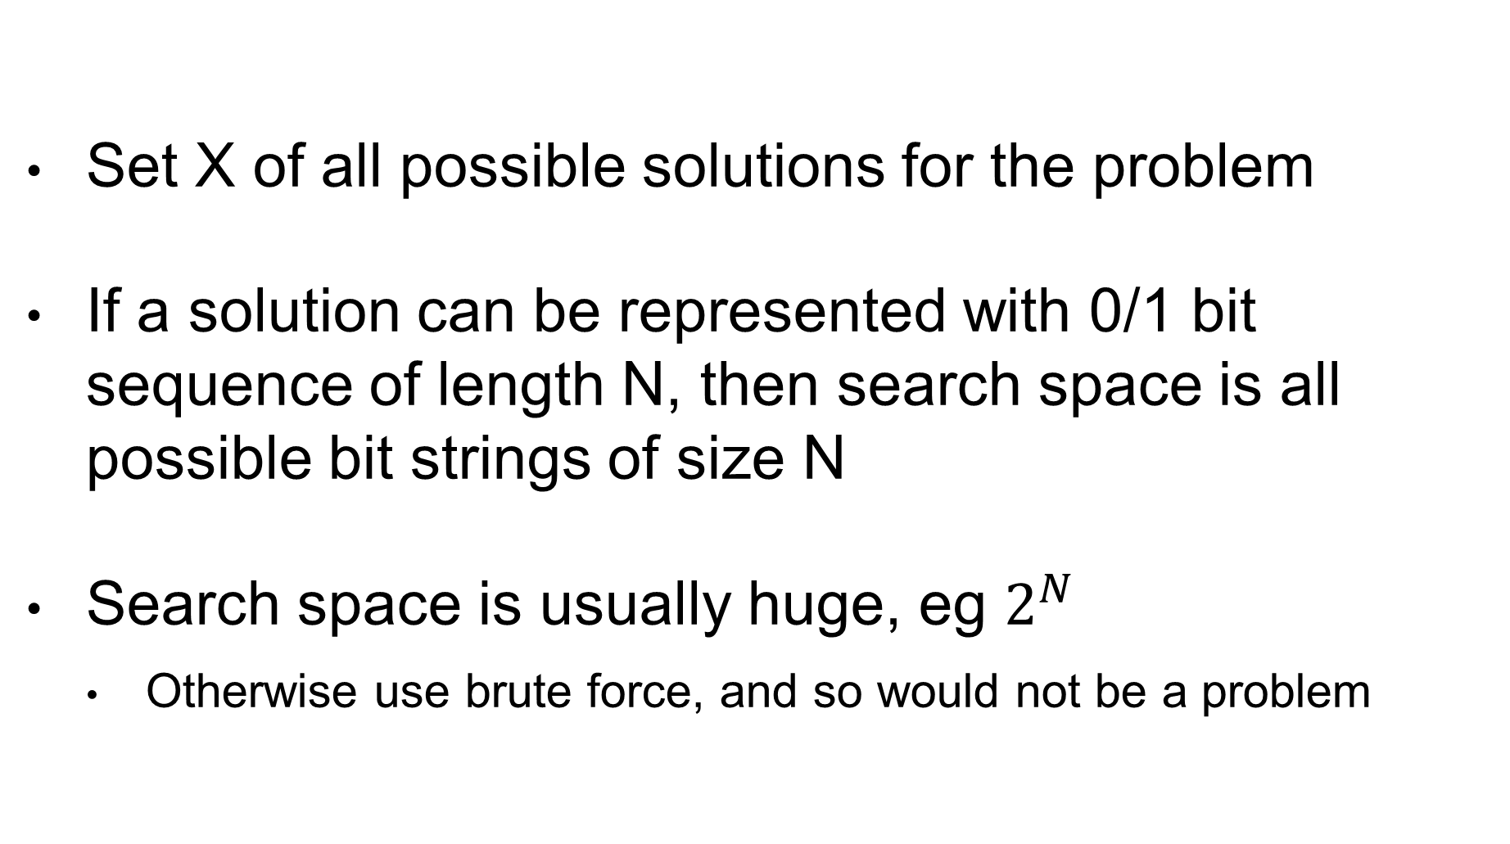
Search Space
Set X of all possible solutions for the problem
If a solution can be represented with 0/1 bit sequence of length N, then search space is all possible bit strings of size N
Search space is usually huge, eg $2^{N}$
Otherwise use brute force, and so would not be a problem

Slide 11
Fitness Function
f(x)=h
Given a solution x in X, calculate an heuristic h that specifies how good the solution is
Problem dependent, to minimize or maximize:
Minimize air resistance
Maximize protein structure properties
Maximize Return Of Investment
etc.

Slide 12
Optimization Algorithms
Algorithm that explores the search space X
Only a tiny sample of X can be evaluated
Use fitness f(x) to guide the exploration to fitter areas of the search space with better solutions
Stopping criterion: after evaluating K solutions (or K amount of time is passed), return best x among the evaluated solutions
Many different kinds of optimization algorithms…
But as a user, still need to provide the representation and f(x)

Slide 13
Search Operator
s(x) = x’
An operator that, from a solution x, gives a new one x’
Still need to evaluate its fitness, ie f(x’)
The optimization algorithm will use the search operators to choose which new x’ in X to evaluate
The search operator will depend on the problem representation
Example: flip a bit in a bit-sequence representation

Slide 14
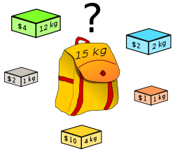
Example: Knapsack Problem (KP)
Insert N items to a knapsack
Each item has a weight w and a value v
The knapsack has a maximum load of weight L
Goal: find the selection of items that can be inserted within limit L, and for which the total value is maximized
Note: many real-world problems are instances of the knapsack problem

Slide 15
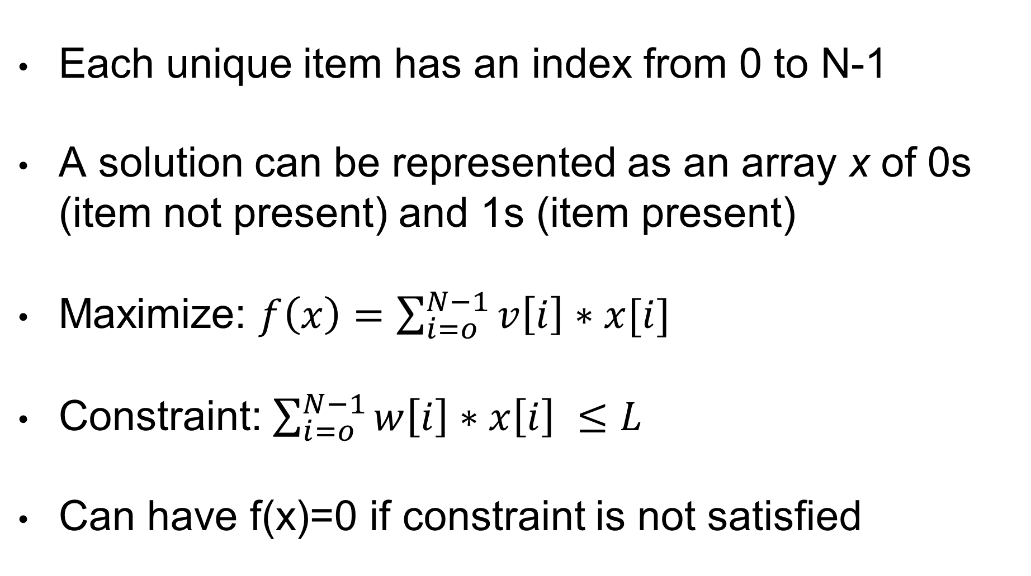
Details
Each unique item has an index from 0 to N-1
A solution can be represented as an array x of 0s (item not present) and 1s (item present)
Maximize: $f\left(x\right)=\sum_{i=o}^{N−1}{v\left[i\right]∗x[i]}$
Constraint: $\sum_{i=o}^{N−1}{w\left[i\right]∗x\left[i\right] ≤L}$
Can have f(x)=0 if constraint is not satisfied

Slide 16
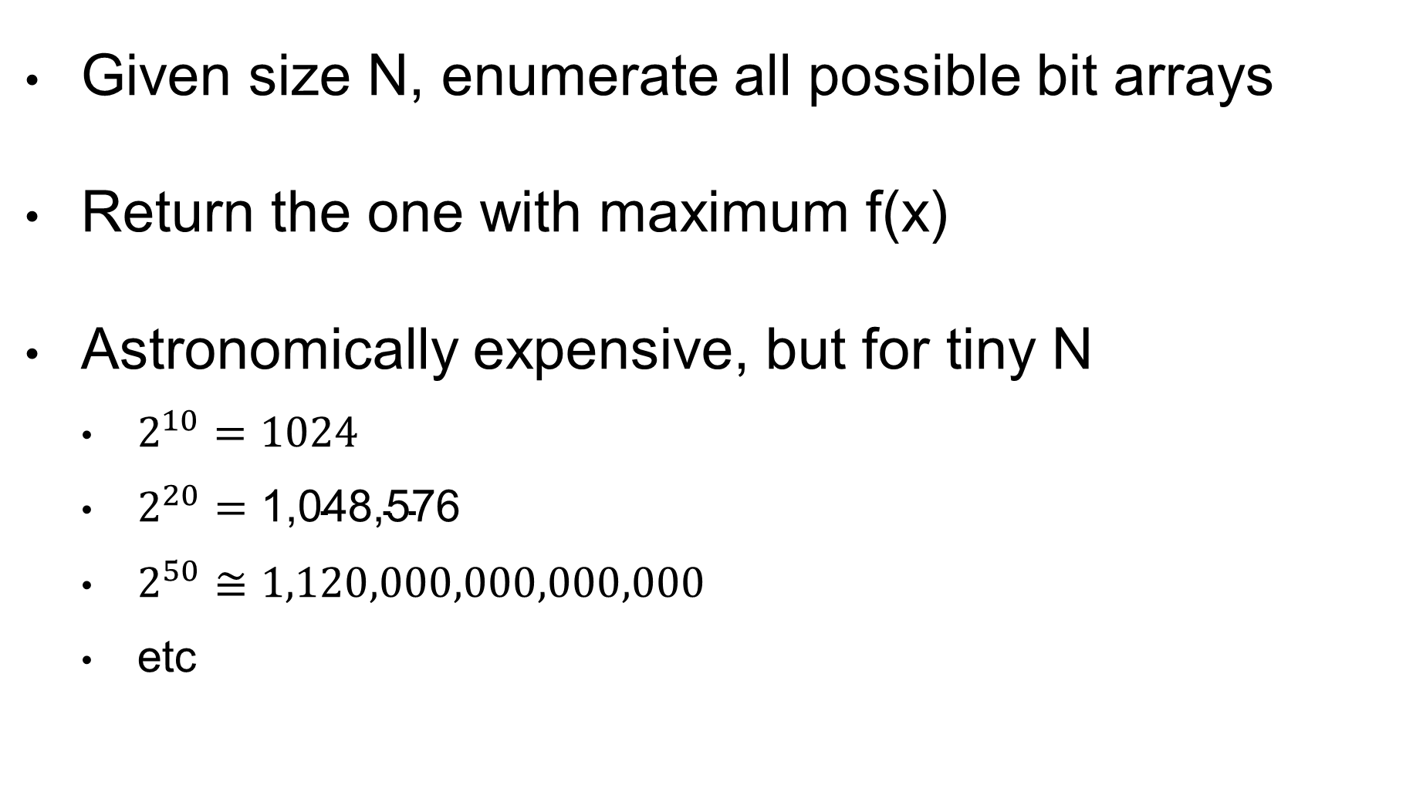
Brute Force
Given size N, enumerate all possible bit arrays
Return the one with maximum f(x)
Astronomically expensive, but for tiny N
$2^{10}=1024$
$2^{20}=\text{1,048,576}$
$2^{50}≅1,120,000,000,000,000$
etc

Slide 17
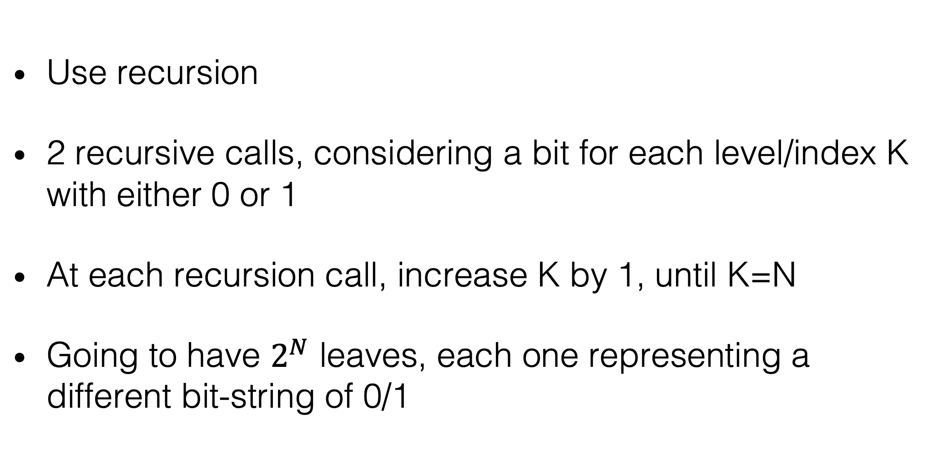
How To Brute Force?
Use recursion
2 recursive calls, considering a bit for each level/index K with either 0 or 1
At each recursion call, increase K by 1, until K=N
Going to have $2^{N}$ leaves, each one representing a different bit-string of 0/1

Slide 18
Example: N=3
? | ? | ?
k=0
0 | ? | ?
1 | ? | ?
k=1
0 | 0 | ?
0 | 1 | ?
1 | 0 | ?
1 | 0 | ?
0 | 0 | 0
0 | 0 | 1
k=2
Can use a single buffer array
When reaching a leaf, clone array, and return it
ie, stopping criterion for the recursion is K=N-1
When a call is finished, the best returned cloned array between the 2 recursive calls is given back
Note: above tree is not completed, due to space…

Slide 19
Cont.
Y
0 | ? | ? | ? | ?
Y
Z
Z: Best starting 01…
0 | 0 | ? | ? | ?
X
Y
X: Best starting 000…
Y: Best starting 001…
Assume Y better than X and Z
When reached a leaf, and we go up the call tree, only the best between the 2 sub-trees is returned to the caller… all the way up to the root
Note: the behavior here is very similar to a depth-first search
Here, not only Y is the best solution starting with 001, but also the best starting with 00 (as better than X), and also the best starting with 0 (as better than Z)

Slide 20
Greedy Algorithm
Build a solution as quickly as possible
Don’t explore the search space, but rather focus on the most promising path in it
Actual implementation is problem dependent
For example on KP:
Start from empty selection x
Add 1 item at a time to x (but how to choose???)
Stop when not possible to add any item

Slide 21
KP Example
L = 26
W = [12, 7, 11, 8, 9]
V = [24, 13, 23, 15, 16]
From https://people.sc.fsu.edu/~jburkardt/datasets/knapsack_01/knapsack_01.html

Slide 22
Greedy: Heaviest First
X | 1 | 0 | 1 | 0 | 0
W | 12 | 7 | 11 | 8 | 9
V | 24 | 13 | 23 | 15 | 16
First choose (12,24)
Then choose (11,13)
Weight becomes 12 + 11 = 23
Cannot add any other element without exceeding L=26
f(x) = 24 + 23 = 47
Is 47 the best score we can achieve???

Slide 23
Greedy: Lightest First
X | 0 | 1 | 0 | 1 | 1
W | 12 | 7 | 11 | 8 | 9
V | 24 | 13 | 23 | 15 | 16
Choosing (7,13), (8,15) and (9,16)
Weight becomes 7 + 8 + 9 = 24 < 26
Cannot add any other element without exceeding L=26
f(x) = 13 + 15 + 16 = 44
Worse solution 44 than previous 47

Slide 24
Greedy: Best Ratio
X | 1 | 0 | 1 | 0 | 0
W | 12 | 7 | 11 | 8 | 9
V | 24 | 13 | 23 | 15 | 16
Ratio | 2.00 | 1.85 | 2.09 | 1.87 | 1.77
Consider first the best ratio v/w, ie which item gives best return for unit of weight
Choose (11,23) and then (12,24)
Cannot add any other element without exceeding L=26
f(x) = 24 + 23 = 47
Different order of insertion, but still 47

Slide 25
Best Solution
X | 0 | 1 | 1 | 1 | 0
W | 12 | 7 | 11 | 8 | 9
V | 24 | 13 | 23 | 15 | 16
Weight is 7 + 11 + 8 = 26
f(x) = 13 + 23 + 15 = 51
Better than the previous 47
Greedy algorithms can be fast, but can give poor results
Need something more general, with better results

Slide 26
General Optimization Algorithms
Random Search (in this class)
Hill Climbing (in this class)
Simulated Annealing
Genetic Algorithms (next class)
Ant Colony Algorithms
Particle Swarm Algorithms
Etc. etc. (there are many)

Slide 27
Random Search (RS)
Easiest of the optimization algorithms
Sample a random solution from search space X
Keep sampling until run out of time
Keep track of best solution found so far

Slide 28

Hill Climbing (HC)
Start from a random solution
Keep track of / store one solution
Use search operator to do small modifications
If better solution, move to it, and repeat
If no better solution in the neighborhood, restart from a random solution

Slide 29
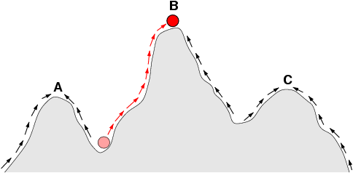
Very Simplified Example
Consider problem in which x is a number
Search operator is +- 1 on such x
“Climb” up to maximize f(x)
B is global optimum
A and C are local optima
Final result depends from starting point
f(x)
x
Fitness Landscape

Slide 30
HC for KP
HC is a general algorithm
But still need to define a proper search operator for each problem domain
Example:
add/remove 1 item (small neighborhood)
remove K items, add J different items (larger neighborhood)
The larger the neighborhood, the slower the ascent, so the less restart we can do within same time
Ie, it is not necessarily better

Slide 31
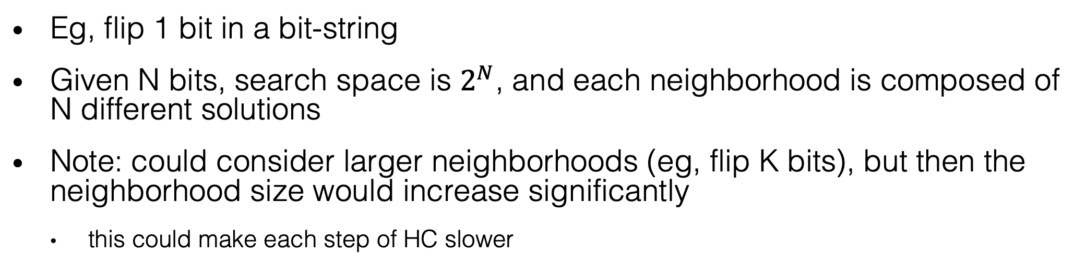
Neighborhood Example
1 | 1 | 0 | 1
0 | 1 | 0 | 1
1 | 1 | 0 | 0
1 | 0 | 0 | 1
1 | 1 | 1 | 1
Eg, flip 1 bit in a bit-string
Given N bits, search space is $2^{N}$, and each neighborhood is composed of N different solutions
Note: could consider larger neighborhoods (eg, flip K bits), but then the neighborhood size would increase significantly
this could make each step of HC slower

Slide 32
No Free Lunch (NFL) Theorem
What is the best optimization algorithm?
Which best variants / choice of parameters?
Considering all optimization problems, mathematically proved (NFL) that all optimization algorithms perform on average the same
Yes, it follows that, on some problems, RS is the best
There exist no best algorithm
But on specific problems, you can have some algorithms that are better than others, especially by exploiting domain knowledge
It follows that a general algorithm will perform worse than a specialized variant for a specific problem

Slide 33
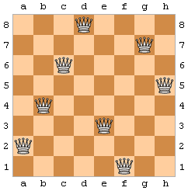
Queen Puzzle (QP)
Position 8 queens such that no 2 queens threaten each other
Generalization: N queens into a N*N board

Slide 34
QP As Optimization
Search Space: matrix N*N of bits
1 for a queen in that position, 0 otherwise
Search operator: flip bits in the matrix
Fitness: need to reward having N queens, and minimize number of threatened queens
00010000
00000010
00100000
00000001
01000000
00001000
10000000
00000100

Slide 35
QP: Better Representation
Binary matrix N*N would allow for any number of queens on the board (eg all 1s)
Domain knowledge: no 2 queens on same row, no 2 queens on the same column
Choose representation and search operator to only explore solution for which these constraints are satisfied
New representation: array of size N, with column indices from 0 to N-1 (position i is for queen in row i)
New operator: swap 2 column indices

Slide 36
QP Cont.
Representation: [f,a,e,b,h,c,g,d]
Eg, queen in row 1 is in column “f”, row 2 is in column “a”, etc
Search operator: swap two elements
Eg, swap “f” with “c”, [c,a,e,b,h,f,g,d]
By construction, I am only exploring board configurations that do not clash on columns/rows
But still a problem, as need to handle threating on diagonals

Slide 37
Decision Problem
Technically, QP is a decision problem
Once we find a solution with N queens no threating any other, we know we have found a global optimum
In optimization problems, usually we cannot know if we found the best
Decision Problem: can say “yes” or “no” about if a solution is optimal or not
For decision problems, still doing the same as optimization, only difference is that we can know when best solution is found
Practically all optimization problems have a decision variant for some metric K, eg “find knapsack configuration with total item values of at least K”

Slide 38
NP
NP: “Nondeterministic Polynomial time”
NP is “the set of all decision problems that can be solved in polynomial time on a theoretical non-deterministic Turing machine”
Equivalent, easier definition: “set of all decision problems whose solutions can be verified in polynomial time”
Ie, can answer “yes” or “no” in polynomial time
KP and QP are in NP:
QP: can quickly verify if N queens do not threaten each other
KP: can quickly verify in linear time if a solution has at least a certain value

Slide 39
P
P is the set of all decision problems that can be solved in polynomial time
P is at least a subset of NP… but is it a strict subset???
P = NP ???
P != NP ???
This is arguably the most important question in computer science for which we do not have an answer (yet)
Consequence: there might be undiscovered, efficient algorithms to solve today’s complex problems, or those might be impossible to design… we simply have no clue ☹

Slide 40
Homework
Study Book pages 910-921
Note: details of optimization algorithm are not in the book
Study code in the org.pg4200.les10 package
Do exercises in exercises/ex10

