Slide 1
Enterprise Programmering 1 Lesson 11: CI and Deployment
Prof. Andrea Arcuri

Slide 2
About these slides
These slides are just high level overviews of the topics covered in class
The details are directly in the code comments on the Git repository

Slide 3
Continuous Integration (CI)

Slide 4
Code Evolution
Every time there is a change in the code, you want to know if application is still working fine
Possible problems:
Code does not compile
Changes broke some functionalities, and some tests now fail
When to check? At each Git Push
Could ask developers to always do a “mvn clean verify” before each commit, but:
They might forget
Test cases might take hours to run

Slide 5
CI Server
A server that automatically pulls from Git at each push
Build your application and run all tests
Inform developers (eg by email) if a build fails
Can keep track of build history
Can check a Git PR (Pull Request) before merging it
Jenkins is the most used CI server, which you can install on your machines
Extremely useful when working in teams
If you end up working in a company not using CI, run away!!!

Slide 6
Travis CI
A cloud CI provider: www.travis-ci.org
Free for open-source projects
Supporting many languages, not just Java
Can be integrated with GitHub, eg build at each Git Push
Quite easy to setup: besides creating an account, in project you just need a “.travis.yml” config file

Slide 7
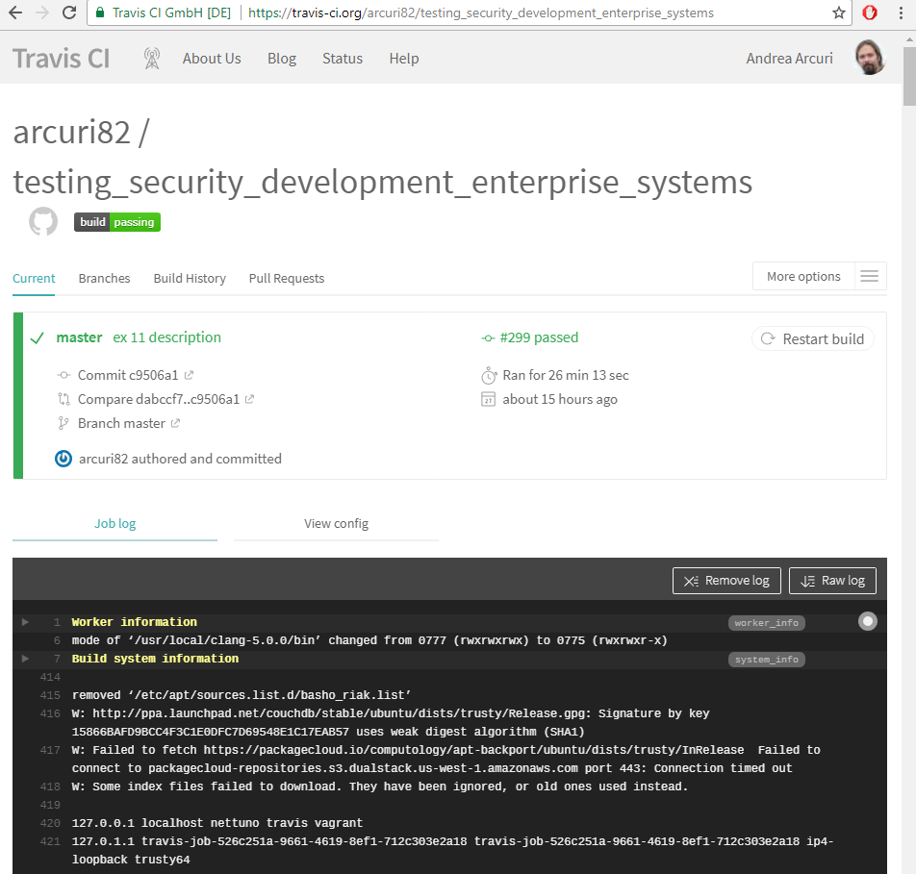
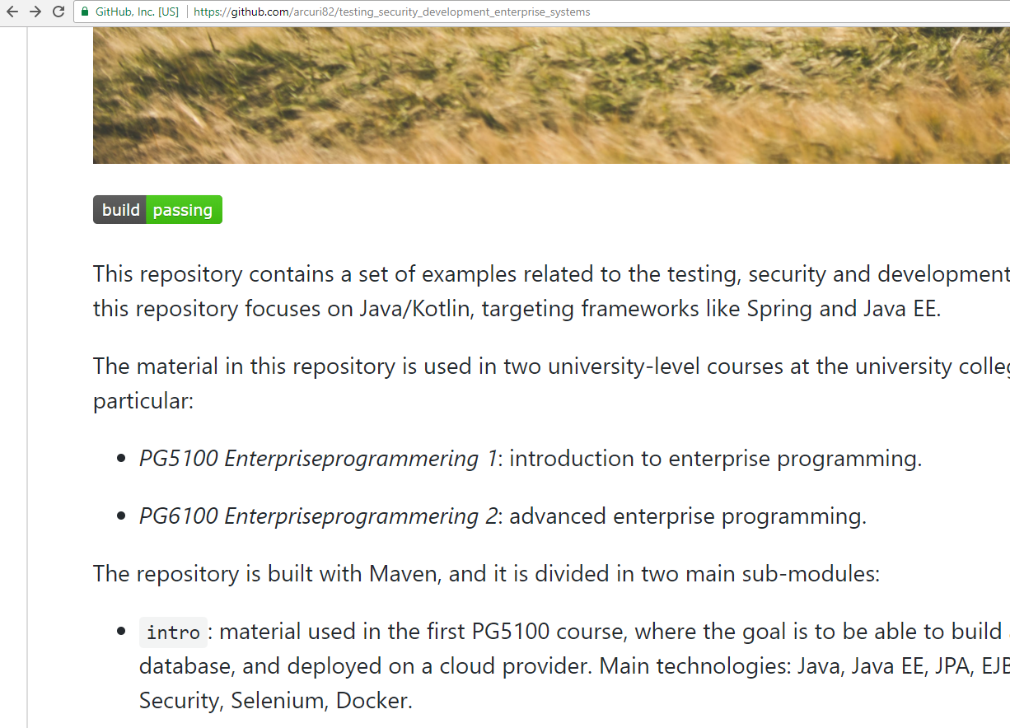

Slide 8
Database Maintenance

Slide 9
Database Migrations
So far, by configuring “create-drop” in Hibernate, we were always recreating the schema of the database
This of course does not work in production… you do not want to delete your database at each application restart!!!
A possible (but not good) solution is to use “update”
It will create a database (based on your entities) if not existing, otherwise will try to update the current one

Slide 10
Issues with “update”
What if you are adding a new column in a @Entity?
What if you are changing the schema by refactoring some @Entity classes (e.g., split one in two)?
What if by mistake/bug some @Entity classes are deleted?
What will happen to the current rows in such tables in the database?

Slide 11
Solution
The evolution of a database has to be handled with special tools
@Entity classes should just map what is currently in the database, not driving its schema creation/update
apart from the very beginning before doing a first production release
No “create-drop”, nor “update”, but rather “validate”
throw exception if @Entity classes do not match what in database schema
Tools to use: Flyway or Liquibase

Slide 12
Flyway
All operations are done on SQL files, by writing SQL commands
Each migration file has a version number, in increasing order
Flyway will check if any new migration has not been applied yet, and apply them otherwise, just once
It creates its own table to keep track of which migrations have been applied so far on a database
SpringBoot automatically runs Flyway if found on classpath

Slide 13
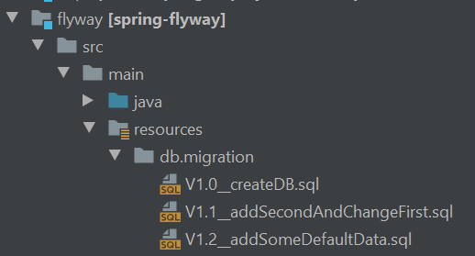
Folder db/migration
Migration files in the form Vx.y_someName.sql
Executed in version order, eg V1.0 executed before V1.1
Recall that IntelliJ will represent folders inside /resources as packages
eg, there is no “db.migration” folder, but rather “db/migration”

Slide 14
Logging

Slide 15
Log Statements
It is important to keep track of what is going on in an application
Especially important when there are bugs, and you want to save the stack-trace of the exceptions
needed for example to help debugging such possible bugs
Logging is a bit tricky, and so there are several libraries that help doing it
e.g., because doing I/O, it can impact the JIT compiler… and you could have optimizations in which a logging framework writes on a buffer, and then another thread reads from it to do the I/O…

Slide 16
SLF4J and Logback
SLF4J is the most common library for logging in Java
It is a “facade”, i.e., set of base classes/interfaces, where the actual implementation is in a different library, and it is abstracted away
i.e., you only import classes from SLF4J in your code
Can use different logging framework bindings for SLF4J, where Logback is the most popular
for example, think of SLF4J as JPA, and Logback as Hibernate
Many third-party libraries use SLF4J, but will not provide a binding
this enables you to have a single binding for your whole app, including the 3rd-party libraries

Slide 17
Loggers
Usually creating one logger per class, named with the full name of the class itself (including the package)
created using LoggerFactory.getLogger(name), and typically stored in a final static variable
Configurations will be in a logback.xml file
For testing, can have a different logback-test.xml file which will have precedence
Many possible configurations
eg, what to do with the logs? Should just be on the console? Should be written to a file? Should be sent to a remote server? Etc.

Slide 18
Log Statements and Levels
Different methods: eg, log.debug(msg) and log.error(msg)
Based on the LEVEL of logging, some messages can be discarded
for example, you could tell the system to discard DEBUG logs, have WARN only on console, and ERROR on console and also saved on a file
Levels: TRACE, DEBUG, INFO, WARN and ERROR
Those are in order: when you activate a level, all levels above it are activated as well
eg, activating DEBUG does activate everything but TRACE

Slide 19
Setting Log Levels
Levels can be fine-tuned
You can a have a log-level for the whole application, e.g. typically WARN or ERROR
Then, can override the level for some specific loggers
e.g., you could put it to INFO for your classes, but not the ones of the 3rd-party libraries
When testing/debugging some classes, you could put DEBUG for just those

Slide 20
String Concatenation
Consider: log.debug(“” + x + “=” + y)
That would be bad: often debug-level logs are ignored (especially in production), and so computing “” + x + “=” + y would be a total waste of CPU cycles
String concatenation is expensive: recall that Strings are immutable, and at each + we create a completely new String object
Solution: log.debug(“{}={}”, x, y)
log statements allow string interpolation, with {} as placeholder
if a log is ignored (eg level WARN), then the string is discarded without the need to interpolate it

Slide 21
Cloud Deployment

Slide 22
Deployment
When your application is ready, you need to deploy it
But where?
You can host your own servers, but then you need to handle everything by yourself
hardware (purchasing and maintenance), backups, DNS, etc.
Many companies do it, but can be difficult for startups and private individuals

Slide 23
Cloud Deployment
Different companies provide cloud hosting solutions for your applications, which frees you from hardware issues, but for a price
Amazon Web Services‎ (AWS) is perhaps the most famous/used one
eg, Netflix runs on AWS
Automated scaling: if you need more load, automatically rent more nodes, and automatically scale down if less load
this is also good for applications targeting a specific country (eg Norway), in which you will not get much load during the night

Slide 24
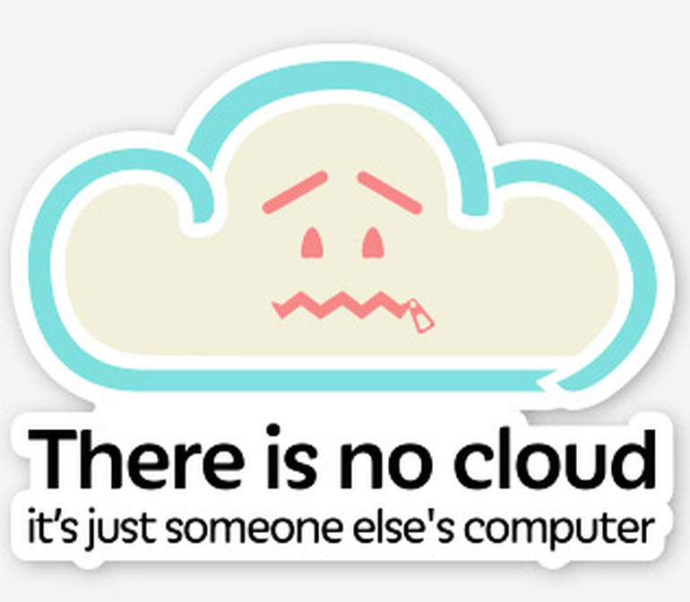
Definition of “Cloud”

Slide 25
Heroku
One of the main cloud providers
Using this one in the examples because, at the time of this writing, it provides easy to use free hosting
note, this might change at any time
Supporting Java and SpringBoot applications
Maven plugin to deploy your self-executable JAR by command line
Automatically setting up environment variables to configure Spring to use Heroku’s databases

Slide 26
Using Heroku
First you need to create an account at www.heroku.com
Install Heroku CLI, which allows you to interact with Heroku from command line
On the web interface, create an “app” with a name of your choice. In these slides, I will use “quizgame-pg5100”
as names are unique, you will need to choose a different name

Slide 27
Jar Deployment
Configure the heroku-maven-plugin
Need to run Maven
mvn clean package heroku:deploy -Dheroku.logProgress=true
The application will then be available online at https://quizgame-pg5100.herokuapp.com
Note the HTTPS protocol, ie encrypted
But before accessing it, you need to configure its environment

Slide 28
From Command Line (CLI)
heroku login
will setup credential for the other commands.
note: if using Windows, this does not work on GitBash, and need to do this command once from a regular Terminal
heroku ps:scale web=1 --app quizgame-pg5100
enable the node resources needed to run the application
Note: might get an error like “Scaling dynos... ! Couldn't find that process type” if you haven’t deployed the JAR yet at least once
heroku addons:create heroku-postgresql --app quizgame-pg5100
add a Postgres database
heroku pg --app quizgame-pg5100
see current status of Postgres database
Note: some (all?) these commands can also be done from web interface

Slide 29
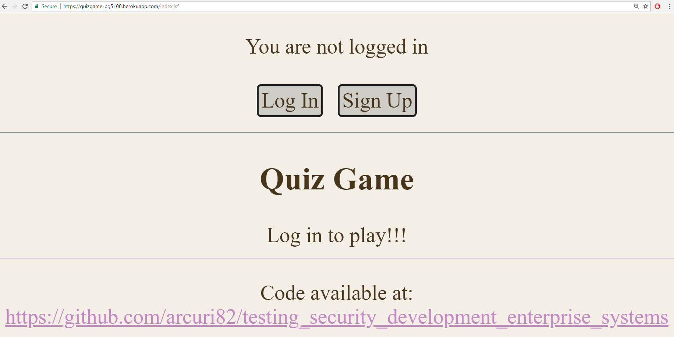

Slide 30
Continuous Delivery (CD)
Deployment can be done from Maven, as part of the build
You could trigger a deployment at each Git Push from a CI server (eg, Travis or Jenkins)
Of course, only if code compiles and all tests pass…
But you might want to have a special Git branch for deployment
eg, development on a “development” Git branch and deployment on a “deployment” branch, done only when changes in “development” are merged into the “deployment” branch

Slide 31
What Next?
With what learned so far, you can build a whole functional web/enterprise application
GUI, security, testing, database, cloud deployment, etc.
But this kind of monolithic application does not scale too well for large systems
Enterprise 2 “advanced” course:
Dig into Web Services (eg REST) and details of HTTP
Distributed systems, in particular Microservices
Integration with frontends using JS + AJAX + WebSockets

Slide 32
Git Repository Modules
NOTE: most of the explanations will be directly in the code as comments, and not here in the slides
.travis.yml
intro/spring/flyway
intro/spring/logging
intro/spring/deployment
Exercises for Lesson 11 (see documentation)

