Slide 1
Enterprise Programmering 2 Lesson 04: Wrapped Responses, Errors and Pagination
Prof. Andrea Arcuri

Slide 2
Goals
Understand the concept of Wrapped Responses, and how it helps in logging/debugging of errors
Understand and tune how Spring deals with uncaught exceptions and bean validation
Understand how to enable Pagination with Links when dealing with requests retrieving large amounts of data

Slide 3
Wrapped Responses

Slide 4
Errors
HTTP request can fail due to a 4xx or 5xx error
But what was the reason?
How to tell the user that a 400 was due to an invalid query parameter s/he provided?
Not so great solution: provide an error message as a HTML body payload
Why not so great? Need to marshal payloads in different ways based on status code…
ie JSON when OK, and HTML when errors

Slide 5
JSON Wrapped Response
{
“code”: 200,
“status”: “SUCCESS”,
“data”: {foo:4, bar:”a”}
“message”: null
}
{
“code”: 400,
“status”: “ERROR”,
“data”: null,
“message”: “Invalid query parameter x”
}

Slide 6
Wrapping
Instead of returning a payload directly in the HTTP body of the response, wrap it in a JSON object
The payload will be in a field called “data”
If there is any error, then “data” will be null, with a field “message” explaining reason, ie the error message
Can also have fields for the status of the response (eg success vs failure/error)

Slide 7
Benefits
Error message, if any, is part of the response body, easy to access
Unmarshaling of HTTP response payload from JSON regardless of success or failure/error
ie, success and error responses have the same JSON structure
Very limited overhead

Slide 8
Standard
How to specify which fields to use in a wrapped response?
This is not part of HTTP, nor something discussed in REST
There is no “standard”
Could use your own format for your APIs
Or use some existing specification like JSend
https://labs.omniti.com/labs/jsend

Slide 9
Errors/Validation In Spring

Slide 10
Validation
In JEE, we have seen how @annotation constraints could be put on the inputs of EJB beans
same way as on JPA @Entity
In Spring, we can do the same, which can be useful when handling query parameters
But Spring does not do validation by default, needs to be activated with @Validated
org.springframework.validation.annotation.Validated

Slide 11
Exceptions
When an exception is thrown and not caught, Spring creates a 500 HTTP response
exceptions in your code will not crash the whole server…
When using Wrapped Responses, the format used by Spring might be different from ours, so we might want to override it
Might be cases in which we want to manually throw exceptions, which should results in 400 responses with our Wrapped format

Slide 12
Overriding Spring Defaults
To change how Spring deals with exceptions, we can create a bean tagged with @ControllerAdvice, extending ResponseEntityExceptionHandler
Can have different exception handlers by using annotation @ExceptionHandler on different methods

Slide 13
Pagination

Slide 14
Amount of Data
Example: GET /news
Return all news in database, marshalling into JSON
But what if the database has 2 billion news???
You do not want to return terabytes of data for a single GET…
It would end up in a easy to exploit Denial-Of-Service (DOS) attack

Slide 15
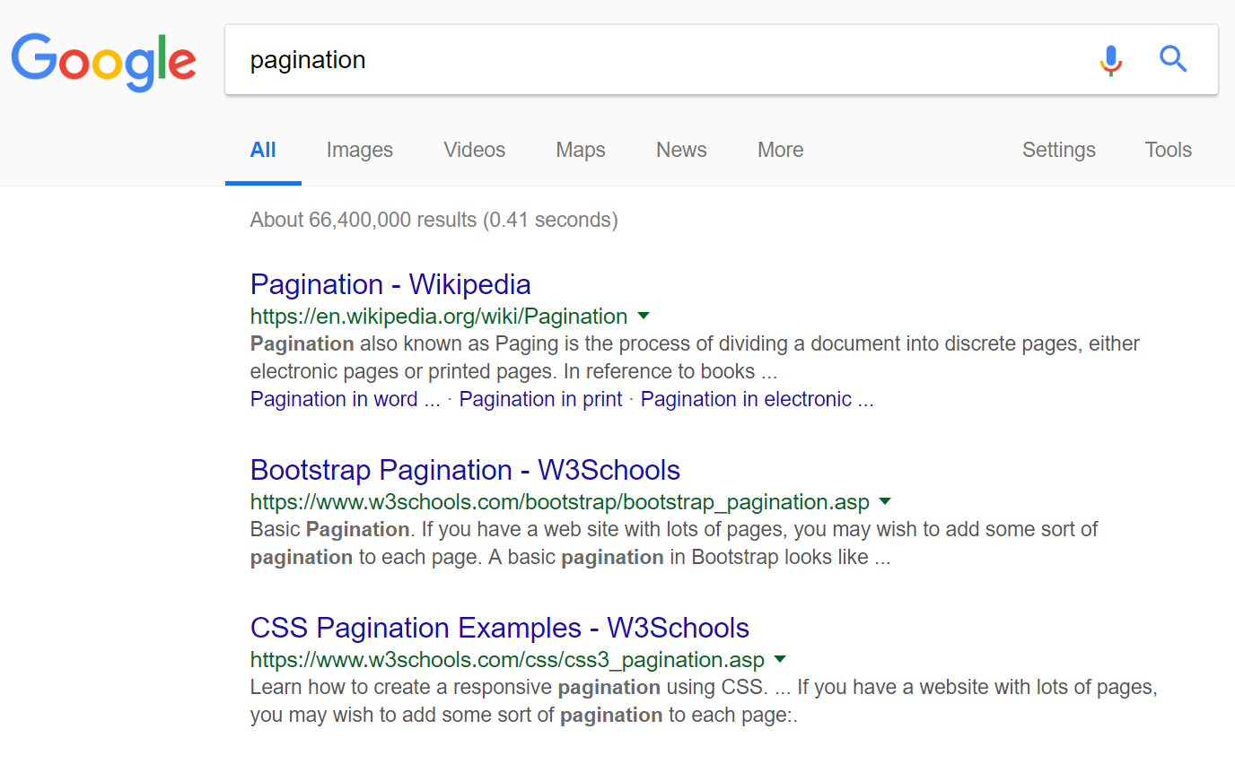
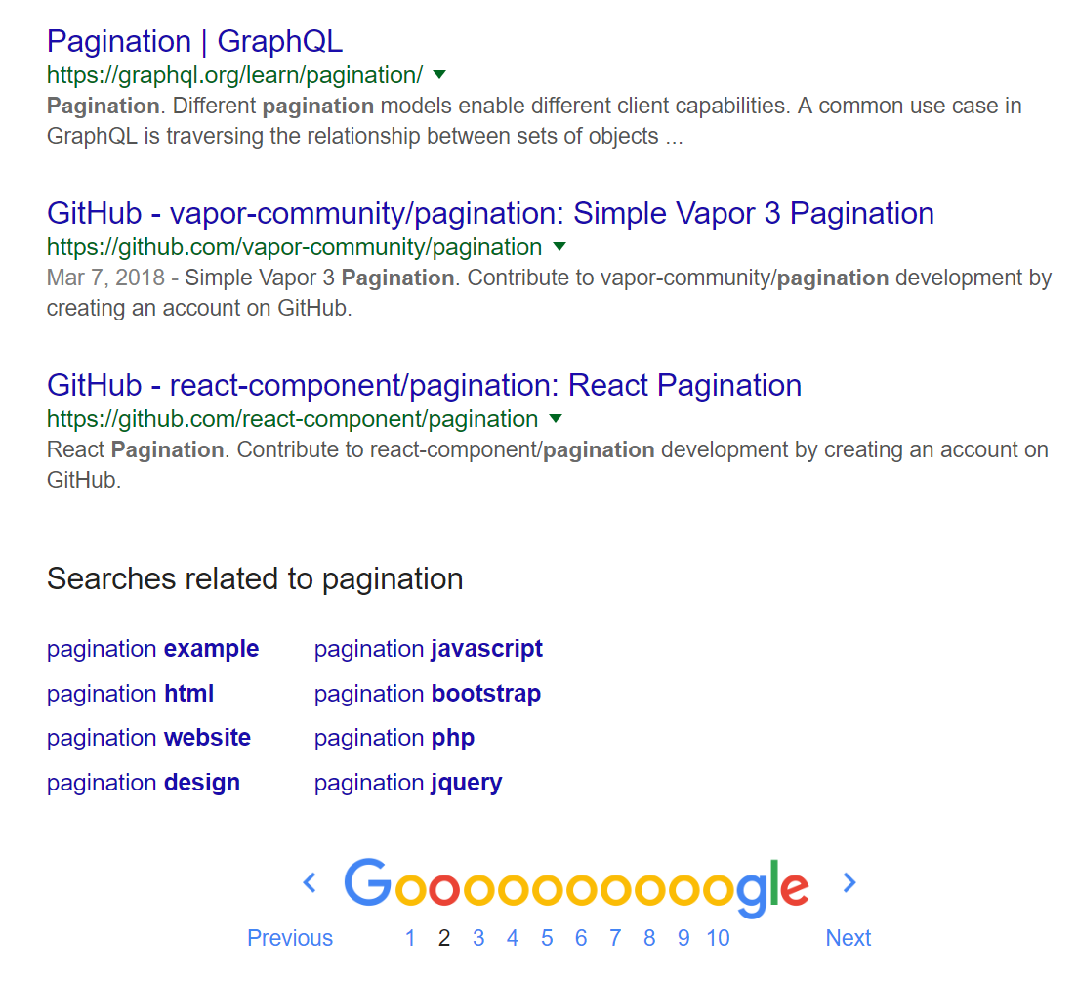
Searches

Slide 16
Page
Instead of billions of elements, just return a single Page
A Page will contain n elements (eg 10 or 20) from the collection
It will have information on the previous and the next page
If you want, can iterate over the whole collection by checking one page at a time, following the next links

Slide 17
dto = { “list”: [ … ], //the actual payload
“rangeMin”: 40,
“rangeMax”: 49, //so, 10 element pages
“totalSize”: 66400000,
“_links”:[
“next”: {“href”: “/news?offset=50&limit=10”},
“self”: {“href”: “/news?offset=40&limit=10”},
“previous” : {“href”: “/news?offset=30&limit=10”},
]
}

Slide 18
Offset/Limit
When dealing with large collections, need a way to specify the boundaries of a Page
Example: GET /news?offset=40&limit=10
Offset: given the collection sorted like an array, this would be the starting index i
Limit: starting from the offset, how many elements to return

Slide 19
Links
To access the next/previous pages, can compute the needed offsets/limits
Or, we could just provide valid URLs in the JSON responses with “links” to those pages
This is an instance of HATEOAS
Hypermedia as the Engine of Application State
Easier to navigate

Slide 20
Standard
There is no official standard to define pages and links
In the past, there were some attempts like HAL, but they look like abandoned

Slide 21
Data Expansion

Slide 22
Expansion
A “news” might have a list of “comments”
A “news” might also have a list of “users” that liked it
When retrieving a single item, might not want to download as well the hundreds/thousands of other items related to it
As returning those lists can be very expensive, can have special query parameters to choose if downloaded or not
Eg.: GET /news?expand=NONE (no lists)
Eg.: GET /news?expand=COMMENTS (include comments)

Slide 23
Tradeoff
Option 1: never return those lists
But, then, need further HTTP calls to retrieve those lists if needed
Option 2: create “expand” query parameters to control what returned
Good: can return everything needed in a single HTTP request
Bad: needs to implement all the needed cases manually
GraphQL: a selling point compared to REST is its ability to exactly specify what to return
we will see GraphQL later in the course

Slide 24
Git Repository Modules
NOTE: most of the explanations will be directly in the code as comments, and not here in the slides
advanced/rest/wrapper
advanced/rest/rest-dto
advanced/rest/exception-handling
advanced/rest/rest-exception
advanced/rest/pagination
advanced/rest/gui-v2
Study relevant sections in RESTful Service Best Practices
Study relevant sections in RFC-7230 and RFC-7231

