Slide 1
Enterprise Programmering 1 Lesson 04: EJB
Prof. Andrea Arcuri

Slide 2
About these slides
These slides are just high level overviews of the topics covered in class
The details are directly in the code comments on the Git repository

Slide 3
Enterprise Java Bean (EJB)
An EJB is just a Java class annotated with a special tag
@Stateless, @Stateful and @Singleton
When an EJB is run in a JEE container (WildFly, GlassFish, etc), the container will enhance it with special functionalities
Example: by default, each EJB method is executed inside a transaction
so, don’t need to explicitly call begin() and commit() on an EntityManager
EJB reduces boilerplate

Slide 4
EJB Enhancements
JEE EJB enhancements are based on 2 main properties
Those are not only for JEE
Dependency Injection: the container will automatically add the dependencies the EJB needs
Proxy Class: container does not return instances of EJBs, but create subclasses with the enhanced functionalities (where method calls are proxied to the actual EJB instances which are inside the proxy)

Slide 5
Dependency Injection by Reflection
@Stateless public class UserBean { @PersistenceContext private EntityManager em; public UserBean(){}
For “em”, no input for constructor, and no setter
JEE container will automatically inject the current active “em”
EJB just needs to declare the dependency as a field… how it is created and injected is a job for the container…

Slide 6
Java Reflection
In Java (not just JEE) each object instance keeps information of its declaring class
Info of the class can be queried at runtime:
methods, fields, annotations, etc.
Fields can be modified with reflection, EVEN IF they are declared private…
… something you should NEVER do, unless you are writing a library that requires it (eg a JEE container, or (un)marshalling of JSON/XML data)

Slide 7
Proxy Class
The proxy would be automatically generated by the container
public class FooProxy extends Foo{ private final Foo original; public FooProxy(Foo original) { this.original = original; } @Override public String someMethod(){ // do something before, eg start a transaction String result = original.someMethod(); //do something after, eg, commit the transaction return result; } }
public class Foo { public String someMethod(){ return "foo"; } }

Slide 8
Generation of Proxy Classes
It is actually quite complex, as a proxy class would not exist at compilation time
The proxy class is created at runtime via bytecode manipulation
The Java SE (not EE) API provides some basic functions to create proxy classes, but they require the existence of interfaces, and not just concrete classes

Slide 9
Lazy Collections
Collections declared with @OneToMany and @ManyToMany are not loaded by default
They are loaded only when accessed (ie, lazy loading)
But you need to access them inside a transaction
If you try to access them outside, you will get an error
So, if need such data, need to force loading by accessing them while in a transaction
Note: we will go into details of transaction boundaries later in the course

Slide 10
Container Deployment
To use EJBs, we need to run them in a JEE Container
WildFly, GlassFish, Payara, etc.
We would need to package the JAR/WAR with our code, install it on a running container
But before that, we would need to download, install and start a container
But how to test the methods of EJBs directly from a JUnit test?

Slide 11
Arquillian
A library extending JUnit that allows you to package JAR/WAR files directly from tests and deploy them on a container
The tests themselves are run in the container, so can use dependency injection @EJB
Configuration in special resource file called arquillian.xml
Limitations: cannot just right-click in IDE to run tests, need some manual settings first…
… plus, you still need to download and install a JEE Container
Note: life will get easier once we start with SpringBoot…

Slide 12
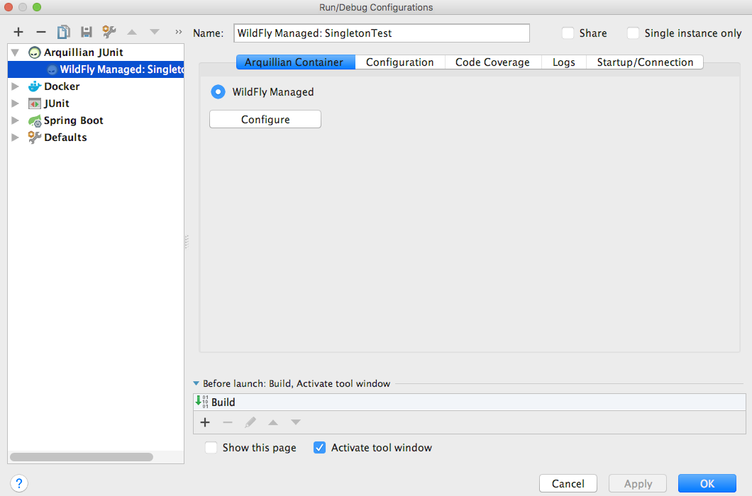
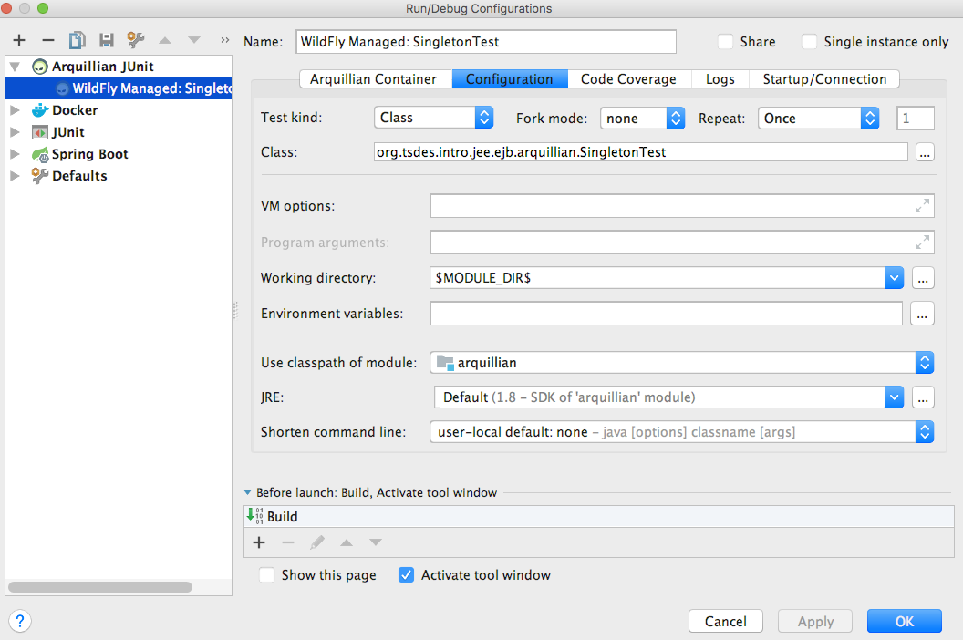
Test Configuration
Arquillian “WildFly Managed”
“Working directory” -> “$MODULE_DIR$”
note: recent versions of IntelliJ might use a different name for such variable, eg “$MODULE_WORKING_DIR$”. Just choose the right one from the drop-down list

Slide 13
Download/Install WildFly
We do it with a Maven plugin, as part of the build
Note: we could use Docker… but here we just want to see how Maven plugins can be used to do several different things during the build
WildFly installed under the “target” folder
So it would be deleted when running “mvn clean”
Need to run “mvn test” at least once to download/install WildFly BEFORE you can run tests in IntelliJ

Slide 14
Multi-Module Projects
Usually, you would run Maven commands like “mvn test” directly from the root of your project
TSDES is a large project: if you build from root, might take a long while…
well, “large” for students, but not compared to actual enterprise systems…
If you build a module directly (eg “mvn test” in the module folder), it will fail if using other modules as dependency
You need to run “mvn install -DskipTests” at least once from the root of the project
so, all JARs of the modules get installed in your ~/.m2 folder, and can be referenced when modules are built in isolation and not from the root of the project

Slide 15
Git Repository Modules
NOTE: most of the explanations will be directly in the code as comments, and not here in the slides
intro/jee/ejb/stateless
intro/jee/ejb/query
intro/jee/ejb/lazy
intro/jee/ejb/framework/injection
intro/jee/ejb/framework/proxy
Exercises for Lesson 04 (see documentation)

