Slide 1
Enterprise Programmering 1 Lesson 02: JPA
Prof. Andrea Arcuri

Slide 2
About these slides
These slides are just high level overviews of the topics covered in class
The details are directly in the code comments on the Git repository

Slide 3
Relationships
Database (DB) tables can have relationship among them
Category
SubCategory
Quiz
1
*
1
*
A category can have many subcategories
A subcategory has one parent category
Same kind of relations between SubCategory and Quiz
“Links” are foreignkey constraints

Slide 4
Relationship Annotations
5 kinds of annotations
@OneToOne
@OneToMany
@ManyToOne
@ManyToMany
@ElementCollection

Slide 5
Links
“Links” are represented with SQL foreign-key constraints
ie, a field in table X is mapped with the value of primary-key in Y
If X has link to Y, then need to decide if Y has link back to X
eg, unidirectional or bidirectional links
In annotations @, this is specified with mappedBy
if forget it, might end up with independent links, eg X x with link to a Y y, where the link back from y could point to a different X k!=x

Slide 6
Many-to-Many
If an X element has links to many Ys, and a Y can have links to many Xs, we need a third table with 2 FKs
Eg, 0 has link to b and e, where e also has link to 1
Unidirectional and bidirectional use same SQL tables
X-PK
0
1
FK-to-X | FK-to-Y
0 | b
0 | e
1 | e
Y-PK
a
b
c
d
e

Slide 7
1-to-Many Unidirectional
If an X element has links to many Ys, and a Y has no link back
Like Many-to-Many, but with UNIQUE constraint of FK-to-Y
Eg, if 0 has link to b and e, e cannot be used in any other relation
FK-to-X | Unique FK-to-Y
0 | b
0 | e
1 | e
X-PK
0
1
Y-PK
a
b
c
d
e

Slide 8
1-To-Many Bidirectional
If a X has links to many Ys, the FK will be from Y to X
The table X has no info on Y, but can use SQL to find all rows in Y that has FK pointing to a specific X x
Better to have bidirectional than unidirectional
Y-PK | Y-FK-to-X
a | 0
b | 1
c | 1
d | 1
e | 0
X-PK
0
1

Slide 9
EntityManager
Object used to sync the entities with the data in the DB
Different operations
persist()
clear()
find()
contains()
merge()
remove()
etc.

Slide 10
Java Persistence query language (JPQL)
You can use EntityManager#find(id) to query an @Entity with a given id
But what if you need to find all quizzes in a given category?
You can of course use SQL
JPQL: similar to SQL in syntax, but works by referring directly to @Entity, and not tables in DB
JPA will translate JPQL into SQL at runtime

Slide 11
JPQL Example
select u from User u where u.address.country = 'Norway'
Very similar to SQL, eg, using SELECT/FROM/WHERE
However, the FROM is an @Entity
We give a name to the entity, eg “u” (but could be anything)
that works as instance of the @Entity, on which we can access fields like an object

Slide 12
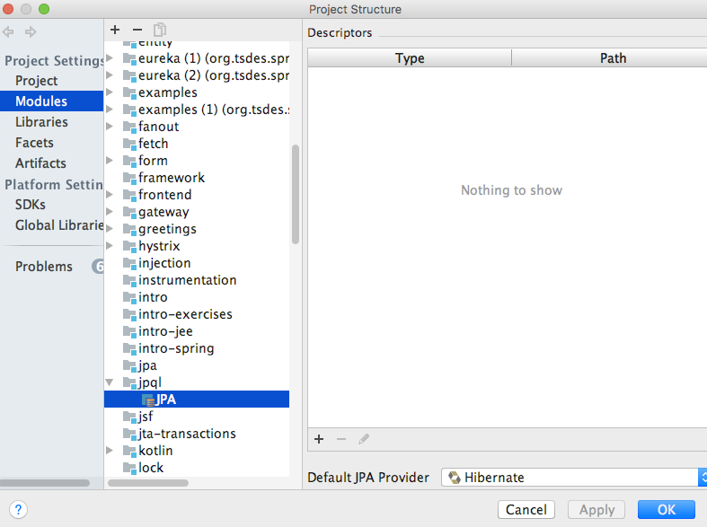
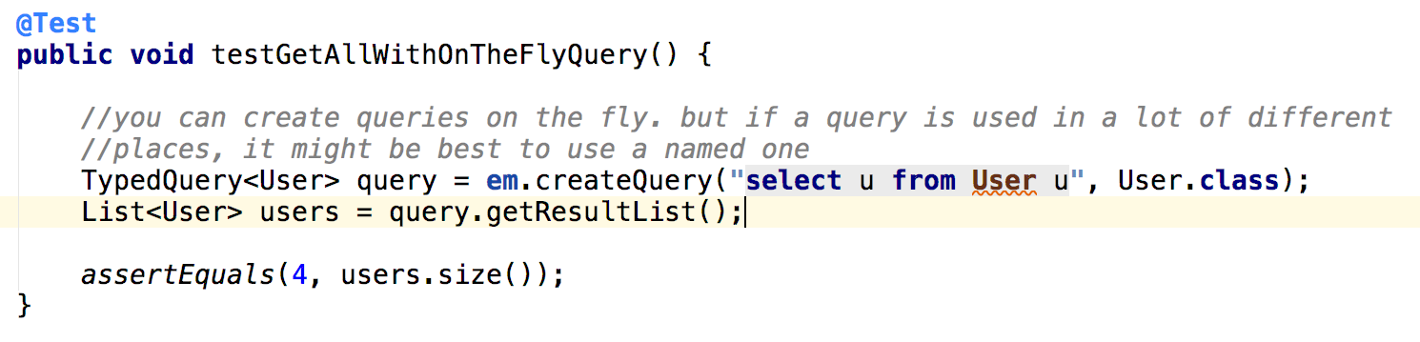
JPQL and IntelliJ
IntelliJ can automatically analyze syntax and do code completion for JPQL strings, but need configuration

Slide 13
Git Repository Modules
NOTE: most of the explanations will be directly in the code as comments, and not here in the slides
intro/jee/jpa/relationship
intro/jee/jpa/relationship-sql
intro/jee/jpa/manager
intro/jee/jpa/jpql
intro/jee/jpa/fetch
Exercises for Lesson 02 (see documentation)

