Slide 1
Enterprise Programmering 1 Lesson 10: Security
Prof. Andrea Arcuri

Slide 2
Authentication/Authorization
Authentication:
do I know who a user X is?
how to distinguish X from a different user Y?
Authorization:
once I know that the current user is X, what is X allowed to do?
can s/he delete data?
can s/he see data of other users?
etc.

Slide 3
Authentication/Authorization failures
If not authenticated, server can:
redirect to login page, HTTP status code 3xx
error page, HTTP status 401 Unauthorized
If authenticated but not authorized
eg user X tries to access data of Y
3xx redirection
HTTP status 403 Forbidden

Slide 4
Blacklisting vs Whitelisting
Authorization is done on the server, and will depend on the language/framework
JEE, Spring, .Net, NodeJS, etc.
user will just get either a 3xx or 403 response
Blacklisting: everything is allowed by default. What is not allowed for a given user/group has to be explicitly stated
Usually not a good idea, as easy to forget to blacklist some critical operation
Whitelisting: nothing is allowed by default. What is allowed has to be explicitly stated
“forgetting to allow something” (reduced functionality) is much, much better than “forgetting to forbid something” (security problem)

Slide 5
Authentication: first steps
Server does not know who the user is
Server only sees incoming HTTP/S messages
not necessarily from a browser… user can do direct TCP connections from scripts
HTTP/S is stateless
Need a way to tell that sequence of HTTP/S calls come from same user
User has to send information of who s/he is at EACH HTTP/S call
But users can lie… (eg, hackers)

Slide 6
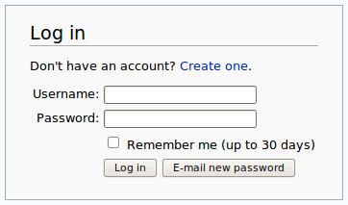
Ids and Passwords
A user will be registered with a unique id
Need also secret password to login
Otherwise anyone could login with the ids of other users…
HTTP/S does not prevent attempts to login to accounts of other users

Slide 7
How to implement a login mechanism?
When talking about security and what to implement on the server, think about HTTP/S messages, not necessarily coming from browsers
Could have endpoint to get token from server given userId/password
Use such token on each following request as parameter
GET /login?userId=x&password=y
userId/password as URL parameters to the /login endpoint
get back new token Z associated to this user, as HTTP/S response body, no HTML page
GET /somePageIWantToBrowse?token=z
pass “token=z” parameter to each HTTP/S request

Slide 8
Awful Solution
That solution would work with HTTPS, but…
“/login?userId=x&password=y” would be cached in your browser history, even after you logout
How to handle the adding of “?token=z” to all your <a> tags in the HTML pages?
doable, but quite cumbersome
How to handle browser bookmarks?
tokens would be there, and made the links useless once they expire, eg after a logout

Slide 9
POST and Cookies
User ids and passwords should never be sent with a GET
GET specs do not allow body in the requests
Should be in HTTP body of a POST
This is also default behavior of <input> forms in HTML
Authentication “tokens” should not be in URLs, but in the HTTP Headers
Cookie: special header that will be used to identify the user
The user does not choose the cookie, it is the server that assigns them
Recall: user can craft its own HTTP messages, so server needs to know if cookie values are valid

Slide 10
Login with Cookies
Browser: POST /login
Username X and password as HTTP body
Server: if login is successful, respond to the POST with a “Set-Cookie” header, with some unique identifier Y
Server needs to remember that cookie Y is associated with user X
Set-Cookie: <cookie-name>=<cookie-value>
Browser: from now on, each following HTTP request will have “Cookie: Y” in the headers
Logout: remove association between cookie Y and user X on server.
Server: HTTP request with no cookie of invalid/expired cookie, do 3xx redirect to login page

Slide 11
Cookies and Sessions
Servers would usually send a “Set-Cookie” regardless of login
want to know if requests are coming from same users, regardless if s/he is registered/authenticated
ie cookies used to define “sessions”
After login could create a new session (ie, invalidate old cookie and create a new one) or use the existing session cookie (eg, the one set by the server when login page was retrieved with the first GET)
Problem with re-using session cookies: make sure all the pages were served with HTTPS and not HTTP
ie, use HTTPS for all pages, even the login one
do not use HTTP and then switch to HTTPS once login is done

Slide 12
Storing cookies
The browser will store cookie values locally
At each HTTP/S request, it will send the cookies in the HTTP headers
Cookies are sent only to same server who asked to set them
Eg, cookies set from “foo.com” are not going to be sent when I do GET requests to “bar.org”
JavaScript can read those cookie values on the browser
What is the problem with it?
You can fabricate a web site with JS that reads all cookies, and then use them to access the user’s Google/Facebook/Bank accounts by doing AJAX calls…
As cookies are arbitrary strings, they can be used to store data
usually up to 4K bytes per domain can be stored in a browser

Slide 13
Expires / Secure / HttpOnly
Set-Cookie: <name>=<value>; Expires=<date>; Secure; HttpOnly
Expires: for how long the cookie should be stored
Secure: browser should send the cookie only over HTTPS, not HTTP
There are kinds of attacks to trick a page to make a HTTP toward the same server instead of HTTPS, and so could read authentication cookies in plain text on the network
HttpOnly: do not allow JS in the browser to read such cookie.
This is critical for authentication cookies

Slide 14

Cookie Tracking
Besides session/login cookies that have an expiration date, server can setup further cookies (ie Set-Cookie header)
There are special laws regarding handling of cookies
Why? Tracking and privacy concerns…

Slide 15
Tracking
Many sites might rely on resources provided by other sites
Images, JavaScript files, CSS files, etc.
eg, Facebook “Like” button
When you download a HTML page from domain X (eg finn.no) which uses a resource from Y (eg, facebook.com), the HTTP GET request for Y will include previous cookies from Y
So, even if you are logged out from Facebook, FB can know which pages you visit (as long as they do use FB resources)
Even worse, FB can track your browser even if you have never used FB!!!
This happens by simply opening the page from X, no need to click anything!!!
referer HTTP header: domain origin of request to Y from page not from Y
Eg, “Referer: X” is added when page loaded from X ask for resource in Y

Slide 16
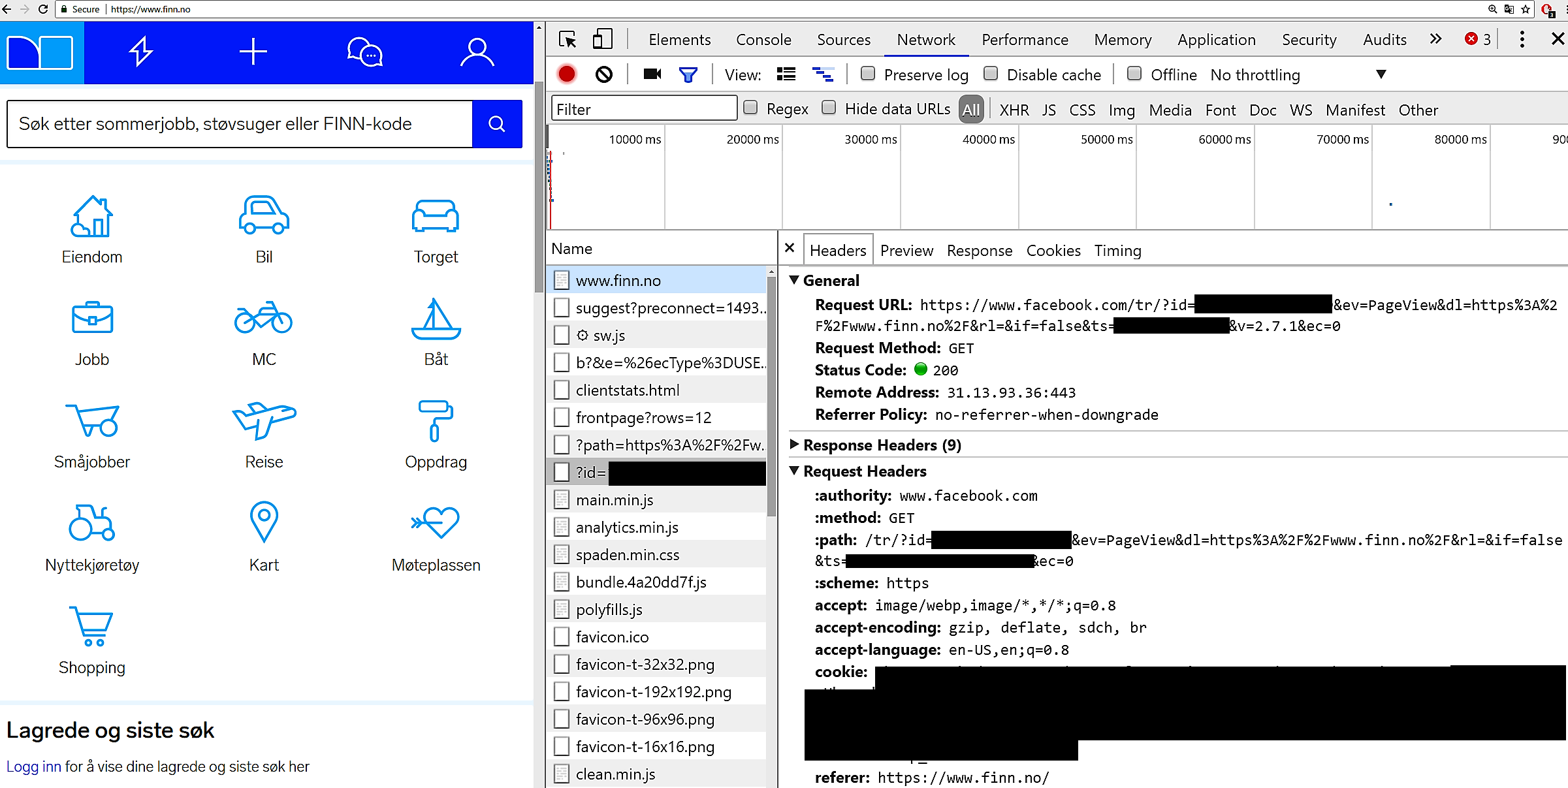

Slide 17
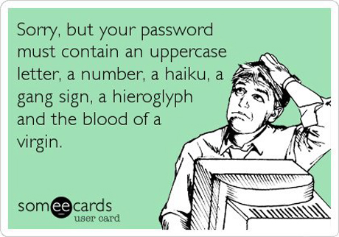
Passwords
Needed to verify identity of a user
Not too short or simple, otherwise too easy to crack with brute-force
Security vs Usability: hard to get a good balance
eg, ideally would have different passwords for each different site, and change them often, eg every week… but who the heck is going to do that???

Slide 18
Password Storage
When creating new user, need to save password somewhere, usually a database
NEVER SAVE A PASSWORD IN PLAIN TEXT
Passwords need to be hashed
Even if an hacker has full access to database, shouldn’t be able to get the password
Typical case is a successful SQL Injection attack
But many more cases: eg disgruntled employee, recovery from broken thrown away hard-drive, etc.
Besides being able to impersonate a user, hacker can try the same password on other sites (Amazon/Facebook/etc)

Slide 19
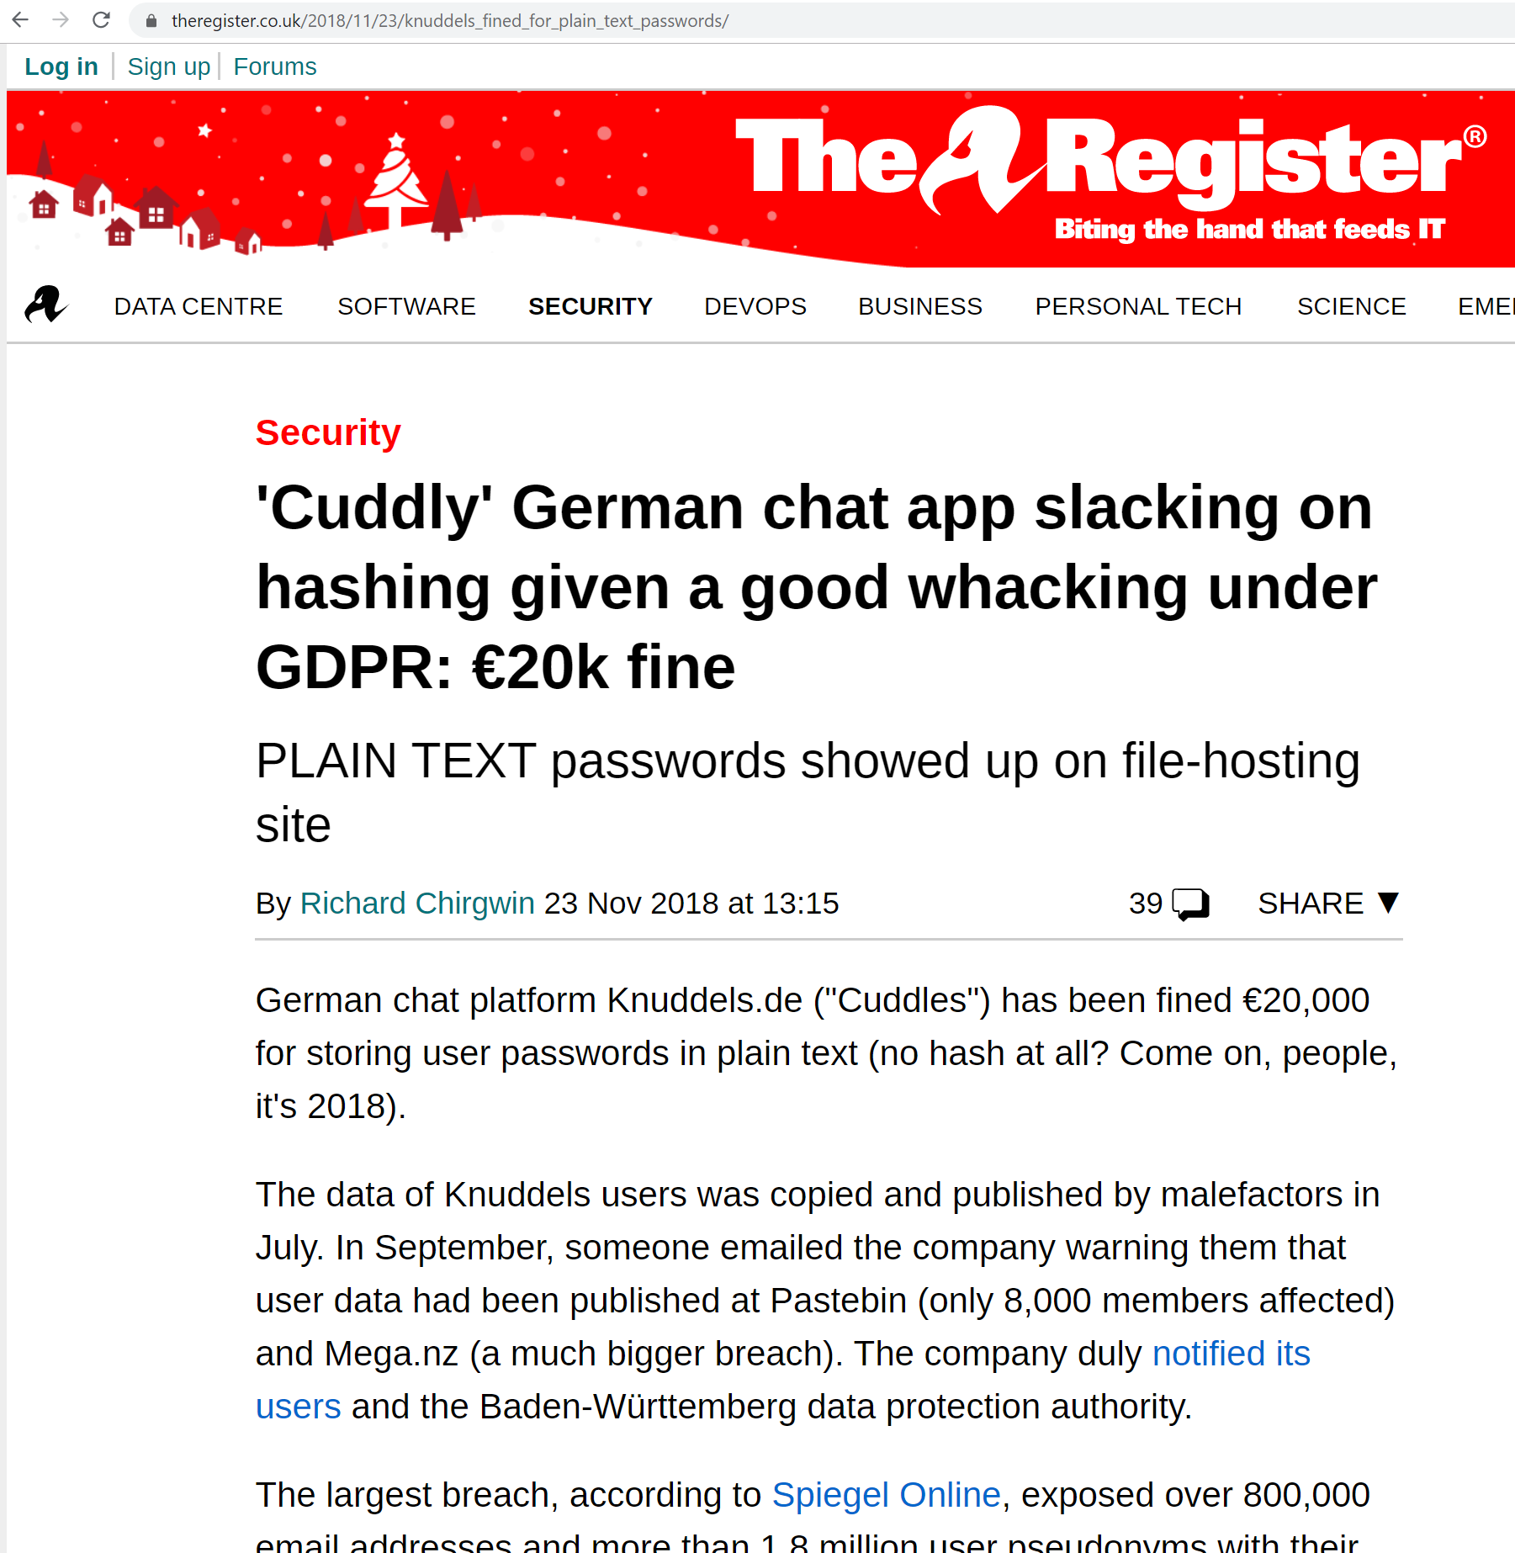
Plain-text Passwords? GDPR fines…

Slide 20
Hash Functions
h(x) = y
It is just a mathematical function from x to y
In our case, x is the password, and y is its hashed value
Deterministic: always same y from same input x
Shouldn’t be able to recover x from y, even if you have full knowledge of how h() is implemented
Small change x’ to x should lead to big different between y and y’
ie, y and y’ should look uncorrelated, and so cannot say if x and x’ are similar
No collision: no two values should have same hash, ie h(x) = y = h(z)

Slide 21
Login with Hashed Passwords
How can server verify the login of user A with password X, if the server does not know the password X, but only the hash Y=h(X)?
Server needs to retrieve from database the hash Y for given user A, recompute the hash h(X) from the input password X, and then verify that the new hash does match Y, ie Y == h(X)

Slide 22
Salted Passwords
Cannot expect users to have long passwords
If hacker has access to DB, from a hash Y, can calculate h(K) for all strings K up to certain length N, eg N=8, and check if any h(K) does match Y
For small N, this is doable. Do not even need to run h(), as those values can be pre-computed, ie Rainbow Tables
Further issue: two users with same passwords will have same hash Y
Solution: add a random salt S (eg a random long string) to the password before hashing, and store the salt together with the hash in the database
h(X+S)=Y
Each user will have its own random salt

Slide 23
Pepper
If hacker has access to the database, s/he can read the salt values
Still non-trivial to break the hash code, but doable
Pepper: yet another random string added before calculating the hash
NOT stored in the database, just somewhere else
files, remote server, hardcoded in the source code, etc
One single pepper string for whole application (and not per user)
Help mitigating if hacker gets access to the database (eg via SQL Injection), as would not be able to read the pepper

Slide 24
Hash Function Speed
You want hash functions that are slow, to make it difficult for the hackers to break them
but still manageable time on server to do authentication
BCrypt is the most used hash function for passwords
However, you can make slow any hash function (eg SHA256) by using a loop, in which the output is re-hashed N times
eg, N=6 -> h(h(h(h(h(h(x)))))) = y

Slide 25
Spring Security

Slide 26
About these slides
These few slides on Spring Security are just high level overviews of what covered in class
The details are directly in the code comments on the Git repository

Slide 27
Security Is Hard
You should NOT roll out your own solutions for security
far too easy to make mistakes
Need to use existing, battle-tested frameworks
Spring Security: the module of Spring that deals with security
However, still important to understand how they work internally

Slide 28
Configuration
Need to have a @Configuration bean that extends WebSecurityConfigurerAdapter
Furthermore, need to use the annotation @EnableWebSecurity
Then, in such class you can override the methods:
configure(AuthenticationManagerBuilder auth) for handling authentication, ie checking of users on database and password storage
configure(HttpSecurity http) for handling authorization, ie the access policy rules

Slide 29
OWASP

Slide 30
Open Web Application Security Project (OWASP)
www.owasp.org
A non-profit organization dedicated to software security
One of the main resources to learn about software security
Also produces some open-source tools (eg ZAP for penetration testing)
Maven plugin dependency-check-maven
Scan your third-party dependency libraries for known vulnerability
Automatically connect to an updated database
Note: nowadays hosting services like GitHub do dependency checks automatically

Slide 31
Git Repository Modules
NOTE: most of the explanations will be directly in the code as comments, and not here in the slides
intro/spring/security/manual
intro/spring/security/authorization
intro/spring/security/dependencies
Exercises for Lesson 10 (see documentation)

