Slide 1
Enterprise Programmering 2 Lesson 07: SOAP and GraphQL
Prof. Andrea Arcuri

Slide 2
Goals
Get a high level overview of SOAP web services
Understand how to use and develop GraphQL web services
Understand the differences between REST, SOAP and GraphQL

Slide 3
SOAP

Slide 4
Simple Object Access Protocol (SOAP)
An application-level communication protocol
REST is not a protocol
Typically used for Web Services communicating over HTTP
In contrast to REST, SOAP can be used outside of HTTP
SOAP is XML based
Started in 1998, by Microsoft

Slide 5
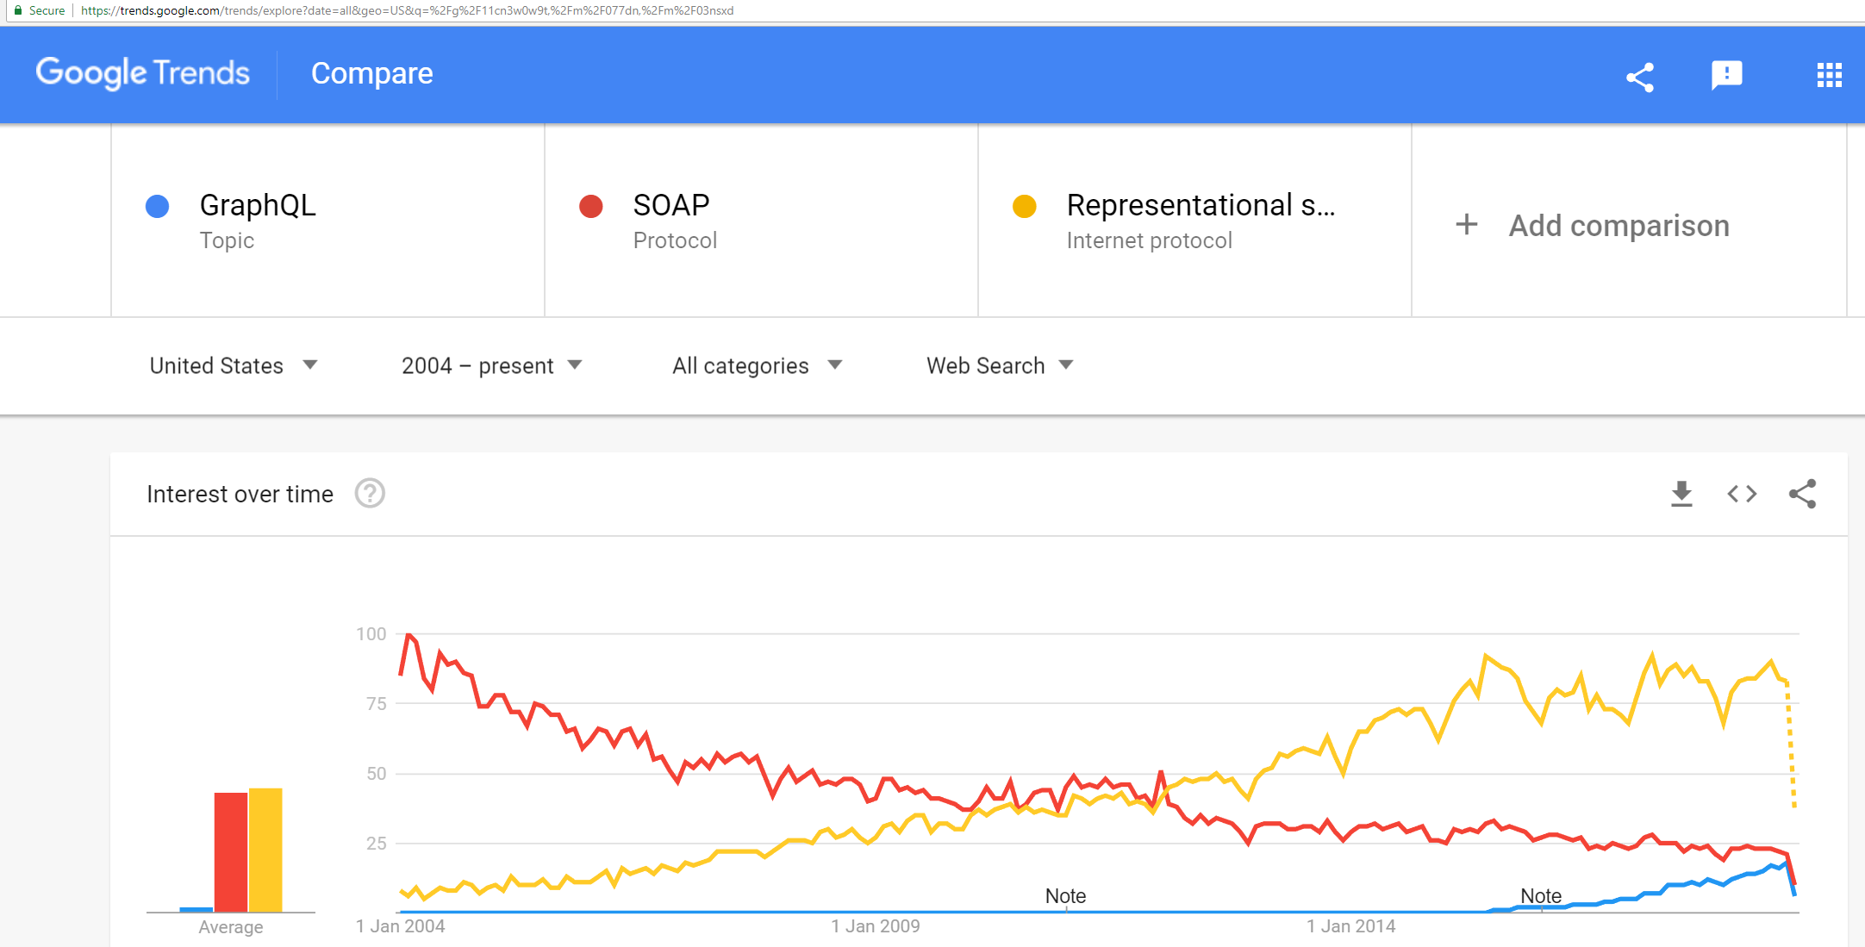
SOAP, REST or GraphQL?
Google Trends, late 2018

Slide 6
Status of SOAP
Major way of developing web services in 2000s decade
But now mainly substituted by REST
With GraphQL (2015) being the new kid on the block
But there are still a lot of SOAP Web Services out there
Important to understand how to use existing SOAP services, but not so much how to implement a new one
Also important to understand why REST won over SOAP

Slide 7
SOAP Over HTTP
One single HTTP endpoint, handling POST
HTTP XML payload not only contains data, but also the instructions of what to do with it
Eg, in following, asking NASDAQ to list current market centers
<?xml version="1.0" ?>
<S:Envelope
xmlns:S="http://schemas.xmlsoap.org/soap/envelope/">
<S:Body>
<ListMarketCenters
xmlns="http://ws.nasdaqdod.com/services/v1/">
</ListMarketCenters>
</S:Body>
</S:Envelope>

Slide 8
SOAP XML
SOAP messages are in XML
Specific tags, like <Envelope> and <Body>
Actual payload of SOAP will be in XML inside <Body>
Server needs to analyze what defined in the XML to determine how to respond, and which actions to take
eg create a new resource, delete it, or just fetch it

Slide 9
SOAP Problems
Quite verbose protocol
And so very tedious to use manually
Need to use client-libraries specific for the target server
Stuck with XML
Coupling between server and client
Not necessarily a bad thing inside a distributed enterprise application, but it hurts maintainability
REST+JSON is more flexible

Slide 10
GraphQL

Slide 11
Graph Query Language (GraphQL)
Made by Facebook
in 2012, but publically released in 2015
Actual protocol used to define how an API can be queried with a specific query language
A GraphQL Web Service will typically run on HTTP, where the GraphQL queries are sent as part of the HTTP messages
GraphQL can be used outside of HTTP

Slide 12
API Data as a Directed Graph
Eg, forum posts with comments, and author info
On backend, could be saved in a SQL database
POST:
- author
- text
- comments
- id
AUTHOR:
- name
- surname
- id
COMMENT:
- author
- parentPost
- text
- id

Slide 13
GraphQL Queries
Start from a method that returns elements of one of the nodes in the data graph
Exactly specify which fields in the node to retrieve
eg just surname and no name in Author
Can follow links on the graph to retrieve other connected data
On such links, still need to specify the fields to retrieve
From links can follow other links
being a graph and not a tree, same data could be accessed several times

Slide 14
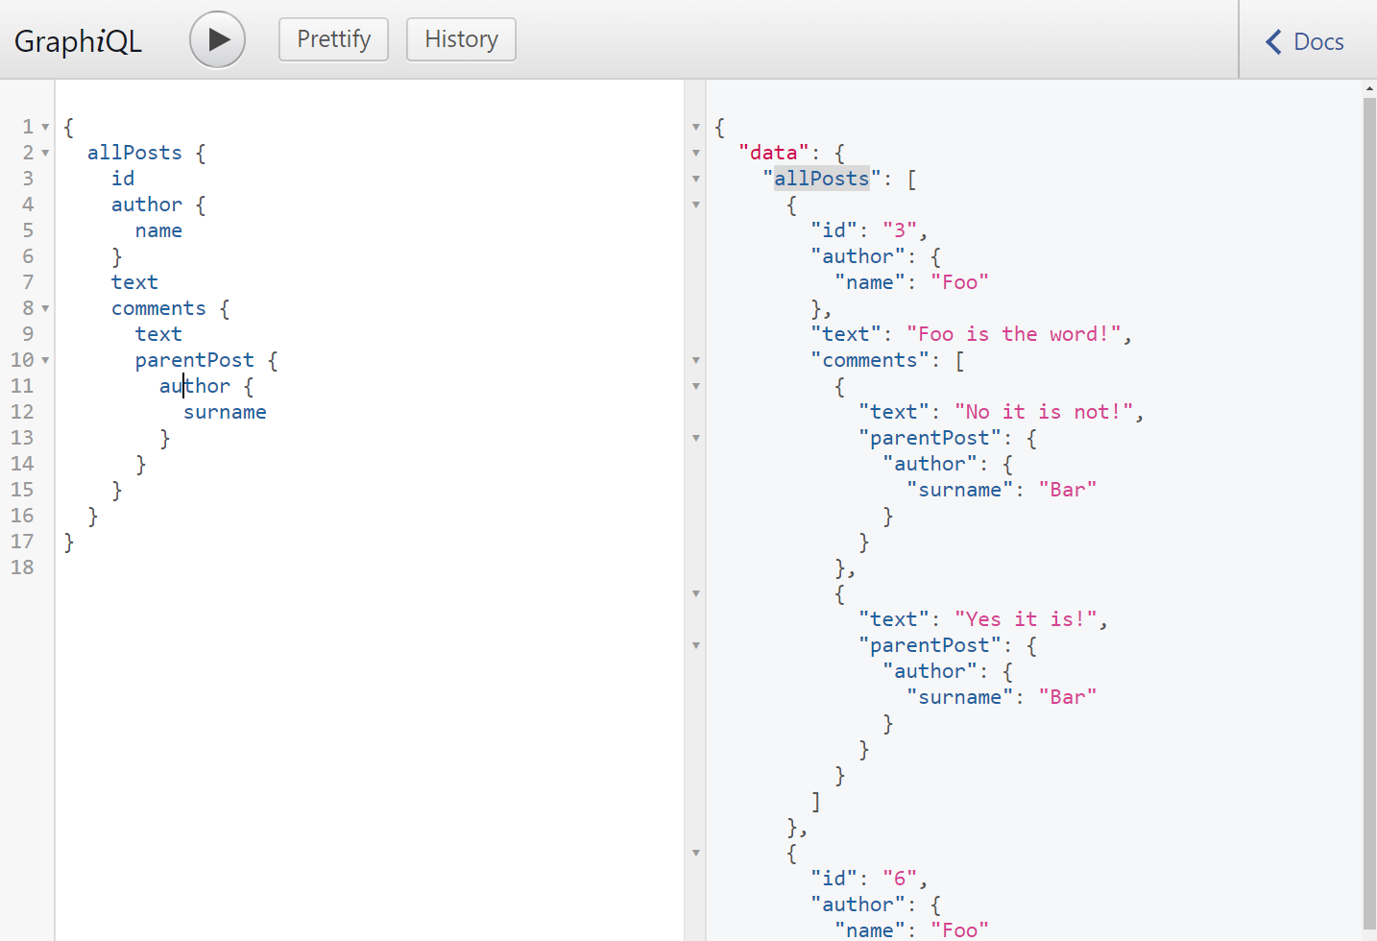
GraphiQL is a tool we can use to visualize and debug queries

Slide 15
Structure of a Query
{
allPosts {
id
author { name }
text
comments {
text
parentPost { author { surname} }
}
}
}
Need an entry point
eg, allPosts
Specify which fields to retrieve from that type
e.g., id, author, text, comments
When field is reference to another type in graph, need to specify its fields
eg, name for author

Slide 16
Cont.
comments here does retrieve a list of comments
Note the use of author: the same instances are accessed twice, but retrieving different fields
ie, name and surname
post.author == post.comments[i].parentPost.author
Working on a graph, a query could be arbitrarily deep when following links between nodes
{
allPosts {
id
author { name }
text
comments {
text
parentPost { author { surname} }
}
}
}

Slide 17
Response
What we get back is a JSON object
Payload is under a “data” field
Payload will have same shape of the query
Similar to a Wrapped Response in REST, where in case of errors we have “data” being null and a “errors” field with info on the error(s)
{
"data": {
"allPosts": [
{ "id": "3",
"author": {"name": "Foo"},
"text": "Foo is the word!",
"comments": [
{ "text": "No it is not!",
"parentPost": {"author": {"surname": "Bar"} }
},
{ "text": "Yes it is!",
"parentPost": { "author": {"surname": "Bar"} }
}
]
},
// other posts…

Slide 18
Change Operators
To modify data, GraphQL defines “mutation” operators
These are Remote Procedure Calls (RPC)
In other words, a GraphQL server can define a set of methods that can be invoked remotely
Input/output data should be basic types
Benefits: high flexibility, can do whatever you want
Downsides: high flexibility, each API will behave differently

Slide 19
GraphQL Over HTTP
Either via a POST or a GET
Eg, POST localhost/graphql
JSON payload: { "query" : "{all{id}}" }
Here, the actual query is a string stored in the variable called “query”
Eg, GET localhost/graphql?query=%7Ball%7Bname%7D%7D
Here the query is passed as a URL query parameter called “query”, and not in a JSON object
Note that symbols { and } need to be escaped with %7B and %7D

Slide 20
HTTP Idempotency
Need to remember that GET is idempotent, whereas POST is not
So, a “mutation” operation that changes the server state must not be sent via a GET
GraphQL HTTP Services will likely throw an exception in those cases
So, “mutations” must go via a POST, whereas read operations could go either way, POST or GET

Slide 21
GraphQL Benefits
Why did Facebook need to create a yet another type of web service instead of just using REST???
Client has full control on what retrieved
Do not retrieve fields that are not needed
Can retrieve all needed data in a SINGLE HTTP call
Very important for mobiles, to reduce bandwidth and energy consumption
Can have drastic changes in what called from clients without the need to change the server
ie, GraphQL is very flexible
Note: could achieve same things in REST, but it will end up in manually re-implementing GraphQL on top of a REST service

Slide 22
GraphQL Downsides
More difficult to implement the server (at least on the JVM)
Can use existing libraries, but still it is more difficult to achieve high server-side performance
eg, think about how to create optimized SQL queries on databases which could be based on GraphQL queries of any shape on the graph
eg., in REST, could provide high performant, optimized endpoints for widely used operations
No common semantics of “mutations” among different services
so, for each new service, need to study its docs/code to have an idea of what they do… which is quite different from typical POST/PUT in REST APIs
No native handling of authentication, versioning and caching
eg, have to rely on transport protocol like HTTP
eg, more complex HTTP caches, as here there is only one single endpoint
Relatively new technology, so tooling still needs improvement
but this will get better with passing of time…

Slide 23
REST or GraphQL???
Will GraphQL replace REST???
Maybe… maybe not… too early to tell
Better for clients, but can be worse for servers
RPC for mutations has quite a few downsides
Personally, I quite like GraphQL, but current tooling still has many rough edges
especially on the JVM
support in JavaScript is better

Slide 24
Git Repository Modules
NOTE: most of the explanations will be directly in the code as comments, and not here in the slides
advanced/graphql/base
advanced/graphql/resolver
advanced/graphql/database
advanced/graphql/graphql-dto
advanced/graphql/mutation
advanced/graphql/news-graphql

