Slide 1
Enterprise Programmering 2 Lesson 03: Charset, PATCH and GUI
Prof. Andrea Arcuri

Slide 2
Goals
Understand how strings are represented in bytes when sent over the network
Understand why all of a sudden your text is full of � symbols or weird letters like Ã
Understand the HTTP method PATCH, and how it is different from PUT
this is rather tricky, and a LOT of APIs out there do it wrong
Learn how to integrate SPA library like React in SpringBoot

Slide 3
Charsets

Slide 4
Charsets
Each character in a string text is mapped to a bitstring representation, which can be seen as a number
But there are many types of mappings, called Charsets
Tradeoff: how many characters we can represent vs the size in bits of the representation

Slide 5
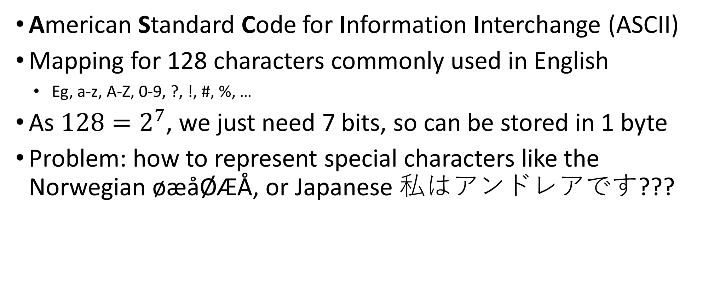
ASCII Codes
American Standard Code for Information Interchange (ASCII)
Mapping for 128 characters commonly used in English
Eg, a-z, A-Z, 0-9, ?, !, #, %, …
As ${128=2}^{7}$, we just need 7 bits, so can be stored in 1 byte
Problem: how to represent special characters like the Norwegian øæåØÆÅ, or Japanese 私はアンドレアです???

Slide 6
Unicode
Standard for encoding of characters
Representing up to 1,114,112 possible characters
Currently mapping around 136,755 characters used in most languages around the world
unfortunately, in 2001 the Unicode Technical Committee rejected the proposal of adding Klingon
It implies we might need at least log2(1114112) = 20.08746 bits for the mapping, ie 3 bytes
Ie, using a single byte is not enough

Slide 7
Common Charsets
ISO/IEC 8859-1: using 1 byte, representing up to 256 characters, including Norwegian and Swedish ones, but not full Unicode (eg, no Japanese)
UTF-8: most used encoding. Multi-byte representation, up to 4 bytes. Can represent whole Unicode. ASCII (most common) codes need 1 byte, but Norwegian need 2
UTF-16: used internally by Java (eg, “char” variables). Each character takes at least 2 bytes. Covers whole Unicode.

Slide 8
Parsing ISO-8859-1
As each character is 1 byte, we just read 1 byte (ie 8 bits) at a time
Direct mapping from 8 bits to a specific character

Slide 9
Parsing UTF-8
Read 1 byte at a time, but need to find out if single byte character (eg, “A”), or beginning of multi-byte one (eg, “Ø” or “す”)
If multi-byte character, need to read all of them before being able to map them to a single char
Look at first 2 bits in each byte:
0xxxxxxx -> single byte character (using remaining 7 bits)
11xxxxxx -> beginning of a multi-byte character
10xxxxxx -> continuation of a multi-byte character

Slide 10
Problem
Reading a bitstring assuming a charset (eg UTF-8) whereas it was encoded in a different one (eg ISO-8859-1)
You might not see this issue for ASCII codes, as those have same codes in most charsets
But, as soon as you have non-Latin letters, good luck…
Example, reading a valid 11xxxxxx 0xxxxxxx from a ISO-8859-1 source would result in a � for the first byte if wrongly displayed as UTF-8 (as 11x… must be followed by 10x…)

Slide 11
HTTP PATCH

Slide 12
PATCH
PATCH was introduced in HTTP later on, in its own RFC (5789)
PUT does a complete replacement of a resource
What if I just want to replace a single field of a resource?
In PUT, I would have to send the old fields as well, otherwise they would be deleted
very inefficient
PATCH allows to do partial changes on a resource

Slide 13
Wrong PUT on Resource /abc
//PUT
{
“foo”: 2
}
//Current Resource
{
“foo”: 5,
“bar”: “hello”,
“x”: 1
}
//Wrong result
{
“foo”: 2,
“bar”: “hello”,
“x”: 1
}
You could implement the PUT this way on the server
But, besides not following HTTP’s semantics, what would be the problem?

Slide 14
Issue With API Maintenance
//PUT
{
“foo”: 0
“bar”: null
“x”: 0
}
//Current Resource
{
“foo”: 5,
“bar”: “hello”,
“x”: 1,
“y”: 7
}
//Wrong result
{
“foo”: 0,
“bar”: null,
“x”: 0,
“y”: 7
}
Assume one day you add an optional field “y”
(Old) Clients replacing/creating resource without specifying “y” will wrongly leave current “y” value instead of null

Slide 15
Partial Updates with PATCH
PATCH allows you to do partial updates
How to do such updates is NOT specified in HTTP
A PATCH request will need to specify how to do the update
For example, could have custom request to increase a numerical field by 1
A (simple) standard format is JSON Merge Patch
but there are others, and you can have your custom formats if you need more flexibility

Slide 16
JSON Merge Patch
Specified in RFC-7396
Send a JSON file, and change only fields specified in it
//PATCH
{
“foo”: 2
}
//Current Resource
{
“foo”: 5,
“bar”: “hello”,
“x”: 1
}
//Result
{
“foo”: 2,
“bar”: “hello”,
“x”: 1
}

Slide 17
Tricky: Null vs Undefined
In JSON, Null and Undefined are two different concepts
In JSON Merge Patch, setting a variable to null means deleting it, and not changing its value into null
//PATCH
{
“foo”: null
}
//Current Resource
{
“foo”: 5,
“bar”: “hello”,
“x”: 1
}
//Result
{
“bar”: “hello”,
“x”: 1
}

Slide 18
Backend Representation
We send JSON, but the resource might have nothing to do with JSON in the backend
Example: a row in a SQL database table
For backend there might be no difference between null and undefined of a field (eg a column in a SQL table)
However, tricky when mapping a JSON to a DTO, as a null field has very different semantics from a missing field

Slide 19
Idempotency
PUT is idempotent
replacing the same resource 1 or n times will result in the same outcome on the server
PATCH is NOT idempotent
if a PATCH adds 1 to a field, repeating it 1 or n times will have very different results
note: the effects of JSON Merge Patch are likely idempotent, but the HTTP request itself is not idempotent because using PATCH
recall that JSON Merge Patch is just one way to PATCH, and a PATCH could do any kind of modification

Slide 20
Other Formats
JSON Merge Patch (RFC-7396) is not the only standard format for PATCH, although likely the most common
Other example: JSON Patch (RFC-6902)
define list of operations to do on the resource
eg: [ { "op": "test", "path": "/a/b/c", "value": "foo" }, { "op": "remove", "path": "/a/b/c" }, { "op": "add", "path": "/a/b/c", "value": [ "foo", "bar" ] }, { "op": "replace", "path": "/a/b/c", "value": 42 }, { "op": "move", "from": "/a/b/c", "path": "/a/b/d" }, { "op": "copy", "from": "/a/b/d", "path": "/a/b/e" } ]
When talking of HTTP PATCH, always need to define the type format of updates

Slide 21
GUIs

Slide 22
Web Applications
In Web Development and API Design course we have seen how to build frontends with React
Web Application: frontend + backend
Frontend: eg, SPA with React
Backend: eg, web service like REST

Slide 23
Static Resources
HTML files
usually just a single index.html is SPAs
CSS
JavaScript source files
eg, bundle.js
Images, documents, or any type of files to download
eg, PDFs
etc.

Slide 24
Dynamic Resources
Data that usually change through time
Can depend on user interactions
create an account, add items to a shopping cart, etc.
Could have long term storage in SQL and NoSQL databases
In REST, usually we will get a representation of those resource in JSON format
Handling/generation of dynamic resources usually depend on business logic in the so called backend

Slide 25
Static vs Dynamic
“Usually”, the static resources will define the frontend of a web application
HTML/CSS/JS/images/etc.
The backend will be a server providing data via JSON, and long term storage with databases
Backend will be a process with business logic written in some programming language (JS, or Java and C#)
Still, for both static and dynamic resources going to use HTTP

Slide 26


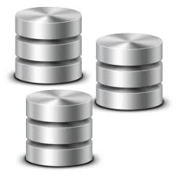
Frontend (e.g., React app) static assets still need to be provided by a HTTP server
Backend (e.g., REST API) with business logic and access to database is still a HTTP server
GET /
GET /style.css
GET /bundle.js
localhost:8080
localhost:8081
GET /api/products
POST /api/products
DELETE /api/products/42

Slide 27
From point of view of the browser, no difference between static assets and JSON responses from a REST API
still going to use HTTP
Frontend and backend can be handled by the same HTTP server
GET /
GET /style.css
GET /bundle.js
GET /api/products
POST /api/products
DELETE /api/products/42
localhost:8080

Slide 28
Web Application in SpringBoot
By default, SpringBoot runs Tomcat server
Files under resources/static will be served as static resources over HTTP
Can call YARN from Maven to build the bundle.js, and copy over directly into target/classes/static
which will be hence part of the generated jar file
Note: in a microservice, we might want to run NodeJS to handle server-side rendering for SPAs to handle SEO
Up to Java 8, that could had been done as well on JVM with Nashorn, but it is now deprecated… could be doable though with GraalVM

Slide 29
Git Repository Modules
NOTE: most of the explanations will be directly in the code as comments, and not here in the slides
advanced/rest/charset
advanced/rest/patch
advanced/rest/gui-v1
Study RFC-5789 and RFC-7396
Study relevant sections in RFC-7230 and RFC-7231

