Slide 1

By Stephanie Reese

Slide 2

LEACH stands for Low-Energy Adaptive Clustering Hierarchy
This WSN is considered to be a dynamic clustering method
LEACH has two phases

Slide 3

The reason we need network protocol such as LEACH is due to the fact that a node in the network is no longer useful when its battery dies
This protocol allows us to space out the lifespan of the nodes, allowing it to do only the minimum work it needs to transmit data

Slide 4

The LEACH Network is made up of nodes, some of which are called cluster-heads
  The job of the cluster-head is to collect data from their surrounding nodes and pass it on to the base station
  LEACH is dynamic because the job of cluster-head rotates

Slide 5

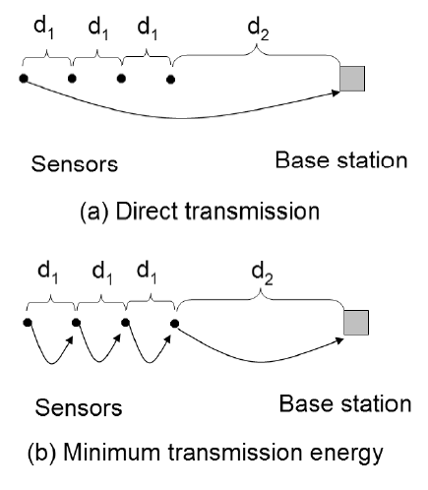
The amount of energy used in figure (a) can be modeled by this formula:
  εampk(3d1 + d2)²
Whereas the amount of energy used in figure (b) uses this formula:
  εampk(3d1² + d2²)

Slide 6

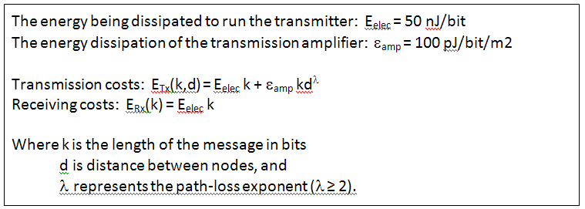
This is the formula for the amount of energy depletion by data transfer:

Slide 7

The LEACH network has two phases: the set-up phase and the steady-state
  The Set-Up Phase
    Where cluster-heads are chosen
  The Steady-State
    The cluster-head is maintained
    When data is transmitted between nodes

Slide 8

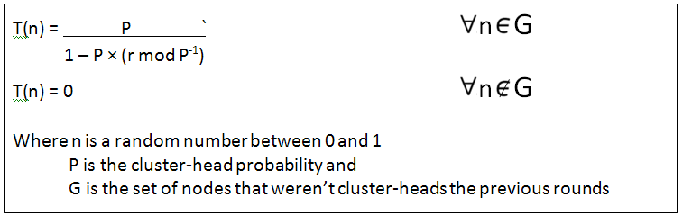
Cluster-heads can be chosen stochastically (randomly based) on this algorithm:
If n < T(n), then that node becomes a cluster-head
The algorithm is designed so that each node becomes a cluster-head at least once

Slide 9

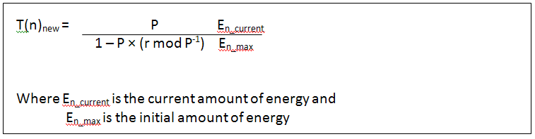
A modified version of this protocol is known as LEACH-C (or LEACH Centralized)
This version has a deterministic threshold algorithm, which takes into account the amount of energy in the node…

Slide 10
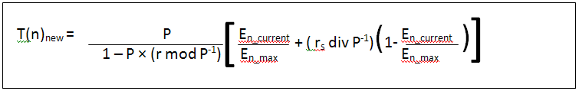
…and/or whether or not the node was recently a cluster-head

Slide 11

REMEMBER: The goal of these protocol is to increase the life of the network
The changes between the LEACH stochastic algorithm and the LEACH-C deterministic algorithm alone is proven to increase the FND (First Node Dies) lifetime by 30% and the HND (Half Node Dies) lifetime by 20%

Slide 12

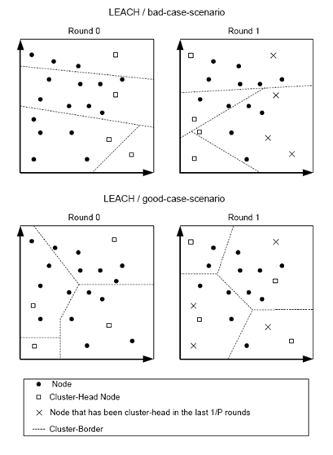
While neither of these diagrams is the optimum scenario, the second is better because the cluster-heads are spaced out and the network is more properly sectioned

Slide 13

“Low Energy Adaptive Clustering Hierarchy with Deterministic Cluster-Head Selection”; M.J. Handy, M. Haas, D. Timmermann; 2002; http://www.vs.inf.ethz.ch/publ/se/IEEE_MWCN2002.pdf
“Probabilistic Modeling of Leach Protocol and Computing Sensor Energy Consumption Rate in Sensor Networks”; Song, Dezhen; February 22, 2005; http://www.cs.tamu.edu/academics/tr/tamu-cs-tr-2005-2-2

