Slide 1
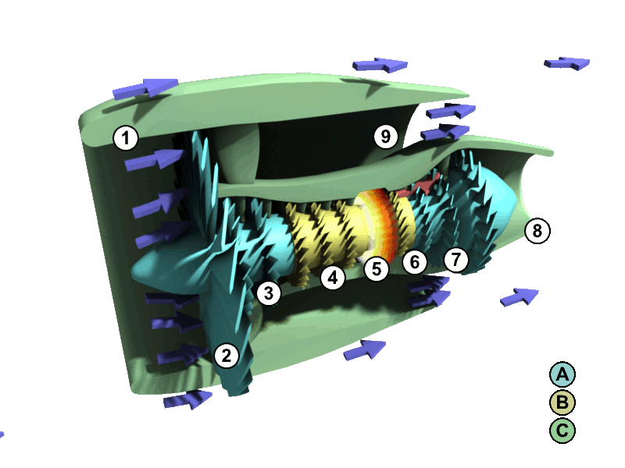
A Study on
Predictive
Maintenance of Turbofan
Aircraft Engines
Image by Zephyris at English Wikipedia, CC BY-SA 3.0, https://commons.wikimedia.org/w/index.php

Slide 2
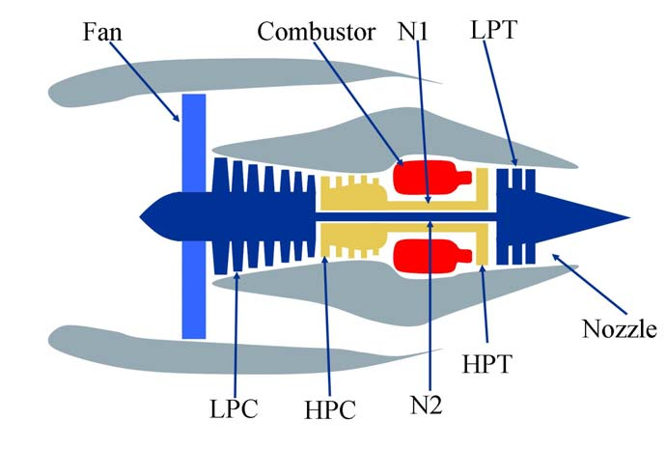
Basic Structure of a Turbofan Engine

Slide 3
The Dataset
NASA

Slide 4
EDA

Slide 5
Properly Framing the Problem
Normal, progressive degradation of engine operations over time
Degradation reduces margins between actual performance and operational limits across many parameters
Failure under study is NOT:
  Anomaly
  Catastrophic
Operability margin: how far engine is operating from limits

Slide 6
Characteristics of the System
Settings: altitude, airspeed, throttle
  Operational condition: hot day take off, maximum climb, cruise
Sensors: temperature, pressure, speed, ratios
  Observables: time series operational variables
Margin: temperature limit, stall condition
Health Index: Current operability margin

Slide 7
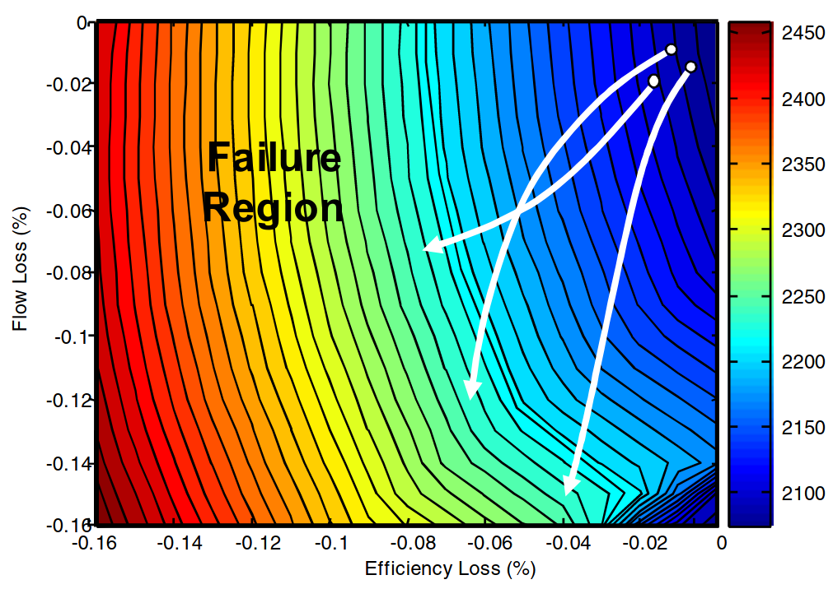

Slide 8
Models

Slide 9
Way Forward

