Slide 1

ISB · SOFTWARE PRODUCT MANAGEMENT · DEMO DAY 2026
Curio.
Swipe. Guess. Keep what sticks.
A swipeable feed of 2-minute, fact-checked knowledge cards.
The Reels habit, pointed at learning — India-first: cricket, markets, Bollywood, history.
LIVE · curio-three-iota.vercel.app · 120 real users
4,884 events tracked — every number in this deck is queried from production.
Notes:
Curio: swipeable, source-grounded knowledge feed. Everything shown is deployed and live; all numbers pulled from production PostHog today.

Slide 2
WHO IS THE CUSTOMER
Built for the curious thumb
Indian, 18–30, two-plus hours a day on short-form video — wants to end the scroll knowing something.
PRIMARY · FROM 2 OF 3 INTERVIEWS
SECONDARY · THE TRUST GATE
Aditya, “The Curious Scroller”
Raghav, “The Skeptical Reader”
“I’m a mile deep in one thing and an inch deep in everything else — and everything out there is either baby-food or a lecture.”
“I don’t have an attention problem, I have a trust problem. One wrong claim and I’m out.”
2+ hrs/day of habitual short-form — “my thumb just did it”
Avoids news apps: too shallow or too heavy, no middle
Professional whose credibility depends on accuracy
Will only touch AI-written content that shows receipts
Discovery: 3 depth interviews (Ashish 25 · Rio 24 · Raj 28) → 2 personas. Sample is small and male-skewed — named as a limitation; next round targets the younger half of 18–30.
Notes:
Two personas from three depth interviews. Aditya is the habitual scroller who wants substance; Raghav barely scrolls but gates on trust. We state the n=3, male-skewed limitation openly.

Slide 3
WHAT IS THE PROBLEM
Two hours a day. Nothing kept.
THE HABIT
THE GAP
THE GATE
“My thumb just did it.”
“Baby-food or a lecture.”
“One wrong claim and I’m out.”
The scroll is habitual, not chosen. Hours go in; nothing comes back out — and users feel it.
Between dumbed-down snippets and textbooks there is nothing. Raghav gave up on macroeconomics for exactly this.
AI-written content fails on trust before it fails on attention. Trust is pass/fail, not a nice-to-have.
The habit is not the enemy — the payoff is. So reuse the swipe loop, and change what it pays.
Notes:
All three quotes are verbatim from discovery. The insight: do not fight the swipe habit — repoint it. That framing is also our ethics answer: same loop, different payoff, with guardrails.

Slide 4


WHAT IS THE SOLUTION
Guess. Read. Keep — with receipts.
Every card opens as a question — retrieval practice, not passive scroll
Type your answer, get judged instantly — then the sourced truth
Go deeper: every claim cited, independently verified before it ships
Notes:
The mechanic: guess-first cards (typed answers, instant verdict), swipe semantics that tune an additive personalization model, and a verification pipeline — a card that fails fact-check never ships. Trust is structural, not aspirational.

Slide 5

THE MVP — LIVE SINCE 22 JULY
Not a prototype. A product people use.
Personalized feed
Typed quizzes
Additive topic weights, visibly tuning — “Mostly Cricket” after ~10 swipes
Guess → judged → sourced answer, on every card
Kept pile + review
Self-refilling feed
Saved cards decay and resurface — spaced repetition, not a bookmark graveyard
Hit the end and 10 fresh cards are written & fact-checked for your taste on demand
Shared comments
Identity + Curio+
One thread per card, profanity-filtered at the database
Anonymous-first, Google sign-in gate at swipe 3, mocked ₹149/mo paywall
React + Vite · Supabase (RLS-enforced trust) · Vercel · PostHog — pipeline: generate → independently verify → cite. Fail closed: an unverified card never ships. 64 verified cards live.
Notes:
Everything listed is deployed. The verification gate is a database policy (RLS), not a promise. The refill feature shipped this week from a real finding: most of the pilot exhausted the library.

Slide 6

WHAT IS THE METRIC
North Star: cards retained per weekly active user
“Retained” = the user came back to a card — reopened it, reviewed it, or recalled it in a quiz. Swipes are motion. Retention is the product.
INPUT METRICS
Activation
Keep rate
% of starts that reach a first card
readers who save ≥ 1 card
Second-day return
Time to first card
came back on another day
seconds from open to reading
GUARDRAILS — WHAT WE REFUSE TO GROW
Session length is a CEILING (6 min), not a target — a learning feed that wants you to leave on time. Doom-scroll numbers going up would be a failure here, not growth. Plus: comment-toxicity watch.
The recall quiz IS the instrument — typed answers make retention measurable
Notes:
North Star deliberately measures learning, not engagement. The recall quiz doubles as measurement: a typed, judged answer is direct evidence of retention. Guardrails are the ethics answer: session length has a ceiling.

Slide 7
WHAT WE MEASURED — POSTHOG, 22 JUL → 11 AUG, PRODUCTION
120 real users, honestly counted
79%
19s
of starts reach a first card (target ≥ 75%)
median from open to first card (target < 60s)
1.9 : 1
30%
interested vs pass — the feed serves hits
of readers save at least one card
43%
~1 min
of users who hit the sign-in gate convert
median session — ceiling is 6 (guardrail holding)
THE FUNNEL — UNIQUE PEOPLE
Notes:
All production numbers, pulled today. Activation works (79% reach a card in 19s). The feed is liked (1.9:1). Gate converts 43% of those who meet it. Sessions are deliberately short — guardrail holding.

Slide 8
THE ANALYSIS
Three findings the data forced on us
01
02
03
The leak is before the first tap
North Star reads ~0 — and that’s the finding
Running out was the real churn
25% of visitors bounce on the intro screen — before touching a single topic (114 → 85). Not choice paralysis: they never got to the choices.
27 people saved cards; only 4 have come back to one. Nothing pulls users back yet (no notifications, by design) — so return is the battleground, not a bug.
Most of the pilot read the entire library — exhaustion, not boredom, ended sessions. The deck now writes 10 personalized, verified cards on demand.
NEXT A/B: OPEN ON THE TOPIC PICKER
SHIPPED: RECALL QUIZ + SELF-REFILLING FEED · SAVES 8 → 29 LAST WEEK
GENERATION MOVED TO THE MOMENT OF DEMAND
Bonus finding: two real testers found two gate bugs desktop testing never showed — both fixed and folded into the spec the same day. Real users beat test plans.
Notes:
Root cause from live data: intro-screen bounce. NS at ~0 is mechanically explainable and points the roadmap at return loops. Exhaustion finding drove this week’s refill feature. Field bug reports (Yashvi, Krittika) fixed same-day.

Slide 9
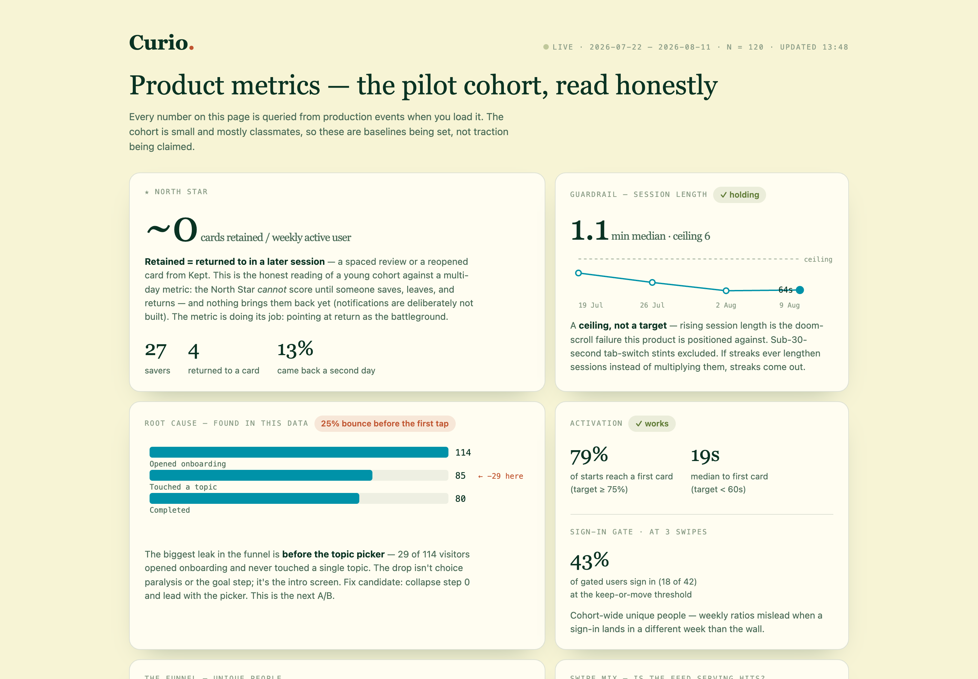
SEE FOR YOURSELF
Everything here is live right now.
THE PRODUCT
curio-three-iota.vercel.app
THE NUMBERS
curio-three-iota.vercel.app/metrics.html
THE DRILL-DOWN
PostHog — full event-level analytics
Open the feed. Swipe your first set.
Ask us anything — the numbers are public.
Notes:
Close on the live dashboard — the metrics page is public and updates from production on every load. Invite the room to open the product during Q&A.

