Slide 1
CURIO
A reading feed for replacing mindless scrolling of brainrot content with short-form knowledge.
TEAM 9
Ankur · Krittika · Garvit · Shruti · Swastika · Yashvi

Slide 2
Short-form content is optimized for attention.
Not for knowledge.
2h 28m
400M+
71%
spent per day on social media, by the average Indian user
Instagram users in India alone
The largest Reels market on Earth
of Indian YouTube users say they're there to learn something new
Every major feed (Reels, Shorts, Moj, Josh) is tuned by the same objective: maximize time-on-app.
Novelty, outrage, and dopamine win the ranking function.
India didn't get TikTok; it got three replacements for it, and the objective function travelled over unchanged.
Depth and retention of knowledge were never the metric.
Millions open Instagram hoping to learn something useful. They leave after 45 minutes having learned almost nothing.
CURIO
02

Slide 3
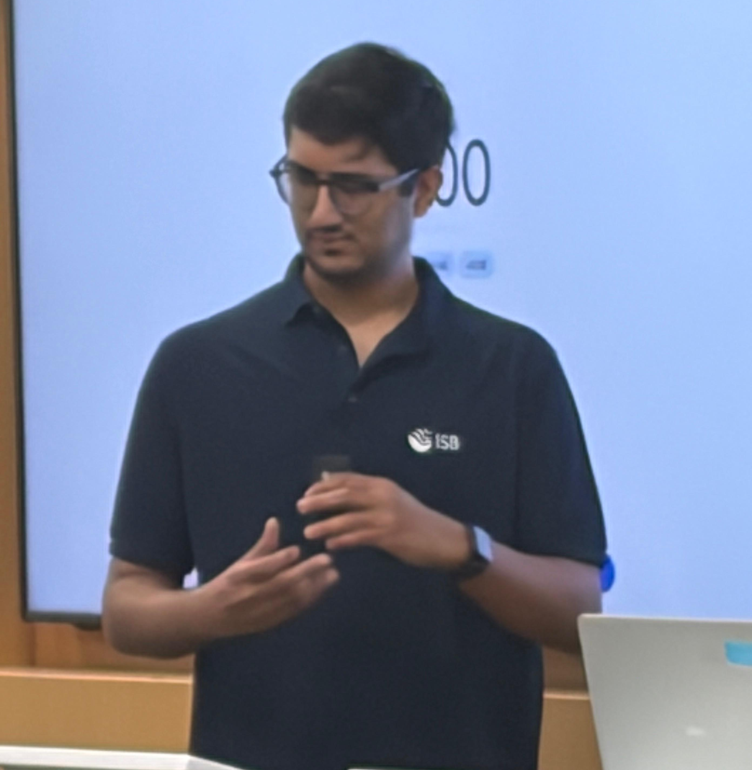
Who are we building for?
GOALS
DO
Stay in the loop enough to hold a conversation or stay informed, without cramming
Unwind at night without the 1am guilt-scroll
Learn passively: no timetable, no course to fall behind on
FRUSTRATIONS
Dhruv Ojha
Reels and Shorts leave nothing behind by morning
Doesn’t have the time or the attention span to read newspaper but wants to sound smart
News apps feel boring
No time for a long article in a busy day
HABITS
“I know I’ve lost another hour to Reels. I just want to feel like I learnt something today as well.”
2.5+ hours a day on Instagram Reels and YouTube Shorts
Opens a news-summary app most mornings, closes it inside 40 seconds
Five WhatsApp groups forwarding ‘must-read’ articles he never opens
CURIO
03

Slide 4
Same habit. Different payoff.
Curio replaces the video with a two-minute read and an algorithm trained on curiosity instead of outrage.
1
Real, sourced 2-minute reads
CURIO
Generated by AI, grounded against real sources: never a copy-pasted feed, never unverified WhatsApp-forward trivia.
ECONOMICS
What Onion Prices Tell Us About Indian Politics
2
Trained on curiosity, not outrage
Onion prices are a famously touchy indicator in Indian politics — sharp spikes have coincided with election losses more than once, and analysts still watch the mandi price as an informal mood gauge.
Every swipe is a preference signal. The mix of topics narrows toward what you actually keep reading. Users spend the same two minutes per swipe but retain useful knowledge instead of entertainment.
3
Never runs out
Endless, on-topic generation: the same infinite-scroll habit, spent on something that compounds. AI automatically creates personalized, source-backed explainers matched to your interests—something static articles and generic chatbots don't provide.
✓ Keep
Pass ✕
CURIO
03

Slide 5
How does it work?
01
02
03
Choose your stacks
Swipe
It learns
Pick 10–15 interests on first open (history, cinema, cricket, markets, philosophy, design and more) each with its own sub-topics.
Two-minute AI-written reads, one per card. Swipe right to keep it, left to pass (similar to a dating app motion).
Every swipe updates your topic weights. The feed narrows toward what you keep and generates more of it.
CURIO
04

Slide 6
The lane between two crowded ones.
Video feeds win on habit but teach nothing. News apps teach but feel like compulsion. Curio sits in between them.
THE HABIT
THE ALTERNATIVE
THE GAP
Reels / Shorts / Moj / Josh
Inshorts / Kuku FM
Curio
Video, algorithmic
News, podcasts, content
AI-generated explainers
Goal: attention
Goal: general news / information
Goal: curiosity
Infinite scroll
Current Affairs
Swipe cards, 2 min each
Feels like: compulsion
Feels like: reading
Feels like: browsing a curated library
CURIO
05

Slide 7
Business model
No ads in the core feed: the content itself is the product. Free earns the habit; Curio+ earns revenue from depth of engagement, not impressions.
UNLIMITED SWIPING
SUBSCRIPTION
Free
Curio+ ₹99/mo OR ₹499/yr
Full library, standard reads, ads-free, forever.
A study tool built on top of the habit, not just a longer read. Details below.
WHY CURIO+
1
2
3
4
AI Tutor Mode
Audio reads
Export to PDF
Smart notes & highlights
Ask ‘why’ or ‘explain more’ on any card — a real answer, not just a longer read.
Same 2-minute packs, narrated — for the commute, the gym, the metro.
Turn your ‘Keep’ pile into an offline, shareable study pack before an exam.
Auto-summarized key lines from everything you've kept, organized by topic.
5
6
7
8
Offline shelf
Early access & priority
Discuss & comment
Profanity Filter
Full library, zero signal needed — built for patchy hostel wifi.
New topic packs and the freshest generations, before anyone else.
React and compare ‘Keeps’ with friends following the same stacks.
Personalize your feed with optional content and language filters.
CURIO
07

Slide 8
Swipe into knowing more.
WHAT'S NEXT
1
Seed content pipeline — generate + fact-check the first topic packs, India-first: cricket, markets, Bollywood, history
2
Ship the swipe MVP, validate retention against a small test group
3
Layer in the real recommendation engine on swipe data
4
Tune the free / Curio+ split
CURIO
07

Slide 9
Thank You!
Any Questions?
TEAM 9
Ankur · Krittika · Garvit · Shruti · Swastika · Yashvi

