Slide 1

DEPARTMENT OF ELECTRONICS AND COMMUNICATION ENGINEERING
MARKET BASKET INSIGHTS
TEAM MEMBERS:
ARCHANA A(113321106005)
AKSHAYA G(113321106028)
DOMMARAJU HANVITHA(11332106024)
MUNAGACHERLA BHAVANA(113321106054)
NAFISA PARVIN S(113321106056)

Slide 2
PROBLEM DEFINITION
The Market Basket Insights problem is a data analysis and machine learning problem commonly encountered in retail and e-commerce industries. It involves analyzing customer purchase data to discover patterns, associations, and insights that can be used to improve various aspects of business operations, including marketing, inventory management, and customer experience. Here is a more detailed problem definition:
Problem: Given a dataset of customer transactions, where each transaction consists of a list of items purchased by a customer, the Market Basket Insights problem aims to uncover meaningful relationships, associations, and patterns among these items. The goal is to gain insights into customer behavior and preferences, as well as to identify opportunities for business improvement.

Slide 3
OBJECTIVES
The objectives of the Market Basket Insights are given below:
Association Rule Mining: Discover frequent itemsets and generate association rules that reveal which items are often purchased together. Association rules typically consist of an antecedent (items in the basket) and a consequent (item likely to be purchased next).
Recommendation: Use association rules and collaborative filtering techniques to make product recommendations to customers based on their purchase history and the purchasing behavior of similar customers.
Market Basket Analysis: Analyze the performance of product bundles, discounts, and promotions by examining how items are grouped in customer transactions and how they influence each other's sales.
Inventory Management: Optimize inventory levels by identifying items that are frequently purchased together or exhibit seasonal trends. This can help reduce stockouts and overstock situations.
Customer Segmentation: Segment customers based on their purchase patterns, allowing for targeted marketing campaigns and personalized offers.

Slide 4
INTEGRATION APPROACH
The integration approach for Market Basket Insights involves seamlessly combining various data sources, analytical techniques, and technologies to derive valuable insights from customer transaction data. First, data sources such as point-of-sale systems, e-commerce platforms, and customer databases need to be integrated into a centralized data repository. This repository should support real-time data ingestion and processing to ensure that insights are up-to-date.
Next, advanced analytics and data mining tools, such as association rule mining algorithms like Apriori, machine learning models for customer segmentation and recommendation systems, and visualization tools, should be integrated into the data pipeline.
Finally, the insights generated should be seamlessly integrated into the decision-making processes of the organization, informing marketing campaigns, inventory management strategies, and product recommendations in real time. This holistic integration approach empowers businesses to leverage data-driven insights to optimize operations, enhance customer experiences, and drive revenue growth.

Slide 5
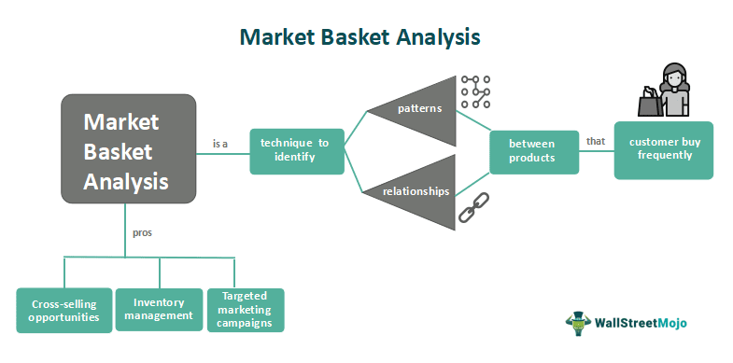

Slide 6

PROCESS OF MARKET BASKET INSIGHTS
Data Collection.
Data Preprocessing
Association Rule Mining
Rule Evaluation
Interpretation and Action

Slide 7
DATA COLLECTION
It involves gathering the transaction data necessary to analyze customer purchasing behavior and discover meaningful patterns and associations between items.
The first step is to identify the sources of data that contain information about customer transactions.
Once the data sources are identified, the relevant transaction data must be extracted.If the data comes from multiple sources, it may need to be integrated into a single dataset.
The cleaned and transformed data is typically stored in a suitable format or database for analysis.Transaction data is often continually collected and updated.
Once the transaction data has been collected, cleaned, and prepared, it is ready for the next steps in market basket analysis, including association rule mining, rule evaluation, interpretation, and action planning.
This analysis helps businesses gain valuable insights into customer behavior and make data-driven decisions to improve their operations and customer satisfaction.

Slide 8
DATA PREPROCESSING
It involves cleaning and transforming raw transaction data to make it suitable for analysis. Duplicate records, if present in the data, need to be identified and removed.
If your data comes from multiple sources or systems, integrate it into a single dataset. Ensure that data from different sources is compatible and that unique product and customer identifiers are mapped correctly.
In cases where there are a large number of items or product categories, dimensionality reduction techniques can be applied to simplify the data without losing important information.
In some analyses, you may choose to split the dataset into training and testing subsets to evaluate model performance. This is common in machine learning-based market basket analysis.
Maintain thorough documentation of all the preprocessing steps performed on the data. Documentation helps ensure transparency and reproducibility of the analysis.

Slide 9
ASSOCIATION RULE MINING
It is employed to discover interesting and meaningful patterns and associations between items that are frequently purchased together in customer transactions.
Association rule mining requires a dataset of customer transactions.Each transaction consists of a list of items that were purchased together, along with transaction identifiers and timestamps.
Association rule mining algorithms generate a large number of candidate rules based on the transaction data and user-defined thresholds for support and confidence. Once the association rules have been generated, businesses can interpret them to gain insights into customer behavior.
Association rule mining is a valuable tool in market basket insights because it helps businesses uncover hidden patterns in customer transaction data, enabling them to make data-driven decisions that can enhance customer satisfaction, increase revenue, and improve overall business operations.

Slide 10
RULE EVALUATION
Rule evaluation in market basket insights is the process of assessing and quantifying the quality and significance of association rules discovered through association rule mining.
Users typically set minimum support and confidence thresholds to filter out rules that do not meet their desired level of significance.
Visual representations, such as scatter plots, heatmaps, or network diagrams, can be used to visualize the relationships between items and the strength of association rules. These visualizations make it easier for analysts to interpret the findings.
Evaluate whether the discovered rules can be translated into actionable business strategies. Some rules may have high support and confidence but may not be practical to implement due to various constraints.
After implementing rules, businesses should monitor their impact and gather feedback to continuously refine the association rule mining process and improve the quality of rules generated.

Slide 11
INTERPRETATION AND ACTION
Interpretation involves making sense of the association rules that have been generated through market basket analysis.
You may need to segment your customer base based on the discovered patterns.
Verify the validity of the insights by discussing them with domain experts or stakeholders in your organization.
They can provide additional context and help assess the practicality of implementing the findings.
Continuously monitor the results of your actions and gather feedback from customers and employees
Integrate market basket insights with other data sources, such as customer demographics or purchase history, to create a more comprehensive understanding of your customers and their preferences.
Keep records of the actions taken and their outcomes. This documentation helps in assessing the long-term impact of market basket insights on your business.

Slide 12
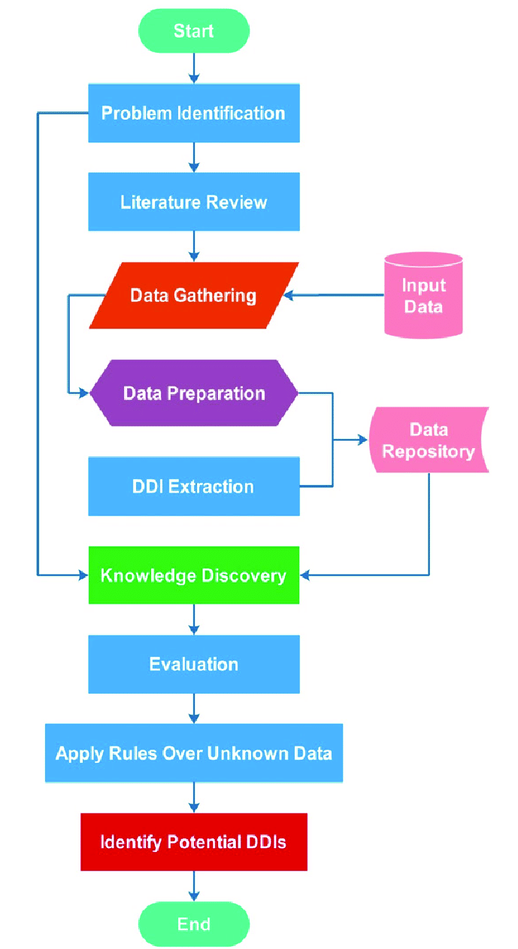
FLOWCHART THAT DEPICTS THE PROCESS CARRIED OUT IN MARKET BASKET INSIGHTS IN A SIMPLE WAY

Slide 13
CODE:
import pandas as pd
from mlxtend.frequent_patterns
import apriori
from mlxtend.frequent_patterns
import association_rules
# Sample transaction dataset
data = {'TransactionID‘ : [1, 2, 3, 4, 5] , 'Items‘ : [['apple', 'banana', 'chocolate'] , ['banana', 'chocolate'], ['apple', 'banana', 'chocolate', 'diapers'] , ['apple', 'diapers‘] , ['apple', 'chocolate', 'ice cream']]}
df = pd.DataFrame(data)
# Convert items into one-hot encoded format
df_encoded = pd.get_dummies(pd.DataFrame(df['Items'].values.tolist()).stack()).sum(level=0)
# Apply Apriori algorithm to find
frequent itemsets
min_support = 0.4
frequent_itemsets = apriori(df_encoded, min_support=min_support, use_colnames=True)
# Generate association rules
min_confidence = 0.7
rules = association_rules(frequent_itemsets, metric="confidence", min_threshold=min_confidence)
# Display frequent itemsets and association rules
print("Frequent Itemsets:")
print(frequent_itemsets)
print("\nAssociation Rules:")print(rules)

Slide 14
OUTPUT
Frequent Itemsets:
support itemsets
0 0.6 (apple)
0.6 (chocolate)
0.4 (banana)
0.4 (diapers)
0.4 (apple, chocolate)
Association Rules:
antecedents consequents
antecedent support consequent support
support confidence lift leverage conviction
0 (apple) (chocolate) 0.6
0.6 0.4 0.666667 1.111111
0.04 1.2
1 (chocolate) (apple)
0.6 0.6 0.4 0.666667 1.111111
0.04 1.2

Slide 15
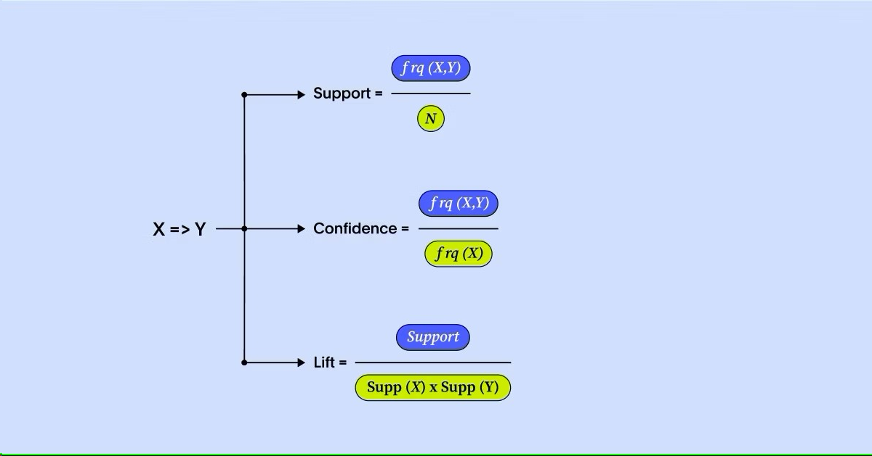
Key concepts in market basket analysis
DIAGRAM
There are three main concepts you need to know in order to successfully understand market basket analysis.
1.SUPPORT
2.CONFIDENCE
3.LIFT

Slide 16
Algorithms Used In Market Basket Analysis
There are multiple data mining techniques and algorithms used in Market Basket Analysis. One of the important objectives is “to predict the probability of items that are being bought together by customers.”
Apriori Algorithm
AIS
SETM Algorithm
FP Growth

Slide 17
Implementing Market Basket Analysis Using the Apriori Method
The Apriori algorithm is frequently used by data scientists. We are required to import the necessary libraries. Python provides the apyori as an API that is required to be imported to run the Apriori Algorithm.
import pandas as pd
import numpy as np
from apyori import apriori
st_df=pd.read_csv("store_data.csv",header=None)
print(st_df)
Now we want to read the dataset that is downloaded from Kaggle. There is no header in the dataset; hence, the first row contains the first transaction, so we have mentioned header = None here.

Slide 18
OUTPUT FOR THE ABOVE DATASET
0 1 2 ... 17 18 19
0 shrimp almonds avocado ... frozen smoothie spinach olive oil
1 burgers meatballs eggs ... NaN NaN NaN
2 chutney NaN NaN ... NaN NaN NaN
3 turkey avocado NaN ... NaN NaN NaN
4 mineral water milk energy bar ... NaN NaN NaN
... ... ... ... ... ... ... ...
7496 butter light mayo fresh bread ... NaN NaN NaN
7497 burgers frozen vegetables eggs ... NaN NaN NaN
7498 chicken NaN NaN ... NaN NaN NaN
7499 escalope green tea NaN ... NaN NaN NaN
7500 eggs frozen smoothie yogurt cake ... NaN NaN NaN
[7501 rows x 20 columns]

Slide 19
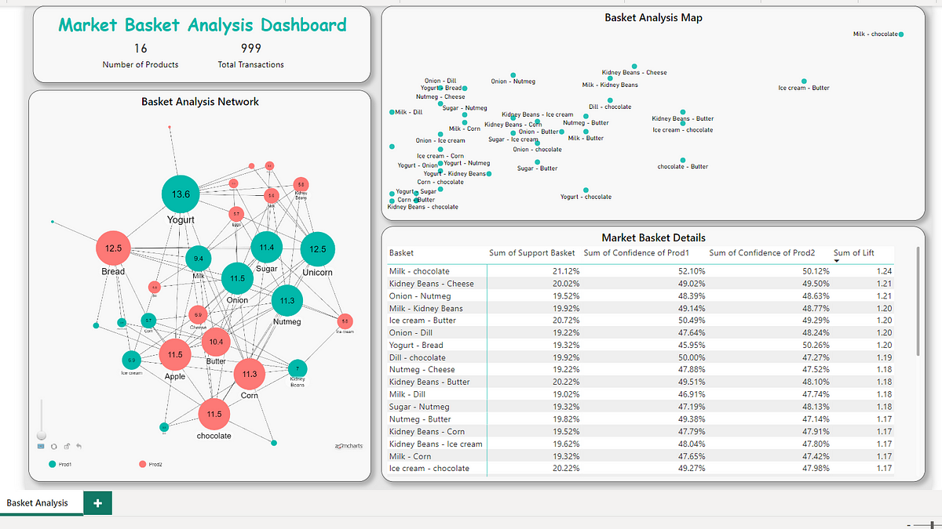
EXAMPLE : TOTAL ANALYSIS FOR DATASET

Slide 20
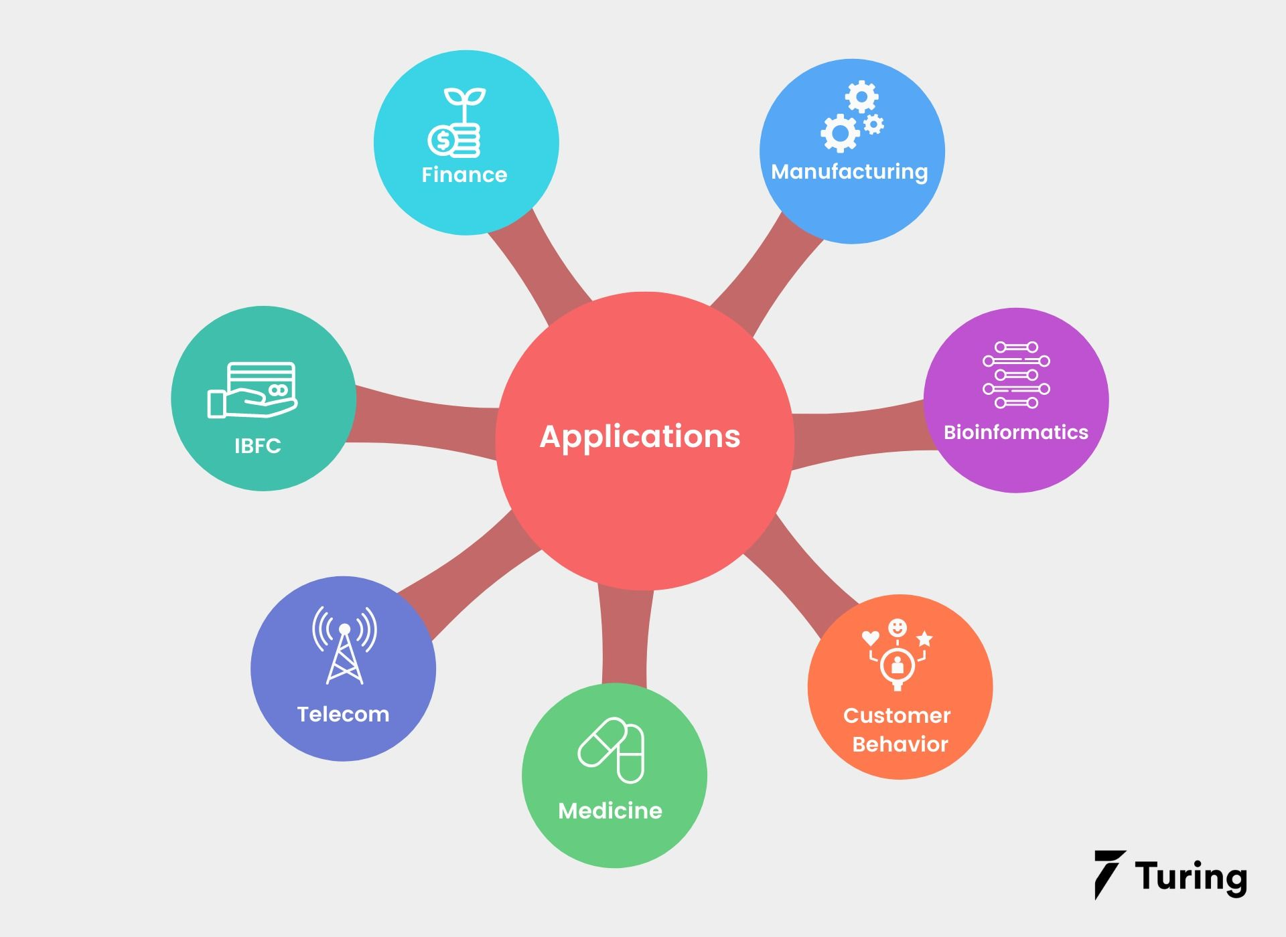
APPLICATIONS
Telecommunication
Bioinformatics
Affinity promotion
Fraud detection
Cross selling

Slide 21
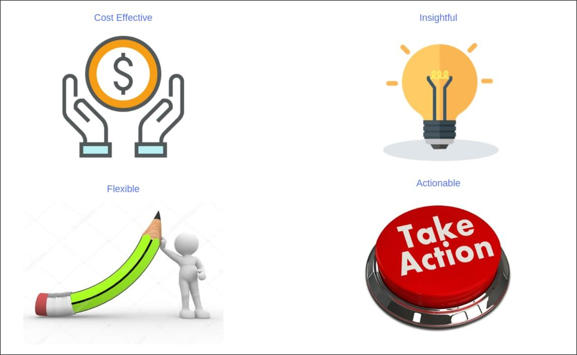
BENEFITS
Cost effective and Flexible
Store Layout
Recommend products based on
customer purchase patterns
Identifies sales influencers

Slide 22
CONCLUSION
In conclusion, Market Basket Insights represent a pivotal tool in the arsenal of modern businesses, particularly those in the retail and e-commerce sectors. The ability to extract actionable intelligence from customer transaction data is a game-changer, offering a multitude of benefits ranging from enhanced customer experiences and increased sales to more efficient inventory management and targeted marketing. By leveraging data analytics, machine learning, and real-time processing, businesses can gain a competitive edge in a rapidly evolving marketplace. Market Basket Insights not only illuminate customer preferences and behaviors but also empower organizations to make data-driven decisions, adapt to changing market dynamics, and ultimately thrive in an era where understanding and meeting customer needs is paramount.

Slide 23
THANK YOU

