Slide 1

DEPARTMENT OF ELECTRONICS AND COMMUNICATION ENGINEERING
MARKET BASKET INSIGHTS
TEAM MEMBERS:
ARCHANA A(113321106005)
AKSHAYA G(113321106028)
DOMMARAJU HANVITHA(11332106024)
MUNAGACHERLA BHAVANA(113321106054)
NAFISA PARVIN S(113321106056)

Slide 2
INTRODUCTION
Market basket insights, also known as market basket analysis or association rule mining, is a powerful data analysis technique used in retail, e-commerce, and various other industries to discover meaningful patterns and relationships within customer transaction data.
It provides valuable insights into consumer behavior and helps businesses make informed decisions regarding product placement, pricing strategies, and marketing campaigns.

Slide 3
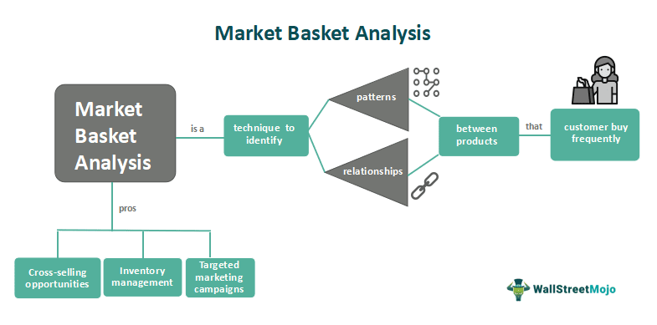

Slide 4
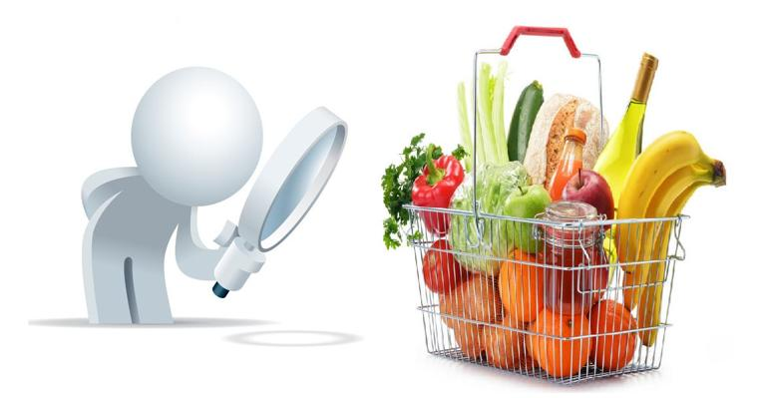
PROCESS OF MARKET BASKET INSIGHTS
Data Collection.
Data Preprocessing
Association Rule Mining
Rule Evaluation
Interpretation and Action

Slide 5
DATA COLLECTION
It involves gathering the transaction data necessary to analyze customer purchasing behavior and discover meaningful patterns and associations between items.
The first step is to identify the sources of data that contain information about customer transactions.
Once the data sources are identified, the relevant transaction data must be extracted.If the data comes from multiple sources, it may need to be integrated into a single dataset.
The cleaned and transformed data is typically stored in a suitable format or database for analysis.Transaction data is often continually collected and updated.
Once the transaction data has been collected, cleaned, and prepared, it is ready for the next steps in market basket analysis, including association rule mining, rule evaluation, interpretation, and action planning.
This analysis helps businesses gain valuable insights into customer behavior and make data-driven decisions to improve their operations and customer satisfaction.

Slide 6
DATA PREPROCESSING
It involves cleaning and transforming raw transaction data to make it suitable for analysis. Duplicate records, if present in the data, need to be identified and removed.
If your data comes from multiple sources or systems, integrate it into a single dataset. Ensure that data from different sources is compatible and that unique product and customer identifiers are mapped correctly.
In cases where there are a large number of items or product categories, dimensionality reduction techniques can be applied to simplify the data without losing important information.
In some analyses, you may choose to split the dataset into training and testing subsets to evaluate model performance. This is common in machine learning-based market basket analysis.
Maintain thorough documentation of all the preprocessing steps performed on the data. Documentation helps ensure transparency and reproducibility of the analysis.

Slide 7
ASSOCIATION RULE MINING
It is employed to discover interesting and meaningful patterns and associations between items that are frequently purchased together in customer transactions.
Association rule mining requires a dataset of customer transactions.Each transaction consists of a list of items that were purchased together, along with transaction identifiers and timestamps.
Association rule mining algorithms generate a large number of candidate rules based on the transaction data and user-defined thresholds for support and confidence. Once the association rules have been generated, businesses can interpret them to gain insights into customer behavior.
Association rule mining is a valuable tool in market basket insights because it helps businesses uncover hidden patterns in customer transaction data, enabling them to make data-driven decisions that can enhance customer satisfaction, increase revenue, and improve overall business operations.

Slide 8
RULE EVALUATION
Rule evaluation in market basket insights is the process of assessing and quantifying the quality and significance of association rules discovered through association rule mining.
Users typically set minimum support and confidence thresholds to filter out rules that do not meet their desired level of significance.
Visual representations, such as scatter plots, heatmaps, or network diagrams, can be used to visualize the relationships between items and the strength of association rules. These visualizations make it easier for analysts to interpret the findings.
Evaluate whether the discovered rules can be translated into actionable business strategies. Some rules may have high support and confidence but may not be practical to implement due to various constraints.
After implementing rules, businesses should monitor their impact and gather feedback to continuously refine the association rule mining process and improve the quality of rules generated.

Slide 9
INTERPRETATION AND ACTION
Interpretation involves making sense of the association rules that have been generated through market basket analysis.
You may need to segment your customer base based on the discovered patterns.
Verify the validity of the insights by discussing them with domain experts or stakeholders in your organization.
They can provide additional context and help assess the practicality of implementing the findings.
Continuously monitor the results of your actions and gather feedback from customers and employees
Integrate market basket insights with other data sources, such as customer demographics or purchase history, to create a more comprehensive understanding of your customers and their preferences.
Keep records of the actions taken and their outcomes. This documentation helps in assessing the long-term impact of market basket insights on your business.

Slide 10
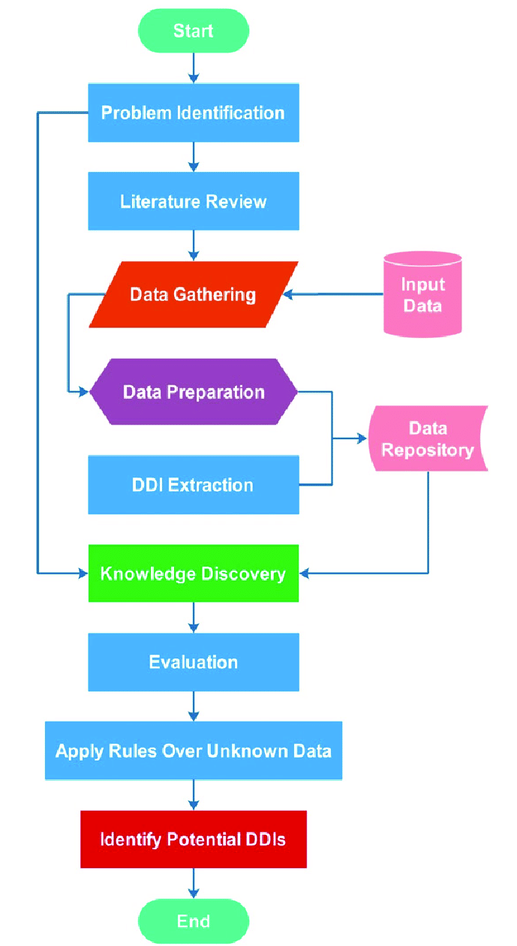
FLOWCHART THAT DEPICTS THE PROCESS CARRIED OUT IN MARKET BASKET INSIGHTS IN A SIMPLE WAY

Slide 11
CODE:
import pandas as pd
from mlxtend.frequent_patterns
import apriori
from mlxtend.frequent_patterns
import association_rules
# Sample transaction dataset
data = {'TransactionID‘ : [1, 2, 3, 4, 5] , 'Items‘ : [['apple', 'banana', 'chocolate'] , ['banana', 'chocolate'], ['apple', 'banana', 'chocolate', 'diapers'] , ['apple', 'diapers‘] , ['apple', 'chocolate', 'ice cream']]}
df = pd.DataFrame(data)
# Convert items into one-hot encoded format
df_encoded = pd.get_dummies(pd.DataFrame(df['Items'].values.tolist()).stack()).sum(level=0)
# Apply Apriori algorithm to find
frequent itemsets
min_support = 0.4
frequent_itemsets = apriori(df_encoded, min_support=min_support, use_colnames=True)
# Generate association rules
min_confidence = 0.7
rules = association_rules(frequent_itemsets, metric="confidence", min_threshold=min_confidence)
# Display frequent itemsets and association rules
print("Frequent Itemsets:")
print(frequent_itemsets)
print("\nAssociation Rules:")print(rules)

Slide 12
OUTPUT
Frequent Itemsets:
support itemsets
0 0.6 (apple)
0.6 (chocolate)
0.4 (banana)
0.4 (diapers)
0.4 (apple, chocolate)
Association Rules:
antecedents consequents
antecedent support consequent support
support confidence lift leverage conviction
0 (apple) (chocolate) 0.6
0.6 0.4 0.666667 1.111111
0.04 1.2
1 (chocolate) (apple)
0.6 0.6 0.4 0.666667 1.111111
0.04 1.2

Slide 13
OUTPUT CONCLUSION
The output for a Python program that performs market basket insights using the code:
This output includes two sections:
1. Frequent Itemsets: This section shows item sets (combinations of items) that have a support greater than the specified minimum support (0.4 in this example). For instance, it indicates that "apple" and "chocolate" are frequently bought together.
2. Association Rules: This section presents rules that meet the minimum confidence threshold (0.7 in this example). For instance, it tells us that there's a rule with "apple" as the antecedent and "chocolate" as the consequent, with a confidence of 0.6667, indicating that 66.67% of transactions containing "apple" also contain "chocolate.“
This information can be used to gain insights into item associations in transaction data and make informed decisions for marketing, product placement, or other business strategies.

Slide 14
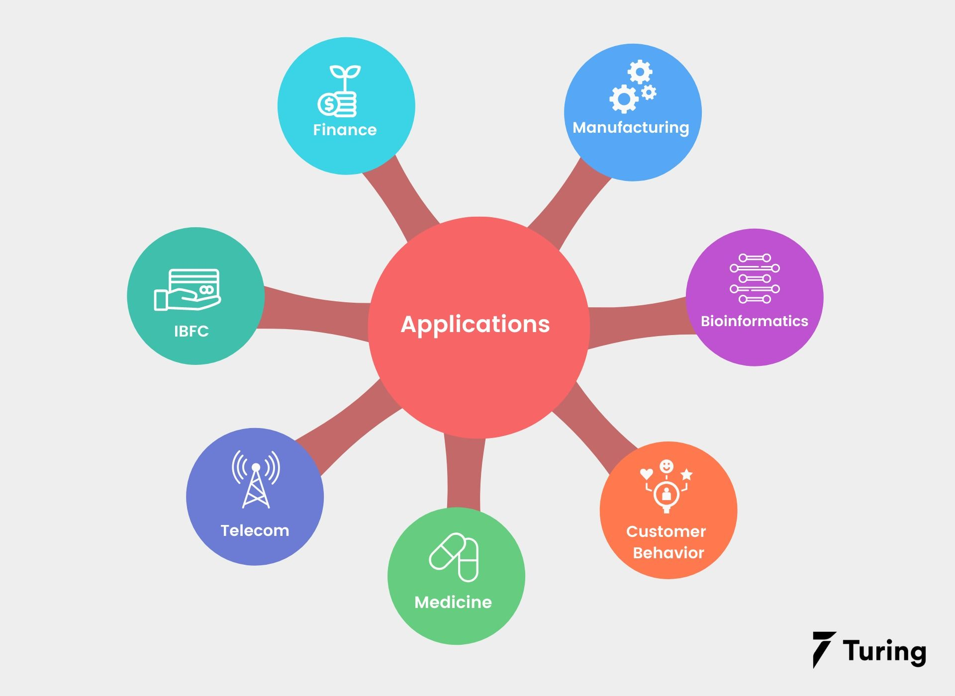
APPLICATIONS
Telecommunication
Bioinformatics
Affinity promotion
Fraud detection
Cross selling

Slide 15
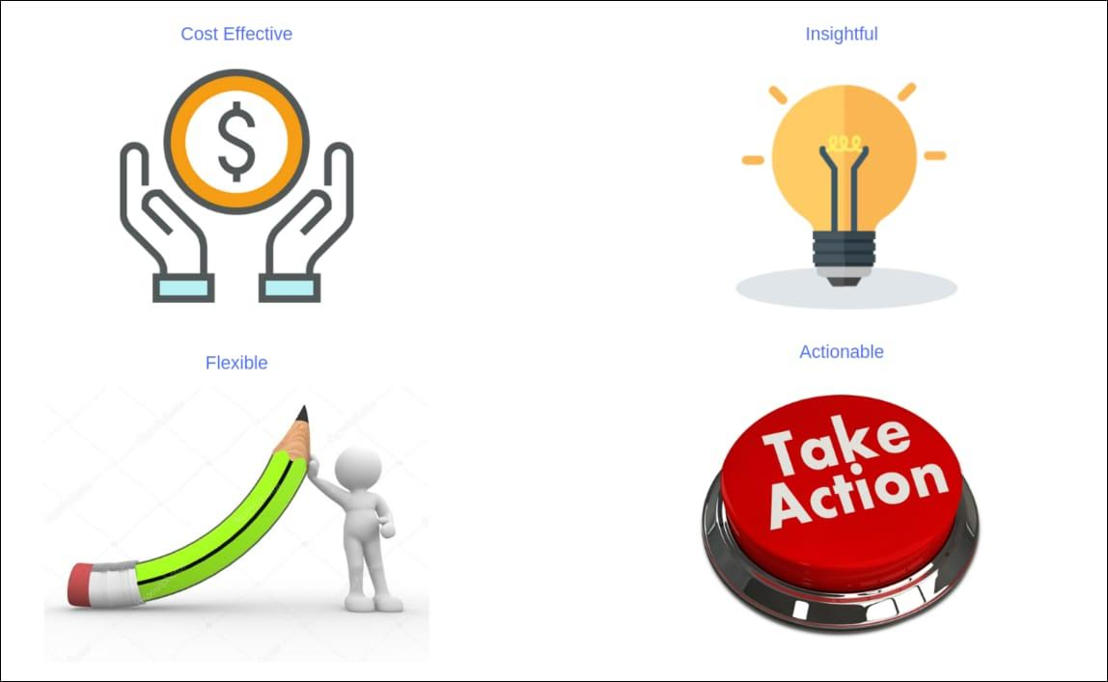
BENEFITS
Cost effective and Flexible
Store Layout
Recommend products based on
customer purchase patterns
Identifies sales influencers

Slide 16
THANK YOU

